Slide 1
ARP & RARP Protocols
-

Slide 2

What is a Protocol?
A set of rules in which computers communicate with each other...
What part of the conversation comes at which time...
How to end the communication...

Slide 3

Different Protocols Used over Internet
IP(Internet Protocol)
HTTP(Hyper Text Transfer Protocol) UDP(User Datagram Protocol) FTP(File Transfer Protocol) TCP(Transfer Control Protocol) ARP(Address Resolution Protocol)
ICMP(Internet Control Message Protocol)

Slide 4
ARP
Used to convert an IP address into a physical address such as an Ethernet address
Used by the Internet Protocol (IP) specifically IPv4, to map IP network addresses to the hardware addresses used by a data link protocol.
The protocol operates below the network layer as a part of the interface between the OSI network and OSI link layer.

Slide 5
Why We Use ARP?
Used to convert an IP address into a physical address such as an Ethernet address
A host wishing to obtain a physical address broadcasting ARP request onto the TCP/IP network.

Slide 6
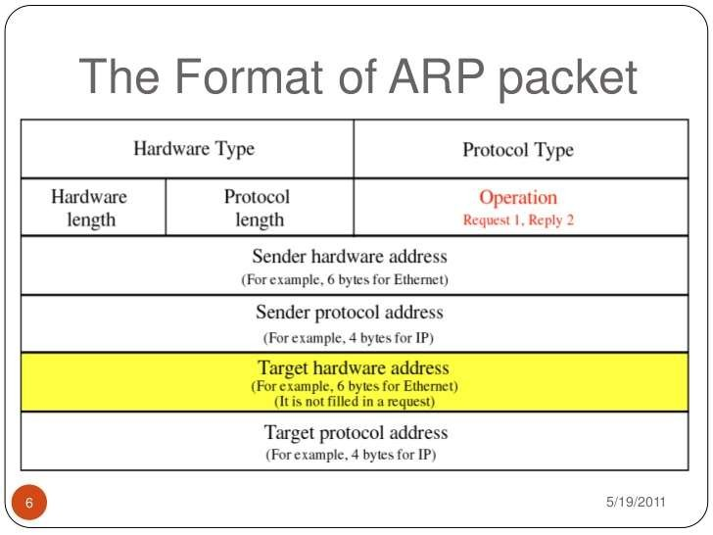

Slide 7
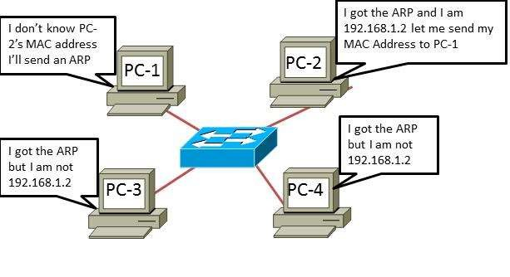

Slide 8
RARP
The Reverse Address Resolution Protocol (RARP) is a computer networking protocol used by a client computer to request its Internet Protocol (IPv4) address from a computer network.

Slide 9
Why We Use RARP?
Reverse Address Resolution Protocol (RARP) is a network layer protocol used to resolve an IP address from a given hardware address (such as an Ethernet address).

Slide 10
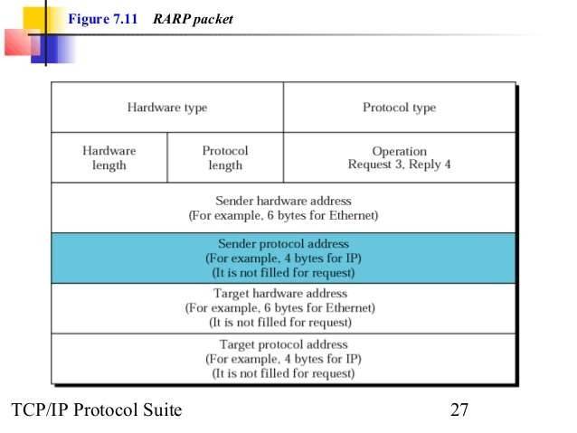

Slide 11
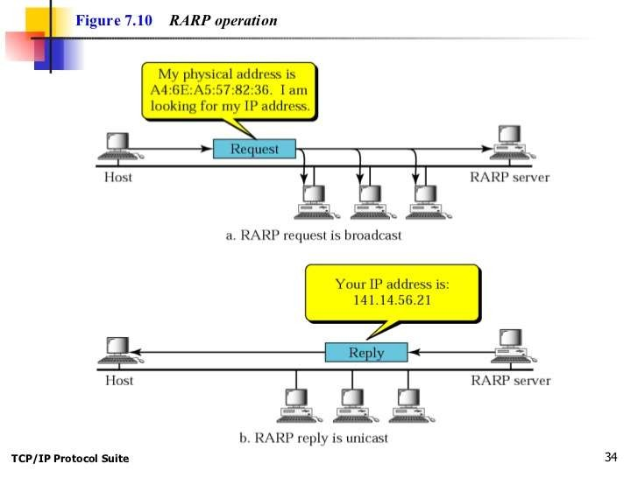

Slide 12
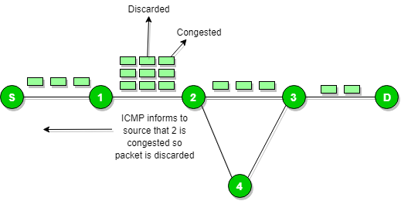
Internet Control Message Protocol (ICMP)
Since IP does not have a inbuilt mechanism for sending error and control messages. It depends on Internet Control Message Protocol(ICMP) to provide an error control. It is used for reporting errors and management queries. It is a supporting protocol and used by networks devices like routers for sending the error messages and operations information.
e.g. the requested service is not available or that a host or router could not be reached.

Slide 13


