Slide 1
DISTANCE VECTOR ROUTING ALGORITHM (DV)

Slide 2
DEFINITION
Distance is a measure of number of Hops the Packet requires to reach the Destination.
Here Vector is defined as (Distance, Direction) next Hop router to which the packet is to be forwarded.
It is also known as Bellman Ford Algorithm.

Slide 3
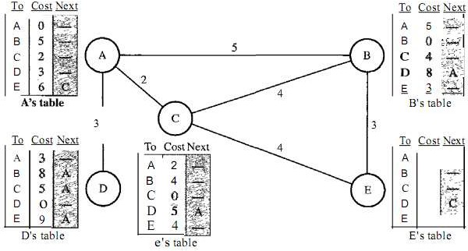
EXAMPLE

Slide 4
EXPLANATION
In Distance Vector Routing Protocol, each node shares its routes in the network only to the neighbors and does not broadcast it. (not to all)
Whenever any node receives the Routing Information it updates its own routing table and inform to its neighbors.

Slide 5
WORKING PRINCIPLE
Firstly each node enters the cost of the neighboring node
A link that is down (not a direct neighbor) is assigned a cost to Infinity

Slide 6
WORKING PRINCIPLE
Every node that sends a message directly connected to the adjacent node about the adjacent neighbors and their cost.
4) After exchanging the nodes information it will find the least cost to reach the other nodes information.

