Slide 1
Agenda
What is React
Why it is Popular
What is DOM and Virtual DOM
Setting up a React Project

Slide 2
What is React
A JavaScript library for building user interfaces. It uses a component based development approach
to manage UI.
Initially it is started by Facebook in 2013. But now it is Open Source.
React is popular because it claims that it is very fast when it comes to handle UI Updates and the
Reason behind this is, it uses virtual DOM to decide whether there should be any update in Real DOM
Or not.

Slide 3
What it Virtual Dom
Virtual Dom at its core is just an abstraction over real DOM OR we can say it’s a copy of real dom. And as per machine’s point view it is fast to work with Virtual DOM than working with the real DOM
React uses this for its UI Management Process.

Slide 4
Let’s create a React App
Npm i create-react-app
Create-react-app my-first-app
Cd my-first-app
Npm start

Slide 5
Agenda
Folder Structure of React App
How files are connected in React app

Slide 6
Agenda
What are Components
Types Of Components
How to Define and use them
Basic styling with class, className and style attribute

Slide 7
Agenda
Props and State In React Component
Difference in between these two

Slide 8
Agenda
Define Components in it’s Own File
Implementation of Routing In React
Browser-Router, Link, Route and Switch

Slide 9
Agenda
NavLink to show active link

Slide 10
Agenda
Nested Routing in React

Slide 11
Agenda
Path Parameters

Slide 12
Agenda
Event Handling

Slide 13
Agenda
Programmatic Navigation In React

Slide 14
Agenda
How to set Html Template in React

Slide 15
Agenda
Form Input Handling in React

Slide 16
Agenda
Multipule Form Input Handling with Single Handler

Slide 17
Agenda
Higher Order Component in React

Slide 18
Agenda
Life Cycle Methods in ReactJS

Slide 19
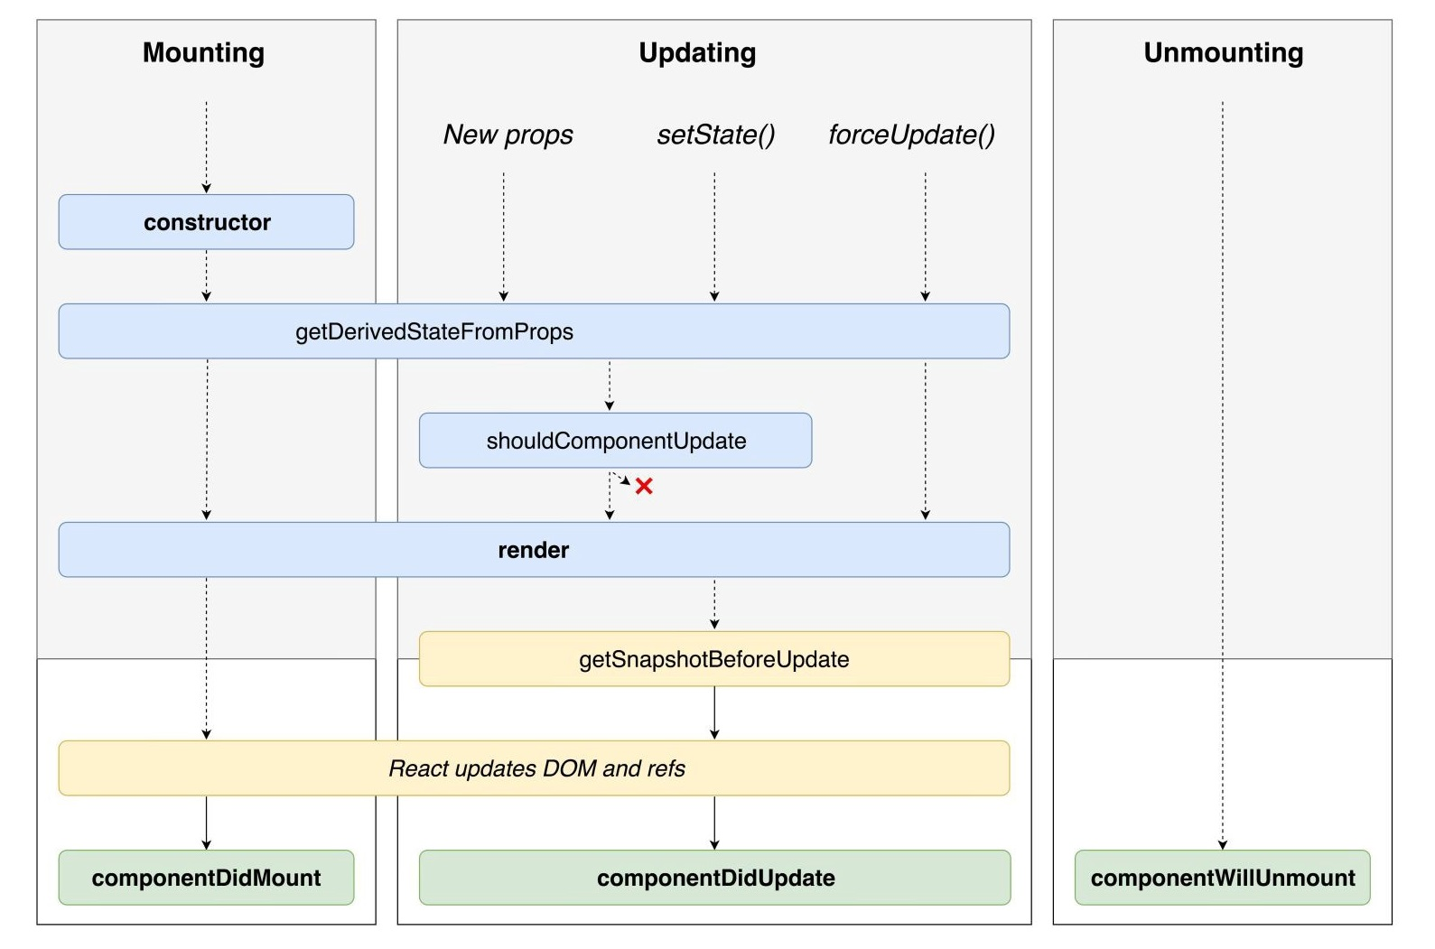

Slide 20
Agenda
Error Boundaries in React JS

Slide 21
Agenda
React.memo in React JS

Slide 22
Agenda
Ref in React JS

Slide 23
Agenda
Using Ref to component in React JS

Slide 24
Agenda
Ref forwarding in React JS

Slide 26
Agenda
Using Ref to component in React JS

Slide 27
Agenda
Validation in Mongodb

