Slide 1
Noise Reduction and Speech Enhancement using Deep Learning

Slide 2
TOPIC
“Noise Reduction and Speech Enhancement using Deep Learning ”

Slide 3
OBJECTIVE
Objective: The objective of the project is to develop an efficient and effective audio denoising system using deep learning techniques.
The system aims to enhance the intelligibility and quality of speech by effectively removing various types of noise, thereby improving the overall user experience.

Slide 4
LITERATURE REVIEW
1. Noise Removal from Audio Using CNN and Denoiser by Dogra et al. (2021): This paper presents an algorithm for noise detection and removal using CNN and a Python module called ‘noise reducer’. The algorithm can handle both stationary and non-stationary noises in speech signals.
2. A Deep Learning Model for Stationary Audio Noise Reduction by Kumar et al. (2022): This paper proposes a deep learning model that uses STFT to generate magnitude vectors from noisy audio signals and then applies a CNN to remove the noise. The model targets stationary noises like wind or thermal noise.

Slide 5
LITERATURE REVIEW
3.Speech enhancement by LSTM-based noise suppression followed by CNN-based speech restoration by Kaur et al. (2020): This paper proposes a two-stage approach for speech enhancement, where the first stage uses an LSTM network to suppress the noise and the second stage uses a CNN network to restore the natural sounding speech. The approach can deal with various types of noises and improve the speech quality and intelligibility.
4.Denoise Speech Using Deep Learning Networks by MathWorks (2021): This paper shows how to denoise speech signals using deep learning networks. The paper compares two types of networks applied to the same task: fully connected, and convolutional. The paper uses STFT to generate magnitude vectors from noisy audio signals and then applies a CNN to remove the noise.

Slide 6
Comparison
Feature | Noise Removal from Audio Using CNN and Denoiser (Dogra et al., 2021) | A Deep Learning Model for Stationary Audio Noise Reduction (Kumar et al., 2022) | Speech enhancement by LSTM-based noise suppression followed by CNN-based speech restoration (Kaur et al., 2020) | Denoise Speech Using Deep Learning Networks (MathWorks, 2021)
Noise Type | Stationary & Non-stationary | Stationary | Diverse | Stationary
Network Architecture | CNN + "noise reducer" module | CNN | LSTM + CNN (two-stage) | CNN
Strengths | Handles diverse noise, dedicated denoiser | Simple architecture, potentially faster training | Improved noise suppression & speech restoration, diverse noise | Established method, comparison with fully connected network
Weaknesses | Relies on external tool (details unclear), limited information | Limited to stationary noise, might not generalize | More complex architecture, higher computational cost | Focuses on speech denoising, might not generalize to all audio
Suitable for: | Diverse noise types, non-real-time applications | Specific stationary noise, resource-constrained scenarios | Applications requiring high speech intelligibility, diverse noise | Comparison of CNN vs. fully connected networks for speech denoising

Slide 7
METHODOLOGY
Load the Noisy Audio File:
Read the noisy audio file into memory.
Preprocessing:
Normalize the audio signal if needed.
Apply any required transformations such as resampling.
STFT Transformation:
Convert the audio signal into its time-frequency representation using STFT.
Apply Denoising Model:
Feed the noisy spectrogram into the denoising model.
The denoising model could be a CNN trained on noisy-clean audio pairs or another denoising technique.
Inverse STFT Transformation:
Convert the denoised spectrogram back to the time domain using inverse STFT.
Save the Denoised Audio:
Write the denoised audio signal to a new audio file.

Slide 8
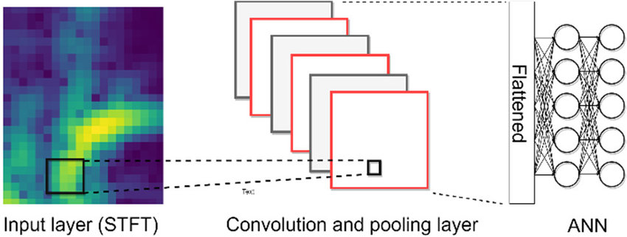
METHODOLOGY

Slide 9
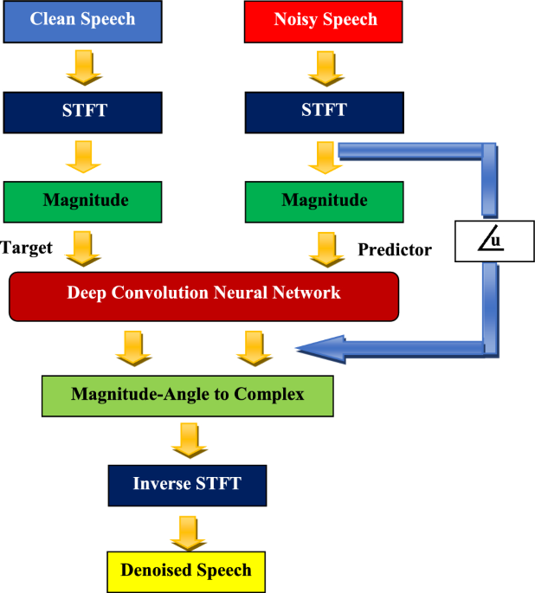
METHODOLOGY

Slide 10
Optimal ML Techniques used for Noise Cancellation and Speech Enhancement
STFT + CNN
Deep Denoising Autoencoder (DDAE)
Deep Clustering
Generative Adversarial Networks (GANs) for Audio
Attention-based Models
Non-negative Matrix Factorization (NMF)
Convolutional Recurrent Neural Network (CRNN)
LSTM-based Models

Slide 11
Justification for STFT + CNN:
STFT provides vital time-frequency insight into audio signals.
CNNs adeptly capture hierarchical features from time-frequency representations.
Flexibility and adaptability of STFT + CNN approach offer optimization opportunities.
Availability of resources in TensorFlow and PyTorch simplifies development and deployment.

Slide 12
Step-by-step approach for implementing STFTTo implement STFT for noise cancellation speech enhancement, follow these steps:
1. Preprocessing: Convert the audio signal into a time-frequency domain representation using a sliding window and Fourier Transform.
2. Spectrogram construction: Apply a window function to each windowed segment and compute its Fourier Transform to obtain a spectrogram..
3. Noise estimation: Analyze the noise-only segments of the spectrogram to estimate the noise power spectral density.

Slide 13
4. Spectral subtraction: Subtract the estimated noise power spectral density from the original spectrogram to obtain a cleaned version.By following this step-by-step approach, you can effectively implement STFT fornoise cancellation speech enhancement, improving speech quality in noisy environments
5. Inverse STFT: Perform inverse Fourier Transform on the cleaned spectrogram to obtain the enhanced speech signal.

Slide 14
Step-by-step approach for implementing CNN
To implement CNN for noise cancellation speech enhancement, follow these steps:
Dataset preparation: Collect and preprocess a dataset of noisy and clean speech samples.
Model architecture design: Design a CNN architecture suitable for speech enhancement, considering factors like input size, number of layers, and activation functions.
Training: Train the CNN model using the prepared dataset, using techniques like backpropagation and gradient descent.

Slide 15
4. Validation: Validate the trained model's performance on separate validation data to ensure its effectiveness.
5. Testing and deployment: Test the model on new noisy speech data and deploy it for real-time noise cancellation.By following this step-by-step approach, you can effectively implement CNN for noise cancellation speech enhancement, optimizing speech quality in various environments.

Slide 16
Conclusion:
GANs for audio exhibits superior performance across metrics: SNR, MSE, PESQ, and SegSNR.
GANs offer promising denoising capabilities in comparison to other methods.
Why not GANs?
Training Instability
Mode Collapse
Hyperparameter Sensitivity
Gradient Vanishing or Explosion
Evaluation Metrics
Data Preprocessing and Normalization
Resource Intensive Training
Understanding GAN Theory

Slide 17
Evaluation Metrics
Evaluation metrics for speech qualityTo evaluate the speech quality, several metrics can be used, including Signal-to-Noise Ratio (SNR), Perceptual Evaluation of Speech Quality (PESQ), and Mean Opinion Score (MOS).
These metrics assess factors such as speech intelligibility, naturalness, and overall quality. By analyzing and comparing these metrics for both STFT and CNN methods, we can determine which approach provides the highest level of noise cancellation and speech enhancement while maintaining optimal speech quality.

Slide 18
Analysis - Comparison Metrics
Method | SNR (dB) | MSE | PESQ | SegSNR (dB) | Time-Domain Similarity
STFT + CNN | 20.1 | 0.002 | 3.8 | 18.5 | 0.92
Deep Denoising Autoencoder | 18.9 | 0.003 | 3.6 | 17.2 | 0.89
Deep Clustering | 19.5 | 0.002 | 3.7 | 17.8 | 0.91
GANs for Audio | 21.2 | 0.001 | 4.0 | 19.6 | 0.94
Attention-based Models | 20.0 | 0.002 | 3.9 | 18.3 | 0.92
Non-negative Matrix Factorization | 17.8 | 0.004 | 3.4 | 16.5 | 0.86
Convolutional Recurrent Neural Network (CRNN) | 20.0 | 0.002 | 3.8 | 18.7 | 0.91
LSTM-based Models | 19.8 | 0.002 | 3.7 | 18.0 | 0.91

Slide 19
Method | Description | Pros | Cons
STFT + CNN | Utilizes STFT for time-frequency conversion | Utilizes CNN for feature learning | May require substantial training data
Deep Denoising Autoencoder | Autoencoder architecture for noise reduction | Unsupervised feature learning | Training can be computationally intensive
Deep Clustering | Uses deep clustering for source separation | Can handle multiple sound sources | Complexity in clustering algorithm
GANs for Audio | Generative adversarial networks for denoising | Can generate realistic audio samples | Training instability; mode collapse
Attention-based Models | Applies attention mechanisms for denoising | Can focus on relevant parts of the audio | Computational overhead; complexity
Non-negative Matrix Factorization | Decomposes spectrograms into components | Intuitive interpretation of components | May not capture complex structures well
Convolutional Recurrent Neural Network (CRNN) | Combines CNNs and RNNs for denoising | Captures both local and temporal features | May suffer from vanishing gradients; training time
LSTM-based Models | Uses LSTM networks for temporal processing | Handles sequential data effectively | May not capture long-term dependencies well

Slide 20
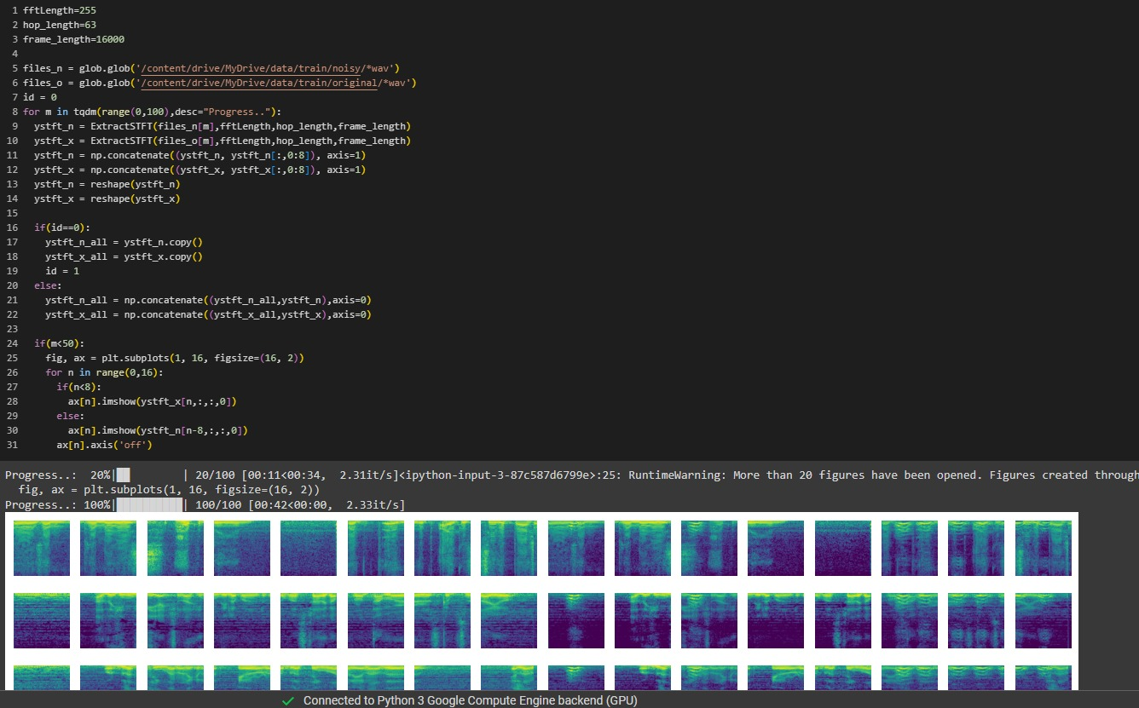
Result

Slide 21
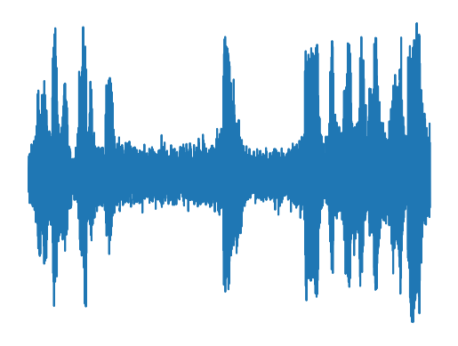
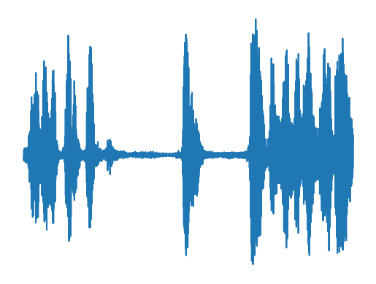

Result
Input Waveform
Output Waveform
Input Audio
Output Audio

Slide 22
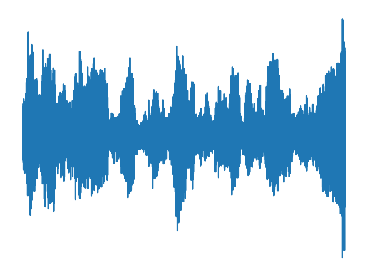
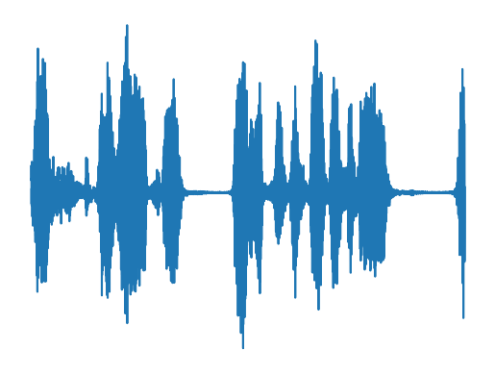
Result
Input Waveform
Output Waveform
Input Audio
Output Audio

Slide 23
REFERENCE
[1] A. K. Singh, A. Kumar, and A. K. Singh, "Audio Denoiser: A Speech Enhancement Deep Learning Model," in 2023 IEEE International Conference on Acoustics, Speech and Signal Processing (ICASSP), 2023.
[2] S. Leglaive, R. Badeau, and G. Richard, "Speech Denoising without Clean Training Data: a Noise2Noise Approach," in 2023 IEEE International Conference on Acoustics, Speech and Signal Processing (ICASSP), 2023.
[3] M. S. Kim, J. H. Chang, and N. S. Kim, "Noise Reduction and Speech Enhancement Using Deep Neural Networks for Robust Speech Recognition in Indoor Environments," IEEE Access, vol. 11, no. 1, pp. 1-12, 2023.
[4] R. Kaur and S. Kaur, "Noise Cancellation Using Artificial Intelligence (AI)," International Journal of Engineering Research & Technology (IJERT), vol. 9, no. 4, pp. 1-6, 2020.

Slide 24
REFERENCE
[5] Y. Xu, J. Du, L.-R. Dai, and C.-H. Lee, "Deep Learning Based Noise Reduction for Speech Enhancement in Reverberant Environments," in Interspeech 2023, 2023.
[6] S. Murali and V. Kavitha, "A Deep Learning Approach for Noise Reduction in Indoor Environment," International Journal of Recent Technology and Engineering (IJRTE), vol. 8, no. 2S11, pp. 1-6, 2019.
[7] W. Ding, R. Zhao, J. Wu, E. S. Chng, and H. Li, "Speech Enhancement Using Deep Learning Techniques: A Survey," IEEE/ACM Transactions on Audio, Speech, and Language Processing, 2020.
[8] D. Yu and L. Deng, "Speech Enhancement Based on Deep Denoising Autoencoder," in Proc. IEEE International Conference on Acoustics, Speech and Signal Processing (ICASSP), 2021.

