Slide 1
Course Title: Object Oriented Programming(Java) Sessional Level -2 Semester- II Course Code: CSE -254
PRESENTATION ON THESIS PROGRESS
Project Tittle :Space Invaders
Presented By
Partha Sarathi Roy-2120104
Md.Alamgir Hossain-2120108
Shahed Khan-1920105
GOVERNMENT SHAHID AKBAR ALI SCIENCE & TECHNOLOGY COLLEGE BALIADANGI, THAKURGAON

Slide 2
OUTLINE
Introduction
Objectives
Limitations
Scope
Game Design
Implementation
Project Output
Conclusion

Slide 3
INTRODUCTION
Overview:
This project aims to recreate this classic game using Java, focusing on object-oriented design and interactive gameplay.
The game offers an opportunity to learn game design principles while implementing advanced programming concepts.
Purpose:
The purpose of this task is to recreate the classic Space Invaders game the usage of Java, exploring fundamental game improvement standards such as animation, user input, and collision detection.

Slide 4
OBJECTIVES
To create an interactive 2D game using java and its swing package.
To implement a game loop that handles user input and collision delection in real time.
To simulate enemy movement and increase difficulty over time.
To display scores and handle end-game scenarios.
To ensure the projects follows clean code practices,such as modular design and reusable components.

Slide 5
LIMITATIONS
The project is limited to a single-player mode.
The enemy's attack patterns are simplistic and do not involve advanced AI behaviors.
The game does not support sound effects or background music due to time constraints.
The game only runs in a fixed window size and does not adapt to various screen sizes or resolutions.

Slide 6
SCOPE
Developing 2D game interface using java swing.
Implementing essential game mechanics like movement ,shooting and collision detection.
Managing multiple enemies(Aliens) and projectiles(bullets) in real time.
Scoring system base on the number of aliens destroyed.
Providing an interactive user interface where the payer can restart the game after its end.

Slide 7
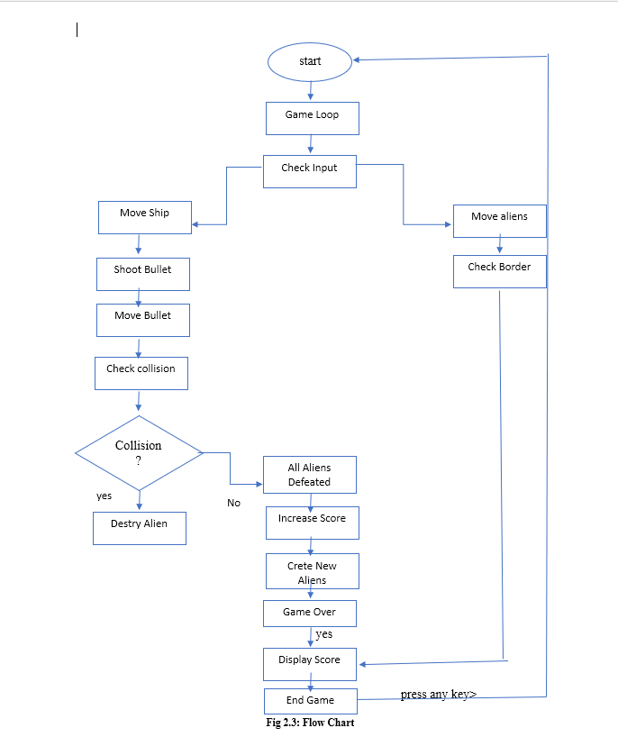
GAME DESIGN(CONT. )
FLOW CHART:

Slide 8
GAME DESIGN
Player Ship:The player's ship is represented as a graphic that the player controls. It can be moved left and right to dodge incoming aliens.
Aliens: Different types of aliens are displayed, each with its unique appearance. They move in formations and become increasingly aggressive as the game progresses.
Bullets: Bullets are shot from the player’s ship and are essential for defeating aliens.
Score: A scoring system keeps track of points earned by shooting aliens, displayed at the top of the screen.

Slide 9
IMPLEMENTATION(CONT. )
PROGRAMMING LANGUAGE AND TOOLS:
Java Development Kit (JDK): The core programming language used to write and compile the code.
Swing: A part of Java Foundation Classes (JFC) used for creating window-based applications, including the game panel and rendering graphics.
Java AWT: Used for handling graphics and event listeners.

Slide 10
IMPLEMENTATION(CONT. )
CODE STRUCTURE
Block Class: A nested class representing game objects like the player ship, aliens, and bullets, encapsulating their properties (position, size, image) and states (alive, used).
Game Variables: Variables for managing game state, including the board dimensions, ship and alien properties, score, and game status._{[1]}
Initialization: The constructor initializes game components, loads images, sets up the game loop, and creates aliens.
Game Loop: Managed by a Timer, this loop calls the move() method to update game state and the repaint() method to render graphics at a consistent frame rate.

Slide 11
IMPLEMENTATION(CONT. )
GAME LOGIC
Movement: The move() method controls the movement of aliens and bullets. Aliens move horizontally and descend upon hitting the screen edges. Bullets move upward and check for collisions with aliens.
Collision Detection: The detect Collision() method checks for collisions between bullets and aliens, updating their states and scores accordingly.
Game Over Condition: If any alien reaches the player’s ship, the game ends, and a "Game Over" message is displayed.

Slide 12
IMPLEMENTATION
GRAPHICS AND ANIMATION
Drawing Images: The player ship, aliens, and bullets are drawn on the game panel using their respective images.
Background Colour: The background of the game panel is set to blue for a space-like appearance.
Score Display: The current score is displayed on the screen using a white font, and a game over message is shown if the player loses.

Slide 13
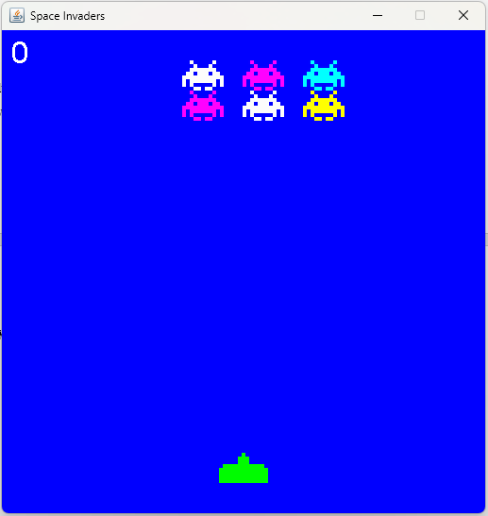
PROJECT OUTPUT

Slide 14
CONCLUSION
This Space Invaders project effectively demonstrates the use of object-oriented programming and basic game development techniques in Java
The game uses a timer for real-time movements and events, while collisions are handled efficiently.
Overall, this project showcases fundamental game design concepts and provides a foundation for more complex game development projects.

Slide 15
THANK YOU

