Slide 1
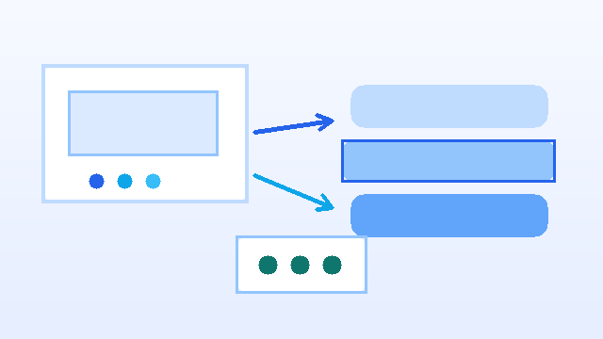
AAOS Persistent Contacts Cache Case Study (Main Deck)
• This is my presentation flow for fast review and decision-making.
• I focus on the problem, my recommendation, and rollout readiness.
• I keep deep pseudocode and extended security notes in the appendix deck.
Main deck: concise decision-oriented story
Prepared on February 20, 2026
1/33

Slide 2
Index
• Click any card below to jump directly to that section.
Executive Summary
Problem, recommendation, and expected impact
Click to open section
Problem and Context
Current vs desired user experience
Click to open section
Options and Decision
Tradeoffs and why Approach 1 wins
Click to open section
Implementation and Security
Data flow, API, crypto, and fallback
Click to open section
Metrics and Rollout
Targets, tests, libraries, and go/no-go
Click to open section
Q&A and Backup
Likely questions and deep-dive appendix
Click to open section
2/33

Slide 3
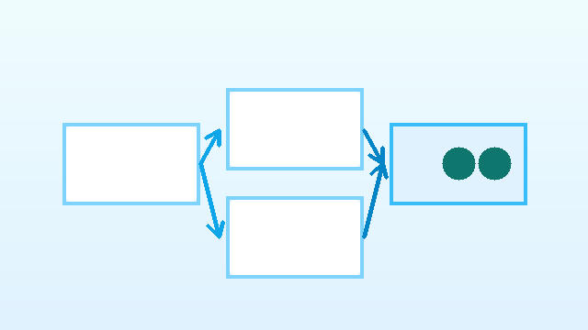
30-Second Executive Summary
• Problem: contacts disappear after reboot/disconnect because cache is volatile.
• Solution: I persist contacts in SQLite with WAL and sync metadata.
• Security: UID access checks plus AES-GCM encryption for sensitive fields.
• Target impact: restart contact load p95 under 400 ms.
• Rollout: phased feature-flag release with automatic fallback gates.
Recommendation: secure durable cache with controlled rollout
3/33

Slide 4
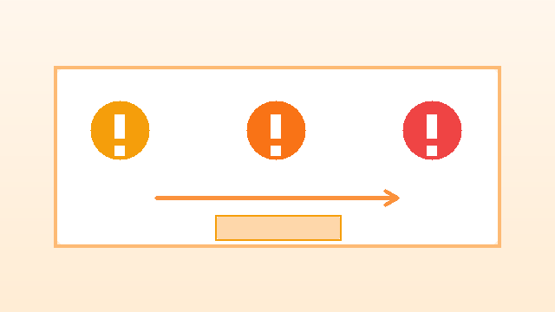
Problem Context (In Simple Terms)
• Users expect saved contacts to be ready every time they enter the car.
• Today, that experience breaks when process/session state is lost.
• Repeated full sync creates visible delay and unnecessary traffic.
• My objective is reliable fast access first, sync catch-up in background.
Volatile state causes user-visible delays and retries
4/33

Slide 5
Current Flow (Today)
1. Phone connects and contacts are loaded into temporary memory.
2. UI works while that process/session remains alive.
3. Reboot/disconnect/process death clears temporary state.
4. Next session requires a fresh, often full, sync cycle.
• Result: inconsistent startup experience for the driver.
Current flow depends too much on volatile process state
5/33

Slide 6
Desired Flow (After My Fix)
1. I still ingest data from PBAP/USB adapters.
2. I write normalized records into durable local cache.
3. On restart, UI reads local cache immediately.
4. Sync then applies only changes (delta) when available.
• Result: quick startup and stable contact availability.
Durable cache enables fast reads before full sync catch-up
6/33

Slide 7
Non-Negotiable Constraints
• Correctness: no stale data overwrite, no silent mass delete on partial payloads.
• Security: only authorized UIDs can read/write provider data.
• Performance: responsive reads even during sync writes.
• Operations: safe schema migration and predictable rollback path.
• Scalability: support multi-device pairing without source collisions.
7/33

Slide 8
Assumptions and Non-Goals
• Assumption: source adapters eventually deliver complete and valid identifiers.
• Assumption: AAOS storage stack and Keystore APIs are available on target build.
• Assumption: UI can tolerate brief stale reads until next delta sync.
• Non-goal: replace upstream contacts source-of-truth semantics.
• Non-goal: solve cloud contact conflicts outside in-vehicle cache boundary.
8/33

Slide 9
Approach Comparison (Quick)
• Approach 1 - SQLite + WAL: strong consistency, fast indexed reads, migration support.
• Approach 2 - JSON snapshots: easiest start, weak scalability and transaction safety.
• Approach 3 - Event log: strong audit trail, heavier read/compaction complexity.
• My choice: Approach 1 for production reliability and maintainability.
9/33

Slide 10
Pros vs Cons Table: Previous vs Current Approach
• I summarized the practical tradeoffs between the earlier flow and my current design.
• This helps quickly explain why I moved to the new architecture.
Area | Previous Approach | Current Approach
Startup UX | Slow after reboot/disconnect | Fast cached load before sync catch-up
Consistency | State can be lost after process reset | Durable transactional state
Sync Cost | Frequent full sync and higher traffic | Delta-first updates, less repeated traffic
Read Speed | No indexed durable query path | Indexed, predictable read latency
Security | Basic controls only | UID ACL + AES-GCM + key rotation
Operations | Lower recovery confidence | Versioned migration + clear fallback
Main Pro | Simple initial implementation | Reliable production behavior
Main Con | Unreliable restart experience | More upfront engineering effort
10/33

Slide 11
Pros vs Cons Table: Three Approaches
• I use this table to compare all three options side by side.
• It helps quickly justify why Approach 1 is my production choice.
Approach | Key Pros | Key Cons | Best Fit
Approach 1: SQLite + WAL + metadata | Fast indexed reads; strong transactions; migration friendly | Higher upfront schema and migration complexity | Production AAOS persistent contacts
Approach 2: JSON snapshot files | Lowest initial complexity; easy manual inspection | Full rewrites; weak query model; no robust transactions | Prototype or very small datasets
Approach 3: Append-only event log | Strong auditability; durable append behavior | Replay/compaction overhead; slower read path at scale | Audit-first, analytics-heavy systems
11/33

Slide 12
Decision in One Slide
• I recommend SQLite + WAL + sync metadata as the default architecture.
• It gives me deterministic writes and fast read path for UI.
• It aligns with AAOS provider patterns and migration practices.
• I accept the upfront schema effort for better long-term stability.
Best tradeoff for production AAOS deployment
12/33

Slide 13
Data Lifecycle (End to End)
• Ingest: receive contacts from PBAP/USB adapter.
• Normalize: sanitize fields, dedupe records, validate payload.
• Protect: encrypt sensitive JSON fields before persistence.
• Persist: upsert/delete inside one transaction and update sync state.
• Serve & retain: read active rows fast, purge old tombstones async.
Lifecycle pseudocode
RawContact batch
-> normalizeAndDedupe()
-> encryptSensitiveFields()
-> inTransaction(applyFullOrDeltaSync)
-> updateSyncState()
-> queryActiveForUI()
-> runRetentionJob()
13/33

Slide 14
API Contract (Sync Input/Output + Error Codes)
• I keep API contracts explicit so source adapters and store stay decoupled.
• I return stable counters plus sync token for resumable sync.
• I use explicit error codes for recovery decisions.
Pseudocode: request/response contract
final class SyncRequest {
String sourceDevice;
boolean fullSnapshot;
long sourceSequence;
String syncToken;
List<RawContact> contacts;
List<String> deletedIds;
}
final class SyncResponse { int inserted, updated, deleted, staleIgnored; String nextSyncToken; ErrorCode error; }
14/33

Slide 15
My Step-by-Step Implementation Plan
• Step 1-2: DB bootstrap, schema, indexes, migration hooks.
• Step 3-5: normalize input, full sync flow, delta sync flow.
• Step 6-8: stale guards, read APIs, UID + encryption security.
• Step 9-10: retention/recovery and feature-flag rollout.
• I keep each step independently testable before release.
15/33

Slide 16
Core Setup Snippet (DB + WAL + Schema Hooks)
• I keep initialization minimal and deterministic.
• WAL and foreign keys are enabled at configure time.
Pseudocode: database helper
@Override public void onConfigure(SQLiteDatabase db) {
db.enableWriteAheadLogging();
db.execSQL("PRAGMA foreign_keys=ON");
db.execSQL("PRAGMA synchronous=NORMAL");
}
@Override public void onCreate(SQLiteDatabase db) {
createTables(db); // contacts + sync_state
createIndexes(db); // query + retention + version guards
}
16/33

Slide 17
Core Sync Snippet (Single Entry Point)
• I route full and delta sync through one orchestrator function.
• I update sync state in the same transaction as row updates.
Pseudocode: sync orchestration
SyncResult handleSync(String source, SyncPayload payload) {
enforceWriteAccess();
assertSequence(payload.meta(), readLastSequence(source));
List<NormalizedContact> rows = normalizeAll(payload.contacts());
return inTransaction(() -> {
if (payload.meta().isFullSnapshot()) applyFullSync(source, rows, payload.meta());
else applyDeltaSync(source, payload.delta(), payload.meta());
upsertSyncState(source, payload.meta());
return SyncResult.success();
});
}
17/33

Slide 18
Core Read Snippet (Fast UI Path)
• I only query active rows and decrypt only for authorized callers.
• I keep reads indexed and sorted for predictable UI latency.
Pseudocode: list API
List<ContactView> listActive(String source, int limit) {
return store.query(
"source_device=? AND deleted=0",
new String[]{source},
"display_name COLLATE NOCASE ASC",
limit
).map(row -> decryptForAuthorizedCaller(source, row));
}
18/33

Slide 19
Threat Model and Mitigations (1:1)
• Unauthorized provider read -> UID allowlist + permission enforcement.
• Stale/out-of-order sync packet -> version and sequence guard rails.
• Ciphertext tampering -> AES-GCM tag validation and fail-closed behavior.
• PII leak in observability -> strict redaction in logs and telemetry.
• DB corruption -> recovery flow: clear cache + trigger fresh full sync.
19/33

Slide 20
Encryption and Decryption Flow
• I encrypt high-risk fields before insert/update.
• I use AES-GCM with random IV and AAD(source|contactId).
• I verify authentication tag during decrypt and fail closed on mismatch.
Pseudocode: field crypto
EncryptedBlob encryptField(String source, String id, String plain, SecretKey key) {
byte[] iv = randomBytes(12);
Cipher c = Cipher.getInstance("AES/GCM/NoPadding");
c.init(Cipher.ENCRYPT_MODE, key, new GCMParameterSpec(128, iv));
c.updateAAD((source + "|" + id).getBytes(UTF_8));
return new EncryptedBlob(base64(c.doFinal(plain.getBytes(UTF_8))), base64(iv));
}
String decryptField(...) { /* same AAD + tag check; fail closed on AEADBadTagException */ }
20/33

Slide 21
Key Management and Rotation
• I store AES keys in Android Keystore (non-exportable).
• I keep key_version per row for controlled migration.
• I rotate keys in small batches and promote only after verification.
Pseudocode: key rotation
void rotateKeysIfDue() {
if (!rotationPolicy.isDue(nowMs())) return;
KeyRef next = keyManager.createNextVersion();
for (Row row : store.rowsByKeyVersion(keyManager.currentVersion())) {
String plain = decryptField(row.source(), row.id(), row.enc(), keyManager.currentKey());
EncryptedBlob reenc = encryptField(row.source(), row.id(), plain, next.key());
store.updateEncryptedPayload(row.source(), row.id(), reenc, next.version());
}
keyManager.promote(next);
}
21/33

Slide 22
Failure Scenarios and Exact Fallback Behavior
• Sequence regression detected -> reject batch, request source recovery/full sync.
• AEAD tag failure on decrypt -> block row read, emit security metric, schedule recovery.
• Migration failure at boot -> keep legacy path enabled and retry next boot.
• Store transaction error -> rollback batch, preserve last consistent state.
• Critical cache failure rate breach -> auto-disable feature flag and fallback.
22/33

Slide 23
Operational Runbook (When Things Go Wrong)
• Step 1: check health dashboard (sync success, decrypt errors, migration failures).
• Step 2: inspect recent logs with PII-safe IDs for failing source device.
• Step 3: validate key alias/version availability in Keystore.
• Step 4: verify sequence/token progression; trigger controlled full sync if needed.
• Step 5: if thresholds are breached, disable feature flag and fall back safely.
23/33

Slide 24
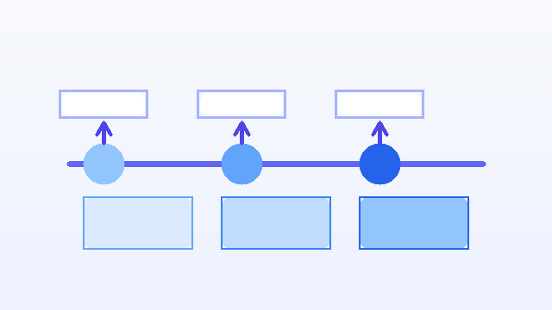
Before vs After Metrics (Target)
• Cold-start contact load (p95): 2500-4000 ms -> <= 400 ms.
• Repeated full-sync frequency per day: high -> reduced by >= 60%.
• Sync success rate: baseline -> >= 99.5% steady-state.
• Stale overwrite incidents: non-zero risk -> 0 tolerated by design guards.
• Recovery time from corruption: manual/slow -> automated next sync cycle.
Operational targets used for release decisions
24/33

Slide 25
Cost and Effort Estimate
• Engineering: 4-6 weeks for core implementation + integration hardening.
• Security: 1-2 weeks for Keystore/AES-GCM validation and threat checks.
• Testing: 2-3 weeks for JVM + instrumentation + migration regression matrix.
• Rollout/monitoring: 1-2 weeks for staged launch and observability tuning.
• Total estimate: 8-13 weeks depending on OEM integration dependencies.
25/33

Slide 26
Test Coverage Matrix (Requirement -> Evidence)
• Persistence after reopen -> `fullSync_persistsAcrossDatabaseReopen`.
• Delta correctness -> `deltaSync_updatesAndDeletesCorrectRows`.
• Partial snapshot safety -> `fullSync_partialSnapshot_doesNotDeleteMissingContacts`.
• Sequence guard -> `syncSequence_regressionIsRejected`.
• Migration/WAL/indexes -> `freshCreate_enablesWalAndCreatesRequiredIndexes`.
• Access control -> `enforceReadAccess_rejectsUnknownUid` + write equivalent.
26/33

Slide 27
Libraries and Frameworks I Used
• Storage framework: Android `SQLiteOpenHelper` + `SQLiteDatabase` + `Cursor`.
• Security boundary: `Binder.getCallingUid()` for provider authorization.
• Serialization: `org.json` for phones/emails payload handling.
• Crypto: Android Keystore + `Cipher` (`AES/GCM/NoPadding`).
• Testing: AndroidX Test (`runner`, `rules`, `core`, `ext.junit`) + JVM tests.
• Build setup: Gradle Kotlin DSL for instrumentation module.
27/33

Slide 28
Go/No-Go Checklist and Rollout Plan
• Go gate 1: cold-start load p95 <= 400 ms for target fleet.
• Go gate 2: sync success >= 99.5% with no critical security regressions.
• Go gate 3: migration pass rate >= 99.9%, rollback path validated.
• Rollout stages: 5% -> 25% -> 100% with automated health checks.
• If any gate fails, I keep fallback active and pause rollout.
• Detailed pseudocode/security deep dive is in the appendix deck.
Controlled rollout with objective go/no-go gates
My recommendation: ship SQLite + WAL + encrypted fields after gates pass.
28/33

Slide 29
Q&A Backup (Likely Questions)
• Q: Why not JSON snapshot for speed? A: it is simple but scales poorly and weakly transactional.
• Q: What if decrypt fails? A: fail closed for row, emit metric, trigger safe recovery.
• Q: What if migration fails in field? A: fallback remains active and retry happens next boot.
• Q: How is stale data prevented? A: version and sequence guard rails block regressions.
• Q: How do we roll back quickly? A: feature flag disable routes reads to legacy path.
29/33

Slide 30
FAQ 1: Product and UX
• Q: Will users notice this change immediately?
• A: Yes, restart/reconnect contact availability should feel significantly faster.
• Q: Does this replace phone contacts as source-of-truth?
• A: No, source device remains authoritative; this is a durable local cache.
• Q: What if source is temporarily offline?
• A: Cached contacts remain readable until sync reconnect succeeds.
30/33

Slide 31
FAQ 2: Security and Privacy
• Q: Are sensitive contact fields encrypted at rest?
• A: Yes, I encrypt high-risk fields via AES-GCM with Keystore-managed keys.
• Q: How is unauthorized read prevented?
• A: Provider entrypoints enforce UID allowlists and permission checks.
• Q: Can logs leak phone/email data?
• A: No, telemetry/logging paths use strict PII redaction.
31/33

Slide 32
FAQ 3: Reliability and Rollout
• Q: What if migration fails on a subset of vehicles?
• A: Fallback remains active and migration retries safely on next boot.
• Q: How do I rollback quickly in production?
• A: Disable feature flag to route reads to legacy path immediately.
• Q: How do I verify rollout safety?
• A: Go/no-go gates enforce latency, sync success, and migration health thresholds.
32/33

Slide 33
Thank You
• Thank you for reviewing my case study.
• Happy to answer more detailed implementation or rollout questions.
End of presentation
33/33

