Slide 1
QUIC protocol Partha sarathi Reddy Under the

Slide 2
Protocols
IP
TCP/UDP
HTTP
REST architecture
SCTP
RTP
webRTC
QUIC
FTP/SFTP

Slide 3
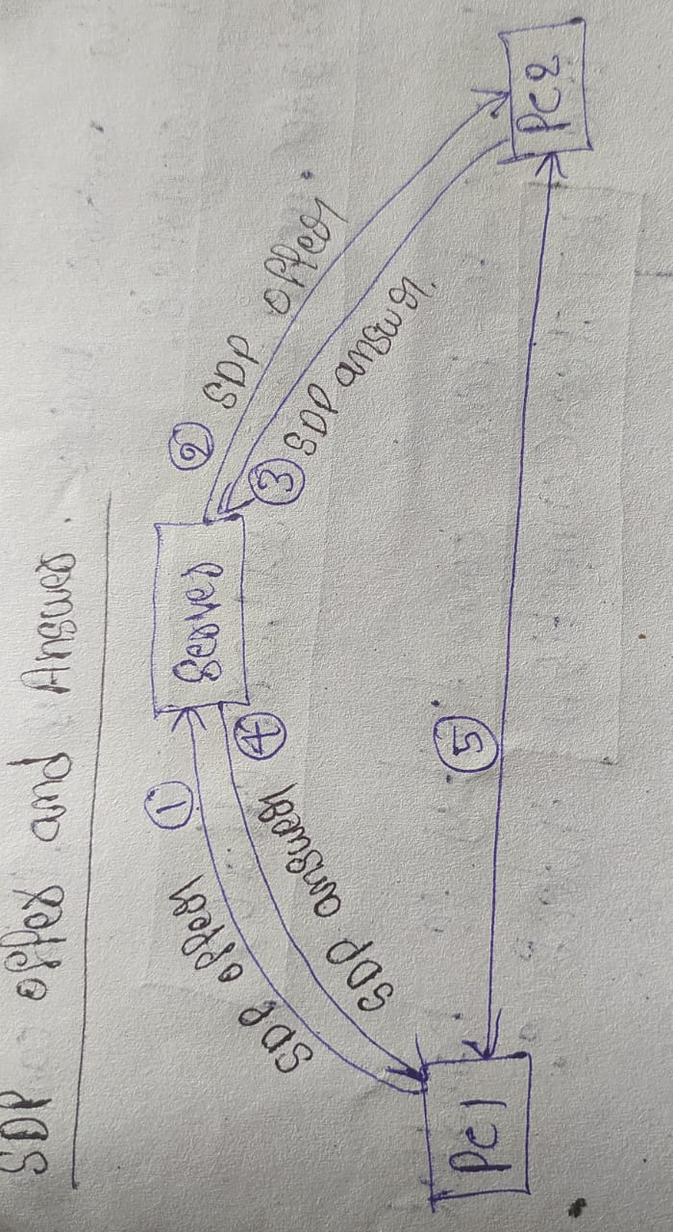
webRTC
Web Real-Time Communication is a
technology, it enalbes peer-to-peer
connections(without server) for real-time
audio, video and data sharing.
var conn = new WebSocket(URI) -> a Websocket connection is used for signaling.
conn.onmessage -> Handle incoming messages from signaling server
peerConnection = new RTCPeerConnection(null); -> This initializes the a new ‘RTCPeerConnection’ object.

Slide 4
peerConnection.onicecandidate = function(event) {}; -> ICE candidates help to establish a direct connection with the remote peer. dataChannel = peerConnection.createDataChannel("dataChannel", { reliable: true }); -> This create data channel between peers. data channel in webRTC allow for bi-directional data transfer. 1. dataChannel.open() -> triggered when the data channel is open 2. dataChannel.close() ->triggered when the data channel is closed 3. dataChannel.onmessage() -> triggered when a message is received. peerConnection.ondatachannel = function(event) {}; -> Data channel is received form the remote peer, ‘ondatachannel’ event handler sets it up by assigning it to ‘datachannel’.

Slide 5
QUIC
QUIC protocol, a next-generation protocol designed for fast and more efficient data transmission than traditional TCP.
ServerConnectionConfig serverConnectionConfig =
ServerConnectionConfig.builder().build(); -> This configuration defines parameters for managing connection.
ServerConnector serverConnector = ServerConnector.builder().build() -> It estalish a QUIC server.
serverConnector.registerApplicationProtocol(“protocol name”); -> registers the factory for the HTTP/3 protocol. This allows the serverto handle HTTP/3 connections.

Slide 6
ApplicationProtocolConnectionFactory -> create connection using a specific application protocol.
ApplicationProtocolConnection() -> handle incoming QUIC connections.

Slide 7
webRTC vs QUIC
webRTC
un-reliable
No signaling server(For signaling depend on others).
Two peers connected using IP and Port.
Slow data transfer compare with “QUIC”.
QUIC
reliable
Provide independent streams over one connection(Solve head-of-line problem).
Connected using “Connection Identifier”(A random number), It helps in “Connection migration”.
Fast data transfer compare with “WebRTC”.

Slide 8
Thank You.

