Slide 1

A Dual-Carrier Framework for Text and Image Steganography with AES Encryption and Exfiltration Detection
CSA5111 - CRYPTOGRAPHY AND NETWORK SECURITY
Guided By:
Dr. Sivasankar chandrasekaran
Presented By :
CHALLA RAVITEJA (192325065)
TALAPALA PARTHA SARATHI (192325042)

Slide 2



Introduction
Sensitive information is frequently transmitted over the internet and requires secure protection.
Traditional encryption secures data but may reveal that confidential communication is taking place.
Ghost Text encrypts secret data using AES and hides it inside images using LSB steganography.
The system performs steganalysis to detect hidden information in suspicious images.
It helps prevent data exfiltration by identifying covert communication and generating security reports.

Slide 3
Problem Statement
Organizations face increasing risks of unauthorized data leakage through covert communication.
Traditional encryption reveals the presence of sensitive communication, while hidden data in images often goes undetected.
Existing steganography tools mainly focus on data hiding and lack effective detection mechanisms.
There is a need for an intelligent system that can securely hide data, detect hidden information, and prevent data exfiltration.

Slide 4
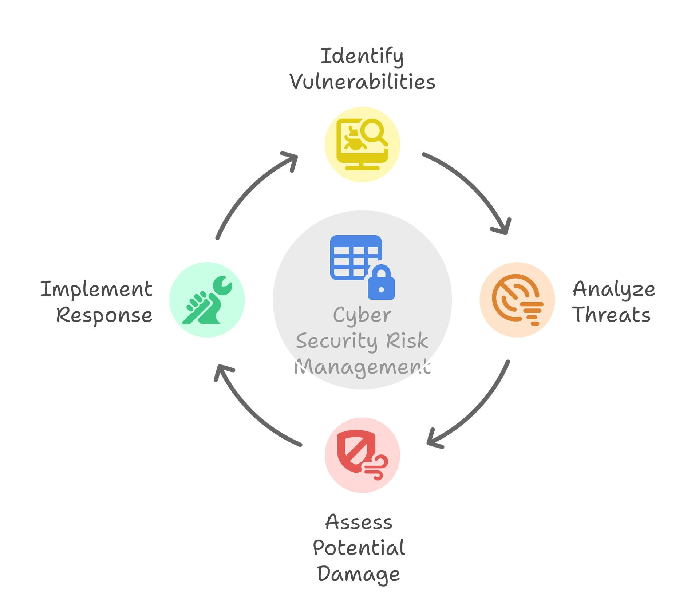
Objectives
The proposed system aims to:
Secure confidential information using AES encryption.
Hide encrypted data inside digital images using LSB steganography.
Detect images containing hidden messages using steganalysis techniques.
Identify possible covert data exfiltration attempts.
Generate security reports for analysis.

Slide 5
Literature Review
S.No | Year | Reference | Related Work Summary | Tools / Tech | Data / Components | Feasibility Study
1 | 2022 | Dhawan & Gupta, Information Security Journal | Studied basic image steganography techniques. | LSB, PVD, DCT | Images, secret messages | LSB is simple and suitable for data hiding.
2 | 2020 | Siddiqa et al., Information Security Journal | Information Security Journal | AES, LSB, Filtering | Text, cover images | Shows that encryption + LSB can improve secure communication.
3 | 2022 | Fatma et al., JUSIFO | Combined AES-128 encryption with LSB for secure text transmission. | AES-128, LSB, PSNR | Text, images | Simple and practical approach for secure message hiding.
4 | 2024 | Aslam et al., Image Steganography using LSB – Systematic Literature Review | Reviewed common LSB-based image hiding methods. | LSB, Image Processing | Cover images, hidden data | Confirms LSB as a widely used and practical technique..

Slide 6
Existing System and Its Limitations
Existing System
Traditional AES encryption protects the confidentiality of message contents.
Text steganography hides information through text formatting or character patterns.
Image steganography embeds data into image pixels using techniques such as LSB.
Security monitoring tools analyze network traffic, file transfers, or system events.
Limitations
Encryption alone does not conceal the existence of a message.
Text carriers may be damaged by formatting changes.
Basic LSB image steganography may be vulnerable to statistical detection.
Separate tools can make the overall workflow more complicated.
Detection systems may produce false positives or miss suspicious events.

Slide 7
Proposed System and Advantages
Proposed System
A unified application that encrypts a message, hides the encrypted payload in either a text or image carrier, and analyzes available files or simulated transfer logs for suspicious activity.
Advantages
Combines encryption and steganography.
Supports two different carrier types.
Uses authenticated encryption to detect payload modification.
Provides a common workflow for embedding, extraction, and decryption.
Generates alerts for suspicious data-transfer patterns.
Allows performance and detection results to be compared.

Slide 8
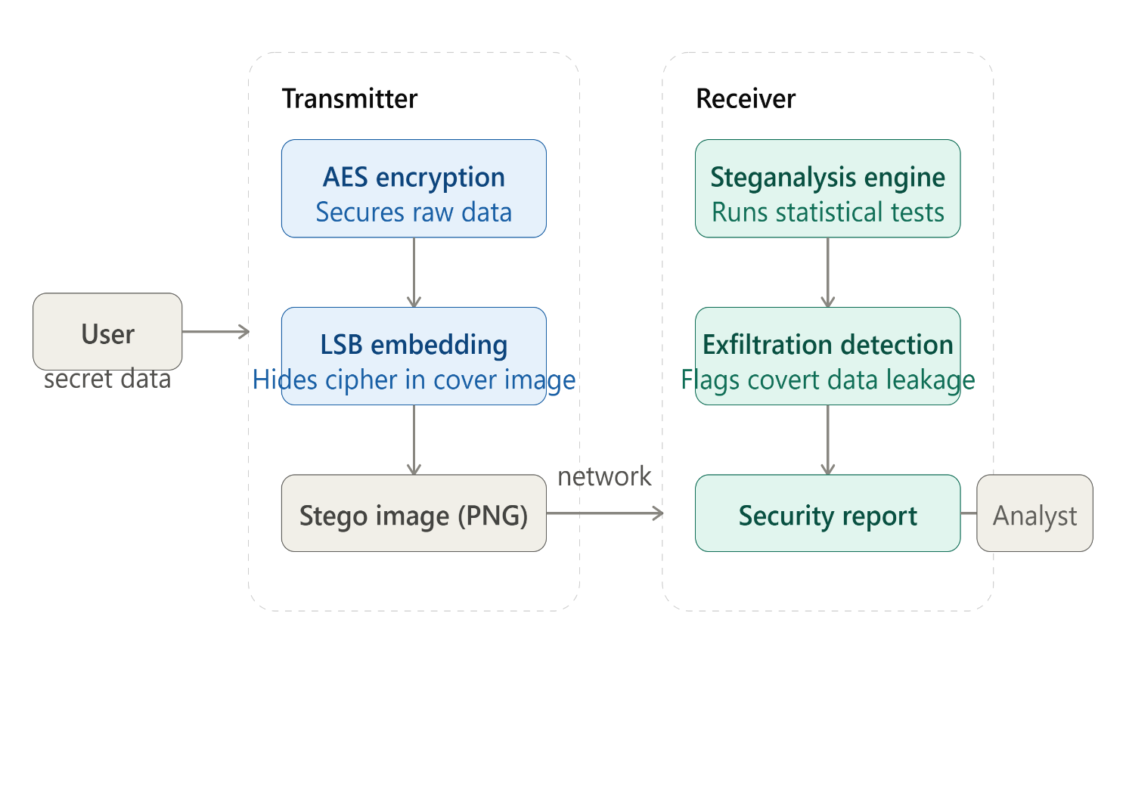
System Architecture

Slide 9
Modules
Module 1: Cryptographic Payload Preparation
Module 2: Dual-Carrier Steganography Engine
Module 3: Security & Exfiltration Detection

Slide 10

Module 1:
Cryptographic Payload Preparation
Purpose: Protect the message before embedding.
Functions
Accept plaintext from the sender.
Generate or obtain a secret encryption key.
Encrypt the message using AES-GCM.
Package the ciphertext, nonce, and authentication tag.
Input: Plaintext and secret key.
Output: Encrypted payload ready for embedding.

Slide 11

Module 2:
Dual-Carrier Steganography Engine
Purpose: Hide and recover the encrypted payload.
Functions
Allow the sender to select text or image.
Embed the payload in a supported carrier.
Save the resulting stego file.
Extract the payload at the receiver's end.
Input: Encrypted payload and carrier file.
Output: Stego file and extracted encrypted payload.

Slide 12

Module 3:
Security & Exfiltration Detection
Purpose: Analyze suspicious data movement and payload characteristics.
Functions
Analyze supported files and simulated transfer events.
Apply rules for unusual file sizes, transfer volumes, or destinations.
Generate alerts with reasons and severity.
Record detection outcomes for evaluation.
Input: Test files, file metadata, and simulated transfer logs.
Output: Detection report, alerts, and event records.

Slide 13
Module-wise Inputs and Outputs
Module | Input | Processing | Output
Module 1 | Plaintext, key | AES-GCM encryption | Encrypted payload
Module 2 | Payload, text/image carrier | Embed or extract data | Stego file or recovered payload
Module 3 | Files, metadata, test logs | Rules and anomaly checks | Alerts and detection report
Common data flow:
The output of Module 1 becomes the input to Module 2. Module 3 analyzes available test files and transfer events. The receiver then extracts and decrypts the message using Modules 2 and 1.

Slide 14
Technologies, Tools, Hardware and Software Requirements
Category | Technology
Programming language | Python
User interface | Streamlit
Encryption | AES-GCM using cryptography
Image processing | Pillow
Text processing | Python string and file handling
Detection | Rule-based analysis using Python
Development tool | VS Code
Operating system | Windows 10/11
Hardware | Laptop/PC, 8 GB RAM recommended
Storage | Local files; SQLite if event logging is required

Slide 15
Output
A fully functional file sharing platform was developed with secure user authentication.
Users were successfully assigned roles (Admin, Manager, User) with distinct access levels.
File upload, download, and sharing features worked correctly based on role permissions.
Access control was enforced both at the backend and in the frontend interface.

Slide 16
Future Scope
Integrate AI and Deep Learning for more accurate steganalysis and hidden data detection.
Extend the system to support video and audio steganography.
Implement cloud-based monitoring for secure storage and remote analysis.
Use blockchain technology to ensure data integrity and prevent tampering.
Develop real-time data exfiltration detection with automated security alerts.
Expand the framework for mobile applications and enterprise-level cybersecurity solutions.

Slide 17

Conclusion
A robust, dual-layered approach to secure communication.
  Empowers users with both offensive (hiding) and defensive (detection) capabilities.
  Zero-trust model operating entirely within the web browser.
  Demonstrates that advanced cryptography and steganography can be highly accessible and deeply integrated into modern web technologies.

Slide 18
References
Selvaraj, A., Ezhilarasan, A., et al. (2021). Digital Image Steganalysis: A Survey on the Paradigm Shift from Machine Learning to Deep Learning Based Techniques. IET Image Processing, 15(2), 504–522.
King, J., Bendiab, G., Savage, N., & Shiaeles, S. (2021). Data Exfiltration: Methods and Detection Countermeasures. 2021 IEEE International Conference on Cyber Security and Resilience (CSR).
Kombrink, M. H., Geradts, Z. J. M. H., & Worring, M. (2024). Image Steganography Approaches and Their Detection Strategies: A Survey. ACM Computing Surveys, 57(2).
Haverkamp, I., & Sarmah, D. K. (2024). Evaluating the Merits and Constraints of Cryptography–Steganography Fusion: A Systematic Analysis. International Journal of Information Security (Springer).
Tang, W., Yang, H., Rao, Y., Zhou, Z., & Peng, F. (2024). Dig a Hole and Fill in Sand: Adversary and Hiding Decoupled Steganography. Proceedings of ACM Multimedia (MM 2024).

Slide 19
Thank you!

