Slide 1
Comparative Analysis of Localities in Bangalore and Chennai, India
Parthasarathy

Slide 2
Problem Statement
The Project is targeted at people who are interested in starting a new business in the Bangalore and Chennai.
Exploring various venues for a new visitor to a city certainly cannot be hassle-free and especially in multilingual and multicultural society like India.
The project enables to understand the similarities and differences between these two cities. It can give economic information and behavioral preferences of the population in the respective metropolitans located 370 KM away.

Slide 3
Introduction
Tagret Audience
This project is catered to address issues for three major categories namely:
Tourists, especially International tourists who face communication problems in finding out localities in Bangalore and Chennai, India
Any organization which is interested to begin their restaurant in Bangalore or Chennai, India, can compare and contrast the characteristics of the cities
Any institution interested to study the way restaurants operate in these cities.

Slide 4
Data
The locations were obtained within the radius of 10KM from the geographical coordinates of the city using two APIs.
Foursquare API
Zomato API

Slide 5
Foursquare API
VARIABLES | DESCRIPTION
VENUE NAME | Name of the location
CATEGORY | Category of the location as defined by the API (e.g.: restaurant, cafe)
LATITUDE | Latitude of the location
LONGITUDE | Longitude of the location

Slide 6
Zomato API
VARIABLES | DESCRIPTION
VENUE NAME | Name of the location
ADDRESS | Detailed address of the location in the city.
PRICE RANGE | Depending upon the price, the Zomato API ranks them on a scale of 1.0-5.0
PRICE FOR TWO | It provides the mean cost of dining at the restaurant for two people.
RATINGS | The average feedback of the location provided by the user represented by stars ranging from 0.0 to 5.0
LATITUDE | Latitude of the location
LONGITUDE | Longitude of the location

Slide 7
Methodology
Location data is extracted from the Foursquare API for all venues up to a distance of 10 kilometers radius from the coordinates of Bangalore and Chennai.
Using data cleaning, the dataset from the two APIs will be combined based on the venue names, latitude, and longitude values.
Data should be checked to remove any redundant data or multiple venues at the same location from the two datasets.
Venues are clustered using K-means clustering in Bangalore and Chennai and see if we can draw meaningful information out of what kind of venues exist in.

Slide 8
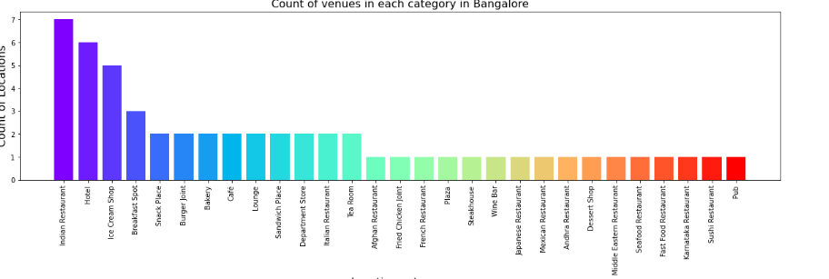
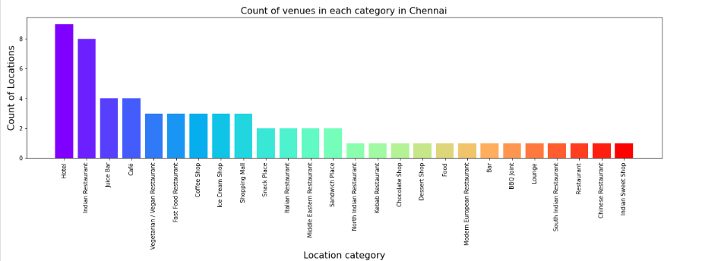
Categories

Slide 9
Clustering
Bangalore:
There are 37 venues in cluster 0 having average price of 1.27 and mean rating as 4.14
There are 4 venues in cluster 1 having average price of 4.00 and mean rating as 4.10
There are 14 venues in cluster 2 having average price of 3.07 and mean rating as 4.09
Chennai:
There are 37 venues in cluster 0 having average price of 1.49 and mean rating as 4.05
There are 6 venues in cluster 1 having average price of 4.00 and mean rating as 4.08
There are 18 venues in cluster 2 having average price of 2.94 and mean rating as 4.14

Slide 10
Results
It was identified that from the venue’s category, majority of them were Hotels and Indian Restaurants in both Bangalore and Chennai.
While the ratings range from 1 to 5, majority venues have ratings close to 4.25 in both Bangalore and Chennai. This means that most restaurants provide good quality food, thus indicating the high rating.
These clusters also have very high ratings. When we take a look at the price values of each venue, we explore that many venues have price that ranges start from Rs 250 and goes up till Rs 1800 in Bangalore and Rs 2000 in Chennai.

Slide 11
Conclusion
The purpose of this project was to explore the places in Bangalore and Chennai could explore.
The map reveals that there are locations that are widespread across the cities.
In terms of categories, cuisine and clustering both cities exhibited similar behavior.
However they differed only in terms of price range, minimally in which Chennai exceeded Bangalore by Rs 200 on the higher end of average price.
Based on the vis rating and price preferences, user can choose a wide variety of cuisines spread across both cities.

