Slide 1

AUTOGRADER
Grade Smarter, Not Harder

Slide 2
Introduction
AutoGrader is a system that automates the grading process using AI and Large Language Models (LLMs) to enhance efficiency and consistency.
By integrating predefined rubrics, it ensures accurate and scalable grading.
Built on Microsoft Azure, Langchain, and Streamlit, the project streamlines grading while promoting fairness and transparency across diverse educational settings.

Slide 3
Business Objectives
Improve
Improve Operational Efficiency: Automate grading to free up educators' time, enabling them to focus more on teaching and student engagement.
Reduce
Reduce Grading Costs: Cut labor and administrative expenses by automating the evaluation process.
Enhance
Enhance Customer Satisfaction: Deliver fast, transparent, and detailed feedback, improving the experience for educators and students alike.

Slide 4

System Description
AI & LLM Grading Engine: Powered by OpenAI’s GPT-4 (via Langchain), it aligns student responses with predefined rubrics for accurate scoring.
Azure AI Search Integration: Leverages Azure AI search to store and retrieve assignment data, enabling efficient, vector-based grading.

Slide 5

SYSTEM ARCHITECTURE

Slide 6
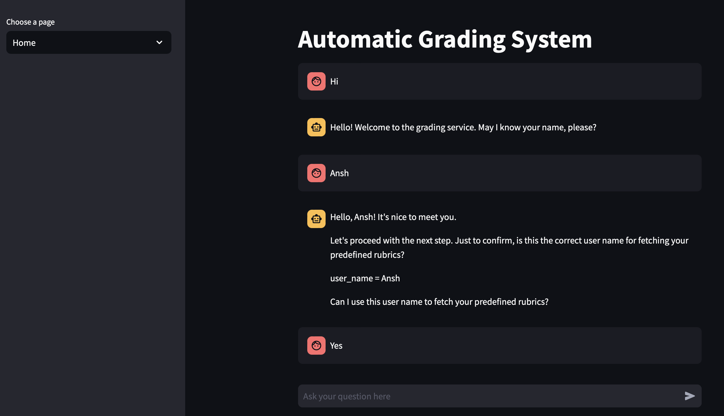
User interface - Homepage

Slide 7
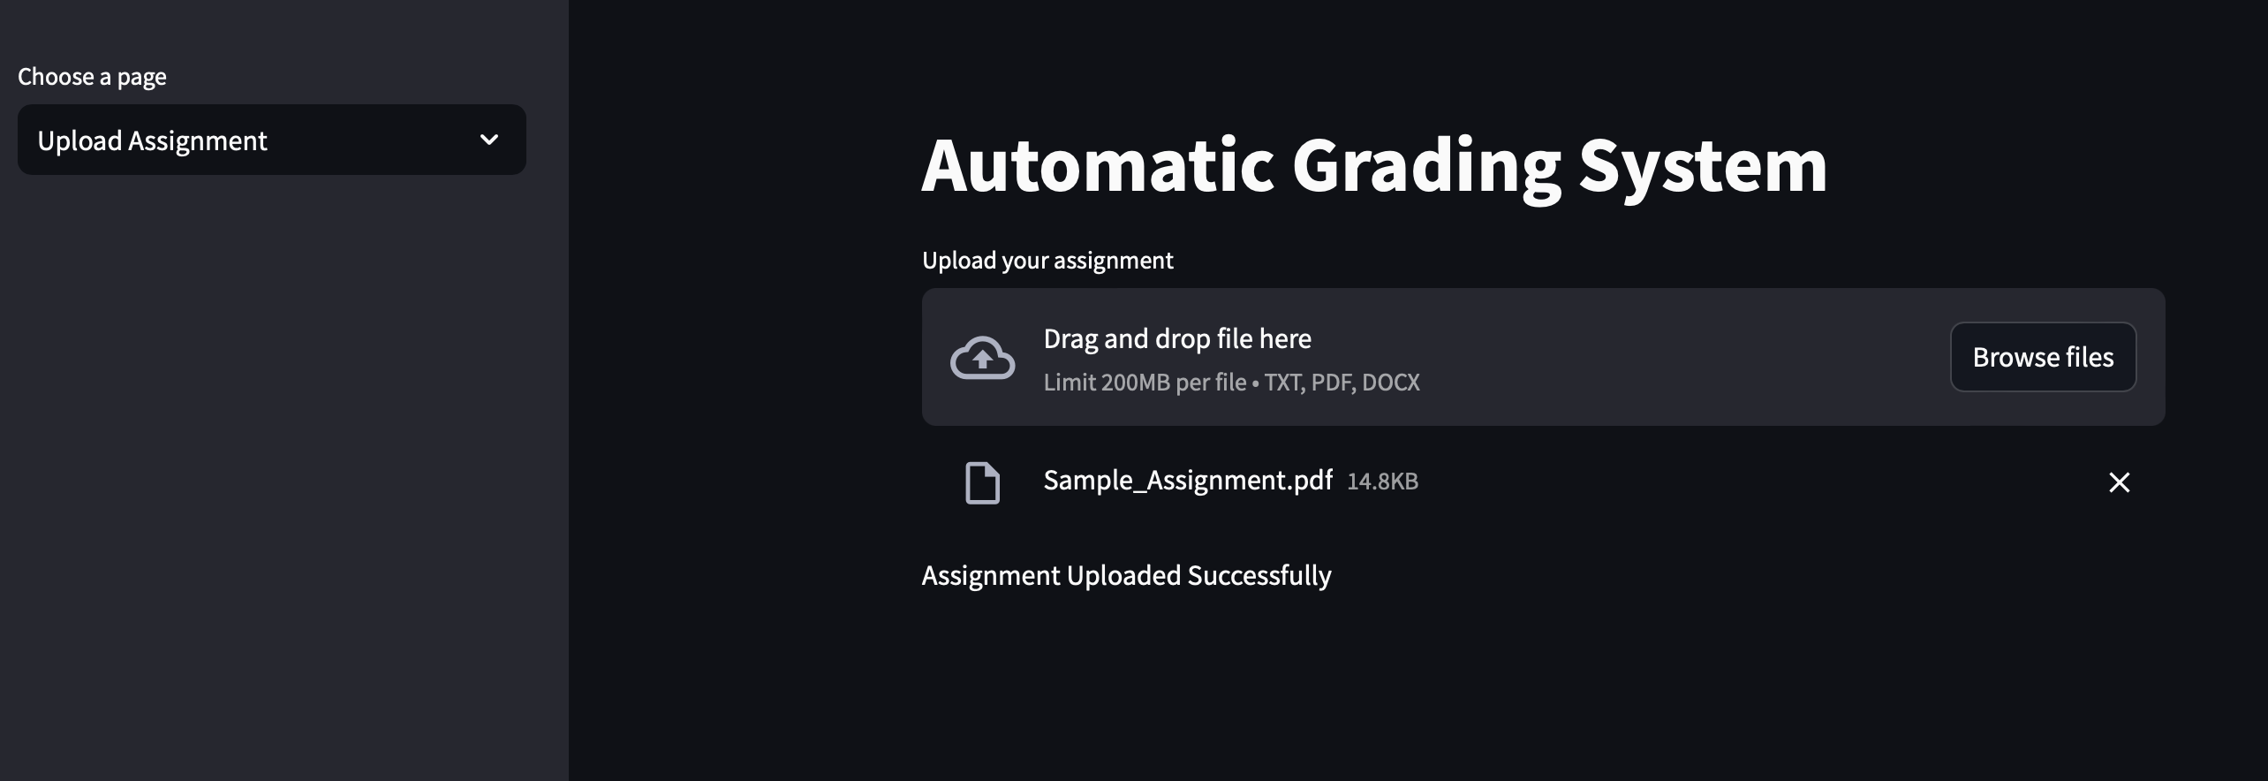
USER INTERFACE - UPLOAD PAGE

Slide 8
Methodology
The project unfolds in stages, beginning with document loading and splitting, where uploaded files are processed and divided into chunks. A tailored system prompt is then crafted for the LLM to ensure grading aligns with predefined rubrics. Azure AI Search enables efficient indexing and retrieval of submissions, storing assignments as vectors for real-time comparison. Grading is executed through Langchain’s LLMChain, generating scores and feedback based on student submissions. Finally, Streamlit provides a user-friendly interface for educators to upload assignments and review grading results, with options for score modifications.

Slide 9
PROJECT SCOPE
Automated Rubric-Based Grading: Generates consistent grades based on predefined rubrics, accommodating various grading criteria including points, weights, and qualitative feedback.
Multi-Format Assignment Support: Processes and grades assignments in PDFs, DOCX, and TXT formats with efficient text extraction.
Scalability and Performance Optimization: Designed for scalability, it efficiently handles large student populations while featuring a user-friendly interface and incorporating continuous feedback for improvement.
Cloud-Based Deployment: The cloud-based deployment ensures security and accessibility, complying with educational data privacy regulations.

Slide 10
Conclusion
The AutoGrader system simplifies and enhances the grading process through AI-powered automation. By utilizing predefined rubrics, LLMs, and Azure AI, it delivers accurate, consistent, and scalable grading solutions. Supporting various file formats and providing real-time feedback, AutoGrader allows educators to focus more on teaching and student engagement. Its user-friendly, cloud-based platform ensures efficiency and reliability, making it a valuable tool for modern education. AutoGrader is set to transform how assignments are graded, offering a smarter, faster, and more streamlined approach to assessment.

Slide 11

QUESTIONS?

Slide 12

THANK YOU

