Slide 1
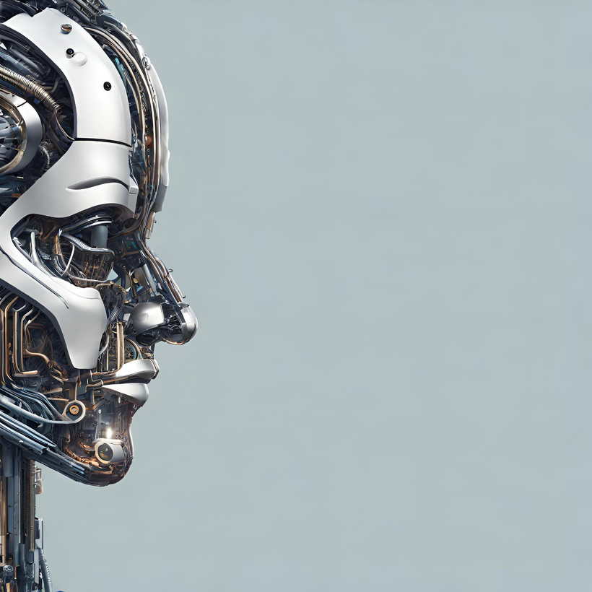
Document Based Q&A System
Streamlined Information Retrieval
By
Ansh Aya

Slide 2
INTRODUCTION
The project is to develop a user-friendly application tailored for students seeking easy access to course-related information.
Users will be able to upload their own documents, ask questions on and receive concise, accurate responses from those documents.
Leveraging advanced technologies like semantic search and Large Language Models (LLM).

Slide 3
Business Objective
In today’s fast-paced educational environment, accessing course materials and clarifying doubts efficiently can significantly impact a student's learning journey.
While the research focus is on academic settings, the scalability of the solution allows for potential applications across various domains.

Slide 4
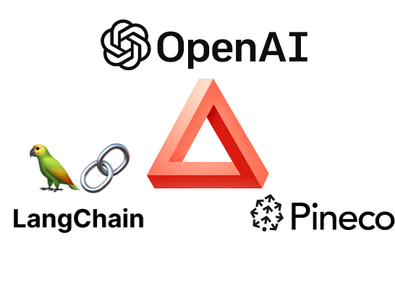
System Description
The approach involves combining Pinecone, a robust vector database engine, with LLM, known for its natural language understanding capabilities. By integrating these technologies, The aim is to improve the search functionality of this application, enabling it to understand and answer diverse queries accurately.

Slide 5
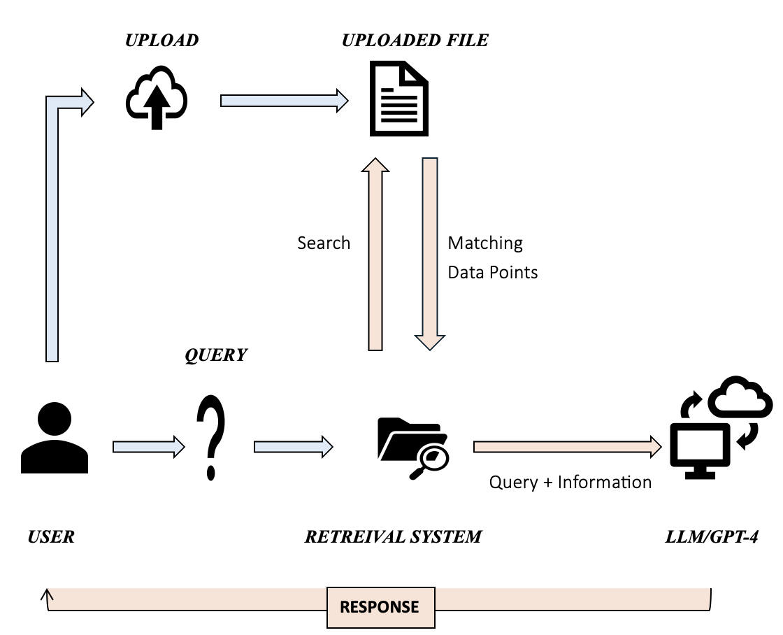
System Architecture

Slide 6
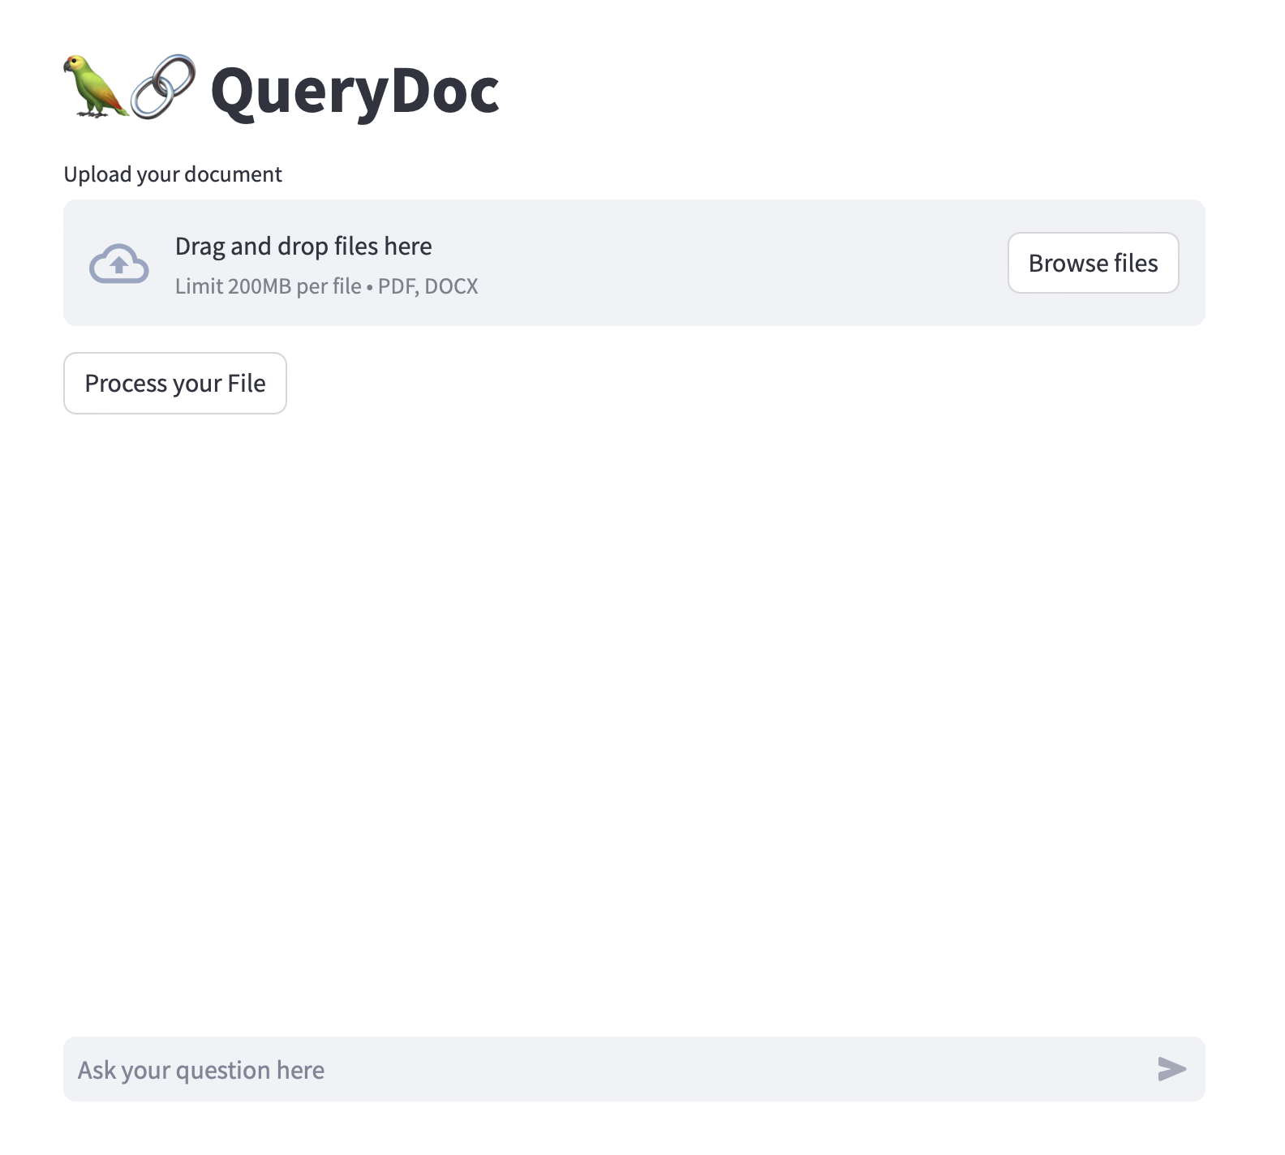
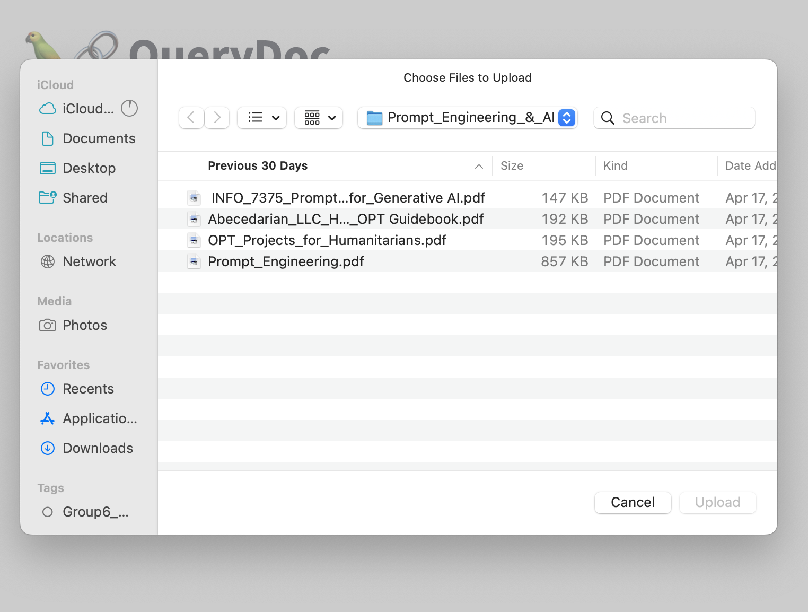
User Interface Upload File

Slide 7
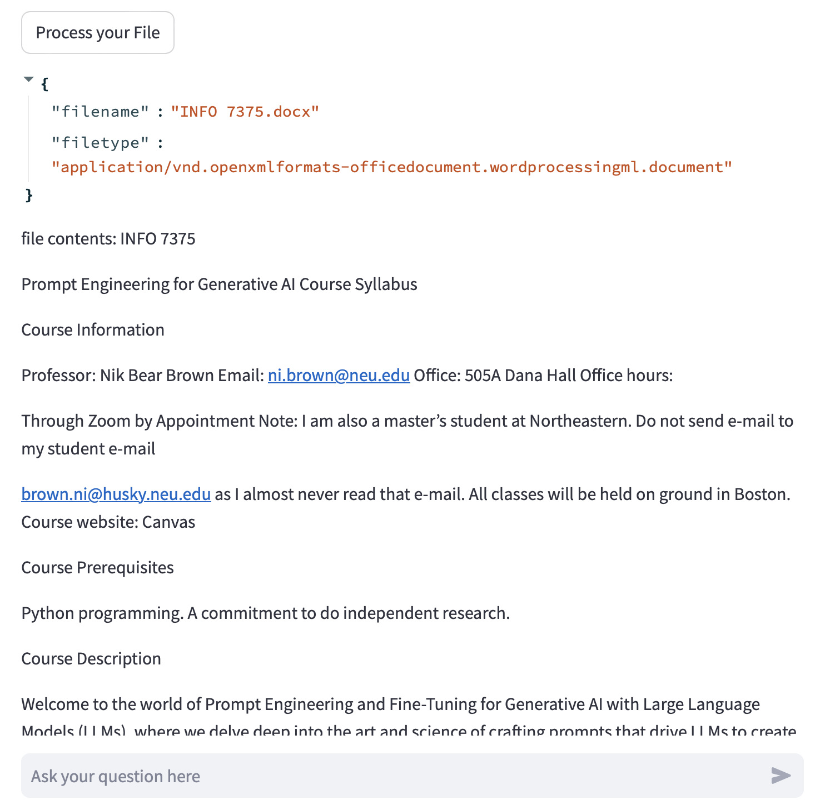
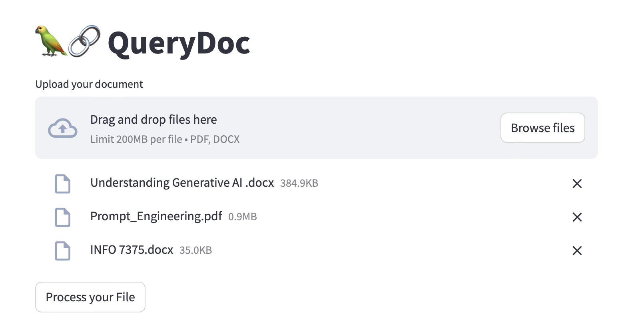
User Interface Process File

Slide 8
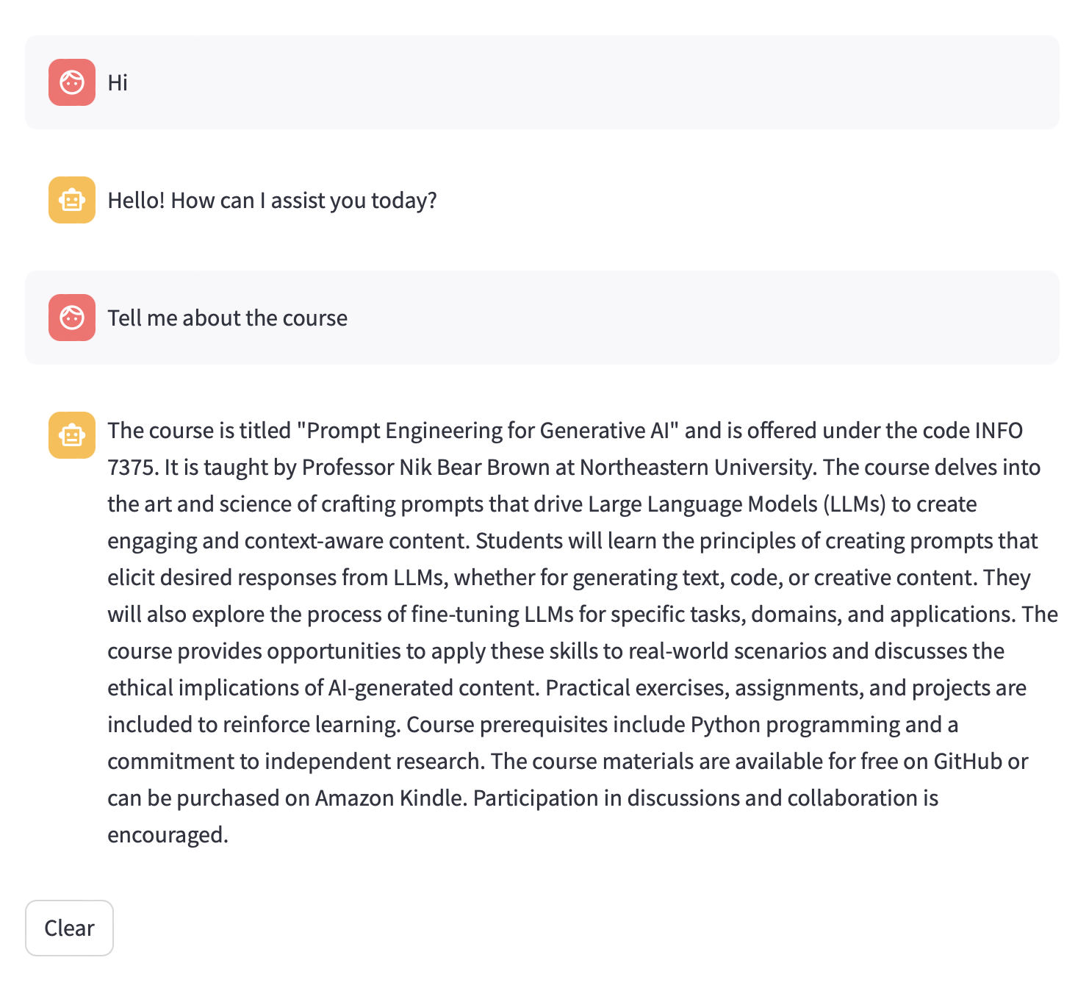
User Interface Chat 1

Slide 9
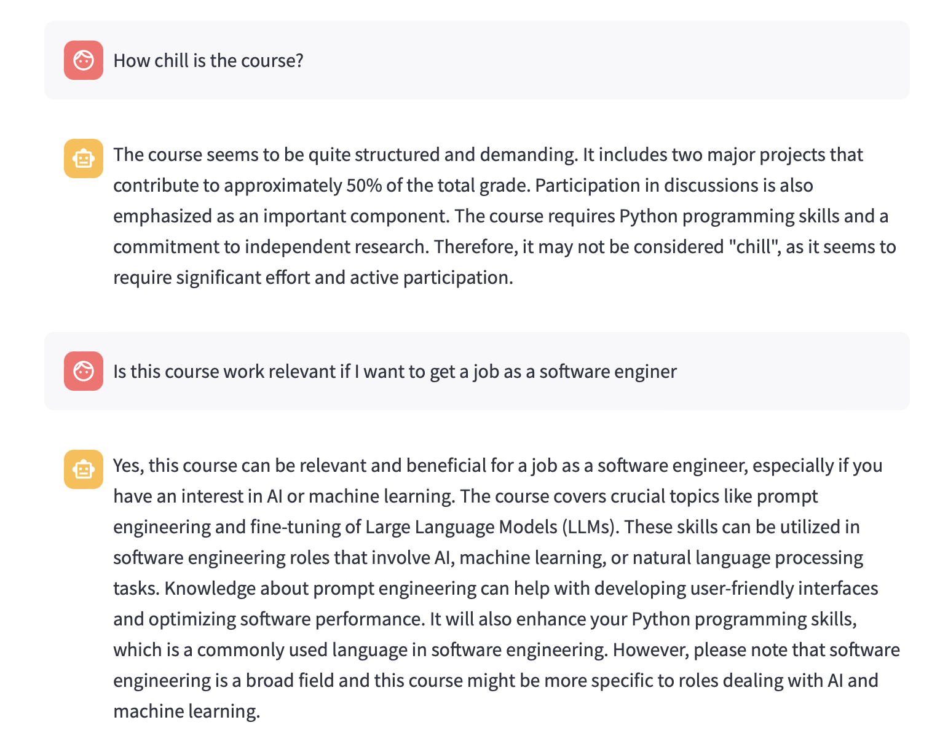
User Interface Chat 2

Slide 10
SCOPE OF THE PROJECT
Prototype system development for extracting answers from various document sources (text documents, PDFs, web pages, Docx, PPTX).
Scalable architecture implementation to handle large document volumes and user queries efficiently.
Integration of advanced NLP algorithms for text analysis, indexing, and answer extraction using techniques like deep learning and semantic analysis.
System performance evaluation through rigorous testing, benchmarking against existing QA systems, and user feedback analysis.
Comprehensive documentation and user guides provided for effective utilization by end-users and developers.

Slide 11
Technical Requirements
Pinecone Vector Database
LangChain
OpenAI
StreamLit

Slide 12

Methodology
Integration of Pinecone and LLM: Combining Pinecone's vector database engine with LLM enhances search accuracy and enables precise question-answering capabilities, boosting platform intelligence.
Deployment with Streamlit: Utilizing Streamlit Python framework ensures attractive, interactive user interfaces. Its versatility allows for visually appealing dashboards and intuitive controls, enhancing overall usability and user experience.

Slide 13
Conclusion
In conclusion, the project represents a significant step forward in improving the educational experience through technology. By leveraging semantic search and Large Language Models, we aim to empower students with a dynamic platform that simplifies information retrieval and fosters deeper understanding. The commitment to delivering a user-friendly, effective solution underscores the dedication to advancing education in the digital age.

Slide 14

Questions?

Slide 15

Thank you

