Slide 1

Presented by-
Partha S. Mukherjee
Akanksha Gupta
Somya Bhargava
Rachna Shivale.

Slide 2
Overview
Introduction
Problem Statement
Objective
Technology
Module
Design
Implementation
Knowledge Gained
Conclusion & Enhancements

Slide 3
Introduction
Project : Web portal for booking domestic flight tickets
Allows user to book flight tickets.
Maintain user’s account information.
Register new user.
Flow of Presentation-
Requirement
Design
Test Cases
Implementation
Conclusion

Slide 4
Objective
To develop an application for users to book domestic flights across India
With good presentation
User friendly

Slide 5
Technology
EJB 3.0
For Business logic and DAO
JPA
For persistence
JSF
For presentation logic

Slide 6
Design
Client
Application Server
Technologies
Application Database
Browser
Oracle Web Logic Server 11gR1
JSF ,Java(EE)
Technologies-Java, EJB ,JPA
Oracle 11g
SQL

Slide 7
Modules
User Module
Search Module
Booking Module

Slide 8
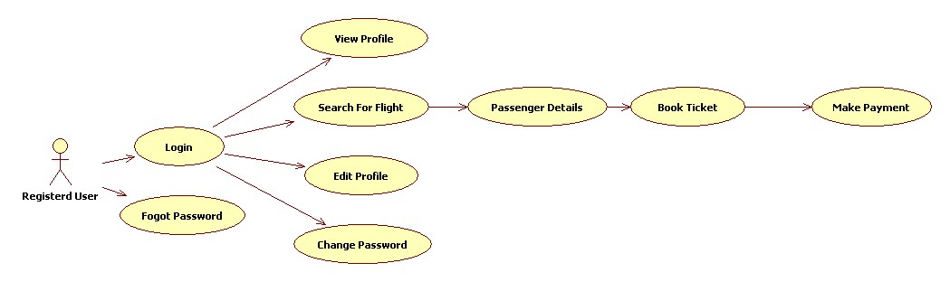
Design-Registered user

Slide 9
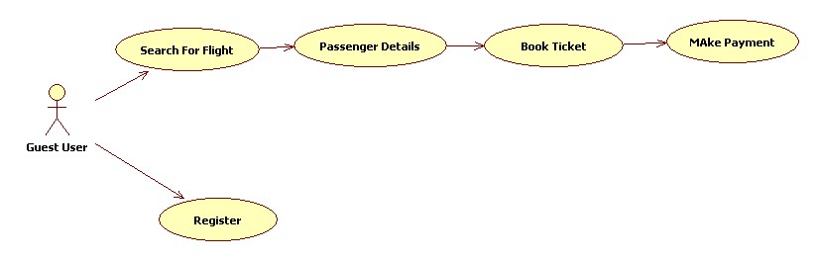
Design-Guest User

Slide 10
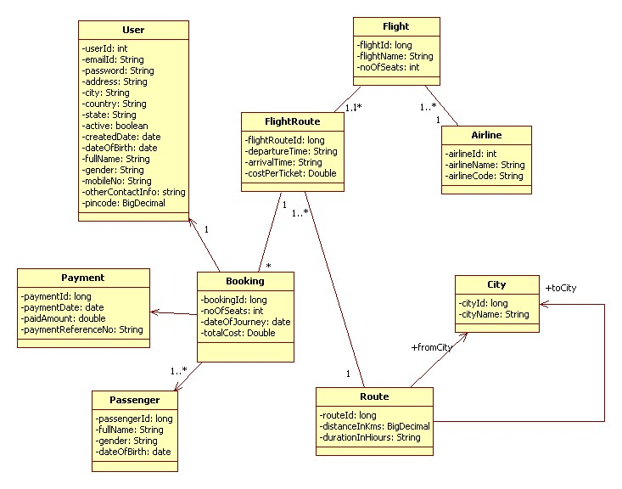
Design-Class Diagram

Slide 11
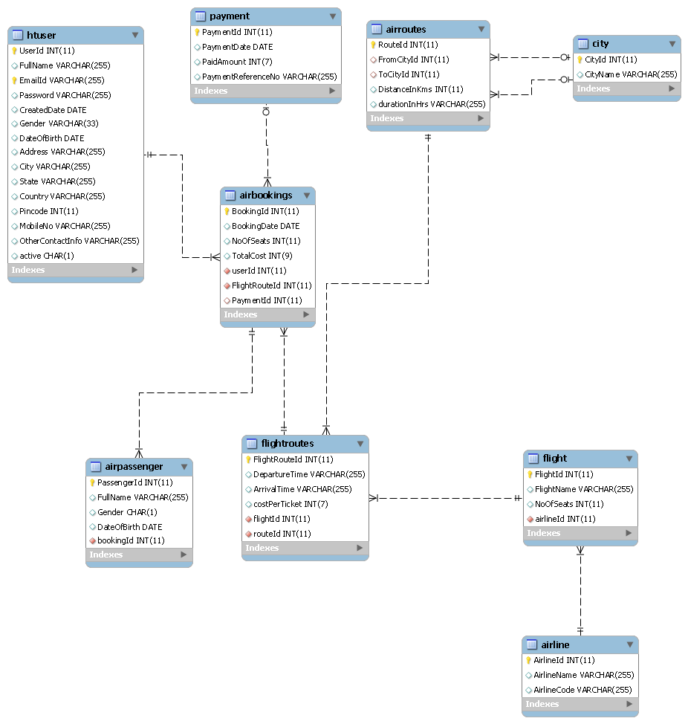
Design- Entity Diagram

Slide 12
Design-High Level Design
Presentation
Control
Search
DAO
Database
Booking
User

Slide 13
Implementation – User
Responsible for creating new user
Displaying and updating user profile
Change password

Slide 14
Implementation- UserDAO Interface
boolean insertRegisteredUser(Genericuser r);
Persisting the registered user into the database
Genericuser getUser(String userName,String password);
Getting a user with given email id and password after checking it
If wrong it throws an exception
boolean emailExists(String email);
Checking if the email id exist in the database
boolean updateGenericUser(Genericuser u);
Merging the the updated generic user into the database

Slide 15
Validators-for Registered User
Email validation
Should be in the format (name@example.com)
Email Existence in Database
Change Password
Correct Old Password
New Password & old password should not be same.
New Password & confirm password should be same.
Registered user should have filled all the personal details before booking the flight.
Date validation.

Slide 16
Validators-for Guest User
Pin code should only be a number of 6 digits
10 digit mobile no or other contact info
Email validation

Slide 17
User Demo

Slide 18
Implementation - Search
Finds all the flights for the given start and destination ,direct and indirect
Displays the details of the flight as well as seats availability

Slide 19
SearchDAO interfaces
RoutesAirline getRouteFromTwoCities(String originCity,String destinationCity);
gets the route which has source and destination as per the arguments
List<City> getCities();
Gets the list of all cities in the database for the dropdowns
List<Flightroute> getFlightRoutesFromRoute(RoutesAirline r);
Gets all the flightroutes for a particular route
Flightroute getFlightRoute(Long fid);
List<Flightroute> getFlightRoutesfromFlight(Flight flight);

Slide 20
SearchDAO interfaces
List<Flightroute[]> getIndirectRoutesFromCities(String originCity,String destinationCity);
Gets the list of flightroute arrays of size 2 which have flightroutes for indirect flights.
List<BookingsAirline> getBookingsFromFlightRouteandDateOfJourney(Flightroute fr,Date dateOfJourney);
Gets all the bookings for a flightroute in a particular date of journey

Slide 21
Validators- Search
Source and destination cannot be the same
Date of journey cant be in the past or should be within 3 months from present
Not available flights for the given source and destination
Ticket cannot be booked without selecting a flight
Ticket cannot be booked in a full flight

Slide 22
Search Demo

Slide 23
Implementation-booking
For a registered user the details of the logged in user is displayed and added to the passenger details
For guest user all the details should be filled
As per the no. of passengers selected the passenger details should be filled
Credit card details
Displays the booked ticket and the gives the option for printing the ticket

Slide 24
BookingDAO interface
boolean insertPassenger(Passenger p);
boolean insertPayment(Payment p);
boolean insertBooking(BookingsAirline b);
boolean insertUnregisteredUser(Genericuser u);

Slide 25
Validators-Booking
Date validation
Mobile no and pin validations
Validation of credit card number(16 digits)
Expiry date should be beyond the present month
CVV(3 digit number)

Slide 26
Booking Demo

Slide 27
Knowledge gained
Working in a group
As per the requirements provided by the client modifying our code and making it easier for the client usage
Understanding the flow of making a project (the thought process used)
Designing database
Making class models
Integrating the different work done by different members of the team
Debugging different problems encountered runtime and compile time
Making the project more interactive and more presentable
Using interfaces to block the user to use some private information

Slide 28
Conclusion & Enhancements
According to the requirements a customer friendly interface was developed
Cancellation module to enable a customer to cancel his flight
Adding a booking history option
Adding the admin module for managering the instruction
If required more features can be added
Rescheduling the flight

Slide 29
Test Cases

Slide 30
Collated Project Status Report

Slide 31


