Slide 1

Fake News Detection System
Parth Azad | Data Engineering & AI/ML Project
PySpark • LSTM • FAISS • Gemini

Slide 2




The Challenge: Fighting Information Warfare
Exponential Growth
Verification Crisis
Fake news spreads 10x faster than legitimate information on social platforms
Manual fact-checking cannot scale with volume of content generated daily
Explainability Gap
Traditional ML models operate as black boxes without transparent reasoning

Slide 3
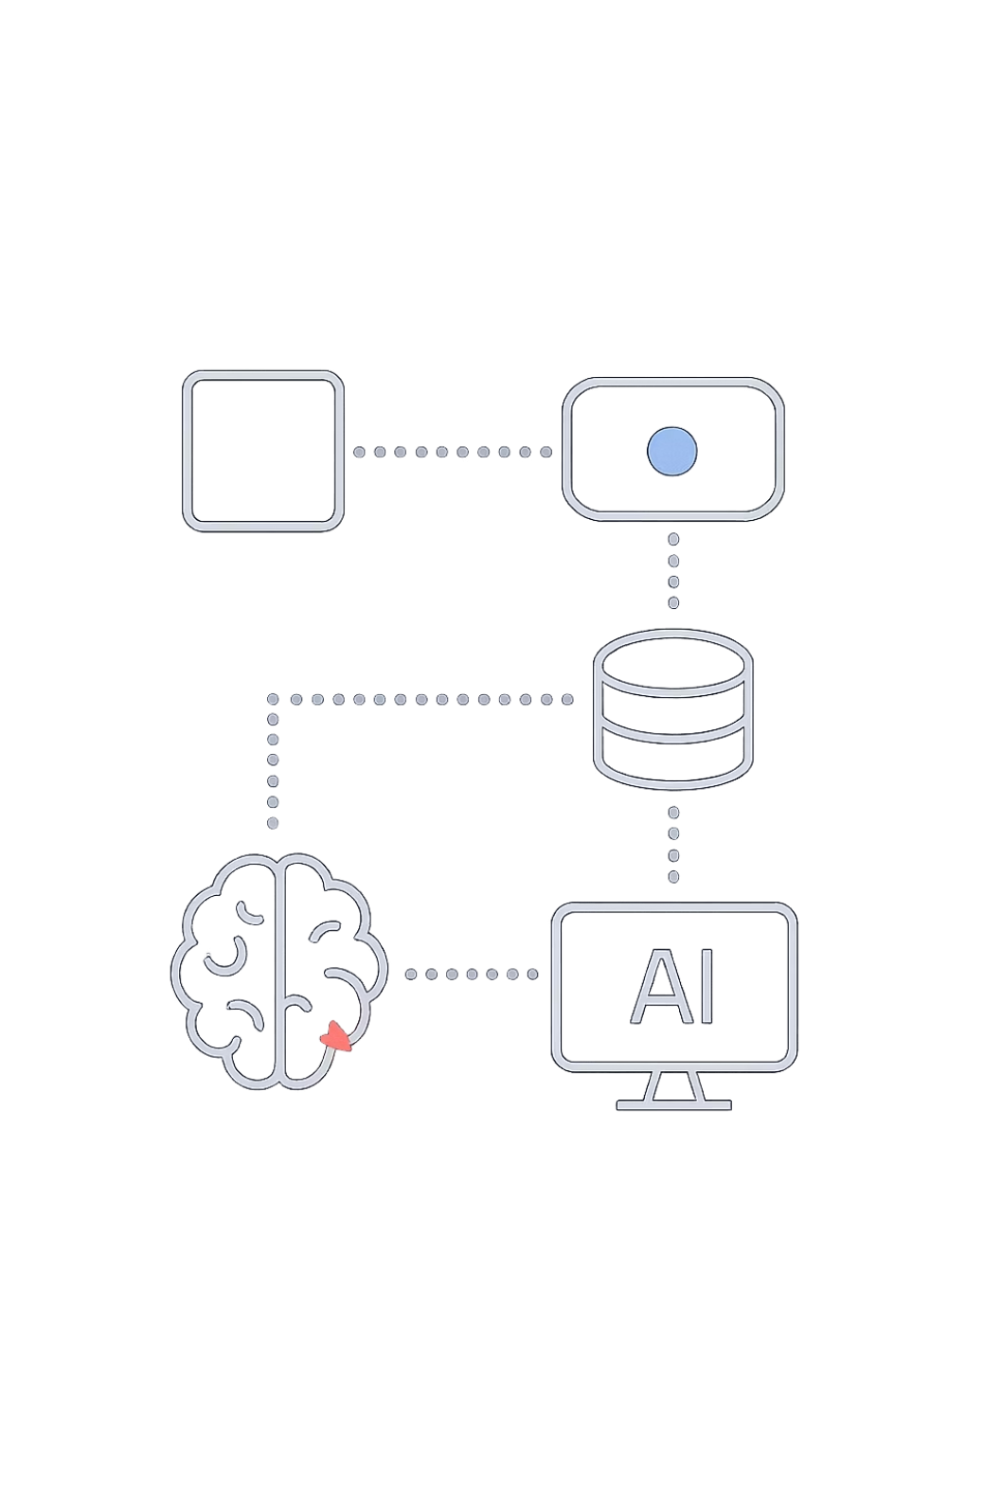
Our Solution: AI-Powered Verification
End-to-End Pipeline
An integrated system combining machine learning, data engineering, and generative AI to deliver accurate, explainable predictions with validation.
Key Capabilities
Binary classification (Fake/Real)
Confidence scoring
Natural language explanations
Source validation

Slide 4

System Architecture
User Input
FAISS Retrieval
LSTM Classification

Slide 5
Data Engineering: Medallion Architecture
Bronze Layer
Raw data ingestion from multiple sources using PySpark
JSON/CSV collection
Initial storage in Parquet format
Silver Layer
Data cleaning and preprocessing
Null value handling
Regex pattern cleaning
Text normalization
Gold Layer
Feature engineering for ML
Lemmatization
Vector embeddings
Business Logic

Slide 6

Machine Learning Model: LSTM Architecture
Why LSTM?
Long Short-Term Memory networks excel at capturing sequential context and dependencies in text, making them ideal for understanding narrative patterns that distinguish fake from real news.
Model Pipeline
Text tokenization
Sequence padding
GloVe embedding lookup
BiLSTM processing
Output probability

Slide 7





RAG Pipeline: Context-Aware Retrieval
Text Encoding
Convert articles to vector embeddings using transformer models
FAISS Indexing
Store vectors in optimized similarity search structure
Top-K Retrieval
Find most similar articles for context
Validation
Compare predictions with retrieved sources

Slide 8

Gemini Integration: Explainable AI
Prompt Engineering
Custom-tuned prompts guide Gemini to analyze LSTM predictions alongside retrieved context, generating comprehensive explanations.
Output Generation
Plain-English reasoning
Source consistency analysis
Confidence justification
Error flagging when uncertain

Slide 9
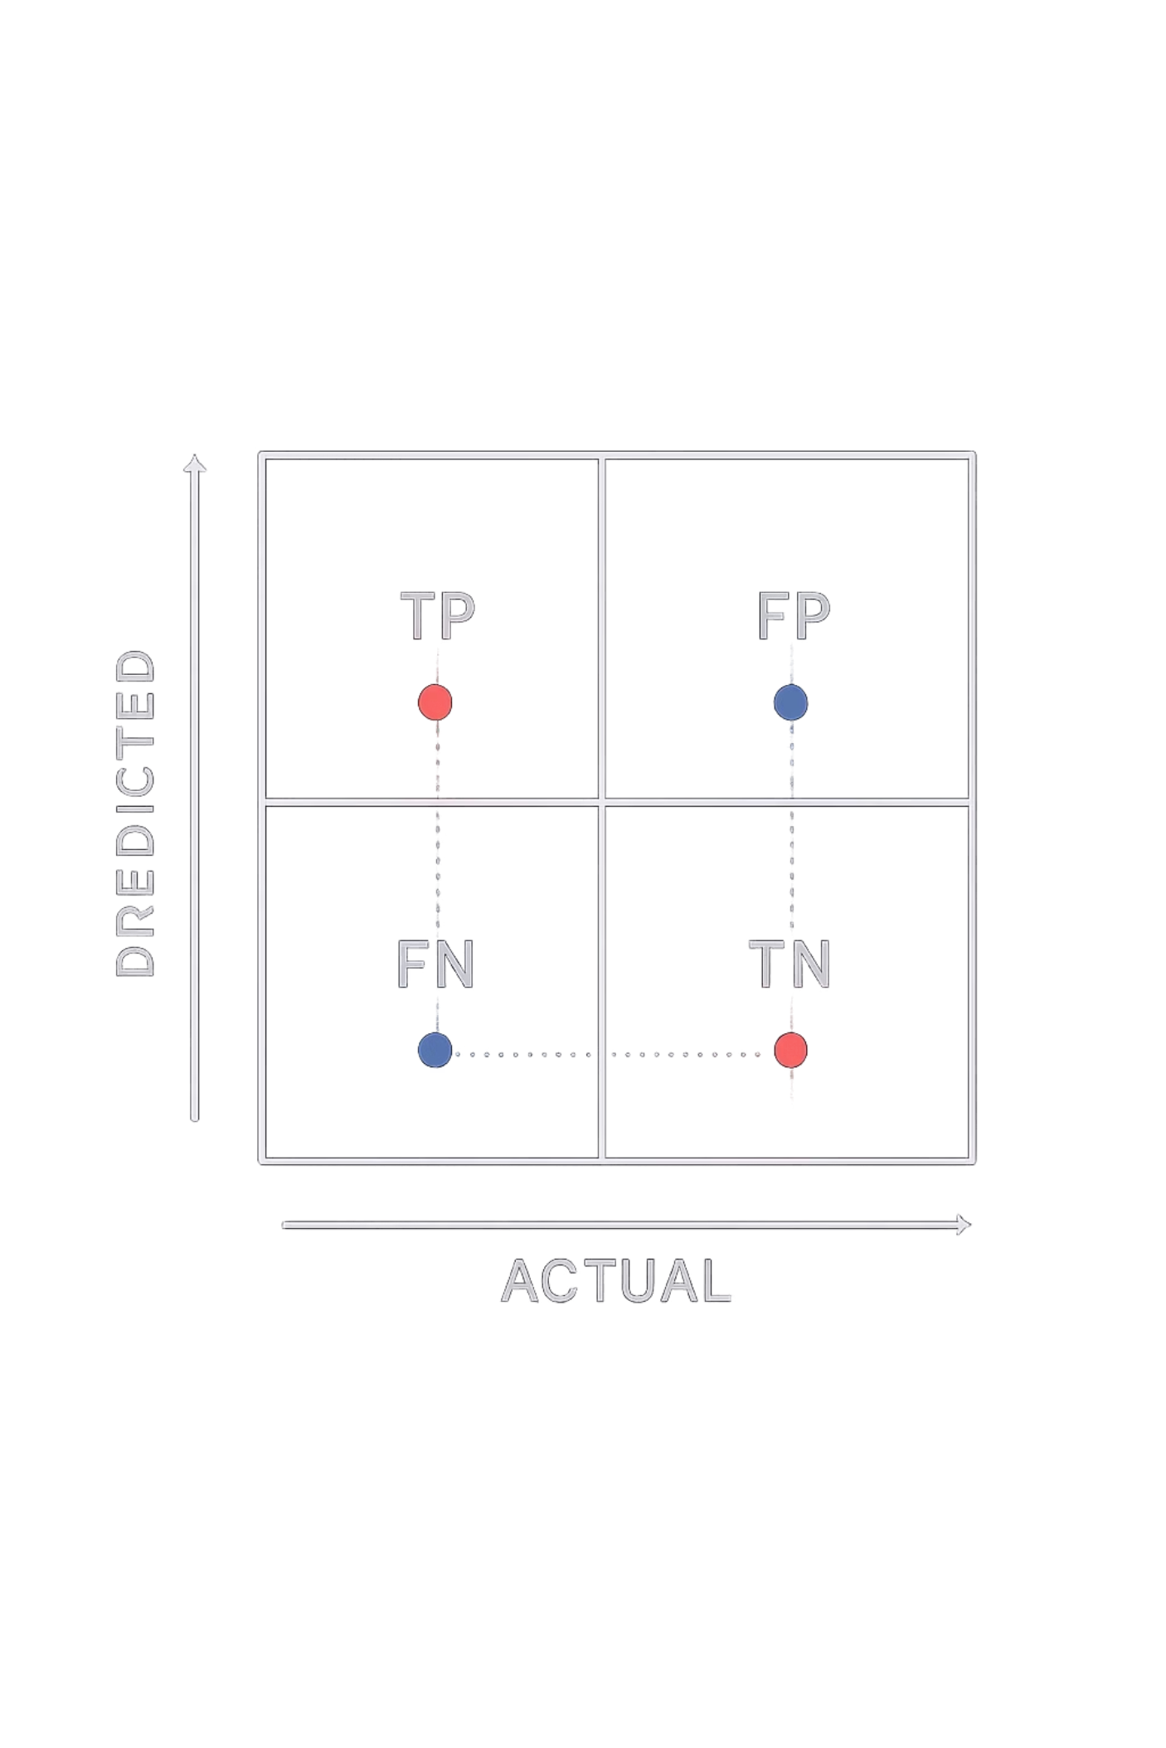
Results & Performance
92%
15%
Model Accuracy
False Positive Reduction
Achieved 90-94% accuracy across multiple train-test splits
RAG integration reduced false positives vs. standalone LSTM
87%
Average Confidence
High confidence scores for validated predictions
Example Output
Prediction: Fake | Confidence: 0.87 | Explanation: Inconsistencies detected with 87% of retrieved sources citing contradictory facts about timeline and participants

Slide 10

Future Roadmap
1
Production Deployment
Deploy on Databricks for enterprise-scale processing
2
Real-Time API
Build REST interface for live article verification
3
BERT Integration
Replace LSTM with transformer-based models for better performance
4
Advanced RAG
Upgrade to Pinecone or Weaviate for better vector search

