Slide 1
AI senior leader masterclass
July 2026
1

Slide 2
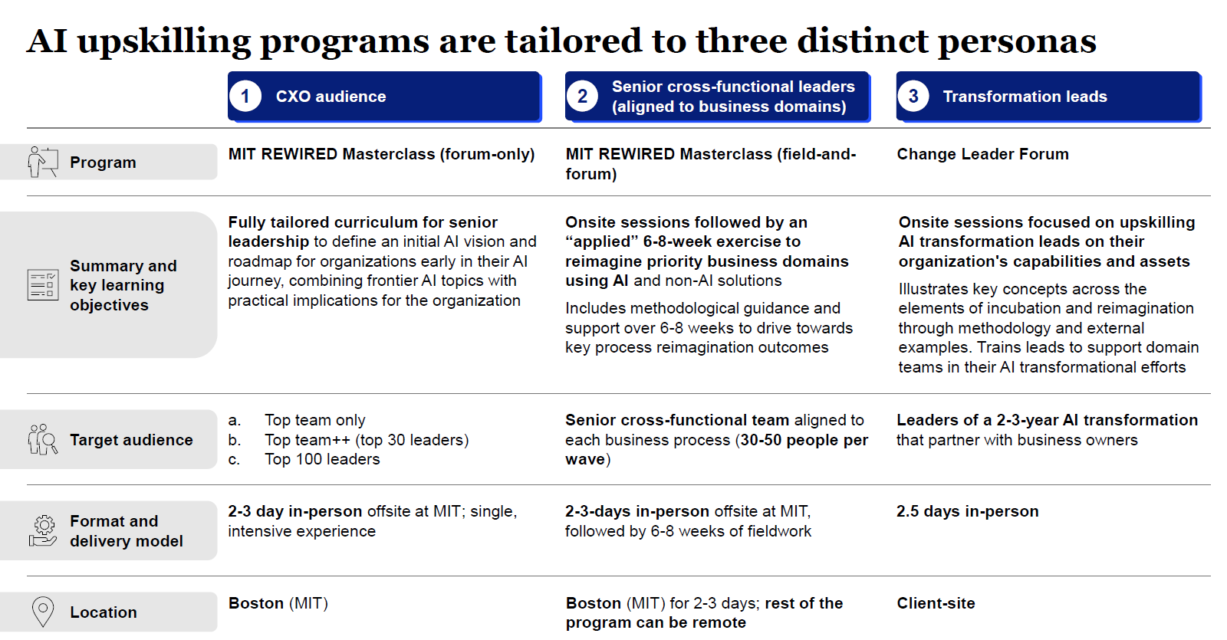
AI upskilling programs are tailored to three distinct personas
Focus of this document
1
CXO audience
2
Senior cross-functional leaders (aligned to business domains)
3
Strategy and transformation leads
Summary and key learning objectives
Fully tailored curriculum for senior leaders to:
Build each leader’s personal AI muscle
Create a common language for core transformation concepts
Define an initial AI vision and roadmap
Build each leader’s personal AI muscle
Create a common language for core transformation concepts for leaders to cascade to the rest of the org
Reimagine priority domains and build execution-ready blueprint for their transformation
Build each leader’s personal AI muscle
Create a common language for core transformation concepts for leaders to cascade to the rest of the org
Reimagine priority domains and build execution-ready blueprint for their transformation
Target audience
Top team only
Top team++ (top 30 leaders)
Senior cross-functional team aligned to each business process (30-50 people per wave)
Strategy and transformation leads
HRBPs (HR business partners)
Change leaders
Format and delivery model
2-3 days in-person, forum only, with some pre- and post-work
2-3 days in-person, followed by 5-6 weeks of field work
2-3 days in-person, forum only

Slide 3
Our core beliefs on what TransUnion needs from its AI skilling acceleration
AI transformation framework and approach
Competitive advantage arises when executives build a “second muscle” in AI / tech
Companies that outcompete in the age of digital and AI have the executive “muscle” to reimagine the business and drive fast innovation cycles – and building that muscle requires “doing it” through structured, hands-on action learning
1
Link it to value
Skilling pays back only when leaders work a real problem, and only if we measure the outcome and hold the discipline on execution (e.g., capturing tangible benefits in a defined tracking tool) after the room empties
2
Reimagine how work gets done
Value comes from reimagining a whole business domain end-to-end, as a roadmap of well-orchestrated use cases – not from point solutions or generic functional training – embedding our tried and tested “Rewired” approach among leaders
3
Make it exciting
The experience should be practical, high-energy, and immediately valuable, so leaders actively pull others into future cohorts
4
Build for scale from day one
Building in a scalable way – with codified content and upskilled HR business partners – creates a pathway to eventually scale AI fluency across the organization
5

Slide 4






Our AI masterclass will drive towards 3 main objectives
Objectives
1
Build each leader’s personal AI muscle
2
Create a common language for core transformation concepts for leaders to cascade to the rest of the org
3
Reimagine priority domains and build execution ready blueprint for their transformation
Key features of the program
1/3-1/3-1/3 approach that combines “learning”, “inspiring”, and “doing”
Customized to organization’s needs to facilitate tailored discussions and maximize impact
Inspiration on “art of the possible” leveraging start-up community, big tech, and QuantumBlack cases
Action learning via “field and forum” approach
Dedicated office hours and coaching with McKinsey experts

Slide 5

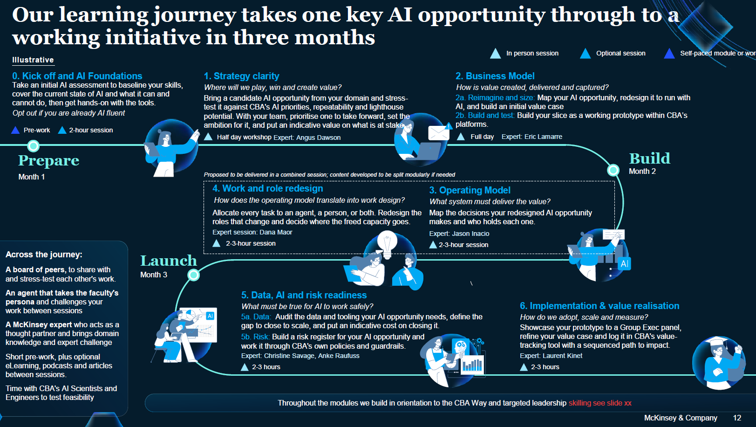
Our learning journey takes every domain to an execution-ready blueprint
Illustrative
Kick-off
Program introduction and pre-work
3-day academic immersion (MIT, Stanford, others)
Build AI fluency and a common language for transformation
1. Baselining & defining problems to be solved
Map the current domain, pain points, and baseline KPIs; define problems to be solved and the opportunity statement
2. Unconstrained reimagination
Develop an initial, unconstrained hypothesis for the reimagined “to-be” domain, using AI and non-AI levers
3. Value creation aspiration
Set a high-level aspiration and target KPIs aimed at bold, 10x impact from baseline – not incremental change
1
2
3
Forum 3 days in person
Field work 5-6 weeks, seven steps
Image
Image
Image
Image
7
6
5
4
Execution-ready AI blueprint
The output for each priority domain, ready for incubation and build
7. Horizons of transformation
Define transformation phases and the capabilities expected at each stage, from MVP through subsequent waves
6. Workforce reconfiguration
Outline the future operating model (teams and roles), capacity unlocked, and the change management approach
5. Trust & governance
Define the governance model (data, AI, SDLC approval workflows) and evals for accuracy and explainability
4. Data & platform enablers and solution architecture
Identify data, AI, and platform capabilities required; define the solution architecture blueprint and orchestration
Image
Weekly expert check-ins / office hours follow the academic immersion, offering ongoing support and expert perspectives throughout the field work
Confidential | Internal use only

Slide 6
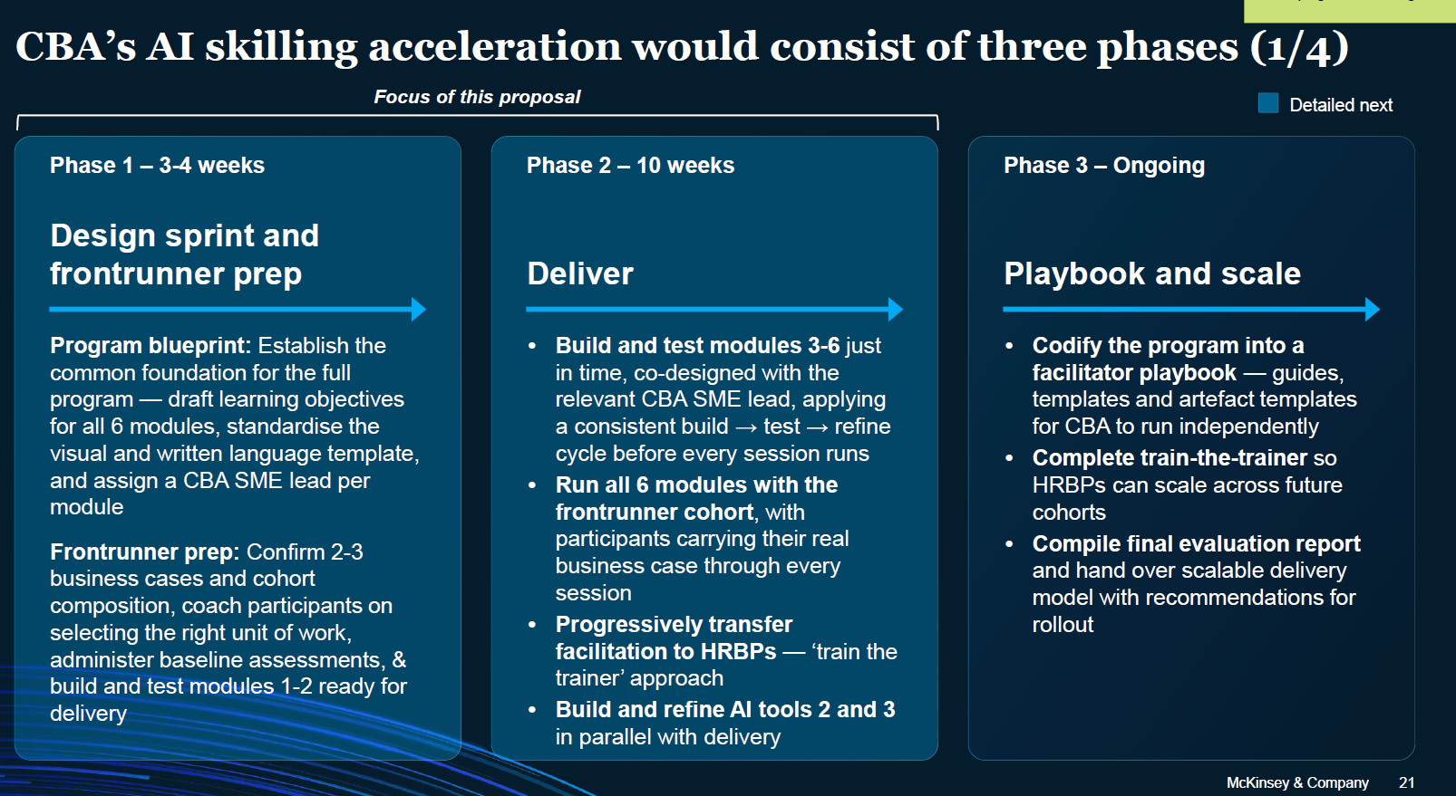
TransUnion’s AI skilling acceleration would consist of three phases
Phase 1 – 3-4 weeks
Phase 2
Phase 3 – 4-5 weeks
Design sprint
Kick-off and academic immersion
Deliver
Co-design the curriculum and program with TransUnion – learning objectives, modules, and field work templates
Confirm priority domains, cohort composition, and participant selection
Prepare pre-work and baseline assessments
Program kick-off to align leaders on objectives, priority domains, and the field work approach
3 days at an academic institution (MIT, Stanford, others) to build AI fluency and a common transformation language
Field work through the seven steps, taking each priority domain to an execution-ready AI blueprint
Weekly expert check-ins / office hours for ongoing support and challenge
Wrap-up session to de-brief field work outcomes and align on the road ahead
Confidential | Internal use only

Slide 7




Proven model. We have a track record of building fluency, driving tool adoption, and scaling AI across leading institutions
Case Example
Detail follows
Aspiration
Approach
Impact
AI Domain Transformation
C | Leading bank
Leading global bank sought to upskill 200-300 top leaders to lead e2e domain transformations in the age of AI, shifting focus from point use cases to holistic domain transformation to unlock enterprise value
We designed a "field-and-forum" AI upskilling program anchored on the Rewired transformation framework, combining a 3-day MIT immersion with custom field assignments to reimagine priority business domains and help leaders identify and accelerate the most impactful initiatives
$100m
Opportunity identified across three business domains in the first cohort
C | Leading financial institution
Leading FI was focusing on upskilling 200+ top senior executives on leading end-to-end transformation in the age of AI and building a common language and shared frameworks across leaders
We designed and delivered a “field-and-forum” AI senior leader masterclass anchored on the Rewired transformation framework, allowing leaders to align on vision, value, roadmap, and enablers of transformation. This included a 3-day training program at MIT and applying learnings through a capstone exercise focused on priority domains
200+
leaders upskilled
E | Leading CPG company
Leading CPG company was aiming to prepare senior leaders to role model & champion Digital & AI
We established a customized approach tailored to senior leaders, including immersive workshops and 1:1 coaching tied to specific business-back value (e.g., exemplar use cases selected based on business impact) and a best-practice Enterprise Capability Building approach
300+
leaders upskilled
AI Literacy
A | Leading Fintech
Launched an AI Champion capability-building program for 40 early adopters and leaders to drive AI literacy and accelerate GenAI readiness
We partnered to design and deliver two experiential workshops focused on building inspiration around Rewired transformation principles and hands-on ideation of GenAI use cases
The sessions combined field-and-forum learning, including applied exercises in GenAI tools,
prioritization simulations, and use case development
40+
90+
AI Champions upskilled
AI use cases ideated and prioritized
AI Adoption
B | Leading Telco
Leading Telco faced challenges such as low adoption of existing GenAI tools, limited IT-HR collaboration, and lack of a coordinated GenAI strategy
We established a GenAI Hub (for a general-purpose copilot) with HR and IT experts to drive change across all elements of the influence model, conducted cohort-based GenAI training with recognized institutions, tailored by level, leveraged change agents (super users) to promote peer learning and employed ongoing re-engagement strategies (e.g., nudges) to ensure sustained adoption
85%
of pilot participants actively engaging with GenAI tools multiple times a week
of daily time savings using GenAI tools
1 Hour

Slide 8









Proven model. Case example of “field-and-forum”
AI upskilling program for a large global bank (1/2)
Context Objectives
Leading global bank seeking to upskill top 200–300 leaders
to lead end-to-end domain transformations in the age of AI
Organization intended to shift focus from isolated point use cases to holistic business domain transformations to unlock greater enterprise value from AI
The bank aimed to amplify and accelerate impact of its top
50 AI initiatives
1
Elevate AI fluency among senior leaders through a
field-and-forum learning experience
2
Create a common language for core transformation
concepts for leaders to cascade to the rest of the org
3
Help leaders identify and accelerate the most impactful initiatives
Key features of the program
Pre- and post-masterclass self-assessment to gauge progress
Framework-driven approach (e.g., Rewired) to create alignment and guide decision making
Inspiration on “art of the possible” leveraging start-up, big tech, and QuantumBlack cases
Action learning via custom field assignment to reimagine business domains
Dedicated senior 1:1 coaching and challenge with experts
Continued access to research publications and case studies

Slide 9












Proven model. Case example of “field-and-forum”
AI upskilling program for a large global bank (2/2)
Reimagination playbook Incubation playbook
Reimagination involves a top-down approach to define the north star and aspiration for reimagined journeys / experiences leveraging AI and non-AI solutions
Five steps to reimagine a journey / experience E2E
Incubation is a bottom-up exercise that details the solution features and execution-ready blueprint to enable implementation
Six steps to develop an execution-ready blueprint for an E2E workflow transformation
1
Baselining & defining problems to be solved
2
Unconstrained
reimagination
3
Value creation
aspiration
4
Data & platform enablers
5
Horizons of
transformation
1
Journey
decomposition
2
Solution architecture blueprint
3
Trust &
governance
4
Workforce reconfigur-ation
5
Execution-
ready backlog
6
Delivery model & resourcing
The AI masterclass focused on reimagination
Design phase (8 weeks)
Delivery phase (8 weeks)
Weekly expert check-ins / office hours, offering ongoing support and expert perspectives as part of the learning journey
Program kick-off
3-day MIT immersion
Wrap-up session
Impact
Exceptional feedback from the first wave of cohorts ( NPS 4.7 / 5 ) , with future waves lined up for the masterclass
$100M+ opportunity identified across three business domains in the first cohort

Slide 10
Appendix

