Slide 1
Vanguard- Enterprise Productivity
Technology productivity: levers, assets to deploy, and expected outputs
July 30, 2026

Slide 2
For discussion
The levers we will go after
The assets we will deploy and the data we need
The outputs to expect

Slide 3
The levers we will go after
Ranges re-checked vs sources: workforce productivity and operating model were swapped vs the Rapid IT diagnostic lever table ('Operating Model 10-15%' = ways of working; 'Talent & Org 10-25%' = org shape and location). Corrected. Tech IDP quotes 20-30% for full engineering excellence programs; automation's 10-25% is the thinnest-supported range.
Deep-dive follows
1
Demand
management
2
Workforce
productivity
3
Operating
model
4
Expense
management
5
Automation
and AI
A. Project prioritization
C. Engineering practices
F. Org structure, spans and layers
H. FinOps
K. Process streamlining
B. Value capture
D. Performance optimization
G. Location mix
I. Supplier management
E. Software delivery outcomes
J. Demand policies
Typical savings:
5 to 25%
10 to 15%
10 to 25%
8 to 25%
10 to 25%
Note: Directional ranges applied only to the addressable slice of spend each lever can touch; not additive. Source: McKinsey Rapid IT cost diagnostic and Tech IDP typical impact ranges

Slide 4
Lever deep dive (1/2): demand management and workforce productivity
Added per Megha: Key analysis and Assets deployed columns. Appendix of sample outputs per asset still to come - Vamsi.
Lever
What we measure
Key analysis
Assets deployed
Illustrative outcome
A. Project prioritization
Portfolio spread across run, change and regulatory spend
Categorize every project and investment by growth cycle and strategic linkage
Tech Performance Assessment
Pause or stop projects with no clear line to business impact
B. Value capture
ROI, expense-to-revenue ratio, budgeted versus actual investment
Deep dive the five largest investments, tracking committed outcomes against actuals
Tech Performance Assessment
Reset funding on the largest programs and tighten expense management
C. Engineering practices
Developer Velocity Index, time split between inner loop and outer loop
Survey developers across business units, benchmark, then interview engineering leads on root causes
Developer Velocity Index
Free developer capacity by automating environment setup and protecting focus time
D. Performance optimization
Average contribution compared to expectation, anonymized
Analyze Jira and Git repository data to compare contribution against team median
ACCE contribution analytics (Jira and Git data)
Lift bottom-quartile contribution toward the team median
E. Software delivery outcomes
DORA metrics: deploy frequency, lead time, change failure rate, time to recover
Collect existing team and org dashboards and compare against benchmarks
DORA benchmarks via existing dashboards
Cut defect rates through testing maturity and automated test coverage

Slide 5
Lever deep dive (2/2): operating model, expense management and automation
Lever
What we measure
Key analysis
Assets deployed
Illustrative outcome
F. Org structure
Role ratios such as PM to developer, pyramid shape, spans and layers
Measure ratios by business unit and squad, compare against best in class
Operating Model Index; Tech Performance FTE baseline
Optimize spans of control and rebalance squad composition
G. Location mix
Onshore versus offshore mix, share of co-located teams
Assess the spread of squads across geographies against industry benchmarks
Tech Performance Assessment (location benchmarks)
Shift the mix toward lower-cost locations and improve co-location
H. FinOps
Cost of unused cloud resources, cloud cost per application, auto-scaling behavior
Review roughly 40 cloud financial management levers across consumption, sourcing and policy
Tech Performance Assessment (cloud cost benchmarks)
Remove double hosting and rationalize on-premise and cloud redundancy
I. Supplier management
Vendor consolidation potential and right-sizing against specifications
Line-by-line review of major contracts covering terms, licenses and rates
Sourcing deep dive (contract teardowns)
Renegotiate and consolidate vendors, stop paying for unused capacity
J. Demand policies
Software and hardware entitlement policies by team
Review spend against policy to find over-provisioned entitlements
Tech Performance Assessment (entitlement benchmarks)
Reduce license counts and extend hardware refresh timelines
K. Process streamlining
Share of build pipeline automated, test coverage, AI generated code
Review the idea-to-live process end to end and identify automation and AI use cases
Tech and AI Quotient; AI process workflow tool
Automate the release pipeline and cut coding time with AI tooling

Slide 6
For discussion
The levers we will go after
The assets we will deploy and the data we need
The outputs to expect

Slide 7
The assets we deploy and data needed
McKinsey assets we will deploy
Data we need from you
Tech Performance Assessment
Financials
1
Spend and FTE baseline by tower and category against peers
Two to three years of technology spend by account, org, vendor and project
600+ companies | 200+ KPIs | 25+ peer set
People
Tech and AI Quotient (AIQ)
Anonymized roster with role, level, location, cost, internal versus contractor
2
Tech and AI maturity across strategy, talent, operating model, data, technology, adoption
800+ companies | 60-question survey, 30 minutes
Projects
Developer Velocity Index
Twelve months of projects with cost, type, benefits and success metrics
3
Engineering practice maturity and developer time in inner loop versus outer loop
Sourcing
Developer survey plus engineering interviews
Partners, capabilities supported and contract renewal dates
Operating Model Index (OMI)
4
Product and platform operating model across 5 areas and 17 dimensions
Engineering
400+ companies | 20 minutes per respondent
Effort and backlog tracking, CI/CD documentation, DORA dashboards
AA tool and AI process workflow tool
Survey and interviews
5
AI value at stake by domain, then re-imagined workflows for the priority domains
Named survey participants, plus 5 to 10 leaders for interviews
Internal value sizing, then AI-assisted workflow redesign

Slide 8
Each lever is measured by a McKinsey asset
Primary source of insight
Supporting evidence
Demand
management
Workforce
productivity
Operating
model
Expense
management
Automation
and AI
Tech Performance Assessment
1
Spend and FTE baseline vs peers
Tech and AI Quotient (AIQ)
2
Tech and AI maturity vs sector
Developer Velocity Index
3
Engineering practice maturity
Operating Model Index (OMI)
4
Product operating model maturity
AA tool and AI process workflow tool
5
Value at stake and re-imagined workflows

Slide 9
What each asset measures and how it runs
Asset
What it measures
How it runs
Benchmark scale
1 Tech Performance Assessment
Full technology spend and FTE baseline by tower and by category, against a peer set
Finance and HR data extracts plus 5-10 leadership interviews; capability survey optional
600+ companies, up to 300 cost and FTE categories, 200+ KPIs, 25+ peer set
2 Tech and AI Quotient (AIQ)
Tech and AI maturity across strategy, talent, operating model, data, technology, and adoption and scaling
Survey of senior leaders, benchmarked to sector peers and cross-sector leaders
800+ companies, about 10,000 participants, 10 sectors and 60+ sub-sectors
3 Developer Velocity Index
Engineering practice maturity and how developer time splits between inner loop and outer loop
Developer survey across business units, then interviews with engineering leads on root causes
McKinsey developer velocity benchmark
4 Operating Model Index (OMI)
Product and platform operating model across five areas and 17 dimensions
About 20 minutes per respondent, Director level and above, minimum 10 responses; 5-8 calibration interviews optional
400+ companies worldwide
5 AA tool and AI process workflow tool
AI value at stake by business domain, and re-imagined future-state workflows for the priority domains
AA tool sizing on domain data (run internally), then AI process workflow tool for redesign
McKinsey value-at-stake benchmarks

Slide 10
Consolidated data request
Category
What we need
Likely source
Priority
Financials
Technology spend for two to three years plus projection, split by account, org, vendor, project, and capex versus opex
General ledger, Apptio or IT budget tool, procurement
Must have
People
Anonymized roster with role, job family, level, location, FTE, fully loaded cost, manager ID, internal versus contractor
HRIS and contractor database
Must have
Projects
Twelve months of projects with cost, type of run, change or regulatory, benefits and success metrics
PPM or PMO
Must have
Sourcing
IT partners, the capabilities they support, and contract renewal dates
Procurement
Must have
Engineering
Effort and backlog tracking, CI/CD documentation, and existing DORA dashboards
Jira, GitHub, internal portals
Must have
Applications
Application list by domain with hosting model, users, licenses, direct and infrastructure cost, incidents
CMDB, IT finance, software asset management
Recommended
Infrastructure
Asset extract from the CMDB with utilization reporting
CMDB
Recommended
Tickets
Twelve-month ticket snapshot with timestamps, severity, assignment group and category
ITSM
Recommended
Survey lists
Participant lists for the developer, AIQ and OMI surveys with team and role
HR and leadership
Must have

Slide 11
For discussion
The levers we will go after
The assets we will deploy and the data we need
The outputs to expect

Slide 12
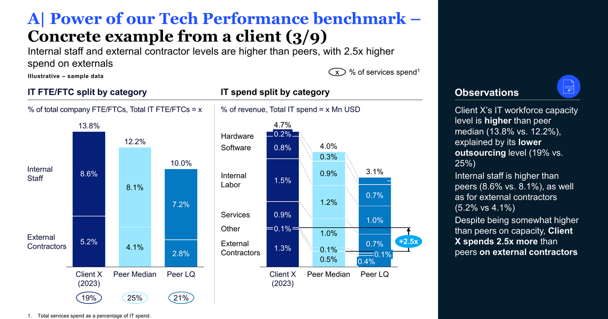
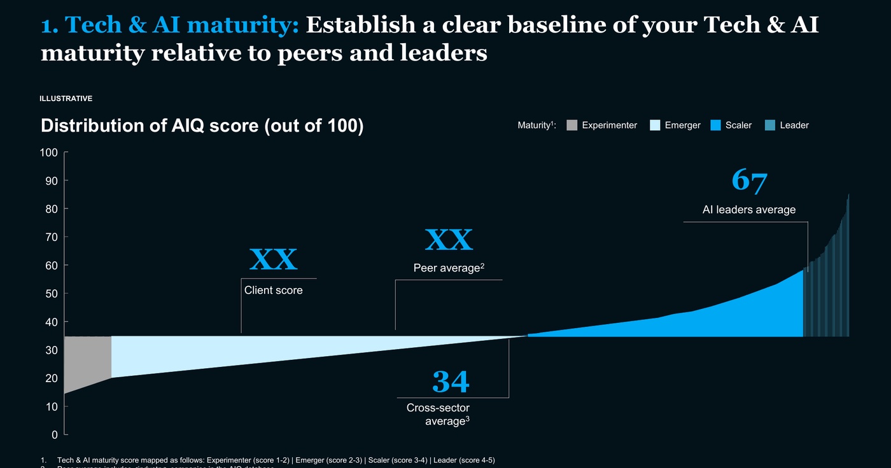
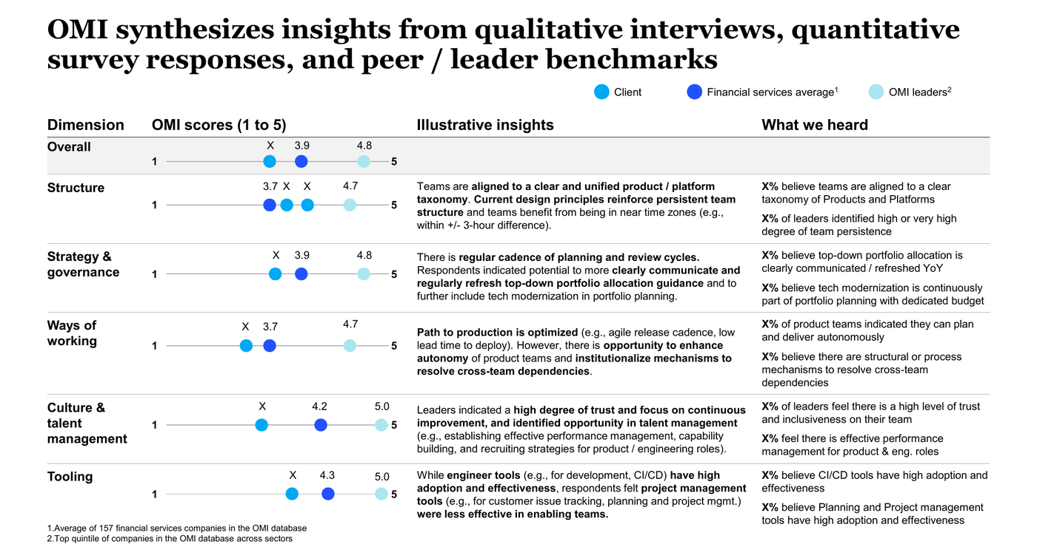
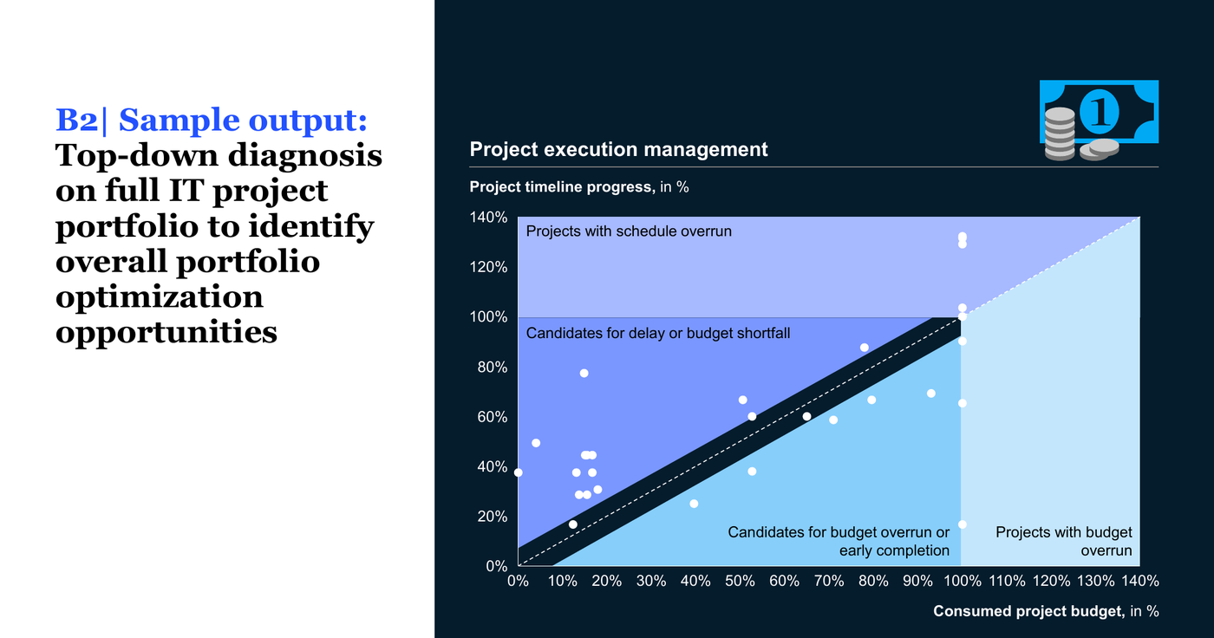
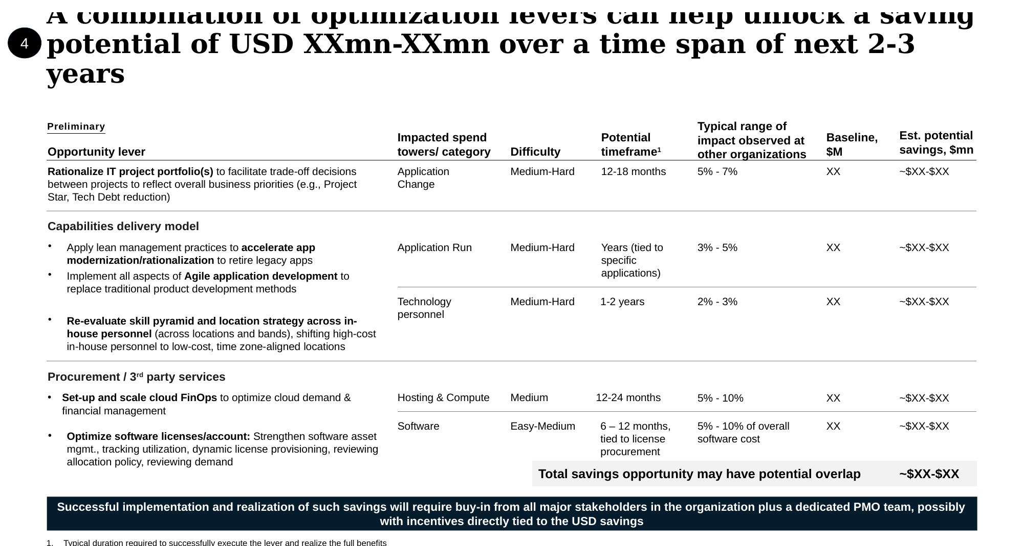
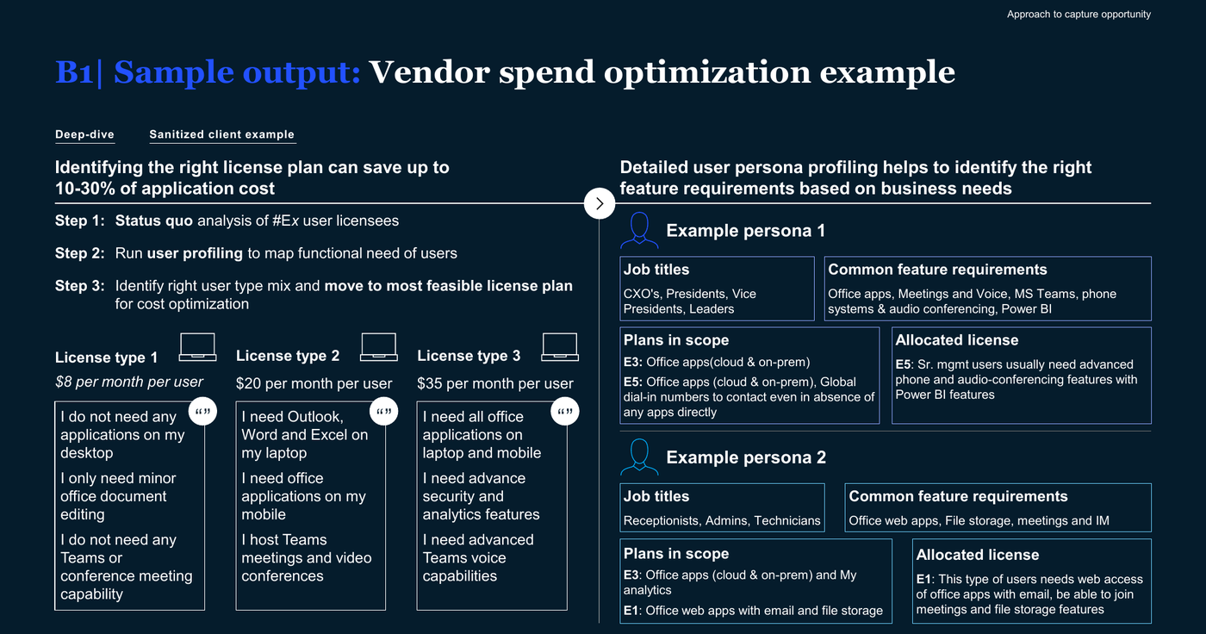
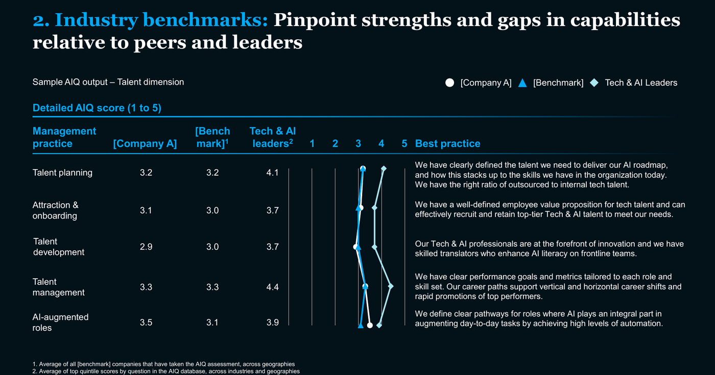
Illustrative outputs from these assets
Screenshot provenance verified: all six tiles come from the shared docs (Rapid IT diagnostic p14/17/19, AIQ p24, OMI p10, Core Tech IDP p9). No DVI or AA tool sample outputs exist in any doc we were given, so the duplicate AIQ tile became the lever value-sizing exhibit. Ask Jen for a DVI sample page and an AI value-at-stake sample to complete asset coverage.
Tech Performance Assessment
Tech and AI Quotient
Operating Model Index
Spend and workforce split against peer benchmarks
Your maturity score against the peer average and AI leaders
Scores by dimension against sector peers and OMI leaders
Portfolio deep dive
Value sizing
Sourcing deep dive
Top-down diagnosis of the full project portfolio
Opportunity sized by lever, with difficulty and timeframe
Vendor spend and license right-sizing opportunity

Slide 13
The outputs each asset produces
Incorporate desc in screenshots on prev page
3 | OUTPUTS
Asset | What you will have in hand
1 Tech Performance Assessment | Spend baseline by tower and category with a peer band showing where you sit high or low | Unit cost and productivity KPIs drawn from the 200+ KPI set | Addressable spend and sized opportunity for each lever
2 Tech and AI Quotient (AIQ) | Maturity score on each of the six dimensions against sector peers and cross-sector leaders | The specific gaps holding back value capture, with actions to close them
3 Developer Velocity Index | Developer time split between inner loop and outer loop against benchmark | Practice maturity by business unit | Capacity that can be freed, expressed in FTE and in dollars
4 Operating Model Index (OMI) | Scores across five areas and 17 dimensions against 400+ companies | Role and time study showing the ratio of orchestrators to doers | A map of who actually owns each stage of the product lifecycle
5 AA tool and AI process workflow tool | AI value at stake by domain from the AA tool | Re-imagined future-state workflows for the priority domains from the AI process workflow tool | A value and feasibility heatmap to choose the domains to reimagine first
Brought together, the CIO gets three things
• A peer-benchmarked cost baseline
• Quantified business cases by lever, with owners
• A sequenced roadmap with Wave 1
9

Slide 14
Appendix

Slide 15
How it comes together over eight weeks
Week 0
Weeks 1 to 2
Weeks 3 to 6
Weeks 7 to 8
Prepare
Baseline and benchmark
Deep dive
Prioritize
Launch the consolidated data request
Confirm survey respondents
Set stakeholders and cadence
Agree the opportunity hypotheses
Build the spend and FTE baseline
Run the three surveys
Working sessions with tech leaders
Shortlist the value-at-stake areas
Infrastructure and vendor contract review
Developer productivity analysis
Five to ten leadership interviews
Size each opportunity against spend
Shape initiatives and sequence them
Assign owners and estimate savings
Set dependencies and Wave 1
Build the high-level roadmap
What we need from you Data owner named, survey lists confirmed
What we need from you Time from technology leaders for working sessions
What we need from you Contract detail and interview slots
What we need from you Decisions on owners and Wave 1 scope
Deliverable Aligned scope and initial fact base
Deliverable Peer-benchmarked cost baseline
Deliverable Quantified business cases by lever
Deliverable Prioritized portfolio and roadmap
The surveys gate the timeline. AIQ, OMI and the developer survey need respondent lists confirmed in week 0; AIQ's standard cycle runs four weeks, so survey results land mid-engagement. Everything downstream moves if lists slip.

Slide 16
Next steps
1
Name a single data owner
One person accountable for the consolidated data request, with authority across finance, HR and the PMO
For Discussion
Scope: the whole technology estate, or the largest towers first
Whether shadow IT outside the CIO budget is in scope
Appetite for an AI reimagination workstream in parallel
Which prior diagnostics to build on rather than repeat
2
Confirm the survey lists
Product and engineering leaders at Director level and above, minimum ten responses per survey
3
Approve leadership access
Five to ten interviews to pressure test the opportunities we size
4
Set the decision forum
A steering cadence with the authority to stop projects, not only review them
5
Choose the deep-dive areas
Two areas to go deeper on, so effort concentrates where the spend sits

