Slide 1
Final Year Project (8th CE)
Project Name : I-Stream
Team Members’ name:
Jeet Parekh(1721BECE30211)
Parth Chavda(1721BECE30215)
Prince Titiya(1721BECE30247)
Internal Guide: Ms.Barkha Bhavsar

Slide 2
What is I-stream ?
I-Stream is a online streaming platform used for educational tutorials, video streaming , game streaming.
The nature of I-Stream will allow mass number of interact with each other and the instructor with each other and with instructor in real time.
I-Stream is also used for software development learning, with communities of users streaming programming projects and talking through their work.

Slide 3
Why I-stream ?
There are many platforms are available for streaming but we want to create a platform for studying also so the like study classes for example
Twitch is mainly use for gaming purpose
YouTube is for mix purpose
Here we want to create a platform for everyone who want to share their knowledge to the world . For example you can use I-Stream for educational purposes, game streaming etc.

Slide 4
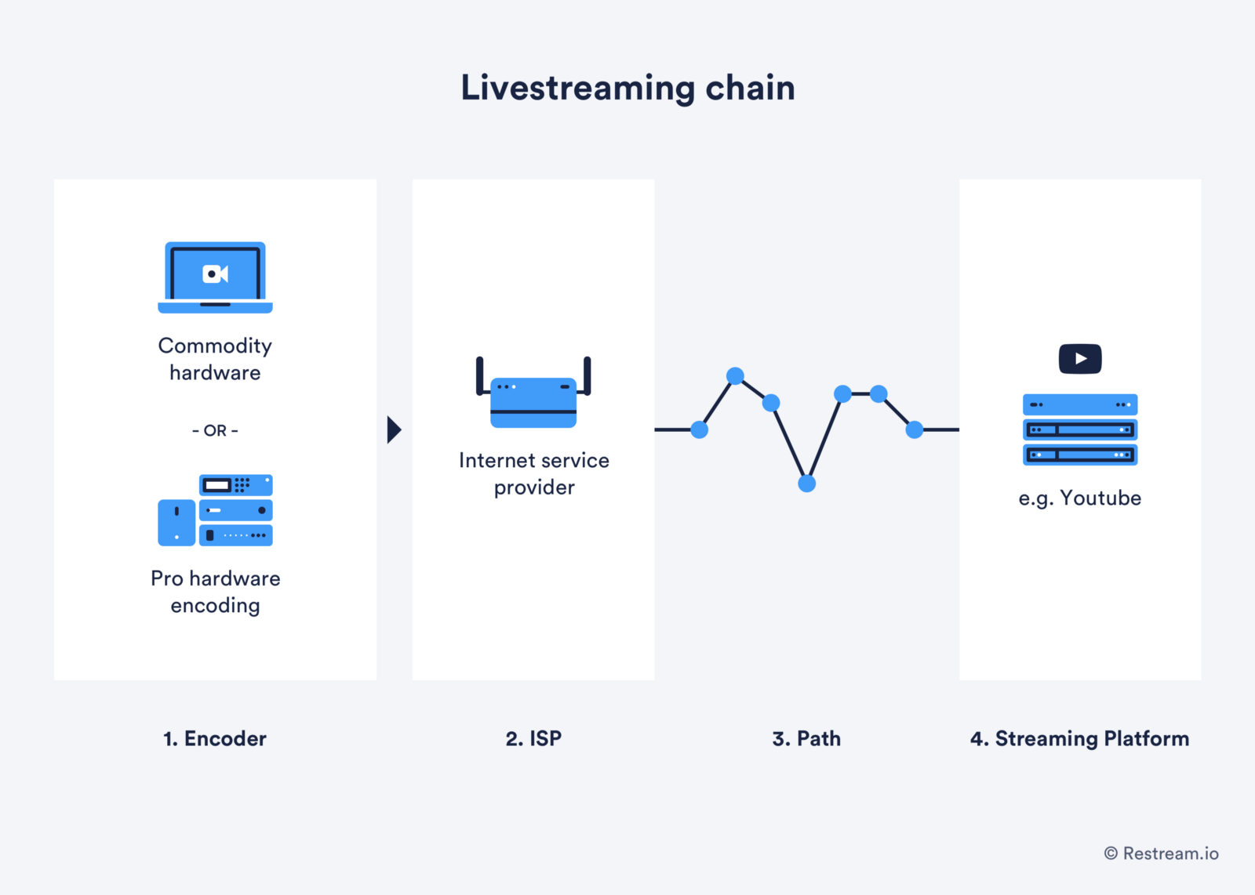
Working Diagram :

Slide 5
Modules:
Administrator Module: This module allows administrator to manage different videos that upload by the users. It allows him to add, modify and delete the videos
User Module: It allows the candidate to register for the website and generate the ID and password. It allows the user login into this application and see the videos. He can view all the videos upload by the admin. He can add videos as Favorites.
Registration: This module allows the users to register for the website. It allows the Users select an option for add favorites with in the stipulated time and continues generating the videos.

Slide 6
Technology :-
Frontend and Backend :
REACT JS, REDUX, SEMANTIC-UI
PYTHON- FLASK
Data base
MONGO DB(Mongoose)

Slide 7
Application :
I-Stream is the live streaming platform for educational purposes, entertainment purposes, gamers and the things we love to share. So people can watch and chat with other fans from around the world.
It can also used to show your skills to whole world like game play and teaching session
The most-popular non-gaming category is IRL (In Real Life) which features streamers simply chatting with their viewers in real-time. Talk Shows is another popular non-gaming option which contains a mix of live panel discussions, podcasts, and even professionally produced variety shows, while Cooking contains, as many would correctly guess, cooking and food shows.

Slide 8
Thank you

