Slide 1
Models of Computation
IT-422

Slide 2
What is it?
The study of abstract computing devices, or “machines.”
Days before digital computers (In 1930s)
  What is possible to compute with an abstract machine
  Seminal work by Alan Turing
  Cook extended the work of Turing (In 1969)
Why is this useful?
  Direct application to creating compilers, programming languages, designing applications.
  Formal framework to analyze new types of computing devices, e.g. biocomputers or quantum computers.

Slide 3
Books
Michael Sipser
John Hopcroft
Dexter Kozen
K L P Misra

Slide 4
Major Topics
Finite state automata
Grammars
Turing Machine
Un decidability
Complexity

Slide 5
Finite State Automata
Automata – plural of “automaton”
Finite state automata is composed of a finite number of states with transitions between the states
Useful to model hardware, software, algorithms, processes
  Software to design and verify circuit behavior
  Lexical analyzer of a typical compiler
  Parser for natural language processing
  An efficient scanner for patterns in large bodies of text (e.g. text search on the web)
  Verification of protocols (e.g. communications, security).

Slide 6
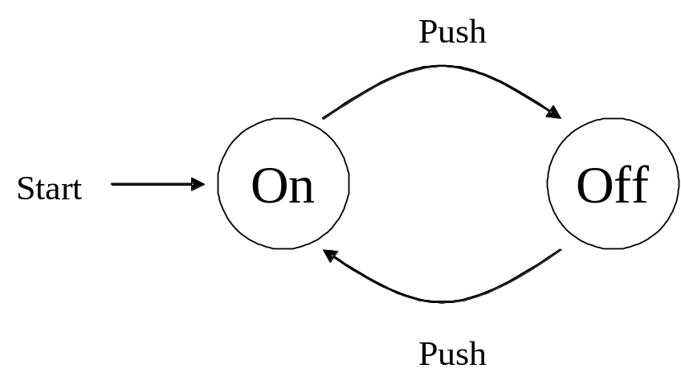
Example
Here is perhaps one of the simplest finite automaton, an on-off switch
States are represented by circles. Generally we will use much more generic names for states (e.g. q1, q2). Edges or arcs between states indicate transitions or inputs to the system. The “start” edge indicates which state we start in.
Sometimes it is necessary to indicate a “final” or “accepting” state. We’ll do this by drawing the state in double circles

Slide 7
Languages and Automaton
Languages provide a different “view” of computing than automata
Consider the example automaton
  We can view this as the problem of determining all of the strings that turns off.
  Designate some states as final or accepting states.
  The set of all valid strings accepted by the automata makes up the Language for this particular problem

Slide 8
Language Definitions (1)
An alphabet is a finite, nonempty set of symbols. By convention we use the symbol ∑ for an alphabet.
  In the previous example, our alphabet consisted of words, but normally our alphabet will consist of individual characters.
  Examples
    ∑ = {0,1} the binary alphabet
    ∑ = {a,b, … z} the set of all lowercase letters

Slide 9
Language Definitions (2)
string (or sometimes a word)
  A finite sequence of symbols chosen from an alphabet. For example, 010101010 is a string chosen from the binary alphabet, as is the string 0000 or 1111.
The empty string is the string with zero occurrences of symbols. This string is denoted ε and may be chosen from any alphabet.
The power notation is used to represent multiple occurrences of a string; e.g. a³ = aaa, a² = aa, etc.

Slide 10
Language Definitions (3)
The length of a string indicates how many symbols are in that string.
  E.g., the string 0101 using the binary alphabet has a length of 4.
  The standard notation for a string w is to use |w|. For example, |0101| is 4.

Slide 11
Language Definitions (4)
Powers of an alphabet
  If ∑ is an alphabet, we can express the set of all strings of a certain length from that alphabet by using an exponential notation.
  ∑^{k} is defined to be the set of strings of length k, each of whose symbols is in ∑.
For example, given the alphabet ∑ = {0,1,2} then:
  ∑⁰ = {ε}
  ∑¹ = {0,1,2}
  ∑² = {00,01,02,10,11,12,20,21,22}
  ∑³ = {000,001,002,... 222}
Note that ∑ and ∑¹ are different. The first is the alphabet; its members are 0,1,2. The second is the set of strings whose members are the strings 0,1,2, each a string of length 1.
By convention, we will try to use lower-case letters at the beginning of the alphabet to denote symbols, and lower-case letters near the end of the alphabet to represent strings.

Slide 12
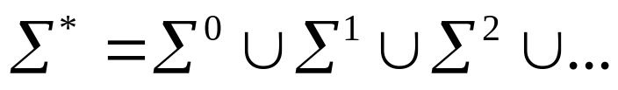
Language Definitions (5)
Set of all Strings
  The set of all strings over an alphabet is denoted by ∑*. That is:
  Sometimes it is useful to exclude the empty string from the set of strings. The set of nonempty strings from the alphabet is denoted by ∑⁺.

Slide 13
Language Definitions (6)
To concatenate strings, we will simply put them right next to one another.
Example:
  If x and y are strings, where x=001 and y=111 then xy = 001111
  For any string w, the following equation holds
  εw = wε = w

Slide 14
Formal Definition of Languages
We have finally covered enough definitions to formally define a language!
A Language
  A set of strings all of which are chosen from some ∑* is called a language.
  If ∑ is an alphabet and L is a subset of ∑* then L is a language over ∑.
  Note that a language need not include all strings in ∑*.

Slide 15
Language Examples
The language of all strings consisting of n 0’s followed by n 1’s, for some n≥0: { ε, 01, 0011, 000111, …}
The set of binary numbers whose value is a prime: { 10, 11, 101, 111, …}
Ø is the empty language, which is a language over any alphabet.
{ε} is the language consisting of only the empty string. Note that this is not the same as example #3, the former has no strings and the latter has one string.

Slide 16
Set-Forming Notation
A notation we will commonly use to define languages is by a “set-former”:
{ w | something about w }
The expression is read “the set of words w such that (whatever is said about w to the right of the vertical bar).”
For example:
  {w | w consists of an equal number of 0’s and 1’s }.
  {w | w is a binary integer that is prime }
  { 0^{n}1^{n} | n >=1 }. This includes 01, 0011, 000111, etc. but not ε
  { 0^{n}1 | n>=0 }. This includes 1, 01, 001, 0001, 00001, etc.

Slide 17
Introduction to Formal Proof
In this class, sometimes we will give formal proofs and at other times intuitive “proofs”
Mostly inductive proofs
First, a bit about deductive proofs

Slide 18
Deductive Proofs
Given a hypothesis H, and some statements, generate a conclusion C
Sherlock Holmes style of reasoning
Example: consider the following theorem
  If x ≥4 then 2^{x} ≥ x²
  Here, H is x ≥ 4 and C is 2^{x} ≥ x²
  Intuitive deductive proof
    Each time x increases by one, the left hand side doubles in size. However, the right side increases by the ratio ((x+1)/x)². When x=4, this ratio is 1.56. As x increases and approaches infinity, the ratio ((x+1)/x)² approaches 1. This means the ratio gets smaller as x increases. Consequently, 1.56 is the largest that the right hand side will increase. Since 1.56 < 2, the left side is increasing faster than the right side

Slide 19
Basic Formal Logic (1)
An “If H then C” statement is typically expressed as:
H⇒C or H implies C
The logic truth table for implication is:
H C H⇒ C (i.e. ¬H ∨ C)
F F T
F T T
T F F
T T T

Slide 20
Basic Formal Logic (2)
If and Only If statements, e.g. “If and only if H then C” means that H⇒C and C⇒ H.
Sometimes this will be written as
H⇔C or “H iff C”.
The truth table is:
H C H⇔C (i.e. H equals C)
F F T
F T F
T F F
T T T

Slide 21
Modus Ponens
modus ponens (Latin for “method of affirming”') can be used to form chains of logic to reach a desired conclusion.
In other words, given:
H⇒C and
H
Then we can infer C
Example: given “If Joe and Sally are siblings then Joe and Sally are related” as a true assertion, and also given “Joe and Sally are siblings” as a true assertion, then we can conclude “Joe and Sally are related.”

Slide 22
Modus Tollens
modus tollens (Latin for “method of denying”'). This reasons backwards across the implication.
  Cognitive psychologists have shown that under 60% of college students have a solid intuitive understanding of Modus Tollens versus almost 100% for Modus Ponens
If we are given:
H⇒C and
¬C
then we can infer ¬H.
For example, given: “If Joe and Sally are siblings then Joe and Sally are related” as a true assertion, and also given “Joe and Sally are not related” as a true assertion, then we can conclude “Joe and Sally are not siblings.”
  What if we are told Joe and Sally are not siblings? Can we conclude anything?

Slide 23
Short Exercises (1)
If Elvis is the king of rock and roll, then Elvis lives. Elvis is the king of rock and roll. Therefore Elvis is alive. Valid or invalid?
  This argument is valid, in that the conclusion is established (by Modus ponens) if the premises are true. However, if you consider the first premise to be false (unless you live in Vegas) then the conclusion is false.

Slide 24
Short Exercises (2)
If the stock market keeps going up, then I'm going to get rich. The stock market isn't going to keep going up. Therefore I'm not going to get rich. Valid or invalid?
  This argument is invalid, specifically an inverse error. Its form is from ¬H and infer ¬C. This yields an inverse error.

Slide 25
Short Exercises (3)
If New York is a big city, then New York has lots of people. New York has lots of people. Therefore New York is a big city. Valid or invalid?
  This argument is invalid, even though the conclusion is true. We are given H⇒C and given C. This does not mean that C⇒H so we can’t infer H is true.

Slide 26
Proof by Contradiction
Suppose that we want to prove H and we know that C is true. Instead of proving H directly, we may instead show that assuming ¬H leads to a contradiction. Therefore H must be true.
Example:
  A large sum of money has been stolen from the bank. The criminal(s) were seen driving away from the scene. From questioning criminals A, B, and C we know:
    No one other than A, B, or C were involved in the robbery.
    C never pulls a job without A
    B does not know how to drive
  Turned into logical statements
    A ∨ B ∨ C A, B, or C is guilty
    C ⇒ A If C is guilty, A is also guilty
    B ⇒ (A ∨ C) If B is guilty, A or C is guilty
  Is A innocent or guilty? Let’s assume that A is innocent, i.e.:
    ¬A
    From ¬A and #2 using modus tollens, we can infer ¬C
    We thus have ¬A ∧ ¬C, which by De Morgan’s Law is logically equivalent to ¬(A ∨ C)
    From ¬(A ∨ C) and #3 using modus tollens, we can infer ¬B
    We now have ¬A and ¬B and ¬C which contradicts assumption #1! A is guilty.

Slide 27
Proof by Contrapositive
Proof by contrapositive takes advantage of the logical equivalence between "H implies C" and "Not C implies Not H".
For example, the assertion "If it is my car, then it is red" is equivalent to "If that car is not red, then it is not mine".
To prove "If P, Then Q" by the method of contrapositive means to prove "If Not Q, Then Not P".

Slide 28
Contrapositive Example
An integer x is called even (respectively odd) if there is another integer k for which x = 2k (respectively 2k+1).
Two integers are said to have the same parity if they are both odd or both even.
Theorem. If x and y are two integers for which x+y is even, then x and y have the same parity

Slide 29
Contrapositive Example
Proof of the theorem
  The contrapositive version of this theorem is "If x and y are two integers with opposite parity, then their sum must be odd."
  Assume x and y have opposite parity.
    Since one of these integers is even and the other odd, there is no loss of generality to suppose x is even and y is odd.
  Thus, there are integers k and m for which x = 2k and y = 2m+1. Then, we compute the sum x+y = 2k + 2m + 1 = 2(k+m) + 1, which is an odd integer by definition.

Slide 30
Contrapositive vs. Contradiction
Both methods somewhat similar, but different.
In contrapositive, we assume ¬C and prove ¬H, given H⇒C.
  The method of Contrapositive has the advantage that your goal is clear: Prove Not H.
In the method of Contradiction, your goal is to prove a contradiction, but it is not always clear what the contradiction is going to be at the start.
  Indeed, one may never be found (and will never be found if the hypothesis is false).

Slide 31
Proof by Induction
Essential for proving recursively defined objects
We can perform induction on integers, automata, and concepts like trees or graphs.
To make an inductive proof about a statement S(X) we need to prove two things:
  Basis: Prove for one or several small values of X directly.
  Inductive step: Assume S(Y ) for Y “smaller than" X; then prove S(X) using that assumption.

Slide 32
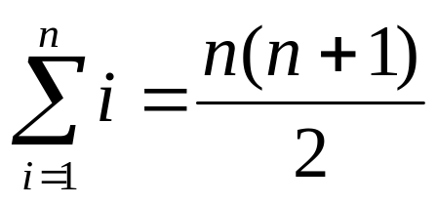
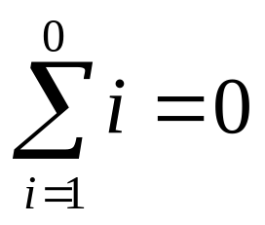
Familiar Induction Example?
For all n ≥ 0, prove that:
First prove the basis. We pick n=0. When n=0, there is a general principle that when the upper limit (0) of a sum is less than the lower limit (1) then the sum is over no terms and therefore the sum is 0. That is:

Slide 33
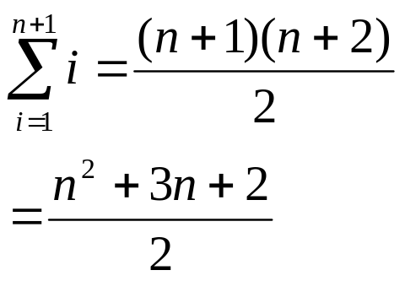
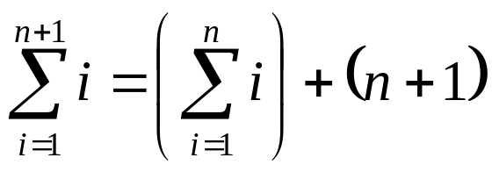
Familiar Induction Example
Next prove the induction. Assume n ≥ 0. We must prove that the theorem implies the same formula when n is larger. For integers, we will use n+1 as the next largest value. This means that the formula should hold with n +1 substituted for n:
This should equal what we came up with previously if we just add on an extra n+1 term:

Slide 34
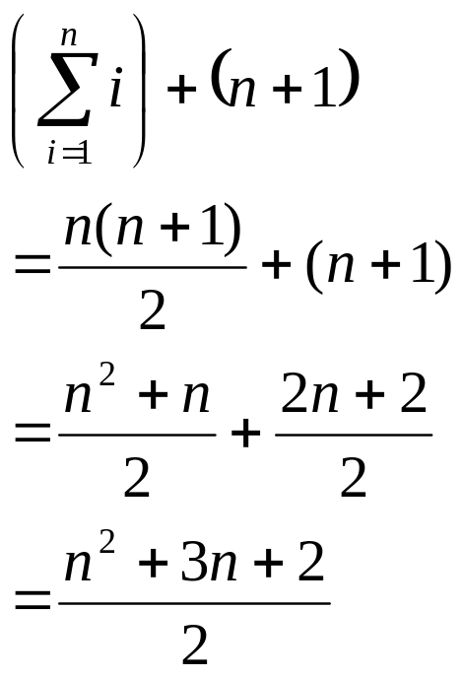
Familiar Induction Example
Continued:
This matches what we got from
the inductive step, and the
proof is complete.

Slide 35
Second Induction Example
If x ≥4 then 2^{x} ≥ x²
Basis: If x=4, then 2^{x} is 16 and x² is 16. Thus, the theorem holds.
Induction: Suppose for some x ≥4 that 2^{x} ≥ x². With this statement as the hypothesis, we need to prove the same statement, with x+1 in place of x: 2^{(x+1)} ≥ (x+1)²

Slide 36
Second Induction Example
2^{(x+1)} ≥ (x+1)² ? (i)
Rewrite in terms of S(x)
  2^{(x+1)} = 2*2^{x}
  We are assuming 2^{x} ≥ x²
  So therefore 2^{(x+1)} = 2*2^{x} ≥ 2x² (ii)
Substitute (ii) into (i)
  2x² ≥ (x+1)²
  2x² ≥ (x²+2x+1)
  x² ≥ 2x+1
  x ≥ 2 + 1/x
  Since x >=4, we get some value >=4 on the left side. The right side will equal at most 2.25 and in fact gets smaller and approaches 2 as x increases. Consequently, we have proven the theorem to be true by induction.

