Slide 1

COVID-19 Data
Analysis with Dashboard
A Summer Internship Presentation By
Parth Prajapati (180770107583)
Internal Faculty Guide:- Prof. Hemal Patel

Slide 2
Table of Content
Part 1: Introduction
Part 2: Data Analysis
Part 3: Data Analysis Tools
Part 4: Data Analysis Process
Part 5: Conclusion

Slide 3
Introduction
COVID-19 has infected millions of people around the world. Countries try to take effective measures to combat the pandemic, prevent the spread, decrease the risk of infection.
Understanding the spread of COVID-19 is critical to informing public health decisions and lessening its impact on communities.
due to the vast amount of data available on COVID-19 from various sources, by using this data in Data analysis, Machine learning, Data Visualization we can prevent the spread, decrease the risk of infection.

Slide 4
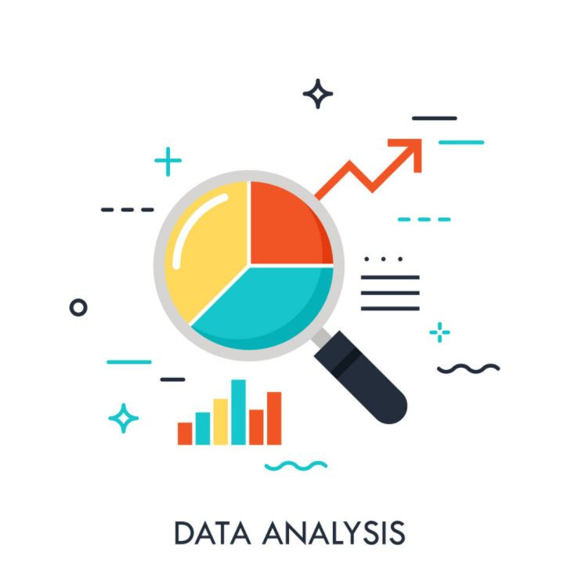
Data Analysis
Data analysis is defined as a process of cleaning, transforming, and modeling data to discover useful information for business decision-making.
The purpose of Data Analysis is to extract useful information from data and taking the decision based upon the data analysis.
Data analysis, on the other hand, focuses on the process of turning raw data into useful statistics, information, and explanations.

Slide 5






Data Analysis Tools
Data analysis tools make it easier for users to process and manipulate data, analyze the relationships and correlations between data sets, and it also helps to identify patterns and trends for interpretation.

Slide 6
Data Analysis Process
Data Requirement Gathering
Data Collection
Data Cleaning
Data Analysis
Data Visualization

Slide 7
Data Requirement Gathering
Daily covid19 confirmed cases
Daily covid19 Deaths
Daily covid19 Recovered
For COVID19 , there are basic data
Which requires for analysis.
This data are global level.

Slide 8
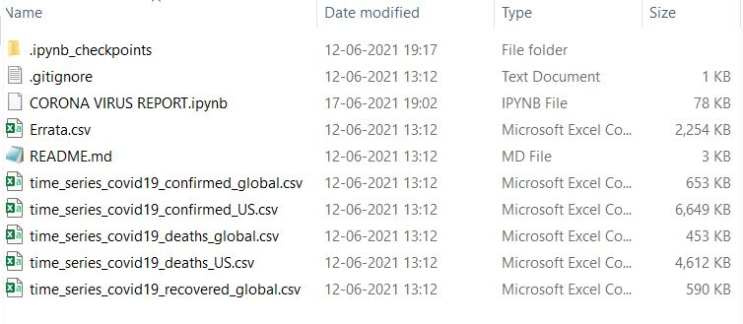
Data Collection
CSSE at Johns Hopkins University in GitHub account, they upload covid19 data on Daily bases which we can use for
Data analysis.
https://github.com/CSSEGISandData/COVID-19

Slide 9
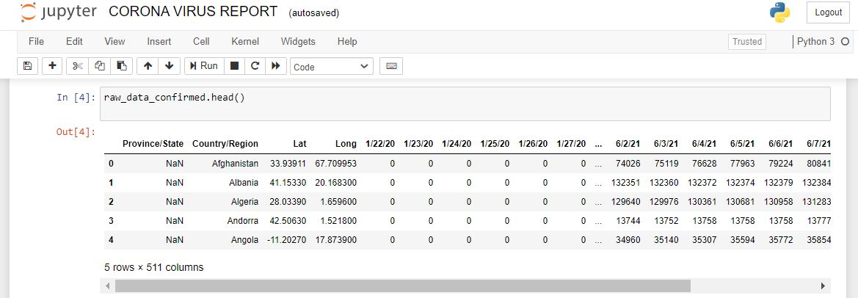
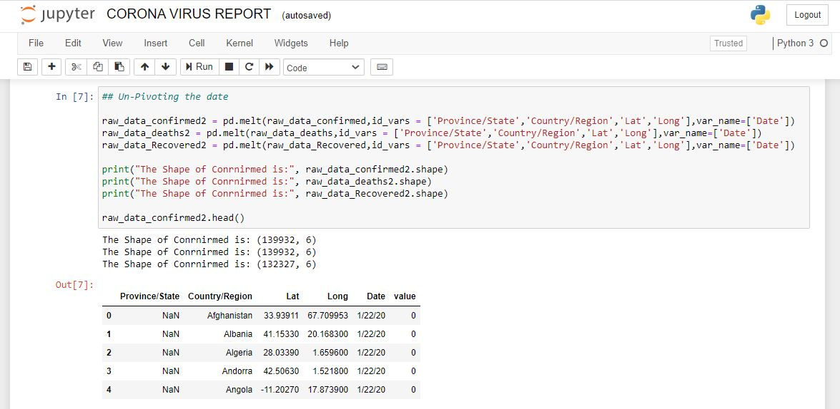
Data Cleaning
In Data Cleaning , we dealing with
The data which is collected may contain duplicate records, white spaces or errors.
In covid19 dataset first we merge
Date columns so it easy understand
Data.

Slide 10
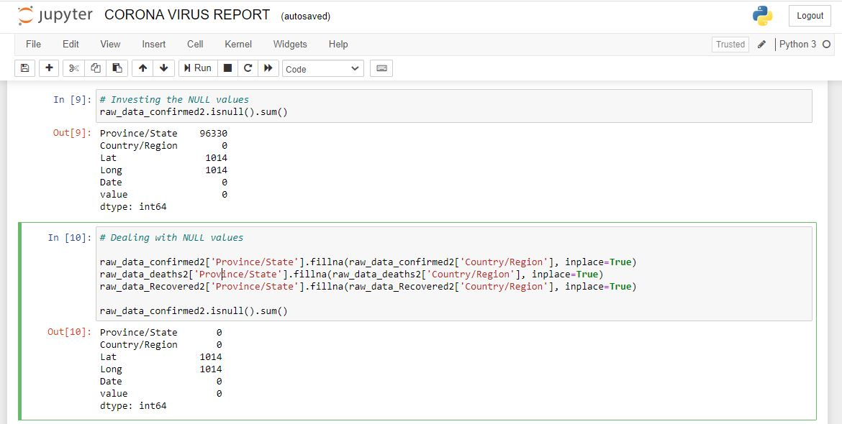
Data Cleaning
Removing Null Values

Slide 11
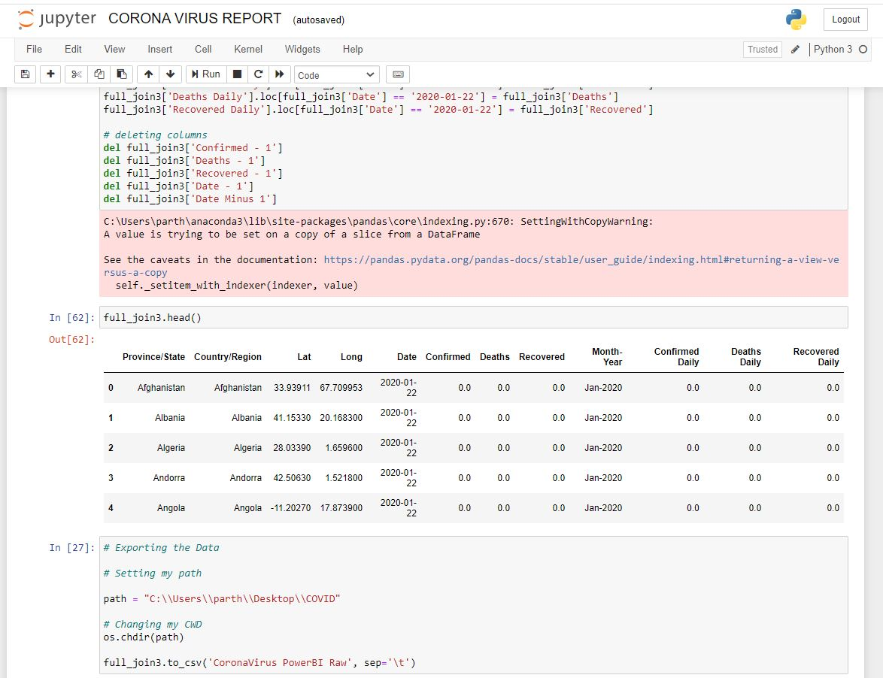
Data Analysis
Data is collected, cleaned, and processed, it is ready for Analysis. As you manipulate data, you may find you have the exact information you need, or you might need to collect more data.
After removing all dates columns and convert into one column and dealing with NULL values, also analysis and merge all
Tables to create column of confirmed daily cases, deaths daily , recovered daily.

Slide 12
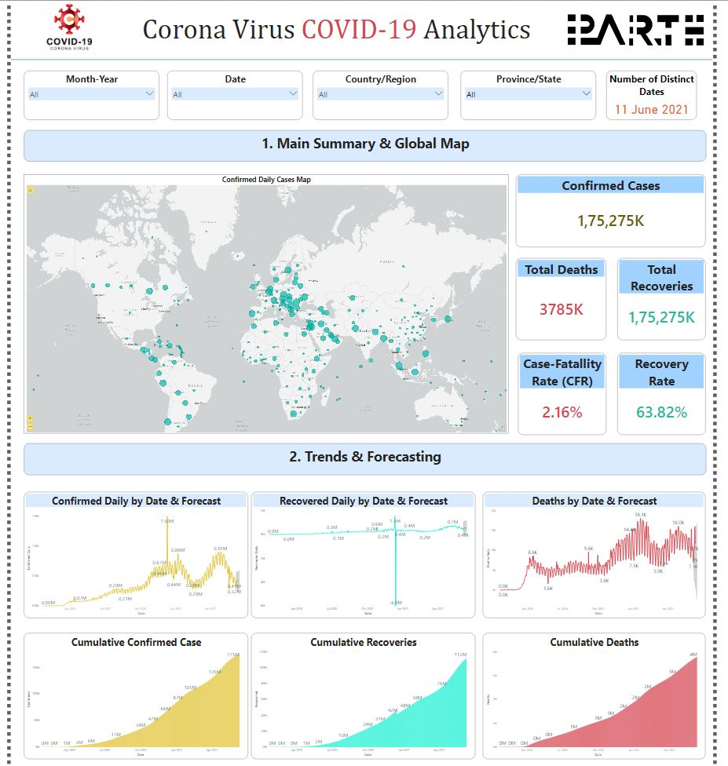
Data Visualization
Data visualization refers to the graphical representation of information gained through data analysis.
PowerBI is used for Data Visualization
With PowerBI create covid19 dashboard which shows relationships and comparing datasets, you can find a way to find out meaningful information. Also used to discover unknown facts and trends

Slide 13
Conclusion
Through this project, the analysis on COVID-19 data has been performed successfully. In this learned how to preprocess and merge datasets to calculate needed measures and prepare them for an Analysis. In this project, we are going to work with the COVID19 dataset, which consists of the data related to the cumulative number of confirmed cases, per day, in each Country and how to make dashboard.
find a pattern of covid 19 spread
future prediction with machine learning
improved Decision Making

Slide 14
THANK YOU !!

