Slide 1
Medical Insurance
Cost Recommender
Class : TE IT Div: A
Harshkumar Bhikadiya: 29
Shivam Bhosale: 30
Parth Dali: 31
Pranav Dalvi: 32

Slide 2
Index
Introduction
Literature Review
Problem statement
Architectural Diagram
Methodology
Implementation
Results and Discussion
Conclusion
References

Slide 3
Introduction
With the constant increasing prices of healthcare in our country, and with the ever-rising instances of diseases, health insurance today is a necessity.
Health insurance provides people with a much-needed financial backup at times of medical emergencies.

Slide 4
Literature Review
Sr.No | Title | Abstract | Future Scope
1. | Predict Health Insurance Cost by using Machine Learning and DNN Regression Models | The research uses various machine learning regression models and deep neural networks to forecast charges of health insurance based on specific attributes, on medical cost personal data set from Kaggle.com | Stochastic gradient boosting can be used in the estimation of insurance costs with better performance than other regression models.
2. | An Ensemble Methods for Medical Insurance Costs Prediction Task | The paper reports three new ensembles of supervised learning predictors for managing medical insurance costs. The open dataset is used for data analysis methods development. | Adding new predictor can improve the predictive accuracy.

Slide 5
Problem Statement
To develop a machine learning model which can recommend the cost of insurance policy which a customer should purchase based on their BMI, age, number of childrens, medical history, and smoking habits.

Slide 6
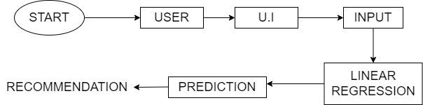
Architectural Diagram

Slide 7
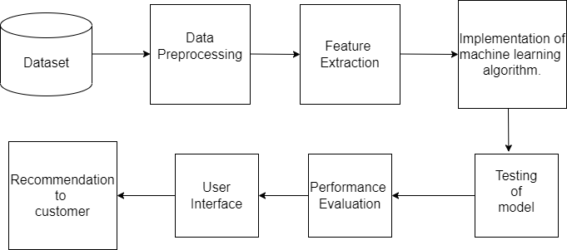
Methodology

Slide 8
Implementation
1.Dataset details
The attributes of dataset are :
Age,sex,BMI,children,smoker.
2. Algorithm
Linear Regression algorithm was used.
3.Performance metrics
R-squared value

Slide 9
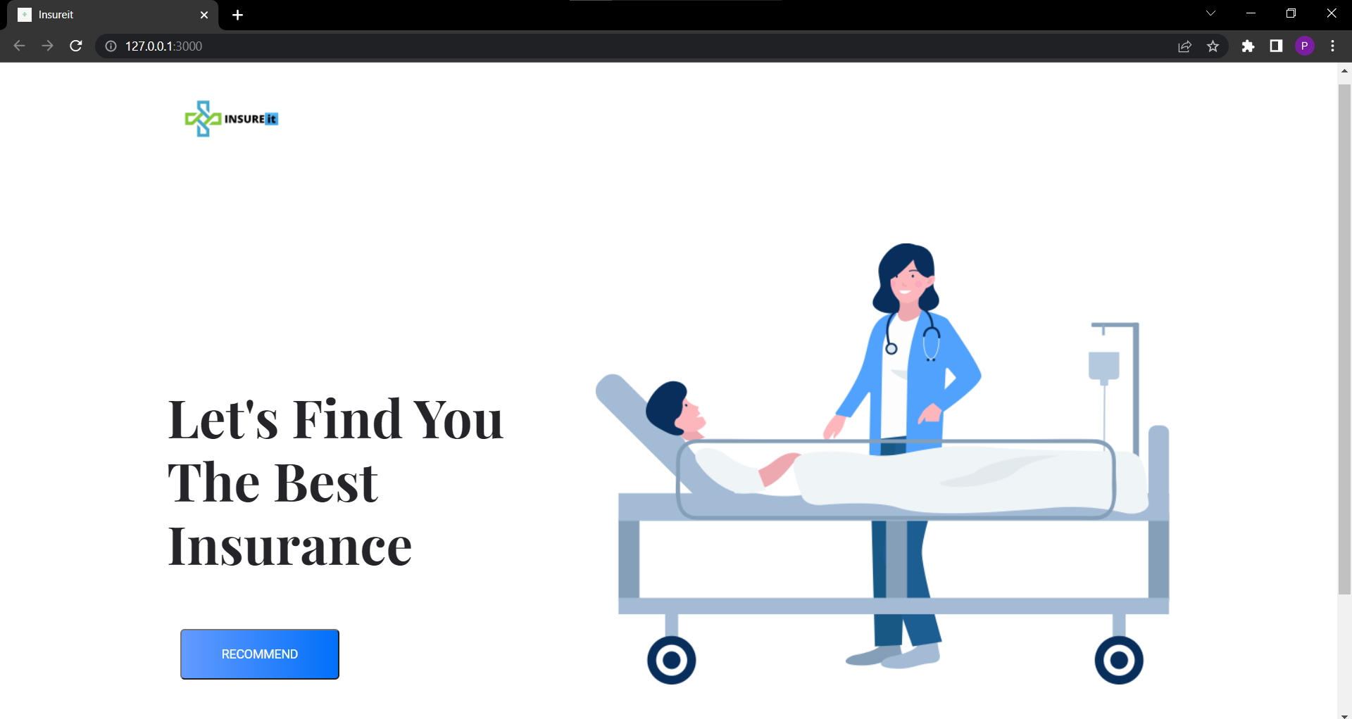
Results and Discussion

Slide 10
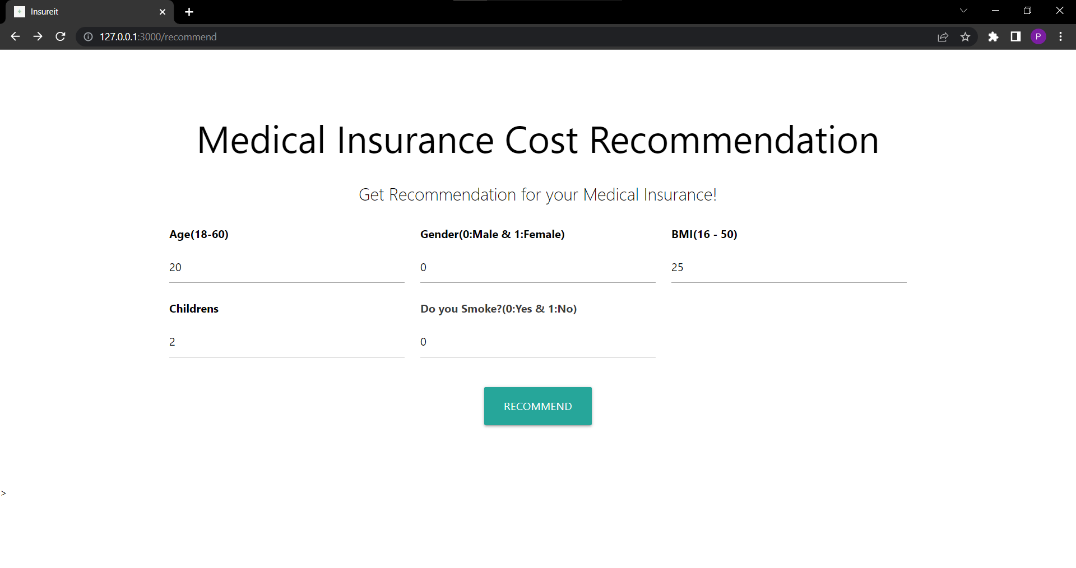
Results and Discussion

Slide 11
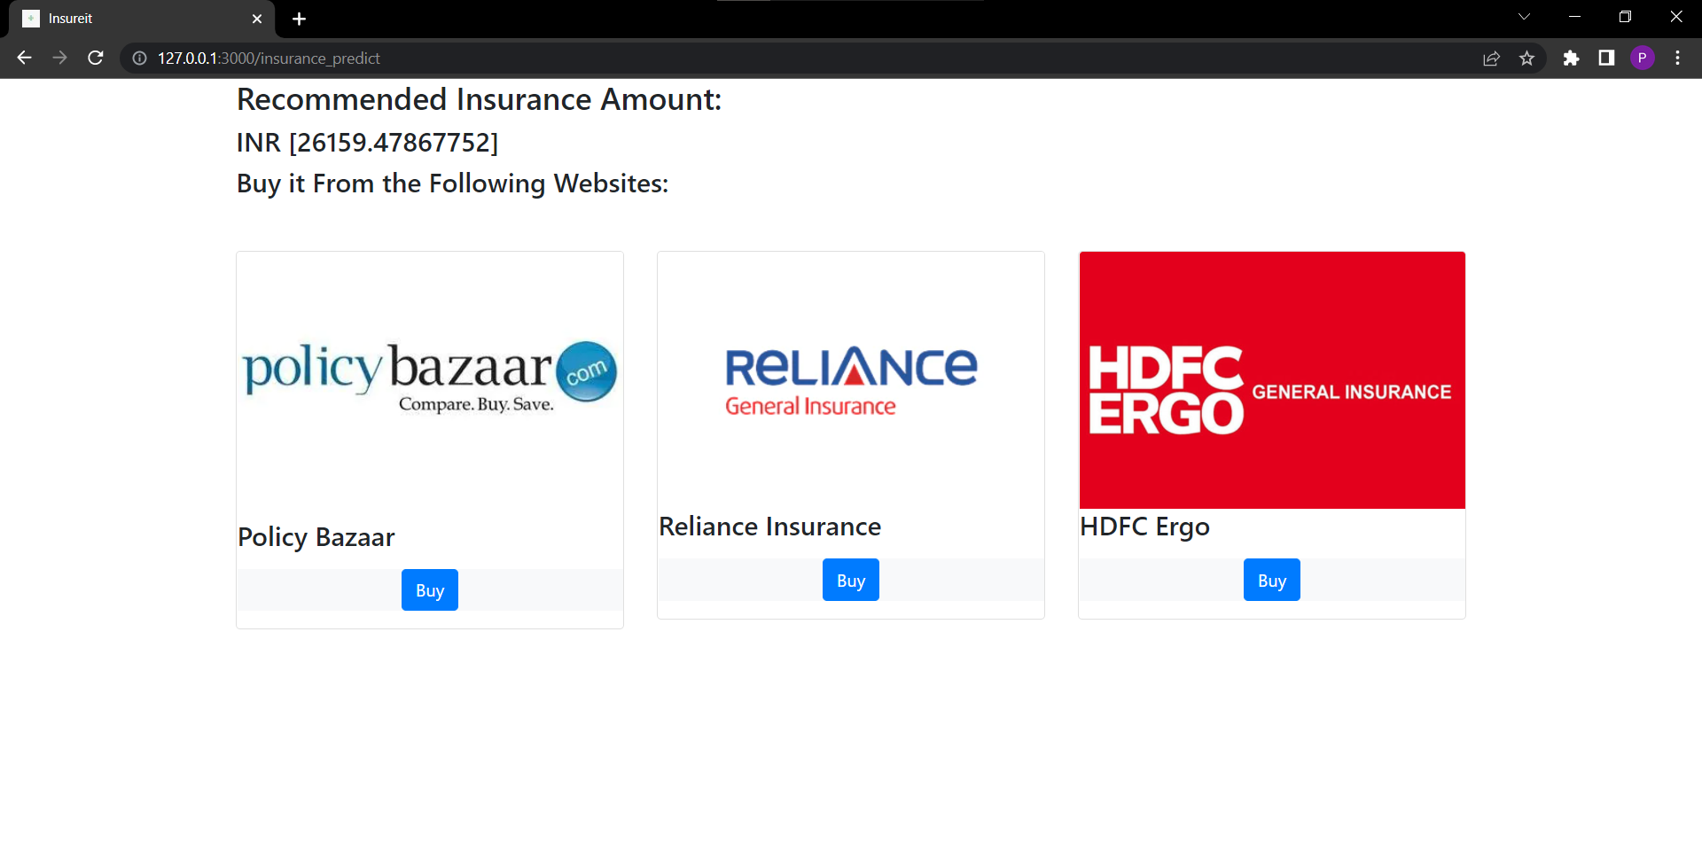
Results and Discussion

Slide 12
Conclusion
In this project, we used linear regression for evaluating individual health insurance data. The predicted premiums from this model was compared with actual premiums to compare the accuracy of the model.
Various factors were used and their effect on predicted amount was examined. It was observed that a person’s age and smoking status affects the recommendation most.
Premium amount recommendation focuses on person’s own health rather than other company’s insurance terms and conditions. The models can be applied to the data collected in coming years to recommend the premium. This can help not only people but also insurance companies to work in tandem for better and more health centric insurance amount.

Slide 13
References
[1] Mohamed hanafy, Omar M. A. Mahmoud."Predict Health Insurance Cost by using Machine Learning and DNN Regression Models" International Journal of Innovative Technology and Exploring Engineering (IJITEE)(2021):2278-3075
[2] Shakhovska, Nataliya, et al. "An ensemble methods for medical insurance costs prediction task." Computers, Materials and Continua 70.2 (2022): 3969-3984.
[3] Kaggle[online].Available
https://www.kaggle.com/datasets/awaiskaggler/insurance-csv(Accessed:Jan 23, 2022)
[4] Researchgate.net.[Online].Available
https://www.researchgate.net/publication/348559741_Predict_Health_Insurance_Cost_by_using_Machine_Learning_and_DNN_Regression_Models. (Accessed: 24-Jan-2022).
[5] moneycrashers.[online].Available
https://www.moneycrashers.com/factors-health-insurance-premium- costs(Accessed:Jan 23, 2022)

