Slide 1

Unit – 3 Probability Distribution
Probability & Statistics (PS)
DU # 2301HS402
Dr. Parag D. Ajani
Department of Humanities & Science
parag.ajani@darshan.ac.in
9909986867

Slide 2

Looping
Topics of Unit 3
Discrete Probability Distributions
Continuous Probability Distributions

Slide 3

Looping
Outline of Unit 3
Discrete Probability Distributions
Method 1 – Binomial Distribution
Method 2 – Poisson Distribution
Continuous Probability Distributions
Method 3 – Normal Distribution
Method 4 – Exponential Distribution

Slide 4
Introduction
In this chapter we shall study some of the probability distribution that figure most prominently in statistical theory and application. We shall also study their parameters. We shall introduce number of discrete probability distribution that have been successfully applied in a wide variety of decision situations.
The purpose of this chapter is to show the types of situations in which these distributions can be applied.

Slide 5
Introduction
Probability function of discrete random variable is known as probability mass function (P.M.F.) and probability function of continuous random variable is known as probability density function (P.D.F.).
Some special probability distributions:
(1) Binomial distribution (P.M.F.)
(2) Poisson distribution (P.M.F.)
(3) Normal distribution (P.D.F.)
(4) Exponential distribution (P.D.F.)

Slide 6
Method 1 Binomial Distribution

Slide 7
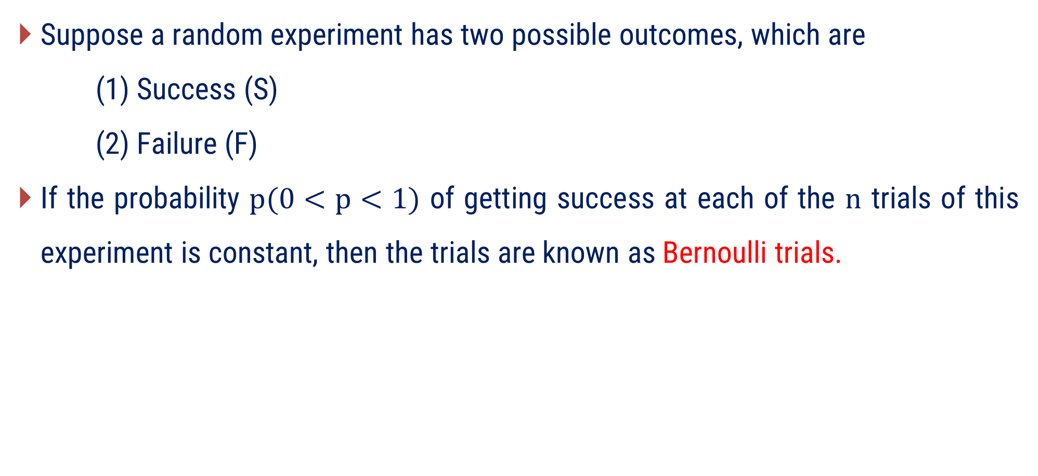
Bernoulli Trials
Suppose a random experiment has two possible outcomes, which are
(1) Success (S)
(2) Failure (F)
If the probability $p(0<p<1)$ of getting success at each of the $n$ trials of this experiment is constant, then the trials are known as Bernoulli trials.

Slide 8
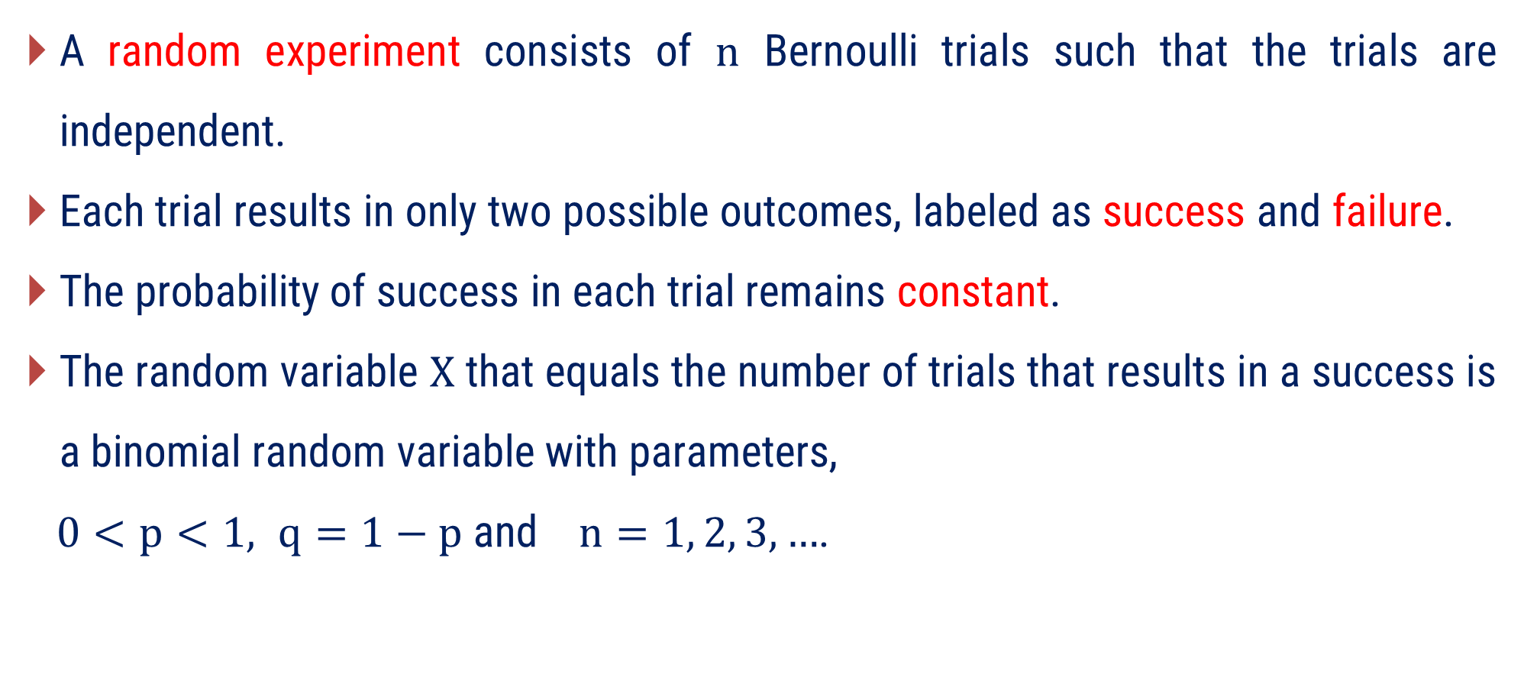
Binomial Distribution
A random experiment consists of $n$ Bernoulli trials such that the trials are independent.
Each trial results in only two possible outcomes, labeled as success and failure.
The probability of success in each trial remains constant.
The random variable $X$ that equals the number of trials that results in a success is a binomial random variable with parameters,
$0<p<1, q=1−p$ and $n=1, 2, 3, …$.

Slide 9
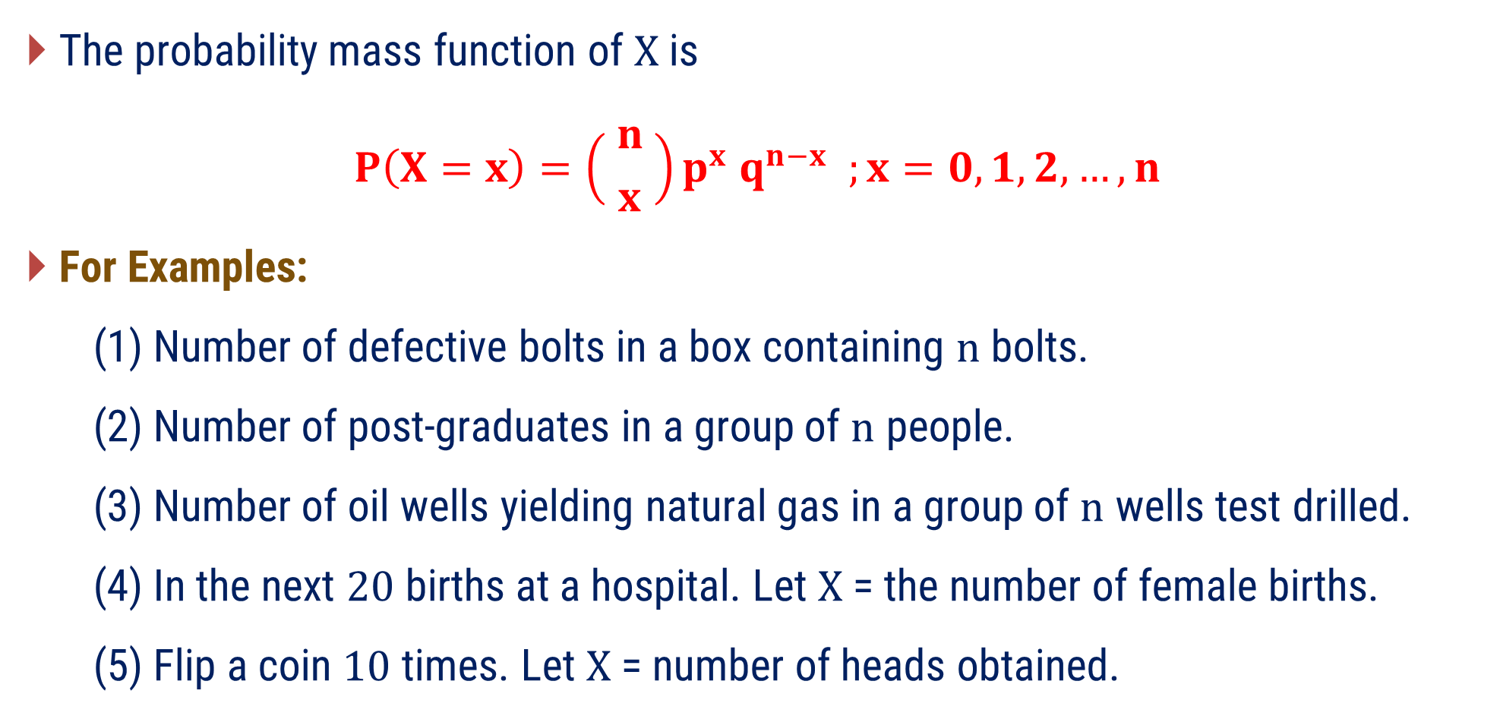
Binomial Distribution
The probability mass function of $X$ is
$$P\left(X=x\right)=\left( {n \atop x} \right)p^{x} q^{n−x} ;x=0, 1, 2,…, n$$
For Examples:
(1) Number of defective bolts in a box containing $n$ bolts.
(2) Number of post-graduates in a group of $n$ people.
(3) Number of oil wells yielding natural gas in a group of $n$ wells test drilled.
(4) In the next $20$ births at a hospital. Let $X$ = the number of female births.
(5) Flip a coin $10$ times. Let $X$ = number of heads obtained.

Slide 10

Properties of Binomial Distribution
The mean of binomial distribution is defined as$μ=E(X)=np$.
The variance of binomial distribution is defined as $V(X)=npq.$
The standard deviation of binomial distribution is defined as $σ=\sqrt{(npq)}$.

Slide 11
Examples of Method 1
Binomial Distribution

Slide 12
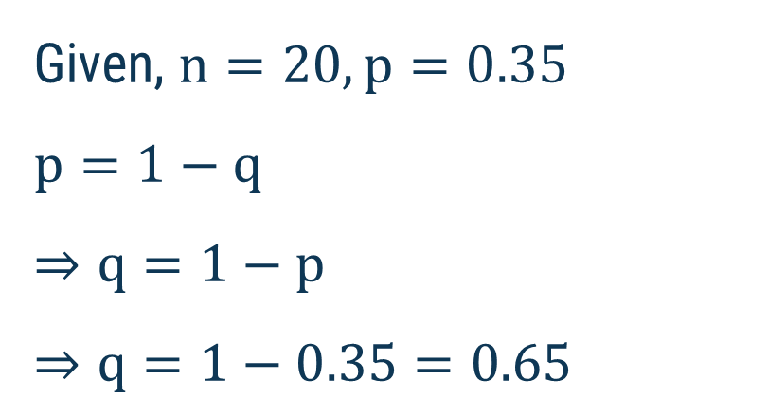

Method 1 ⇝ Example 1
For the binomial distribution with $n=20,p=0.35$. Find mean, variance and standard deviation.
Solution:
Given, $n=20,p=0.35$
$$p=1−q$$
$$⇒q=1−p$$
$$⇒q=1−0.35=0.65$$

Slide 13
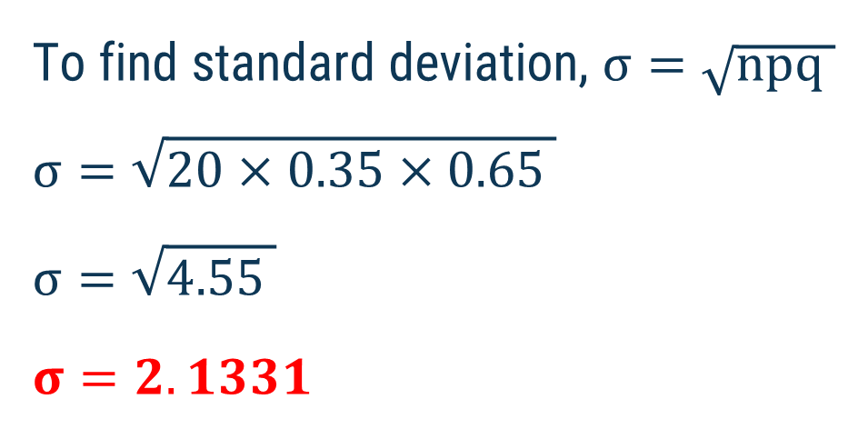
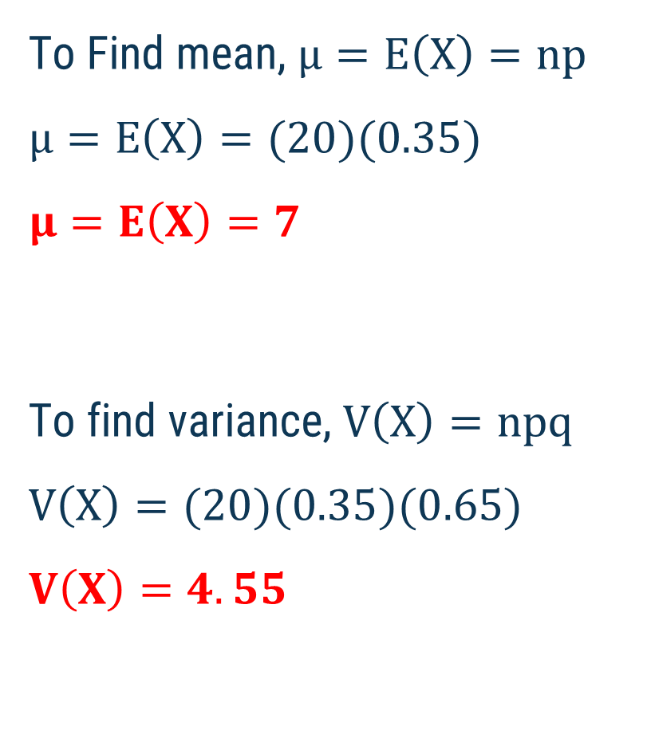
Method 1 ⇝ Example 1 (Continue)
To Find mean, $μ=E\left(X\right)=np$
$$μ=E\left(X\right)=(20)(0.35)$$
$$μ=E\left(X\right)=7$$
To find variance, $V\left(X\right)=npq$
$$V\left(X\right)=(20)(0.35)(0.65)$$
$$V\left(X\right)=4.55$$
To find standard deviation, $σ=\sqrt{npq }$
$$σ=\sqrt{20×0.35×0.65 }$$
$$σ=\sqrt{4.55 }$$
$$σ=2.1331$$

Slide 14
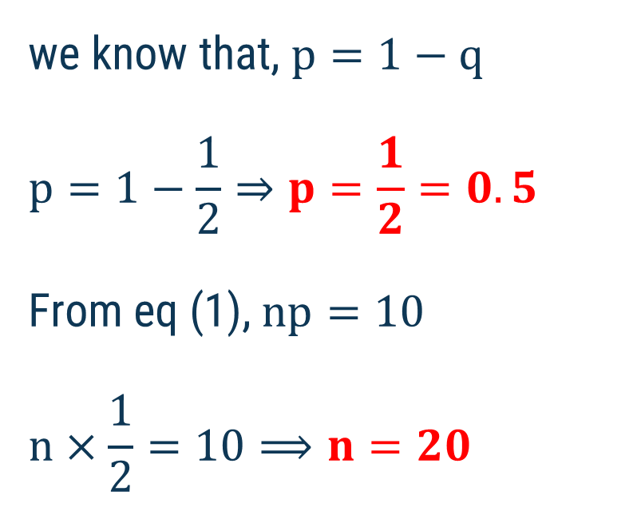
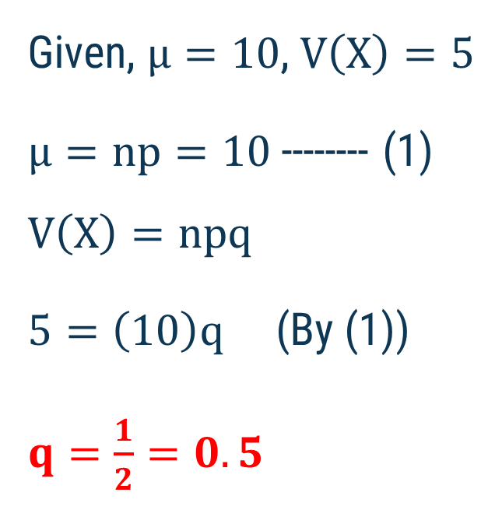
Method 1 ⇝ Example 2
Obtain the binomial distribution function for which mean is 10 and variance is 5.
Solution:
Given, $μ=10$, $V\left(X\right)=5$
$μ=np=10$ -------- (1)
$$V\left(X\right)=npq$$
$5=\left(10\right)q$ (By (1))
$q=\frac{1}{2}=0.5$
we know that, $p=1−q$
$$p=1−\frac{1}{2}⇒p=\frac{1}{2}=0.5$$
From eq (1), $np=10$
$$n×\frac{1}{2}=10⟹n=20$$

Slide 15
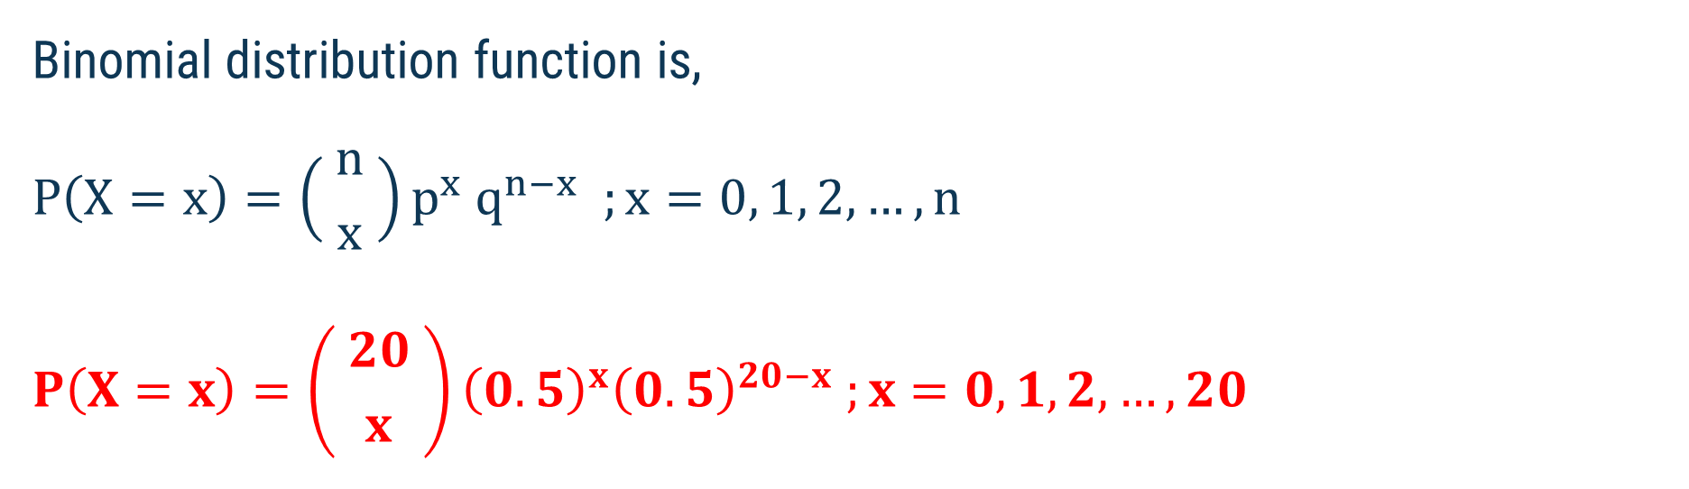
Method 1 ⇝ Example 2 (Continue)
Binomial distribution function is,
$$P\left(X=x\right)=\left( {n \atop x} \right)p^{x} q^{n−x} ;x=0, 1, 2,…, n$$
$$P\left(X=x\right)=\left( {20 \atop x} \right){\left(0.5\right)}^{x}{\left(0.5\right)}^{20−x} ;x=0,1,2,…,20$$

Slide 16
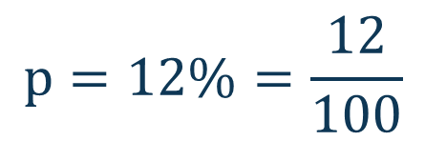
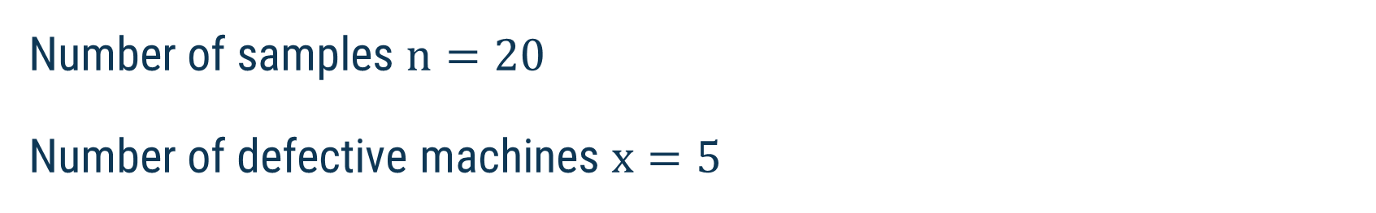
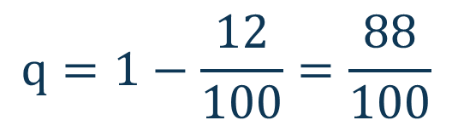
Method 1 ⇝ Example 3
12% of the tablets produced by a tablet machine are defective. What is the probability that out of a random sample of 20 tablets produced by the machine, 5 are defective?
Solution:
Number of samples $n=20$
Number of defective machines $x=5$
$$p=12\%=\frac{12}{100}$$
Success of event : defective,
$$q=1−\frac{12}{100}=\frac{88}{100}$$
Failure of event : not defective,

Slide 17
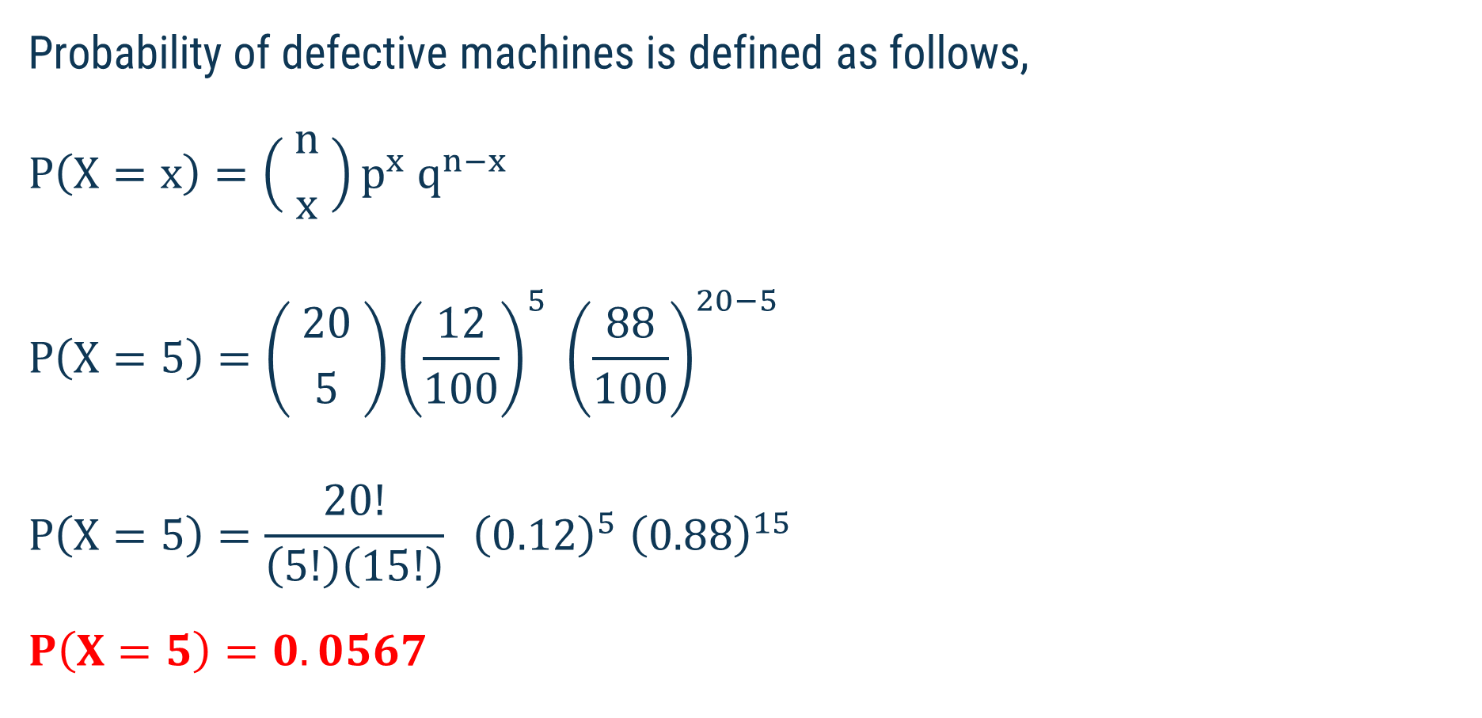
Method 1 ⇝ Example 3 (Continue)
Probability of defective machines is defined as follows,
$$P\left(X=x\right)=\left( {n \atop x} \right)p^{x} q^{n−x}$$
$$P\left(X=5\right)=\left( {20 \atop 5} \right){\left(\frac{12}{100}\right)}^{5} {\left(\frac{88}{100}\right)}^{20−5}$$
$$P\left(X=5\right)=\frac{20!}{\left(5!\right)\left(15!\right)} {\left(0.12\right)}^{5} {\left(0.88\right)}^{15}$$
$$P\left(X=5\right)=0.0567$$

Slide 18
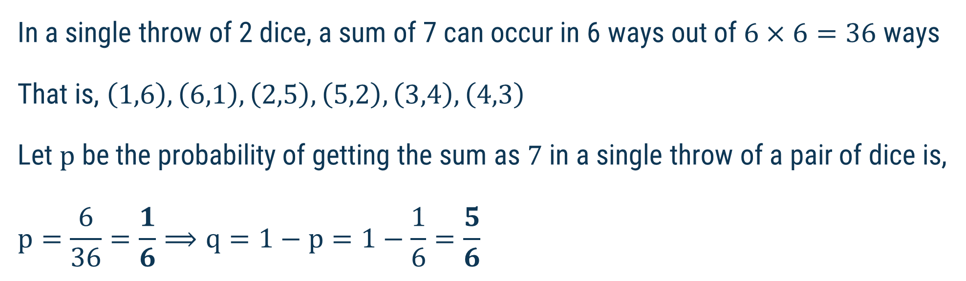
Method 1 ⇝ Example 4
Find probability of getting a sum of 7 at least once in 3 tosses of a pair of dice.
Solution:
Number of tosses $n=3$
In a single throw of 2 dice, a sum of 7 can occur in 6 ways out of $6×6=36$ ways
That is, $\left(1,6\right), \left(6,1\right), \left(2,5\right), \left(5,2\right), \left(3,4\right), \left(4,3\right)$
Let $p$ be the probability of getting the sum as $7$ in a single throw of a pair of dice is,
$$p=\frac{6}{36}=\frac{1}{6}⟹q=1−p=1−\frac{1}{6}=\frac{5}{6}$$

Slide 19
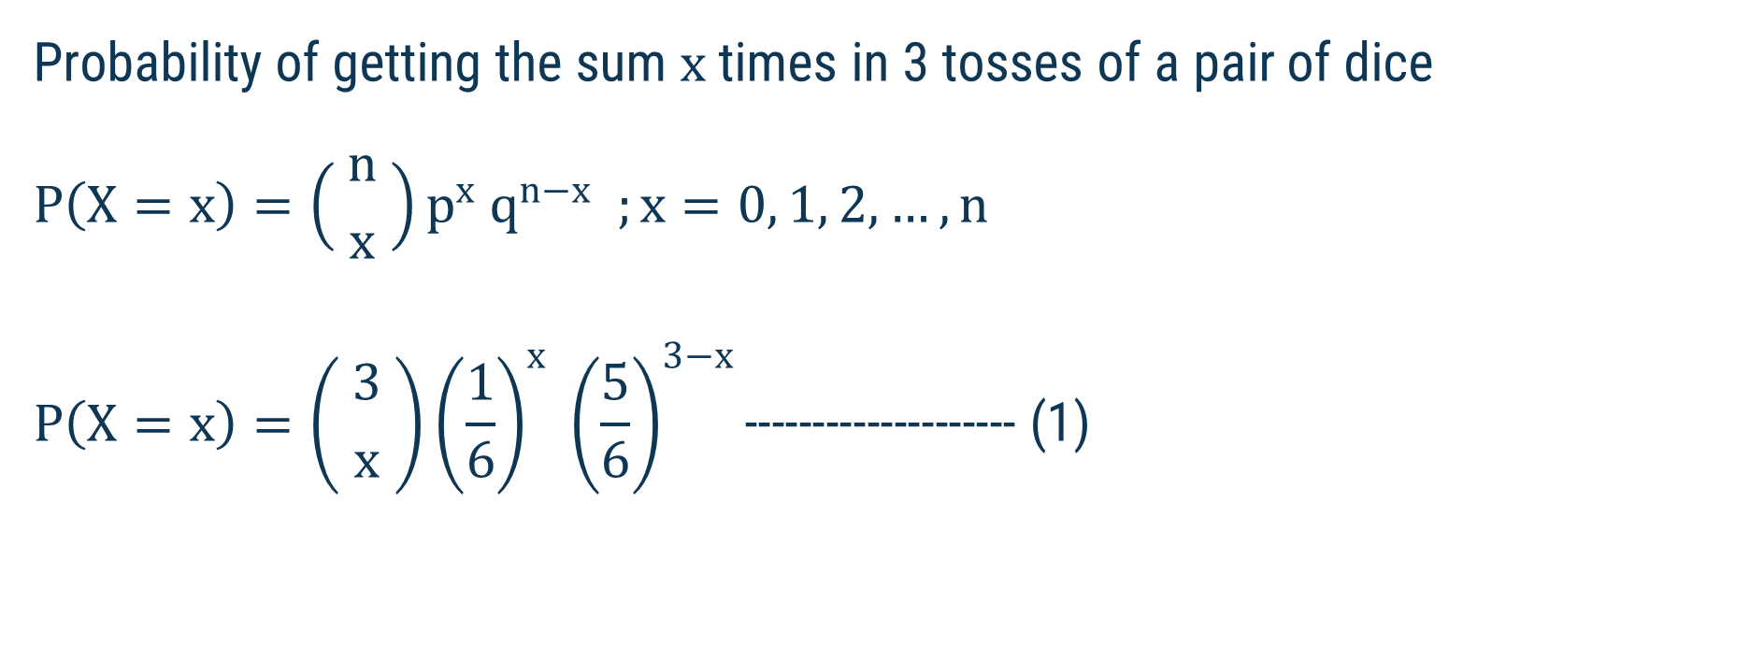
Method 1 ⇝ Example 4 (Continue)
Probability of getting the sum $x$ times in 3 tosses of a pair of dice
$$P\left(X=x\right)=\left( {n \atop x} \right)p^{x} q^{n−x} ;x=0, 1, 2,…, n$$
$$P\left(X=x\right)=\left( {3 \atop x} \right){\left(\frac{1}{6}\right)}^{x} {\left(\frac{5}{6}\right)}^{3−x}\text{−−−−−−−−−−−−−−−−−−−− (1)}$$

Slide 20
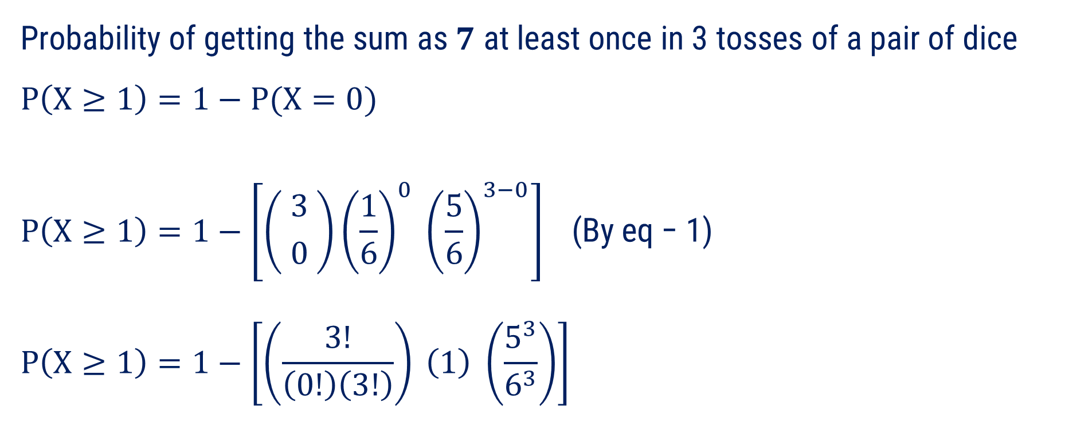
Method 1 ⇝ Example 4 (Continue)
Probability of getting the sum as $7$ at least once in 3 tosses of a pair of dice
$$P\left(X≥1\right)=1−P(X=0)$$
$$P\left(X≥1\right)=1−\left[\left( {3 \atop 0} \right){\left(\frac{1}{6}\right)}^{0} {\left(\frac{5}{6}\right)}^{3−0}\right] \text{(}\text{By} \text{eq}\text{ − 1)}$$
$$P\left(X≥1\right)=1−\left[\left(\frac{3!}{\left(0!\right)\left(3!\right)}\right) \left(1\right) \left(\frac{5^{3}}{6^{3}}\right)\right]$$

Slide 21

Method 1 ⇝ Example 4 (Continue)
$$P\left(X≥1\right)=1−\left[\left(\frac{3!}{\left(0!\right)\left(3!\right)}\right) \left(1\right) \left(\frac{5^{3}}{6^{3}}\right)\right]$$
$$P\left(X≥1\right)=1−\left[\left(1\right) \left(1\right) \left(\frac{125}{216}\right)\right]$$
$$P\left(X≥1\right)=1−\left[\left(\frac{125}{216}\right)\right]$$
$$P\left(X≥1\right)=\frac{91}{216}$$

Slide 22
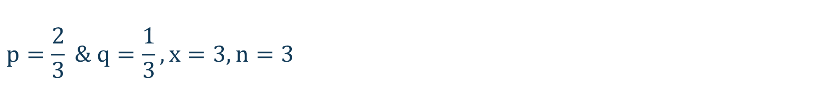
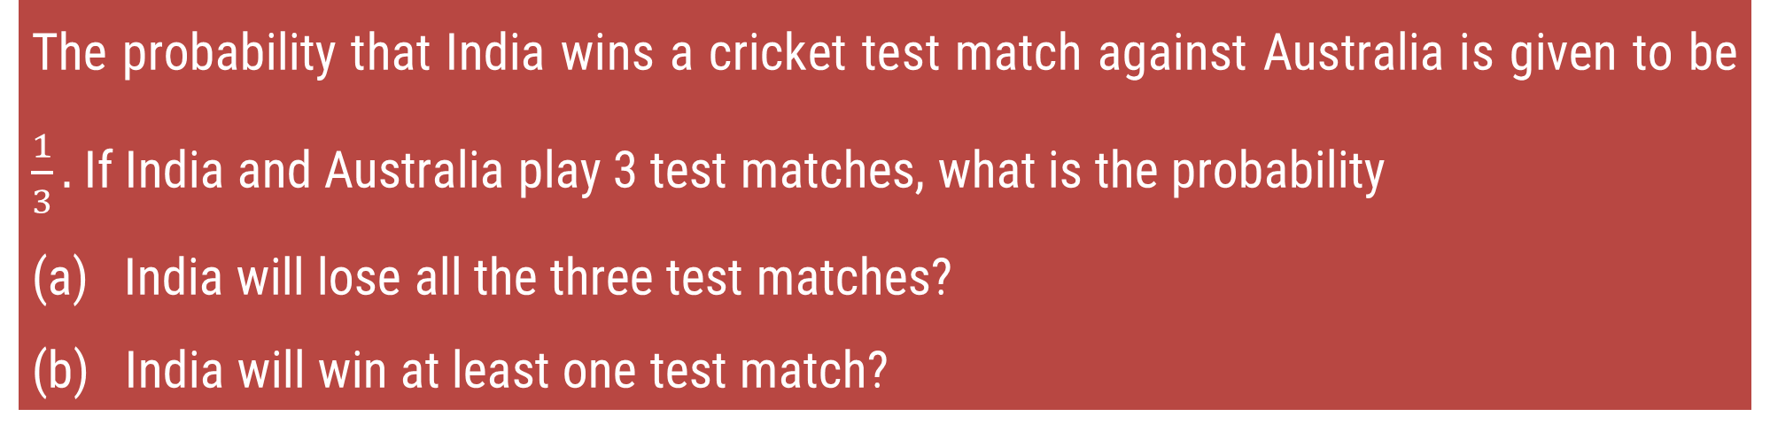
Method 1 ⇝ Example 5
The probability that India wins a cricket test match against Australia is given to be $\frac{1}{3}.$If India and Australia play 3 test matches, what is the probability
(a) India will lose all the three test matches?
(b) India will win at least one test match?
Solution:
(a) Method – 1 Success : Lose all three test match
$$p=\frac{2}{3} \& q=\frac{1}{3}, x=3, n=3$$

Slide 23

Method 1 ⇝ Example 5 (Continue)
$$P\left(X=x\right)=\left( {n \atop x} \right)p^{x} q^{n−x} ;x=0, 1, 2,…, n$$
$$P\left(X=3\right)=\left( {3 \atop 3} \right){\left(\frac{2}{3}\right)}^{3} {\left(\frac{1}{3}\right)}^{0}$$
$$P\left(X=3\right)=\left(\frac{3!}{\left(3!\right)\left(0!\right)}\right) \left(\frac{2^{3}}{3^{3}}\right) \left(\frac{1^{0}}{3^{0}}\right)$$
$$P\left(X=3\right)=\frac{8}{27}=0.2963$$

Slide 24
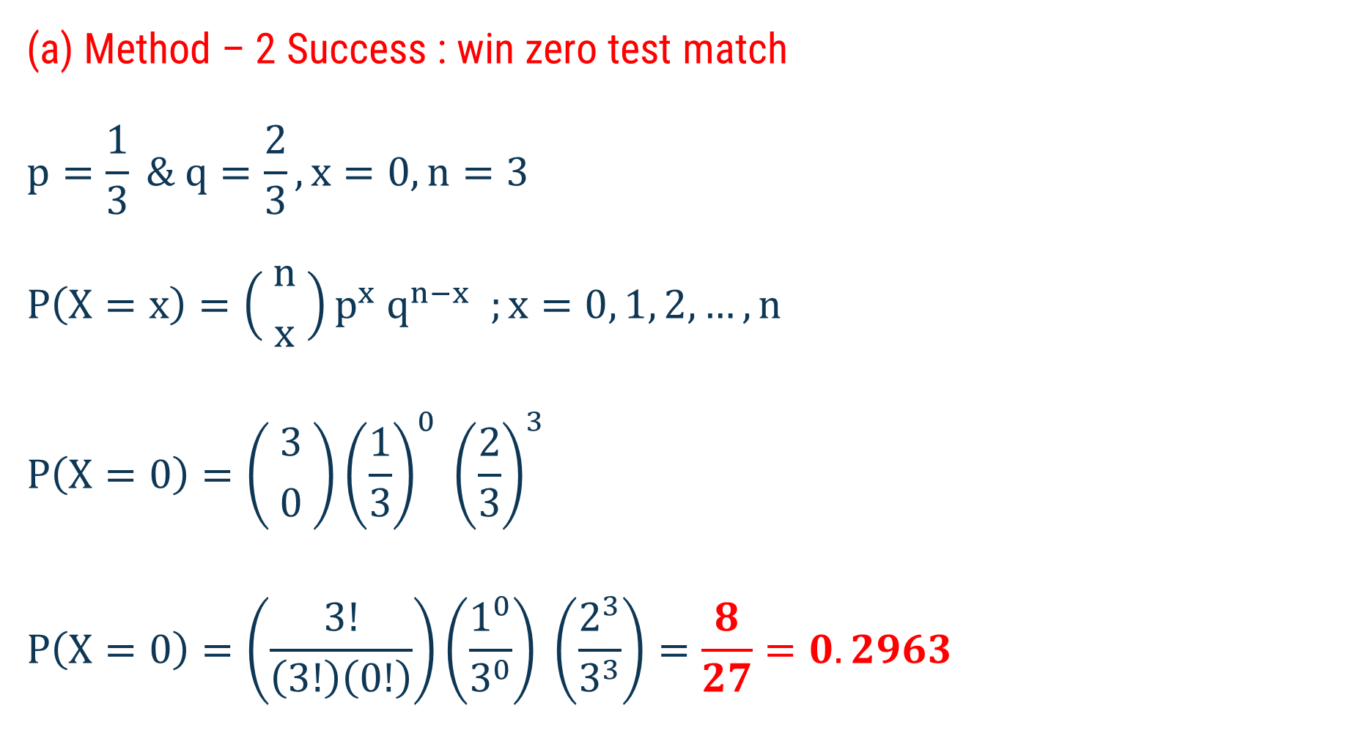
Method 1 ⇝ Example 5 (Continue)
(a) Method – 2 Success : win zero test match
$$p=\frac{1}{3} \& q=\frac{2}{3}, x=0, n=3$$
$$P\left(X=x\right)=\left( {n \atop x} \right)p^{x} q^{n−x} ;x=0, 1, 2,…, n$$
$$P\left(X=0\right)=\left( {3 \atop 0} \right){\left(\frac{1}{3}\right)}^{0} {\left(\frac{2}{3}\right)}^{3}$$
$$P\left(X=0\right)=\left(\frac{3!}{\left(3!\right)\left(0!\right)}\right)\left(\frac{1^{0}}{3^{0}}\right) \left(\frac{2^{3}}{3^{3}}\right)=\frac{8}{27}=0.2963$$

Slide 25
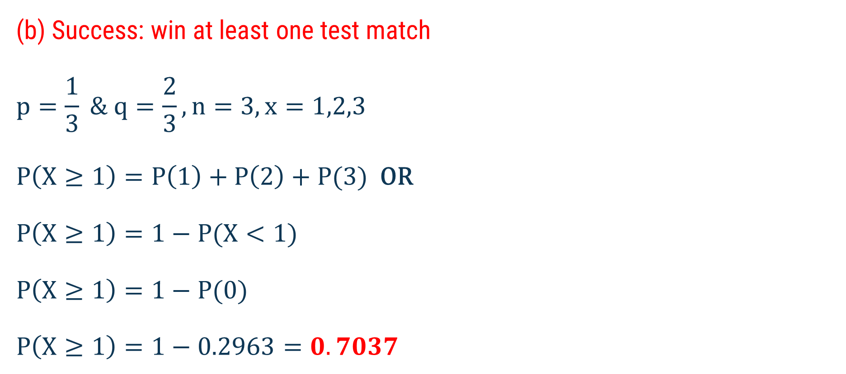
Method 1 ⇝ Example 5 (Continue)
(b) Success: win at least one test match
$$p=\frac{1}{3} \& q=\frac{2}{3}, n=3, x=1,2,3$$
$P\left(X≥1\right)=P\left(1\right)+P\left(2\right)+P(3)$ OR
$P\left(X≥1\right)=1−P(X<1)$
$P\left(X≥1\right)=1−P(0)$
$P\left(X≥1\right)=1−0.2963=0.7037$

Slide 26
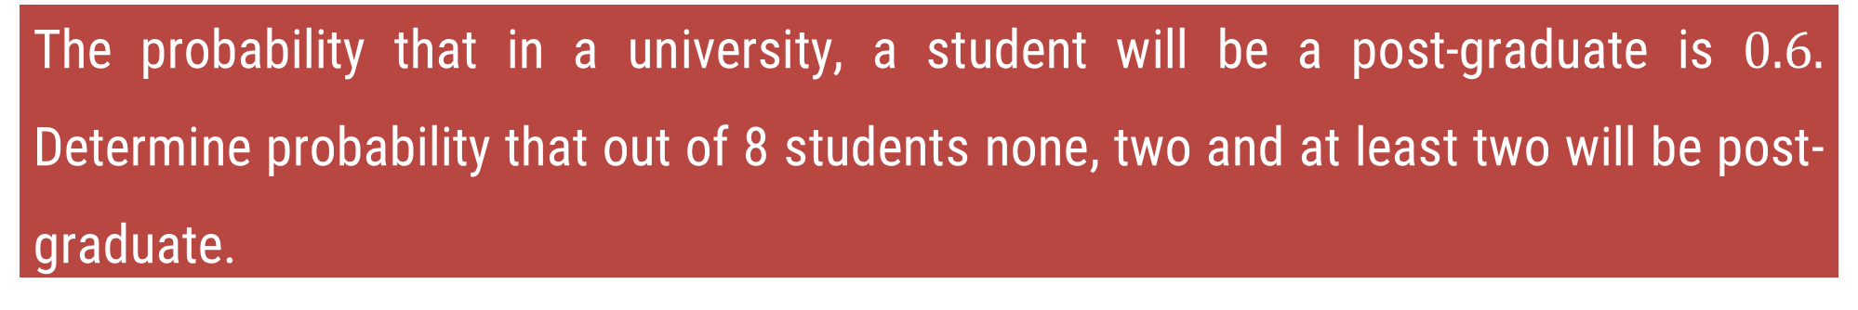
Method 1 ⇝ Example 6
The probability that in a university, a student will be a post-graduate is $0.6.$ Determine probability that out of 8 students none, two and at least two will be post-graduate.
Solution:
Success of event = Student will be a post graduate
$$n=8, p=0.6 \& q=\left(1−p\right)=\left(1−0.6\right)=0.4$$

Slide 27
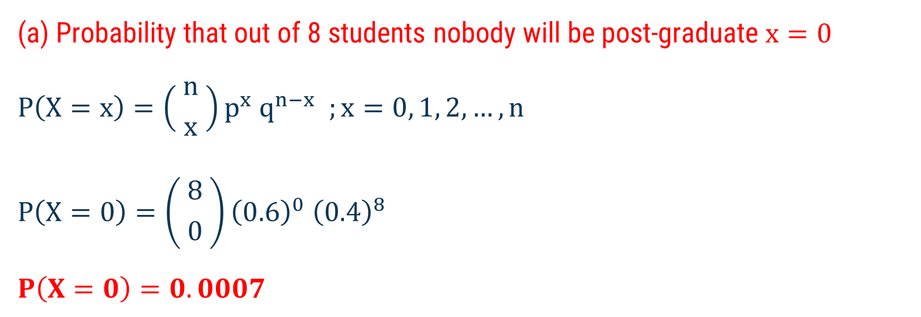
Method 1 ⇝ Example 6 (Continue)
(a) Probability that out of 8 students nobody will be post-graduate $x=0$
$$P\left(X=x\right)=\left( {n \atop x} \right)p^{x} q^{n−x} ;x=0, 1, 2,…, n$$
$$P\left(X=0\right)=\left( {8 \atop 0} \right){\left(0.6\right)}^{0} {\left(0.4\right)}^{8}$$
$$P\left(X=0\right)=0.0007$$

Slide 28
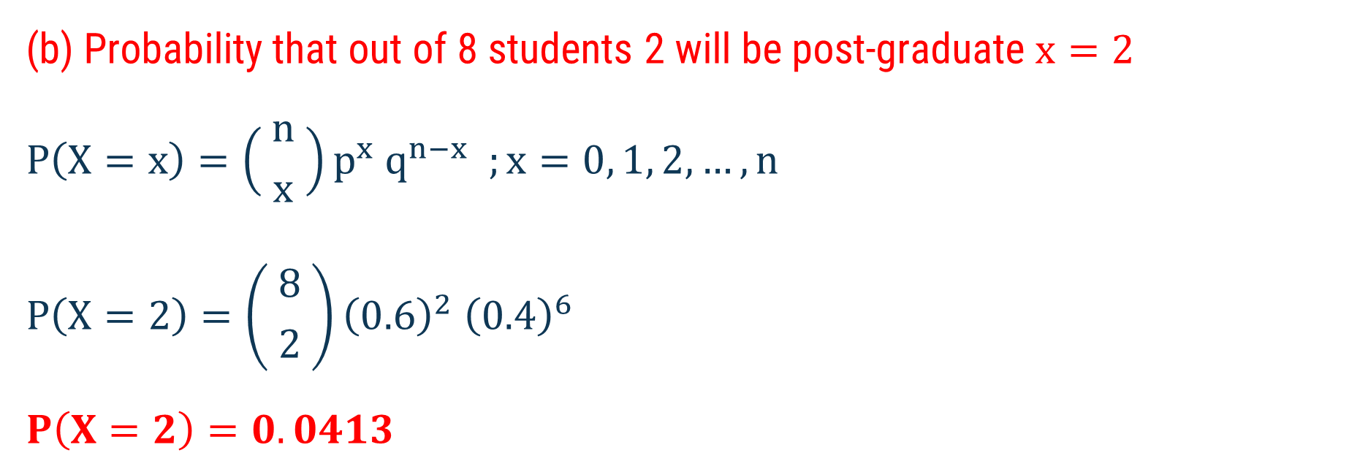
Method 1 ⇝ Example 6 (Continue)
(b) Probability that out of 8 students 2 will be post-graduate $x=2$
$$P\left(X=x\right)=\left( {n \atop x} \right)p^{x} q^{n−x} ;x=0, 1, 2,…, n$$
$$P\left(X=2\right)=\left( {8 \atop 2} \right){\left(0.6\right)}^{2} {\left(0.4\right)}^{6}$$
$$P\left(X=2\right)=0.0413$$

Slide 29
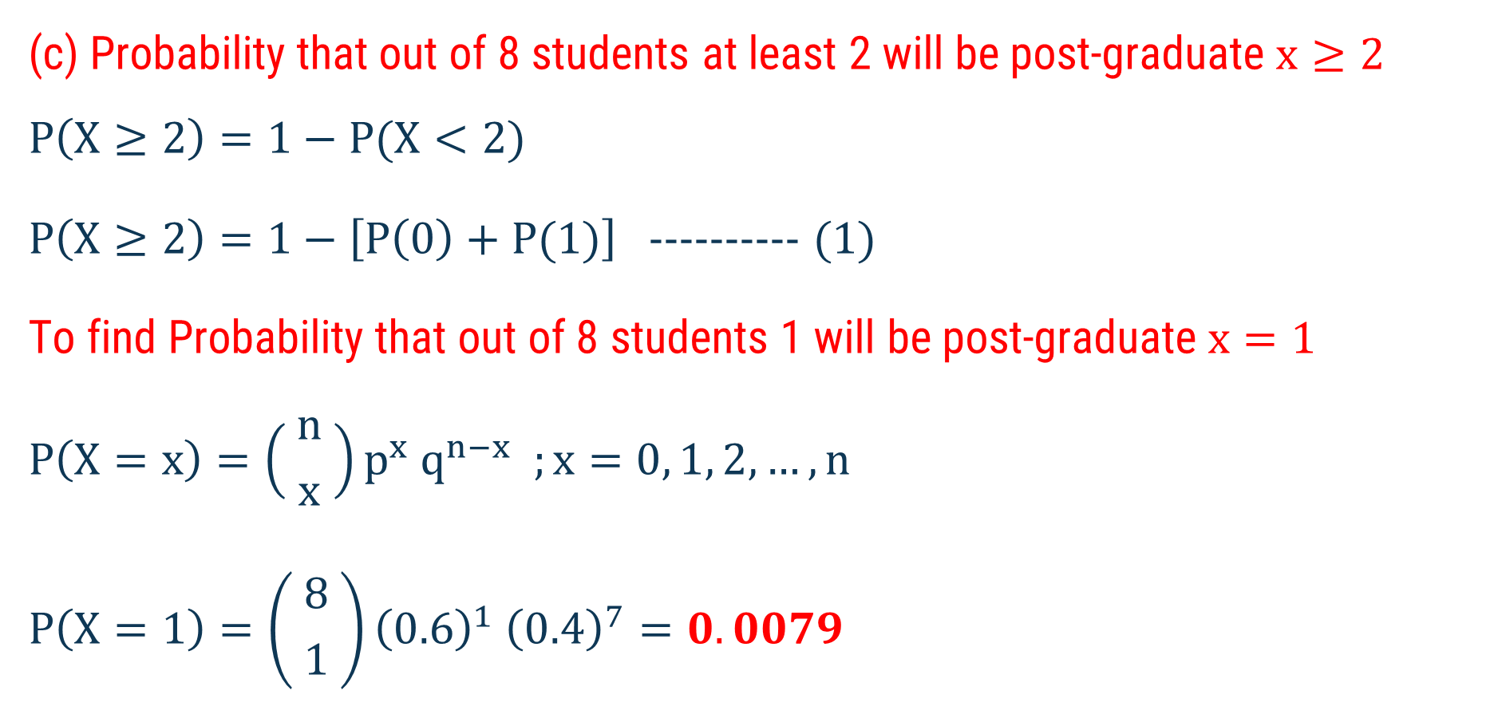
Method 1 ⇝ Example 6 (Continue)
(c) Probability that out of 8 students at least 2 will be post-graduate $x≥2$
$$P\left(X≥2\right)=1−P(X<2)$$
$P\left(X≥2\right)=1−\left[P\left(0\right)+P(1)\right]$ ---------- (1)
To find Probability that out of 8 students 1 will be post-graduate $x=1$
$$P\left(X=x\right)=\left( {n \atop x} \right)p^{x} q^{n−x} ;x=0, 1, 2,…, n$$
$$P\left(X=1\right)=\left( {8 \atop 1} \right){\left(0.6\right)}^{1} {\left(0.4\right)}^{7}=0.0079$$

Slide 30
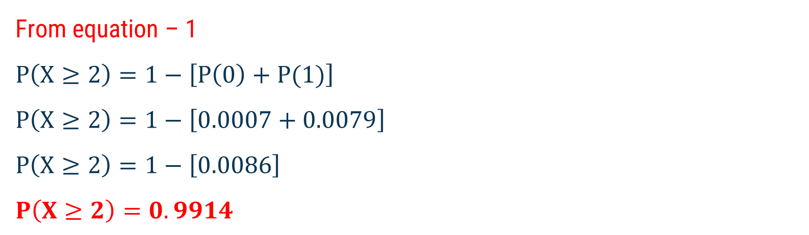
Method 1 ⇝ Example 6 (Continue)
From equation – 1
$$P\left(X≥2\right)=1−\left[P\left(0\right)+P(1)\right]$$
$$P\left(X≥2\right)=1−\left[0.0007+0.0079\right]$$
$$P\left(X≥2\right)=1−\left[0.0086\right]$$
$$P\left(X≥2\right)=0.9914$$

Slide 31
Method 1 ⇝ Example 7
The probability that an infection is cured by a particular antibiotic drug within 5 days is 0.75. Suppose 4 patients are treated by this antibiotic drug. What is the probability that no patient, exactly two patients, and at least two patients, are cured?
Solution:
Success of event = Infection is cured
$$n=4, p=0.75 \& q=\left(1−p\right)=\left(1−0.75\right)=0.25$$

Slide 32
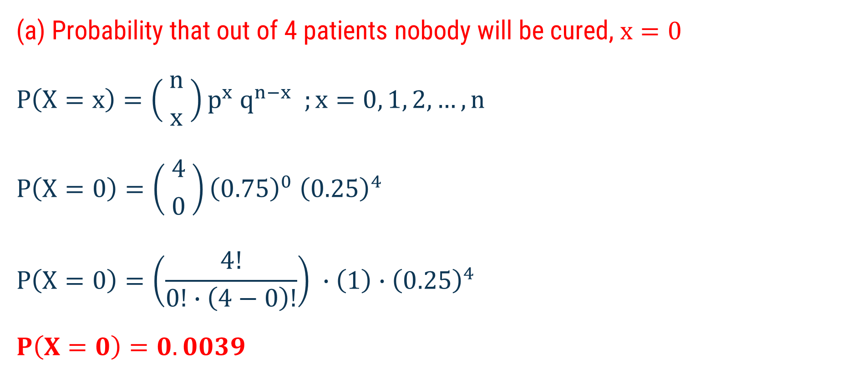
Method 1 ⇝ Example 7 (Continue)
(a) Probability that out of 4 patients nobody will be cured, $x=0$
$$P\left(X=x\right)=\left( {n \atop x} \right)p^{x} q^{n−x} ;x=0, 1, 2,…, n$$
$$P\left(X=0\right)=\left( {4 \atop 0} \right){\left(0.75\right)}^{0} {\left(0.25\right)}^{4}$$
$$P\left(X=0\right)=\left(\frac{4!}{0!∙\left(4−0\right)!}\right) ∙\left(1\right)∙{\left(0.25\right)}^{4}$$
$$P\left(X=0\right)=0.0039$$

Slide 33
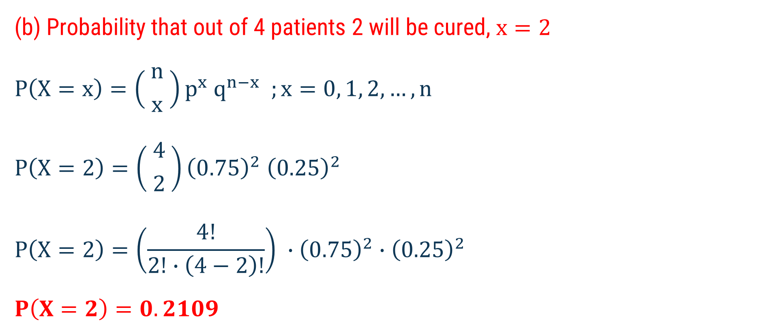
Method 1 ⇝ Example 7 (Continue)
(b) Probability that out of 4 patients 2 will be cured, $x=2$
$$P\left(X=x\right)=\left( {n \atop x} \right)p^{x} q^{n−x} ;x=0, 1, 2,…, n$$
$$P\left(X=2\right)=\left( {4 \atop 2} \right){\left(0.75\right)}^{2} {\left(0.25\right)}^{2}$$
$$P\left(X=2\right)=\left(\frac{4!}{2!∙\left(4−2\right)!}\right) ∙{\left(0.75\right)}^{2}∙{\left(0.25\right)}^{2}$$
$$P\left(X=2\right)=0.2109$$

Slide 34
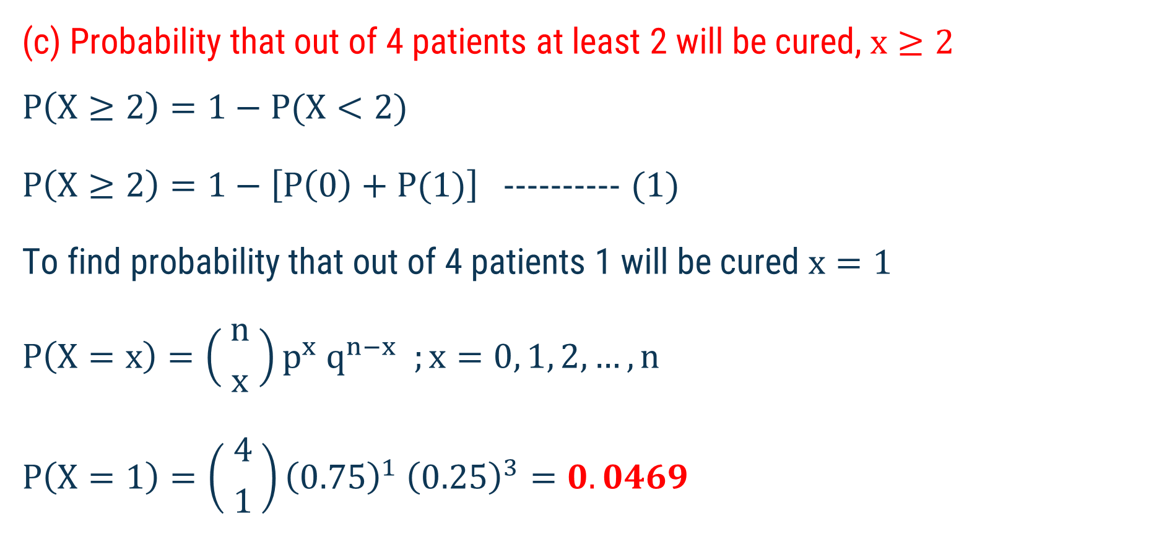
Method 1 ⇝ Example 7 (Continue)
(c) Probability that out of 4 patients at least 2 will be cured, $x≥2$
$$P\left(X≥2\right)=1−P(X<2)$$
$P\left(X≥2\right)=1−\left[P\left(0\right)+P(1)\right]$ ---------- (1)
To find probability that out of 4 patients 1 will be cured $x=1$
$$P\left(X=x\right)=\left( {n \atop x} \right)p^{x} q^{n−x} ;x=0, 1, 2,…, n$$
$$P\left(X=1\right)=\left( {4 \atop 1} \right){\left(0.75\right)}^{1} {\left(0.25\right)}^{3}=0.0469$$

Slide 35
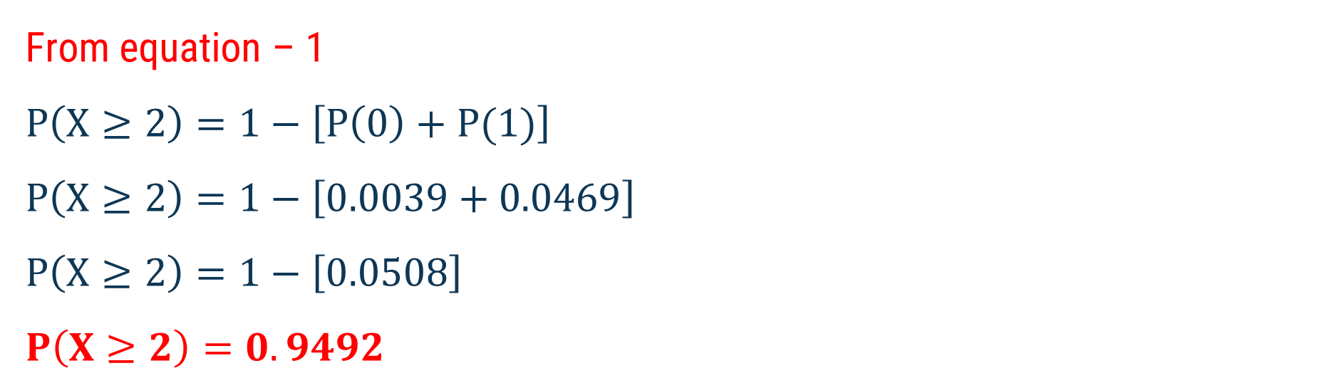
Method 1 ⇝ Example 7 (Continue)
From equation – 1
$$P\left(X≥2\right)=1−\left[P\left(0\right)+P(1)\right]$$
$$P\left(X≥2\right)=1−\left[0.0039+0.0469\right]$$
$$P\left(X≥2\right)=1−\left[0.0508\right]$$
$$P\left(X≥2\right)=0.9492$$

Slide 36
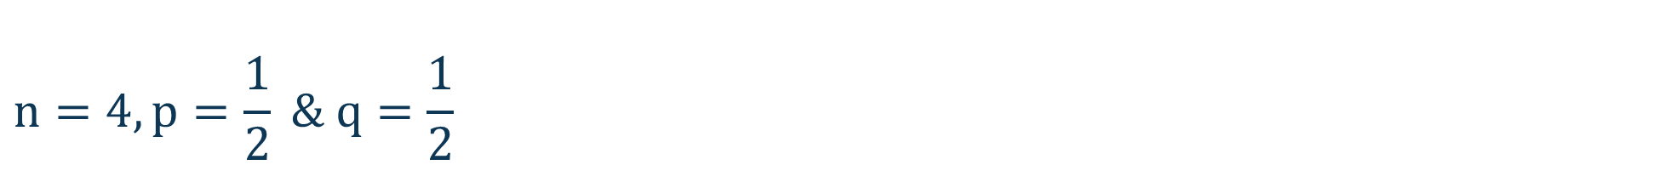
Method 1 ⇝ Example 8
By assuming equal probabilities for boys and girls. Out of 800 families with 4 children each, how many would you expect to have
(a) 2 boys and 2 girls? (b) at least 1 boy?
(c) at most 2 girls? (d) no girl?
Assuming equal probabilities for boys and girls,
Solution:
Since, Total Probability $=1$
$$n=4, p=\frac{1}{2} \& q=\frac{1}{2}$$

Slide 37
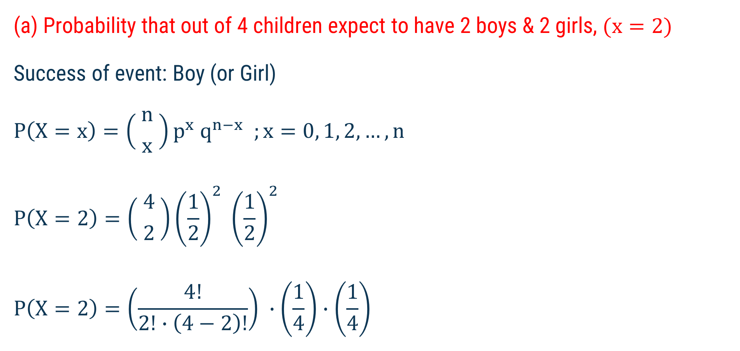
Method 1 ⇝ Example 8 (Continue)
(a) Probability that out of 4 children expect to have 2 boys & 2 girls, $(x=2)$
Success of event: Boy (or Girl)
$$P\left(X=x\right)=\left( {n \atop x} \right)p^{x} q^{n−x} ;x=0, 1, 2,…, n$$
$$P\left(X=2\right)=\left( {4 \atop 2} \right){\left(\frac{1}{2}\right)}^{2} {\left(\frac{1}{2}\right)}^{2}$$
$$P\left(X=2\right)=\left(\frac{4!}{2!∙\left(4−2\right)!}\right) ∙\left(\frac{1}{4}\right)∙\left(\frac{1}{4}\right)$$

Slide 38
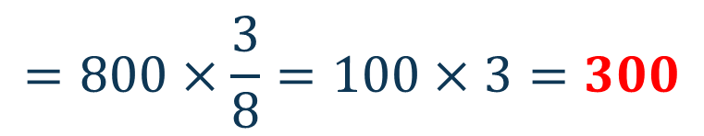

Method 1 ⇝ Example 8 (Continue)
$$P\left(X=2\right)=\left(\frac{4!}{2!∙\left(4−2\right)!}\right) ∙\left(\frac{1}{4}\right)∙\left(\frac{1}{4}\right)$$
$$P\left(X=2\right)=\left(\frac{4∙3∙2!}{2!.2!}\right) ∙\left(\frac{1}{4}\right)∙\left(\frac{1}{4}\right)$$
$$P\left(X=2\right)=\frac{3}{8}$$
Number of families
$$=800×\frac{3}{8}=100×3=300$$

Slide 39
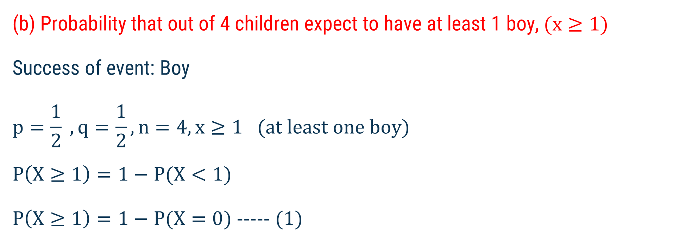
Method 1 ⇝ Example 8 (Continue)
(b) Probability that out of 4 children expect to have at least 1 boy, $(x≥1)$
Success of event: Boy
$$p=\frac{1}{2} , q=\frac{1}{2}, n=4, x≥1 (at least one boy)$$
$$P\left(X≥1\right)=1−P(X<1)$$
$P\left(X≥1\right)=1−P(X=0)$ ----- (1)

Slide 40

Method 1 ⇝ Example 8 (Continue)
To find $P(X=0)$
$$P\left(X=x\right)=\left( {n \atop x} \right)p^{x} q^{n−x} ;x=0, 1, 2,…, n$$
$$P\left(X=0\right)=\left( {4 \atop 0} \right){\left(\frac{1}{2}\right)}^{0} {\left(\frac{1}{2}\right)}^{4}$$
$$P\left(X=0\right)=\left(\frac{4!}{0!∙\left(4−0\right)!}\right) ∙\left(1\right)∙\left(\frac{1}{16}\right)=\frac{1}{16}$$

Slide 41


Method 1 ⇝ Example 8 (Continue)
From equation (1)
$$P\left(X≥1\right)=1−P(0)$$
$$P\left(X≥1\right)=1−\left(\frac{1}{16}\right)$$
$$P\left(X≥1\right)=\frac{15}{16}$$
Number of families
$$=800×\frac{15}{16}=50×15=750$$

Slide 42
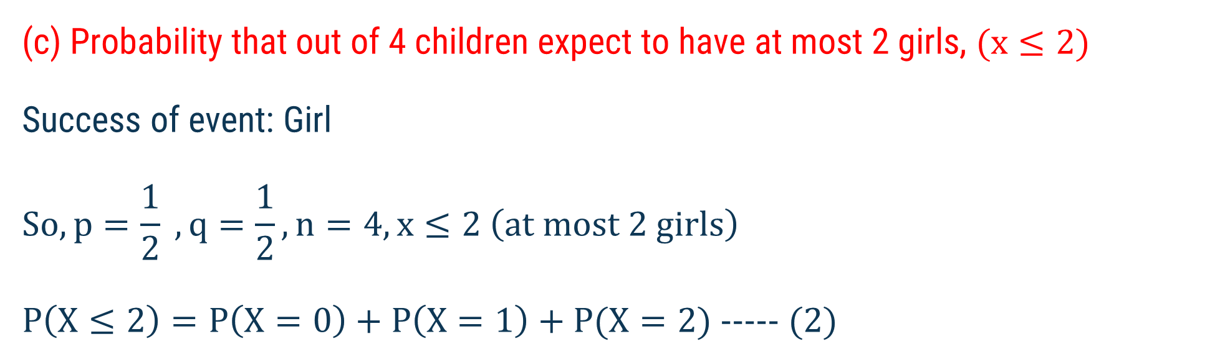
Method 1 ⇝ Example 8 (Continue)
(c) Probability that out of 4 children expect to have at most 2 girls, $(x≤2)$
Success of event: Girl
$$So, p=\frac{1}{2} , q=\frac{1}{2}, n=4, x≤2 \left(at most 2 girls\right)$$
$P\left(X≤2\right)=P\left(X=0\right)+P\left(X=1\right)+P(X=2)$ ----- (2)

Slide 43

Method 1 ⇝ Example 8 (Continue)
To find $P(X=1)$
$$P\left(X=x\right)=\left( {n \atop x} \right)p^{x} q^{n−x} ;x=0, 1, 2,…, n$$
$$P\left(X=1\right)=\left( {4 \atop 1} \right){\left(\frac{1}{2}\right)}^{1} {\left(\frac{1}{2}\right)}^{3}$$
$$P\left(X=1\right)=\left(\frac{4!}{1!∙\left(4−1\right)!}\right) ∙\left(\frac{1}{2}\right)∙\left(\frac{1}{8}\right)=\frac{1}{4}$$

Slide 44
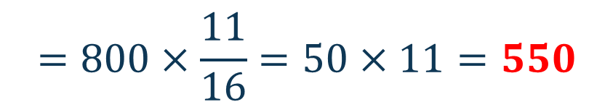
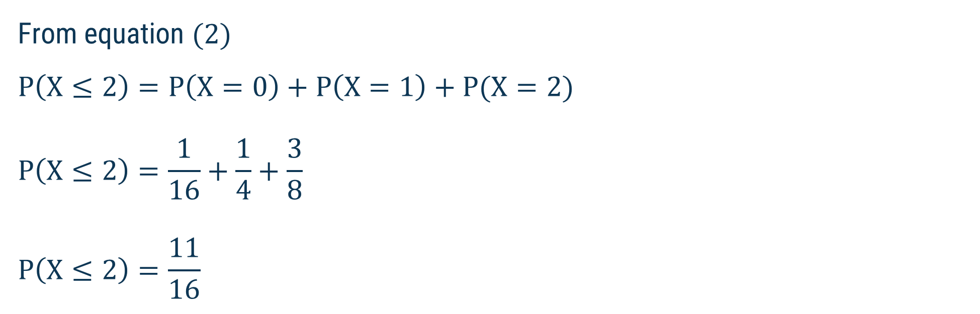
Method 1 ⇝ Example 8 (Continue)
From equation (2)
$$P\left(X≤2\right)=P\left(X=0\right)+P\left(X=1\right)+P(X=2)$$
$$P\left(X≤2\right)=\frac{1}{16}+\frac{1}{4}+\frac{3}{8}$$
$$P\left(X≤2\right)=\frac{11}{16}$$
Number of families
$$=800×\frac{11}{16}=50×11=550$$

Slide 45
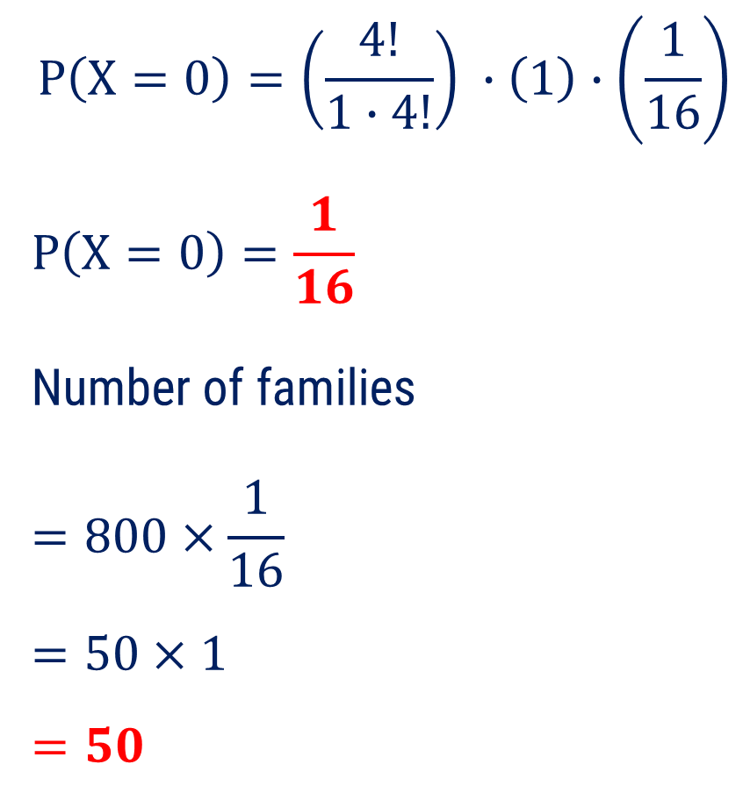
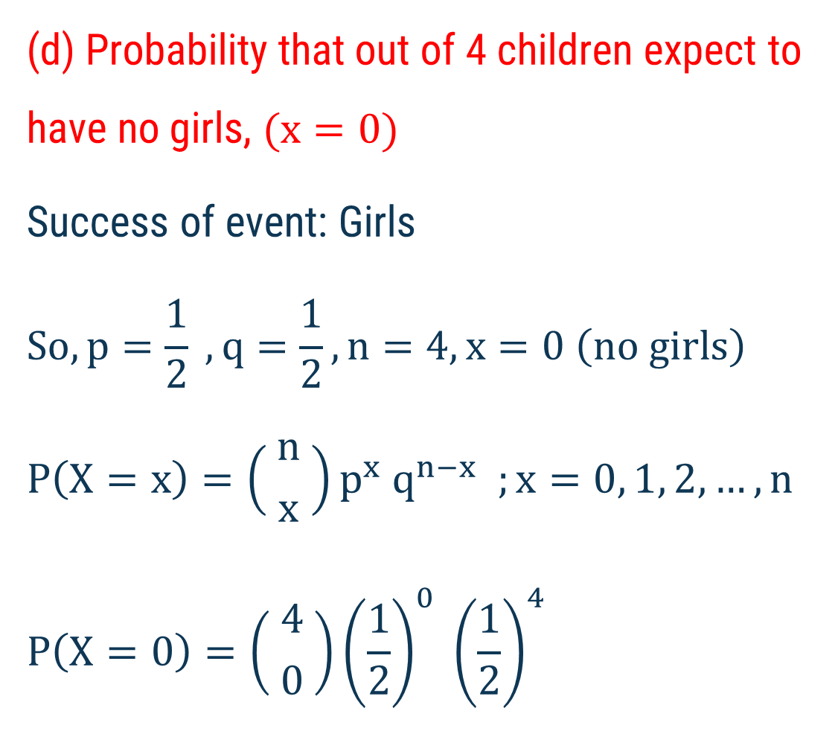
Method 1 ⇝ Example 8 (Continue)
(d) Probability that out of 4 children expect to have no girls, $(x=0)$
Success of event: Girls
$$So,p=\frac{1}{2} , q=\frac{1}{2}, n=4, x=0 \left(no girls\right)$$
$$P\left(X=x\right)=\left( {n \atop x} \right)p^{x} q^{n−x} ;x=0, 1, 2,…, n$$
$$P\left(X=0\right)=\left( {4 \atop 0} \right){\left(\frac{1}{2}\right)}^{0} {\left(\frac{1}{2}\right)}^{4}$$
$$P\left(X=0\right)=\left(\frac{4!}{1∙4!}\right) ∙\left(1\right)∙\left(\frac{1}{16}\right)$$
$$P\left(X=0\right)=\frac{1}{16}$$
Number of families
$$=800×\frac{1}{16}$$
$$=50×1$$
$$=50$$

Slide 46
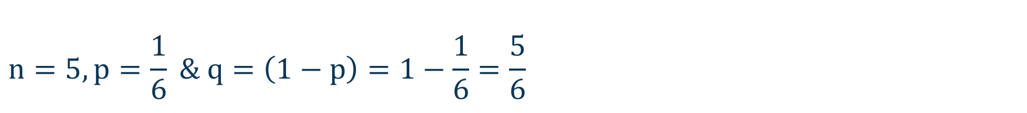
Method 1 ⇝ Example 9
Find the probability that in five tosses of a fair die, 3 will appear twice, at most once, at least two times.
Success of the event: 3 will appear
Solution:
$$n=5, p=\frac{1}{6} \& q=\left(1−p\right)=1−\frac{1}{6}=\frac{5}{6}$$

Slide 47
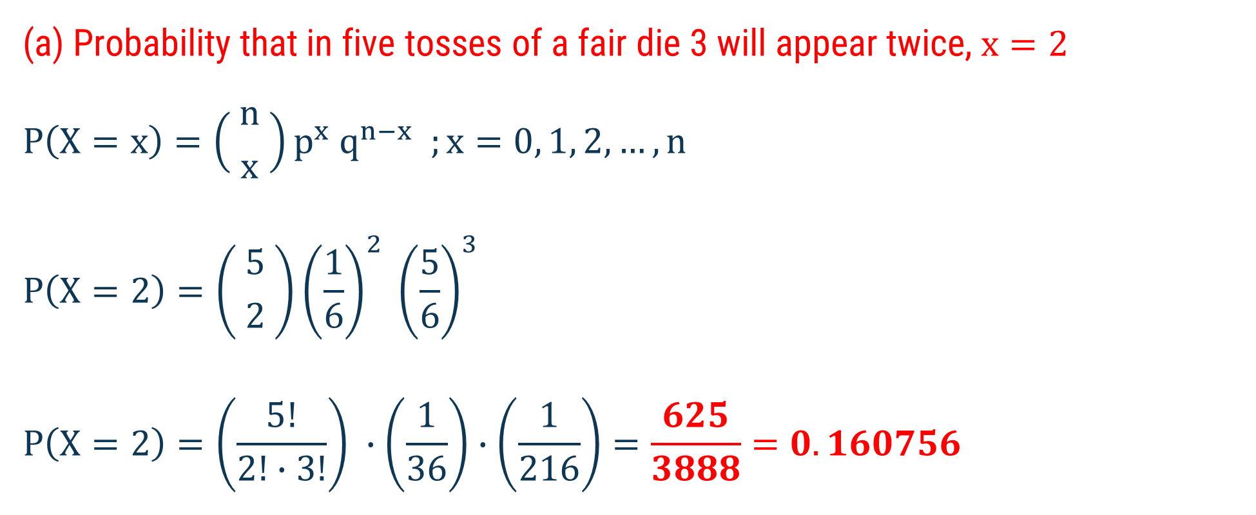
Method 1 ⇝ Example 9 (Continue)
(a) Probability that in five tosses of a fair die 3 will appear twice, $x=2$
$$P\left(X=x\right)=\left( {n \atop x} \right)p^{x} q^{n−x} ;x=0, 1, 2,…, n$$
$$P\left(X=2\right)=\left( {5 \atop 2} \right){\left(\frac{1}{6}\right)}^{2} {\left(\frac{5}{6}\right)}^{3}$$
$$P\left(X=2\right)=\left(\frac{5!}{2!∙3!}\right) ∙\left(\frac{1}{36}\right)∙\left(\frac{1}{216}\right)=\frac{625}{3888}=0.160756$$

Slide 48
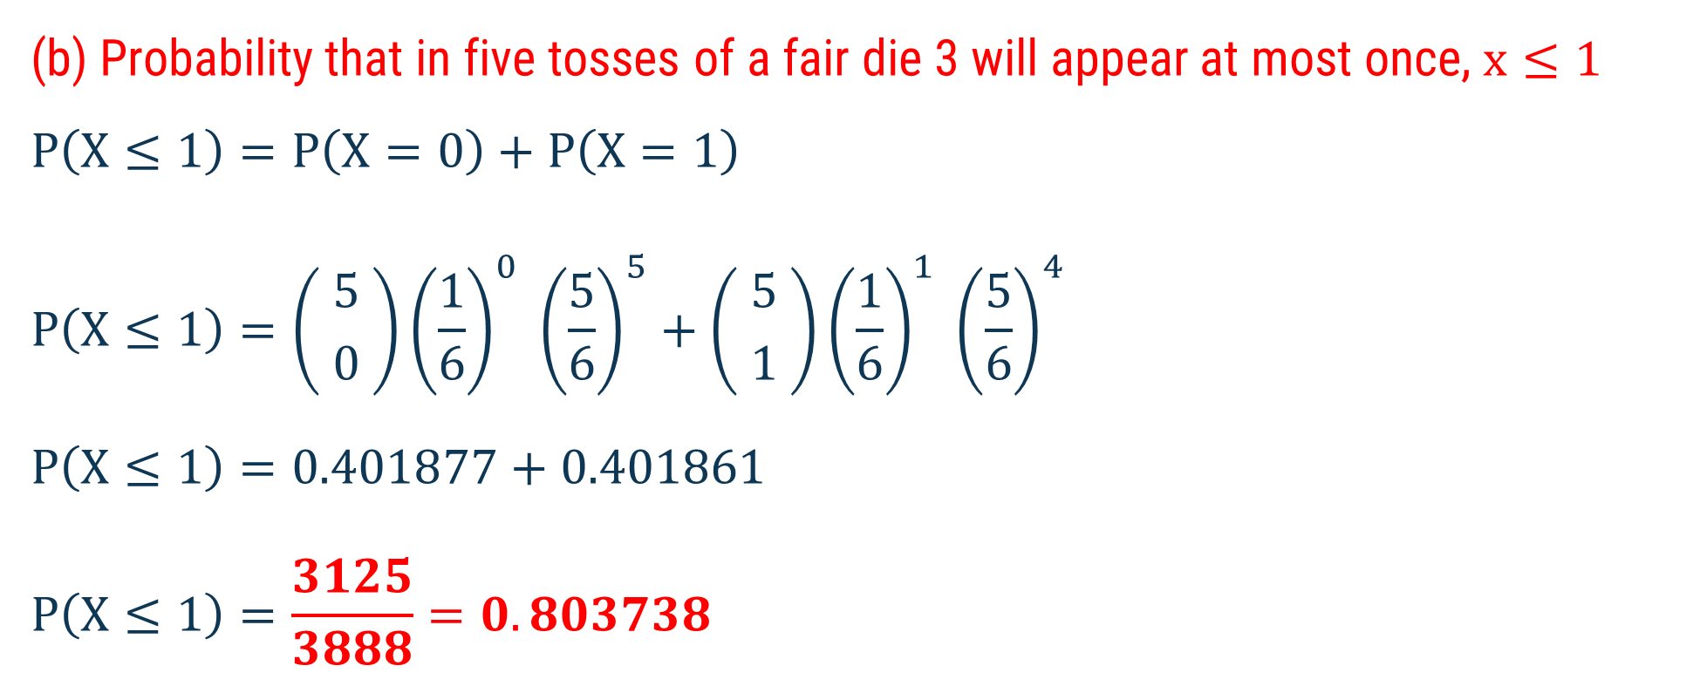
Method 1 ⇝ Example 9 (Continue)
(b) Probability that in five tosses of a fair die 3 will appear at most once, $x≤1$
$$P\left(X≤1\right)=P\left(X=0\right)+P\left(X=1\right)$$
$$P\left(X≤1\right)=\left( {5 \atop 0} \right){\left(\frac{1}{6}\right)}^{0} {\left(\frac{5}{6}\right)}^{5}+\left( {5 \atop 1} \right){\left(\frac{1}{6}\right)}^{1} {\left(\frac{5}{6}\right)}^{4}$$
$$P\left(X≤1\right)=0.401877+0.401861$$
$$P\left(X≤1\right)=\frac{3125}{3888}=0.803738$$

Slide 49
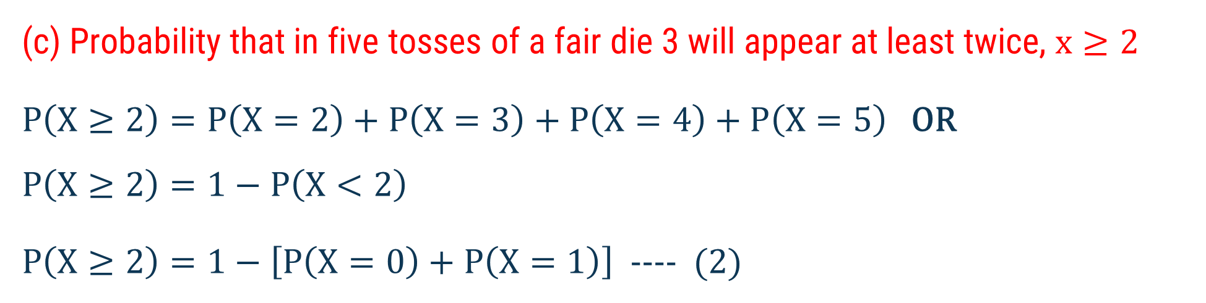
Method 1 ⇝ Example 9 (Continue)
(c) Probability that in five tosses of a fair die 3 will appear at least twice, $x≥2$
$P\left(X≥2\right)=P\left(X=2\right)+P\left(X=3\right)+P\left(X=4\right)+P\left(X=5\right)$ OR
$$P\left(X≥2\right)=1−P\left(X<2\right)$$
$P\left(X≥2\right)=1−\left[P\left(X=0\right)+P\left(X=1\right)\right]$ ---- (2)

Slide 50

Method 1 ⇝ Example 9 (Continue)
To find $P\left(X=0\right)$
$$P\left(X=x\right)=\left( {n \atop x} \right)p^{x} q^{n−x} ;x=0, 1, 2,…, n$$
$$P\left(X=0\right)=\left( {5 \atop 0} \right){\left(\frac{1}{6}\right)}^{0} {\left(\frac{5}{6}\right)}^{5}$$
$$P\left(X=0\right)=(1)∙(1)∙(0.401877)$$
$$P\left(X=0\right)=0.401877$$

Slide 51

Method 1 ⇝ Example 9 (Continue)
To find $P\left(X=1\right)$
$$P\left(X=x\right)=\left( {n \atop x} \right)p^{x} q^{n−x} ;x=0, 1, 2,…, n$$
$$P\left(X=1\right)=\left( {5 \atop 1} \right){\left(\frac{1}{6}\right)}^{1} {\left(\frac{5}{6}\right)}^{4}$$
$$P\left(X=1\right)=0.401861$$

Slide 52

Method 1 ⇝ Example 9 (Continue)
From equation – 2
$$P\left(X≥2\right)=1−\left[P\left(X=0\right)+P\left(X=1\right)\right]$$
$$P\left(X≥2\right)=1−\left[0.401877+0.401861\right]$$
$$P\left(X≥2\right)=1−\left[0.803738\right]$$
$$P\left(X≥2\right)=0.196262$$

Slide 53
Method 2 Poisson Distribution

Slide 54

Poisson Distribution
Probability mass function of Poisson Distribution is given by
$$P\left(X=x\right)=\frac{ e^{−λ} λ^{x} }{x !}; x=0,1,2,3,…$$
Where $λ=$mean of the Poisson distribution

Slide 55

Poisson Distribution
A discrete random variable $X$ is said to follow Poisson distribution if it assumes only non-negative values.
Its probability mass function is given by
$$P\left(X=x\right)=\frac{ e^{−λ} λ^{x} }{x !}; x=0,1,2,3,…$$
Where $λ=$mean of the Poisson distribution

Slide 56

Properties of Poisson Distribution
The random variable $X$ should be discrete.
The number of trials $n$ is very large.
The probability of success $p$ is very small (very close to zero).
The occurrences are rare.
The mean and variance of the Poisson distribution with parameter $λ$ are defined as mean$μ=E(X)=λ=np \&$variance$V(X)=σ^{2}=λ$

Slide 57
Poisson Distribution
For Examples:
(1) Number of telephone calls per minute at a switchboard.
(2) Number of cars passing a certain point in one minute.
(3) Number of printing mistakes per page in a large text.
(4) Number of persons born blind per year in a large city.

Slide 58
Examples of Method 2
Poisson Distribution

Slide 59


Method 2 ⇝ Example 1
For Poisson variant $X$, if $P\left(X=3\right)=P(X=4)$, then find $P\left(X=0\right).$
Solution:
We know that, $P\left(X=x\right)=\frac{ e^{−λ} λ^{x} }{x !}; x=0,1,2,3,…$
$$\text{Given} P\left(X=3\right)=P\left(X=4\right)$$
$$⇒\frac{ e^{−λ} λ^{3} }{3 !}=\frac{ e^{−λ} λ^{4} }{4 !}$$
$$⇒\frac{ 4! }{3 !}=\frac{ e^{−λ} λ^{4} }{e^{−λ} λ^{3}}$$
$$⇒λ=\frac{4×3! }{3!}=4$$
To find $P(X=0)$
$$P\left(X=0\right)=\frac{ e^{−4}× 4^{0} }{0 !}$$
$$P\left(X=0\right)= e^{−4}$$

Slide 60

Method 2 ⇝ Example 2
The number of page requests that arrive at a Web server is a Poisson random variable. Its probability distribution is as follows:
Number of x requests/sec. | 0 | 1 | 2 | 3 | 4 | 5 | 6
Probability $\left(x\right)$ | 0.368 | 0.368 | 0.184 | 0.061 | 0.015 | 0.003 | 0.001
The Find the mean and variance of this probability distribution.

Slide 61


Method 2 ⇝ Example 2 (Continue)
$$Mean=λ=\sum_{x=0}^{6}{x∙p(x)}$$
Solution:
$$Mean=λ=\left[0×p\left(0\right)\right]+\left[1×p\left(1\right)\right]+\left[2×p\left(2\right)\right]+…+\left[6×p\left(6\right)\right]$$
$$Mean=λ=\left[0×0.368\right]+\left[1×0.368\right]+\left[2×0.184\right]+\left[3×0.061\right]$$
$+\left[4×0.015\right]$ $+\left[5×0.003\right]+\left[6×0.001\right]$
$$Mean=λ=0+0.368+0.368+0.183+0.060+0.015+0.006$$
$$Mean=λ=1$$

Slide 62

Method 2 ⇝ Example 2 (Continue)
$$Variance=V\left(X\right)=λ$$
$$Variance=V\left(X\right)=1$$

Slide 63

Method 2 ⇝ Example 3
In sampling a large number of parts manufactured by a machine, the mean number of defectives in a sample of 20 is 2. Out of 1000 such samples, how many would be expected to contain exactly two defective parts?
Given $λ=2$
Solution:
$\text{To} \text{find} \text{the} \text{probability} \text{of} \text{exactly} \text{two} \text{defective} \text{parts}\text{, }x=2$ in a sample of 20
$$P\left(X=x\right)=\frac{ e^{−λ} λ^{x} }{x !}; x=0,1,2,3,…$$

Slide 64

Method 2 ⇝ Example 3 (Continue)
$$P\left(X=2\right)=\frac{ e^{−2} ×{(2)}^{2} }{2 !}=0.2707$$
Number of sample contain exactly two $(x=2)$ defective parts
$$=0.2707×1000$$
$$=270.7$$
$$=271$$
In a sample of 20, out of 1000 such samples 271 samples have exactly 2 defective parts

Slide 65

Method 2 ⇝ Example 4
Potholes on a highway can be serious problems. The past experience suggests that there are, on an average, 2 potholes per mile after a certain amount of usage. It is assumed that Poisson process applies to random variable “no. of potholes”. What is the probability that no more than four potholes will occur in a given section of 5 miles?
Given $λ=2$ potholes per mile
Solution:
$$\text{Than} \text{number} \text{of} \text{potholes} \text{per}\text{ 5 }\text{mile}=10 \text{potholes}$$
$$⇒λ=10 \text{potholes} \text{per}\text{ 5 }\text{mile}$$

Slide 66

Method 2 ⇝ Example 4 (Continue)
To find the probability of no more than 4 potholes occur $\left(x≤4\right),$
$$P\left(X=x\right)=\frac{ e^{−λ} λ^{x} }{x !}; x=0,1,2,3,…$$
$P\left(X≤4\right)=P\left(X=0\right)+P\left(X=1\right)+P\left(X=2\right)+P\left(X=3\right)+P(X=4)$ --- (1)
$$P\left(X=0\right)=\frac{ e^{−10} ×{(10)}^{0} }{0!}=e^{−10}=0.000045$$
$$P\left(X=1\right)=\frac{ e^{−10} ×{(10)}^{1} }{1!}=0.000453$$

Slide 67

Method 2 ⇝ Example 4 (Continue)
$$P\left(X=2\right)=\frac{ e^{−10} ×{(10)}^{2} }{2!}=0.002269$$
$$P\left(X=3\right)=\frac{ e^{−10} ×{(10)}^{3} }{3!}=0.007566$$
$$P\left(X=4\right)=\frac{ e^{−10} ×{(10)}^{4} }{4!}=0.018916$$

Slide 68

Method 2 ⇝ Example 4 (Continue)
From equation – 1
$$P\left(X≤4\right)=P\left(X=0\right)+P\left(X=1\right)+P\left(X=2\right)+P\left(X=3\right)+P(X=4)$$
$$P\left(X≤4\right)=0.000045+0.000453+0.002269+0.007566+0.018916$$
$$P\left(X≤4\right)=0.0293$$

Slide 69


Method 2 ⇝ Example 5
In a company, there are $250$ workers. The probability of a worker remains absent on any one day is $0.02.$ Find the probability that on a day, seven workers are absent.
Given $n=250, p=0.02. x=7$
Solution:
$$λ=np=250×0.02=5$$
$\text{To} \text{find} \text{the} \text{probability} \text{that} \text{on} \text{a} \text{day}\text{,}\text{ 7} \text{workers} \text{are} \text{absent}$ $x=7$
$$P\left(X=x\right)=\frac{ e^{−λ} λ^{x} }{x !}; x=0,1,2,3,…$$

Slide 70

Method 2 ⇝ Example 5 (Continue)
$$P\left(X=x\right)=\frac{ e^{−λ} λ^{x} }{x !}; x=0,1,2,3,…$$
$$P\left(X=7\right)=\frac{ e^{−5}× {(5)}^{7} }{7 !}=0.1044$$
$$P\left(X=7\right)=0.1044$$

Slide 71

Method 2 ⇝ Example 6
Average number of accidents on any day on a national highway is 1.8. Determine the probability that the number of accidents are at least 1 and at most 1.
Given $λ=1.8$
Solution:
(a) To find the probability that the number of accidents are at least 1 $(x≥1)$
$$P\left(X≥1\right)=1−P\left(X<1\right)$$
$P\left(X≥1\right)=1−P(0)$ -------- (1)

Slide 72


Method 2 ⇝ Example 6 (Continue)
To find $P\left(X=0\right)$,
$$P\left(X=x\right)=\frac{ e^{−λ} λ^{x} }{x !}; x=0,1,2,3,…$$
$$P\left(X=0\right)=\frac{ e^{−1.8}× {(1.8)}^{0} }{0 !}$$
$$P\left(X=0\right)=0.1653$$
From equation (1),
$$P\left(X≥1\right)=1−P(0)$$
$$P\left(X≥1\right)=1−0.1653$$
$$P\left(X≥1\right)=0.8347$$

Slide 73


Method 2 ⇝ Example 6 (Continue)
(b) To find the probability that the number of accidents are at most 1 $\left(x≤1\right),$
$P\left(X≤1\right)=P\left(X=0\right)+P\left(X=1\right)$ ----- (2)
To find, $P\left(X=1\right)$
$$P\left(X=x\right)=\frac{ e^{−λ} λ^{x} }{x !}; x=0,1,2,3,…$$
$$P\left(X=1\right)=\frac{ e^{−1.8}× {(1.8)}^{1} }{1 !}=0.2975$$
From eq (2),
$$P\left(X≤1\right)=P\left(X=0\right)+P\left(X=1\right)$$
$$P\left(X≤1\right)=0.1653+0.2975$$
$$P\left(X≤1\right)=0.4628$$

Slide 74


Method 2 ⇝ Example 7
The probability that a person catch corona virus is 0.001. Find the probability that out of 3000 persons exactly 3, more than 2 persons will catch the virus.
Given $n=3000 and p=0.001$ so $λ=np=3000×0.001=3$
Solution:
(a) To find the probability of exactly 3 persons will catch the virus $(x=3)$
$$P\left(X=x\right)=\frac{ e^{−λ} λ^{x} }{x !}; x=0,1,2,3,…$$
$$P\left(X=3\right)=\frac{ e^{−3}× 3^{3} }{3!}=0.2240$$

Slide 75

Method 2 ⇝ Example 7 (Continue)
(b) To find the probability of more than 2 persons will catch the virus, $(x>2)$
$$P\left(X>2\right)=1−P\left(X≤2\right)$$
$$P\left(X>2\right)=1−[P\left(X=0\right)+P\left(X=1\right)+P(X=2)]$$
$$P\left(X>2\right)=1−\left[\frac{ e^{−3}× 3^{0} }{0!}+\frac{ e^{−3}× 3^{1} }{1!}+\frac{ e^{−3}× 3^{2} }{2!}\right]$$
$$P\left(X>2\right)=1−\left[0.049787+0.149361+0.224041\right]$$
$$P\left(X>2\right)=1−\left[0.423189\right]$$
$$P\left(X>2\right)=0.576811$$

Slide 76


Method 2 ⇝ Example 8
Suppose 1$\%$ of the items made by machine are defective. In a sample of 100 items find the probability that the sample contains all good, 1 defective and at least 3 defectives.
Given $n=100 and p=1\%=0.01$ so $λ=np=100×0.01=1$
Solution:
(a) To find the probability that the sample contains all good items $(x=0)$
$$P\left(X=x\right)=\frac{ e^{−λ} λ^{x} }{x !}; x=0,1,2,3,…$$
$$P\left(X=0\right)=P\left(0\right)=\frac{ e^{−1}× {(1)}^{0} }{0 !}=0.3679$$

Slide 77

Method 2 ⇝ Example 8 (Continue)
(b) To find the probability that the sample contains 1 defective item, $(x=1)$
$$P\left(X=x\right)=\frac{ e^{−λ} λ^{x} }{x !}; x=0,1,2,3,…$$
$$P\left(X=1\right)=P\left(0\right)=\frac{ e^{−1}× {(1)}^{1} }{1!}=0.3679$$

Slide 78

Method 2 ⇝ Example 8 (Continue)
(c) To find the probability that sample contains at least 3 defective items, $(x≥3)$
$$P\left(X≥3\right)=1−P(X<3)$$
$$P\left(X≥3\right)=1−\left[P\left(0\right)+P\left(1\right)+P\left(2\right)\right]$$
$$P\left(X≥3\right)=1−\left[0.3679+0.3679+\frac{ e^{−2}× {(1)}^{2} }{2!}\right]$$
$$P\left(X≥3\right)=1−\left[0.3679+0.3679+0.1839\right]$$
$$P\left(X≥3\right)=0.0803$$

Slide 79
Method 3 Exponential Distribution

Slide 80



Exponential Distribution
A random variable $X$ is said to have an exponential distribution with parameter $θ>0$, if its probability density function is given by
$$f\left(X=x\right)=\left\{ \begin{aligned}θ{∙e}^{−θx} &; x≥0 \\ \\ 0 &; otherwise\end{aligned}\right.$$
$$θ=\frac{ 1 }{mean}$$
$$=\frac{ 1 }{θ^{2}}$$
Where,
and variance

Slide 81

Exponential Distribution
In exponential distribution we can find the probability as given below:
(1) $P(X≤x)=1−e^{−θx}$
(2) $P\left(X≥x\right)=e^{−θx}$
(3) $P(a≤X≤b)=e^{−aθ}−e^{−bθ}$

Slide 82
Properties of Exponential Distribution
Exponential distribution is used to describe lifespan and waiting times.
Exponential distribution can be used to describe (waiting) times between Poisson events.

Slide 83
Examples of Method 3
Exponential Distribution

Slide 84



Method 3 ⇝ Example 1
The lifetime T of an alkaline battery is exponentially distributed with $θ=0.05$ per hour. What are mean and standard deviation of batteries lifetime?
Solution:
Given $θ=0.05$ per hour
$$Mean=\frac{1}{θ}$$
$$Mean=\frac{1}{0.05 }$$
$Mean=20$
S.D. $=\sqrt{Variance}$
$$S.D.=\sqrt{\frac{1}{θ^{2}}}$$
$$S.D.=\frac{1}{θ}=\frac{1}{0.05 }=20$$

Slide 85

Method 3 ⇝ Example 2
The time between breakdowns of a particular machine follows an exponential distribution with a mean of 17 days. Calculate the probability that a machine breakdown in 15 days period.
Solution:
Given Mean $=17$ days
$$θ=\frac{1}{Mean}=\frac{1}{17}$$

Slide 86

Method 3 ⇝ Example 2 (Continue)
To find the probability that a machine breakdown in 15 day period $\left(0≤X≤15\right),$
$$P\left(a≤X≤b\right)=e^{−aθ}−e^{−bθ}$$
Here $a=0 \& b=15$
$$P\left(0≤X≤15\right)=e^{−0×\frac{1}{17}}−e^{−15×\frac{1}{17}}$$
$$P\left(0≤X≤15\right)=e^{0}−e^{−\frac{15}{17}}$$

Slide 87

Method 3 ⇝ Example 2 (Continue)
To find the probability that a machine breakdown in 15 day period $\left(0≤X≤15\right),$
$$P\left(0≤X≤15\right)=e^{0}−e^{−\frac{15}{17}}$$
$$P\left(0≤X≤15\right)=1−e^{−\frac{15}{17}}$$
$$P\left(0≤X≤15\right)=1−0.413808$$
$$P\left(0≤X≤15\right)=0.5862$$

Slide 88

Method 3 ⇝ Example 3
The lifetime T of an alkaline battery is exponentially distributed with $θ=0.05$ per hour.
(a) What are the probabilities for battery to last between 10 and 15 hours?
(b) What are the probabilities for the battery to last more than 20 hours?
Solution:
Given $θ=0.05$ per hour

Slide 89

Method 3 ⇝ Example 3 (Continue)
(a) To find the probability for battery to last between 10 & 15 hours $\left(10≤X≤15\right),$
$$P\left(a≤X≤b\right)=e^{−aθ}−e^{−bθ}$$
Here $a=10 \& b=15$
$$P\left(10≤X≤15\right)=e^{−10×0.05}−e^{−15×0.05}$$
$$P\left(10≤X≤15\right)=e^{−0.5}−e^{−0.75}$$
$$P\left(10≤X≤15\right)=0.606530−0.472366$$
$$P\left(10≤X≤15\right)=0.1342$$

Slide 90

Method 3 ⇝ Example 3 (Continue)
(b) To find the probability for battery to last more than 20 hours $\left(X≥20\right),$
$$P\left(X≥x\right)=e^{−θx}$$
Here $x=20$
$$P\left(X≥20\right)=e^{−0.05x20}$$
$$P\left(X≥20\right)=e^{−1}$$
$$P\left(X≥20\right)=0.3678$$

Slide 91

Method 3 ⇝ Example 4
In a large corporate computer network, user log-on to the system can be modeled as a Poisson process with a mean of 25 log-on per hour.
(a) What is the probability that there are no log-on in an interval of 6 min.?
(b) What is the probability that time until next log-on is between 2 & 3 min.?
Solution:
Given Poisson process with a mean of 25 log on per hours
$⇒λ=25$ per hours
As per exponential distribution $θ=25$ per hours

Slide 92




Method 3 ⇝ Example 4 (Continue)
(a) To find the probability that there are no log-on in an interval of 6 min $\left(x=0\right),$
$$P\left(X=x\right)=\frac{e^{−λ} λ^{x}}{x!}$$
$$P\left(X=0\right)=\frac{e^{−2.5}×{\left(2.5\right)}^{0}}{0!}$$
$$P\left(X=0\right)=e^{−2.5}$$
$$P\left(X=0\right)=0.0821$$
$λ=25$log on per hour
$⇒λ=25 \text{log} \text{on} \text{per}$ 60 minutes
To find log on in an interval of 6 min
$$λ=\frac{25×6}{60}=2.5$$
$$\text{log} \text{on} \text{per}\text{ 6 }\text{minutes}$$

Slide 93


Method 3 ⇝ Example 4 (Continue)
(b)To find the probability of time until next log on is between 2 & 3 min $P(2≤X≤3)$
$$P\left(2≤X≤3\right)=e^{−2×\frac{25}{60}}−e^{−3×\frac{25}{60}}$$
$$P\left(2≤X≤3\right)=e^{−2×\frac{25}{60}}−e^{−3×\frac{25}{60}}$$
$$P\left(2≤X≤3\right)=e^{−(0.833333)}−e^{−(1.25)}$$
$$P\left(2≤X≤3\right)=0.434598−0.286504$$
$$P\left(2≤X≤3\right)=0.1481$$
Since $θ=25$ per hours
$⇒θ=\frac{25}{60}$ per minute
$$P\left(a≤X≤b\right)=e^{−aθ}−e^{−bθ}$$
Here $a=2 \& b=3$

Slide 94



Method 3 ⇝ Example 5
A random variable has an exponential distribution with probability density function given by$f\left(x\right)=3e^{−3x} ;x>0 \& f\left(x\right)=0 ;x≤0$.
What is the probability that X is not less than 4?
Solution:
P.D.F. given by $f\left(x\right)=\left\{ \begin{aligned}3e^{−3x} &; x>0 \\ \\ 0 &; x≤0\end{aligned}\right.$
Comparing with $f\left(x\right)=\left\{ \begin{aligned}θe^{−θx} &; x>0 \\ \\ 0 &; x≤0\end{aligned}\right.$
We get $θ=3$

Slide 95

Method 3 ⇝ Example 5 (Continue)
To find the probability that random variable $X$ is not less than 4, $(x≮4)$
That is $\left(x≥4\right),$
We know that, $P\left(X≥x\right)=e^{−θx}$
$P\left(X≥4\right)=e^{−3×4}$
$$P\left(X≥4\right)=e^{−12}$$

Slide 96



Method 3 ⇝ Example 6
The income tax of a man is exponentially distributed with $f\left(x\right)=\frac{ 1 }{3 }e^{−\left(\frac{ x }{3 }\right)};x>0.$
What is the probability that his income will exceed Rs. 17000? Assume that the income tax is levied at the rate of 15% on the income above Rs. 15000.
P.D.F. given by $f\left(x\right)=\left\{ \begin{aligned}\frac{1}{3}e^{−\left(\frac{x}{3}\right)} &; x>0 \\ \\ 0 &; x≤0\end{aligned}\right.$
Comparing with $f\left(x\right)=\left\{ \begin{aligned}θe^{−θx} &; x>0 \\ \\ 0 &; x≤0\end{aligned}\right.$
Solution:
$$θ=\frac{1}{3}$$
We get,

Slide 97

Method 3 ⇝ Example 6 (Continue)
Given that if income is above 15000 then income tax is levied at the rate of 15%
We will find the probability that income will exceed Rs. 17000,
Note that, income tax is levied 15% on $\left(17000−15000\right)=2000$ Rs.
$$So, x=\frac{2000×15}{100}=300$$

Slide 98

Method 3 ⇝ Example 6 (Continue)
To find the probability that income will exceed Rs. 17000, $(x≥300)$
We know that, $P\left(X≥x\right)=e^{−θx}$
$$P\left(X≥300\right)=e^{−\frac{1}{3}×300}$$
$$P\left(X≥300\right)=e^{−100}$$

Slide 99

Method 3 ⇝ Example 7
A random variable has an exponential distribution with probability density
$$f\left(x\right)=\left\{ \begin{aligned}\frac{1 }{6} &; −3<x<3 \\ \\ 0 &; otherwise\end{aligned}\right.$$
$$Find \left(a\right) P\left(X<2\right), \left(b\right) P\left(\left| X \right|≤2\right)$$

Slide 100



Method 3 ⇝ Example 7 (Continue)
$$Note that: P\left(X<x\right)=\int_{−∞}^{x}{f\left(x\right)} dx \& P\left(X>x\right)=\int_{x}^{∞}{f\left(x\right)} dx$$
Solution:
To find, $P(X<2)$
$$P\left(X<x\right)=\int_{−∞}^{x}{f\left(x\right)} dx$$
$$P\left(X<2\right)=\int_{−∞}^{2}{f\left(x\right)} dx$$
$$P\left(X<2\right)=\int_{−∞}^{−3}{f\left(x\right)} dx+\int_{−3}^{2}{f\left(x\right)} dx$$
$$P\left(X<2\right)=0+\int_{−3}^{2}{\frac{1}{6}} dx$$

Slide 101

Method 3 ⇝ Example 7 (Continue)
$$P\left(X<2\right)=0+\frac{1}{6}\int_{−3}^{2}{1} dx$$
$$P\left(X<2\right)=\frac{1}{6} {\left[x\right]}_{−3}^{2}$$
$$P\left(X<2\right)=\frac{1}{6} [2−(−3)]$$
$$P\left(X<2\right)=\frac{5}{6}$$

Slide 102



Method 3 ⇝ Example 7 (Continue)
$$Note that: P\left(X<x\right)=\int_{−∞}^{x}{f\left(x\right)} dx \& P\left(X>x\right)=\int_{x}^{∞}{f\left(x\right)} dx$$
(b) To find, $P(\left|X\right|≤2)$
$$P(\left|X\right|≤2)=P(−2<x<2)$$
$$P(\left|X\right|≤2)=\int_{−2}^{2}{f\left(x\right)} dx$$
$$P(\left|X\right|≤2)=\int_{−2}^{2}{\frac{1}{6}} dx$$
$$P(\left|X\right|≤2)=\frac{1}{6}\int_{−2}^{2}{1} dx$$
$$P\left(\left|X\right|≤2\right)=\frac{1}{6} {\left[x\right]}_{−2}^{2}=\frac{2}{3}$$

Slide 103

Method 3 ⇝ Example 8
A random variable has an exponential distribution with probability density
$$f\left(x\right)=\left\{ \begin{aligned}\frac{1 }{5}e^{−\left(\frac{x}{5}\right)} &; x>0 \\ \\ 0 &;otherwise\end{aligned}\right.$$
$Find \left(a\right) P\left(X>2\right), \left(b\right) P\left(3≤X≤6\right)$, (c) Mean (d) Variance

Slide 104


Method 3 ⇝ Example 8 (Continue)
$$\text{P}\text{.}\text{D}\text{.}\text{F}\text{. }\text{given} \text{by} f\left(x\right)=\left\{ \begin{aligned}\frac{1}{5}e^{−\left(\frac{x}{5}\right)} &; x>0 \\ \\ 0 &; x≤0\end{aligned}\right.$$
$$\text{Comparing} \text{with} f\left(x\right)=\left\{ \begin{aligned}θe^{−θx} &; x>0 \\ \\ 0 &; x≤0\end{aligned}\right.$$
Solution:
$$We get, θ=\frac{1}{5}$$

Slide 105

Method 3 ⇝ Example 8 (Continue)
(a) To find $P(X>5)$,
$$P\left(X>x\right)=e^{−θx}$$
$$P\left(X>5\right)=e^{−\frac{1}{5}×5}$$
$$P\left(X>5\right)=e^{−1}$$
$$P\left(X>5\right)=0.3679$$

Slide 106

Method 3 ⇝ Example 8 (Continue)
(b) To find $P(3≤X≤6)$
$$P\left(a≤X≤b\right)=e^{−aθ}−e^{−bθ}$$
Here $a=3 \& b=6$
$$P\left(3≤X≤6\right)=e^{−3×\frac{1}{5}}−e^{−6×\frac{1}{5}}$$
$$P\left(3≤X≤6\right)=e^{−(0.6)}−e^{−(1.2)}$$
$$P\left(3≤X≤6\right)=0.548811−0.301194$$
$$P\left(3≤X≤6\right)=0.2476$$

Slide 107

Method 3 ⇝ Example 8 (Continue)
(c) To find Mean
$$Mean=\frac{1}{θ}$$
$$Mean=\frac{1}{\frac{1}{5}}$$
Mean $=5$

Slide 108

Method 3 ⇝ Example 8 (Continue)
(d) To find Variance
$$Variance=\frac{1}{θ^{2}}$$
$$Variance=\frac{1}{{\left(\frac{1}{5}\right)}^{2}}$$
$$Variance={\left(5\right)}^{2}$$
Variance$=25$

Slide 109
Method 4 Normal Distribution

Slide 110

Normal Distribution
A continuous random variable $X$ is said to follows a normal distribution if its probability density function is given by
$$f\left(x\right)=\frac{ 1 }{σ \sqrt{2π } } \exp\left[ −\frac{ 1 }{2 }{\left(\frac{x−μ }{σ }\right)}^{2} \right]$$
$$Where,−∞<x<∞ \& σ>0$$
μ = mean of the distribution
$σ$ = standard deviation of the distribution

Slide 111





Normal Distribution
Here, $μ$ (mean) & $σ^{2}$ (variance) are known as parameters of the distribution.
If X is a normal random variable with mean $μ$ and standard deviation $σ,$ then we can find the random variable defined as below
$$Z=\frac{ x−μ }{σ }$$
$$−∞$$
$$x=μ$$
$$∞$$

Slide 112

Normal Distribution
If $μ=0$ and $σ=1$, then Z is known as the standard (standardized) normal variable and probability destiny function (P.D.F.) is given by
$$f(z)=\frac{1}{\sqrt{2π}}e^{−\frac{1}{2} z^{2}} ; −∞<z<∞$$
The distribution of any normal variate $X$ can always be transformed into the distribution of the standard normal variate $Z$.
$$P\left(x_{1}≤X≤x_{2}\right)=P\left(\frac{ x_{1}−μ }{σ }≤\frac{ X−μ }{σ }≤ \frac{ x_{2}−μ }{σ }\right)=P\left(z_{1}≤Z≤z_{2}\right)$$

Slide 113

Normal Distribution
This probability is equal to area under the standard normal curve between the coordinates at $Z=z_{1}$ and $Z=z_{2}$.

Slide 114





Methods for Finding the Probability (area) from $Z−$Table
Normal curve is a curve of normal density function and it can be seen in figure.
The probability(area) of shaded region between the curve and $x–$axis is equal to 1.
$$−∞$$
$$z=0$$
$$+∞$$

Slide 115

Methods for Finding the Probability (area) from $Z−$Table
The probability(area) to the right side of $X=μ$ is 0.5 and it is denoted by $P\left(X≥μ\right)=0.5$
The probability(area) to the left side of $X=μ$ is also 0.5 and it is denoted by $P\left(X≤μ\right)=0.5$
Let’s discuss some cases which is useful to solve examples
$$−∞$$
$$z=0$$
$$+∞$$

Slide 116

Important Cases
Area between $Z=0 to Z=z_{1},$ which can be represented as $P\left(0≤Z≤z_{1}\right)$
Find $z_{1}$ by using first row and column of $Z$-table to get the answer of $P\left(0≤Z≤z_{1}\right)$

Slide 117

Important Cases
For Example:
Suppose $z_{1}=1.43$ Use below steps to find value at $z=1.43.$
Step 1: Split $1.43$ as $1.4+0.03$.
Step 2: Find 1.4 in first column and 0.03 in first row.
Step 3: Intersection of that row and column is answer of $P\left(0≤Z≤1.43\right).$
Here, $P\left(0≤Z≤1.43\right)=0.4236$

Slide 118






Important Cases
Note:
Area between $Z=−z_{1}$ to $Z=0$, which can be represented as$P\left(−z_{1}≤Z≤0\right)$
$P\left(−z_{1}≤Z≤0\right)=P\left(0≤Z≤z_{1}\right)$ as normal distribution is symmetric about $x –$axis. That is, $P(0≤Z≤1.43)=P(−1.43≤Z≤0)=0.4236$
$$−z_{1}$$
$$0$$
$$0$$
$$z_{1}$$

Slide 119









Important Cases
(2) Area between $Z=−∞ to Z=z_{1},$ which can be represented as $P\left(Z≤z_{1}\right)$
$P\left(Z≤z_{1}\right)=P\left(−∞≤Z≤0\right)+P\left(0≤Z≤z_{1}\right)$
Since, $P\left(−∞≤Z≤0\right)=0.5$ and $P\left(0≤Z≤z_{1}\right)$ can be found by using case – I
$$z_{1}$$
$$−∞$$
$$0$$
$$0$$
$$z_{1}$$
$$−∞$$
$$0$$

Slide 120








Important Cases
Note:
Area between $Z=−z_{1} to Z=∞$ which can be represented as $P\left(Z≥−z_{1}\right)$
$P\left(Z≥−z_{1}\right)=P\left(Z≤z_{1}\right)$ as normal distribution is symmetric about x – axis.
That is, $P\left(Z≥−1.43\right)=P\left(Z≤1.43\right)=0.9236$
$$−∞$$
$$0$$
$$z_{1}$$
$$−∞$$
$$0$$
$$0$$
$$z_{1}$$

Slide 121









Important Cases
(3) Area between $Z=−∞ to Z={−z}_{1},$ which can be represented as $P\left(Z≤{−z}_{1}\right)$
$P\left(Z≤−z_{1}\right)=P\left(−∞≤Z≤0\right)−P\left(−z_{1}≤Z≤0\right)$
Since, $P\left(−∞≤Z≤0\right)=0.5$ & $P\left(−z_{1}≤Z≤0\right)$ can be found by using case – I
$$−∞$$
$${−z}_{1}$$
$$0$$
$$−∞$$
$$0$$
$${−z}_{1}$$
$$0$$

Slide 122








Important Cases
Note:
Area between $Z=z_{1} to Z=∞$ which can be represented as $P\left(Z≥z_{1}\right)$
$P\left(Z≥z_{1}\right)=P\left(Z≤−z_{1}\right)$ as normal distribution is symmetric about x – axis.
That is, $P\left(Z≥1.43\right)=P\left(Z≤−1.43\right)=0.0764$
$$−∞$$
$${−z}_{1}$$
$$0$$
$$−∞$$
$$0$$
$${−z}_{1}$$
$$0$$

Slide 123








Important Cases
(4) Area between $Z=z_{1} to Z=z_{2},$ which can be represented as $P\left(z_{1}≤Z≤z_{2}\right)$
$P\left(z_{1}≤Z≤z_{2}\right)=P\left(0≤Z≤z_{2}\right)−P\left(0≤Z≤z_{1}\right)$
Since, $P\left(0≤Z≤z_{1}\right)$ & $P\left(0≤Z≤z_{2}\right)$ can be found by using case – I
$$z_{1}$$
$$z_{2}$$
$$0$$
$$z_{2}$$
$$0$$
$$z_{1}$$

Slide 124

Important Cases
Note:
Area between $Z={−z}_{2} to Z=−z_{1}$ which can be represented as $P\left(−z_{2}≤Z≤−z_{1}\right)$
$P\left(−z_{2}≤Z≤−z_{1}\right)=P\left(z_{1}≤Z≤z_{2}\right)$ as normal distribution is symmetric about x – axis. That is, $P\left(−2≤Z≤−1.43\right)=P\left(1.43≤Z≤2\right)=0.0436$

Slide 125









Important Cases
(5) Area between $Z={−z}_{1} to Z=z_{2},$ which can be represented as $P\left(−z_{1}≤Z≤z_{2}\right)$
$P\left(−z_{1}≤Z≤z_{2}\right)=P\left(−z_{1}≤Z≤0\right)+P\left(0≤Z≤z_{2}\right)$
Since, $P\left(−z_{1}≤Z≤0\right)$ & $P\left(0≤Z≤z_{2}\right)$ can be found by using case – I
$${−z}_{1}$$
$$0$$
$$z_{2}$$
$${−z}_{1}$$
$$0$$
$$0$$
$$z_{2}$$

Slide 126

Important Cases
Note:
Area between $Z={−z}_{1} to Z=z_{2}$ which can be represented as $P\left(−z_{1}≤Z≤z_{2}\right)$ as normal distribution is symmetric about x – axis.
That is, $P\left(−1≤Z≤2\right)=P\left(−1≤Z≤0\right)+P\left(0≤Z≤2\right)$
$=0.3413+0.4772$
$=0.8185$

Slide 127

Properties of Normal Distribution
The curve is bell shaped and symmetrical about the line $x=μ.$
Mean, median and mode of the distribution coincide. i.e. the normal distribution is symmetrical.
As $x$ increases numerically, $f(x)$ decreases rapidly, the maximum probability occurring at the point $x=μ$.
$x$ - axis is an asymptote to the curve.

Slide 128
Importance
Most of the distributions occurring in practice, e.g., Binomial, Poisson, etc. can be approximated by normal distribution.
Even if a variable is not normally distributed, it can sometimes be brought to normal form by simple transformation of variable.
The entire theory of small sample tests is based on the fundamental assumption that the parent populations from which the samples have been drawn follows normal distribution.

Slide 129
Examples of Method 4
Normal Distribution

Slide 130

Method 4 ⇝ Example 1
If $X$ is normally distributed and the mean of $X$ is 12 and the SD is 4. Find out the probability of the following.
(a) $X≥20, (b) X≤20, (c) 0≤X≤12$
$$\left[P\left(z=2\right)=0.4773, P\left(z=2\right)=0.4987\right]$$
Solution:
Given Mean $μ=12$ and $σ=4$

Slide 131

Method 4 ⇝ Example 1 (Continue)
(a) To find $(X≥20)$
For, $x=20$
$$Z=\frac{ x−μ }{σ }$$
$$Z=\frac{ 20−12 }{4}$$
$$Z=2$$

Slide 132




Method 4 ⇝ Example 1 (Continue)
We find $P(Z≥2)$
$$P\left(Z≥2\right)=P\left(0<Z<∞\right)−P(0<Z<2)$$
$$P\left(Z≥2\right)=0.5−P(z=2)$$
$$P\left(Z≥2\right)=0.5−0.4773$$
$$P\left(Z≥2\right)=0.0227$$
 | $$=$$ |  | $$−$$
$0$ $2$ $0$ $∞$ $0$ $2$

Slide 133

Method 4 ⇝ Example 1 (Continue)
(b) To find $(X≤20)$
For, $x=20$
$$Z=\frac{x−μ }{σ }$$
$$Z=\frac{ 20−12 }{4}$$
$$Z=2$$

Slide 134




Method 4 ⇝ Example 1 (Continue)
We find $P(Z≤2)$
$$P\left(Z≤2\right)=P\left(−∞<Z<0\right)+P(0<Z<2)$$
$$P\left(Z≤2\right)=P\left(0<Z<∞\right)+P(0<Z<2)$$
$$P\left(Z≤2\right)=0.5+P(z=2)$$
$$P\left(Z≤2\right)=0.5+0.4773$$
$$P\left(Z≤2\right)=0.9773$$
$−∞$ $0$ $2$ $−∞$ $0$ $0$ $2$

Slide 135

Method 4 ⇝ Example 1 (Continue)
(c) To find $(0≤X≤12)$
For, $x=0$
$$Z=\frac{x−μ }{σ }=\frac{ 0−12 }{4}=−3$$
$$\text{For}\text{,} X=12$$
$$Z=\frac{x−μ }{σ }=\frac{ 12−12 }{4}=0$$

Slide 136



Method 4 ⇝ Example 1 (Continue)
We find $P(−3≤Z≤0)$
$$P\left(−3≤Z≤0\right)=P(0≤Z≤3)$$
$$P\left(−3≤Z≤0\right)=P(z=3)$$
$$P\left(−3≤Z≤0\right)=0.4987$$
$−3$ $0$ $0$ $3$

Slide 137


Method 4 ⇝ Example 2
For a random variable having the normal distribution with $μ=18.2$ and $σ=1.25$, find the probabilities that it will take on a value less than 16.5, between 16.5 and 18.8 $[P(z=1.36)=0.4131, P(z=0.48)=0.1843]$
Solution:
Given Mean $μ=18.2$ and $σ=1.25$

Slide 138

Method 4 ⇝ Example 2 (Continue)
(a)To find the probability of a value less than $16.5$ $\left(X<16.5\right),$
For, $x=16.5$
$$Z=\frac{x−μ }{σ }$$
$$Z=\frac{ 16.5−18.2 }{1.25 }=−1.36$$
We find $P(Z<−1.36)$

Slide 139



Method 4 ⇝ Example 2 (Continue)
To find $P(Z<−1.36)$
$$P(Z<−1.36)=0.5−P(−1.36<Z<0)$$
$$P(Z<−1.36)=0.5−P(0<Z<1.36)$$
$$P(Z<−1.36)=0.5−P(z=1.36)$$
$$P(Z<−1.36)=0.5−0.4131$$
$$P(Z<−1.36)=0.0869$$
$−1.36$ $0$ $−∞$ $0$ $−1.36$ $0$

Slide 140

Method 4 ⇝ Example 2 (Continue)
(b) To find the probabilities that it will take a value between 16.5 and 18.8, $(16.5<X<18.8)$
For, $x=16.5⇒Z=−1.36$,
For, $x=18.8$
$$Z=\frac{x−μ }{σ }$$
$$Z=\frac{ 18.8−18.2 }{1.25 }=0.48$$
We find $P(−1.36<Z<0.48)$

Slide 141


Method 4 ⇝ Example 2 (Continue)
To find $P(−1.36<Z<0.48)$
$$P\left(−1.36<Z<0.48\right)=P\left(−1.36<Z<0\right)+P(0<Z<0.48)$$
$$P\left(−1.36<Z<0.48\right)=P\left(0<Z<1.36\right)+P(0<Z<0.48)$$
$−1.36$ $0$ $0.48$ $−1.36$ $0$ $0$ $0.48$

Slide 142

Method 4 ⇝ Example 2 (Continue)
To find $P(−1.36<Z<0.48)$
$$P\left(−1.36<Z<0.48\right)=P\left(−1.36<Z<0\right)+P(0<Z<0.48)$$
$$P\left(−1.36<Z<0.48\right)=P\left(0<Z<1.36\right)+P(0<Z<0.48)$$
$$P\left(−1.36<Z<0.48\right)=P\left(z=1.36\right)+P(Z=0.48)$$
$$P\left(−1.36<Z<0.48\right)=0.4131+0.1843$$
$$P\left(−1.36<Z<0.48\right)=0.5974$$

Slide 143

Method 4 ⇝ Example 3
The compressive strength of the sample of cement can be modelled by normal distribution with mean 6000$kg/cm^{2}$and standard deviation 100$kg/cm^{2}$.
(a) What is the probability that a sample strength is less than 6250$kg/cm^{2}$?
(b) What is probability if sample strength is between 5800 and 5900$kg/cm^{2}$?
(c) What strength is exceeded by 95% of the samples?
$$[P(z=2.5)=0.4938, P(z=1)=0.3413, P(z=2)=0.4773, P\left(z=1.65\right)=0.4505]$$
Solution:
Given Mean $μ=6000$ and $σ=100$

Slide 144

Method 4 ⇝ Example 3 (Continue)
(a) To find the probabilities that a sample strength is less than 6250, $(X<6250)$
For, $x=6250$
$$Z=\frac{x−μ }{σ }$$
$$Z=\frac{ 6250−6000 }{100 }$$
$Z=2.5$
We find $P(Z<2.5)$

Slide 145



Method 4 ⇝ Example 3 (Continue)
To find $P(Z<2.5)$
$$P\left(Z<2.5\right)=0.5+P(0<Z<2.5)$$
$$P\left(Z<2.5\right)=0.5+P(z=2.5)$$
$$P\left(Z<2.5\right)=0.5+0.4938$$
$$P\left(Z<2.5\right)=0.9938$$
$−∞$ $0$ $2.5$ $−∞$ $0$ $0$ $2.5$

Slide 146



Method 4 ⇝ Example 3 (Continue)
(b) To find the probabilities that a sample strength is between 5800 and 5900, $(5800<X<5900)$
For, $x=5800$
$$Z=\frac{x−μ }{σ }=\frac{ 5800−6000 }{100 }=−2$$
For, $x=5900$
$$Z=\frac{x−μ }{σ }=\frac{ 5900−6000 }{100 }=−1$$
$0$ $1$ $2$ $0$ $2$ $0$ $1$

Slide 147

Method 4 ⇝ Example 3 (Continue)
(b) To find the probabilities that a sample strength is between 5800 and 5900, $(5800<X<5900)$
We find $P(−2<Z<−1)$
$$P\left(−2<Z<−1\right)=P\left(−2<Z<0\right)−P(−1<Z<0)$$
$$P\left(−2<Z<−1\right)=P\left(0<Z<2\right)−P(0<Z<1)$$
$$P\left(−2<Z<−1\right)=P\left(z=2\right)−P(z=1)$$
$$P\left(−2<Z<−1\right)=0.4773−0.3413$$
$$P\left(−2<Z<−1\right)=0.1360$$

Slide 148



Method 4 ⇝ Example 3 (Continue)
(c) To find the strength that exceeded by 95% of the samples
That is, $P\left(X>x\right)=0.95$
$$P\left(0<X<x\right)+P\left(0<X<∞\right)=0.95$$
$$P\left(0<X<x\right)+0.5=0.95$$
$P\left(0<X<x\right)=0.45$ $⇒Z=1.65$ [Note that: $P\left(z=1.65\right)=0.4505$]
 | $$=$$ |  | $$+$$
$x$ $0$ $x$ $0$ $0$ $∞$

Slide 149


Method 4 ⇝ Example 3 (Continue)
(c) To find the strength that exceeded by 95% of the samples
That is, $P\left(X>x\right)=0.95$
Now,
$$Z=\frac{ x−μ }{σ }$$
$$x=Zσ+μ$$
$$x=\left[\left(1.65\right)×100\right]+6000$$
$$x=6165$$

Slide 150

Method 4 ⇝ Example 4
A sample of 100 dry battery cell tested & found that average life is 12 hours & standard deviation 3 hours. Assuming data to be normally distributed what % of battery cells are expected to have life
(a) more than 15 hrs.?
(b) less than 6 hrs.?
(c) between 10 & 14 hrs.?
$$[P(z=1)=0.3413, P(z=2)=0.4773, P(z=0.67)=0.2486]$$
Solution:
Given Mean $μ=12$ and $σ=3$

Slide 151

Method 4 ⇝ Example 4 (Continue)
(a) To find the probabilities of percentage (%) of battery cells are expected to have life more than 15 hours $\left(X>15\right),$
For, $x=15$
$$Z=\frac{x−μ }{σ }$$
$$Z=\frac{ 15−12 }{3 }$$
$Z=1$
We find $P(Z>1)$

Slide 152



Method 4 ⇝ Example 4 (Continue)
To find $P(Z>1)$
$$P\left(Z>1\right)=P\left(0<Z<∞\right)−P(0<Z<1)$$
$$P\left(Z>1\right)=0.5−P(z=1)$$
$$P\left(Z>1\right)=0.5−0.3413$$
$$P\left(Z>1\right)=0.1587$$
 | $$=$$ |  | $$−$$
$0$ $1$ $0$ $∞$ $0$ $1$

Slide 153

Method 4 ⇝ Example 4 (Continue)
To find the percentage of battery cells,
$$P\left(Z>1\right)=0.1587×100$$
$$P\left(Z>1\right)=15.87\%$$

Slide 154

Method 4 ⇝ Example 4 (Continue)
(b) To find the probabilities of percentage (%) of battery cells are expected to have life less than 6 hours $\left(X<6\right),$
For, $x=6$
$$Z=\frac{x−μ }{σ }$$
$$Z=\frac{ 6−12 }{3 }$$
$Z=−2$
We find $P(Z<−2)$

Slide 155



Method 4 ⇝ Example 4 (Continue)
To find $P(Z<−2)$
$$P(Z<−2)=P\left(−∞<Z<0\right)−P(−2<Z<0)$$
$$P(Z<−2)=0.5−P(0<Z<2)$$
$$P(Z<−2)=0.5−P(z=2)$$
$$P(Z<−2)=0.5−0.4773$$
$$P(Z<−2)=0.0227$$
$−2$ $0$ $−∞$ $0$ $−2$ $0$

Slide 156

Method 4 ⇝ Example 4 (Continue)
To find the percentage of battery cells,
$$P\left(Z<−2\right)=0.0227×100$$
$$P\left(Z<−2\right)=2.27\%$$

Slide 157


Method 4 ⇝ Example 4 (Continue)
(c) To find the probabilities of percentage (%) of battery cells are expected to have life between 10 to 14 hours $\left(10<X<14\right),$
For, $x=10$
$$Z=\frac{x−μ }{σ }$$
$$Z=\frac{ 10−12 }{3 }$$
$Z=−0.6667$
For, $x=14$
$$Z=\frac{x−μ }{σ }$$
$$Z=\frac{ 14−12 }{3 }$$
$Z=0.6667$
We find $P(−0.6667<Z<0.6667)$

Slide 158


Method 4 ⇝ Example 4 (Continue)
To find $P(−0.6667<Z<0.6667)$
$$P\left(−0.6667<Z<0.6667\right)=P\left(−0.6667<Z<0\right)+P(0<Z<0.6667)$$
$$P\left(−0.6667<Z<0.6667\right)=P\left(0<Z<0.6667\right)+P(0<Z<0.6667)$$
$−0.66$ $0$ $0.66$ $−0.66$ $0$ $0$ $0.66$

Slide 159

Method 4 ⇝ Example 4 (Continue)
To find $P(−0.6667<Z<0.6667)$
$$P\left(−0.6667<Z<0.6667\right)=P\left(−0.6667<Z<0\right)+P(0<Z<0.6667)$$
$$P\left(−0.6667<Z<0.6667\right)=P\left(0<Z<0.6667\right)+P(0<Z<0.6667)$$
$$P\left(−0.6667<Z<0.6667\right)=2 \left[P\left(0<Z<0.6667\right)\right]$$
$$P\left(−0.6667<Z<0.6667\right)=2 \left[P\left(z=0.67\right)\right]$$
$$P\left(−0.6667<Z<0.6667\right)=2 ×0.2486$$
$$P\left(−0.6667<Z<0.6667\right)=0.4972$$

Slide 160

Method 4 ⇝ Example 4 (Continue)
To find the percentage of battery cells,
$$P\left(−0.6667<Z<0.6667\right)=0.4972×100$$
$$P\left(−0.6667<Z<0.6667\right)=49.72\%$$

Slide 161

Method 4 ⇝ Example 5
In a photographic process, the developing time of prints may be looked upon as a random variable having normal distribution with mean of 16.28 seconds and standard deviation of 0.12 seconds. Find the probability that
(a) It will take anywhere from 16.00 to 16.50 sec to develop one of the prints
(b) At least 16.20 sec to develop one of the prints
(c) At most 16.35 sec to develop one of the prints.
$$\left[P\left(z=1.83\right)=0.4664, P\left(z=2.33\right)=0.4901\right], [P(z=0.67)=0.2486, P(z=0.58)=0.2190]$$
Solution:
Given Mean $μ=16.28$ and $σ=0.12$

Slide 162


Method 4 ⇝ Example 5 (Continue)
(a) To find the probabilities of developing time of prints from 16.00 to 16.50 sec, $\left(16.00<X<16.50\right)$
For, $x=16$
$$Z=\frac{x−μ }{σ }$$
$$Z=\frac{ 16−16.28 }{0.12}$$
$Z=−2.3333$
For, $x=16.50$
$$Z=\frac{x−μ }{σ }$$
$$Z=\frac{ 16.50−16.28 }{0.12}$$
$Z=1.8333$
We find $P(−2.3333<Z<1.8333)$

Slide 163


Method 4 ⇝ Example 5 (Continue)
We find $P(−2.3333<Z<1.8333)$
$$P(−2.3333<Z<1.8333)=P(−2.3333<Z<0)+P(0<Z<1.8333)$$
$$P\left(−2.3333<Z<1.8333\right)=P\left(0<Z<2.3333\right)+P(0<Z<1.8333)$$
$−2.33$ $0$ $1.83$ $−2.33$ $0$ $0$ $1.83$

Slide 164

Method 4 ⇝ Example 5 (Continue)
We find $P(−2.3333<Z<1.8333)$
$$P(−2.3333<Z<1.8333)=P(−2.3333<Z<0)+P(0<Z<1.8333)$$
$$P\left(−2.3333<Z<1.8333\right)=P\left(0<Z<2.3333\right)+P(0<Z<1.8333)$$
$$P\left(−2.3333<Z<1.8333\right)=P\left(z=2.33\right)+P(z=1.83)$$
$$P\left(−2.3333<Z<1.8333\right)=0.4901+0.4664$$
$$P\left(−2.3333<Z<1.8333\right)=0.9565$$

Slide 165

Method 4 ⇝ Example 5 (Continue)
(b) To find the probabilities of developing time of prints take at least 16.20 sec, $\left(X≥16.20\right)$
For, $x=16.20$
$$Z=\frac{x−μ }{σ }$$
$$Z=\frac{ 16.20−16.28 }{0.12}$$
$Z=−0.6667$
We find $P(Z≥−0.6667)$

Slide 166


Method 4 ⇝ Example 5 (Continue)
To find $P(Z≥−0.6667)$
$$P\left(Z≥−0.6667\right)=P\left(−0.6667<Z<0\right)+P(0<Z<∞)$$
$$P\left(Z≥−0.6667\right)=P\left(0<Z<0.6667\right)+0.5$$
 | $$=$$ |  | $$+$$
$−0.6667$ $0$ $−0.6667$ $0$ $0$ $∞$

Slide 167

Method 4 ⇝ Example 5 (Continue)
To find $P(Z≥−0.6667)$
$$P\left(Z≥−0.6667\right)=P\left(−0.6667<Z<0\right)+P(0<Z<∞)$$
$$P\left(Z≥−0.6667\right)=P\left(0<Z<0.6667\right)+0.5$$
$$P\left(Z≥−0.6667\right)=P\left(z=0.67\right)+0.5$$
$$P\left(Z≥−0.6667\right)=0.2486+0.5$$
$$P\left(Z≥−0.6667\right)=0.7486$$

Slide 168

Method 4 ⇝ Example 5 (Continue)
(c) To find the probabilities of developing time of prints take at most 16.35 sec, $\left(X≤16.35\right)$
For, $x=16.35$
$$Z=\frac{x−μ }{σ }$$
$$Z=\frac{ 16.35−16.28 }{0.12}$$
$Z=0.5833$
We find $P(Z≤0.5833)$

Slide 169


Method 4 ⇝ Example 5 (Continue)
To find $P(Z≤0.5833)$
$$P\left(Z≤0.5833\right)=P\left(−∞<Z<0\right)+P(0<Z<0.5833)$$
$$P\left(Z≤0.5833\right)=0.5+P(z=0.58)$$
$$P\left(Z≤0.5833\right)=0.5+0.2190$$
$$P\left(Z≤0.5833\right)=0.7190$$
$−∞$ $0$ $0.58$ $−∞$ $0$ $0$ $0.58$

Slide 170

Method ⇝ Example 6
Assuming that the diameters of 1000 brass plugs taken consecutively from a machine form a normal distribution with mean 0.7515 cm and standard deviation 0.002 cm. Find the number of plugs likely to be rejected if the approved diameter is 0.752$±$0.004 cm.
$$[P(z=1.75)=0.4599, P(z=2.25)=0.4878]$$
Solution:
Given Mean $μ=0.7515$ and $σ=0.002$

Slide 171



Method 4 ⇝ Example 6 (Continue)
To find the number of plugs likely to be rejected for the approved diameter
$0.752±0.004$ cm, $\left(X=0.752±0.004\right)$
So, $x=0.752+0.004=0.756$ and $x=0.752−0.004=0.748$
For, $x=0.756$
$$Z=\frac{x−μ }{σ }$$
$$Z=\frac{ 0.756−0.7515 }{0.002}=2.25$$
For, $x=0.748$
$$Z=\frac{x−μ }{σ }$$
$$Z=\frac{ 0.748−0.7515 }{0.002}$$
$Z=−1.75$
We find $P(−1.75<Z<2.25)$

Slide 172


Method 4 ⇝ Example 6 (Continue)
To find $P(−1.75<Z<2.25)$
$$P\left(−1.75<Z<2.25\right)=P\left(−1.75<Z<0\right)+P(0<Z<2.25)$$
$$P\left(−1.75<Z<2.25\right)=P\left(0<Z<1.75\right)+P(0<Z<2.25)$$
$−1.75$ $0$ $2.25$ $−1.75$ $0$ $0$ $2.25$

Slide 173

Method 4 ⇝ Example 6 (Continue)
To find $P(−1.75<Z<2.25)$
$$P\left(−1.75<Z<2.25\right)=P\left(−1.75<Z<0\right)+P(0<Z<2.25)$$
$$P\left(−1.75<Z<2.25\right)=P\left(0<Z<1.75\right)+P(0<Z<2.25)$$
$$P\left(−1.75<Z<2.25\right)=P\left(z=1.75\right)+P(z=2.25)$$
$$P\left(−1.75<Z<2.25\right)=0.4599+0.4878$$
$$P\left(−1.75<Z<2.25\right)=0.9477$$
Non – defective plugs are $100×0.9477=948$
Approved diameter is 948
The number of plugs likely to be rejected $=1000−948=52$

Slide 174

Method ⇝ Example 7
In an examination, minimum 40 marks for passing and 75 marks for distinction are required. In this examination 45% students passed and 9% obtained distinction. Find average marks and standard deviation of this distribution of marks.
$$[P(z=0.125)=0.05, P(z=1.34)=0.4099]$$
Solution:
Given, minimum 40 marks for passing and 75 marks for distinction are required.

Slide 175

Method 4 ⇝ Example 7 (Continue)
Now, $45\%$ students passed in this exam.
That is, $P\left(z_{1}<Z<∞\right)=0.45$
$9\%$ obtained distinction, that is $P\left(z_{2}<Z<∞\right)=0.09$

Slide 176


Method 4 ⇝ Example 7 (Continue)
From the figure, $P\left(z_{1}<Z<z_{2}\right)=P\left(z_{1}<Z<∞\right)−P\left(z_{2}<Z<∞\right)$
$$P\left(z_{1}<Z<z_{2}\right)=0.45−0.09$$
$$P\left(z_{1}<Z<z_{2}\right)=0.36$$
 | $$=$$ |  | $$−$$
$0$ $z_{1}$ $z_{2}$ $0$ $z_{1}$ $∞$ $0$ $z_{2}$ $∞$

Slide 177


Method 4 ⇝ Example 7 (Continue)
Now, from the figure $P\left(0<Z<z_{1}\right)=P\left(0<Z<∞\right)−P\left(z_{1}<Z<∞\right)$
$$P\left(0<Z<z_{1}\right)=0.5−0.45$$
$$P\left(0<Z<z_{1}\right)=0.05⇒z_{1}=0.125$$
 | $$=$$ |  | $$+$$
$0$ $z_{1}$ $0$ $∞$ $0$ $z_{1}$ $∞$

Slide 178


Method 4 ⇝ Example 7 (Continue)
Now, from the figure $P\left(0<Z<z_{2}\right)=P\left(0<Z<z_{1}\right)+P\left(z_{1}<Z<z_{2}\right)$
$$P\left(0<Z<z_{2}\right)=0.05+0.36$$
$$P\left(0<Z<z_{2}\right)=0.41⇒z_{2}=1.34$$
 | $$=$$ |  | $$+$$
$0$ $z_{1}$ $z_{2}$ $0$ $z_{1}$ $0$ $z_{1}$ $z_{2}$

Slide 179

Method 4 ⇝ Example 7 (Continue)
To find average marks $(μ)$ and standard deviation $(σ)$
For passing marks 40, $z_{1}=0.125$
$$z_{1}=\frac{x−μ}{σ}$$
$0.125=\frac{40−μ}{σ}⇒40−μ=\left(0.125\right)σ$ -------- (1)

Slide 180

Method 4 ⇝ Example 7 (Continue)
To find average marks $(μ)$ and standard deviation $(σ)$
For distinction, 75 marks are required, $z_{2}=1.34$
$$z_{2}=\frac{x−μ}{σ}$$
$1.34=\frac{75−μ}{σ}⇒75−μ=\left(1.34\right)σ$ ---- (2)

Slide 181


Method 4 ⇝ Example 7 (Continue)
To solve equation (1) & (2),
Consider [eq (2) – eq (1)]
$$75−μ=\left(1.34\right)σ$$
$$−$$
$$40−μ=\left(0.125\right)σ$$
$$35=\left(1.215\right)σ$$
$$⇒σ=28.81$$
Now, substitute $σ=28.81$ in equation (1)
$$40−μ=\left(0.125\right)σ$$
$$40−μ=\left(0.125\right)\left(28.81\right)$$
$$40−μ=3.60125$$
$$⇒μ=36.40$$

Slide 182
Probability & Statistics (PS)
DU # 2301HS402
THANK YOU
Dr. Parag D. Ajani
Department of Humanities & Science
parag.ajani@darshan.ac.in
9909986867

