Slide 1

Unit: 4 Inferential Statistics – I
Probability & Statistics (P&S)
DU # 2301HS402
Prof. Prashant Bakotiya
Department of Humanities and Science
prashant.bakotiya@darshan.ac.in
9979421867

Slide 2

Looping
Topics of Unit 4
Correlation & Regression:
Correlation Co-Efficient
Rank Correlation Co-Efficient
Linear Regression
Curve Fitting (Least Square Method)
Hypothesis Testing:
Types of Sampling
Parameter and Statistic
Basic Concepts of Tests of Significance

Slide 3

Looping
Topics of Unit 4 - Continue
Hypothesis Testing for Large Samples – I:
Test for Single Proportion
Test for Difference Between Two Proportion

Slide 4

Looping
Outline of Unit 4
Introduction
Correlation
Karl Pearson’s coefficient of correlation
Spearman’s coefficient of rank correlation
Regression
Linear Regression
Curve Fitting
Straight Line
Parabola

Slide 5

Looping
Outline of Unit 4
Hypothesis Testing for Large Sample
Test for Single Proportion
Test for difference between Proportion

Slide 6
Introduction

Slide 7
What is Inferential statistics?
Inferential statistics is a branch of statistics that deals with making inferences about a population based on a sample of data from that population.
The goal of inferential statistics is to make generalizations about a larger group of individuals or objects based on the characteristics observed in a smaller sample.

Slide 8
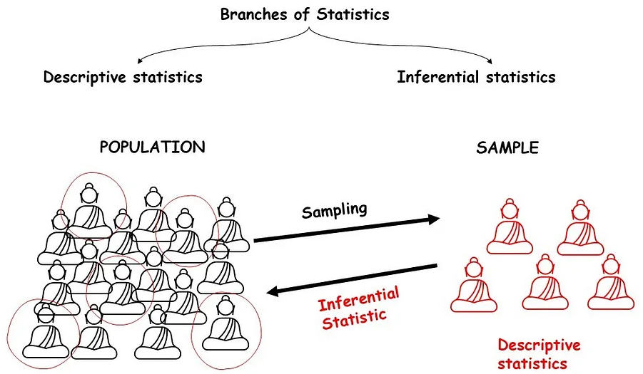

Slide 9
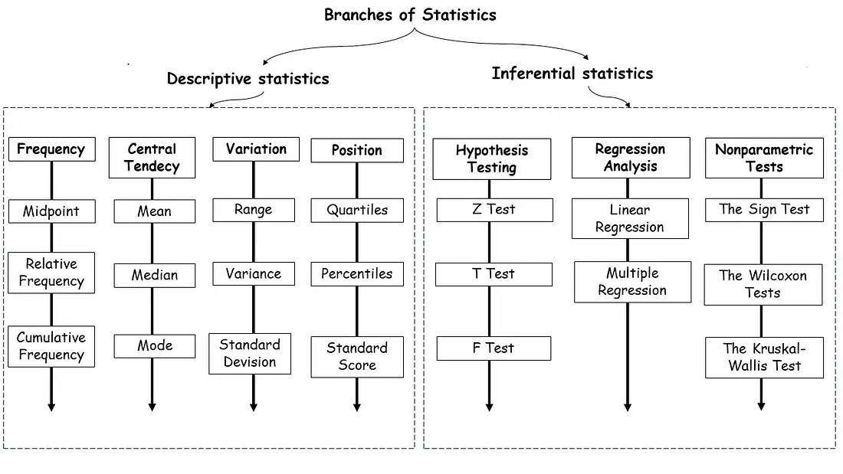

Slide 10
What is Inferential statistics?
In quantitative research,
after collecting data, the first step of statistical analysis is to describe characteristics of the responses, such as the average of one variable (e.g., age), or the relation between two variables (e.g., age and creativity).
After summarizing the data,
we use Inferential Statistics, which help us to decide whether your data confirms or refutes your statement/hypothesis or it can be generalizable to a larger population or not.

Slide 11
Correlation
Correlation Coefficient
Rank Correlation Coefficient
Regression
Linear Regression
Inferential Statistics
Hypothesis Testing
t – Test
Z - Test
Curve Fitting
Chi Square Test
F - Test

Slide 12
Correlation
Types of Correlation
Methods of Studying Correlation

Slide 13
Introduction
Correlation and Regression are the most commonly used techniques for investigating the relationship between two quantitative variables.

Slide 14
Correlation
Correlation refers to the
relationship of two or more variables.
Regression
Regression establishes a functional relationship between the variables.
Here both variables
x and y are random variable.
Here x is random variable and
y is fixed variable.
The coefficient of correlation is
a relative measure.
The coefficient of regression is
an absolute measure.
i.e., Correlation only measures the strength and direction of the relationship between two variables. whereas, a regression coefficient quantifies the actual change in one variable resulting from a one-unit change in another.

Slide 15
What is Correlation ?
Two variables are known as correlated
If a change in one variable affects a change in the other variable.
A data connecting two variables is called bivariate data.
For Example:
Relationship between heights and weights.
Relationship between price and demand of commodity.
Relationship between age of husband and age of wife.

Slide 16
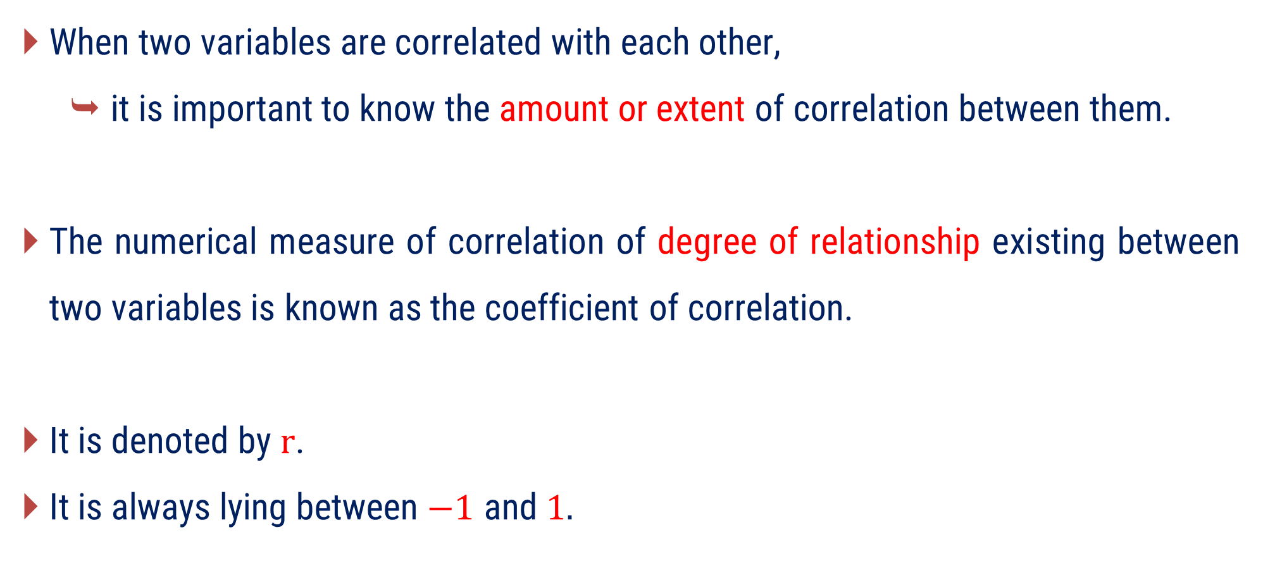
Coefficient of Correlation
When two variables are correlated with each other,
it is important to know the amount or extent of correlation between them.
The numerical measure of correlation of degree of relationship existing between two variables is known as the coefficient of correlation.
It is denoted by $r$.
It is always lying between $−1$ and $1.$

Slide 17
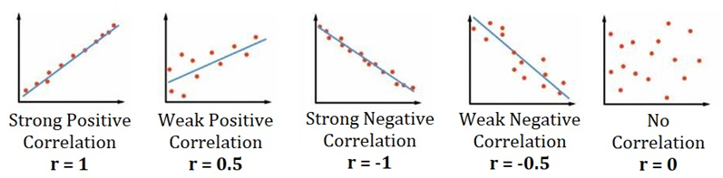
Coefficient of Correlation
The value of $r$ is
$±0.9$ or $±0.8$ etc shows high degree of relationship between the variables.
$±0.2$ or $±0.1$ etc shows low degree of relationship between the variables.

Slide 18
Types of Correlation
Types of Correlation
Positive
Correlation
Negative
Correlation
Linear
Correlation
Nonlinear
Correlation

Slide 19
Positive Correlation
If both the variables vary in same direction, then such a correlation is known as positive correlation.
In other words,
If the value of one variable increases, the value of other variables also increases. or
If the value of one variable decreases, the value of other variables also decreases.

Slide 20
Positive Correlation
For Example:
The correlation between heights and weights of group of persons is a positive correlation.
Height(cm) | $$\text{150}$$ | $$\text{152}$$ | $$\text{155}$$ | $$\text{160}$$ | $$\text{162}$$ | $$\text{165}$$
Weight(kg) | $$\text{60}$$ | $$\text{62}$$ | $$\text{64}$$ | $$\text{65}$$ | $$\text{67}$$ | $$\text{69}$$

Slide 21
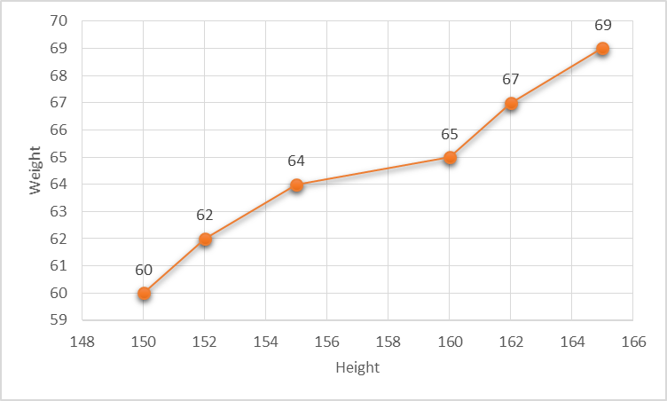

Slide 22
Negative Correlation
If both the variables vary in opposite direction, then such a correlation is known as negative correlation.
In other words,
If the value of one variable increases, the value of other variables decreases. or
If the value of one variable decreases, the value of other variables also increases.

Slide 23
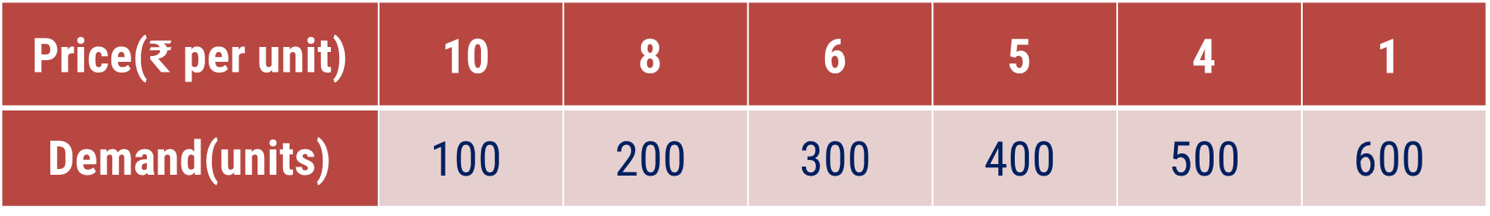
Negative Correlation
For Example:
The correlation between the price and demand of a commodity is a negative correlation.
Price(₹ per unit) | $$\text{10}$$ | $$\text{8}$$ | $$\text{6}$$ | $$\text{5}$$ | $$\text{4}$$ | $$\text{1}$$
Demand(units) | $$\text{100}$$ | $$\text{200}$$ | $$\text{300}$$ | $$\text{400}$$ | $$\text{500}$$ | $$\text{600}$$

Slide 24
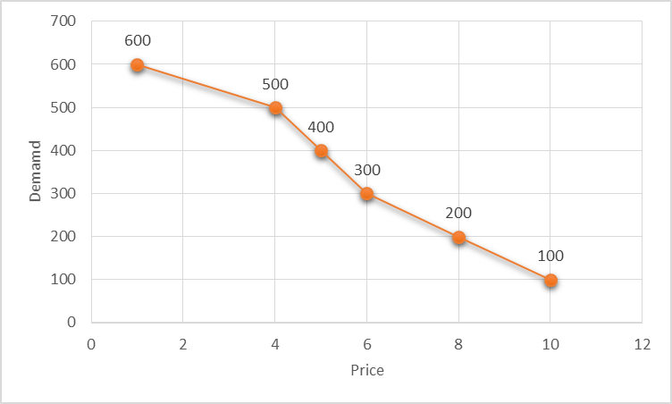

Slide 25
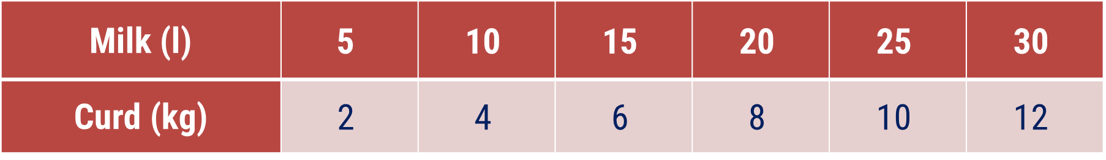
Linear Correlation
If the ratio of change between two variables is constant, then such a correlation is known as linear correlation.
If such variables are plotted on a graph paper, a straight line is obtained.
For Example:
Milk (l) | $$\text{5}$$ | $$\text{10}$$ | $$\text{15}$$ | $$\text{20}$$ | $$\text{25}$$ | $$\text{30}$$
Curd (kg) | $$\text{2}$$ | $$\text{4}$$ | $$\text{6}$$ | $$\text{8}$$ | $$\text{10}$$ | $$\text{12}$$

Slide 26
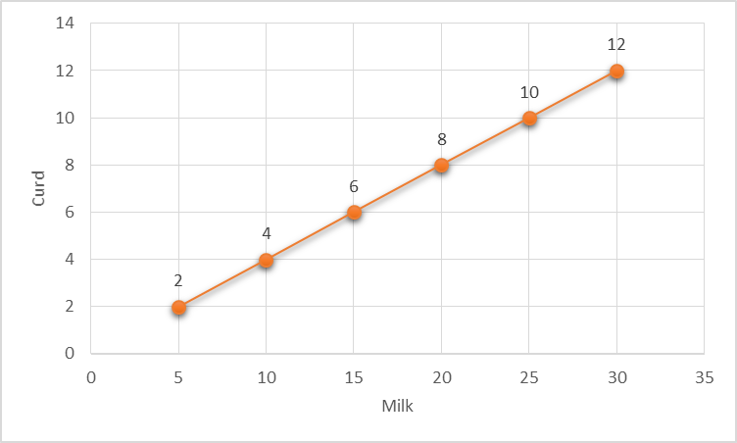

Slide 27
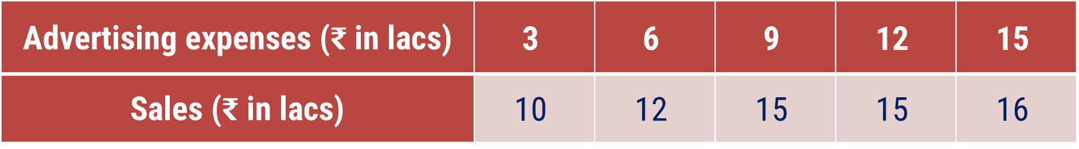
Nonlinear Correlation
If the ratio of change between two variables is not constant, then such a correlation is known as nonlinear correlation.
If such variables are plotted on a graph paper, a straight curve is obtained.
For Example:
Advertising expenses (₹ in lacs) | $$\text{3}$$ | $$\text{6}$$ | $$\text{9}$$ | $$\text{12}$$ | $$\text{15}$$
Sales (₹ in lacs) | $$\text{10}$$ | $$\text{12}$$ | $$\text{15}$$ | $$\text{15}$$ | $$\text{16}$$

Slide 28
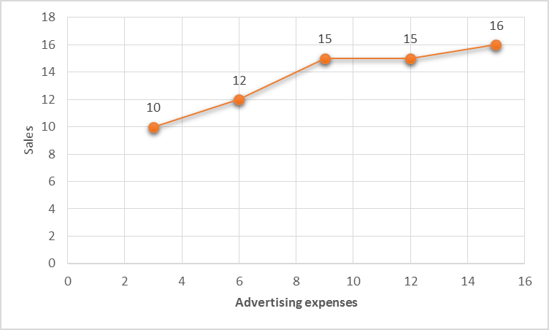

Slide 29
Methods of Studying Correlation
Graphical Methods
Scatter Diagram
Simple Graph
Mathematical Methods
Karl Pearson’s coefficient of correlation
Spearman’s coefficient of rank correlation

Slide 30
Method – 1 Correlation Coefficient
Karl Pearson’s coefficient of correlation

Slide 31
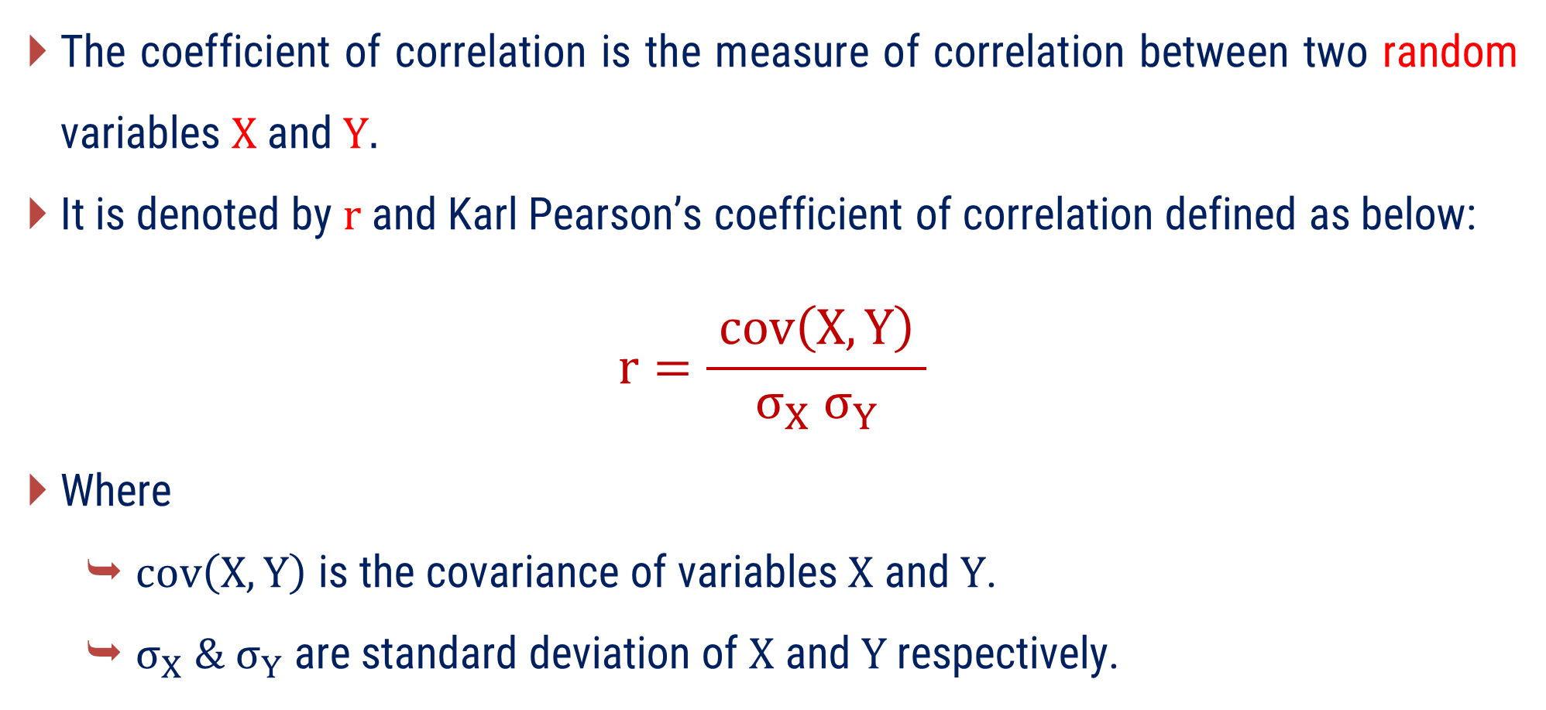
Karl Pearson’s Coefficient of Correlation
The coefficient of correlation is the measure of correlation between two random variables $X$ and $Y.$
It is denoted by $r$ and Karl Pearson’s coefficient of correlation defined as below:
$$r=\frac{ cov\left(X, Y\right) }{σ_{X} σ_{Y}}$$
Where
$cov\left(X, Y\right)$ is the covariance of variables $X$ and $Y$.
$σ_{X} \& σ_{Y}$ are standard deviation of $X$ and $Y$ respectively.

Slide 32

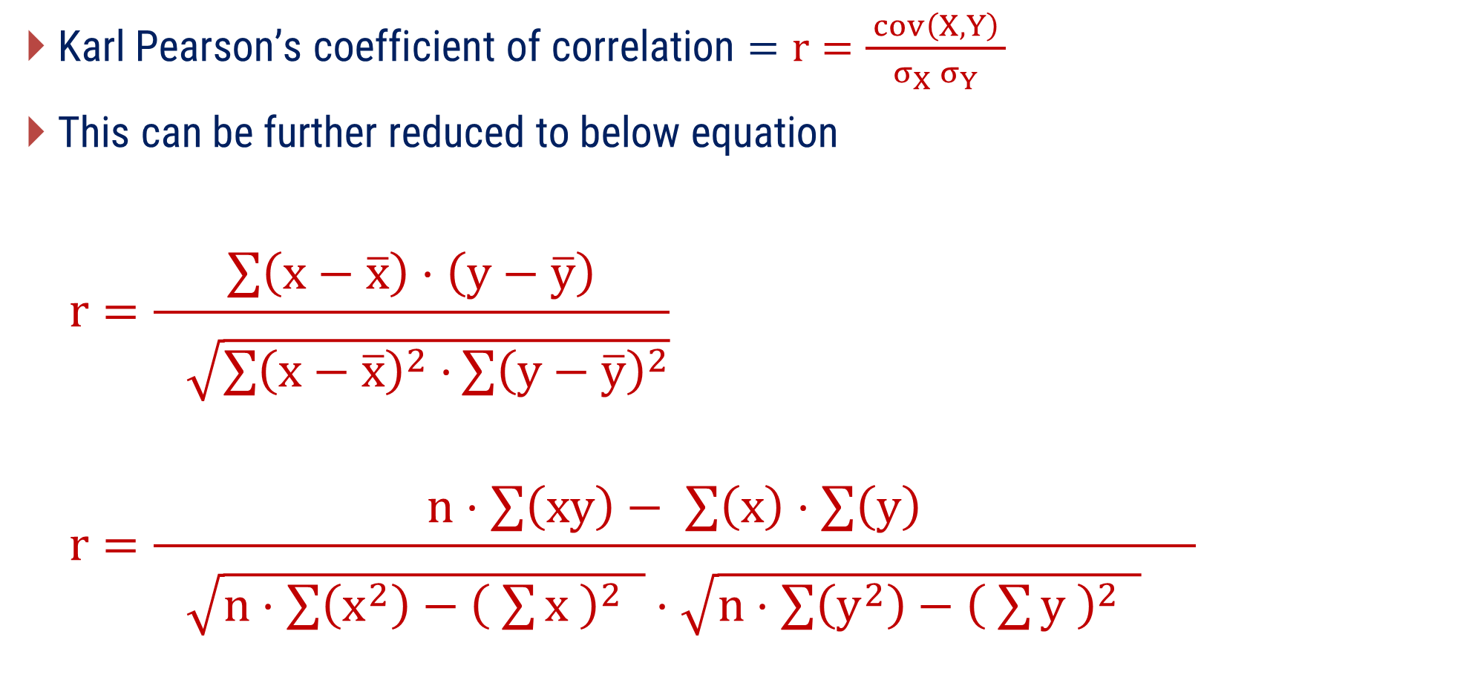
Karl Pearson’s Coefficient of Correlation
$\text{Karl} \text{Pearson}\text{’}\text{s} \text{coefficient} \text{of} \text{correlation}=r=\frac{ cov\left(X, Y\right) }{σ_{X} σ_{Y}}$
This can be further reduced to below equation
$$r=\frac{\sum{\left(x−\overline{x}\right)⋅\left(y−\overline{y}\right)}}{\begin{aligned} \\ \sqrt{\sum{{\left(x−\overline{x}\right)}^{2}⋅}\sum{{\left(y−\overline{y}\right)}^{2}}}\end{aligned}}$$
$$r=\frac{n⋅\sum{\left(xy\right)}− \sum{\left(x\right)}⋅\sum{\left(y\right)}}{\begin{aligned} \\ \sqrt{n⋅\sum{\left(x^{2}\right)}−{\left( \sum{x} \right)}^{2} }⋅\sqrt{n⋅\sum{\left(y^{2}\right)}−{\left( \sum{y} \right)}^{2} } \end{aligned}}$$
$$cov\left(X, Y\right)=\frac{1}{n}⋅\sum{\left(x−\overline{x}\right)⋅\left(y−\overline{y}\right)}$$
$$σ_{X}=\sqrt{\frac{\sum{{\left(x−\overline{ x }\right)}^{2}}}{n}}$$
$${ σ}_{y}=\sqrt{\frac{\sum{{\left(y−\overline{ y }\right)}^{2}}}{n}}$$

Slide 33

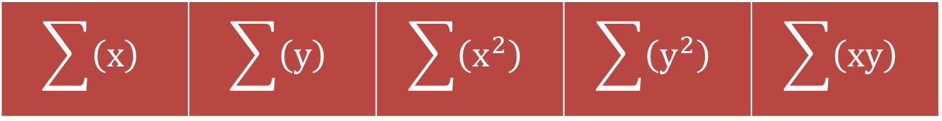
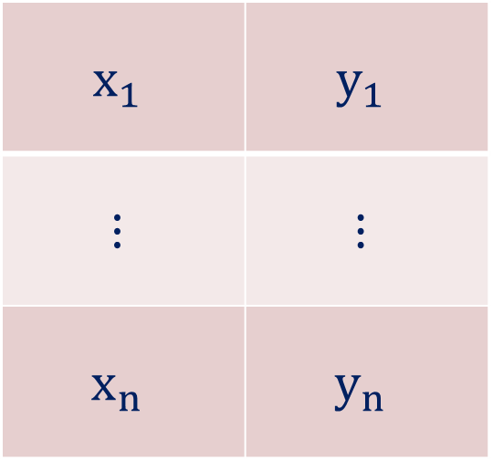
Procedure to find r from the given values of $x$ & $y$
Prepare the table with 5 columns using the given values of $x$ & $y$.
$$x$$ | $$y$$ | $$x^{2}$$ | $$y^{2}$$ | $$xy$$
$$x_{1}$$ | $$y_{1}$$
$$⋮$$ | $$⋮$$
$$x_{n}$$ | $$y_{n}$$
find
find
find
find
find
find
find
find
find
Sum of above data
$$\sum{\left(x\right)}$$ | $$\sum{\left(y\right)}$$ | $$\sum{\left(x^{2}\right)}$$ | $$\sum{\left(y^{2}\right)}$$ | $$\sum{\left(xy\right)}$$

Slide 34
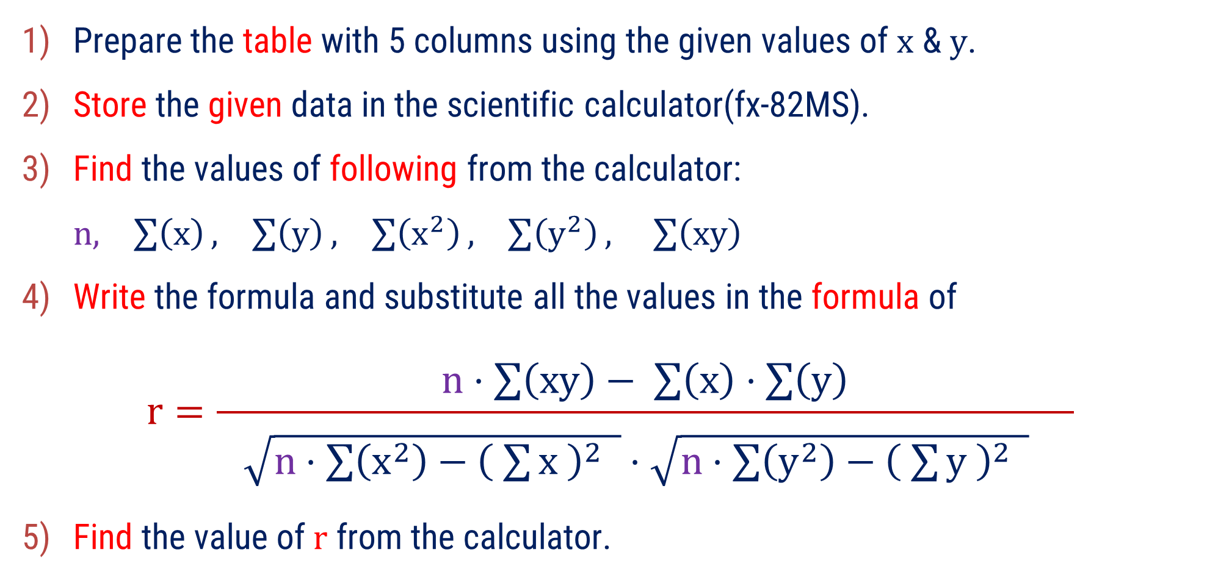
Procedure to find $r$ from the given values of $x$ & $y$
Prepare the table with 5 columns using the given values of $x$ & $y$.
Store the given data in the scientific calculator(fx-82MS).
Find the values of following from the calculator:
$n, \sum{\left(x\right)}, \sum{\left(y\right)}, \sum{\left(x^{2}\right)}, \sum{\left(y^{2}\right)}, \sum{\left(xy\right)}$
Write the formula and substitute all the values in the formula of
$$r=\frac{n⋅\sum{\left(xy\right)}− \sum{\left(x\right)}⋅\sum{\left(y\right)}}{\begin{aligned} \\ \sqrt{n⋅\sum{\left(x^{2}\right)}−{\left( \sum{x} \right)}^{2} }⋅\sqrt{n⋅\sum{\left(y^{2}\right)}−{\left( \sum{y} \right)}^{2} } \end{aligned}}$$
Find the value of $r$ from the calculator.

Slide 35
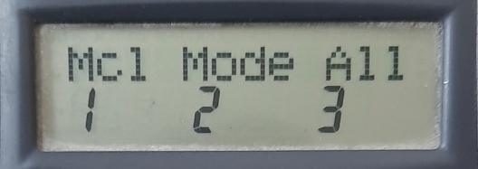
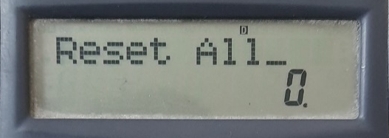
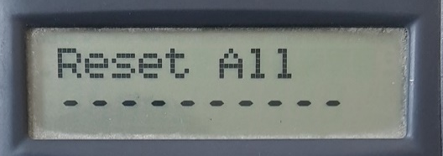
How to store given data in the calculator?
Step-1: Clear the memory of the calculator
Shift
Mode
All(3)
=

Slide 36
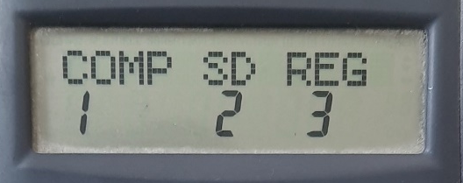
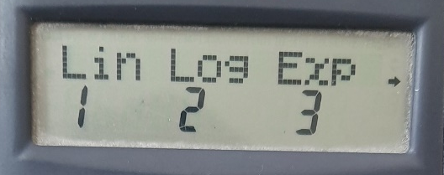
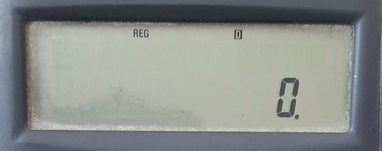
How to store given data in the calculator?
Step-2: Change the mode into Regression ---> Linear
Mode
Reg(3)
Lin(1)

Slide 37





How to store given data in the calculator?
Step-3: Store the given pairs of $x$ and $y$
1st value of x
,
1st value of y
M+
2nd value of x
,
2nd value of y
M+
$$⋮$$
$$⋮$$
$$⋮$$
$$⋮$$
Last value of x
,
Last value of y
M+

Slide 38
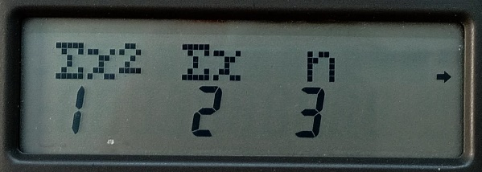
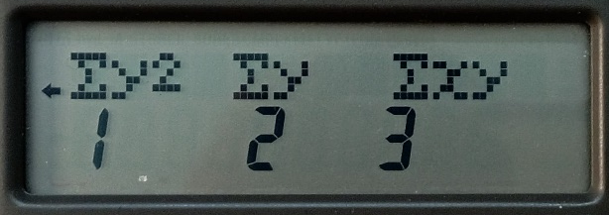
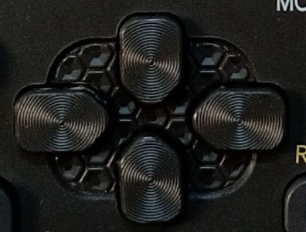
How to find required values from the calculator?
Shift
1
Digit
=
Right side
Digit
=
1
Shift

Slide 39
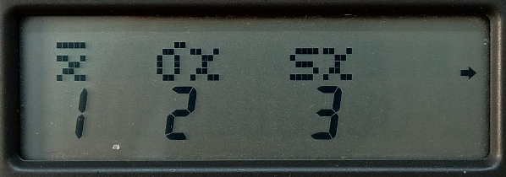
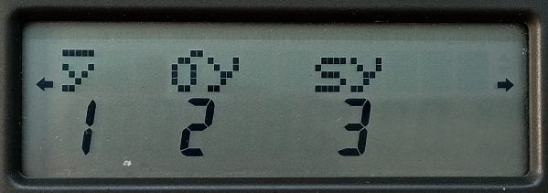
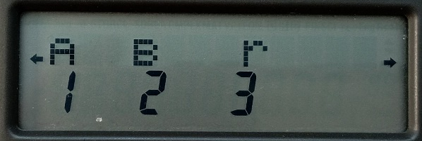
How to find required values from the calculator?
Shift
2
Right side 2 times
3
=

Slide 40
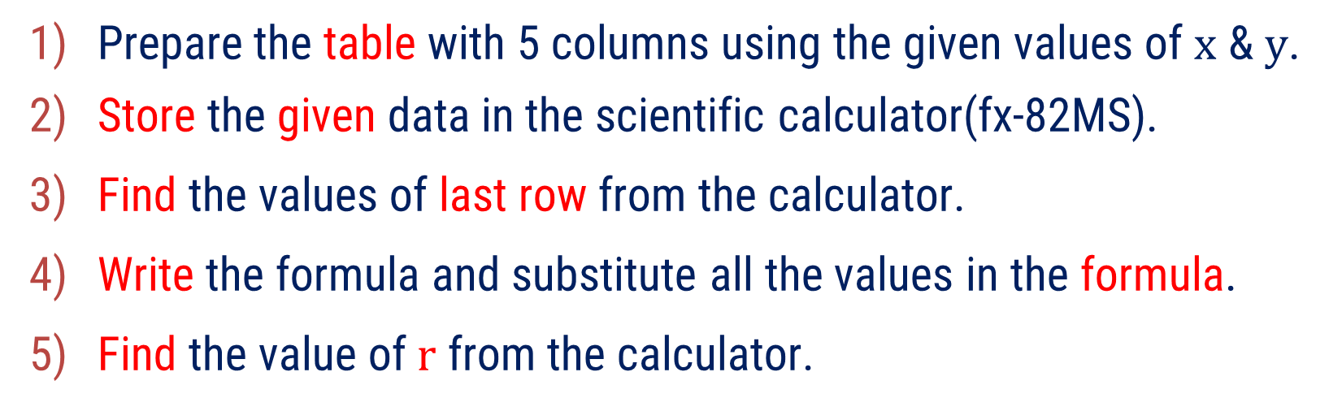
Method 1 ⇝ Example 1
Compute the coefficient of correlation between x and y using the following data:
x | 2 | 4 | 5 | 6 | 8 | 11
y | 18 | 12 | 10 | 8 | 7 | 5
Solution:
Prepare the table with 5 columns using the given values of $x$ & $y$.
Store the given data in the scientific calculator(fx-82MS).
Find the values of last row from the calculator.
Write the formula and substitute all the values in the formula.
Find the value of $r$ from the calculator.

Slide 41






Method 1 ⇝ Example 2(Continue)
$$x$$ | $$y$$ | $$x^{2}$$ | $$y^{2}$$ | $$xy$$
2 | 18
4 | 12
5 | 10
6 | 8
8 | 7
11 | 5
4
324
36
16
144
48
25
100
50
36
64
48
64
49
56
121
25
55
$$\sum{\left(x\right)}=36$$
$$\sum{\left(y\right)}=60$$
$$\sum{\left(x^{2}\right)}=266$$
$$\sum{\left(y^{2}\right)}=706$$
$$\sum{\left(xy\right)}=293$$

Slide 42

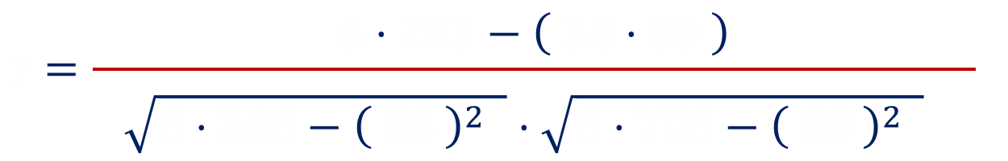
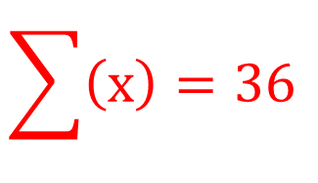
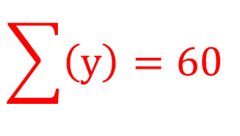
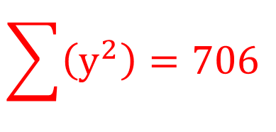


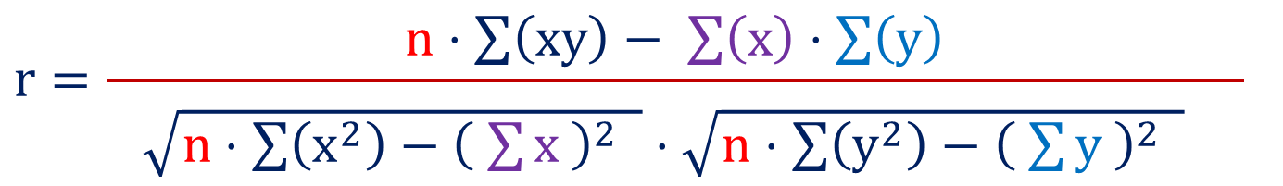


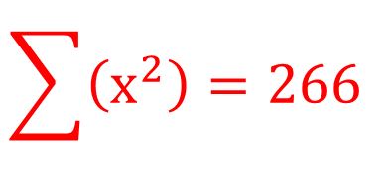


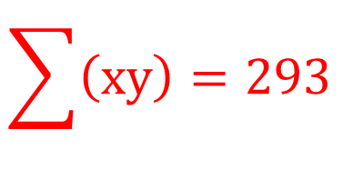





Method 1 ⇝ Example 1(Continue)
Let us substitute all the values in the formula to find the coefficient of correlation
$$n=6$$
$$r=\frac{n⋅\sum{\left(xy\right)}− \sum{\left(x\right)}⋅\sum{\left(y\right)}}{\begin{aligned} \\ \sqrt{n⋅\sum{\left(x^{2}\right)}−{\left( \sum{x} \right)}^{2} }⋅\sqrt{n⋅\sum{\left(y^{2}\right)}−{\left( \sum{y} \right)}^{2} } \end{aligned}}$$
$$\sum{\left(x\right)}=36$$
$$\sum{\left(y\right)}=60$$
$$6$$
$$293$$
$$36$$
$$60$$
$$r=\frac{6⋅293−\left( 36⋅60 \right)}{\begin{aligned} \\ \sqrt{6⋅266−{\left( 36 \right)}^{2} }⋅\sqrt{6⋅706−{\left( 60 \right)}^{2} } \end{aligned}}$$
$$\sum{\left(x^{2}\right)}=266$$
$$6$$
$$266$$
$$36$$
$$6$$
$$706$$
$$60$$
$$\sum{\left(y^{2}\right)}=706$$
$$r=−0.9203$$
$$\sum{\left(xy\right)}=293$$
$$∴\text{The} \text{coefficient} \text{of} \text{correlation} =− 0.9203$$

Slide 43
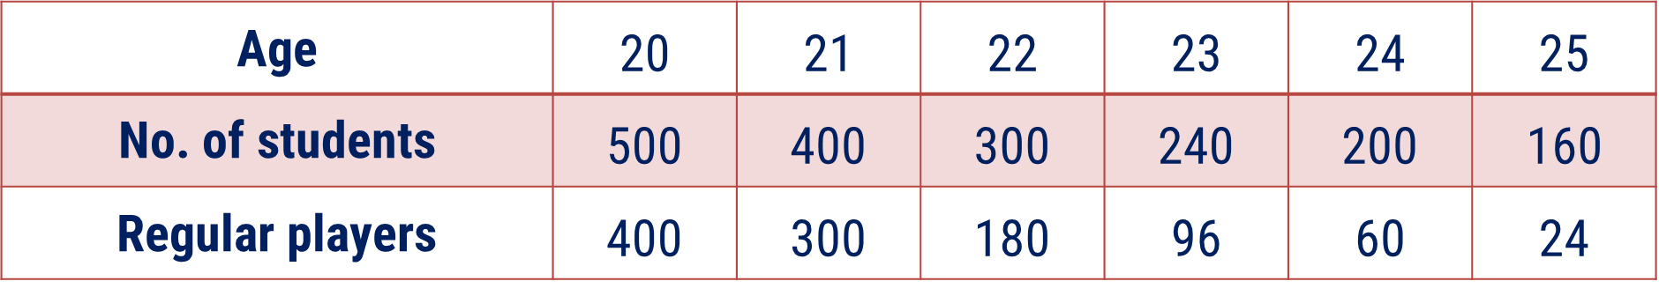
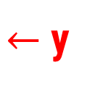
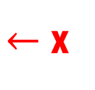
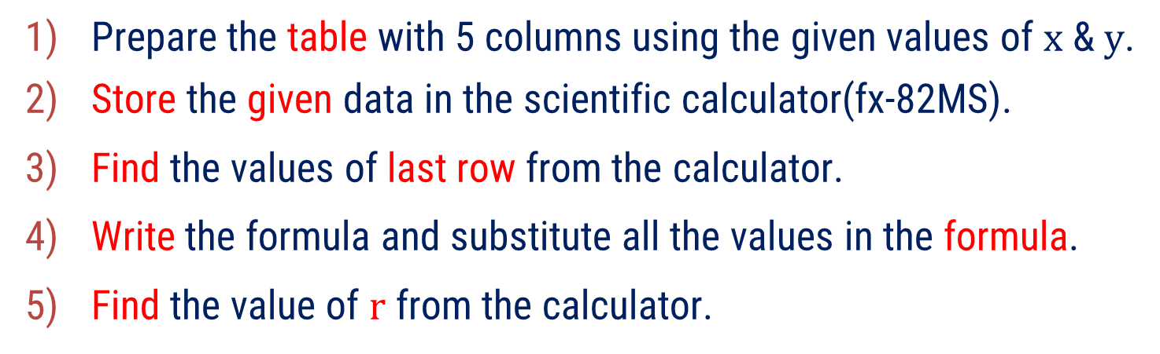
Method 1 ⇝ Example 2
Calculate Karl Pearson’s coefficient of correlation between age and playing habits:
Age | $$\text{20}$$ | $$\text{21}$$ | $$\text{22}$$ | $$\text{23}$$ | $$\text{24}$$ | $$\text{25}$$
No. of students | $$\text{500}$$ | $$\text{400}$$ | $$\text{300}$$ | $$\text{240}$$ | $$\text{200}$$ | $$\text{160}$$
Regular players | $$\text{400}$$ | $$\text{300}$$ | $$\text{180}$$ | $$\text{96}$$ | $$\text{60}$$ | $$\text{24}$$
$←$x
$←$y
Solution:
Prepare the table with 5 columns using the given values of $x$ & $y$.
Store the given data in the scientific calculator(fx-82MS).
Find the values of last row from the calculator.
Write the formula and substitute all the values in the formula.
Find the value of $r$ from the calculator.

Slide 44






Method 1 ⇝ Example 2(Continue)
$$x$$ | $$y$$ | $$x^{2}$$ | $$y^{2}$$ | $$xy$$
20 | 400
21 | 300
22 | 180
23 | 96
24 | 60
25 | 24
400
160000
8000
441
90000
6300
484
32400
3960
529
32400
2208
576
3600
1440
625
576
600
$$\sum{\left(x\right)}=135$$
$$\sum{\left(y\right)}=1060$$
$$\sum{\left(x^{2}\right)}=3055$$
$$\sum{\left(y^{2}\right)}=295792$$
$$\sum{\left(xy\right)}=22508$$

Slide 45
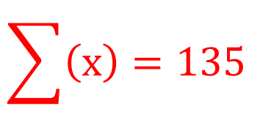

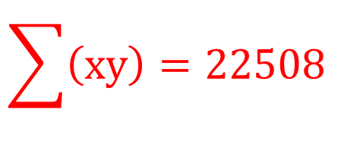
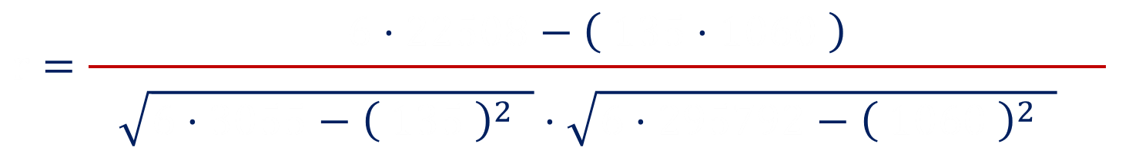



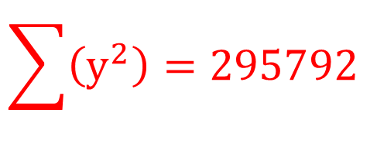


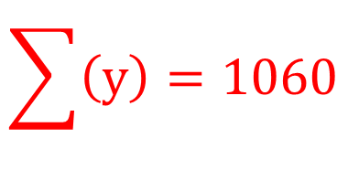






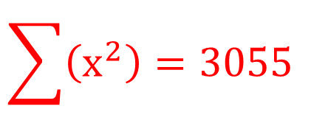
Method 1 ⇝ Example 2(Continue)
Let us substitute all the values in the formula to find the coefficient of correlation
$$n=6$$
$$\sum{\left(x\right)}=135$$
$$r=\frac{n⋅\sum{\left(xy\right)}− \sum{\left(x\right)}⋅\sum{\left(y\right)}}{\begin{aligned} \\ \sqrt{n⋅\sum{\left(x^{2}\right)}−{\left( \sum{x} \right)}^{2} }⋅\sqrt{n⋅\sum{\left(y^{2}\right)}−{\left( \sum{y} \right)}^{2} } \end{aligned}}$$
$$\sum{\left(y\right)}=1060$$
$$6$$
$$22508$$
$$135$$
$$1060$$
$$r=\frac{6⋅22508−\left( 135⋅1060 \right)}{\begin{aligned} \\ \sqrt{6⋅3055−{\left( 135 \right)}^{2} }⋅\sqrt{6⋅295792−{\left( 1060 \right)}^{2} } \end{aligned}}$$
$$\sum{\left(x^{2}\right)}=3055$$
$$6$$
$$3055$$
$$135$$
$$6$$
$$295792$$
$$1060$$
$$\sum{\left(y^{2}\right)}=295792$$
$$r=−0.9738$$
$$\sum{\left(xy\right)}=22508$$
$$∴\text{The} \text{coefficient} \text{of} \text{correlation} =− 0.9738$$

Slide 46



Method 1 ⇝ Example 3
$$\text{Determine} \text{the} \text{coefficient} \text{of} \text{correlation} \text{if} n=10, \overline{ x }=5.5, \overline{ y }=4,$$
$$\sum{x^{2}=385}, \sum{y^{2}=192}, \sum{{\left(x+y\right)}^{2}=947}.$$
Solution:
$$\text{W}\text{e} \text{have} n=10, \overline{ x }=5.5, \overline{ y }=4,$$
$$\sum{x^{2}=385}, \sum{y^{2}=192}, \sum{{\left(x+y\right)}^{2}=947}$$
$$∴\text{We} \text{have} \text{to} \text{find}\sum{x}, \sum{y}, \sum{xy}$$

Slide 47








Method 1 ⇝ Example 3(Continue)
$$\text{We} \text{know} \text{that} \overline{ x }=\frac{ \sum{x }}{n}$$
$$\text{Similarly} \overline{ y }=\frac{ \sum{y }}{n}$$
$$⇒\sum{x}=\overline{ x }∙n$$
$$⇒\sum{y}=\overline{ y }∙n$$
$$⇒\sum{x}=5.5∙10$$
$$⇒\sum{y}=4∙10$$
$$⇒\sum{x}=55………(1)$$
$$⇒\sum{y}=40………(2)$$

Slide 48










Method 1 ⇝ Example 3(Continue)
$$\text{We} \text{have}\sum{{\left(x+y\right)}^{2}=947}$$
$$⇒2\sum{\left(xy\right)}=947−385−192$$
$$⇒\sum{\left(x^{2}+y^{2}+2xy\right)}=947$$
$$⇒2\sum{\left(xy\right)}=370$$
$$⇒\sum{\left(x^{2}\right)}+\sum{\left(y^{2}\right)}+2\sum{\left(xy\right)}=947$$
$$⇒\sum{\left(xy\right)}=\frac{370}{2}$$
$$⇒385+192+2\sum{\left(xy\right)}=947$$
$$⇒\sum{\left(xy\right)}=185………(3)$$
$$385$$
$$192$$

Slide 49


















Method 1 ⇝ Example 3(Continue)
Let us substitute all the values in the formula to find the coefficient of correlation
$$n=10$$
$$r=\frac{n⋅\sum{\left(xy\right)}− \sum{\left(x\right)}⋅\sum{\left(y\right)}}{\begin{aligned} \\ \sqrt{n⋅\sum{\left(x^{2}\right)}−{\left( \sum{x} \right)}^{2} }⋅\sqrt{n⋅\sum{\left(y^{2}\right)}−{\left( \sum{y} \right)}^{2} } \end{aligned}}$$
$$\sum{\left(x\right)}=55$$
$$\sum{\left(y\right)}=40$$
$$10$$
$$185$$
$$55$$
$$40$$
$$r=\frac{10⋅185−\left( 55⋅40 \right)}{\begin{aligned} \\ \sqrt{10⋅385−{\left( 55 \right)}^{2} }⋅\sqrt{10⋅192−{\left( 40 \right)}^{2} } \end{aligned}}$$
$$\sum{\left(x^{2}\right)}=385$$
$$10$$
$$385$$
$$55$$
$$10$$
$$192$$
$$40$$
$$\sum{\left(y^{2}\right)}=192$$
$$r=−0.6812$$
$$\sum{\left(xy\right)}=185$$
$$∴\text{The} \text{coefficient} \text{of} \text{correlation} =− 0.6812$$

Slide 50



Method 1 ⇝ Example 4
$$\text{Given} \text{that} n=25, \sum{x=125}, \sum{x^{2}=650}, \sum{y=100}, \sum{y^{2}=460}$$
$$\text{and} \sum{xy=508}.\text{Later} \text{on}\text{, }\text{it} \text{was} \text{found} \text{that} \text{two} \text{of} \text{the} \text{points} \left(8, 12\right) \text{and} \left(6, 8\right)$$
$$\text{were} \text{wrongly} \text{entered} \text{as} \left(6, 14\right) \text{and} \left(8, 6\right). \text{Prove} \text{that} r=\frac{2}{ 3 }.$$
Solution:
$$\text{W}\text{e} \text{have} n=25, \sum{x=125}, \sum{x^{2}=650}$$
$$\sum{xy=508}, \sum{y=100}, \sum{y^{2}=460}$$

Slide 51









Method 1 ⇝ Example 4(Continue)
$$\text{It} \text{was} \text{found} \text{that} \text{two} \text{of} \text{the} \text{points} (8, 12) \text{and} (6, 8) \text{were} \text{wrongly} \text{entered} \text{as}$$
$$(6, 14) \text{and} (8, 6)$$
It means, In $x$, $6$ & $8$ were incorrect and $8$ & $6$ are correct.
It means, In $y$, $14$ & $6$ were incorrect and $12$ & $8$ are correct.
$$∴\text{Corrected} \sum{x}=125−6−8+8+6$$
$$− 6−8$$
$$+ 8+6$$
$$=125$$
$$∴\text{Corrected} \sum{y}=100−14−6+12+8$$
$$− 14−6$$
$$+ 12+8$$
$$=100$$

Slide 52
















Method 1 ⇝ Example 4(Continue)
$$∴\text{Corrected} \sum{x^{2}}=650−6^{2}−8^{2}+8^{2}+6^{2}$$
$$\text{Correct}$$
$\left(8, 12\right) \text{and} \left(6, 8\right)$
Incorrect
$(6, 14) \text{and} (8, 6)$
$$− 6^{2}−8^{2}$$
$$+ 8^{2}+6^{2}$$
$$=650$$
$$∴\text{Corrected} \sum{y^{2}}=460−{14}^{2}−6^{2}+{12}^{2}+8^{2}$$
$$− {14}^{2}−6^{2}$$
$$+ {12}^{2}+8^{2}$$
$$=436$$
$$∴\text{Corrected} \sum{xy}=508−\left(6∙14\right)−\left(8∙6\right)+\left(8∙12\right)+\left(6∙8\right)$$
$$6∙14$$
$$8∙6$$
$$8∙12$$
$$6∙8$$
$$=508−84−48+96+48$$
$$=520$$

Slide 53



















Method 1 ⇝ Example 4(Continue)
Let us substitute all the values in the formula to find the coefficient of correlation
$$n=25$$
$$r=\frac{n⋅\sum{\left(xy\right)}− \sum{\left(x\right)}⋅\sum{\left(y\right)}}{\begin{aligned} \\ \sqrt{n⋅\sum{\left(x^{2}\right)}−{\left( \sum{x} \right)}^{2} }⋅\sqrt{n⋅\sum{\left(y^{2}\right)}−{\left( \sum{y} \right)}^{2} } \end{aligned}}$$
$$\sum{\left(x\right)}=125$$
$$\sum{\left(y\right)}=100$$
$$25$$
$$520$$
$$125$$
$$100$$
$$r=\frac{25⋅520−\left( 125⋅100 \right)}{\begin{aligned} \\ \sqrt{25⋅650−{\left( 125 \right)}^{2} }⋅\sqrt{25⋅436−{\left( 100 \right)}^{2} } \end{aligned}}$$
$$\sum{\left(x^{2}\right)}=650$$
$$25$$
$$650$$
$$125$$
$$25$$
$$436$$
$$100$$
$$\sum{\left(y^{2}\right)}=436$$
$$r=\frac{500}{ 25∙30 }=\frac{20}{ 30 }=\frac{2}{ 3 }$$
$$\sum{\left(xy\right)}=520$$
$$\text{Hence} \text{Proved}\text{.}$$

Slide 54
Method – 2 Rank Correlation Coefficient
Spearman’s coefficient of rank correlation

Slide 55

What is Rank Correlation ?
Let a group of $n$ individuals be arranged in order of merit with respect to some characteristics.
Let us take the example of 100 persons of Mohali.
Characteristic $A$ = Intelligence
Characteristic $B$ = Beauty
It is clear that order of people are different(in general) in both characteristics.
Note that a person who is ranked at the top for the characteristic $A$ may be ranked at the bottom for the characteristic $B$.

Slide 56

What is Rank Correlation ?
The same group of $n$ individuals would give a different order(rank) for different characteristics.
Considering the orders corresponding to two characteristics $A$ and $B$,
the correlation between these $n$ pairs of ranks is known as rank correlation in the characteristics A and B for that group of individuals.

Slide 57

Coefficient of Rank Correlation
The coefficient of correlation between the two different ranks $x$ & $y$ is known as the coefficient of rank correlation between the characteristics $A$ and $B$.
It is denoted by $ρ.$

Slide 58

Spearman’s Coefficient of Rank Correlation
Let $x$ and $y$ be the two different ranks of $n$ individual with two characteristics $A$ and $B$ respectively.
The Spearman’s coefficient of rank correlation defined as below:
$$ρ=1−\frac{ 6∙\sum{d^{2}} }{ n \left(n^{2}−1\right) }$$
Where, $d=Difference of ranks=x_{i}−y_{i},$ $i=1,2,…n$
Note that $\sum{d}=0$.

Slide 59


Procedure to find $ρ$ from the given values of $x$ & $y$
Prepare the table with 4 columns using the given ranks.
$$x$$ | $$y$$ | $$d=x−y$$ | $$d^{2}$$
$$x_{1}$$ | $$y_{1}$$
$$⋮$$ | $$⋮$$
$$x_{n}$$ | $$y_{n}$$
find
find
find
find
find
find
$$\sum{\left(d\right)=0}$$ | $$\sum{\left(d^{2}\right)}$$

Slide 60

Procedure to find $ρ$ from the given values of $x$ & $y$
Prepare the table with 4 columns using the given ranks.
Find the last row of the Table.
Identify n = number of pairs of given data.
Substitute all the values in the formula of
$$ρ=1−\frac{ 6∙\sum{d^{2}} }{ n \left(n^{2}−1\right) }$$

Slide 61


Method 2 ⇝ Example 1
In a college, IT department has arranged one competition for IT students to develop an efficient program to solve a problem. Ten students took part in the competition and ranked by two judges given in the following table. Find the degree of agreement between the two judges using rank correlation coefficient.
1st judge | 3 | 5 | 8 | 4 | 7 | 10 | 2 | 1 | 6 | 9
2nd judge | 6 | 4 | 9 | 8 | 1 | 2 | 3 | 10 | 5 | 7
Solution:
Let, $x=$ Rank given by 1st judge
Let, $y=$ Rank given by 2nd judge

Slide 62


Method 2 ⇝ Example 1(Continue)
$$x$$ | $$y$$ | $$d$$ | $$d^{2}$$
3 | 6
5 | 4
8 | 9
4 | 8
7 | 1
10 | 2
2 | 3
1 | 10
6 | 5
9 | 7
-3
9
1
1
-1
1
-4
16
6
36
8
64
-1
1
-9
81
1
1
$$\sum{\left(d\right)=0}$$ | $$\sum{\left(d^{2}\right)}=214$$
2
4

Slide 63








Method 2 ⇝ Example 1(Continue)
Substitute all the values in the formula to find the coefficient of rank correlation
$$ρ=1−\frac{ 6∙\sum{d^{2}} }{\begin{aligned} \\ n \left(n^{2}−1\right) \end{aligned}}$$
$$n=10$$
$$214$$
$$ρ=1−\frac{ 6∙214 }{\begin{aligned} \\ 10 \left({10}^{2}−1\right) \end{aligned}}$$
$$\sum{\left(d^{2}\right)}=214$$
$$10$$
$$10$$
$$∴ρ=−0.2970$$
$$∴\text{The} \text{coefficient} \text{of} \text{rank} \text{correlation} =− 0.2970$$

Slide 64



Method 2 ⇝ Example 2
The competitions in a beauty contest are ranked by three judges. Use rank correlation to discuss which pair of judges has nearest approach to beauty.
1st judge | 1 | 5 | 4 | 8 | 9 | 6 | 10 | 7 | 3 | 2
2nd judge | 4 | 8 | 7 | 6 | 5 | 9 | 10 | 3 | 2 | 1
3rd judge | 6 | 7 | 8 | 1 | 5 | 10 | 9 | 2 | 3 | 4
Solution:
Let, $x=$ Rank given by 1st judge
Let, $y=$ Rank given by 2nd judge
Let, $z=$ Rank given by 3rd judge

Slide 65

Method 2 ⇝ Example 2(Continue)
$$x$$ | $$y$$ | $$z$$ | $$d_{12}=x−y$$ | $$d_{23}=y−z$$ | $$d_{13}=x−z$$ | $$d_{12}^{ 2}$$ | $$d_{23}^{ 2}$$ | $$d_{13}^{ 2}$$
1 | 4 | 6
5 | 8 | 7
4 | 7 | 8
8 | 6 | 1
9 | 5 | 5
6 | 9 | 10
10 | 10 | 9
7 | 3 | 2
3 | 2 | 3
2 | 1 | 4
-3
-2
-5
9
4
25
-3
1
-2
9
1
4
-3
-1
-4
9
1
16
2
5
7
4
25
49
4
0
4
16
0
16
-3
-1
-4
9
1
16
0
1
1
0
1
1
4
1
5
16
1
25
1
-1
0
1
1
0
1
-3
-2
1
9
4

Slide 66





Method 2 ⇝ Example 2(Continue)
$$d_{12}^{ 2}$$ | $$d_{23}^{ 2}$$ | $$d_{13}^{ 2}$$
9 | 4 | 25
9 | 1 | 4
9 | 1 | 16
4 | 25 | 49
16 | 0 | 16
9 | 1 | 16
0 | 1 | 1
16 | 1 | 25
1 | 1 | 0
1 | 9 | 4
$$\sum{\left(d_{12}^{ 2}\right)}=74$$ | $$\sum{\left(d_{23}^{ 2}\right)}=44$$ | $$\sum{\left(d_{13}^{ 2}\right)}=156$$
$$74$$
$$44$$
$$156$$

Slide 67
Method 2 ⇝ Example 2(Continue)
Now let us find the $ρ\left(\text{the} \text{coefficient} \text{of} \text{rank} \text{correlation}\right)$ for each $d.$
$$ρ_{12}=1−\frac{ 6∙\sum{d_{12}^{ 2}} }{\begin{aligned} \\ n \left(n^{2}−1\right) \end{aligned}}$$
$$74$$
$$n=10$$
$$ρ_{12}=1−\frac{ 6∙74 }{\begin{aligned} \\ 10 \left({10}^{2}−1\right) \end{aligned}}$$
$$10$$
$$10$$
$$\sum{\left(d^{2}\right)}=74$$
$$∴ρ_{12}=0.5515$$

Slide 68
Method 2 ⇝ Example 2(Continue)
Now let us find the $ρ\left(\text{the} \text{coefficient} \text{of} \text{rank} \text{correlation}\right)$ for each $d.$
$$ρ_{23}=1−\frac{ 6∙\sum{d_{23}^{ 2}} }{\begin{aligned} \\ n \left(n^{2}−1\right) \end{aligned}}$$
$$44$$
$$n=10$$
$$ρ_{12}=1−\frac{ 6∙74 }{\begin{aligned} \\ 10 \left({10}^{2}−1\right) \end{aligned}}$$
$$10$$
$$10$$
$$\sum{\left(d^{2}\right)}=44$$
$$∴ρ_{23}=0.7333$$

Slide 69
Method 2 ⇝ Example 2(Continue)
Now let us find the $ρ\left(\text{the} \text{coefficient} \text{of} \text{rank} \text{correlation}\right)$ for each $d.$
$$ρ_{13}=1−\frac{ 6∙\sum{d_{13}^{ 2}} }{\begin{aligned} \\ n \left(n^{2}−1\right) \end{aligned}}$$
$$156$$
$$n=10$$
$$ρ_{12}=1−\frac{ 6∙74 }{\begin{aligned} \\ 10 \left({10}^{2}−1\right) \end{aligned}}$$
$$10$$
$$10$$
$$\sum{\left(d^{2}\right)}=156$$
$$∴ρ_{13}=0.0545$$

Slide 70
Method 2 ⇝ Example 2(Continue)
Now let us compare all $ρ$ to find nearest approach to beauty.
$$ρ_{12}=0.5515,$$
$$ρ_{23}=0.7333,$$
$$ρ_{13}=0.0545$$
It is clear that coefficient of rank correlation of 2nd & 3rd judge has maximum value.
$$∴ \text{Pair} \text{of}\text{ 2}\text{nd} \text{and}\text{ 3}\text{rd} \text{judge} \text{has} \text{nearest} \text{approach} \text{to} \text{beauty}\text{.}$$

Slide 71
Method 2 ⇝ Example 3
Find the rank correlation coefficient and comment on its value.
Roll No. | 1 | 2 | 3 | 4 | 5 | 6 | 7 | 8 | 9
Marks in Mathematics | 78 | 36 | 98 | 25 | 75 | 82 | 90 | 62 | 65
Marks in Chemistry | 84 | 51 | 91 | 60 | 68 | 62 | 86 | 58 | 53
Solution:
Here, Rank of roll no. is not given.
∴ We have to assign the rank to each roll no. by given characteristics
∴ i.e. marks in Mathematics & marks in Chemistry.

Slide 72
Method 2 ⇝ Example 3(Continue)
$$Roll No.$$ | $$Math.$$ | $$Chem.$$ | $$x$$ | $$y$$ | $$d=x−y$$ | $$d^{2}$$
1 | 78 | 84
2 | 36 | 51
3 | 98 | 91
4 | 25 | 60
5 | 75 | 68
6 | 82 | 62
7 | 90 | 86
8 | 62 | 58
9 | 65 | 53
4
3
1
1
8
9
-1
1
1
1
0
0
9
6
3
9
5
4
1
1
3
5
-2
4
2
2
0
0
7
7
0
0
$$\sum{\left(d^{2}\right)}=20$$
6
8
-2
4

Slide 73
Method 2 ⇝ Example 3(Continue)
Substitute all the values in the formula to find the coefficient of rank correlation
$$ρ=1−\frac{ 6∙\sum{d^{2}} }{\begin{aligned} \\ n \left(n^{2}−1\right) \end{aligned}}$$
$$n=9$$
$$\sum{\left(d^{2}\right)}=20$$
$$20$$
$$ρ=1−\frac{ 6∙214 }{\begin{aligned} \\ 10 \left(0^{2}−1\right) \end{aligned}}$$
$$9$$
$$9$$
$$∴ρ=0.8333$$
$$∴\text{The} \text{coefficient} \text{of} \text{rank} \text{correlation} = 0.8333$$
Comment: ρ shows strong positive rank correlation.

Slide 74
Tied Rank / Repeated Rank
In previous example,
If two or more students had obtained the same marks in Mathematics or Chemistry, what rank would you give to those students?
If there is a tie between the ranks, then it is known as tied rank.
In case of tie between individuals’ ranks,
the rank is divided among equal individuals.

Slide 75
Tied Rank / Repeated Rank
For Example:
If there is tie with two items at 4th rank, then give average rank 4.5 as rank to both items.
$$\text{Average} \text{rank}=\frac{ 4+5 }{2}=4.5$$
If there is tie with two items at 8th rank, then give average rank 8.5 as rank to both items.
$$\text{Average} \text{rank}=\frac{ 8+9 }{2}=8.5$$
Note: After tie at 4th rank, next rank is 6th rank.

Slide 76
Tied Rank / Repeated Rank
For Example:
If there is tie with three items at 2nd rank, then give average rank 3 as rank to all three items.
$$\text{Average} \text{rank}=\frac{ 2+3+4 }{3}=3$$
If there is tie with three items at 4th rank, then give average rank 5 as rank to all three items.
$$\text{Average} \text{rank}=\frac{ 4+5+6 }{3}=5$$
Note: After tie at 2nd rank, next rank is 5th rank.

Slide 77



Spearman’s Coefficient of Rank Correlation for Tied Rank
$$ρ=1−\frac{ 6∙\left[\begin{aligned} \\ \sum{d^{2}+\frac{ 1 }{ 12 }\left({m_{1}}^{3}−m_{1}\right)+\frac{ 1 }{ 12 }\left({m_{2}}^{3}−m_{2}\right)}+… \\ \end{aligned}\right]}{ n \left(n^{2}−1\right) }$$
Where
$d= \text{Difference} \text{of} \text{Ranks}=x_{i}−y_{i}$
$m_{i}=\text{number} \text{of} \text{times} \text{a} \text{data} \text{repeats}=2, 3, …$
Note:
If any data $x_{i}$ is repeated $2$ times, then $m_{1}=2$
If any data $x_{j}$ is repeated $3$ times, then $m_{2}=3$
$$\frac{ 1 }{12 }\left({m_{1}}^{3}−m_{1}\right)$$
$$\frac{ 1 }{12 }\left({m_{2}}^{3}−m_{2}\right)$$

Slide 78
Method 2 ⇝ Example 4
Calculate coefficient of rank correlation by Spearman’s method from following:
Sales | 45 | 56 | 39 | 54 | 45 | 40 | 56 | 60 | 30 | 36
Cost | 40 | 36 | 30 | 44 | 36 | 32 | 45 | 42 | 20 | 36
Solution:
Here, Rank of given data is not given.
∴ We have to assign the rank to each data by given characteristics
∴ i.e. sales & cost.

Slide 79



Method 2 ⇝ Example 4(Continue)
$$Sales$$ | $$Cost$$ | $$x$$ | $$y$$ | $$d=x−y$$ | $$d^{2}$$
45 | 40
56 | 36
39 | 30
54 | 44
45 | 36
40 | 32
56 | 45
60 | 42
30 | 20
36 | 36
For Sales,
56 is repeated 2 times
at 2nd rank
2.5
$∴$ Rank of 56
$$=\frac{ 2+3 }{2}=2.5$$
2.5
1
$$∴m_{1}=2$$

Slide 80


Method 2 ⇝ Example 4(Continue)
$$Sales$$ | $$Cost$$ | $$x$$ | $$y$$ | $$d=x−y$$ | $$d^{2}$$
45 | 40
56 | 36
39 | 30
54 | 44
45 | 36
40 | 32
56 | 45
60 | 42
30 | 20
36 | 36
For Sales,
45 is repeated 2 times
at 5th rank
5.5
2.5
4
$∴$ Rank of 45
$$=\frac{ 5+6 }{2}=5.5$$
5.5
2.5
1
$$∴m_{2}=2$$

Slide 81


Method 2 ⇝ Example 4(Continue)
$$Sales$$ | $$Cost$$ | $$x$$ | $$y$$ | $$d=x−y$$ | $$d^{2}$$
45 | 40
56 | 36
39 | 30
54 | 44
45 | 36
40 | 32
56 | 45
60 | 42
30 | 20
36 | 36
For Cost,
36 is repeated 3 times
at 5th rank
5.5
4
2.5
6
8
9
4
2
$∴$ Rank of 36
$$=\frac{ 5+6+7 }{3}=6$$
5.5
6
7
8
2.5
1
1
3
$$∴m_{3}=3$$
10
10
9
6

Slide 82


Method 2 ⇝ Example 4(Continue)
$$Sales$$ | $$Cost$$ | $$x$$ | $$y$$ | $$d=x−y$$ | $$d^{2}$$
45 | 40
56 | 36
39 | 30
54 | 44
45 | 36
40 | 32
56 | 45
60 | 42
30 | 20
36 | 36
5.5
4
1.5
2.25
2.5
6
-3.5
12.25
8
9
-1
1
4
2
2
4
5.5
6
-0.5
0.25
7
8
-1
1
2.5
1
1.5
2.25
1
3
-2
4
10
10
0
0
$$\sum{\left(d^{2}\right)}=36$$
9
6
3
9

Slide 83













Method 2 ⇝ Example 4(Continue)
Substitute all the values in the formula to find the coefficient of rank correlation
$$ρ=1−\frac{ 6∙\left[\begin{aligned} \\ \sum{d^{2}}+\frac{ 1 }{ 12 }\left({m_{1}}^{3}−m_{1}\right)+\frac{ 1 }{ 12 }\left({m_{2}}^{3}−m_{2}\right)+\frac{ 1 }{ 12 }\left({m_{3}}^{3}−m_{3}\right) \\ \end{aligned} \right]}{\begin{aligned} \\ n \left(n^{2}−1\right) \end{aligned}}$$
$$n=10$$
$$\sum{\left(d^{2}\right)}=36$$
$$ρ=1−\frac{ 6∙\left[\begin{aligned} \\ 36+\frac{ 1 }{ 12 }\left(2^{3}−2\right)+\frac{ 1 }{ 12 }\left(2^{3}−2\right)+\frac{ 1 }{ 12 }\left(3^{3}−3\right) \\ \end{aligned}\right]}{\begin{aligned} \\ 10 \left({10}^{2}−1\right) \end{aligned}}$$
$$36$$
$$2^{3}−2$$
$$2^{3}−2$$
$$3^{3}−3$$
$$m_{1}=2$$
$$m_{2}=2$$
$$10$$
$$10$$
$$m_{3}=3$$

Slide 84










Method 2 ⇝ Example 4(Continue)
$$ρ=1−\frac{ 6∙\left[\begin{aligned} \\ 36+\frac{ \left(2^{3}−2\right) }{ 12 }+\frac{ \left(2^{3}−2\right) }{ 12 }+\frac{ \left(3^{3}−3\right) }{ 12 } \\ \end{aligned}\right]}{\begin{aligned} \\ 10 \left({10}^{2}−1\right) \end{aligned}}$$
$$ρ=1−\frac{ 6∙\left[\begin{aligned} \\ 36+\frac{ 6 }{ 12 }+\frac{ 6 }{ 12 }+\frac{ 24 }{ 12 } \\ \end{aligned}\right]}{\begin{aligned} \\ 10 \left(100−1\right) \end{aligned}}$$
$$6$$
$$6$$
$$24$$
$$ρ=1−\frac{ 6∙\left[\begin{aligned} \\ 36+\frac{ 1 }{ 2 }+\frac{ 1 }{ 2 }+2 \\ \end{aligned}\right]}{\begin{aligned} \\ 990 \end{aligned}}$$
$$\frac{ 1 }{ 2 }$$
$$\frac{ 1 }{ 2 }$$
$$2$$
$$990$$

Slide 85



Method 2 ⇝ Example 4(Continue)
$$∴ρ=1−\frac{ 6∙\left[\begin{aligned} \\ 36+\frac{ 1 }{ 2 }+\frac{ 1 }{ 2 }+2 \\ \end{aligned}\right]}{\begin{aligned} \\ 990 \end{aligned}}$$
$$∴ρ=1−\frac{ 6∙\left[ 39 \right]}{\begin{aligned} \\ 990 \end{aligned}}$$
$$∴ρ=0.7636$$
$$∴\text{The} \text{coefficient} \text{of} \text{rank} \text{correlation} = 0.7636$$

Slide 86





Method 2 ⇝ Example 5
The coefficient of rank correlation of marks obtained by $10$ students in English and Economics was found to be $0.6$. It was later discovered that the difference in ranks in the two subjects obtained by one of the students was wrongly taken as $7$ instead of $1$. Find the correct coefficient of rank correlation.
Solution:
$$\text{Here}\text{,} n=10$$
$$\text{Incorrect} ρ=0.6$$
Incorrect difference $d=7$
Correct difference $d=1$

Slide 87









Method 2 ⇝ Example 5(Continue)
$$∴\text{We} \text{have} \text{to} \text{find}\sum{d^{2}} \text{and} \text{then} \text{need} \text{to} \text{correct} \text{it} \text{to} \text{find} \text{correct} ρ.$$
$$\text{We} \text{know} \text{that} ρ=1−\frac{ 6∙\sum{d^{2}} }{\begin{aligned} \\ n \left(n^{2}−1\right) \end{aligned}}$$
$$⇒0.6=1−\frac{ 6∙\sum{d^{2}} }{\begin{aligned} \\ 10 \left({10}^{2}−1\right) \end{aligned}}$$
$$ρ=0.6$$
$$0.6$$
$$10$$
$$10$$
$$n=10$$
$$⇒0.6=1−\frac{ 6∙\sum{d^{2}} }{\begin{aligned} \\ 990 \end{aligned}}$$

Slide 88















Method 2 ⇝ Example 5(Continue)
$$⇒0.6=1−\frac{ 6∙\sum{d^{2}} }{\begin{aligned} \\ 990 \end{aligned}}$$
$$⇒\sum{d^{2}}=66$$
$$⇒\frac{ 6∙\sum{d^{2}} }{\begin{aligned} \\ 990 \end{aligned}}=1−0.6$$
$$∴\text{Corrected} \sum{d^{2}}=66−{\left(7\right)}^{2}+{\left(1\right)}^{2}$$
$$\frac{ 6∙\sum{d^{2}} }{\begin{aligned} \\ 990 \end{aligned}}$$
$$0.6$$
$$7$$
$$1$$
$$⇒6∙\sum{d^{2}}=0.4∙990$$
$$∴\text{Corrected} \sum{d^{2}}=18$$
$$990$$
$$\text{Incorrect} \text{difference} d=7$$
$$⇒\sum{d^{2}}=\frac{ 0.4∙990 }{6}$$
$$\text{Correct} \text{difference} d=1$$
$$6$$

Slide 89








Method 2 ⇝ Example 5(Continue)
$$∴\text{corrected} ρ=1−\frac{ 6∙\sum{d^{2}} }{\begin{aligned} \\ n \left(n^{2}−1\right) \end{aligned}}$$
$$18$$
$$∴\text{corrected} ρ=1−\frac{ 6∙18 }{\begin{aligned} \\ 10 \left({10}^{2}−1\right) \end{aligned}}$$
$$n=10$$
$$10$$
$$10$$
$$\sum{d^{2}}=18$$
$$∴\text{corrected} ρ=0.8909$$
$$∴\text{The} \text{corrected} \text{coefficient} \text{of} \text{rank} \text{correlation} = 0.8909$$

Slide 90
Regression
Types of Regression
Methods of Studying Regression

Slide 91
Regression
Regression is the estimation or prediction of
unknown values of one variable
from known values of another variable.
Regression is defined as a method of estimating the value of one variable when the other variable is known and both are correlated.
Regression measures the nature and extent of correlation.

Slide 92
Regression
Regression is a highly valuable tool for prediction purpose in economics and business.
Regression is useful in statistical estimation of demand curve, supply curve, production function, cost function, consumption function etc.

Slide 93
Types of Regression
Types of Regression
Simple
Regression
Multiple
Regression
Linear
Regression
Nonlinear
Regression

Slide 94

Types of Regression
The regression analysis for studying only two variables at a time is known as simple regression.
The regression analysis for studying more than two variables at a time is known as multiple regression.
Prediction of Income
Prediction of Income

Slide 95

Types of Regression
If the regression curve is a straight line, the regression is known as linear regression.
If the regression curve is not a straight line, the regression is known as nonlinear regression.

Slide 96
Methods of Studying Regression
Least Square
Scatter Diagram

Slide 97
Method – 3 Linear Regression
Line of Regression

Slide 98

Linear Regression
If the variables, which are highly correlated, are plotted on a graph then the points are around a straight line, the line is known as the line of regression.
If such a line exist then regression is called Linear Regression.

Slide 99
Types of Linear Regression
Line of Regression
of
y on x
Line of Regression
of
x on y

Slide 100
Line of Regression
Line of Regression of y on x:
This line of regression gives
the best prediction or estimation of y
for given values of x.
Line of Regression of x on y:
This line of regression gives
the best prediction or estimation of x
for given values of y.
Useful to
predict y
when x is given
Useful to
predict x
when y is given

Slide 101

Line of Regression of y on x
The line of regression of y on x is
$$y−\overline{ y }=b_{yx} \left( x−\overline{ x }\right)$$
Where,
$b_{yx}=r \frac{ σ_{y} }{ σ_{x} } \text{is} \text{called} \text{the} \text{regression} \text{coefficient} \text{of} y \text{on} x$
$r=\text{c}\text{orrelation} \text{coefficient} \text{between} x \text{and} y$
$\overline{ x }, σ_{x}=\text{Mean}\text{, } \text{Standard} \text{Deviation} \text{of} \text{all} x­_{i}$
$\overline{ y }, σ_{y}=\text{Mean}\text{, }\text{Standard} \text{Deviation} \text{of} \text{all} y­_{i}$

Slide 102

Line of Regression of x on y
The line of regression of x on y is
$$x−\overline{ x }=b_{xy} \left( y−\overline{ y }\right)$$
Where,
$b_{xy}=r \frac{ σ_{x} }{ σ_{y} } \text{is} \text{called} \text{the} \text{regreesion} \text{coefficient} \text{of} x \text{on} y$
$r=\text{c}\text{orrelation} \text{coefficient} \text{between} x \text{and} y$
$\overline{ x }, σ_{x}=\text{Mean}\text{, } \text{Standard} \text{Deviation} \text{of} \text{all} x­_{i}$
$\overline{ y }, σ_{y}=\text{Mean}\text{, }\text{Standard} \text{Deviation} \text{of} \text{all} y­_{i}$

Slide 103

Properties of Regression Coefficients
The correlation coefficient is less than or equal to the arithmetic mean of the regression coefficients.
$$∴r≤\frac{ b_{xy}+b_{yx} }{2 }$$
The correlation coefficient is equal to the geometric mean of the regression coefficients.
$$∴ r=\sqrt{ b_{yx}⋅ b_{xy} }$$

Slide 104

Properties of Regression Coefficients
The product of both $b_{xy}$ and $b_{yx}$ cannot be more than 1.
One of the regression coefficients is grater than 1 then other regression coefficients must be less than 1.
The correlation coefficient and both the regression coefficients have same sign.
They are either all positive or all negative.
i.e. If, $b_{yx}<0 \& b_{xy}<0$then, $r<0$
if, $b_{yx}>0 \& b_{xy}>0$ then , $r>0$

Slide 105

Procedure to find line of regression from the given values of $x$ & $y$
Store the given data in the scientific calculator(fx-82MS).
Find the values of following from the calculator:
$$\overline{ x }, \overline{ y }, σ_{x}, σ_{y}, r$$
Substitute all the values in the formula and find the line of regression.
$$y−\overline{ y }=r\frac{ σ_{y} }{ σ_{x} }\left( x−\overline{ x }\right) or$$
$$x−\overline{ x }=r\frac{ σ_{x} }{ σ_{y} }\left( y−\overline{ y }\right)$$

Slide 106


Method 3 ⇝ Example 1
Obtain the two lines of regression for the following data:
Sales (No. of tablets) | 190 | 240 | 250 | 300 | 310 | 335 | 300
Advertising expense (Rs.) | 5 | 10 | 12 | 20 | 20 | 30 | 30
Solution:
Here we want to find both lines of regression.
i.e.
Line of regression of $y$ on $x$ and
Line of regression of $x$ on $y$

Slide 107



Method 3 ⇝ Example 1(Continue)
Regression Line of $y$ on $x$ :
$$\text{1) }\text{S}\text{tore} \text{the} \text{given} \text{data} \text{in} \text{the} \text{calculator}\text{.}$$
Clear the memory ---> Change the mode ---> Store the given pairs of $x$ and $y$
$\text{2)} \text{Find} \text{the} \text{required} \text{values} \text{from} \text{the} \text{calculator}$.
Shit ---> 2 ---> digit ---> $=$
$\text{3)}$Substitute all the values in the formula and find the line of regression.

Slide 108











Method 3 ⇝ Example 1(Continue)
Regression Line of $y$ on $x$ :
From the given data$\overline{ x }=275,$
$$σ_{x}=46.5219,$$
$$\text{From} \text{the} \text{given} \text{data} \overline{ y }=18.1429,$$
$$σ_{y}=8.9830,$$
$$r=0.9144$$
Now Regression Line of y on x is
$$∴y−\overline{ y }=r\frac{ σ_{y} }{ σ_{x} }\left( x−\overline{ x }\right)$$
$$8.9830$$
$$∴y−18.1429=0.9144 \frac{8.9830 }{ \begin{aligned} \\ 46.5219 \end{aligned}}\left( x−275\right)$$
$$18.1429$$
$$0.9144$$
$$275$$
$$46.5219$$

Slide 109








Method 3 ⇝ Example 1(Continue)
Regression Line of $y$ on $x$ :
$$∴y−18.1429=0.9144 \frac{8.9830}{\begin{aligned} \\ 46.5219\end{aligned}}\left( x−275 \right)$$
Calculation in calculator
$$r×σ_{y}÷σ_{x}$$
$$∴y−18.1429=0.1766 \left( x−275 \right)$$
$$0.1766$$
$$0.1766$$
$$48.5650$$
$$∴y−18.1429=0.1766 x−48.5650$$
$$∴y=0.1766 x−48.5650+18.1429$$
$$+ 18.1429$$
$$∴y=0.1766 x−30.4221$$
$$30.4221$$
$$∴\text{The} \text{Regression} \text{line} \text{of} \text{y} \text{on} \text{x} \text{is} y=0.1766 x−30.4221$$

Slide 110








Method 3 ⇝ Example 1(Continue)
Regression Line of $x$ on $y$ :
From the given data$\overline{ x }=275,$
$$σ_{x}=46.5219,$$
$$\text{From} \text{the} \text{given} \text{data} \overline{ y }=18.1429,$$
$$σ_{y}=8.9830,$$
$$r=0.9144$$
Now Regression Line of x on y is
$$∴x−\overline{ x }=r\frac{ σ_{x} }{ σ_{y} }\left( y−\overline{ y }\right)$$
$$46.5219$$
$$∴x−275=0.9144 \frac{ 46.5219 }{\begin{aligned} \\ 8.9830\end{aligned}}\left( y−18.1429 \right)$$
$$275$$
$$0.9144$$
$$18.1429$$
$$8.9830$$

Slide 111








Method 3 ⇝ Example 1(Continue)
Regression Line of $x$ on $y$ :
$$∴x−275=0.9144 \frac{ 46.5219 }{\begin{aligned} \\ 8.9830\end{aligned}}\left( y−18.1429 \right)$$
Calculation in calculator:
$$r×σ_{x}÷σ_{y}$$
$$4.7357$$
$$∴x−275=4.7357 \left( y−18.1429 \right)$$
$$85.9193$$
$$∴x−275=4.7357 y−85.9193$$
$$4.7357$$
$$+ 275$$
$$∴x=4.7356 y−85.9193+275$$
$$∴x=4.7356 y+189.0825$$
$$189.0807$$
$$∴\text{The} \text{Regression} \text{line} \text{of} \text{x} \text{on} \text{y} \text{is} x=4.7356 y+189.0807$$

Slide 112

Method 3 ⇝ Example 2
A study of amount of rainfall and quantity of air pollution removed is given by bellow table.
(a) Find the equation of the regression line to predict the particulate removed from the amount of daily rainfall.
(b) Find the amount of particulate removed when daily rainfall is 4.8.
Daily rainfall (0.01 cm) | 4.3 | 4.5 | 5.9 | 5.6 | 6.1 | 5.2 | 3.8 | 2.1 | 7.5
Particulate removed unit | 126 | 121 | 116 | 118 | 114 | 118 | 132 | 141 | 108
Solution:
Let us take, $x=$ Daily rainfall, $y=$ Particulate removed unit
$∴$ We have to find the regression line of $y$ on $x$.

Slide 113










Method 3 ⇝ Example 2(Continue)
Regression Line of $y$ on $x$ :
From the given data$\overline{ x }=5,$
$$σ_{x}=1.4629,$$
$$\text{From} \text{the} \text{given} \text{data} \overline{ y }=121.5556,$$
$$σ_{y}=9.4529,$$
$$r=−0.9787$$
Now Regression Line of y on x is
$$∴y−\overline{ y }=r\frac{ σ_{y} }{ σ_{x} }\left( x−\overline{ x }\right)$$
$$9.4529$$
$$∴y−121.5556=−0.9787 \frac{ 9.4529 }{\begin{aligned} \\ 1.4629\end{aligned}}\left( x−5\right)$$
$$121.5556$$
$$−0.9787$$
$$5$$
$$1.4629$$

Slide 114







Method 3 ⇝ Example 2(Continue)
Regression Line of $y$ on $x$ :
$$∴y−121.5556=−0.9787 \frac{ 9.4529 }{\begin{aligned} \\ 1.4629\end{aligned}}\left( x−5 \right)$$
Calculation in calculator
$$r×σ_{y}÷σ_{x}$$
$$−6.3240$$
$$∴y−121.5556=−6.3240 \left( x−5 \right)$$
$$−6.3240$$
$$+ 31.6199$$
$$∴y−121.5556=−6.3240 x+31.6199$$
$$∴y=−6.3240 x+31.6199+121.5556$$
$$+ 121.5556$$
$$∴y=−6.3240 x+153.1755$$
$$153.1755$$
$$∴\text{The} \text{Regression} \text{line} \text{of} \text{y} \text{on} \text{x} \text{is} y=−6.3240 x+153.1755$$

Slide 115



Method 3 ⇝ Example 2(Continue)
(b) Find the amount of particulate removed when daily rainfall is 4.8.
That means, we need to find $y$ when $x = 4.8$
We have
$$y=−6.3240 x+153.1755$$
$$⇒y=−6.3240 (4.8)+153.1755$$
$$⇒y=122.8203$$
$$∴\text{W}\text{hen} \text{daily} \text{rainfall} \text{is} 4.8\text{, }\text{the} \text{amount} \text{of} \text{particulate} \text{removed} = 122.8203$$

Slide 116

Other form of Regression Coefficient
$\text{Th}\text{e} \text{regreesion} \text{coefficient} \text{of} y \text{on} x \text{is}$
$$b_{yx}=r \frac{ σ_{y} }{ σ_{x} }$$
$$⇒b_{yx}=\frac{ n\sum{xy}−\left( \sum{x} \right)\left( \sum{y} \right) }{\begin{aligned} \\ n\sum{x^{2}}−{\left( \sum{x} \right)}^{2} \end{aligned}}$$

Slide 117

Other form of Regression Coefficient
$\text{Th}\text{e} \text{regreesion} \text{coefficient} \text{of} x \text{on} y \text{is}$
$$b_{xy}=r \frac{ σ_{x} }{ σ_{y} }$$
$$⇒b_{xy}=\frac{ n\sum{xy}−\left( \sum{x} \right)\left( \sum{y} \right) }{\begin{aligned} \\ n\sum{y^{2}}−{\left( \sum{y} \right)}^{2} \end{aligned}}$$

Slide 118



Method 3 ⇝ Example 3
The following data regarding the height(y) and weight(x) of 100 students are given:
$\sum{x}=15000, \sum{y}=6800, \sum{x^{2}}=2272500, \sum{y^{2}}=463025,$
$\sum{xy}=1022250.$Find the equation of regression line of height on weight.
Solution:
Here, $x=$ weight, $y=$ height
$∴$ We have to find the regression line of $y$ on $x$.
$\text{W}\text{e} \text{have} n=100, \sum{x}=15000, \sum{y}=6800,$
$\sum{x^{2}=2272500}, \sum{y^{2}=463025}, \sum{xy=1022250}$

Slide 119







Method 3 ⇝ Example 3(Continue)
Regression Line of $y$ on $x$ :
Now Regression Line of y on x is
$$y−\overline{ y }=b_{yx} \left( x−\overline{ x }\right)………\left(1\right)$$
$∴$ We have to find the values of $\overline{ x }, \overline{ y }, b_{yx}$ from the given data.
$$\text{We} \text{know} \text{that} \overline{ x }=\frac{ \sum{x }}{n}$$
$$⇒\overline{ x }=\frac{ 15000 }{100}$$
$$⇒\overline{ x }=150………(2)$$
$$\overline{ y }=\frac{ \sum{y }}{n}$$
$$⇒\overline{ y }=\frac{ 6800 }{100}$$
$$⇒\overline{ y }=68………(3)$$

Slide 120




















Method 3 ⇝ Example 3(Continue)
$$\text{Now} b_{yx}=\frac{ n∙\sum{xy}−\left( \sum{x} \right)∙\left( \sum{y} \right) }{\begin{aligned} \\ n∙\sum{x^{2}}−{\left( \sum{x} \right)}^{2} \end{aligned}}$$
$$n=100$$
$$\sum{\left(x\right)}=15000$$
$$100$$
$$1022250$$
$$15000$$
$$6800$$
$$⇒b_{yx}=\frac{ 100∙1022250−\left( 15000 \right)∙\left( 6800 \right) }{\begin{aligned} \\ 100∙2272500−{\left( 15000 \right)}^{2} \end{aligned}}$$
$$\sum{\left(y\right)}=6800$$
$$100$$
$$2272500$$
$$15000$$
$$\sum{\left(x^{2}\right)}=2272500$$
$$102225000$$
$$102000000$$
$$⇒b_{yx}=\frac{ 102225000 −102000000 }{\begin{aligned} \\ 227250000 −225000000 \end{aligned}}$$
$$\sum{\left(xy\right)}=1022250$$
$227250000$
$$225000000$$
$$⇒b_{yx}=0.1………(4)$$

Slide 121











Method 3 ⇝ Example 3(Continue)
$$\text{Substitute} \text{the} \text{vaules} \text{of} \text{equations} (2), (3), (4) \text{in} (1)$$
$$∴y−\overline{ y }=b_{yx} \left( x−\overline{ x }\right)$$
$$68$$
$$∴y−68=0.1 \left( x−150\right)$$
$$0.1$$
$$150$$
$$0.1$$
$$∴y−68=0.1 x−15$$
$$15$$
$$+ 68$$
$$∴y=0.1 x−15+68$$
$$∴y=0.1 x+53$$
$$∴\text{The} \text{Regression} \text{line} \text{of} \text{height}\text{(}\text{y}\text{) }\text{on} \text{weight}\text{(}\text{x}\text{) }\text{is} y=0.1 x+53$$

Slide 122



Method 3 ⇝ Example 4
The data for advertising and sale given below. Correlation coefficient between prices is 0.8. (a) Calculate the two regression lines.
(b) Find the likely sales when advertising expenditure is 15 lakhs.
(c) What should be the advertising expenditure if the company wants to attain a sales target of 120 lakhs?
 | Adv. Exp.(x) (Rs. lakh) | Sales(y) (Rs. lakh)
Mean | 10 | 90
Standard deviation | 3 | 12
$$\overline{ x }=$$
$$\overline{ y }=$$
$$σ_{x}=$$
$$σ_{y}=$$

Slide 123
Method 3 ⇝ Example 4(Continue)
Solution:
From the given data$\overline{ x }=10,$
$$σ_{x}=3,$$
$$\text{From} \text{the} \text{given} \text{data} \overline{ y }=90,$$
$$σ_{y}=12,$$
$$r=0.8$$
Now Regression Line of y on x is
$$∴y−\overline{ y }=r\frac{ σ_{y} }{ σ_{x} }\left( x−\overline{ x }\right)$$
$$12$$
$$∴y−90=0.8 \frac{ 12 }{\begin{aligned} \\ 3\end{aligned}}\left( x−10\right)$$
$$90$$
$$0.8$$
$$10$$
$$3$$

Slide 124
Method 3 ⇝ Example 4(Continue)
Regression Line of $y$ on $x$ :
$$∴y−90=0.8 \frac{ 12 }{\begin{aligned} \\ 3\end{aligned}}\left( x−10\right)$$
$$∴y−90=3.2 \left( x−10 \right)$$
$$3.2$$
$$∴y−90=3.2 x−32$$
$$3.2$$
$$− 32$$
$$∴y=3.2 x−32+90$$
$$+ 90$$
$$∴y=3.2 x+58$$
$$∴\text{The} \text{Regression} \text{line} \text{of} \text{y} \text{on} \text{x} \text{is} y=3.2 x+58$$

Slide 125






Method 3 ⇝ Example 4(Continue)
Solution:
From the given data$\overline{ x }=10,$
$$σ_{x}=3,$$
$$\text{From} \text{the} \text{given} \text{data} \overline{ y }=90,$$
$$σ_{y}=12,$$
$$r=0.8$$
Now Regression Line of x on y is
$$∴x−\overline{ x }=r\frac{ σ_{x} }{ σ_{y} }\left( y−\overline{ y }\right)$$
$$3$$
$$∴x−10=0.8 \frac{ 3 }{\begin{aligned} \\ 12 \end{aligned}}\left( y−90\right)$$
$$10$$
$$0.8$$
$$90$$
$$12$$

Slide 126










Method 3 ⇝ Example 4(Continue)
Regression Line of $x$ on $y$ :
$$∴x−10=0.8 \frac{ 3 }{\begin{aligned} \\ 12 \end{aligned}}\left( y−90\right)$$
$$∴x−10=3.2 \left( y−90 \right)$$
$$0.2$$
$$∴x−10=3.2 y−32$$
$$0.2$$
$$− 18$$
$$∴x=0.2 y−18+90$$
$$+ 10$$
$$∴x=0.2 y−8$$
$$∴\text{The} \text{Regression} \text{line} \text{of} \text{y} \text{on} \text{x} \text{is} x=0.2 y−8$$

Slide 127





Method 3 ⇝ Example 4(Continue)
(b) Find the likely sales when advertising expenditure is 15 lakhs.
That means, we need to find $y$ when $x =15$
We have regression line of $y$ on $x$
$$y=3.2 x+58$$
$$⇒y=3.2 (15)+58$$
$$⇒y=106$$
$$∴\text{W}\text{hen} \text{advertising} \text{expenditure} \text{is} 15 \text{lakhs}\text{, }\text{the} \text{likely} \text{sales} =106 \text{lakhs}$$

Slide 128





Method 3 ⇝ Example 4(Continue)
(c) What should be the advertising expenditure if the company wants to attain a sales target of 120 lakhs?
That means, we need to find $x$ when $y =120$
We have regression line of $x$ on $y$
$$x=0.2 y−8$$
$$⇒x=0.2 \left(120\right)−8$$
$$⇒x=16$$
$$∴\text{W}\text{hen} \text{sales} \text{target} \text{is} 120 \text{lakhs}\text{, }\text{the} \text{advertising} \text{expenditure} =16 \text{lakhs}$$

Slide 129





Method 3 ⇝ Example 5
A study of prices of a certain commodity at Raipur and Kanpur yields the below data. Correlation coefficient between prices at Raipur and Kanpur is 0.774.
Estimate the most likely price at Raipur corresponding to the price of 3.052 per kilo at Kanpur.
 | Raipur (Rs) | Kanpur (Rs)
Average price/kg | 2.463 | 2.797
Standard deviation | 0.326 | 0.207
$$\overline{ x }=$$
$$\overline{ y }=$$
$$σ_{x}=$$
$$σ_{y}=$$
Solution:
Let us take, $x=$ Prices at Raipur, $y=$ Prices at Kanpur
$∴$ We have to find the regression line of $x$ on $y$.

Slide 130












Method 3 ⇝ Example 5(Continue)
Solution:
From the given data$\overline{ x }=2.463,$
$$σ_{x}=0.326,$$
$$\text{From} \text{the} \text{given} \text{data} \overline{ y }=2.797,$$
$$σ_{y}=0.207,$$
$$r=0.774$$
Now Regression Line of x on y is
$$∴x−\overline{ x }=r\frac{ σ_{x} }{ σ_{y} }\left( y−\overline{ y }\right)$$
$$0.326$$
$$∴x−2.463=0.774 \frac{ 0.326 }{\begin{aligned} \\ 0.207 \end{aligned}}\left( y−2.797\right)$$
$$2.463$$
$$0.774$$
$$2.797$$
$$0.207$$

Slide 131








Method 3 ⇝ Example 4(Continue)
$$∴x−2.463=0.774 \frac{ 0.326 }{\begin{aligned} \\ 0.207 \end{aligned}}\left( y−2.797\right)$$
$$1.219$$
$$∴x−2.463=1.219 \left( y−2.797\right)$$
$$3.4094$$
$$∴x−2.463=1.219 y−3.4094$$
$$1.219$$
$$∴x=1.219 y−3.4094+2.463$$
$$+ 2.463$$
$$∴x=1.219 y−0.9464$$
$$∴\text{The} \text{Regression} \text{line} \text{of} \text{x} \text{on} \text{y} \text{is} x=1.219 y−0.9464$$

Slide 132




Method 3 ⇝ Example 4(Continue)
Estimate the most likely price at Raipur(x) corresponding to the price of 3.052 per kilo at Kanpur(y).
That means, we need to find $x$ when $y =3.052$
We have regression line of $x$ on $y$
$$x=1.219 y−0.9464$$
$$⇒x=1.219 \left(3.052\right)−0.9464$$
$$⇒x=2.7740$$
$$∴\text{W}\text{hen} \text{the} \text{price} \text{at} \text{Kanpur} \text{is} 3.052\text{, }\text{the} \text{price} \text{at} \text{Raipur} =2.7740$$

Slide 133
Curve Fitting
Least Square Method

Slide 134
Introduction
We come across many situations where we often require to find a relationship between two or more variables.
For example:
Weight and Height of a person,
Demand and Supply, etc.
This relation may be expresses by polynomial or exponential or logarithmic relationship.
In order to determine such relationship, first it is requiring to collect the data showing corresponding values of the variables under consideration.

Slide 135


Introduction
Suppose a set of $n$ points $\left(x_{1}, y_{1}\right), \left(x_{2}, y_{2}\right), ……, \left(x_{n}, y_{n}\right)$ be the given data of the variables $x$ and $y$.
If we plot the above data on a coordinate system($xy$ plan), then it forms a scatter diagram.

Slide 136
Introduction
From this diagram, it is sometimes possible to visualize a smooth curve approximating the data.
Such a curve is known as an approximating curve.

Slide 137

Introduction
If the data approximate well to a straight line, then we say that a linear relationship exists between the variables.
It is quite possible that the relationship of the form $y=f\left(x\right)$ between two variables x and y, giving the approximating curve which fit the given data of x and y.
Finding equations of approximating curve that fits given sets of data is known as curve fitting.
We will learn Least Square Method to find the equation of approximating curve.

Slide 138

Least Square Method
From the scatter diagram, It is possible to have more than one curve which is appropriate for the given data.
Least Square Method is used to find a curve which is passes through the maximum number of points.

Slide 139






Least Square Method
$\left(x_{1}, y_{1}\right), \left(x_{2}, y_{2}\right), ……, \left(x_{n}, y_{n}\right)$ be the given data.
Where x is independent variable
y is dependent variable.
Let us assume that $y = f\left(x\right)$ is the approximating curve.
$\left(x_{1}, y_{1}\right)$ is the actual point.
But curve is passing through $\left(x_{1},f\left(x_{1}\right)\right)$.
$$\left(x_{1}, y_{1}\right)$$
$$y=f\left(x\right)$$
$$\left(x_{1},f\left(x_{1}\right)\right)$$
$$X$$
$$Y$$

Slide 140

Least Square Method
The distance between $y_{1}$ and $f\left(x_{1}\right)$ is known as deviation or error or residual in the point $\left(x_{1}, y_{1}\right)$.
$$∴d_{1}=y_{1}−f\left(x_{1}\right)$$
In general, deviation in the point $\left(x_{i}, y_{i}\right)$ is $d_{i}=y_{i}−f\left(x_{i}\right)$
Deviation may be positive or negative or zero.
$$\left(x_{1}, y_{1}\right)$$
$$y=f\left(x\right)$$
$$\left(x_{1},f\left(x_{1}\right)\right)$$
$$X$$
$$Y$$

Slide 141

Least Square Method

Slide 142

Least Square Method
To give equal weightage to all deviations, we square each of these $d_{i}$.
To find the best fitting curve to given data, $D$ must be minimum.
Where $D={d_{1}}^{2}+{d_{2}}^{2}+…+{d_{n}}^{2}$
$$= \sum_{i=1}^{n}{d_{i}^{ 2}} D= \sum_{i=1}^{n}{{\left[{ y}_{i}−f\left(x_{i}\right) \right]}^{2}}$$
If $D=0$, then all $n$ points will lie on $y=f\left(x\right)$.
If $D≠0$, then We have to choose $y=f\left(x\right)$ such that $D$ is minimum.

Slide 143
Least Square Method
Using this method, we will find the two type of curves:
Linear Curve
Straight line
$$y=a+bx$$
𝐲=𝐚+𝐛𝐱
Quadratic Curve
Parabola
$$y=a+bx+{cx}^{2}$$
𝐲=𝐚+𝐛𝐱+〖𝐜𝐱〗^𝟐

Slide 144
Method – 4.1 Linear Curve Fitting
Fitting of Linear Curves or
Fitting a Straight Line

Slide 145

Linear Curve Fitting
Let, $\left(x_{1}, y_{1}\right), \left(x_{2}, y_{2}\right), ……, \left(x_{n}, y_{n}\right)$ be the set of $n$ values.
Let, the relation between $x$ and $y$ be $y=a+bx.$
To find the best fitting straight line to the given data,
we need to find the best values of $a$ & $b$ by minimizing $D$.
To minimize D, We have to solve
$$\frac{∂D}{∂a}=0 \& \frac{∂D}{∂b}=0$$
After simplifying above two equations, We will have two normal equations.
To find the best values of $a$ & $b$, we have to solve these two normal equations.

Slide 146

Linear Curve Fitting
Let, $\left(x_{1}, y_{1}\right), \left(x_{2}, y_{2}\right), ……, \left(x_{n}, y_{n}\right)$ be the set of $n$ values.
Let, the relation between $x$ and $y$ be $y=a+bx.$
To find the best fitting straight line to the given data,
we need to find the best values of $a$ & $b$ by solving two normal equations:
$$\sum{y }=na+b\sum{x}, \sum{xy}=a\sum{x}+b\sum{x^{2}}$$
By substituting the values of $a$ and $b$ in the $y=a+bx$, We will obtain the best fitting straight line to the given data.

Slide 147

Procedure to find best fitting straight line to the given data
Store the given data($n$ points) in the scientific calculator(fx-82MS).
Find the values of following from the calculator:
$n, \sum{x}, \sum{y}, \sum{x^{2}}, \sum{xy}$
Substitute all values in the normal equations.
Find the values of $a$ & $b$ from the calculator.
Substitute the values of $a$ & $b$ in the best fitting straight line $y=a+bx$.

Slide 148


Method 4.1 ⇝ Example 1
Fit a straight line for the given pairs of $(x, y)$.
$$\left(1, 5\right), \left(2, 7\right), (3, 9), (4, 10), (5, 11)$$
Solution:
Store the given data($n$ points) in the scientific calculator(fx-82MS).
Find the values of following from the calculator:
$n, \sum{x}, \sum{y}, \sum{x^{2}}, \sum{xy}$
Substitute all values in the normal equations.
Find the values of $a$ & $b$ from the calculator.
Substitute the values of $a$ & $b$ in the line $y=a+bx$.

Slide 149


















Method 4.1 ⇝ Example 1(Continue)
From the given data$n=5$
$$⇒\left\{\begin{aligned}042=5∙a+b∙15 \\ \\ ⇒376=a∙15+b∙55 \end{aligned}\right.$$
$$42$$
$$5$$
$$15$$
$\sum{x}=15$
$\sum{y}=42$
$$376$$
$$15$$
$$55$$
$\sum{x^{2}}=55$
$\sum{xy}=376$
Solving above equations, We get
Substitute these values in the
Normal Equations
$$a=3.9$$
$$b=1.5$$
$∴$ The best fitting straight line to the given data is $y=a+bx$
$\sum{y }=na+b\sum{x}$
$\sum{xy}=a\sum{x}+b\sum{x^{2}}$
$$⇒y=3.9+1.5 x$$

Slide 150







Method 4.1 ⇝ Example 2
Fit a straight line $y = ax+b$ to the following data:
$$\text{x}$$ | $$\text{−2}$$ | $$\text{−1}$$ | $$\text{0}$$ | $$\text{1}$$ | $$\text{2}$$
$$\text{y}$$ | $$\text{1}$$ | $$\text{2}$$ | $$\text{3}$$ | $$\text{3}$$ | $$\text{4}$$
Solution:
We want to find straight line $y=ax+b$
Which is not in our standard form $y=a+bx$.
$∴$ Let us take $b′=a$ & $a′=b$
$∴$We will find straight line
$$y=ax+b$$
$$⇒y=b^{′}x+a′$$

Slide 151

















Method 4.1 ⇝ Example 2(Continue)
From the given data$n=5$
$$⇒\left\{\begin{aligned}13=5∙a′+b′∙0 \\ \\ 07=a′∙0+b′∙10 \end{aligned}\right.$$
$$13$$
$$5$$
$$0$$
$\sum{x}=0$
$\sum{y}=13$
$$7$$
$$0$$
$$10$$
$\sum{x^{2}}=10$
$\sum{xy}=7$
Solving above equations, We have
Substitute these values in the
Normal Equations
$$a′=2.6$$
$$b′=0.7$$
$∴$ The best fitting straight line to the given data is $y=b^{′}x+a′$
$\sum{y }=na′+b′\sum{x}$
$\sum{xy}=a′\sum{x}+b′\sum{x^{2}}$
$$⇒y=0.7 x+2.6$$

Slide 152








Method 4.1 ⇝ Example 3
By method of least squares, fit a linear relation of the form $P=a+bW$ to the following data. Also estimate P, when W is 150; where P is the pull required to lift a weight W.
$$\text{P}$$ | $$\text{50}$$ | $$\text{70}$$ | $$\text{10}\text{0}$$ | $$\text{120}$$
$$\text{W}$$ | $$\text{1}\text{2}$$ | $$\text{15}$$ | $$\text{21}$$ | $$\text{25}$$
Solution:
We want to find straight line $P=a+bW$
Which is not in our standard form $y=a+bx$.
$∴$ Let us take $P=y$ & $W=x$
$∴$We will find straight line
$$P=a+bW$$
$$⇒y=a+bx$$

Slide 153















Method 4.1 ⇝ Example 3(Continue)
From the given data$n=4$
$$⇒\left\{\begin{aligned}0340=4∙a+b∙73 \\ \\ 6750=a∙73+b∙14\text{35} \end{aligned}\right.$$
$$340$$
$$4$$
$$73$$
$\sum{x}=73$
$\sum{y}=340$
$$6750$$
$$73$$
$$1435$$
$\sum{x^{2}}=1435$
$\sum{xy}=6750$
Solving above equations, We have
Substitute these values in the
Normal Equations
$$a=−11.8005$$
$$b=5.3041$$
$∴$ The best fitting straight line to the given data is $y=a+bx$
$\sum{y }=na+b\sum{x}$
$\sum{xy}=a\sum{x}+b\sum{x^{2}}$
$$⇒y=−11.8005+5.3041 x$$

Slide 154




Method 3 ⇝ Example 2(Continue)
Estimate P, when W is 150.
That means, we need to find $P$ when $W =150$
We have
$$y=−11.8005+5.3041 x$$
$$⇒P=−11.8005+5.3041 W$$
$$⇒P=−11.8005+5.3041 \left(150\right)$$
$$⇒P=783.8145$$
$$∴\text{Pu}\text{ll} \text{required} \text{to} \text{lift} \text{a} \text{weight} \text{of} 150 =783.8145$$

Slide 155
Method – 4.2 Quadratic Curve Fitting
Fitting of Quadratic Curves or
Fitting a Parabola

Slide 156

Quadratic Curve Fitting
Let, $\left(x_{1}, y_{1}\right), \left(x_{2}, y_{2}\right), ……, \left(x_{n}, y_{n}\right)$ be the set of $n$ values.
Let, the relation between $x$ and $y$ be $y=a+bx+cx^{2}.$
To find the best fitting parabola to the given data,
we need to find the best values of $a, b$ & $c$ by solving three normal equations:
$$\sum{y }=na + b\sum{x} + c\sum{x^{2}}$$
$$\sum{xy }=a\sum{x} + b\sum{x^{2}} + c\sum{x^{3}}$$
$$\sum{x^{2}y }=a\sum{x^{2}}+ b\sum{x^{3}} + c\sum{x^{4}}$$

Slide 157

Quadratic Curve Fitting
Let, $\left(x_{1}, y_{1}\right), \left(x_{2}, y_{2}\right), ……, \left(x_{n}, y_{n}\right)$ be the set of $n$ values.
Let, the relation between $x$ and $y$ be $y=a+bx+cx^{2}.$
To find the best fitting parabola to the given data,
we need to find the best values of $a, b$ & $c$ by solving three normal equations:
By substituting the values of $a, b$ and $c$ in the $y=a+bx+{cx}^{2}$, We will obtain the best fitting parabola to the given data.

Slide 158

Procedure to find best fitting parabola to the given data
Store the given data($n$ points) in the scientific calculator(fx-82MS).
Find the values of following from the calculator:
$n, \sum{x}, \sum{x^{2}}, \sum{x^{3}}, \sum{x^{4}}, \sum{y}, \sum{xy}, \sum{x^{2}y}\text{.}$
Substitute all values in the normal equations.
Find the values of $a, b$ & $c$ from the calculator.
Substitute the values of $a, b$ & $c$ in the best fitting parabola $y=a+bx+{cx}^{2}$.
How ?
How ?

Slide 159
How to store given data in the calculator?
Step-1: Clear the memory of the calculator
Shift
Mode
All(3)
=
Step-2: Change the mode into Regression ---> Quadratic
Mode
Reg(3)
Right side
Quad(3)

Slide 160
How to store given data in the calculator?
Step-3: Store the given pairs of $x$ and $y$
1st value of x
,
1st value of y
M+
2nd value of x
,
2nd value of y
M+
$$⋮$$
$$⋮$$
$$⋮$$
$$⋮$$
Last value of x
,
Last value of y
M+

Slide 161
How to find required values from the calculator?
Find Summation
Shift
1
Digit
=
Shift
1
Digit
=
Right Side

Slide 162
How to find required values from the calculator?
Find Variable
Shift
2
Digit
=
Shift
2
Digit
=
Right Side

Slide 163



Method 4.2 ⇝ Example 1
Fit a polynomial of degree two using least square method for the following experimental data. Also, estimate $y\left(2.4\right).$
$$x$$ | $$\text{1}$$ | $$\text{2}$$ | $$\text{3}$$ | $$\text{4}$$ | 5
$$y$$ | $$\text{5}$$ | $$\text{12}$$ | $$\text{26}$$ | $$\text{60}$$ | 97
Solution:
Store the given data($n$ points) in the scientific calculator(fx-82MS).
Find the values of following from the calculator:
$n, \sum{x}, \sum{x^{2}}, \sum{x^{3}}, \sum{x^{4}}, \sum{y}, \sum{xy}, \sum{x^{2}y}\text{.}$
Substitute all values in the normal equations.
Find the values of $a, b$ & $c$ from the calculator.
Substitute the values of $a, b$ & $c$ in the parabola $y=a+bx+{cx}^{2}$.

Slide 164






















Method 4.2 ⇝ Example 1(Continue)
From the given data$n=5$
$$\sum{y }=a n+b\sum{x}+c\sum{x^{2}}$$
$$\sum{xy }=a\sum{x}+b\sum{x^{2}}+c\sum{x^{3}}$$
$$\sum{x^{2}y }=a\sum{x^{2}}+b\sum{x^{3}}+c\sum{x^{4}}$$
$\sum{x}=15$
$\sum{y}=200$
$\sum{x^{2}}=55$
$\sum{xy}=832$
$\sum{x^{3}}=225$
$\sum{x^{2}y}=3672$
$$∴0200=a∙5+b∙15+c∙55$$
$$∴0832=a∙15+b∙55+c∙225$$
$$∴3672=a∙55+b∙225+c∙979$$
$\sum{x^{4}}=979$
$$200$$
$$5$$
$$15$$
$$55$$
$$832$$
$$15$$
$$55$$
$$225$$
Now, substitute these values in the
Normal Equations
$$3672$$
$$55$$
$$225$$
$$979$$

Slide 165




Method 4.2 ⇝ Example 1(Continue)
$$∴0200=a∙05+b∙015+c∙055$$
$$∴0832=a∙15+b∙055+c∙225$$
$$∴3672=a∙55+b∙225+c∙979$$
Solving above equations, We have
$$a=10.4000$$
$$b=−11.0857$$
$$c=5.7143$$
$∴$ The best fitting parabola to the given data is $y=a+bx+{cx}^{2}$
$$⇒y=10.4−11.0857 x+5.7143 x^{2}$$

Slide 166





Method 4.2 ⇝ Example 1(Continue)
Estimate $y(2.4)$.
That means, we need to find $y$ when $x =2.4$
We have
$$y=10.4−11.0857 x+5.7143 x^{2}$$
$$⇒y=10.4−11.0857 \left(2.4\right)+5.7143 {\left(2.4\right)}^{2}$$
Calculation in calculator
$$a+\left(b×2.4\right)+({c×2.4}^{2})$$
$$⇒y=16.7086$$
$$∴y\left(2.4\right) =16.7086$$

Slide 167






Method 4.2 ⇝ Example 2
Fit a second – degree parabola $y=ax^{2}+bx+c$ to the following data:
$$x$$ | $$\text{−3}$$ | $$\text{−2}$$ | $$\text{−1}$$ | $$\text{0}$$ | 1 | 2 | 3
$$y$$ | $$\text{12}$$ | $$\text{4}$$ | $$\text{1}$$ | $$\text{2}$$ | 7 | 15 | 30
Solution:
We want to fit parabola $y={ax}^{2}+bx+c$
Which is not in our standard form $y=a+bx+{cx}^{2}$.
$∴$ Let us take $c′=a$ & $a′=c$
$∴$We will fit the parabola
$$y={ax}^{2}+bx+c$$
$$⇒y={c′x}^{2}+bx+a′$$

Slide 168






















Method 4.2 ⇝ Example 2(Continue)
From the given data$n=7$
$$\sum{y }=a′ n+b′\sum{x}+c′\sum{x^{2}}$$
$$\sum{xy }=a′\sum{x}+b′\sum{x^{2}}+c′\sum{x^{3}}$$
$$\sum{x^{2}y }=a′\sum{x^{2}}+b′\sum{x^{3}}+c′\sum{x^{4}}$$
$\sum{x}=0$
$\sum{y}=71$
$\sum{x^{2}}=28$
$\sum{xy}=82$
$\sum{x^{3}}=0$
$\sum{x^{2}y}=462$
$$∴071=a^{′}∙7+b^{′}∙ + c′∙$$
$$∴082=a′∙0+b′∙28+c′∙0$$
$$∴462=a′∙28+b′∙0+c′∙196$$
$\sum{x^{4}}=196$
$$71$$
$$7$$
$$0$$
$$28$$
$$82$$
$$0$$
$$28$$
$$0$$
Now, substitute these values in the
Normal Equations
$$462$$
$$28$$
$$0$$
$$196$$

Slide 169




Method 4.2 ⇝ Example 2(Continue)
$$∴071=a′∙07+b′∙00+c′∙028$$
$$∴082=a′∙00+b′∙28+c′∙000$$
$$∴462=a′∙28+b′∙00+c′∙196$$
Solving above equations, We have
$$a′=1.6667$$
$$b′=2.9286$$
$$c′=2.1190$$
$∴$ The best fitting parabola to the given data is $y={c′x}^{2}+bx+a′$
$$⇒y=2.119 x^{2}+2.9286 x+1.6667$$

Slide 170







Method 4.2 ⇝ Example 3
Fit a relation of the form $R=a+bV+cV^{2}$ to the following data, where V is the velocity in km/hr. and R is the resistance in km/quintal. Estimate R when $V = 90$.
$$\text{V}$$ | 20 | 40 | 60 | 80 | 100 | 120
$$\text{R}$$ | 5.5 | 9.1 | 14.9 | 22.8 | 33.3 | 46.0
Solution:
We want to fit $R=a+bV+{cV}^{2}$
Which is not in our standard form $y=a+bx+{cx}^{2}$.
$∴$ Let us take $R=y$ & $V=x$
$∴$We will fit
$$R=a+bV+{cV}^{2}$$
$$⇒y=a+bx+cx^{2}$$

Slide 171









Method 4.2 ⇝ Example 3(Continue)
From the given data$n=6$
$$\sum{y }=a n+b\sum{x}+c\sum{x^{2}}$$
$$\sum{xy }=a\sum{x}+b\sum{x^{2}}+c\sum{x^{3}}$$
$$\sum{x^{2}y }=a\sum{x^{2}}+b\sum{x^{3}}+c\sum{x^{4}}$$
$\sum{x}=420$
$\sum{y}=131.6$
$\sum{x^{2}}=36400$
$\sum{xy}=12042$
$\sum{x^{3}}=3528000$
$\sum{x^{2}y}=1211720$
$\sum{x^{4}}=364000000$
Now, substitute these values in the
Normal Equations

Slide 172






















Method 4.2 ⇝ Example 3(Continue)
$$∴000131.6=a∙6+b∙420+c∙36400$$
$$∴.0012042=a∙420+b∙36400+c∙3528000$$
$$∴.1211720=a∙36400+b∙3528000+c∙364000000$$
$$131.6$$
$$420$$
$$36400$$
$$12042$$
$$420$$
$$36400$$
$$3528000$$
$$1211720$$
$$36400$$
$$3528000$$
$$364000000$$
Solving above equations, We have
$\sum{x}=420$
$\sum{y}=131.6$
$$a=4.3500$$
$$b=0.0024$$
$$c=0.0029$$
$\sum{x^{2}}=36400$
$\sum{xy}=12042$
$∴$ The best fitting parabola to the given data is $y=a+bx+{cx}^{2}$
$\sum{x^{3}}=3528000$
$\sum{x^{2}y}=1211720$
$$⇒y=4.35+0.0024 x+0.0029 x^{2}$$
$\sum{x^{4}}=364000000$

Slide 173





Method 4.2 ⇝ Example 3(Continue)
Estimate R, when V $=$ 90.
That means, we need to find $R$ when $V =90$
We have
$$y=4.35+0.0024 x+0.0029 x^{2}$$
$$⇒R=4.35+0.0024 V+0.0029 V^{2}$$
$$⇒R=4.35+0.0024 \left(90\right)+0.0029 {\left(90\right)}^{2}$$
Calculation in calculator
$$a+\left(b×90\right)+({c×90}^{2})$$
$$⇒R=27.8183$$
$$∴\text{When} \text{V} \text{is}\text{ 90, }\text{R} =27.8183$$

Slide 174
Hypothesis Testing - I

Slide 175
Introduction
Many problems in engineering required to decide which of two competing claims for statements about parameter is true.
Statements are known as Hypothesis, and
the decision making procedure is known as hypothesis testing.
This is one of the most useful aspects of statistical inference, because many types of decision-making problem, tests or experiments in the engineering world can be formulated as hypothesis testing problems.

Slide 176


What is Hypothesis ?
Hypothesis
A STATEMENT/ASSUMPTION WHICH IS MADE TO FIND
OUT SOLUTION OF THE PROBLEM.
ASSUMPTION
COVID IS STOPPED BY WASHING HANDS.
STUDY ON THIS STATEMENT IS CALLED HYPOTHESIS.

Slide 177

Population OR Universe
People of Gujarat is POPULATION.

Slide 178
Population OR Universe
An aggregate of objects under study is known as Population OR Universe.
It is collection of individuals or of their attributes (qualities) or of results of operation which can be numerically specified.
A universe containing a finite number of individuals or members is known as a finite universe.
For Example:
The universe of the weight of students in a particular class.

Slide 179
Population OR Universe
A universe with infinite number of members is known as an infinite universe.
For Example:
The universe of stars
Set of points in real line
Set of email id’s

Slide 180
Population OR Universe
The collection of all possible ways in which a specified event can happen is known as a hypothetical universe.
Outcome 5
Outcome 1
Hypothetical Universe
Outcome 4
Outcome 2
Outcome 3

Slide 181
Population OR Universe
For Example:
Event: Rolling a six-sided die.
1
6
2
Hypothetical Universe
5
3
4

Slide 182



Sampling
People of Rajkot is SAMPLE.
Sample size “ n ”
Large sample : $n≥30$
Small sample : $n<30$
People of Gujarat is POPULATION.

Slide 183

Sampling
A finite subset of a universe or population is known as a sample.
A sample is the small portion of the universe.
The number of individuals in a sample is known as sample size.
Sample size is denoted by “ n ” and population size is denoted by “ N ”.
If a sample size $n≥30$, then it is known as Large sample, otherwise it is known as Small sample.
The process of selecting a sample from a universe is known as sampling.
The theory of sampling is a study of relationship between a population and samples drawn from the population.

Slide 184
Sampling
The fundamental object of sampling is to get as much information as possible of the whole universe by examining only a part of it.
Sampling is a quite often used in our day-to-day life.
For Example:
In a shop we assess the quality of sugar, rice or any commodity by taking only a handful of it from the bag and then decide whether to purchase it or not.

Slide 185
Parameter and Statistics
The statistical constants of population are known as parameter.
The statistical constants of sample are known as statistics.

Slide 186












Parameter and Statistics
Notations for statistical constants are as below:
Statistical Constant | For sample | For Population
No. of elements (Size)
$$n$$
$$N$$
Proportion
$$p$$
$$P$$
Mean
$$\overline{x}$$
$$μ$$
Standard Deviation
$$s$$
$$σ$$
Variance
$$s^{2}$$
$$σ^{2}$$
Correlation Coefficient
$$r$$
$$ρ$$

Slide 187

Test of Significance
An important aspect of the sampling theory is to study the test of significance, which will enable us to decide, on the basis of the results of the sample.
For applying the tests of significance, we first set up a hypothesis which is a definite statement about the population parameter known as null hypothesis, denoted by$H_{0}$.
Note that, Null hypothesis $H_{0}$ is always in equality.
Any hypothesis which is complementary to the null hypothesis is known as an alternative hypothesis denoted by$H_{1}$.

Slide 188



Null Hypothesis and Alternative Hypothesis
Invented new drugs of cancer
True !
Claim: New drug is as effective as the old drug
False !

Slide 189


Null Hypothesis and Alternative Hypothesis
Claim: New drug is as effective as the old drug
False !
$$H_{0}$$
Null Hypothesis
No change, or No difference between old and new drug
True !
$$H_{1}$$
Alternative Hypothesis
New drug is actually better then the old one

Slide 190

Null Hypothesis and Alternative Hypothesis
if we want to test the null hypothesis that the population has a specified mean $μ_{0},$then we have
$H_{0} : μ=μ_{0}$
Note that, Null hypothesis $H_{0}$ is always in equality.

Slide 191

Null Hypothesis and Alternative Hypothesis
Alternative hypothesis will be
Two tailed alternative hypothesis = $H_{1} : μ≠μ_{0}$
Right (One) tailed alternative hypothesis = $H_{1} : μ>μ_{0}$
Left (One) tailed alternative hypothesis = $H_{1} : μ<μ_{0}$
Hence, alternative hypothesis helps to know whether the test is two tailed or one tailed test.
Note that, Alternate hypothesis $H_{1}$ is either in the form of less than OR greater than OR not equal.

Slide 192

Errors in Sampling
The main aim of the sampling theory is to draw a valid conclusion about the population parameters.
In doing this we may commit the following two type of errors.
Type I error : When $H_{0}$ is true, we may reject it.
$P\left(Reject H_{0} when H_{0} is true\right)=α$
Where, $α$ is called the size of the type I error or product’s risk.
Type II error : When $H_{0}$ is wrong, we may accept it.
$P\left(Accept H_{0} when H_{1} is true\right)=β$
Where,$β$ is called the size of the type II error or consumer’s risk.

Slide 193

Level of Significance
The maximum probability of making a type I error is known as level of significance.
It is denoted by $α$. $\left(\text{i}\text{.}\text{e}\text{., }\text{P}\text{ (}\text{Rejecting} H_{0} \text{when} H_{0} \text{is} \text{true}\text{) = }α\text{.}\right)$
The commonly used level of significance in practice are $5\% (0.05)$ and $1\% (0.01)$.
For 5% level of significance means that there is a probability of making 5 out of 100 type I error. Similarly, 1% level of significance.
If no level of significance is given, $α$ is taken as $5\%=0.05$

Slide 194


Critical Region
The region of the standard normal curve corresponding to predetermined level of significance $α$ is known as Critical Region or Rejection Region.
If level of significance $α=5\%(0.05)$ (for two tailed test)
Thus, the statistic which leads to rejection of null hypothesis $H_{0}$ gives rejection region or critical region.
Rejection Region
(Critical Region)
Rejection Region
(Critical Region)
$$μ$$

Slide 195



Acceptance Region
The region under the normal curve which is not covered by the rejection region is known as Acceptance Region.
If level of significance $α=5\%(0.05)$ (for two tailed test)
Note:
If no level of significance is given, $α$ is taken as $5\%=0.05$.
Acceptance
Region
$$μ$$

Slide 196













Graphical representation
Two tailed test
L.O.S $α=5\% (0.05)$
$$1−α= 0.95$$
$$∴\frac{1−α}{2}=\frac{0.95}{2}=0.475$$
If the value of test statistic belong to this region then we accept null hypothesis.
$$1−α= 0.95$$
If the value of test statistic belong to yellow region then we Reject$H_{0}$.
$$0.475$$
$$0.475$$
Acceptance
Region
$$\frac{α}{2}=0.025$$
Rejection Region
(Critical Region)
$$\frac{α}{2}=0.025$$
Rejection Region
(Critical Region)
$$μ−1.96σ$$
$$μ+1.96σ$$
$$−1.96σ$$
$$μ$$
$$1.96σ$$
Critical point
Critical point

Slide 197






Graphical representation
Right tailed test
L.O.S $α=5\% (0.05)$
If the value of test statistic belong to yellow region then we Reject$H_{0}$.
If the value of test statistic belong to this region then we accept null hypothesis.
$$1−α= 0.95$$
Acceptance
Region
$$α=0.05$$
Rejection Region
(Critical Region)
$$μ$$
$$1.645σ$$
Critical point

Slide 198

Standard Error
The standard deviation of the sampling distribution of a statistic is known as the Standard Error.
It is denoted by $SE(t)$ and read standard error of t.
It plays an important role in the theory of large samples and it forms a basis of testing of hypothesis.
The standard error of the mean, or simply standard error, indicates how different the population mean is likely to be from a sample mean. It tells you how much the sample mean would vary if you were to repeat a study using new samples from within a single population.

Slide 199
Standard Error
Standard Error : Variability across samples
Sample - A
Sample - B
Sample - C
Standard Deviation : Variability within a samples

Slide 200
Standard Error
For Example:
In a random sample of 200 students, the mean math score is 550.
Suppose, standard deviation of the math scores is 180.
This number reflects on average how much each score differs from the sample mean score of 550.
The standard error of the math scores, tells you how much the sample mean score of 550 differs from other sample mean scores.

Slide 201

Standard Error
How to calculate ?
find the square root of your sample size (n).
$\sqrt{n }=\sqrt{200 }=14.1$
Next, divide the sample standard deviation by the number you found in above step.
$SE= \frac{s}{\sqrt{n }}=\frac{180}{14.1}=12.8$
Sample size : 200
Mean : 500
SD : 180
Note : SE formula may change. That is depends on context of the population.

Slide 202



Test Statistics
If $t$ is any statistic, for large sample, then test statistics
Expected value of t
$$Z=\frac{t−E(t)}{SE(t)}$$
normally distributed with
mean 0 and variance 1
$$\sim N(0, 1)$$
Standard error of t

Slide 203
Confidence Limit or Confidence Interval
The confidence interval is the range of values that you expect your estimate to fall between a certain percentage of the time if you run your experiment again or re-sample from the population in the same way.
Confidence, in statistics, is another way to describe probability.
For example:
If you construct a confidence interval with a 95% confidence level, you are confident that 95 out of 100 times the estimate will fall between the upper and lower values specified by the confidence interval.

Slide 204

Steps for Testing of Statistical Hypothesis
Set up Null Hypothesis $H_{0}$.
Set up Alternative Hypothesis $H_{1}$.
Set up level of significance $α$.
Apply test statistic.
Set up critical region.
Conclusion.

Slide 205

Conclusion
Compare the computed value of $Z$ with critical value $Z_{α}$.
If$\left| Z \right|>\left| Z_{α} \right|$, we reject $H_{0}$ and conclude that there is significant difference.
If$\left| Z \right|<\left| Z_{α} \right|$, we accept $H_{0}$ and conclude that there is no significant difference.
Note that, Null Hypothesis $H_{0}$ is rejected when $\left| Z \right|>3$ without mentioning any level of significance.

Slide 206
Hypothesis Testing for Large Sample - I

Slide 207
Method – 5 Test for single Proportion

Slide 208


Test for a Single Proportion
Consider a sample $X$ of size $n$ with proportion $p$ taken from population with proportion $P$ of size $N$.
This test is used to find the significant difference between proportion of sample $p$ & proportion of population $P$.
In this test,
$$SE\left(t\right)=\left\{\begin{aligned}&\sqrt{\frac{ P Q }{ n } } ; P is known \\ & \\ &\sqrt{\frac{ p q }{ n } } ; P is unknown\end{aligned}\right.$$

Slide 209


Test for a Single Proportion
Formula for Test Statistics
When population proportion P is known
$$Z=\frac{ p−P }{ \sqrt{\frac{ P Q }{ n } } }$$
where$, Q=1−P$

Slide 210

Test for a Single Proportion
Confidence Limit
Confidence Limits $=\left\{ \begin{aligned}&P±Z_{α} SE\left(t\right) ; P is known \\ & \\ &p±Z_{α} SE\left(t\right) ; P is unknown\end{aligned}\right.$
where, $Z_{α}=$ Critical value at level of significance $α$

Slide 211






Method 5 ⇝ Example 1
In a random sample of 160 worker exposed to a certain amount of radiation, 24 experienced some ill effects. Construct a 95% confidence interval for the corresponding true percentage. $\left( \left| Z_{0.05} \right|=1.96 \right)$
Solution:
$$n=160$$
$$=\frac{24}{160}$$
$p=$Sample proportion of workers exposed to radiation
$$=0.15$$
$$q=1−p$$
$$∴q=0.85$$

Slide 212




Method 5 ⇝ Example 1(Continue)
Confidence interval at $95\%$ level of significance is
$$\left(p−Z_{α} SE\left(t\right), p±Z_{α} SE\left(t\right)\right)$$
$$∴\left(p−1.96\sqrt{\frac{ p q }{ n } }, p+1.96\sqrt{\frac{ p q }{ n } }\right)$$
$$∴\left(0.15−1.96\sqrt{\frac{ \left(0.15\right)\left(0.85\right)}{160} }, 0.15+1.96\sqrt{\frac{ \left(0.15\right)\left(0.85\right)}{160}}\right)$$
$$∴\left(0.0947, 0.2053\right)$$

Slide 213







Method 5 ⇝ Example 2
A political party claims that $45\%$ of the voters in an election district prefer its candidate. A sample of $200$ voters include $80$ who prefer this candidate. Test if the claim is valid at the $5\%$ significance level.$\left( \left|Z_{0.05} \right|=1.96 \right)$
Solution:
$$n=200$$
$$=\frac{80}{200}$$
$p=$Sample proportion of workers exposed to radiation
$$=0.4$$
$P=$ Population proportion
$$=0.45$$
$$Q=0.55$$

Slide 214















Method 5 ⇝ Example 2(Continue)
$H_{0} :$
$P=0.45$
Critical Region :
$$\left|Z_{0.05} \right|=1.96$$
$H_{1} :$
$P≠0.45$
(Two tailed test)
Conclusion :
$L.O.S =5\%$
$$\left| Z \right|=1.45$$
$$<$$
$$\left|Z_{0.05} \right|=1.96$$
Test :
$∴H_{0}$ Accept
$$Z=\frac{ p−P }{ \sqrt{\frac{ P Q }{ n } } }$$
i.e., claim of political party’s is valid at $5\%$ LOS .
$$\left(P is known\right)$$
$$=\frac{ 0.4−0.45 }{ \sqrt{\frac{ \left(0.45\right)\left(0.55\right)}{ 200 } } }$$
$=−1.42$

Slide 215











Method 5 ⇝ Example 3
A certain cubical die was thrown $9000$ times and $5$ or $6$ was obtained $3240$ times. On the assumption of certain throwing, do the data indicate an unbiased die? $\left( \left|Z_{0.05}\right|=1.96 \right)$
Solution:
$$n=9000$$
$$\frac{ 3240 }{9000}$$
$$\frac{ 2 }{6}$$
$$=\frac{ 1 }{3}$$
$p=$
$$=0.36$$
$P=$
$$=0.33$$
$$Q=1−P$$
$$Q=0.67$$

Slide 216










Method 5 ⇝ Example 3(Continue)
$H_{0} :$
$P=0.33$
(die is unbiased)
Critical Region :
$$\left|Z_{0.05} \right|=1.96$$
$H_{1} :$
$P≠0.33$
(die is biased)
Conclusion :
$L.O.S =5\%$
$$\left| Z \right|=6.05$$
$$>$$
$$3$$
Test :
$∴H_{0}$ Reject
$$Z=\frac{ p−P }{ \sqrt{\frac{ P Q }{ n } } }$$
i.e., die is biased at $5\%$ LOS .
$$\left(P is known\right)$$
$$=\frac{ 0.36−0.33 }{ \sqrt{\frac{ \left(0.33\right)\left(0.67\right)}{ 9000 } } }$$
$=6.05$

Slide 217









Method 5 ⇝ Example 4
A manufacturer claimed that at least 95% of the equipment which he supplied to a factory conformed to specification. An examination of a sample of 200 pieces of equipment revealed that 18 were faulty. Test this claim at 5% level of significance. $\left( Z_{0.05}=−1.645 \right)$
$$Check velidity of claim also focus on at least$$
Solution:
$$n=200$$
$$=\frac{200−18}{200}$$
$p=$Sample proportion of good equipment
$$=0.91$$
$$q=1−p$$
$$∴q=0.09$$
$$P=0.95$$
$$∴Q=0.05$$

Slide 218











Method 5 ⇝ Example 4(Continue)
$H_{0} :$
$P≥0.95$
Critical Region :
$$\left|Z_{0.05} \right|=1.645$$
$H_{1} :$
$P<0.95$
(left tailed test)
Conclusion :
$L.O.S =5\%$
$$\left| Z \right|=2.59$$
$$>$$
$$\left|Z_{0.05} \right|=1.645$$
Test :
$∴H_{0}$ Reject
$$Z=\frac{ p−P }{ \sqrt{\frac{ P Q }{ n } } }$$
i.e., manufacturer claim is invalid at
$5\%$ LOS .
$$\left(P is known\right)$$
$$=\frac{ 0.91−0.95 }{ \sqrt{\frac{ \left(0.95\right)\left(0.05\right)}{ 200 } } }$$
$=−2.59$

Slide 219







Method 5 ⇝ Example 5
The fatality rate of typhoid patients is believed to be 17.26%. In a certain year 640 patients suffering from typhoid were treated in a metropolitan hospital and only 63 patients died. Can you consider the hospital efficient at 1% level of significance? $\left( Z_{0.01}=−2.33 \right)$
Solution:
$$n=640$$
$$=\frac{63}{640}$$
$p=$Sample proportion
$$=0.0984$$
$$P=0.1726$$
$$Q=1−P=0.8274$$

Slide 220









Method 5 ⇝ Example 5(Continue)
$H_{0} :$
$$P=0.1726$$
Critical Region :
$$\left|Z_{0.01} \right|=2.33$$
$H_{1} :$
$$P<0.1726$$
(left tailed test)
Conclusion :
$L.O.S =5\%$
$$\left| Z \right|=4.97$$
$$>$$
$$3$$
Test :
$∴H_{0}$ Reject
$$Z=\frac{ p−P }{ \sqrt{\frac{ P Q }{ n } } }$$
i.e., The hospital is efficient at $1\%$ LOS.
$$\left(P is known\right)$$
i.e., the hospital can be considered
efficient in treating typhoid patients.
$$=\frac{0.0984−0.1726}{ \sqrt{\frac{ \left(0.1726\right)\left(0.8274\right)}{ 640 } } }$$
$=−4.97$

Slide 221






Method 5 ⇝ Example 6
In a sample of $400$ parts manufactured by a factory; the number of defective parts found to be$30$. The company, however, claims that at most $5\%$ of their product is defective. Is the claim tenable? $\left( Z_{0.05}=1.645 \right)$
Solution:
$$n=400$$
$$=\frac{30}{400}$$
$p=$Sample proportion
$$=0.075$$
$$P=0.05$$
$$Q=1−P=0.95$$

Slide 222









Method 5 ⇝ Example 6(Continue)
$H_{0} :$
$$P=0.05$$
Critical Region :
$$\left|Z_{0.05} \right|=1.645$$
$H_{1} :$
$$P>0.05$$
(Right tailed test)
Conclusion :
$L.O.S =5\%$
$$\left| Z \right|=2.29$$
$$>$$
$$\left|Z_{0.05} \right|=1.645$$
Test :
$∴H_{0}$ Reject
$$Z=\frac{ p−P }{ \sqrt{\frac{ P Q }{ n } } }$$
i.e., The company’s claim is invalid at
$5\%$ LOS.
$$\left(P is known\right)$$
$$=\frac{0.075−0.05}{ \sqrt{\frac{ \left(0.05\right)\left(0.95\right)}{ 400 } } }$$
$=2.29$

Slide 223







Method 5 ⇝ Example 7
In a big city, 325 men out of 600 were found to be smokers. Does information support the conclusion that the majority of men in this city are smokers?
$$\left(Z_{0.05}=1.645 \right)$$
Solution:
$$n=600$$
$$=\frac{325}{600}$$
$p=$Sample proportion
$$=0.5417$$
$$P=0.5$$
$$Q=1−P=0.5$$

Slide 224







Method 5 ⇝ Example 7(Continue)
$H_{0} :$
$$P=0.5$$
Critical Region :
$$\left|Z_{0.05} \right|=1.645$$
$H_{1} :$
$$P>0.5$$
(Right tailed test)
Conclusion :
$L.O.S =5\%$
$$\left| Z \right|=2.09$$
$$>$$
$$\left|Z_{0.05} \right|=1.645$$
Test :
$∴H_{0}$ Reject
$$Z=\frac{ p−P }{ \sqrt{\frac{ P Q }{ n } } }$$
i.e., Majority of men in this city are
smokers at $5\%$ LOS.
$$\left(P is known\right)$$
$$=\frac{0.5417−0.5}{ \sqrt{\frac{ \left(0.5\right)\left(0.5\right)}{ 600 } } }$$
$=2.04$

Slide 225
Method – 6 Test for Difference of Proportions

Slide 226


Test for a Difference of Proportion
Consider two samples $X_{1}$ and $X_{2}$ of sizes $n_{1}$ & $n_{2}$ and of proportion $p_{1}$ & $p_{2}$ respectively taken from two different population of sizes $N_{1}$ & $N_{2}$ and of proportion $P_{1}$ & $P_{2}$.
This test is used to find the significant difference between sample proportion $p_{1}$ & $p_{2}$ or population proportion $P_{1}$ & $P_{2}$.
In this test,
$$SE\left(t\right)=\left\{\begin{aligned}&\sqrt{\frac{P_{1}Q_{1} }{n_{1 }}+\frac{ P_{2}Q_{2} }{n_{2 }}}; P is known \\ & \\ &\sqrt{pq\left(\frac{ 1 }{n_{1 }}+\frac{ 1 }{n_{2 }}\right)}; P is unknown\end{aligned}\right.$$

Slide 227





Test for a Single Proportion
Formula for Test Statistics
When population proportion P is known
When population proportion P is not known
$$Z=\frac{ P_{1}−P_{2} }{ \sqrt{\frac{ P_{1}Q_{1} }{{ n}_{1 }}+\frac{ P_{2}Q_{2} }{{ n}_{2 }} } }$$
$$Z=\frac{ p_{1}−p_{2} }{ \sqrt{pq\left(\frac{ 1 }{{ n}_{1 }}+\frac{ 1 }{{ n}_{2 }}\right) } }$$
$$where,Q_{1}= 1−P_{1}$$
$$where, p=\frac{ n_{1}p_{1}+n_{2}p_{2} }{ n_{1}+n_{2} } and$$
$q=1−p$
$$Q_{2}= 1−P_{2}$$

Slide 228

Test for a Single Proportion
Confidence Limit
Confidence Limits$=\left\{ \begin{aligned}&\left(P_{1}−P_{2}\right)±Z_{α} SE\left(t\right); P is known \\ & \\ &\left(p_{1}−p_{2}\right)±Z_{α} SE\left(t\right); P is unknown\end{aligned}\right.$
where, $Z_{α}=$ Critical value at level of significance $α$

Slide 229









Method 6 ⇝ Example 1
A random sample of 300 shoppers at a supermarket includes 204 who regularly uses cents off coupons. In another sample of 500 shoppers at a supermarket includes 75 who regularly uses cents off coupons. Obtain 95% confidence limits for the difference in the populations. $\left( \left| Z_{0.05} \right|=1.96 \right)$
Solution:
Sample 1
Sample 2
$$n_{1}=300$$
$$n_{2}=500$$
$$p_{1}=\frac{204}{300}$$
$$p_{2}=\frac{75}{500}$$
$$=0.68$$
$$=0.15$$
$$q_{1}=0.32$$
$$q_{2}=0.85$$

Slide 230







Method 6 ⇝ Example 1(Continue)
Confidence interval at $95\%$ level of significance is
$$\left(\left(p_{1}−p_{2}\right)−Z_{α} SE\left(t\right), \left(p_{1}−p_{2}\right)+Z_{α} SE\left(t\right)\right)$$
$$∴\left(\left(p_{1}−p_{2}\right)−1.96\sqrt{pq\left(\frac{ 1 }{n_{1 }}+\frac{ 1 }{n_{2 }}\right)}, \left(p_{1}−p_{2}\right)+1.96\sqrt{pq\left(\frac{ 1 }{n_{1 }}+\frac{ 1 }{n_{2 }}\right)}\right)$$
Calculation
$$\left(p_{1}−p_{2}\right)=$$
$$\left(0.68−0.15\right)$$
$$=0.53$$
$$p=\frac{ n_{1}p_{1}+n_{2}p_{2} }{ n_{1}+n_{2} }$$
$$=\frac{ \left(300\right)\left(0.68\right)+\left(500\right)\left(0.53\right)}{ 300+500 }$$
$$=0.5863$$

Slide 231








Method 6 ⇝ Example 1(Continue)
$$q=1−p$$
$$=1−0.5863$$
$$=0.4137$$
$$\sqrt{pq\left(\frac{ 1 }{n_{1 }}+\frac{ 1 }{n_{2 }}\right)}=$$
$$\sqrt{\left(0.5863\right)\left(0.4137\right)\left(\frac{ 1 }{300}+\frac{ 1 }{500}\right)}$$
$$=0.0360$$
$$∴\left(\left(p_{1}−p_{2}\right)−1.96\sqrt{pq\left(\frac{ 1 }{n_{1 }}+\frac{ 1 }{n_{2 }}\right)}, \left(p_{1}−p_{2}\right)+1.96\sqrt{pq\left(\frac{ 1 }{n_{1 }}+\frac{ 1 }{n_{2 }}\right)}\right)$$
$$∴\left(0.53−1.96\left(0.0360\right), 0.53+1.96\left(0.0360\right)\right)$$
$$∴\left(0.4594, 0.6006\right)$$

Slide 232







Method 6 ⇝ Example 2
Random samples of 400 men and 600 women were asked whether they would like to have a flyover near their residence. 200 men and 325 women were in favor of the proposal. Test the hypothesis that proportions of men and women in favor of the proposal are same at 5% level of significance. $\left( \left| Z_{0.05} \right|=1.96 \right)$
Solution:
Sample of men
Sample of women
$$n_{1}=400$$
$$n_{2}=600$$
$$p_{1}=\frac{200}{400}$$
$$p_{2}=\frac{325}{600}$$
$$=0.5$$
$$=0.5416$$

Slide 233















Method 6 ⇝ Example 2(Continue)
$H_{0} :$
$$P_{1}=P_{2}$$
(i.e., there is no significant difference in proportion of men and
women in favor of the proposal)
$H_{1} :$
$$P_{1}≠P_{2}$$
(two tailed test)
$$=\frac{ \left(400\right)\left(0.5\right)+\left(600\right)\left(0.5416\right)}{ 400+600 }$$
$L.O.S =5\%$
Test :
$$\left(P is not known\right)$$
$=0.525$
$$Z=\frac{ p_{1}−p_{2} }{ \sqrt{pq\left(\frac{ 1 }{{ n}_{1 }}+\frac{ 1 }{{ n}_{2 }}\right) } }$$
$$q=1−p$$
$$=1−0.525$$
$$=0.475$$
$$∴Z=\frac{ 0.5−0.5416 }{ \sqrt{\left(0.525\right)\left(0.475\right)\left(\frac{ 1 }{400}+\frac{ 1 }{600}\right) } }$$
$$p=\frac{ n_{1}p_{1}+n_{2}p_{2} }{ n_{1}+n_{2} }$$
$=−1.28$

Slide 234





Method 6 ⇝ Example 2(Continue)
Critical Region :
$$\left|Z_{0.05} \right|=1.96$$
$$\left| Z \right|=1.28$$
$$<$$
$$\left|Z_{0.05} \right|=1.96$$
Conclusion :
$H_{0}$ Accept
i. e., There is no significant difference of opinion between men and
women in favor of the proposal.

Slide 235









Method 6 ⇝ Example 3
On the basis of their total scores, 200 candidates of a civil service examination are divided into two groups, the upper 30% and the remaining 70%. Consider the first question of examination. Among the first group, 40 had the correct answer, whereas among the second group, 80 had the correct answer. On the basis of these results, can one conclude that the first question is not good at discriminating ability of the type being examined here? $\left( \left| Z_{0.05} \right|=1.96 \right)$
Solution:
$$n_{1}=30 \% of 200$$
$$=60$$
Sample 2
$$n_{2}=70 \% of 200$$
$$=140$$
Sample 1
$$p_{1}=\frac{40}{60}$$
$$p_{2}=\frac{80}{140}$$
$$=0.6666$$
$$=0.5714$$

Slide 236







Method 6 ⇝ Example 3(Continue)
$H_{0} :$
$$P_{1}=P_{2}$$
(i.e., The question does not differentiate between the top 30% and
the remaining 70%)
$H_{1} :$
$$P_{1}≠P_{2}$$
(two tailed test)
$$=\frac{ \left(60\right)\left(0.666\right)+\left(140\right)\left(0.5714\right)}{ 60+140 }$$
$L.O.S =5\%$
Test :
$$\left(P is not known\right)$$
$=0.6$
$$Z=\frac{ p_{1}−p_{2} }{ \sqrt{pq\left(\frac{ 1 }{{ n}_{1 }}+\frac{ 1 }{{ n}_{2 }}\right) } }$$
$$q=1−p$$
$$=1−0.59978$$
$$=0.4$$
$$∴Z=\frac{ 0.666−0.5714 }{ \sqrt{\left(0.6\right)\left(0.4\right)\left(\frac{ 1 }{60}+\frac{ 1 }{140}\right) } }$$
$$p=\frac{ n_{1}p_{1}+n_{2}p_{2} }{ n_{1}+n_{2} }$$
$=1.25$

Slide 237


Method 6 ⇝ Example 3(Continue)
Critical Region :
$$\left|Z_{0.05} \right|=1.96$$
$$\left| Z \right|=1.25$$
$$<$$
$$\left|Z_{0.05} \right|=1.96$$
Conclusion :
$H_{0}$ Accept
i.e., The first question doesn’t clearly show whether it can identify
stronger or weaker candidates based on these results.

Slide 238













Method 6 ⇝ Example 4
In two large populations, there are 30% and 25% fair haired people respectively. Is this difference likely to be hidden in samples of 1200 and 900 respectively from the two populations? $\left( \left| Z_{0.05} \right|=1.96 \right)$
Solution:
Sample 1
Sample 2
$$n_{1}=1200$$
$$n_{2}=900$$
$$P_{1}=$$
Proportion of faired people
in the first population
$$P_{2}=$$
Proportion of faired people
in the second population
$$=30 \%$$
$$=25 \%$$
$$=0.3$$
$$=0.25$$
$$Q_{1}=1−P_{1}$$
$$=0.7$$
$$Q_{2}=1−P_{2}$$
$$=0.75$$

Slide 239




Method 6 ⇝ Example 4(Continue)
$H_{0} :$
$$P_{1}=P_{2}$$
(i.e., The difference in population proportions is likely to be hidden in
sampling)
$H_{1} :$
$$P_{1}≠P_{2}$$
(two tailed test)
$L.O.S =5\%$
Test :
$$\left(P is not known\right)$$
$$∴Z=\frac{ 0.3−0.25}{ \sqrt{\frac{ \left(0.3\right)\left(0.7\right)}{1200}+\frac{\left(0.25\right)\left(0.75\right)}{900}} }$$
$$Z=\frac{ P_{1}−P_{2} }{ \sqrt{\frac{ P_{1}Q_{1} }{{ n}_{1 }}+\frac{ P_{2}Q_{2} }{{ n}_{2 }} } }$$
$=2.56$

Slide 240



Method 6 ⇝ Example 4(Continue)
Critical Region :
$$\left|Z_{0.05} \right|=1.96$$
$$\left| Z \right|=2.56$$
$$>$$
$$\left|Z_{0.05} \right|=1.96$$
Conclusion :
$H_{0}$ Reject
i.e., The difference in population proportions is likely to be hidden in
sampling

Slide 241







Method 6 ⇝ Example 5
In a certain city A, $100$ men in a sample of $400$ are found to be smokers. In another city B, $300$ men in a sample of $800$ are found to be smokers. Does this indicate that there is greater proportion of smokers in B than in A?$\left( Z_{0.05}=−1.645 \right)$
Solution:
Sample 1
Sample 2
$$n_{1}=400$$
$$n_{2}=800$$
$$p_{1}=\frac{100}{400}$$
$$p_{2}=\frac{300}{800}$$
$$=0.25$$
$$=0.375$$

Slide 242








Method 6 ⇝ Example 5(Continue)
$H_{0} :$
$$P_{1}=P_{2}$$
(i.e., There is no significant difference between the smokers in city A
and city B)
$H_{1} :$
$$P_{1}>P_{2}$$
(Right tailed test)
$$=\frac{ \left(400\right)\left(0.25\right)+\left(800\right)\left(0.375\right)}{ 400+800 }$$
$L.O.S =5\%$
Test :
$$\left(P is not known\right)$$
$=0.3333$
$$Z=\frac{ p_{1}−p_{2} }{ \sqrt{pq\left(\frac{ 1 }{{ n}_{1 }}+\frac{ 1 }{{ n}_{2 }}\right) } }$$
$$q=1−p$$
$$=1−0.3333$$
$$=0.6667$$
$$∴Z=\frac{ 0.25−0.375 }{ \sqrt{\left(0.3333\right)\left(0.6667\right)\left(\frac{ 1 }{400}+\frac{ 1 }{800}\right) } }$$
$$p=\frac{ n_{1}p_{1}+n_{2}p_{2} }{ n_{1}+n_{2} }$$
$=−4.34$

Slide 243



Method 6 ⇝ Example 5(Continue)
Critical Region :
$$\left|Z_{0.05} \right|=1.645$$
$$\left| Z \right|=4.34$$
$$>$$
$$3$$
Conclusion :
$H_{0}$ Reject
i.e., There is greater proportion of smokers in city B than in city A.

Slide 244







Method 6 ⇝ Example 6
A question in a true-false is considered to be smart if it discriminates between intelligent person (IP) and average person (AP). Suppose $205$ out of $250$ IP’s and $137$ out of $250$ AP’s answer a quiz question correctly. Test of $0.01$ level of significance whether for the given question, proportion of correct answers can be expected to be at least $15\%$ higher among IP’s than among the AP’s.
$$\left( Z_{0.01}=2.33 \right)$$
Solution:
Sample 1 for IP’s
Sample 2 for AP’s
$$n_{2}=250$$
$$p_{1}=\frac{205}{250}$$
$$n_{1}=250$$
$$=0.82$$
$$p_{2}=\frac{137}{250}$$
$$=0.548$$

Slide 245








Method 6 ⇝ Example 6(Continue)
$H_{0} :$
$$P_{1}=P_{2}$$
(i.e., There is no significant difference between the proportion of IP’s and AP’s)
$H_{1} :$
$$P_{1}>P_{2}$$
or
$$(P_{1}>P_{2}+15 \%)$$
$$=\frac{ \left(250\right)\left(0.82\right)+\left(250\right)\left(0.548\right)}{ 250+250 }$$
$L.O.S =5\%$
Test :
$$\left(P is not known\right)$$
$=0.699$
$$Z=\frac{ p_{1}−p_{2} }{ \sqrt{pq\left(\frac{ 1 }{{ n}_{1 }}+\frac{ 1 }{{ n}_{2 }}\right) } }$$
$$q=1−p$$
$$=1−0.699$$
$$=0.301$$
$$∴Z=\frac{ 0.82−0.548}{ \sqrt{\left(0.699\right)\left(0.301\right)\left(\frac{ 1 }{250}+\frac{ 1 }{250}\right) } }$$
$$p=\frac{ n_{1}p_{1}+n_{2}p_{2} }{ n_{1}+n_{2} }$$
$=6.63$

Slide 246


Method 6 ⇝ Example 6(Continue)
Critical Region :
$$\left|Z_{0.01} \right|=1.33$$
$$>$$
$$3$$
$$\left| Z \right|=6.63$$
Conclusion :
$H_{0}$ Reject
i.e., proportion of correct answers expected to be at least 15% higher among IP’s than among the AP’s.

Slide 247





















Method 6 ⇝ Example 6(Continue)
$H_{0} :$
$$P_{1}=P_{2}$$
$$q=1−p$$
$$=1−0.525$$
$$=0.475$$
$H_{1} :$
$$P_{1}>P_{2}$$
(two tailed test)
$$∴Z=\frac{ 0.5−0.5416 }{ \sqrt{\left(0.525\right)\left(0.475\right)\left(\frac{ 1 }{400}+\frac{ 1 }{600}\right) } }$$
$L.O.S =5\%$
Test :
$$\left(P is not known\right)$$
$$Z=\frac{ p_{1}−p_{2} }{ \sqrt{pq\left(\frac{ 1 }{{ n}_{1 }}+\frac{ 1 }{{ n}_{2 }}\right) } }$$
$=−1.28$
Critical Region :
$$\left|Z_{0.05} \right|=1.96$$
$$<$$
$$\left|Z_{0.05} \right|=1.96$$
$$\left| Z \right|=1.28$$
$$p=\frac{ n_{1}p_{1}+n_{2}p_{2} }{ n_{1}+n_{2} }$$
Conclusion :
$H_{0}$ Accept
i.e., Proposal of men and women are not same at $5\%$ LOS.
$$=\frac{ \left(400\right)\left(0.5\right)+\left(600\right)\left(0.5416\right)}{ 400+600 }$$
$=0.525$

Slide 248
Probability & Statistics (P&S)
DU # 2301HS402
THANK YOU

Slide 249

A700
A400
A200
A100
900
800
700
600
500
400
300
200
100
50
Use this 500

