Slide 1

Unit: 5 Inferential Statistics – II
Probability & Statistics (P&S)
DU # 2301HS402
Prof. Prashant Bakotiya
Department of Humanities and Science
prashant.bakotiya@darshan.ac.in
9979421867

Slide 2

Looping
Topics of Unit 5
Hypothesis Testing for Large Sample – II :
Test for Single Mean
Test for Difference between Mean
Test for Difference between Standard Deviation
Hypothesis Testing for Small Sample :
t – test for single Mean
t – test for Difference between Mean
t – test for Correlation Coefficient

Slide 3

Looping
Topics of Unit 5 - Continue
F – Test for Ratio of Variances
Chi – Square Test : Goodness of Fit
Chi – Square Test : Independence of Attributes

Slide 4


What is Hypothesis ?
Hypothesis
A STATEMENT/ASSUMPTION WHICH IS MADE TO FIND
OUT SOLUTION OF THE PROBLEM.
ASSUMPTION
COVID IS STOPPED BY WASHING HANDS.
STUDY ON THIS STATEMENT IS CALLED HYPOTHESIS.

Slide 5

Population OR Universe
People of Gujarat is POPULATION.

Slide 6



Sampling
People of Rajkot is SAMPLE.
Sample size “ n ”
Large sample : $n≥30$
Small sample : $n<30$
People of Gujarat is POPULATION.

Slide 7
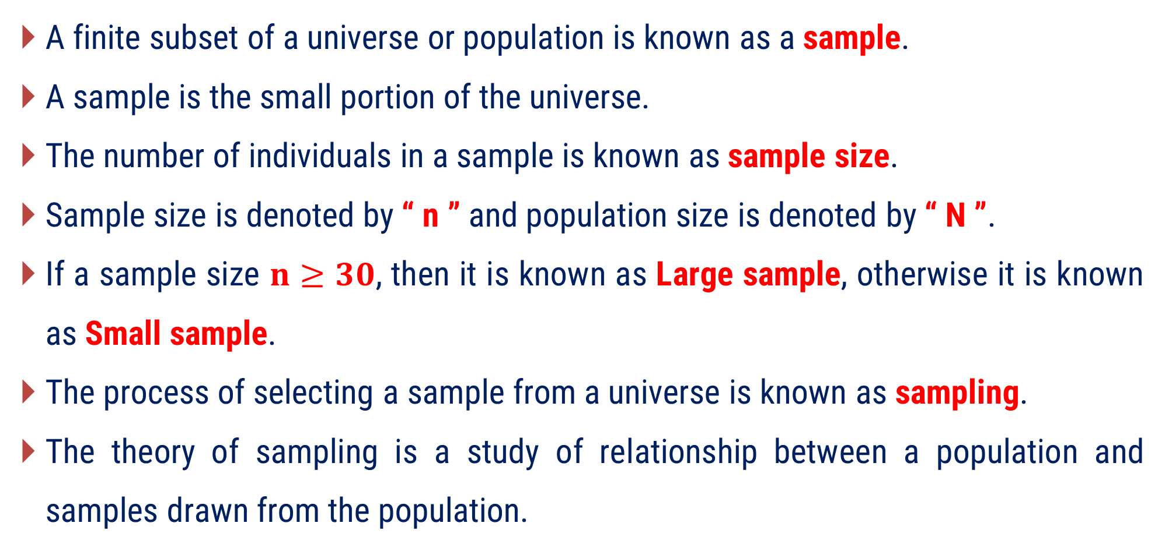
Sampling
A finite subset of a universe or population is known as a sample.
A sample is the small portion of the universe.
The number of individuals in a sample is known as sample size.
Sample size is denoted by “ n ” and population size is denoted by “ N ”.
If a sample size $n≥30$, then it is known as Large sample, otherwise it is known as Small sample.
The process of selecting a sample from a universe is known as sampling.
The theory of sampling is a study of relationship between a population and samples drawn from the population.

Slide 8
Sampling
The fundamental object of sampling is to get as much information as possible of the whole universe by examining only a part of it.
Sampling is a quite often used in our day-to-day life.
For Example:
In a shop we assess the quality of sugar, rice or any commodity by taking only a handful of it from the bag and then decide whether to purchase it or not.

Slide 9
Parameter and Statistics
The statistical constants of population are known as parameter.
The statistical constants of sample are known as statistics.

Slide 10












Parameter and Statistics
Notations for statistical constants are as below:
Statistical Constant | For sample | For Population
No. of elements (Size)
$$n$$
$$N$$
Proportion
$$p$$
$$P$$
Mean
$$\overline{x}$$
$$μ$$
Standard Deviation
$$s$$
$$σ$$
Variance
$$s^{2}$$
$$σ^{2}$$
Correlation Coefficient
$$r$$
$$ρ$$

Slide 11
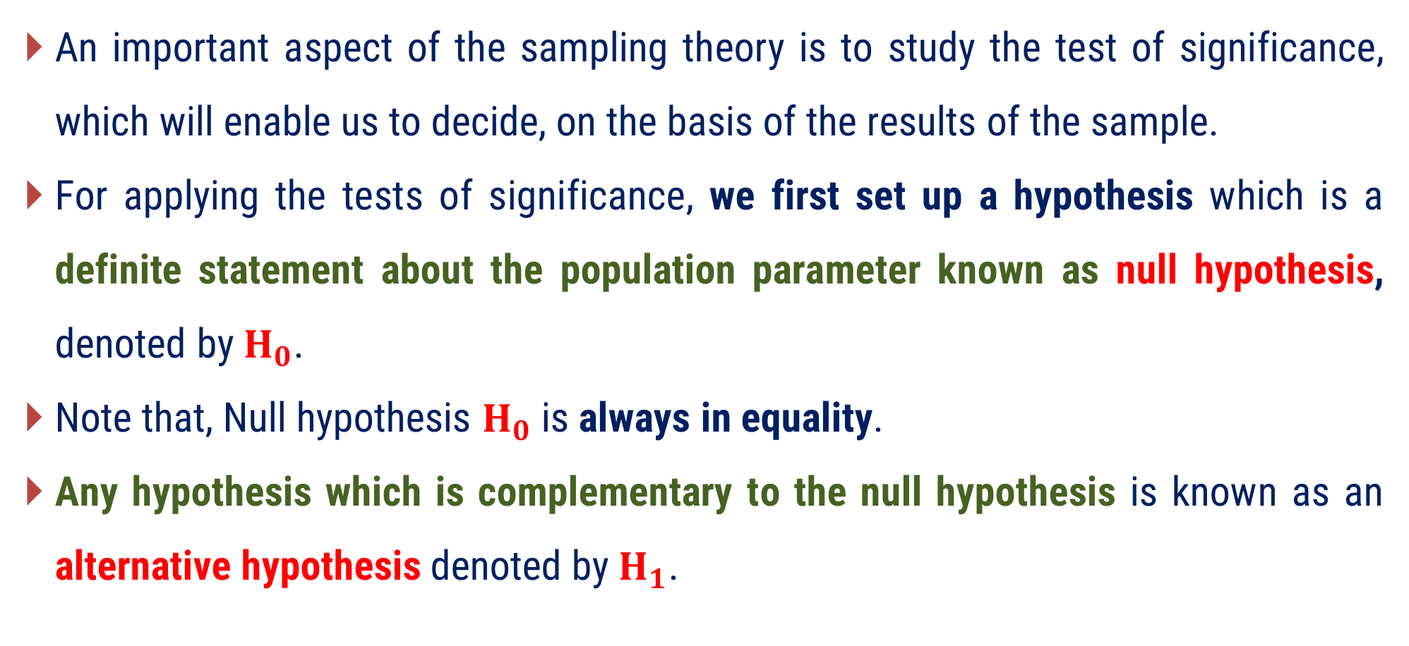
Test of Significance
An important aspect of the sampling theory is to study the test of significance, which will enable us to decide, on the basis of the results of the sample.
For applying the tests of significance, we first set up a hypothesis which is a definite statement about the population parameter known as null hypothesis, denoted by$H_{0}$.
Note that, Null hypothesis $H_{0}$ is always in equality.
Any hypothesis which is complementary to the null hypothesis is known as an alternative hypothesis denoted by$H_{1}$.

Slide 12

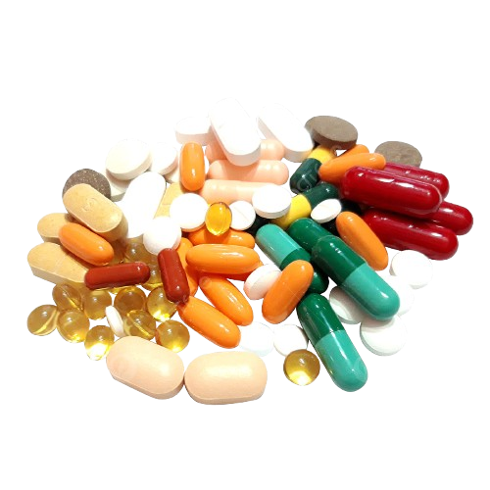

Null Hypothesis and Alternative Hypothesis
Invented new drugs of cancer
True !
Claim: New drug is as effective as the old drug
False !

Slide 13


Null Hypothesis and Alternative Hypothesis
Claim: New drug is as effective as the old drug
False !
$$H_{0}$$
Null Hypothesis
No change, or No difference between old and new drug
True !
$$H_{1}$$
Alternative Hypothesis
New drug is actually better then the old one

Slide 14

Null Hypothesis and Alternative Hypothesis
if we want to test the null hypothesis that the population has a specified mean $μ_{0},$then we have
$H_{0} : μ=μ_{0}$
Note that, Null hypothesis $H_{0}$ is always in equality.

Slide 15
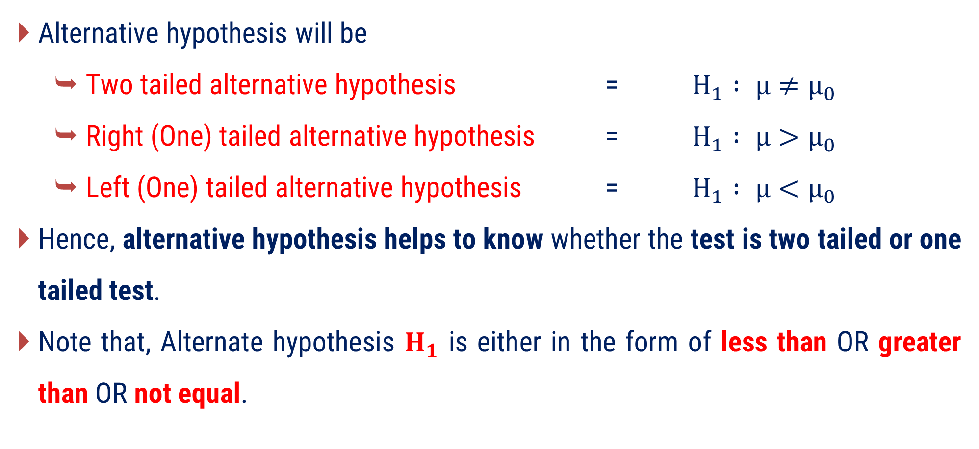
Null Hypothesis and Alternative Hypothesis
Alternative hypothesis will be
Two tailed alternative hypothesis = $H_{1} : μ≠μ_{0}$
Right (One) tailed alternative hypothesis = $H_{1} : μ>μ_{0}$
Left (One) tailed alternative hypothesis = $H_{1} : μ<μ_{0}$
Hence, alternative hypothesis helps to know whether the test is two tailed or one tailed test.
Note that, Alternate hypothesis $H_{1}$ is either in the form of less than OR greater than OR not equal.

Slide 16
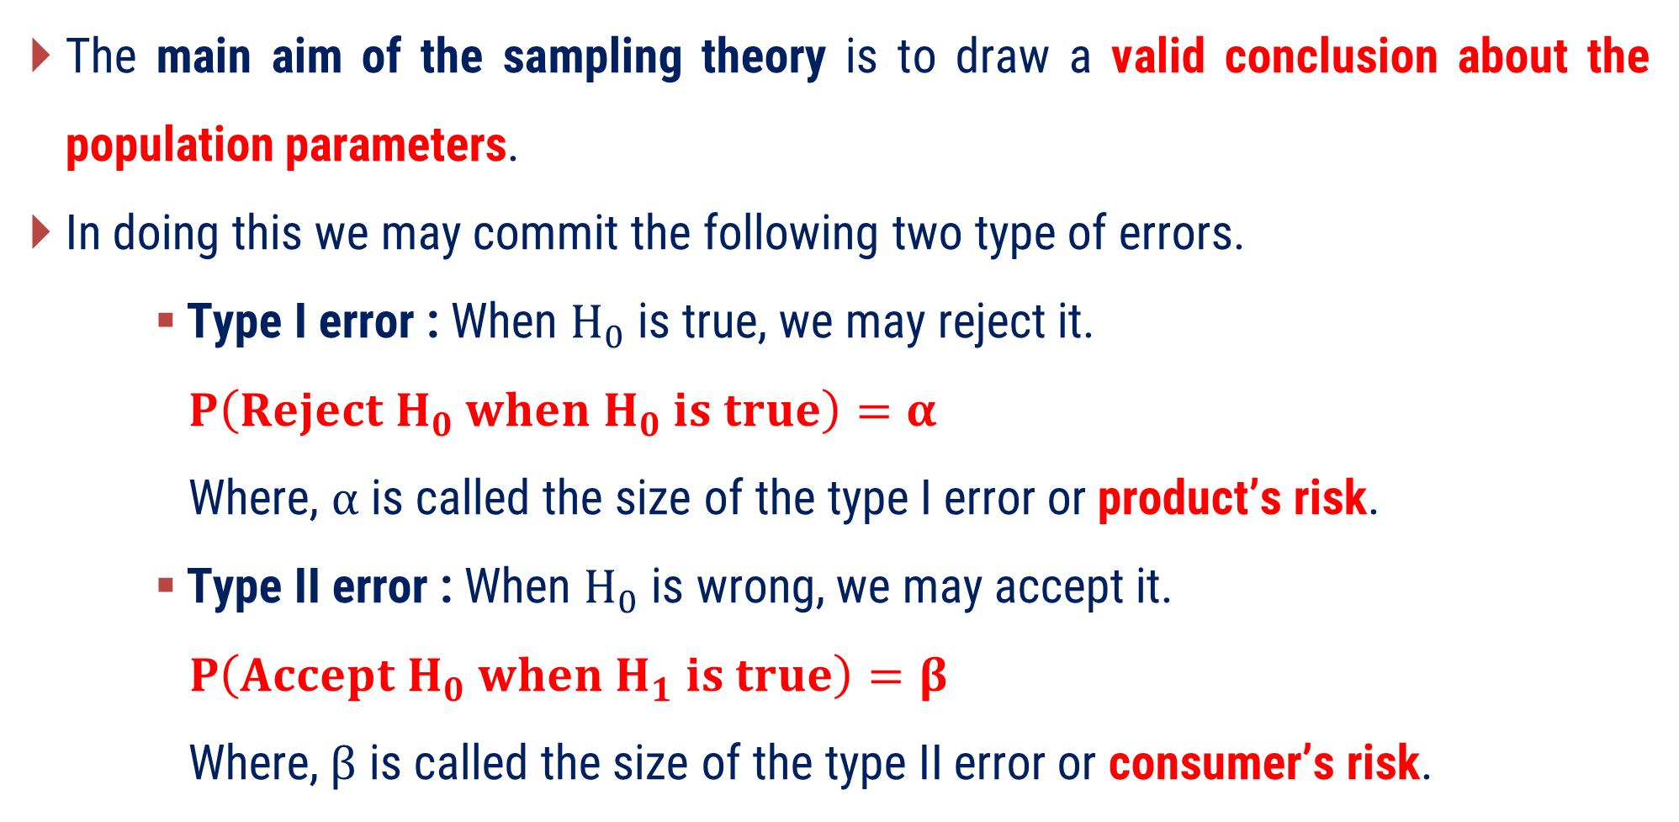
Errors in Sampling
The main aim of the sampling theory is to draw a valid conclusion about the population parameters.
In doing this we may commit the following two type of errors.
Type I error : When $H_{0}$ is true, we may reject it.
$P\left(Reject H_{0} when H_{0} is true\right)=α$
Where, $α$ is called the size of the type I error or product’s risk.
Type II error : When $H_{0}$ is wrong, we may accept it.
$P\left(Accept H_{0} when H_{1} is true\right)=β$
Where,$β$ is called the size of the type II error or consumer’s risk.

Slide 17
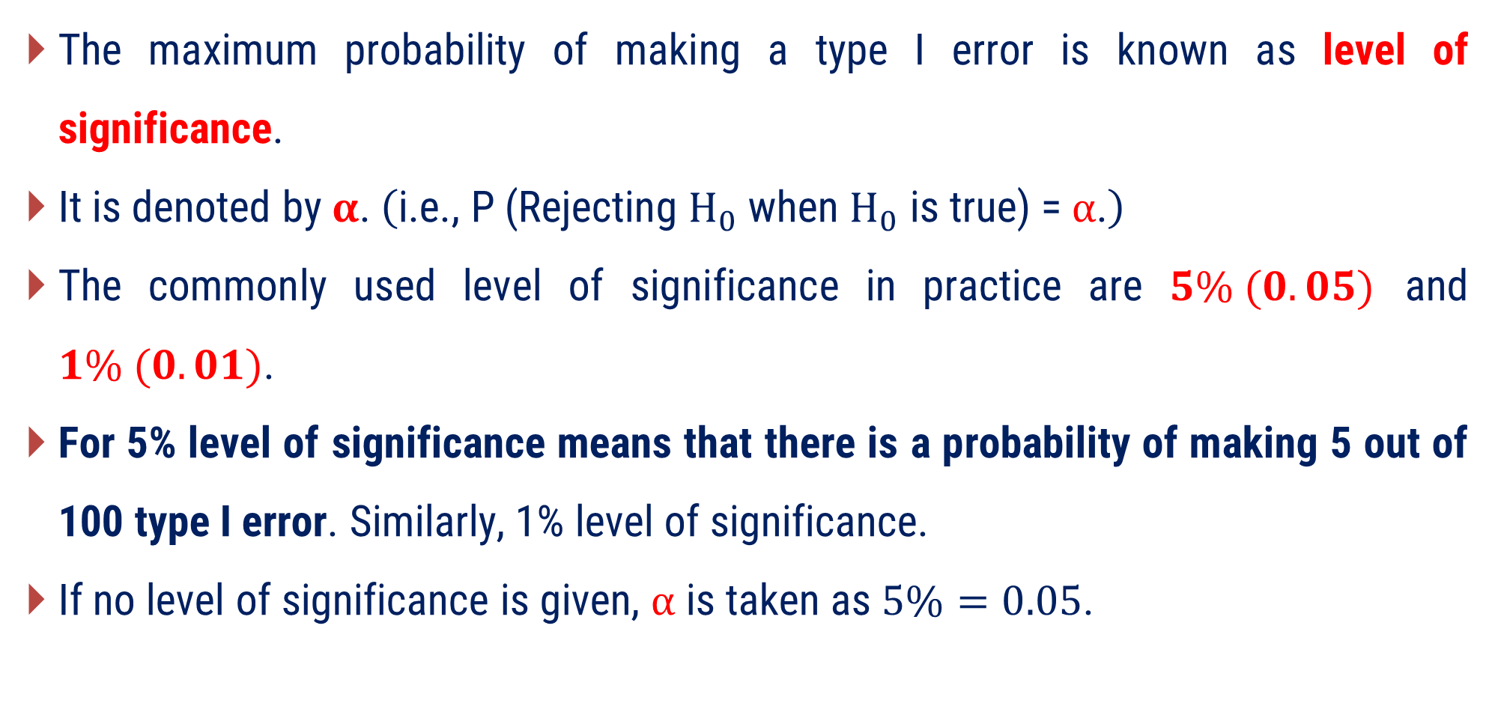
Level of Significance
The maximum probability of making a type I error is known as level of significance.
It is denoted by $α$. $\left(\text{i}\text{.}\text{e}\text{., }\text{P}\text{ (}\text{Rejecting} H_{0} \text{when} H_{0} \text{is} \text{true}\text{) = }α\text{.}\right)$
The commonly used level of significance in practice are $5\% (0.05)$ and $1\% (0.01)$.
For 5% level of significance means that there is a probability of making 5 out of 100 type I error. Similarly, 1% level of significance.
If no level of significance is given, $α$ is taken as $5\%=0.05$.

Slide 18

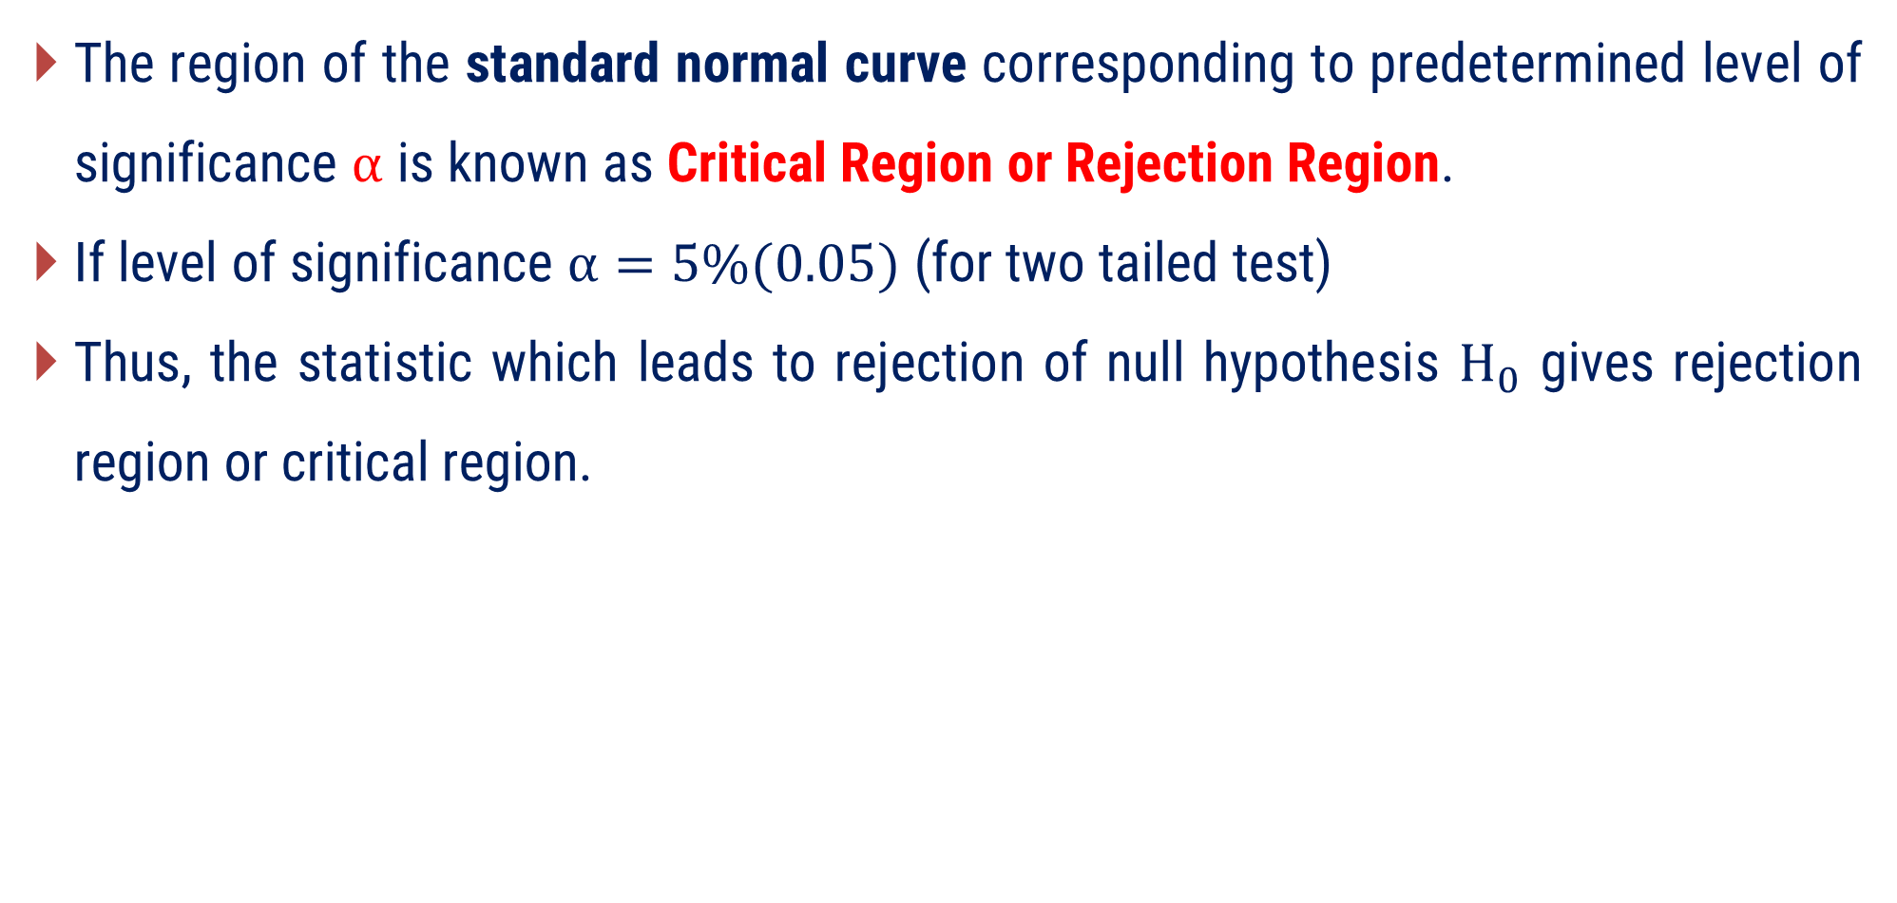
Critical Region
The region of the standard normal curve corresponding to predetermined level of significance $α$ is known as Critical Region or Rejection Region.
If level of significance $α=5\%(0.05)$ (for two tailed test)
Thus, the statistic which leads to rejection of null hypothesis $H_{0}$ gives rejection region or critical region.
Rejection Region
(Critical Region)
Rejection Region
(Critical Region)
$$μ$$

Slide 19


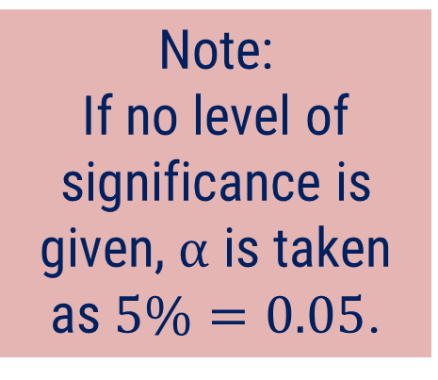
Acceptance Region
The region under the normal curve which is not covered by the rejection region is known as Acceptance Region.
If level of significance $α=5\%(0.05)$ (for two tailed test)
Note:
If no level of significance is given, $α$ is taken as $5\%=0.05$.
Acceptance
Region
$$μ$$

Slide 20

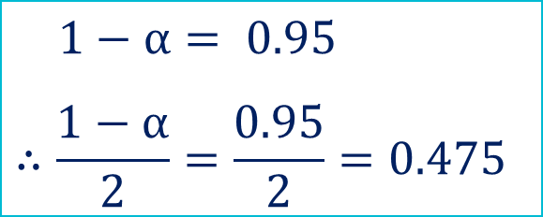








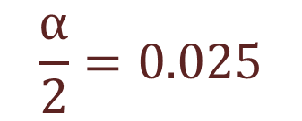

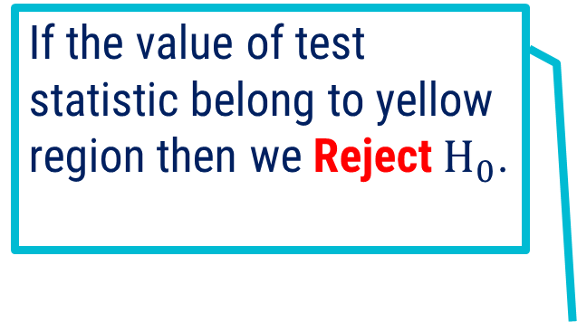
Graphical representation
Two tailed test
L.O.S $α=5\% (0.05)$
$$1−α= 0.95$$
$$∴\frac{1−α}{2}=\frac{0.95}{2}=0.475$$
If the value of test statistic belong to this region then we accept null hypothesis.
$$1−α= 0.95$$
If the value of test statistic belong to yellow region then we Reject$H_{0}$.
$$0.475$$
$$0.475$$
Acceptance
Region
$$\frac{α}{2}=0.025$$
Rejection Region
(Critical Region)
$$\frac{α}{2}=0.025$$
Rejection Region
(Critical Region)
$$μ−1.96σ$$
$$μ+1.96σ$$
$$−1.96σ$$
$$μ$$
$$1.96σ$$
Critical point
Critical point

Slide 21

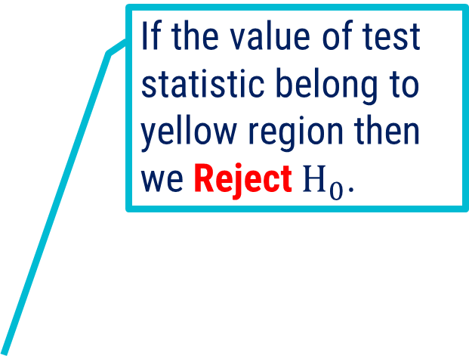




Graphical representation
Right tailed test
L.O.S $α=5\% (0.05)$
If the value of test statistic belong to yellow region then we Reject$H_{0}$.
If the value of test statistic belong to this region then we accept null hypothesis.
$$1−α= 0.95$$
Acceptance
Region
$$α=0.05$$
Rejection Region
(Critical Region)
$$μ$$
$$1.645σ$$
Critical point

Slide 22
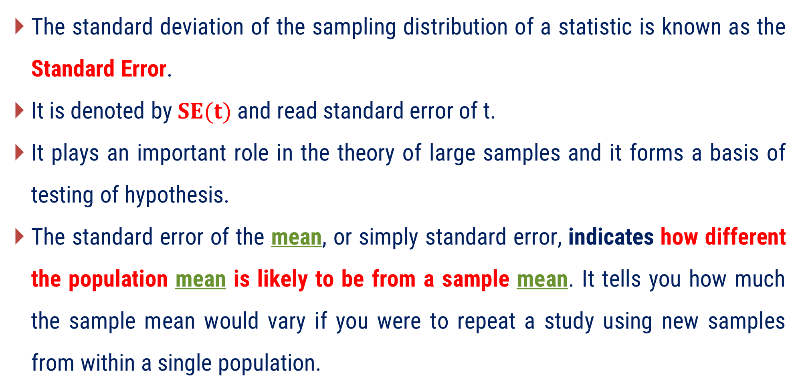
Standard Error
The standard deviation of the sampling distribution of a statistic is known as the Standard Error.
It is denoted by $SE(t)$ and read standard error of t.
It plays an important role in the theory of large samples and it forms a basis of testing of hypothesis.
The standard error of the mean, or simply standard error, indicates how different the population mean is likely to be from a sample mean. It tells you how much the sample mean would vary if you were to repeat a study using new samples from within a single population.

Slide 23
Standard Error
Standard Error : Variability across samples
Sample - A
Sample - B
Sample - C
Standard Deviation : Variability within a samples

Slide 24
Standard Error
For Example:
In a random sample of 200 students, the mean math score is 550.
Suppose, standard deviation of the math scores is 180.
This number reflects on average how much each score differs from the sample mean score of 550.
The standard error of the math scores, tells you how much the sample mean score of 550 differs from other sample mean scores.

Slide 25
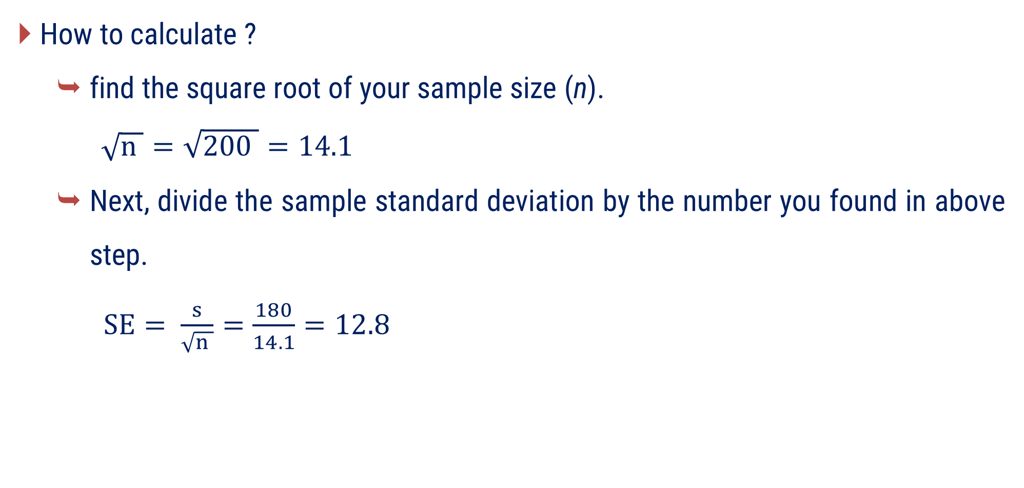
Standard Error
How to calculate ?
find the square root of your sample size (n).
$\sqrt{n }=\sqrt{200 }=14.1$
Next, divide the sample standard deviation by the number you found in above step.
$SE= \frac{s}{\sqrt{n }}=\frac{180}{14.1}=12.8$
Sample size : 200
Mean : 500
SD : 180
Note : SE formula may change. That is depends on context of the population.

Slide 26



Test Statistics
If $t$ is any statistic, for large sample, then test statistics
Expected value of t
$$Z=\frac{t−E(t)}{SE(t)}$$
normally distributed with
mean 0 and variance 1
$$\sim N(0, 1)$$
Standard error of t

Slide 27
Confidence Limit or Confidence Interval
The confidence interval is the range of values that you expect your estimate to fall between a certain percentage of the time if you run your experiment again or re-sample from the population in the same way.
Confidence, in statistics, is another way to describe probability.
For example:
If you construct a confidence interval with a 95% confidence level, you are confident that 95 out of 100 times the estimate will fall between the upper and lower values specified by the confidence interval.

Slide 28

Steps for Testing of Statistical Hypothesis
Set up Null Hypothesis $H_{0}$.
Set up Alternative Hypothesis $H_{1}$.
Set up level of significance $α$.
Apply test statistic.
Set up critical region.
Conclusion.

Slide 29
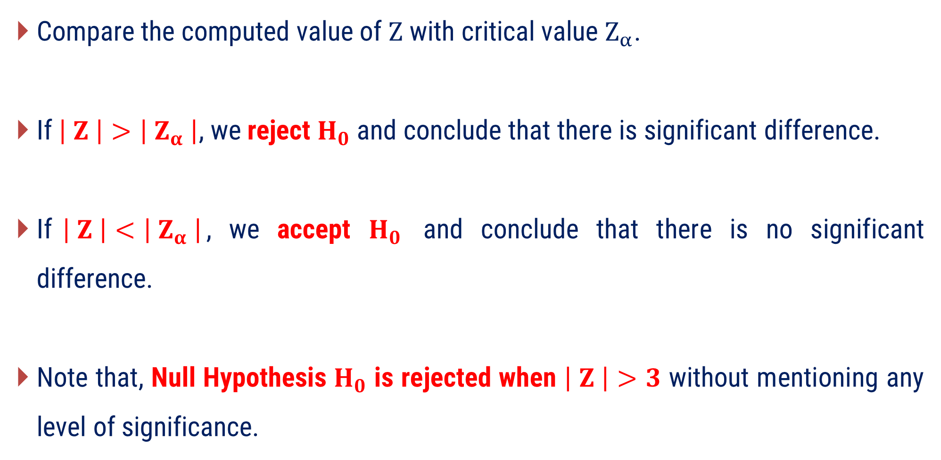
Confidence Limit or Confidence Interval
Compare the computed value of $Z$ with critical value $Z_{α}$.
If$\left| Z \right|>\left| Z_{α} \right|$, we reject $H_{0}$ and conclude that there is significant difference.
If$\left| Z \right|<\left| Z_{α} \right|$, we accept $H_{0}$ and conclude that there is no significant difference.
Note that, Null Hypothesis $H_{0}$ is rejected when $\left| Z \right|>3$ without mentioning any level of significance.

Slide 30
Method – 1 Test for Single Mean

Slide 31

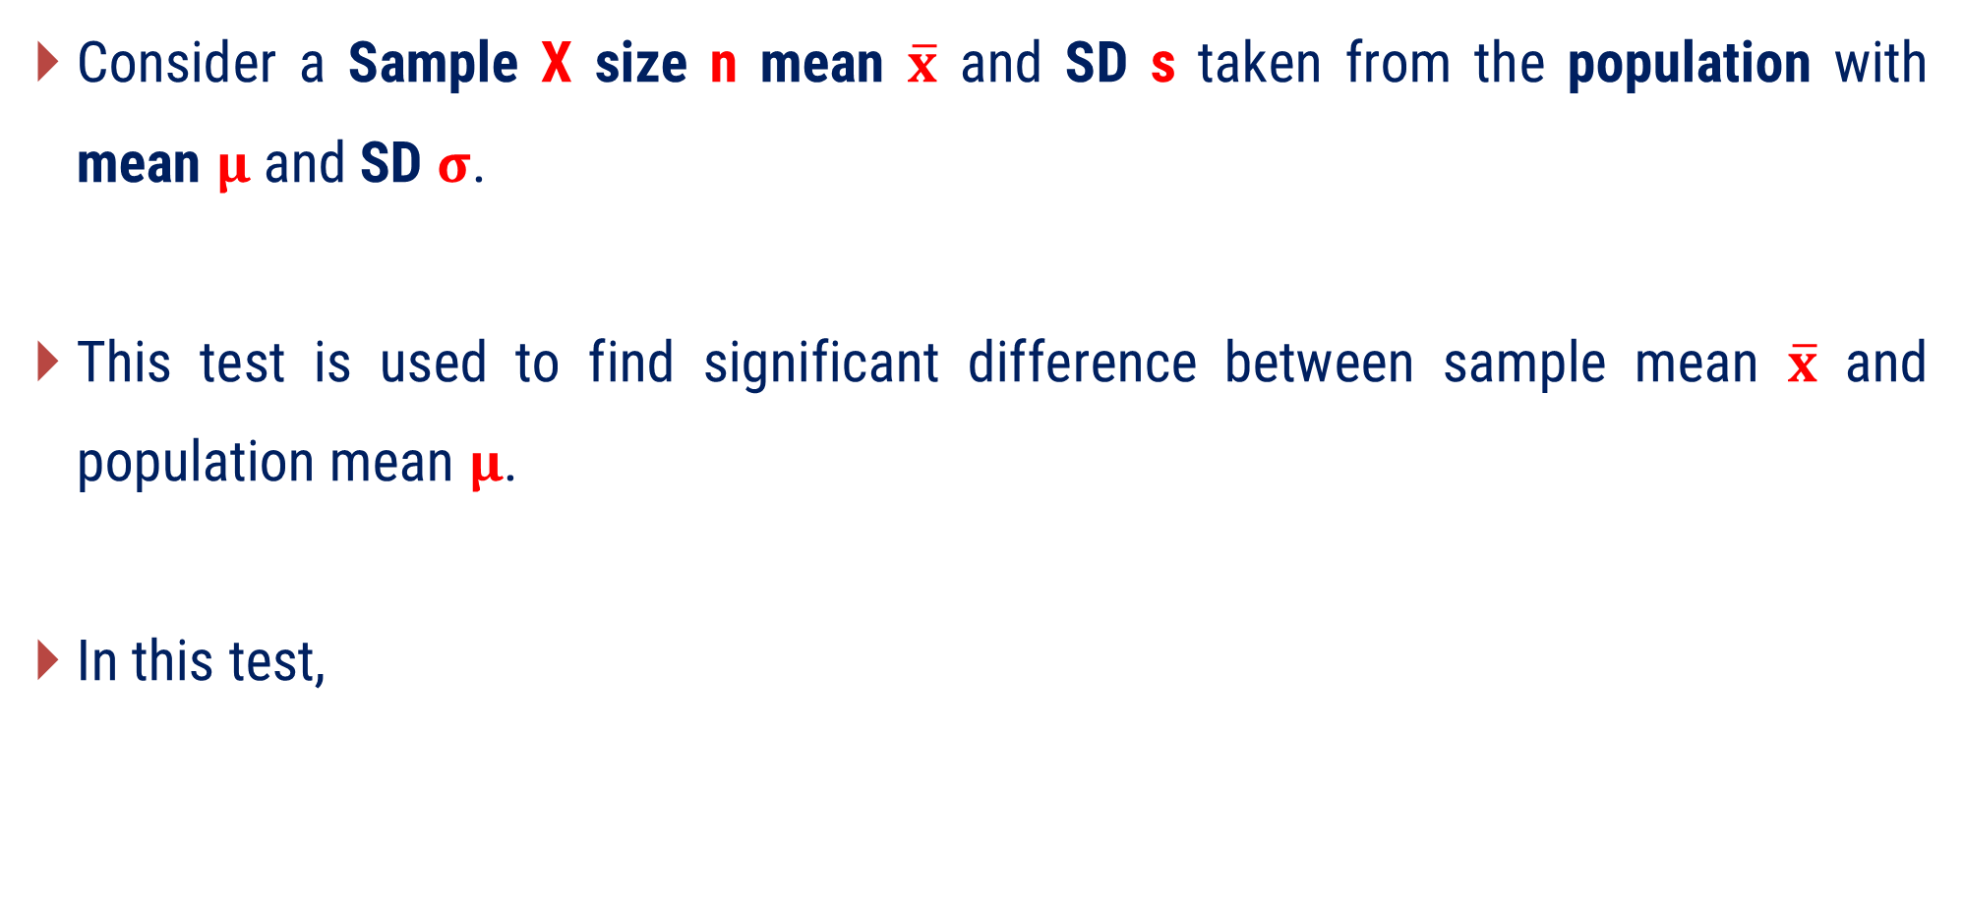
Test for Single Mean
Consider a Sample X size n mean $\overline{x}$ and SD s taken from the population with mean $μ$ and SD $σ$.
This test is used to find significant difference between sample mean $\overline{x}$ and population mean $μ$.
In this test,
$$SE\left(t\right)=\left\{\begin{aligned}& \frac{σ}{\begin{aligned}& \\ &\sqrt{n } \end{aligned}} ; σ is known \\ & \\ & \frac{s}{\begin{aligned}& \\ &\sqrt{n } \end{aligned}} ; σ is unknown\end{aligned}\right.$$

Slide 32



Test for Single Mean
Formula for Test Statistics
When population SD $σ$ is known
When population SD $σ$ is not known
$$Z=\frac{ \overline{ x }−μ }{\begin{aligned}& \\ &\frac{σ}{\begin{aligned}& \\ &\sqrt{n } \end{aligned}}\end{aligned}}$$
$$Z=\frac{ \overline{ x }−μ }{\begin{aligned}& \\ &\frac{s}{\begin{aligned}& \\ &\sqrt{n } \end{aligned}}\end{aligned}}$$

Slide 33

Test for Single Mean
Confidence Limits
Confidence Limits $=\overline{ x } ± Z_{α} SE(t)$
Where, $Z_{α}=$ Critical value at level of Significance$α$

Slide 34
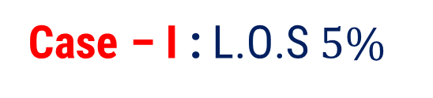
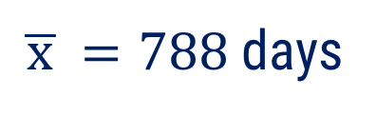
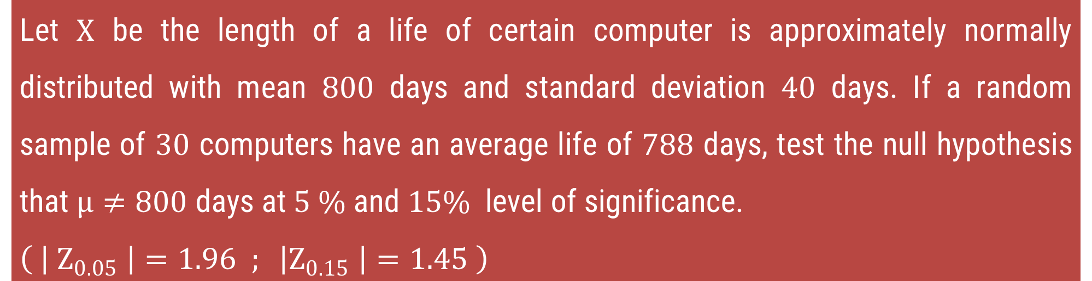

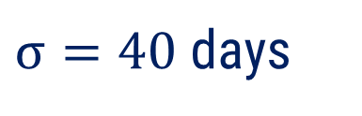
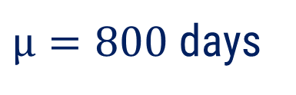
Method 1 ⇝ Example 1
Let $X$ be the length of a life of certain computer is approximately normally distributed with mean $800$ days and standard deviation $40$ days. If a random sample of $30$ computers have an average life of $788$ days, test the null hypothesis that $μ≠800$ days at $5 \%$ and $15\%$ level of significance.
$$\left( \left| Z_{0.05} \right|=1.96 ; \left|Z_{0.15} \right|=1.45 \right)$$
Solution:
Case – I : L.O.S$5\%$
$μ=800$ days
$σ=40$ days
$n=30$
$\overline{ x }=788$ days

Slide 35

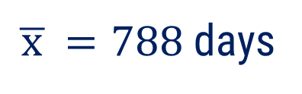
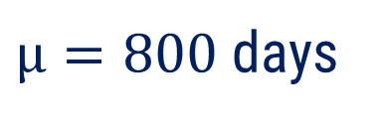

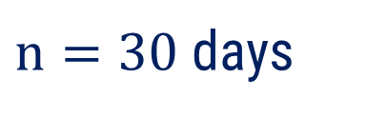

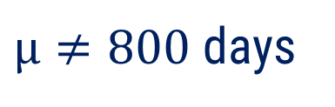



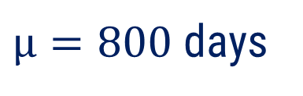

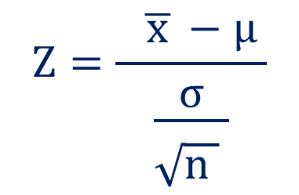
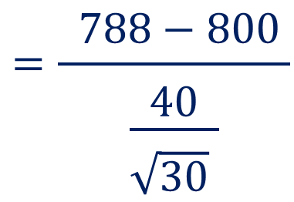
Method 1 ⇝ Example 1
Case – I : L.O.S $5\%$
$μ=800$ days
$H_{0} :$
$μ=800$ days
$n=30$ days
$H_{1} :$
$μ≠800$ days
(Two tailed test)
$σ=40$ days
$\overline{ x }=788$ days
$L.O.S =5\%$
$$Z=\frac{ \overline{ x }−μ }{\begin{aligned}& \\ &\frac{σ}{\begin{aligned}& \\ &\sqrt{n } \end{aligned}}\end{aligned}}$$
$$=\frac{ 788−800 }{\begin{aligned}& \\ &\frac{40}{\begin{aligned}& \\ &\sqrt{30} \end{aligned}}\end{aligned}}$$
$Test$ :
$$=−1.6438$$

Slide 36



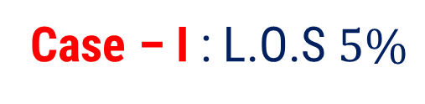



Method 1 ⇝ Example 1
Case – I : L.O.S $5\%$
$$\left| Z_{0.05} \right|=1.96$$
$$Z=−1.6438$$
Conclusion :
$$\left|Z\right|=1.6438$$
$$<$$
$$\left| Z_{0.05} \right|=1.96$$
We accept $H_{0}$
i.e., There is insufficient evidence to suggest that the mean life differs from 800
days at this level.

Slide 37
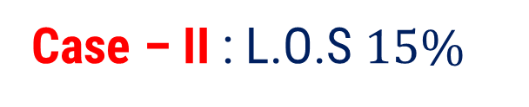


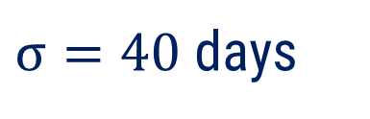


Method 1 ⇝ Example 1
Case – II : L.O.S $15\%$
$μ=800$ days
$H_{0} :$
$μ=800$ days
$n=30$ days
$σ=40$ days
$H_{1} :$
$μ≠800$ days
(Two tailed test)
$\overline{ x }=788$ days
$L.O.S =15\%$
$$Z=\frac{ \overline{ x }−μ }{\begin{aligned}& \\ &\frac{σ}{\begin{aligned}& \\ &\sqrt{n } \end{aligned}}\end{aligned}}$$
$$=\frac{ 788−800 }{\begin{aligned}& \\ &\frac{40}{\begin{aligned}& \\ &\sqrt{30} \end{aligned}}\end{aligned}}$$
$Test$ :
$$=−1.6438$$

Slide 38


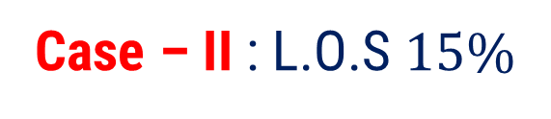


Method 1 ⇝ Example 1
Case – II : L.O.S $15\%$
$$\left|Z_{0.15} \right|=1.45$$
$$Z=−1.6438$$
Conclusion :
$$\left|Z\right|=1.6438$$
$$>$$
$$\left| Z_{0.15} \right|=1.45$$
We reject $H_{0}$
i.e., There is sufficient evidence to suggest that the mean life differs from 800
days at this level.

Slide 39










Method 1 ⇝ Example 2
The mean IQ of a sample of 1600 children was 99. Is it likely that this was a random sample from a population with mean IQ 100 and SD 15? $\left( \left| Z_{0.05} \right|=1.96 \right)$
Solution:
$μ=100$
$σ=15$
$n=1600$
$$\overline{ x }=99$$
$H_{0} :$
$μ=100$
$H_{1} :$
$μ≠100$
(Two tailed test)
$L.O.S =5\%$

Slide 40
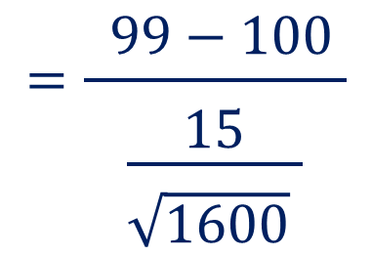


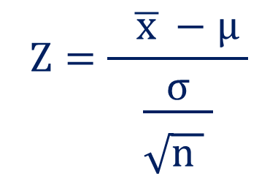








Method 1 ⇝ Example 2
$$Z=\frac{ \overline{ x }−μ }{\begin{aligned}& \\ &\frac{σ}{\begin{aligned}& \\ &\sqrt{n } \end{aligned}}\end{aligned}}$$
$$=\frac{ 99−100 }{\begin{aligned}& \\ &\frac{15}{\begin{aligned}& \\ &\sqrt{1600} \end{aligned}}\end{aligned}}$$
$μ=100$
$Test$ :
$n=1600$
$σ=15$
$$=−2.6667$$
$$\overline{ x }=99$$
Conclusion :
$$\left|Z\right|=2.6667$$
$$>$$
$$\left| Z_{0.05} \right|=1.96$$
We reject $H_{0}$
i.e., Sample do not come from the population with mean IQ 100 and SD 15.

Slide 41
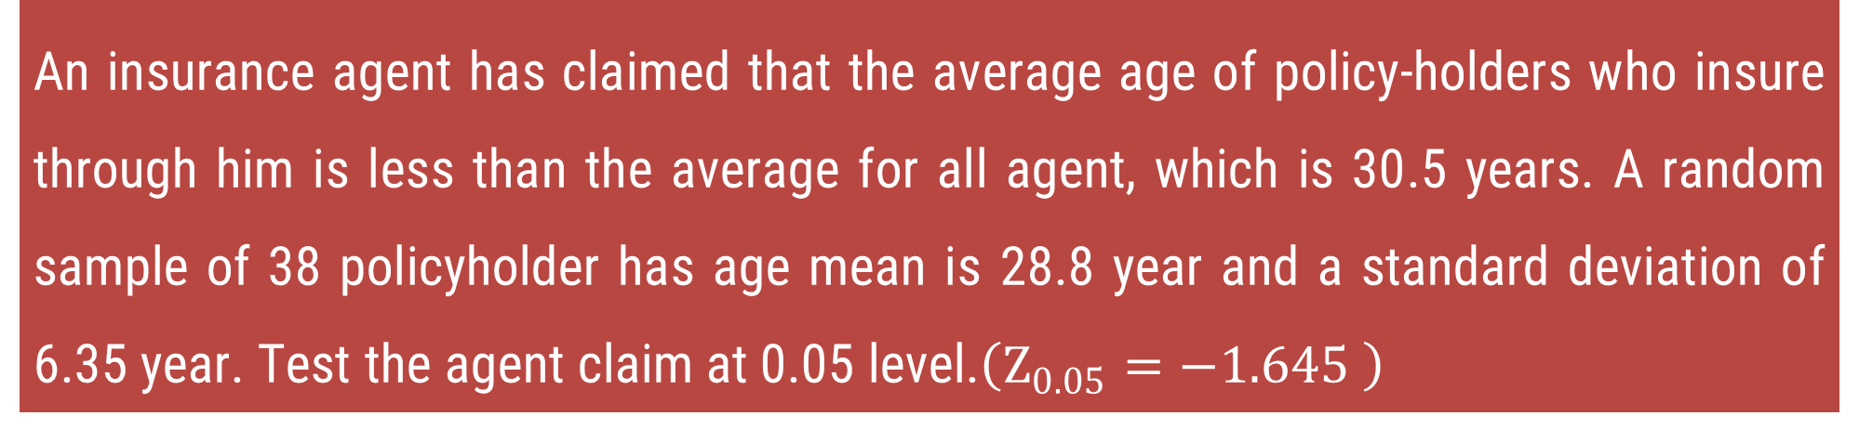
Method 1 ⇝ Example 3
An insurance agent has claimed that the average age of policy-holders who insure through him is less than the average for all agent, which is 30.5 years. A random sample of 38 policyholder has age mean is 28.8 year and a standard deviation of 6.35 year. Test the agent claim at 0.05 level.$\left(Z_{0.05}=−1.645 \right)$
Solution:
What is this question asking?
An insurance agent is claiming that his customers are younger than the overall average customer age, which is 30.5 years.
એક વીમા એજન્ટ દાવો કરે છે કે તેની પાસેથી વીમો લેવા વાળા લોકોની ઉંમર 30.5 વર્ષ કરતા ઓછી હોય છે.

Slide 42
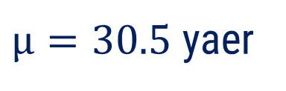
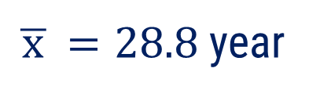


Method 1 ⇝ Example 3
An insurance agent has claimed that the average age of policy-holders who insure through him is less than the average for all agent, which is 30.5 years. A random sample of 38 policyholder has age mean is 28.8 year and a standard deviation of 6.35 year. Test the agent claim at 0.05 level.$\left(Z_{0.05}=−1.645 \right)$
Solution:
$μ=30.5$ yaer
$s=6.35$ year
$n=38$
$\overline{ x }=28.8$ year

Slide 43
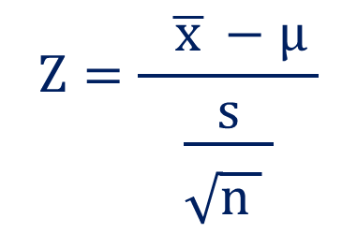
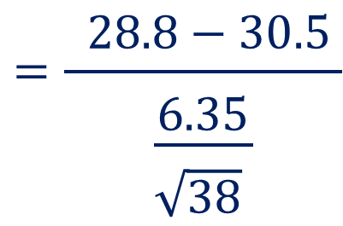







Method 1 ⇝ Example 3
$H_{0} :$
$μ=30.5$ year
$μ=30.5$ years
$n=38$
$H_{1} :$
$μ<30.5$ days
(Left tailed test)
$s=6.35$ years
$L.O.S =5\%$
$\overline{ x }=28.8$ years
$$Z=\frac{ \overline{ x }−μ }{\begin{aligned}& \\ &\frac{s}{\begin{aligned}& \\ &\sqrt{n } \end{aligned}}\end{aligned}}$$
$$=\frac{ 28.8−30.5 }{\begin{aligned}& \\ &\frac{6.35}{\begin{aligned}& \\ &\sqrt{38} \end{aligned}}\end{aligned}}$$
$Test$ :
$$=−1.6503$$

Slide 44





Method 1 ⇝ Example 3
$$Z=−1.6503$$
Conclusion :
$$\left|Z\right|=1.6503$$
$$>$$
$$\left| Z_{0.05} \right|=1.645$$
We reject $H_{0}$
i.e., There is sufficient evidence to support the insurance agent's claim that the
average age of policyholders who insure through him is less than 30.5 years
at the 0.050 level of significance.

Slide 45










Method 1 ⇝ Example 4
A college claims that its average class size is $35$ students. A random sample of $64$ students from college has a mean of $37$ with a standard deviation of $6$. Test at the $α=0.05$ level of significance if the claimed value is too low.$\left( Z_{0.05}=1.645 \right)$
Solution:
$μ=35$ students
$s=6$ students
$n=64$
$\overline{ x }=37$ students
$H_{0} :$
$μ=35$ students
$H_{1} :$
$μ>35$ students
(Right tailed test)
Is the actual class size bigger than what the college claims (35 students)?
$L.O.S =5\%$

Slide 46













Method 1 ⇝ Example 4
$$Z_{0.05}=1.645$$
$$Z=\frac{ \overline{ x }−μ }{\begin{aligned}& \\ &\frac{s}{\begin{aligned}& \\ &\sqrt{n } \end{aligned}}\end{aligned}}$$
$$=\frac{ 37−35 }{\begin{aligned}& \\ &\frac{6}{\begin{aligned}& \\ &\sqrt{64} \end{aligned}}\end{aligned}}$$
$μ=35$ student
$Test$ :
$n=64$
$s=6$ student
$$=2.67$$
$\overline{ x }=37$ student
Conclusion :
$$\left|Z\right|=2.67$$
$$>$$
$$\left| Z_{0.05} \right|=1.645$$
We reject $H_{0}$
i.e., There is strong evidence that the actual class size is greater than 35 students. The college’s claim of an average class size of 35 is too low.

Slide 47
Method – 2 Test for Difference of Mean

Slide 48


Test for Difference of Mean
Consider a two sample $X_{1}$ and $X_{2}$ size $n_{1}$ and $n_{2}$, mean $\overline{{ x}_{1}}$ and $\overline{{ x}_{2}}$ SD $s_{1}$ and $s_{2}$ respectively taken from two different population with size $N_{1}$ and $N_{2}$, mean $\overline{{ μ}_{1}}$ and $\overline{{ μ}_{2}}$ and SD $σ_{1}$ and $σ_{2}$.
This test is used to find significant difference between sample mean $\overline{{ x}_{1}}$ and $\overline{{ x}_{2}}$.
In this test,
$$SE\left(t\right)=\left\{\begin{aligned}& \sqrt{\frac{{σ_{1}}^{2}}{n_{1}}+\frac{{σ_{2}}^{2}}{n_{2}}}; σ is known \\ & \\ &\sqrt{\frac{{s_{1}}^{2}}{n_{1}}+\frac{{s_{2}}^{2}}{n_{2}}}; σ is unknown\end{aligned}\right.$$

Slide 49


Test for Difference of Mean
Formula for Test Statistics
When population SD $σ$ is known
When population SD $σ$ is not known
$$Z=\frac{ \overline{ x_{1}}−\overline{ x_{2}}}{\begin{aligned}& \\ &\sqrt{\frac{{{ σ}_{1}}^{2} }{n_{1}}+\frac{{ σ_{2}}^{2} }{n_{2}}}\end{aligned}}$$
$$Z=\frac{\overline{ x_{1}}−\overline{ x_{2}}}{\begin{aligned}& \\ &\sqrt{\frac{{{ s}_{1}}^{2} }{n_{1}}+\frac{ {s_{2}}^{2} }{n_{2}}}\end{aligned}}$$

Slide 50

Test for Difference of Mean
Confidence Limits
Confidence Limits $=( \overline{ x_{1}}−\overline{ x_{2}} )± Z_{α} SE(t)$
Where, $Z_{α}=$ Critical value at level of Significance $α$

Slide 51







Method 2 ⇝ Example 1
Test the significance of the difference between the means of two normal population with the same standard deviation from the following data:
$\left( Z_{0.05}=1.96 \right)$
 | Size | Mean | SD
Sample I | 100 | 64 | 6
Sample II | 200 | 67 | 8
Solution:
$$n_{1}=100$$
$$\overline{ x_{1}}=64$$
$$s_{1}=6$$
$$n_{2}=200$$
$$\overline{ x_{2}}=67$$
$$s_{2}=8$$

Slide 52
















Method 2 ⇝ Example 1
$H_{0} :$
$$μ_{1}=μ_{2}$$
$$n_{1}=100$$
$H_{1} :$
$$μ_{1}≠μ_{2}$$
(Two tailed test)
$$n_{2}=200$$
$L.O.S =5\%$
$$\overline{ x_{1}}=64$$
$$Z=\frac{ \overline{ x_{1}}−\overline{ x_{2}}}{\begin{aligned}& \\ &\sqrt{\frac{{{ s}_{1}}^{2} }{n_{1}}+\frac{{ s_{2}}^{2} }{n_{2}}}\end{aligned}}$$
$$=\frac{ 64−67 }{\begin{aligned}& \\ &\end{aligned}\sqrt{\frac{36}{ 100 }+\frac{64}{ 200 }}}$$
$$\overline{ x_{2}}=67$$
$Test$ :
$$s_{1}=6$$
$$s_{2}=8$$
$$=\frac{ −3}{\begin{aligned}& \\ &\end{aligned}0.8246}$$
$$=−3.6381$$

Slide 53





Method 2 ⇝ Example 1
Conclusion :
$$Z_{0.05}=1.96$$
$$>$$
$$Z_{0.05}=1.96$$
$$|Z| =3.6381$$
$∴$ We reject $H_{0}$
i.e., There is a significant difference between the means of the two samples.

Slide 54








Method 2 ⇝ Example 2
In a random sample of 100 light bulbs manufactured by a company A, the mean lifetime of light bulb is 1190 hours with standard deviation of 90 hours. Also, in a random sample of 75 light bulbs manufactured by company B, the mean lifetime of light bulb is 1230 hours with standard deviation of 120 hours. Is there a difference between the mean lifetime of the two brands of light bulbs at a significance level of 0.05 and 0.01? $\left( Z_{0.05}=1.96 \right)$ $\left( Z_{0.01}=2.58 \right)$
Solution:
Case – I : L.O.S $5\%$
$$n_{1}=100$$
$\overline{ x_{1}}=1190$hr
$s_{1}=90$hr
$$n_{2}=75$$
$\overline{ x_{2}}=1230$hr
$s_{2}=120$ hr

Slide 55

















Method 2 ⇝ Example 2
Case – I : L.O.S $5\%$
$$n_{1}=100$$
$H_{0} :$
$$μ_{1}=μ_{2}$$
$$n_{2}=75$$
$H_{1} :$
$$μ_{1}≠μ_{2}$$
(Two tailed test)
$$\overline{ x_{1}}=1190$$
$L.O.S =0.05=5\%$
$$\overline{ x_{2}}=1230$$
$$Z=\frac{ \overline{ x_{1}}−\overline{ x_{2}}}{\begin{aligned}& \\ &\sqrt{\frac{{{ s}_{1}}^{2}}{n_{1}}+\frac{{{ s}_{2}}^{2}}{n_{2}}}\end{aligned}}$$
$$=\frac{ 1190−1230 }{\begin{aligned}& \\ &\end{aligned}\sqrt{\frac{ 8100 }{ 100 }+\frac{ 14400 }{ 75 }}}$$
$Test$ :
$$s_{1}=90$$
$$s_{2}=120$$
$$=\frac{ −40}{\begin{aligned}& \\ &\end{aligned}16.5227 }$$
$$=−2.4209$$

Slide 56





Method 2 ⇝ Example 2
Conclusion :
$$|Z_{0.05}| =1.96$$
$$>$$
$$|Z| =2.4209$$
$$|Z_{0.05}| =1.96$$
$∴$ we reject $H_{0 }$
i.e., There is significant difference between the mean life time of company A
light bulbs and company B light bulbs.

Slide 57















Method 2 ⇝ Example 2
Case – II : L.O.S $1\%$
$$n_{1}=100$$
$H_{0} :$
$$μ_{1}=μ_{2}$$
$$n_{2}=75$$
$H_{1} :$
$$μ_{1}≠μ_{2}$$
(Two tailed test)
$$\overline{ x_{1}}=1190$$
$L.O.S =0.01=1\%$
$$\overline{ x_{2}}=1230$$
$$Z=\frac{ \overline{ x_{1} }−\overline{ x_{2} }}{\begin{aligned}& \\ &\sqrt{\frac{{s_{1}}^{2}}{n_{1}}+\frac{{s_{2}}^{2}}{n_{2}}}\end{aligned}}$$
$$=\frac{ 1190−1230 }{\begin{aligned}& \\ &\end{aligned}\sqrt{\frac{8100}{ 100 }+\frac{14400 }{ 75 }}}$$
$Test$ :
$$s_{1}=90$$
$$s_{2}=120$$
$$=\frac{ −40}{\begin{aligned}& \\ &\end{aligned}16.5227 }$$
$$=−2.4209$$

Slide 58




Method 2 ⇝ Example 2
Conclusion :
$$|Z_{0.01}| =2.58$$
$$<$$
$$|Z| =2.4209$$
$$|Z_{0.01}| =2.58$$
$∴$ we accept $H_{0 }$
i.e., There is no significant difference between the mean life time of company A
light bulbs and company B light bulbs.

Slide 59

Method 2 ⇝ Example 3
A company A manufactured tube lights and claims that its tube lights are superior than its main competitor company B. The study showed that a sample of 40 tube lights manufactured by company A has a mean lifetime of 647 hours of continuous use with a standard deviation of 27 hours, while a sample of 40 tube lights manufactured by company B had a mean lifetime 638 hours of continuous use with a standard deviation of 31 hours. Does this substantiate the claim of company A that their tube lights are superior than manufactured by company B at 0.05 level of significance? $\left( Z_{0.05}=1.645 \right)$

Slide 60





Method 2 ⇝ Example 3
Solution:
$$n_{1}=40$$
$H_{0} :$
$μ_{1}=μ_{2}$ (i.e. company’s claim is invalid)
$$n_{2}=40$$
$\overline{ x_{1}}=64$7
$H_{1} :$
$$μ_{1}>μ_{2}$$
(Right tailed test)
$$\overline{ x_{2}}=638$$
$L.O.S =5\%=0.05\%$
$$s_{1}=27$$
$$Z=\frac{ \overline{ x_{1} }−\overline{ x_{2} }}{\begin{aligned}& \\ &\sqrt{\frac{{ s_{1}}^{2}}{n_{1}}+\frac{{ s_{2}}^{2}}{n_{2}}}\end{aligned}}$$
$$=\frac{ 647−638 }{\begin{aligned}& \\ &\end{aligned}\sqrt{\frac{ 729 }{ 40 }+\frac{ 961 }{ 40 }}}$$
$Test$ :
$$s_{2}=31$$
$$=1.3846$$

Slide 61
Method 2 ⇝ Example 3
Conclusion :
$$|Z_{0.05}| =1.645$$
$$<$$
$$|Z| =1.3846$$
$$|Z_{0.05}| =1.645$$
$∴$ we accept $H_{0 }$
i.e., at 5% , The claim of company A is not valid.

Slide 62




Method 2 ⇝ Example 4
The average of marks scored by 32 boys is 72 with standard deviation 8 while that of 36 girls is 70 with standard deviation 6. Test at 1% level of significance whether the boys perform better than the girls.$\left( Z_{0.01}=1.645 \right)$
Solution:
$$n_{1}=32$$
$$\overline{ x_{1}}=72$$
$$s_{1}=8$$
$$n_{2}=36$$
$$\overline{ x_{2}}=70$$
$$s_{2}=6$$
$H_{0} :$
$$μ_{1}=μ_{2}$$
(i.e. there is no difference in performance)
$H_{1} :$
$$μ_{1}>μ_{2}$$
(Right tailed test)
$L.O.S =1\%$

Slide 63















Method 2 ⇝ Example 4
$$Z=\frac{ \overline{ x_{1} }−\overline{ x_{2} }}{\begin{aligned}& \\ &\sqrt{\frac{{{ s}_{1}}^{2}}{n_{1}}+\frac{{{ s}_{2}}^{2}}{n_{2}}}\end{aligned}}$$
$$=\frac{ 72−70 }{\begin{aligned}& \\ &\end{aligned}\sqrt{\frac{ 64 }{32}+\frac{ 36 }{36}}}$$
$$n_{1}=32$$
$Test$ :
$$n_{2}=36$$
$$\overline{ x_{1}}=72$$
$$=1.1547$$
$$\overline{ x_{2}}=70$$
Conclusion :
$$s_{1}=8$$
$$<$$
$$|Z| =1.1547$$
$$|Z_{0.01}| =1.645$$
$$s_{2}=6$$
$∴$ we accept $H_{0 }$
$$|Z_{0.01}| =1.645$$
i.e., The boys do not perform better than the girls.

Slide 64
Method – 3 Test for Difference of Standard Deviation

Slide 65


Test for Difference of Standard Deviation
Consider a two sample $X_{1}$ and $X_{2}$ size $n_{1}$ and $n_{2}$, SD $s_{1}$ and $s_{2}$ respectively taken from two different population with size $N_{1}$ and $N_{2}$ and SD $σ_{1}$ and $σ_{2}$.
This test is used to find significant difference between sample SD $s_{1}$and $s_{2}$.
In this test,
$$SE\left(t\right)=\left\{\begin{aligned}& \sqrt{\frac{{σ_{1}}^{2}}{{2n}_{1}}+\frac{{σ_{2}}^{2}}{{2n}_{2}}}; σ is known \\ & \\ &\sqrt{\frac{{s_{1}}^{2}}{{2n}_{1}}+\frac{{s_{2}}^{2}}{{2n}_{2}}}; σ is unknown\end{aligned}\right.$$

Slide 66



Test for Difference of Standard Deviation
Formula for Test Statistics
When population SD $σ$ is known
When population SD $σ$ is not known
$$Z=\frac{ s_{1}−s_{2}}{\begin{aligned}& \\ &\sqrt{\frac{{{ σ}_{1}}^{2} }{2n_{1}}+\frac{{{ σ}_{2}}^{2} }{{2n}_{2}}}\end{aligned}}$$
$$Z=\frac{s_{1}−s_{2}}{\begin{aligned}& \\ &\sqrt{\frac{{{ s}_{1}}^{2} }{{2n}_{1}}+\frac{{ { s}_{2}}^{2} }{{2n}_{2}}}\end{aligned}}$$

Slide 67

Test for Difference of Standard Deviation
Confidence Limits
Confidence Limits $=(s_{1}−s_{2})± Z_{α} SE(t)$
Where, $Z_{α}=$ Critical value at level of Significance $α$

Slide 68










Method 3 ⇝ Example 1
The SD of a random sample of 900 members is 4.6 and that of another independent sample of 1600 members is 4.8. Examine if the two samples could have been drawn from a population with SD 4? $\left( Z_{0.05}=1.96 \right)$
Solution:
$$n_{1}=900$$
$$s_{1}=4.6$$
$$n_{2}=1600$$
$$s_{2}=4.8$$
$H_{0} :$
$$σ_{1}=σ_{2}=4$$
$H_{1} :$
$$σ_{1}≠σ_{2}$$
(Two tailed test)
$L.O.S =0.05\%$

Slide 69













Method 3 ⇝ Example 1
$$=\frac{ 4.6−4.8 }{\begin{aligned}& \\ &\end{aligned}\sqrt{\frac{ 21.1600 }{1800}+\frac{ 23.040 }{3200}}}$$
$$n_{1}=900$$
$$Z=\frac{ s_{1}−s_{2}}{\begin{aligned}& \\ &\sqrt{\frac{{{ s}_{1}}^{2}}{{ 2n}_{1} }+\frac{{{ s}_{2}}^{2} }{ 2n_{2} }}\end{aligned}}$$
$Test$ :
$$n_{2}=1600$$
$$s_{1}=4.6$$
$$=−1.4514$$
$$s_{2}=4.8$$
$$Z_{0.05}=1.96$$
Conclusion :
$$<$$
$$|Z| =1.4514$$
$$|Z_{0.05}| =1.96$$
$∴$ we accept $H_{0 }$
i.e., samples could have been drawn from the population having same standard
deviation.

Slide 70









Method 3 ⇝ Example 2
Random samples drawn from two countries gave the following data relating to the heights of adult males:
$\left( Z_{0.05}=1.96 \right)$
$\left( Z_{0.05}=1.96 \right)$
 | Country A | Country B
Standard Deviation | 2.58 | 2.50
Number in samples | 1000 | 1200
Solution:
$$n_{1}=1000$$
$$n_{2}=1200$$
$$s_{1}=2.58$$
$$s_{2}=2.50$$
$H_{0} :$
$$σ_{1}=σ_{2}$$
(There is no significant difference between SD.)
$H_{1} :$
$$σ_{1}≠σ_{2}$$
(Two tailed test)

Slide 71











Method 3 ⇝ Example 2
$$n_{1}=1000$$
$L.O.S =5\%$
$$=\frac{ 2.58−2.50}{\begin{aligned}& \\ &\end{aligned}\sqrt{\frac{ 6.6564 }{2000}+\frac{ 6.2500 }{2400}}}$$
$$n_{2}=1200$$
$Test$ :
$$Z=\frac{ s_{1}−s_{2}}{\begin{aligned}& \\ &\sqrt{\frac{ { s_{1}}^{2} }{{2n}_{1}}+\frac{ {s_{2}}^{2} }{2n_{2}}}\end{aligned}}$$
$$s_{1}=2.58$$
$$s_{2}=2.50$$
$$=1.0390$$
$$Z_{0.05}=1.96$$
Conclusion :
$$<$$
$$|Z| =1.0390$$
$$|Z_{0.05}| =1.96$$
$∴$ we accept $H_{0 }$
i.e., There is no significant difference between sample SDs.

Slide 72
Hypothesis Testing for Small Sample

Slide 73

Introduction
If the sample are large$\left(n>30\right)$ then the sampling distribution of a statistics is normal. But if the samples are small $\left(n<30\right)$ then method that we have seen in previous does not hold good.
For estimating of the parameter as well as for testing a hypothesis, following distributions are used:
Student’s t – distribution
Snedecor’s F – distribution
Chi – Square distribution

Slide 74

Degree of Freedom
Degrees of freedom (DOF) refers to the number of values in your data set that are free to vary.
For Example:
Suppose you want to calculate the average height of 5 students in a class:
The heights are: 160 cm, 165 cm, 155 cm, 170 cm, and $X$.
You know the average is 162 cm.
Using this information, $X$, the fifth student's height, is not free—it must be calculated to keep the average 162.
Therefor, DOF $=n−k=5 −1=4$

Slide 75

Steps for Testing of Statistical Hypothesis
Set up Null Hypothesis $H_{0}$.
Set up Alternative Hypothesis $H_{1}$.
Set up level of significance $α$.
Apply test statistic.
Set up critical region and Find Appropriate degree of freedom.
Conclusion.

Slide 76

Conclusion
Compare the computed value of $Z$ with critical value $Z_{α}$.
If$\left| t \right|>\left| t_{α, v} \right|$, we reject $H_{0}$ and conclude that there is significant difference.
If$\left| t \right|<\left|{ t}_{α, v} \right|$, we accept $H_{0}$ and conclude that there is no significant difference.

Slide 77
Method – 4 t – Test for Single Mean

Slide 78


t - Test for Single Mean
Consider a Sample X size n mean $\overline{x}$ taken from a normal population with mean $μ$ and size N.
This test is used to find significant difference between sample mean $\overline{x}$ and population mean $μ$ when variance of the population is unknown.
In this test,
$$SE\left(t\right)=\left\{\begin{aligned}& \frac{s}{\begin{aligned}& \\ &\sqrt{n−1 } \end{aligned}} ; s is given \\ & \\ & \frac{S}{\begin{aligned}& \\ &\sqrt{n } \end{aligned}} ; s is not given\end{aligned}\right.$$

Slide 79





t - Test for Single Mean
In this test,
$$=\sqrt{ \frac{ 1 }{n}⋅\sum_{i=1}^{n}{{\left(x_{i}−\overline{x}\right)}^{2}} }$$
$$SE\left(t\right)=\left\{\begin{aligned}& \frac{s}{\begin{aligned}& \\ &\sqrt{n−1 } \end{aligned}} ; s is given \\ & \\ & \frac{S}{\begin{aligned}& \\ &\sqrt{n } \end{aligned}} ; s is not given\end{aligned}\right.$$
$s=$ sample SD
$S=$ unbiased estimator of SD
$$=\sqrt{ \frac{ 1 }{ n−1 }⋅\sum_{i=1}^{n}{{\left(x_{i}−\overline{x}\right)}^{2}} }$$

Slide 80




t - Test for Single Mean
Relation between , $s$ and $S$.
$$n⋅s^{2}=\left( n−1 \right)⋅S^{2}$$
$$⇒ \frac{s^{2}}{n−1}=\frac{S^{2}}{n}$$
$$⇒ \frac{s}{\sqrt{n−1}}=\frac{S}{\sqrt{n }}$$

Slide 81


t - Test for Single Mean
Formula for Test Statistics
When s is known
When s is not known
$$t=\frac{ \overline{ x }−μ }{\begin{aligned}& \\ &\frac{s}{\begin{aligned}& \\ &\sqrt{n−1 } \end{aligned}}\end{aligned}}$$
$$t=\frac{ \overline{ x }−μ }{\begin{aligned}& \\ &\frac{S}{\begin{aligned}& \\ &\sqrt{n } \end{aligned}}\end{aligned}}$$

Slide 82

t - Test for Single Mean
Confidence Limits
Confidence Limits $=\overline{ x } ± t_{α,v} SE(t)$
Where, $t_{α,v}=$ Critical value at level of Significance α & dof v .

Slide 83





Method 4 ⇝ Example 1
A random sample of size $16$ has $53$ as mean. The sum of squares of the deviation from mean is 135. Can this sample be regarded as taken from population having $56$ as mean? $\left( \left| t_{0.01, 15} \right|=2.1314 \right)$
Solution:
$n=16<30$
$$\overline{ x }=53$$
sum of squares of the deviation from mean is 135
$$\sum_{i=1}^{n}{{\left(x_{i}−\overline{x}\right)}^{2}}=135$$
$μ=56$

Slide 84













Method 4 ⇝ Example 1
$H_{0} :$
$$μ=56$$
$$\overline{ x }=53$$
$μ=56$
$n=16$
$H_{1} :$
$$μ≠35$$
(two tailed test)
$$\sum_{i=1}^{n}{{\left(x_{i}−\overline{x}\right)}^{2}}=135$$
$L.O.S =5\%$
$$t=\frac{ \overline{ x }−μ }{\begin{aligned}& \\ &\frac{s}{\begin{aligned}& \\ &\sqrt{n−1 } \end{aligned}}\end{aligned}}$$
$$=\frac{ 53−56 }{\begin{aligned}& \\ &\frac{2.9047}{\begin{aligned}& \\ &\sqrt{15 } \end{aligned}}\end{aligned}}$$
$Test$ :
$$=−4$$
$$s=\sqrt{ \frac{ 1 }{n}⋅\sum_{i=1}^{n}{{\left(x_{i}−\overline{x}\right)}^{2}} }$$
$$=\sqrt{ \frac{ 1 }{16}⋅135}$$
$$=2.9047$$

Slide 85




Method 4 ⇝ Example 1
Conclusion :
$$>$$
$$\left| t_{0.01, 15} \right|=2.1314$$
$$\left|t\right|=4$$
We reject $H_{0}$
i.e., The sample cannot be regarded as taken from a population with a mean of
56 at the 1% significance level.

Slide 86




Method 4 ⇝ Example 2
The heights of 10 males of a given locality are found to be 175, 168, 155, 170, 152, 170, 175, 160, 160 and 165 cm. Based on this sample, find the 95% confidence limits for the heights of males in that locality.
$$\left(\left|t_{0.05, 9} \right|=2.2622 \right)$$
Solution:
$n=10<30$
$$\frac{175+168+155+170+152+170+175+160+160+165 }{10}$$
$$\overline{ x }=$$
$=165$ cm

Slide 87






Method 4 ⇝ Example 2
95 % Confidence Limit
($\left|t_{0.05, 9} \right|=2.2622$)
$$=\overline{ x } ± t_{α,v} SE(t)$$
$$s=\sqrt{ \frac{ 1 }{n}⋅\sum_{i=1}^{n}{{\left(x_{i}−\overline{x}\right)}^{2}} }$$
$$=\overline{ x } ± 2.2622 \frac{s}{\begin{aligned}& \\ &\sqrt{n−1 } \end{aligned}}$$
$$=165 ± 2.2622 \frac{7.6026}{\begin{aligned}& \\ &\sqrt{10−1} \end{aligned}}$$
$$=7.6026$$
(use calculator)
$$=\left[159.27 cm, 170.73 cm\right]$$
Thus, the 95% confidence limits for the heights of males in the locality are approximately 159.27 cm to 170.73 cm.

Slide 88




Method 4 ⇝ Example 3
Ten individuals were chosen random from a normal population and their heights were found to be in inches $63, 63, 66, 67, 68, 69, 70, 70, 71 and 71.$ Test the hypothesis that the mean height of the population is $66$ inches.
$$\left(\left|t_{0.05, 9} \right|=2.2622 \right)$$
Solution:
$n=10<30$
$μ=66$ inch
$$\frac{63+63+66+67+68+69+70+70+70+71 }{10}$$
$$\overline{ x }=$$
$=67.7$ cm

Slide 89









Method 4 ⇝ Example 3
$H_{0} :$
$$μ=66$$
$μ=66$
$$\overline{ x }=67.5$$
$H_{1} :$
$$μ≠66$$
(two tailed test)
$n=10$
$L.O.S =5\%$
$$t=\frac{ \overline{ x }−μ }{\begin{aligned}& \\ &\frac{s}{\begin{aligned}& \\ &\sqrt{n−1 } \end{aligned}}\end{aligned}}$$
$$=\frac{ 67.5−66 }{\begin{aligned}& \\ &\frac{2.7586}{\begin{aligned}& \\ &\sqrt{9 } \end{aligned}}\end{aligned}}$$
$Test$ :
$$=1.6313$$
$$s=\sqrt{ \frac{ 1 }{n}⋅\sum_{i=1}^{n}{{\left(x_{i}−\overline{x}\right)}^{2}} }$$
$$=2.7586$$
(use calculator)

Slide 90




Method 4 ⇝ Example 3
Conclusion :
$$\left|t\right|=1.6313$$
$$<$$
$$\left|t_{0.05, 9} \right|=2.2622$$
We accept $H_{0}$
i.e., There is no significant difference between the population mean and sample
mean.

Slide 91









Method 4 ⇝ Example 4
A soap manufacturing company was distributing a particular brand of soap through large number of retail shops. Before a heavy advertisement campaign, the mean sales per week per shop was 140 dozen. After the campaign, a sample of 26 shops was taken and the mean sales was found to be 147 dozen with standard deviation 16. Can you consider the advertisement effective? $\left( t_{0.05, 25}=1.7081 \right)$
Solution:
$n=26<30$
$μ=140$ dozen
$\overline{ x }=147$ dozen
$s=16$ dozen
$H_{0} :$
$$μ=140$$
$H_{1} :$
$$μ>140$$
(Right tailed test)

Slide 92











Method 4 ⇝ Example 4
$$t_{0.05, 25}=1.7081$$
$L.O.S =5\%$
$μ=140$
$$\overline{ x }=147$$
$$t=\frac{ \overline{ x }−μ }{\begin{aligned}& \\ &\frac{s}{\begin{aligned}& \\ &\sqrt{n−1 } \end{aligned}}\end{aligned}}$$
$$=\frac{ 147−140 }{\begin{aligned}& \\ &\frac{16}{\begin{aligned}& \\ &\sqrt{25 } \end{aligned}}\end{aligned}}$$
$Test$ :
$n=26$
$$s=16$$
$$=2.1875$$
Conclusion :
$$\left|t\right|=2.1875$$
$$>$$
$$\left|t_{0.05, 25} \right|=1.7081$$
We reject $H_{0}$
i.e., Advertisement is effective

Slide 93
Method – 5 t – Test for Difference of Mean

Slide 94

t - Test for difference of Mean
Consider two Samples ${\text{X}}_{1}$ and ${\text{X}}_{2}$ of sizes $n_{1}$ and $n_{2}$ and of mean $\overline{x}$ and $\overline{y}$ respectively taken from two different population of sizes ${\text{N}}_{1}$ & ${\text{N}}_{2}$and mean $μ_{x}$ and $μ_{y}$.
This test is used to find significant difference between sample mean $\overline{x}$ and $\overline{y}$ under the assumption that the population variance are equal ($σ_{ X}=σ_{ Y}=σ$).

Slide 95







t - Test for difference of Mean
In this test,
$$SE\left(t\right)=S⋅\sqrt{ \frac{1}{n_{1}} + \frac{1}{n_{2}} }$$
$$\&$$
$$df \left(v\right)=n_{1}+n_{2}−2$$
$$\left\{\begin{aligned}& \\ & \\ & \\ \end{aligned}\right.$$
$$\sqrt{ \frac{ 1 }{ n_{1}+n_{2}−2 }⋅\left[ \sum_{i=1}^{n}{{\left(x_{i}−\overline{ x }\right)}^{2}}+\sum_{i=1}^{n}{{\left(y_{i}−\overline{ y }\right)}^{2}} \right] }$$
; When SD is not given
Where,
$$S=$$
$$\sqrt{ \frac{ n_{1}s_{1}^{ 2}+n_{2} s_{2}^{ 2} }{ n_{1}+n_{2}−2 } }$$
; When SD is given

Slide 96




t - Test for difference of Mean
Formula for Test Statistics
When SD is given
When SD is not given
$$t=\frac{ \overline{ x }−\overline{ y }}{\begin{aligned}& \\ &S \sqrt{\frac{1}{ n_{1} }+\frac{1}{ n_{2} }}\end{aligned}}$$
$$; S=\sqrt{ \frac{ n_{1}s_{1}^{ 2}+n_{2} s_{2}^{ 2} }{ n_{1}+n_{2}−2 } }$$
$$t=\frac{ \overline{ x }−\overline{ y }}{\begin{aligned}& \\ &S \sqrt{\frac{1}{ n_{1} }+\frac{1}{ n_{2} }}\end{aligned}}$$
$$; S=\sqrt{ \frac{ 1 }{ n_{1}+n_{2}−2 }⋅\left[ \sum_{i=1}^{n}{{\left(x_{i}−\overline{ x }\right)}^{2}}+\sum_{i=1}^{n}{{\left(y_{i}−\overline{ y }\right)}^{2}} \right] }$$

Slide 97

t - Test for difference of Mean
Confidence Limits
Confidence Limits $=\left(\overline{x }−\overline{ y }\right)± t_{α, v} SE\left(t\right)$
Where, $t_{α,v}=$ Critical value at level of Significance $α$ & dof v .

Slide 98

Method 5 ⇝ Example 1
Two types of batteries are tested for their length of life and the following data are obtained:
Is there a significant difference in the two means? Find 95% confidence limits for the difference in means. $\left( \left| t_{0.05, 15} \right|=2.1314 \right)$
 | No. of Samples | Mean life in hours | Variance
Type A | 9 | 600 | 121
Type B | 8 | 640 | 144

Slide 99














Method 5 ⇝ Example 1
Solution:
 | No. of Samples | Mean life in hours | Variance
Type A | 9 | 600 | 121
Type B | 8 | 640 | 144
Type - A
Type - B
$$n_{A}=9$$
$$n_{B}=8$$
$${\overline{x}}_{A}=600$$
$${\overline{x}}_{B}=640$$
$${s_{A}}^{2}=121$$
$${s_{B}}^{2}=144$$
$H_{0} :$
$$μ_{A}=μ_{B}$$
$$df \left(v \right)=n_{1}+n_{2}−2$$
$H_{1} :$
$$μ_{A}≠μ_{B}$$
(two tailed test)
$$=9+8−2$$
$L.O.S =5\%$
$$=15$$

Slide 100

















Method 5 ⇝ Example 1
$$S=\sqrt{ \frac{ n_{A}s_{A}^{ 2}+n_{B} s_{B}^{ 2} }{ n_{1}+n_{2}−2 } }$$
$$=\sqrt{ \frac{ \left(9\right)\left(121\right)+\left(8\right)\left(144\right)}{ 15 } }$$
Type - A
$$=12.2229$$
$$n_{A}=9$$
$${\overline{x}}_{A}=600$$
$$t=\frac{{\overline{x}}_{A}−{\overline{x}}_{B}}{\begin{aligned}& \\ &S \sqrt{\frac{1}{ n_{1} }+\frac{1}{ n_{2} }}\end{aligned}}$$
$$=\frac{ 600−640}{\begin{aligned}& \\ &\left(12.2229\right) \sqrt{\frac{1}{ 9 }+\frac{1}{ 8 }}\end{aligned}}$$
$${s_{A}}^{2}=121$$
$Test$ :
Type - B
$$n_{B}=8$$
$$=−6.7350$$
$${\overline{x}}_{B}=640$$
Conclusion :
$${s_{B}}^{2}=144$$
$$\left|t\right|=6.7350$$
$$>$$
$$\left|t_{0.05, 15} \right|=2.1314$$
$∴$We reject $H_{0}$

Slide 101







Method 5 ⇝ Example 1
Solution:
95% Confidence limit
$$\left|t_{0.05, 15} \right|=2.1314$$
Type - A
$$=\left({\overline{x}}_{A}−{\overline{x}}_{B}\right)± t_{α, v} SE\left(t\right)$$
$$n_{A}=9$$
$$=\left({\overline{x}}_{A}−{\overline{x}}_{B}\right)± t_{α, v}⋅ S \sqrt{\frac{1}{ n_{1} }+\frac{1}{ n_{2} }}$$
$${\overline{x}}_{A}=600$$
$${s_{A}}^{2}=121$$
$$\begin{aligned}& \\ &\left(12.2229\right) \sqrt{\frac{1}{ 9 }+\frac{1}{ 8 }}\end{aligned}$$
Type - B
$$=\left(600−640\right)±\left(2.1314\right)⋅$$
$$n_{B}=8$$
$$=−40±12.6586$$
$${\overline{x}}_{B}=640$$
$${s_{B}}^{2}=144$$
$$=\left[−52.6586 , −27.3414\right]$$

Slide 102

Method 5 ⇝ Example 2
The following data represents the biological values of protein from cow’s milk and buffalo’s milk at a certain level:
Examine if the average values of protein in the two samples significantly differ. $\left( \left| t_{0.05,10} \right|=2.2281 \right)$
Cow’s milk | 1.82 | 2.02 | 1.88 | 1.61 | 1.81 | 1.54
Buffalo's milk | 2.00 | 1.83 | 1.86 | 2.03 | 2.19 | 1.88

Slide 103









Method 5 ⇝ Example 2
Solution:
Cow’s milk $\left(x\right)$ | 1.82 | 2.02 | 1.88 | 1.61 | 1.81 | 1.54
Buffalo's milk $\left(y\right)$ | 2.00 | 1.83 | 1.86 | 2.03 | 2.19 | 1.88
This data represents the biological values of protein from cow’s milk and buffalo’s milk at a certain level
Here, number of observation
for Cow’s milk $\left(x\right)$
$$n_{1}=6$$
for Buffalo's milk $\left(y\right)$
$$n_{2}=6$$
$$∴ df \left(v\right)=n_{1}+n_{2}−2$$
$$=6+6−2$$
$${∴n}_{1}=n_{2}=n=6$$
$$=10$$

Slide 104













Method 5 ⇝ Example 2
Cow’s milk $\left(x\right)$ | 1.82 | 2.02 | 1.88 | 1.61 | 1.81 | 1.54
Buffalo's milk $\left(y\right)$ | 2.00 | 1.83 | 1.86 | 2.03 | 2.19 | 1.88
$$\overline{ x }=1.78$$
$$s_{1}^{ 2}=0.03132$$
$$\overline{ y }=1.97$$
$$s_{2}^{ 2}=0.01851$$
(use calculator)
$H_{0} :$
$$μ_{cow}=μ_{Buffalow}$$
$H_{1} :$
$$μ_{cow}≠μ_{Buffalow}$$
(two tailed test)
$L.O.S =5\%$
$$df \left(v \right)=n_{1}+n_{2}−2$$
$$=6+6−2$$
$$=10$$

Slide 105

















Method 5 ⇝ Example 2
$$\left| t_{0.05,10} \right|=2.2281$$
$$S=\sqrt{ \frac{ n_{1}s_{1}^{ 2}+n_{1} s_{1}^{ 2} }{ n_{1}+n_{2}−2 } }$$
$$=\sqrt{ \frac{ \left(6\right)\left(0.0313\right)+\left(6\right)\left(0.0185\right)}{ 10 } }$$
$$\overline{ x }=1.78$$
$$\overline{ y }=1.97$$
$$s_{1}^{ 2}=0.03132$$
$$=0.1719$$
$$s_{2}^{ 2}=0.01851$$
$$t=\frac{\overline{x}−\overline{y}}{\begin{aligned}& \\ &S \sqrt{\frac{1}{ n_{1} }+\frac{1}{ n_{2} }}\end{aligned}}$$
$$=\frac{ 1.78−1.97}{\begin{aligned}& \\ &\left(0.1719\right) \sqrt{\frac{1}{ 6 }+\frac{1}{ 6 }}\end{aligned}}$$
$$n_{1}=n_{2}=6$$
$Test$ :
$$= −0.3291$$
Conclusion :
$$\left|t\right|=0.3291$$
$$<$$
$$\left|t_{0.05, 10} \right|=2.2281$$
$∴$We accept $H_{0}$

Slide 106





Method 5 ⇝ Example 2
Conclusion :
$$\left| t_{0.05,10} \right|=2.2281$$
$$\left|t\right|=0.3291$$
$$<$$
$$\left|t_{0.05, 10} \right|=2.2281$$
$∴$We accept $H_{0}$
i.e., There is no significant difference in average values of proteins in two milk samples.

Slide 107









Method 5 ⇝ Example 3
The mean height and SD height of 8 randomly chosen soldiers are 166.9 cm and 2.29 cm respectively. The corresponding values of 6 randomly chosen sailors are 107.3 cm and 8.50 cm respectively. Based on this data, can we conclude that soldiers are, in general, shorter than sailors?
$$\left(t_{0.05, 12}=−1.7823 \right)$$
Solution:
$n_{1}=8$ Soldiers
$$\overline{ x }=166.9 cm$$
$$s_{1}=2.29 cm$$
$$s_{1}^{ 2}=5.2441$$
$n_{2}=6$ sailors
$$\overline{ y }=107.3 cm$$
$$s_{2}=8.50 cm$$
$$s_{2}^{ 2}=72.2500$$

Slide 108








Method 5 ⇝ Example 3
Solution:
$H_{0} :$
$$μ_{soldiers}=μ_{sailors}$$
$H_{1} :$
$$μ_{soldiers}<μ_{sailors}$$
(left tailed test)
$L.O.S =5\%$
$$df \left(v \right)=n_{1}+n_{2}−2$$
$$=8+6−2$$
$$=12$$

Slide 109


















Method 5 ⇝ Example 3
$$t_{0.05, 12}=−1.7823$$
$$S=\sqrt{ \frac{ n_{1}s_{1}^{ 2}+n_{2} s_{2}^{ 2} }{ n_{1}+n_{2}−2 } }$$
$$=\sqrt{ \frac{ \left(8\right)\left(5.2441\right)+\left(6\right)\left(72.2500\right)}{ 12 } }$$
$n_{1}=8$
$$n_{2}=6$$
$$\overline{ x }=166.9 cm$$
$$=6.2945$$
$$\overline{ y }=107.3 cm$$
$$t=\frac{\overline{x}−\overline{y}}{\begin{aligned}& \\ &S \sqrt{\frac{1}{ n_{1} }+\frac{1}{ n_{2} }}\end{aligned}}$$
$$=\frac{ 166.9−107.3}{\begin{aligned}& \\ &\left(6.2945\right) \sqrt{\frac{1}{ 8 }+\frac{1}{ 6 }}\end{aligned}}$$
$$s_{1}^{ 2}=5.2441$$
$Test$ :
$$=17.5325$$
$$s_{2}^{ 2}=72.2500$$
Conclusion :
$$\left|t\right|=17.5325$$
$$>$$
$$\left|t_{0.05, 12} \right|=1.7823$$
$∴$We reject $H_{0}$
i.e., The soldiers are shorter than sailors.

Slide 110

Method 5 ⇝ Example 4
Samples of two types of electric bulbs were tested for length of life and the following data were obtained.
Is the difference in the means sufficient to warrant that type 1 bulbs are superior to type 2 bulbs? $\left( t_{0.05, 13}=1.7709 \right)$
 | Size | Mean | SD
Sample 1 | 8 | 1234 hr | 36 hr
Sample 2 | 7 | 1036 hr | 40 hr

Slide 111










Method 5 ⇝ Example 4
Solution:
 | Size | Mean | SD
Sample 1 | 8 | 1234 hr | 36 hr
Sample 2 | 7 | 1036 hr | 40 hr
Sample - 1
Sample - 2
$$n_{1}=8$$
$$n_{2}=7$$
${\overline{x}}_{1}=1234$ hr
${\overline{x}}_{2}=1036$ hr
${s_{1}}^{2}=1296$ hr
${s_{2}}^{2}=1600$ hr
$H_{0} :$
$$μ_{1}=μ_{2}$$
$$df \left(v \right)=n_{1}+n_{2}−2$$
$H_{1} :$
$$μ_{1}>μ_{2}$$
(right tailed test)
$$=8+7−2$$
$L.O.S =5\%$
$$=13$$

Slide 112


















Method 5 ⇝ Example 4
$$t_{0.05, 13}=1.7709$$
$$S=\sqrt{ \frac{ n_{1}s_{1}^{ 2}+n_{1} s_{1}^{ 2} }{ n_{1}+n_{2}−2 } }$$
$$=\sqrt{ \frac{ \left(8\right)\left(1296\right)+\left(7\right)\left(1600\right)}{ 13 } }$$
$$n_{1}=8$$
$$=40.7318$$
$$n_{2}=7$$
$$t=\frac{{\overline{x}}_{1}−{\overline{x}}_{2}}{\begin{aligned}& \\ &S \sqrt{\frac{1}{ n_{1} }+\frac{1}{ n_{2} }}\end{aligned}}$$
$$=\frac{ 1234−1036}{\begin{aligned}& \\ &\left(40.7318\right) \sqrt{\frac{1}{ 8 }+\frac{1}{ 7 }}\end{aligned}}$$
${\overline{x}}_{1}=1234$ hr
$Test$ :
${\overline{x}}_{2}=1036$ hr
${s_{1}}^{2}=1296$ hr
$$=9.3924$$
${s_{2}}^{2}=1600$ hr
Conclusion :
$$\left|t\right|=9.3924$$
$$>$$
$$\left|t_{0.05, 13} \right|=1.7709$$
$∴$We reject $H_{0}$
i.e., The type 1 bulbs are superior to type 2 bulbs.

Slide 113
Method – 6 t – Test for Correlation Coefficient

Slide 114

t - Test for Correlation Coefficient
Consider two Samples ${\text{X}}_{1}$ and ${\text{X}}_{2}$ of sizes $n_{1}$ and $n_{2}$ with correlation coefficient $r$ taken from population with correlation coefficient $ρ$.
This test is used to find whether the sample correlation is significant of any correlation in the population or not.

Slide 115




t - Test for Correlation Coefficient
In this test,
Formula for test statistics
$$SE\left(t\right)=\frac{1−r^{2}}{\sqrt{ n }}$$
$$\&$$
$$df \left(v\right)=n−2$$
Confidence Limits
$$=r ± t_{α, v} SE\left(t\right)$$
$$t=\frac{ r \sqrt{n−2 }}{\sqrt{1−r^{2} }}$$

Slide 116











Method 6 ⇝ Example 1
A random sample of $27$ pairs of observations from a normal population gave a correlation coefficient of $0.6.$ Is this significant of correlation in the population? $\left( \left| t_{0.05,25} \right|=2.0595 \right)$
Solution:
$n=27<30$
$$r=0.6$$
$H_{0} :$
$$ρ=0$$
i.e., There is no correlation in the population
$H_{1} :$
$$ρ≠0$$
i.e., There is correlation in the population
$L.O.S =5\%$
$$df \left(v\right)=n−2$$
$$=27−2$$
$$=25$$

Slide 117











Method 6 ⇝ Example 1
$$t=\frac{ r \sqrt{n−2 }}{\sqrt{1−r^{2} }}$$
$n=27<30$
$Test$ :
$$r=0.6$$
$$\left| t_{0.05,25} \right|=2.0595$$
$$=\frac{ 0.6 \sqrt{27−2 }}{\sqrt{1−{0.6}^{2} }}$$
$$=3.75$$
Conclusion :
$$>$$
$$\left|t_{0.05, 25} \right|=2.0595$$
$$\left|t\right|=3.75$$
$∴$We reject $H_{0}$
i.e., The sample and population are corelated.

Slide 118



Method 6 ⇝ Example 2
The correlation coefficient between income and food expenditure for sample of $7$ household from a low-income group is $0.9.$ Using $1\%$ level of significance, test whether the correlation coefficient between incomes and food expenditure is positive. Assume that the population of both variables are normally distributed. $\left( t_{0.01, 5}=3.3649 \right)$
Solution:
$n=7<30$
$$r=0.9$$

Slide 119










Method 6 ⇝ Example 2
$n=7<30$
$$r=0.9$$
$H_{0} :$
$$ρ=0$$
i.e., There is no positive correlation between income and
food expenditure
$H_{1} :$
$$ρ>0$$
i.e., There is positive correlation between income and
food expenditure
$L.O.S =5\%$
$$df \left(v \right)=n−2$$
$$=7−2$$
$$=5$$

Slide 120








Method 6 ⇝ Example 2
$$t=\frac{ r \sqrt{n−2 }}{\sqrt{1−r^{2} }}$$
$n=7<30$
$Test$ :
$$r=0.9$$
$$\left| t_{0.01,5} \right|=3.3649$$
$$=\frac{ 0.9 \sqrt{7−2 }}{\sqrt{1−{0.9}^{2} }}$$
$$=3.75$$
Conclusion :
$$>$$
$$\left|t\right|=4.6169$$
$$\left|t_{0.01, 5} \right|=3.3649$$
$∴$We reject $H_{0}$
i.e., The data strongly support the idea that as income
increases, food expenditure also tends to increase.

Slide 121
Method – 7 F – Test for Ratio of Variances

Slide 122

F - Test for Ratio of Variance
Consider two Samples ${\text{X}}_{1}$ and ${\text{X}}_{2}$ of sizes $n_{1}$ and $n_{2}$ and of mean $\overline{x}$ and $\overline{y}$ respectively taken from two different population of sizes ${\text{N}}_{1}$ & ${\text{N}}_{2}$and mean $μ$and standard deviation $σ$.
This test is used to find significant difference between population standard deviations $σ_{1}$ and $σ_{2}$ using unbiased estimates of SDs $S_{1}$ and $S_{2}$.
In this case,
Degree of freedom : $df \left(v\right)=n−1$

Slide 123





F - Test for Ratio of Variance
Formula for Test Statistics
If $S_{1}>S_{2}$
If $S_{1}<S_{2}$
$$S_{1}=\sqrt{ \frac{ 1 }{ n_{1}−1 }⋅\sum_{i=1}^{n}{{\left( x_{i}−\overline{ x } \right)}^{2}} }$$
$$F=\frac{ {\left( S_{1} \right)}^{2} }{ {\left( S_{2} \right)}^{2} }$$
Where,
$$S_{2}=\sqrt{ \frac{ 1 }{ n_{2}−1 }⋅\sum_{i=1}^{n}{{\left( y_{i}−\overline{ y } \right)}^{2}} }$$
$$F=\frac{ {\left( S_{2} \right)}^{2} }{ {\left( S_{1} \right)}^{2} }$$

Slide 124



F - Test for Ratio of Variance
Relationship between sample SD “ s ” & estimates of SD “ S ” is
$$n⋅s^{2}=\left( n−1 \right)⋅S^{2}$$
$$⇒S^{2}=\frac{n⋅s^{2}}{ n−1 }$$
$$So, {S_{1}}^{2}=\frac{n_{1}⋅s_{1}^{ 2}}{ n_{1}−1 } ; {S_{2}}^{2}=\frac{n_{2}⋅s_{2}^{ 2}}{ n_{2}−1 }$$

Slide 125

Method 7 ⇝ Example 1
In a laboratory experiment two samples gave the following results:
Test the equality of sample variances at 5 % level of significance.
$$\left(F_{0.05}\left( 11, 9 \right)=3.10 \right)$$
Sample no. | Size | Mean | Variance
I | 10 | 15 | 90
II | 12 | 14 | 108

Slide 126












Method 7 ⇝ Example 1
Solution:
Sample no. | Size | Mean | Variance
I | 10 | 15 | 90
II | 12 | 14 | 108
Sample - 1
Sample - 2
$$n_{1}=10$$
$$n_{2}=12$$
$${\overline{x}}_{1}=15$$
$${\overline{x}}_{2}=14$$
$${s_{1}}^{2}=90$$
$${s_{2}}^{2}=108$$
$${S_{1}}^{2}=\frac{n_{1}⋅s_{1}^{ 2}}{ n_{1}−1 }$$
$$=\frac{10⋅90}{ 10−1 }$$
$$=100$$
$${S_{2}}^{2}=\frac{n_{2}⋅s_{2}^{ 2}}{ n_{2}−1 }$$
$$=\frac{12⋅108}{ 12−1 }$$
$$=117.8182$$

Slide 127























Method 7 ⇝ Example 1
$$n_{1}=10$$
$H_{0} :$
$${σ_{1}}^{2}={σ_{2}}^{2}$$
i.e., The variances of the two populations are equal
$$n_{2}=12$$
$${\overline{x}}_{1}=15$$
$H_{1} :$
$${σ_{1}}^{2}≠{σ_{2}}^{2}$$
i.e., The variances of the two populations are not equal
$${\overline{x}}_{2}=14$$
$L.O.S =5\%$
$${s_{1}}^{2}=90$$
$$df \left(v\right)=\left(n_{2}−1 ,n_{1}−1\right)$$
$$=\left(12−1 ,10−1\right)$$
$${s_{2}}^{2}=108$$
$$=\left(11 , 9\right)$$
$${S_{1}}^{2}=100$$
$${S_{2}}^{2}=117.8182$$
$$F=\frac{ {\left( S_{2} \right)}^{2} }{ {\left( S_{1} \right)}^{2} }$$
$$=\frac{ 117.8182}{ 100 }$$
$Test$ :
$$=1.1781$$
$$<$$
$$F_{0.05}\left( 11, 9 \right)=3.10$$
Conclusion :
We accept $H_{0}$
i.e., The two population have the same variances

Slide 128

Method 7 ⇝ Example 2
The time taken by workers in performing a job by method I and method II is given below.
Do the data show that the variances of time distribution in a population from which these samples are drawn do not differ significantly?
$$\left(F_{0.05}\left( 6, 4 \right)=6.16 \right)$$
Method 1 | 20 | 16 | 26 | 27 | 22 | - | -
Method 2 | 27 | 33 | 42 | 35 | 32 | 34 | 38

Slide 129










Method 7 ⇝ Example 2
Solution:
Method 1 | 20 | 16 | 26 | 27 | 22 | - | -
Method 2 | 27 | 33 | 42 | 35 | 32 | 34 | 38
Method - 1
Method - 2
$$n_{1}=5$$
$$n_{2}=7$$
$${s_{1}}^{2}=16.16$$
$${s_{2}}^{2}=19.1020$$
(use calculator)
$${S_{1}}^{2}=\frac{n_{1}⋅s_{1}^{ 2}}{ n_{1}−1 }$$
$$=\frac{5⋅16.16}{ 5−1 }$$
$$=20.2$$
$${S_{2}}^{2}=\frac{n_{2}⋅s_{2}^{ 2}}{ n_{2}−1 }$$
$$=\frac{7⋅19.1020}{ 7−1 }$$
$$=22.2856$$

Slide 130
















Method 7 ⇝ Example 2
$$n_{1}=5$$
$H_{0} :$
$${σ_{1}}^{2}={σ_{2}}^{2}$$
i.e., Data do not differ significantly
$$n_{2}=7$$
$H_{1} :$
$${σ_{1}}^{2}≠{σ_{2}}^{2}$$
i.e., Data differ significantly
$${s_{1}}^{2}=16.16$$
$L.O.S =5\%$
$${s_{2}}^{2}=19.1020$$
$$df \left(v\right)=\left(n_{2}−1 ,n_{1}−1\right)$$
$$=\left(7−1 ,5−1\right)$$
$${S_{1}}^{2}=20.2$$
$$=\left(6 , 4\right)$$
$${S_{2}}^{2}=22.2856$$
$$F_{0.05}\left( 6, 4 \right)=6.16$$
$$F=\frac{ {\left( S_{2} \right)}^{2} }{ {\left( S_{1} \right)}^{2} }$$
$$=\frac{ 22.2856}{ 20.2}$$
$Test$ :
$$=1.1032$$
$$<$$
$$F_{0.05}\left( 6, 4 \right)=6.16$$
Conclusion :
We accept $H_{0}$
i.e., Data do not differ significantly

Slide 131

Method 7 ⇝ Example 3
Two random samples gave the following data:
Can we conclude that the two samples have been drawn from the same normal population? $\left( F_{0.05}\left( 24, 15 \right)=2.29 ;\left| t_{0.05, 39} \right|=2.0227 \right)$
Sample no. | Size | Mean | Variance
I | 16 | 9.6 | 40
II | 25 | 16.5 | 42

Slide 132
Method 7 ⇝ Example 3
Solution:
Discussion about question
Question is…
“ Can we conclude that the two samples have been drawn from the same normal
population ? ”
We know that $N \sim \left( μ , σ^{2}\right)$. i.e., Normal distribution has two parameter $μ$ & $σ^{2}$ .
So, it is necessary to check whether $H_{0}$ is accepted in t – test and $H_{0}$ is accepted in F - test.
If $H_{0}$ is accepted in both the test then we can conclude that both the sample drawn from the same normal population.

Slide 133














Method 7 ⇝ Example 3
Solution:
t - test
Sample no. | Size | Mean | Variance
I | 16 | 9.6 | 40
II | 25 | 16.5 | 42
Sample - 1
Sample - 2
$$n_{1}=16$$
$$n_{2}=25$$
$${\overline{x}}_{1}=9.6$$
$${\overline{x}}_{2}=16.5$$
$${s_{1}}^{2}=40$$
$${s_{2}}^{2}=42$$
$$df \left(v\right)=n_{1}+n_{2}−2$$
$H_{0} :$
$$μ_{1}=μ_{2}$$
$H_{1} :$
$$μ_{1}≠μ_{2}$$
(two tailed test)
$$=16+25−2$$
$$=39$$
$L.O.S =5\%$

Slide 134


















Method 7 ⇝ Example 3
$$\left| t_{0.05, 39} \right|=2.0227$$
$$S=\sqrt{ \frac{ n_{1}s_{1}^{ 2}+n_{2} s_{2}^{ 2} }{ n_{1}+n_{2}−2 } }$$
$$=\sqrt{ \frac{ \left(16\right)\left(40\right)+\left(25\right)\left(42\right)}{ 39 } }$$
$$n_{1}=16$$
$$=6.5828$$
$$n_{2}=25$$
$${\overline{x}}_{1}=9.6$$
$$t=\frac{{\overline{x}}_{1}−{\overline{x}}_{2}}{\begin{aligned}& \\ &S \sqrt{\frac{1}{ n_{1} }+\frac{1}{ n_{2} }}\end{aligned}}$$
$$=\frac{ 9.6−16.5}{\begin{aligned}& \\ &\left(6.5828\right) \sqrt{\frac{1}{ 16 }+\frac{1}{ 25 } }\end{aligned}}$$
$${\overline{x}}_{2}=16.5$$
$Test$ :
$$=−3.2746$$
$${s_{1}}^{2}=40$$
$${s_{2}}^{2}=42$$
Conclusion :
$$\left|t\right|=3.2726$$
$$>$$
$$\left|t_{0.05, 39} \right|=2.0227$$
$∴$We reject $H_{0}$
i.e., There is significant difference between mean of two population.

Slide 135










Method 7 ⇝ Example 3
Solution:
F - test
Sample no. | Size | Mean | Variance
I | 16 | 9.6 | 40
II | 25 | 16.5 | 42
Sample - 1
Sample - 2
$$n_{1}=16$$
$$n_{2}=25$$
$${\overline{x}}_{1}=9.6$$
$${\overline{x}}_{2}=16.5$$
$${s_{1}}^{2}=40$$
$${s_{2}}^{2}=42$$
$${S_{1}}^{2}=\frac{n_{1}⋅s_{1}^{ 2}}{ n_{1}−1 }$$
$$=\frac{16⋅40}{ 16−1 }$$
$$=42.6666$$
$${S_{2}}^{2}=\frac{n_{2}⋅s_{2}^{ 2}}{ n_{2}−1 }$$
$$=\frac{25⋅42}{ 25−1 }$$
$$=43.75$$

Slide 136

















Method 7 ⇝ Example 3
$$n_{1}=16$$
$H_{0} :$
$${σ_{1}}^{2}={σ_{2}}^{2}$$
i.e., The variances of the two populations are equal
$$n_{2}=25$$
$H_{1} :$
$${σ_{1}}^{2}≠{σ_{2}}^{2}$$
i.e., The variances of the two populations are not
equal
$${s_{1}}^{2}=40$$
$L.O.S =5\%$
$${s_{2}}^{2}=42$$
$$df \left(v\right)=\left(n_{2}−1 ,n_{1}−1\right)$$
$$=\left(7−1 ,5−1\right)$$
$${S_{2}}^{2}=43.75$$
$${S_{1}}^{2}=42.6666$$
$$=\left(6 , 4\right)$$
$$F_{0.05}\left( 24, 15 \right)=2.29$$
$$F=\frac{ {\left( S_{2} \right)}^{2} }{ {\left( S_{1} \right)}^{2} }$$
$$=\frac{ 43.75 }{ 42.6666 }$$
$Test$ :
$$=1.0253$$
$$<$$
$$F_{0.05}\left(24, 15 \right)=2.29$$
Conclusion :
We accept $H_{0}$
i.e., The variances of the two populations are equal

Slide 137







Method 7 ⇝ Example 3
Final Conclusion :
$$\left|t\right|=3.2726$$
$$>$$
$$\left|t_{0.05, 39} \right|=2.0227$$
$∴$We reject $H_{0}$
$$F=1.0253$$
$$<$$
$$F_{0.05}\left(24, 15 \right)=2.29$$
$∴$We accept $H_{0}$
Thus, The two samples are not drawn from the same normal population.

Slide 138

Method 7 ⇝ Example 4
Two nicotine contents in two random samples of tobacco are given below:
Can we say that two samples came from the same population?
$$\left(F_{0.05}\left( 5, 4 \right)=6.26 ; \left|t_{0.05,9} \right|=2.2622 \right)$$
Sample 1 | 21 | 24 | 25 | 26 | 27 | -
Sample 2 | 22 | 27 | 28 | 30 | 31 | 36

Slide 139
Method 7 ⇝ Example 4
Solution:
Discussion about question
Question is…
“ Can we conclude that the two samples have been drawn from the same normal
population ? ”
We know that $N \sim \left( μ , σ^{2}\right)$. i.e., Normal distribution has two parameter $μ$ & $σ^{2}$ .
So, it is necessary to check whether $H_{0}$ is accepted in t – test and $H_{0}$ is accepted in F - test.
If $H_{0}$ is accepted in both the test then we can conclude that both the sample drawn from the same normal population.

Slide 140








Method 7 ⇝ Example 4
Solution:
t - test
Sample 1 | 21 | 24 | 25 | 26 | 27 | -
Sample 2 | 22 | 27 | 28 | 30 | 31 | 36
Sample - 1
Sample - 2
$$n_{1}=5$$
$$n_{2}=6$$
$${\overline{x}}_{1}=24.6$$
$${\overline{x}}_{2}=29$$
$${s_{1}}^{2}=4.24$$
$${s_{2}}^{2}=18$$
$$df \left(v\right)=n_{1}+n_{2}−2$$
$H_{0} :$
$$μ_{1}=μ_{2}$$
$H_{1} :$
$$μ_{1}≠μ_{2}$$
(two tailed test)
$$=5+6−2$$
$$=9$$
$L.O.S =5\%$

Slide 141


















Method 7 ⇝ Example 4
$$\left|t_{0.05,9} \right|=2.2622$$
$$S=\sqrt{ \frac{ n_{1}s_{1}^{ 2}+n_{2} s_{2}^{ 2} }{ n_{1}+n_{2}−2 } }$$
$$=\sqrt{ \frac{ \left(5\right)\left(4.24\right)+\left(6\right)\left(18\right)}{ 9 } }$$
$$n_{1}=5$$
$$=3.7888$$
$$n_{2}=6$$
$${\overline{x}}_{1}=24.6$$
$$t=\frac{{\overline{x}}_{1}−{\overline{x}}_{2}}{\begin{aligned}& \\ &S \sqrt{\frac{1}{ n_{1} }+\frac{1}{ n_{2} }}\end{aligned}}$$
$$=\frac{ 24.6−29}{\begin{aligned}& \\ &\left(3.7888\right) \sqrt{\frac{1}{ 5 }+\frac{1}{ 6 } }\end{aligned}}$$
$Test$ :
$$=−1.9180$$
$${\overline{x}}_{2}=29$$
$${s_{1}}^{2}=4.24$$
$${s_{2}}^{2}=18$$
Conclusion :
$$\left|t\right|=1.9180$$
$$<$$
$$\left|t_{0.05, 9} \right|=2.2622$$
$∴$We accept $H_{0}$
i.e., There is no significant difference between mean of two population.

Slide 142




Method 7 ⇝ Example 4
Solution:
F - test
Sample 1 | 21 | 24 | 25 | 26 | 27 | -
Sample 2 | 22 | 27 | 28 | 30 | 31 | 36
Sample - 1
Sample - 2
$$n_{1}=5$$
$$n_{2}=6$$
$${\overline{x}}_{1}=24.6$$
$${\overline{x}}_{2}=29$$
(use calculator)
$${s_{1}}^{2}=4.24$$
$${s_{2}}^{2}=18$$
$${S_{1}}^{2}=\frac{n_{1}⋅s_{1}^{ 2}}{ n_{1}−1 }$$
$$=\frac{5⋅4.24}{ 5−1 }$$
$$=5.3000$$
$${S_{2}}^{2}=\frac{n_{2}⋅s_{2}^{ 2}}{ n_{2}−1 }$$
$$=\frac{6⋅18}{ 6−1 }$$
$$=21.6000$$

Slide 143
















Method 7 ⇝ Example 4
$H_{0} :$
$${σ_{1}}^{2}={σ_{2}}^{2}$$
$$n_{1}=5$$
i.e., The variances of the two populations are equal
$$n_{2}=6$$
$H_{1} :$
$${σ_{1}}^{2}≠{σ_{2}}^{2}$$
i.e., The variances of the two populations are not
equal
$${\overline{x}}_{1}=24.6$$
$L.O.S =5\%$
$${\overline{x}}_{2}=29$$
$$df \left(v\right)=\left(n_{2}−1 ,n_{1}−1\right)$$
$$=\left(6−1 ,5−1\right)$$
$${S_{1}}^{2}=5.3000$$
$$=\left(5 , 4\right)$$
$${S_{2}}^{2}=21.6000$$
$$F_{0.05}\left( 5, 4 \right)=6.26$$
$$F=\frac{ {\left( S_{2} \right)}^{2} }{ {\left( S_{1} \right)}^{2} }$$
$$=\frac{ 21.6000 }{ 5.3000 }$$
$Test$ :
$$=4.0755$$
$$<$$
$$F_{0.05}\left(5, 4\right)=6.26$$
Conclusion :
We accept $H_{0}$
i.e., The variances of the two populations are equal

Slide 144





Method 7 ⇝ Example 4
Final Conclusion :
$$\left|t\right|=1.9180$$
$$<$$
$$\left|t_{0.05, 9} \right|=2.2622$$
$∴$We accept $H_{0}$
$$F=4.0755$$
$$<$$
$$F_{0.05}\left(5, 4\right)=6.26$$
$∴$We accept $H_{0}$
Thus, The two samples are drawn from the same normal population.

Slide 145
Chi Square Test

Slide 146
Introduction
The chi-square distribution was first introduced by the German mathematician Karl Pearson in 1900 as a part of his work on goodness-of-fit test.
The chi-square (χ²) is a statistical measure used to compare observed data with expected data under a certain hypothesis.
It quantifies the difference between observed and expected frequencies and helps determine whether the differences are statistically significant or due to random variation.

Slide 147



Introduction
If $χ^{2}=0$, the observed and expected frequencies completely coincides. As the value of $χ^{2}$ increases, the discrepancy between the observed and theoretical frequency decreases.
If $f_{o_{1}},f_{o_{2}},… ,f_{o_{n}}$be a set of observed frequencies and $f_{e_{1}},f_{e_{2}},… ,f_{e_{n}}$ be the corresponding set of expected frequencies $χ^{2}$then it is defined by,
$$χ^{2}=\frac{{\left(f_{o_{1}}−f_{e_{1}}\right)}^{2}}{f_{e_{1}}}+\frac{{\left(f_{o_{2}}−f_{e_{2}}\right)}^{2}}{f_{e_{2}}}+…+\frac{{\left(f_{o_{n}}−f_{e_{n}}\right)}^{2}}{f_{e_{n}}}$$
$$=\sum_{\begin{aligned}& \\ &i = 1 \end{aligned}}^{n}{\frac{{\left(f_{o_{i}}−f_{e_{i}}\right)}^{2}}{f_{e_{i}}}}$$

Slide 148

Introduction
Conditions for validity of $χ^{2}$ test:
The sample observations should be independent.
The total frequency $N=\sum{f_{i}}$ should be reasonably large say, greater than 50.
Each expected frequency $f_{e_{i}}≥5$.
If not, then it is pooled with preceding or succeeding frequency so that the pooled frequency is more than 5.
In this case, we need to adjust degree of freedom lost in pooling.

Slide 149

Introduction
Applications of $χ^{2}$ test:
Goodness of Fit:
When to use:
When you want to see if your observed data matches a theoretical or expected distribution.
Example: You roll a fair die 60 times and want to check if all faces appear equally often.

Slide 150
Introduction
Independence of Attributes:
When to use:
When you want to see if two categorical variables are related or if they are independent of each other.
Example: You want to check if gender (Male/Female) and preference for a product (Product A/Product B) are related.

Slide 151

Working Rule for Chi – Square Test
Set up Null Hypothesis $H_{0}$.
Set up Alternative Hypothesis $H_{1}$.
Set up level of significance $α$.
Find appropriate $f_{e}$ and apply test statistic.
Find appropriate degree of freedom and set up critical region.
Conclusion

Slide 152

Conclusion
Compare the computed value of $χ^{2}$ with critical value $χ_{α, v}$ .
If$χ^{2}>χ_{α, v}$ , we reject $H_{0}$ and conclude that there is significant difference.
If$χ^{2}<χ_{α, v}$ , we accept $H_{0}$ and conclude that there is no significant difference.

Slide 153
Method – 8 Chi – Square Test: Goodness of Fit

Slide 154

Chi – Square Test: Goodness of Fit
The values of $χ^{2}$ is used to test whether the deviations of the observed frequencies from the expected frequencies are significant or not.

Slide 155
Degree of Freedom
Degrees of freedom (DOF) refers to the number of values in your data set that are free to vary.
For Example:
Suppose you want to calculate the average height of 5 students in a class:
The heights are: 160 cm, 165 cm, 155 cm, 170 cm, and $X$.
You know the average is 162 cm.
Using this information, $X$, the fifth student's height, is not free—it must be calculated to keep the average 162.
Therefor, DOF $=n−k=5 −1=4$

Slide 156

Degree of Freedom for Goodness of Fit
DOF…
For If the data is given in a series of n numbers
$v=n−1$
Expected Frequency
$$f_{e}=mean=\frac{ \sum{x_{i}} }{n}$$

Slide 157





Degree of Freedom for Goodness of Fit
DOF…
For In case of Binomial Distribution
$v=n−1$
Expected Frequency
$$f_{e}=N⋅p\left( x \right) ;$$
$$p\left( x \right)={}_{n }^{}{C_{ x}^{}}⋅p^{x}⋅q^{ n − x}$$
$x=$Observed data $\left(x_{i}\right)$
$n=$Total Observation
$N=$Sum of Observed frequency

Slide 158





Degree of Freedom for Goodness of Fit
DOF…
For In case of Poisson Distribution
$v=n−2$
Expected Frequency
$$f_{e}=N⋅p\left( x \right) ;$$
$$p\left( x \right)=\frac{ e^{− λ}⋅λ^{x} }{x !}$$
$x=$Observed data $\left(x_{i}\right)$
$N=$Sum of Observed frequency
$$λ=\frac{\sum{x_{i}}}{N}$$

Slide 159




Degree of Freedom for Goodness of Fit
DOF…
For In case of Normal Distribution
$v=n−3$
Expected Frequency
$$f_{e}=N⋅Difference of area under the curve up to Z_{x_{i}} and Z_{x_{i + 1}}$$
$$Z_{x}=\frac{\overline{x}−μ}{σ}$$
$\overline{x }=$ Sample Mean (Given in Data OR Manually calculate from data)
$μ=$ Population Mean ( Given in Data )
$σ=$ Population SD ( Given in Data )

Slide 160

Chi – Square Test: Goodness of Fit
Formula for Test of Significance
$$χ^{2}=\sum_{\begin{aligned}& \\ &i = 1 \end{aligned}}^{n}{\frac{{\left(f_{o_{i}}−f_{e_{i}}\right)}^{2}}{f_{e_{i}}}}$$

Slide 161





Method 8 ⇝ Example 1
Suppose that a die is tossed $120$ times and the recorded data is as follows:
Test the hypothesis that the die is unbiased at $α=0.05.$ $\left({χ^{2}}_{0.05, 5}=11.070 \right)$
Face Observed | 1 | 2 | 3 | 4 | 5 | 6
Frequency | 20 | 22 | 17 | 18 | 19 | 24
Solution:
$$n=6$$
$$N=120$$
$H_{0} :$
Die is unbiased
$H_{1} :$
Die is Biased
$L.O.S =5\%$

Slide 162












Method 8 ⇝ Example 1
$$\frac{{\left(f_{o_{i}}−f_{e_{i}}\right)}^{2}}{f_{e_{i}}}$$
Test :
No. Obtained
$$f_{0}$$
$$f_{e}=N⋅P$$
$$χ^{2}=\sum_{\begin{aligned}& \\ &i = 1 \end{aligned}}^{n}{\frac{{\left(f_{o_{i}}−f_{e_{i}}\right)}^{2}}{f_{e_{i}}}}$$
1
20
120$⋅\frac{1}{6}=20$
0
22
120$⋅\frac{1}{6}=20$
0.2
2
$=$ 1.7
3
17
120$⋅\frac{1}{6}=20$
0.45
120$⋅\frac{1}{6}=20$
0.2
4
18
19
120$⋅\frac{1}{6}=20$
0.05
5
24
120$⋅\frac{1}{6}=20$
0.8
$$χ^{2}=\sum_{\begin{aligned}& \\ &i = 1 \end{aligned}}^{n}{\frac{{\left(f_{o_{i}}−f_{e_{i}}\right)}^{2}}{f_{e_{i}}}}$$
=1.7
6

Slide 163




Method 8 ⇝ Example 1
Conclusion :
$$χ^{2}=1.7$$
$${χ^{2}}_{0.05, 5}=11.070$$
$$>$$
We accept $H_{0}$
i.e., Die is unbiased

Slide 164



Method 8 ⇝ Example 2
Theory predicts that the proportion of beans in the four group A, B, C, D should be $9 :3 :3 :1.$ In an experiment among 1600 beans, the numbers in the four groups were $882, 313, 287$ and $118$. Do the experimental results support the theory? $\left( {χ^{2}}_{0.05, 3}=7.815 \right)$
Solution:
$H_{0} :$
The proportion of beans in four group A, B, C, D is 9 : 3 : 3 : 1
$H_{1} :$
The proportion of beans in four group A, B, C, D is not 9 : 3 : 3 : 1
$L.O.S =5\%$

Slide 165










Method 8 ⇝ Example 2
$$\frac{{\left(f_{o_{i}}−f_{e_{i}}\right)}^{2}}{f_{e_{i}}}$$
$f_{e}$ Calculation :
Group
$$f_{0}$$
$$f_{e}=N⋅P$$
Proportion of bean is given 9 : 3 : 3 : 1
A
882
16$00⋅\frac{9}{16}=900$
0.36
Divided into four Groups
A B C & D
B
313
16$00⋅\frac{3}{16}=300$
0.56
Calculate total parts in ratio:
9 + 3 + 3 + 1 = 16
C
287
16$00⋅\frac{3}{16}=300$
0.56
16$00⋅\frac{1}{16}=100$
3.24
Proportion of each group:
A : $\frac{9}{16}$ , B : $\frac{3}{16}$ , C : $\frac{3}{16}$ , D : $\frac{1}{16}$
D
118
Test:
$$χ^{2}=\sum_{\begin{aligned}& \\ &i = 1 \end{aligned}}^{n}{\frac{{\left(f_{o_{i}}−f_{e_{i}}\right)}^{2}}{f_{e_{i}}}}$$
= 4.72

Slide 166




Method 8 ⇝ Example 2
Conclusion :
$${χ^{2}}_{0.05, 3}=7.815$$
$$>$$
$$χ^{2}=4.72$$
We accept $H_{0}$
i.e., Proportion of bean in the four groups is 9 : 3 : 3 : 1

Slide 167

Method 8 ⇝ Example 3
Records taken of the number of male and female births in $830$ families having four children are as follows:
Test whether data are consistent with hypothesis that the binomial law holds and the chance of male birth is equal to that of female birth, namely.$\left( {χ^{2}}_{0.05, 4}=9.488 \right)$
No. of male birth | 0 | 1 | 2 | 3 | 4
No. of female birth | 4 | 3 | 2 | 1 | 0
No. of families | 32 | 178 | 290 | 236 | 94

Slide 168






Method 8 ⇝ Example 3
Solution:
$H_{0} :$
The number of male births follows the binomial distribution with $p=0.5$
$H_{1} :$
The number of male births does not follows the binomial distribution with $p=0.5$
$L.O.S =5\%$
$$χ^{2}=\sum_{\begin{aligned}& \\ &i = 1 \end{aligned}}^{n}{\frac{{\left(f_{o_{i}}−f_{e_{i}}\right)}^{2}}{f_{e_{i}}}}$$
Test :

Slide 169


Method 8 ⇝ Example 3
$$\frac{{\left(f_{o_{i}}−f_{e_{i}}\right)}^{2}}{f_{e_{i}}}$$
$f_{e}$ Calculation :
No. of male birth
$$f_{0}$$
$$f_{e}=N⋅P$$
Binomial Distribution
$$p\left(x\right)= \left({n \atop x}\right)p^{x}q^{n−x}$$
0
32
51.875
1
178
$x=0$ , $n=4$
$$p\left(0\right)= \left({4 \atop 0}\right){\left(\frac{1}{2}\right)}^{0}{\left(\frac{1}{2}\right)}^{4−0}$$
$=0.0625$
$=0.0625 ⋅830$
$=51.875$
2
290
3
236
4
94

Slide 170

Method 8 ⇝ Example 3
$$\frac{{\left(f_{o_{i}}−f_{e_{i}}\right)}^{2}}{f_{e_{i}}}$$
$f_{e}$ Calculation :
No. of male birth
$$f_{0}$$
$$f_{e}=N⋅P$$
Binomial Distribution
$$p\left(x\right)= \left({n \atop x}\right)p^{x}q^{n−x}$$
0
32
51.875
1
178
207.5
$x=1$ , $n=4$
$$p\left(1\right)= \left({4 \atop 1}\right){\left(\frac{1}{2}\right)}^{1}{\left(\frac{1}{2}\right)}^{4−1}$$
$=0.25$
$=0.25 ⋅830$
$=207.5$
2
290
3
236
4
94

Slide 171

Method 8 ⇝ Example 3
$$\frac{{\left(f_{o_{i}}−f_{e_{i}}\right)}^{2}}{f_{e_{i}}}$$
$f_{e}$ Calculation :
No. of male birth
$$f_{0}$$
$$f_{e}=N⋅P$$
Binomial Distribution
$$p\left(x\right)= \left({n \atop x}\right)p^{x}q^{n−x}$$
0
32
51.875
1
178
207.5
$x=2$ , $n=4$
$$p\left(2\right)= \left({4 \atop 2}\right){\left(\frac{1}{2}\right)}^{2}{\left(\frac{1}{2}\right)}^{4−2}$$
$=0.375$
$=0.375 ⋅830$
$=311.25$
2
290
311.25
3
236
4
94

Slide 172

Method 8 ⇝ Example 3
$$\frac{{\left(f_{o_{i}}−f_{e_{i}}\right)}^{2}}{f_{e_{i}}}$$
$f_{e}$ Calculation :
No. of male birth
$$f_{0}$$
$$f_{e}=N⋅P$$
Binomial Distribution
$$p\left(x\right)= \left({n \atop x}\right)p^{x}q^{n−x}$$
0
32
51.875
1
178
207.5
$x=3$ , $n=4$
$$p\left(3\right)= \left({4 \atop 3}\right){\left(\frac{1}{2}\right)}^{3}{\left(\frac{1}{2}\right)}^{4−3}$$
$=0.25$
$=0.25 ⋅830$
$=207.5$
2
290
311.25
3
236
207.5
4
94

Slide 173

Method 8 ⇝ Example 3
$$\frac{{\left(f_{o_{i}}−f_{e_{i}}\right)}^{2}}{f_{e_{i}}}$$
$f_{e}$ Calculation :
No. of male birth
$$f_{0}$$
$$f_{e}=N⋅P$$
Binomial Distribution
$$p\left(x\right)= \left({n \atop x}\right)p^{x}q^{n−x}$$
0
32
51.875
1
178
207.5
$x=4$ , $n=4$
$$p\left(4\right)= \left({4 \atop 4}\right){\left(\frac{1}{2}\right)}^{4}{\left(\frac{1}{2}\right)}^{4−4}$$
$=0.0625$
$=0.0625 ⋅830$
$=51.875$
2
290
311.25
3
236
207.5
4
94
51.875

Slide 174
Method 8 ⇝ Example 3
$$\frac{{\left(f_{o_{i}}−f_{e_{i}}\right)}^{2}}{f_{e_{i}}}$$
$f_{e}$ Calculation :
No. of male birth
$$f_{0}$$
$$f_{e}=N⋅P$$
Binomial Distribution
$$p\left(x\right)= \left({n \atop x}\right)p^{x}q^{n−x}$$
0
32
51.875
7.6148
1
178
207.5
4.1940
$x=4$ , $n=4$
$$p\left(4\right)= \left({4 \atop 4}\right){\left(\frac{1}{2}\right)}^{4}{\left(\frac{1}{2}\right)}^{4−4}$$
$=0.0625$
$=0.0625 ⋅830$
$=51.875$
2
290
311.25
1.4508
3
236
207.5
5.7361
4
94
51.875
34.2075
53.2023

Slide 175





Method 8 ⇝ Example 3
Conclusion :
$${χ^{2}}_{0.05, 4}=9.488$$
$$<$$
$$χ^{2}=53.2023$$
We Reject $H_{0}$
i.e., The number of male births does not follows the binomial distribution with $p=0.5$

Slide 176




Method 8 ⇝ Example 4
Suppose that during $400$ five-minute intervals the air-traffic control of an airport received $0, 1, 2,… or 13$ radio messages with respective frequencies of $3, 15, 47, 76, 68, 74, 46, 39, 15, 9, 5, 2, 0 and 1.$ Test at $0.05$ level of significance, the hypothesis that the number of radio messages received during $5$ minute interval follows Poisson distribution with $λ=4.6.$ $\left( {χ^{2}}_{0.05, 8}=15.507 \right)$
Solution:
$H_{0} :$
Number of massage follows Poisson Distribution with $λ=4.6$
$H_{1} :$
Number of massage does not follows Poisson Distribution with $λ=4.6$
$L.O.S =5\%$

Slide 177









Method 8 ⇝ Example 4
$$N=400$$
$$λ=4.6$$
No. of Massage
(x)
$$\frac{{\left(f_{o_{i}}−f_{e_{i}}\right)}^{2}}{f_{e_{i}}}$$
New$f_{0}$
$$P\left(x\right)=\frac{e^{−λ}⋅λ^{x}}{x!}$$
New$f_{e}$
$$f_{0}$$
$$f_{e}=N⋅P$$
0
3
0.0100
4
18
22.48
0.8928
1
15
0.0462
18.48
2
47
47
0.1063
42.52
42.52
0.4720
3
76
76
0.1630
65.20
65.20
1.7889
4
68
68
0.1875
75
75
0.6533
5
74
74
0.1725
69
69
0.3623

Slide 178
Method 8 ⇝ Example 4
$$N=400$$
$$λ=4.6$$
No. of Massage
(x)
$$\frac{{\left(f_{o_{i}}−f_{e_{i}}\right)}^{2}}{f_{e_{i}}}$$
New$f_{0}$
$$P\left(x\right)=\frac{e^{−λ}⋅λ^{x}}{x!}$$
New$f_{e}$
$$f_{0}$$
$$f_{e}=N⋅P$$
6
46
46
0.1322
52.90
52.90
0.9000
7
39
39
0.0869
34.76
34.76
0.5172
8
15
15
0.0500
19.99
19.99
1.2456
9
9
9
0.0255
10.21
10.21
0.1434

Slide 179
Method 8 ⇝ Example 4
No. of Massage
New$f_{0}$
New$f_{e}$
$$\frac{{\left(f_{o_{i}}−f_{e_{i}}\right)}^{2}}{f_{e_{i}}}$$
$$f_{0}$$
$$P\left(x\right)=\frac{e^{−λ}⋅λ^{x}}{x!}$$
$$f_{e}=N⋅P$$
10
5
0.0118
4.70
11
2
0.0049
1.96
8
6.6626
0.2685
12
0
0.0500
0.0019
13
1
0.0255
0.0007

Slide 180








Method 8 ⇝ Example 4
$$χ^{2}=\sum_{\begin{aligned}& \\ &i = 1 \end{aligned}}^{n}{\frac{{\left(f_{o_{i}}−f_{e_{i}}\right)}^{2}}{f_{e_{i}}}}$$
Test :
= 7.2440
Conclusion :
$${χ^{2}}_{0.05, 4}=15.507$$
$$>$$
$$χ^{2}=7.2440$$
We Accept $H_{0}$
i.e., Number of massage follows Poisson Distribution with $λ=4.6$
7.2240

Slide 181

Method 8 ⇝ Example 5
The following table indicates $(a)$ the frequencies of a given distribution with $(b)$ the frequencies of the normal distribution having the same mean, standard deviation and the total frequency as in $(a)$.
Apply the $χ^{2}$ - test of goodness of fit. $\left( {χ^{2}}_{0.05,4}=9.488 \right)$
(a) | 1 | 2 | 3 | 4 | 5 | 6
(b) | 20 | 22 | 17 | 18 | 19 | 24

Slide 182



Method 8 ⇝ Example 5
Solution:
$H_{0} :$
There is no significant difference between observed and expected frequency.
$H_{1} :$
There is significant difference between observed and expected frequency.
$L.O.S =5\%$

Slide 183










Method 8 ⇝ Example 5
$$\frac{{\left(f_{o_{i}}−f_{e_{i}}\right)}^{2}}{f_{e_{i}}}$$
Test :
$$f_{0}$$
$$f_{e}$$
$$χ^{2}=\sum_{\begin{aligned}& \\ &i = 1 \end{aligned}}^{n}{\frac{{\left(f_{o_{i}}−f_{e_{i}}\right)}^{2}}{f_{e_{i}}}}$$
$=$ 82.44
1
20
18.05
2
22
18.18
Conclusion :
$${χ^{2}}_{0.05,4}=9.488$$
$$χ^{2}=82.44$$
3
17
11.52
$$<$$
4
18
10.88
We Reject $H_{0}$
5
19
10.31
6
24
$$χ^{2}=\sum_{\begin{aligned}& \\ &i = 1 \end{aligned}}^{n}{\frac{{\left(f_{o_{i}}−f_{e_{i}}\right)}^{2}}{f_{e_{i}}}}$$
= 82.44
13.50

Slide 184
Method – 9 Chi – Square Test: Independence of Attributes

Slide 185

Chi - Square Test : Independence of Attributes
In statistics, sometimes we have to deal with attributes or qualitative characters, which cannot be measured accurately, although items can be divided into two or more categories with respect to the attributes.
Let A and B be two attributes of the population. A can be divided into $m$ categories $A_{1},A_{2},…,A_{m}$ and B can be divided into $n$ categories $B_{1},B_{2},{…B}_{n}$.

Slide 186

Chi - Square Test : Independence of Attributes
The data can be shown in the form of a two-way table with $m$ rows and$n$ columns, as in a bivariate frequency distribution. This two-way frequency table for attributes is known as $m×n$ contingency table.
The frequency of observations belonging to both categories$A_{i}$and$B_{j}$ simultaneously is shown in the cell at $i^{th}$ row and $j^{th}$ column and denoted by $(A_{i} B_{j})$. Similarly $(A_{i})$ and ${(B}_{j})$ denote the frequency of items belonging to categories $A_{i}$ and $B_{j}$ respectively and N is the total frequency.

Slide 187


























Chi - Square Test : Independence of Attributes
Contingency Table
Attributes
$$B_{1}$$
$$B_{2}$$
$$B_{3}$$
$$B_{4}$$
Total
$$A_{1}$$
$$\left(A_{1}{ B}_{1}\right)$$
$$\left(A_{1}{ B}_{2}\right)$$
$$\left(A_{1}{ B}_{3}\right)$$
$$\left(A_{1}{ B}_{4}\right)$$
$$\left(A_{1}\right)$$
$$A_{2}$$
$$\left(A_{2}{ B}_{1}\right)$$
$$\left(A_{2}{ B}_{2}\right)$$
$$\left(A_{2}{ B}_{3}\right)$$
$$\left(A_{2}{ B}_{4}\right)$$
$$\left(A_{2}\right)$$
$$A_{3}$$
$$\left(A_{3}{ B}_{1}\right)$$
$$\left(A_{3}{ B}_{2}\right)$$
$$\left(A_{3}{ B}_{3}\right)$$
$$\left(A_{3}{ B}_{4}\right)$$
$$\left(A_{3}\right)$$
Total
$$\left(B_{1}\right)$$
$$\left(B_{2}\right)$$
$$\left(B_{3}\right)$$
$$\left(B_{4}\right)$$
N

Slide 188

Degree of Freedom for Independence of Attributes
DOF…
$v=\left(Number of row −1\right)×\left(Number of column −1\right)$
Expected Frequency
$f_{e ( A_{i} B_{j} )}=\frac{ \left(Total of i^{th} column \right) \left( Total of j^{th} row \right)}{Total of all frequnecy}=\frac{ \left(A_{i}\right) \left(B_{j}\right) }{N}$

Slide 189
Chi - Square Test : Independence of Attributes
Formula for Test of Significance
$$χ^{2}=\sum_{\begin{aligned}& \\ &i = 1 \end{aligned}}^{n}{\frac{{\left(f_{o_{i}}−f_{e_{i}}\right)}^{2}}{f_{e_{i}}}}$$

Slide 190

Method 9 ⇝ Example 1
1000 students at college level were graded according to their IQ and the economic conditions of their home. Use $χ^{2}$ test to find out whether there is any association between condition at home and IQ. $\left( {χ^{2}}_{0.05, 1}=3.841 \right)$
Economic Condition | IQ
 | High | Low
Rich | 460 | 140
Poor | 240 | 160

Slide 191


Method 8 ⇝ Example 3
Solution:
$H_{0} :$
There is no association between condition at home and IQ.
$H_{1} :$
There is association between condition at home and IQ.
$L.O.S =5\%$
Economic Condition | IQ |  | Total
 | High | Low
Rich | 460 | 140 | 600
Poor | 240 | 160 | 400
Total | 700 | 300 | 1000

Slide 192








Method 8 ⇝ Example 3
Solution:
Economic Condition | IQ |  | Total
 | High | Low
Rich | 460 | 140 | 600
Poor | 240 | 160 | 400
Total | 700 | 300 | 1000
$$f_{e}=\frac{ \left(A_{i}\right) \left(B_{j}\right) }{N}$$
$$\frac{{\left(f_{o}−f_{e}\right)}^{2}}{f_{e}}$$
$$f_{0}$$
$$\frac{\text{600} ×\text{ 700}}{1000}$$
460
= 420
3.81
$$\frac{\text{600} × \text{3}\text{00}}{1000}$$
140
= 180
8.89
$$\frac{\text{4}\text{00} ×\text{ 700}}{1000}$$
240
= 280
5.71
$$\frac{\text{4}\text{00} × \text{3}\text{00}}{1000}$$
$$χ^{2}=\sum_{\begin{aligned}& \\ &i = 1 \end{aligned}}^{n}{\frac{{\left(f_{o}−f_{e}\right)}^{2}}{f_{e}}}$$
160
= 120
13.33
= 31.74

Slide 193





Method 8 ⇝ Example 4
$$χ^{2}=\sum_{\begin{aligned}& \\ &i = 1 \end{aligned}}^{n}{\frac{{\left(f_{o}−f_{e}\right)}^{2}}{f_{e}}}$$
Test :
= 31.74
Conclusion :
$${χ^{2}}_{0.05, 1}=3.841$$
$$>$$
$$χ^{2}=31.74$$
We Accept $H_{0}$
i.e., There is no association between condition at home and IQ.

Slide 194

Method 9 ⇝ Example 2
Test the hypothesis at $5\%$ level of significance that the presence or absence of hypertension is independent of smoking habits from the following data of 1$80$ persons. $\left( {χ^{2}}_{0.05, 2}=5.991 \right)$
 | Non Smokers | Moderate Smokers | Heavy Smokers
HT | 21 | 36 | 30
No HT | 48 | 26 | 19

Slide 195
Method 8 ⇝ Example 3
Solution:
$H_{0} :$
Hypertension (HT) is independent of smoking habits.
$H_{1} :$
Hypertension (HT) is not independent of smoking habits.
$L.O.S =5\%$
 | Non Smokers | Moderate Smokers | Heavy Smokers | Total
HT | 21 | 36 | 30 | 87
No HT | 48 | 26 | 19 | 93
Total | 69 | 62 | 49 | 180

Slide 196





Method 8 ⇝ Example 3
Solution:
 | Non Smokers | Moderate Smokers | Heavy Smokers | Total
HT | 21 | 36 | 30 | 87
No HT | 48 | 26 | 19 | 93
Total | 69 | 62 | 49 | 180
$$f_{e}=\frac{ \left(A_{i}\right) \left(B_{j}\right) }{N}$$
$$\frac{{\left(f_{o}−f_{e}\right)}^{2}}{f_{e}}$$
$$f_{0}$$
$$\frac{\text{87} × \text{69}}{180}$$
21
= 33.35
4.57
$$\frac{\text{87} × \text{62}}{180}$$
36
= 29.96
1.21
$$\frac{\text{87} × \text{49}}{180}$$
30
= 23.68
1.68

Slide 197



Method 8 ⇝ Example 3
Solution:
 | Non Smokers | Moderate Smokers | Heavy Smokers | Total
HT | 21 | 36 | 30 | 87
No HT | 48 | 26 | 19 | 93
Total | 69 | 62 | 49 | 180
$$f_{e}=\frac{ \left(A_{i}\right) \left(B_{j}\right) }{N}$$
$$\frac{{\left(f_{o}−f_{e}\right)}^{2}}{f_{e}}$$
$$f_{0}$$
$$\frac{\text{93} × \text{69}}{180}$$
48
= 35.65
4.27
$$\frac{\text{93} × \text{62}}{180}$$
26
= 32.03
1.13
$$\frac{\text{93} × \text{49}}{180}$$
19
= 25.31
1.57

Slide 198






Method 8 ⇝ Example 4
$$χ^{2}=\sum_{\begin{aligned}& \\ &i = 1 \end{aligned}}^{n}{\frac{{\left(f_{o}−f_{e}\right)}^{2}}{f_{e}}}$$
Test :
= 14.43
Conclusion :
$${χ^{2}}_{0.05, 2}=5.991$$
$$<$$
$$χ^{2}=14.43$$
We Reject $H_{0}$
i.e., Hypertension (HT) is not independent of smoking habits.
= 14.43

Slide 199
Probability & Statistics (P&S)
DU # 2301HS402
THANK YOU
Prof. Prashant Bakotiya
Department of Humanities and Science
prashant.bakotiya@darshan.ac.in
9979421867

