Slide 1

Banking, Financial Services
and Insurance (BFSI)
DU # 2301CS594
Banking Introduction
Prof. Prashant Kachhela
prashant.kachhela@darshan.ac.in
9106232023

Slide 2





What is Banking?
Deposits
Loans / Advances
ATM/
CDM
Locker
Debit /
Credit card
Cheque /
DD
UPI / NEFT / RTGS
Other Payment Modes

Slide 3

What is Banking?
According to section 5 (1)(b) of the Banking Regulation Act, 1949
“Banking means accepting for the purpose of lending or investment of deposits of money
From the public
Repayable on demand or otherwise and
Withdrawable by cheque, draft, order or otherwise”.
Source: https://www.rbi.org.in/commonman/english/scripts/Notification.aspx?Id=47

Slide 4
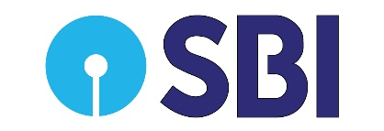





Banks and Bank Branches
12 Public Sector Banks
21 Private Sector Banks
43 RRBs
44 Foreign Banks
11 Small Finance Banks
6 Payment Banks
India
Source: RBI
Gujarat
Bank
Branches
10,659
ATMs
11,993
Source: https://findmybank.gov.in/FMB/

Slide 5
Indian Banking Sector Growth
Deposits in Banks
As on Jan 10, 2025, ₹178.01 trillion.
Growth: 11.47% Year on Year.
As on Jan 10, 2025, ₹221.50 trillion.
Growth: 10.83% Year on Year
Bank Credit
Source: https://www.business-standard.com/industry/banking/bank-deposits-grow-10-83-to-rs-221-50-trn-show-steady-improvement-in-jan-125012301422_1.html

Slide 6
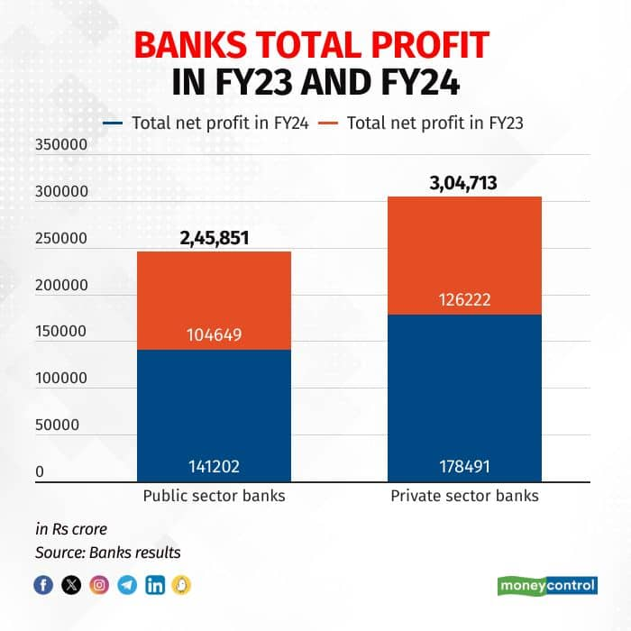
Source: https://www.moneycontrol.com/news/business/private-banks-report-higher-jump-in-net-profit-in-fy24-beating-psbs-12727326.html

Slide 7
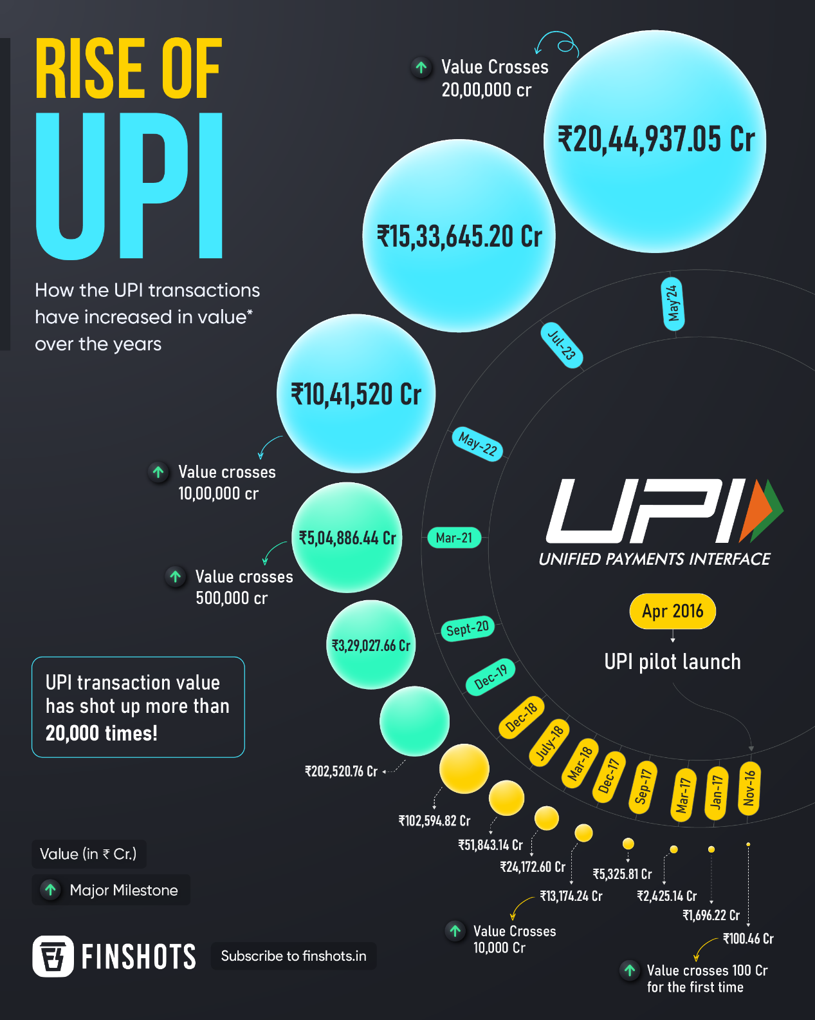


Slide 8
Unit-1 Banking System
Banking, Financial Services
and Insurance (BFSI)
DU # 2301CS594
CO 1: Understand the basics of the Indian Banking System, including different types of banks, accounts, loans, and related banking concepts.
Prof. Prashant Kachhela
prashant.kachhela@darshan.ac.in
9106232023

Slide 9

Looping
Topics
Indian Banking System
RBI, Scheduled Commercial Banks, Scheduled Co-operative Banks
Functions of Commercial Banks
Types of Bank Accounts
Cheque and Demand Draft
Debit Card and Forex Card
Credit Card
Secured and Secured Loans
Personal Loans
Home Loans

Slide 10

Looping
Topics
Concept of NPA
CIBIL Score
CO 1: Understand the basics of the Indian Banking System, including different types of banks, accounts, loans, and related banking concepts.

Slide 11
Indian Banking System

Slide 12

Introduction
Bank is the financial institution which manages our money (Individuals / Businesses).
Bank accepts money/deposits from customers in various forms such as Saving deposits, Current Deposits, Fixed deposits & Recurring Deposits.
It utilizes these money / deposits in the investment or lending purpose (Giving loans and Advances)
RBI is the govering / controlling / regulating body which controls all the banks and some of the NBFCs.

Slide 13
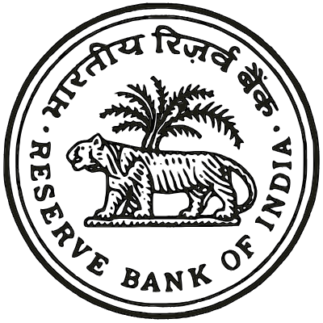
Main Functions of RBI
Monetary Authority
Formulates, implements and monitors the monetary policy.
It helps in maintaining price stability & growth.
Regulator and supervisor of the financial system
Prescribes broad parameters of banking operations which all the banks and NBFCs follows.
It helps in maintaining public confidence in the system.
Manager of Foreign Exchange
Facilitates external trade and payments.
Promote development and maintenance of forex market in India.
Issuer of currency
Issues, circulate and destroys currency notes.
1 rupee note and all the coins are not issued by RBI but it helps in circulation.

Slide 14
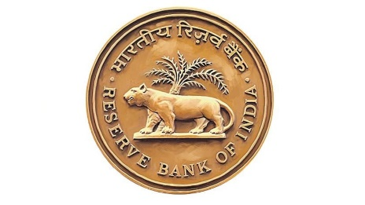
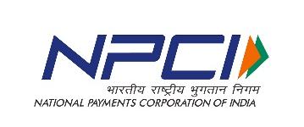
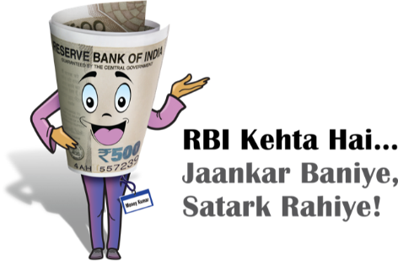
Main Functions of RBI
Regulator and Supervisor of Payment and Settlement Systems
Introduces and upgrades safe and efficient modes of payment systems.
Ex - Cheque, NEFT, RTGS, UPI etc.
Banker to the Government
Act as the banker for central & state governments.
Banker to Banks
Maintain banking accounts of all scheduled banks and provides loans to them also.
Development Role
Performs wide range of promotional functions such as
Establishment of financial institutions ex - 2008
Promotes Financial awareness ex -

Slide 15
Banking System in India
RBI
Scheduled Banks
Non-Scheduled Banks
Development Banks
NBFCs
Commercial Banks
Co-operative Banks
Public Sector Banks
Private Sector Banks
Regional Rural Banks
Foreign Banks
Urban Co-operative Banks
Rural Co-operative Banks
Payment Banks
Small Finance Banks
Source: Book of ICSI, Banking & Insurance Laws & Practice,
Website: Department of Financial Services

Slide 16











Scheduled Banks
Non-Scheduled Banks
SBI
HDFC
HSBC
Raj Bank
Gondal Nagrik
Sahkari Bank
Jivan Commercial
Cooperative Bank
AU Small
Finance Bank
India Post
Payment Bank
Saurashtra
Gramin Bank
Rajkot Commercial
Co-operative Bank
Shree Dharti
Co-operative Bank
This banks are authorized to borrow funds from RBI.
This banks are usually not authorized
to borrow funds from RBI.
However, in emergency condition they can borrow the fund from RBI.

Slide 17
Scheduled Banks
Non-Scheduled Banks
Can Apply to join the clearing house.*
Not eligible for the membership of clearing house.
*Financial institution which facilitate exchange of payment
Have to keep CRR (Cash Reserve Ratio) deposits with RBI.
It can maintain CRR by the way of either cash with themselves or in the form of balance in current account with RBI or State Co-operative Banks.
Financially stable & less risky.
More Riskier.

Slide 18
Commercial Banks

Slide 19
Commercial Banks
Meaning
It refers to those banks which are running on a commercial basis.
It means that they operate and offer services to earn a profit.
EX. SBI’s profit for F.Y. 2023-24 was Rs. 61,077 Crore. 22% YOY Growth. (Source: India Today/Money Control)
HDFC’s Profit for F.Y. 2023-24 was Rs. 64,060 Crore. 39.3% YOY Growth. (Source: Press released by HDFC Bank)
Types of Commercial Banks
(i) Public Sector Banks
(ii) Private Sector Banks
(iii) Foreign Banks
(iv) Regional rural banks
(v) Small Finance Bank
(vi) Payment Banks

Slide 20

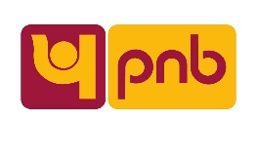






Commercial Banks
Public Sector Banks
Public sector banks are those banks in which Government owns more than 50% of Shares.
Ex. SBI (57.54%), BOB (63.97%), UCO (95.39%)
Govt. will change the share (%) from 95.39% to 90.59% in UCO Bank which means that the govt. will sell 2000 Shares.
Currently, there are 12 public sector banks in India.
Private Sector Banks
Majority of share capitals are kept by business houses and individuals.
RBI permitted the entry of private sector banks in 1993.
Currently, there are 21 private sector banks in India.

Slide 21



Commercial Banks
Regional Rural Banks (RRBs)
RRBs are setup to increase the flow of credit to the smaller borrowers in the rural areas.
There are currently 43 RRBs in India.
Share capital distribution GOI (50%), respective state govt. (15%) & Sponsoring Bank (35%) (Source: NABARD)
All RRBs are supervised by NABARD.
Foreign Banks
Foreign banks are those which incorporated outside India and open their branches in India.
There are currently 44 Foreign banks available in India.

Slide 22








Commercial Banks
Small Finance Banks
They were introduced with the objective of further financial inclusion to unserved or underserved sections such as small farmers, MSMEs, small business units etc.
RBI permitted SFBs in 2014.
There are currently 11 SFBs.
Payment Banks
Payment Banks are specialized financial institution that provides basic banking services.
They can not offer loans or credit cards.
There are currently 6 Payment Banks.

Slide 23
Cooperative Banks

Slide 24
Co-operative Banks
It is financial institution which is owned & operated by its members.
These banks operate on the principles co-operation, mutual aid and democratic decision making.
Co-operative banks are setup to serve the banking requirements of their members and specific communities.
The operation area is small.
These banks are under the regulation and supervision of state governments, RBI/NABARD.
Source: Developments in co-operative banking by RBI

Slide 25
Co-operative Banks (Cont.)
The co-operatives are at present under the control of state govt. in all matters relating to:
Registration
Membership
Election
Financial assistance
Loaning powers
Business operations
Loan recovery and audit
Source: Developments in co-operative banking by RBI

Slide 26
Types of Co-operative Banks
Co-operative Bank
Urban Co-operative banks
Rural Co-operative Banks
Urban & Semi Urban Areas
Rural Areas * Primarily
Non – Agricultural sector particularly
small borrowers
Agricultural sector & Rural
development
Supervisory Jurisdiction – RBI
Supervisory Jurisdiction – NABARD
Ex. Rajkot Nagrik Sahkari Bank
Ex. Gujarat State Co-operative Bank

Slide 27
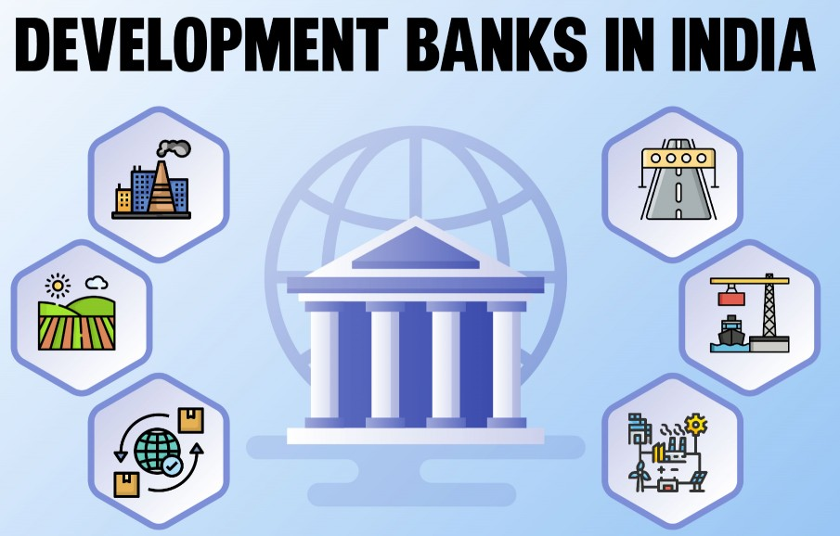
Development Bank
Development banks are also known as term-lending institution or development financial institution.
They are specialized bank which provides long term finance to higher risk sectors.
It plays bigger role in economical development.

Slide 28
Development Bank (Cont.)
Development Financial Institutions
Industrial Development Banks
Agricultural Development Banks
Export Import Development Banks
Infrastructure Development Banks
IFCI
IDBI
SIDBI
NABARD
EXIM Bank
NHB
IIFCL

Slide 29
Non-Banking Financial Company
NBFC is a company registered under Companies Act, 1956 or Companies Act, 2013.
RBI does not regulate all financial companies. Some may fall under the regulatory purview of other regulators like SEBI, IRDAI, GOI etc.
NBFCs can not accept demand deposits.
NBFCs do not form part of payment and settlement system and can not issue cheques.
Deposit insurance facility is not available to the depositors.
Currently, the total no. of NBFCs registered with RBI is 9291.
Source: https://www.rbi.org.in/commonman/english/scripts/FAQs.aspx?Id=1167

Slide 30








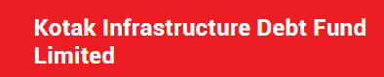
Non-Banking Financial Company (Cont.)
Investment & Credit Company
Infrastructure Finance Company
Micro Finance Institution
Core Investment Company
Infra Debt Fund

Slide 31
Functions of Banks

Slide 32
(I) Primary Functions
Accepting Deposits
It is the most important function of commercial banks.
They accept deposits in several forms which can be categorized as Demand Deposits & Time Deposits.
Demand Deposits
Saving Account Deposits
Current Account Deposits
Time Deposits
Fixed Deposits
Recurring Deposits
Functions of Bank
Primary Functions
Secondary Functions
Grant of Loans and Advances
Accepting Deposits
32

Slide 33
Grant of Loans and Advances
The deposits received by banks are not allowed to remain idle.
After keeping certain cash reserves (CRR, SLR), the balance is given to needy borrowers
The interest is charged from them, which is the main source of income for these banks.
Loans: A loan is granted for a specific time period.
Loans can be short term to long term.
It can be Secured and Unsecured Loans.
Functions of Bank
Primary Functions
Secondary Functions
Grant of Loans and Advances
Accepting Deposits
33

Slide 34
Grant of Loans and Advances
Advances: An advance is a credit facility provided by the bank to its customers.
Loans may be granted for long term, but advances are normally granted for short term period.
Further, the purpose of granting advances is to meet the day to day requirements of business.
Ex.
Cash Credit
Overdraft
Discounting of Bills
Functions of Bank
Primary Functions
Secondary Functions
Grant of Loans and Advances
Accepting Deposits
34

Slide 35
(II) Secondary Functions
Agency Functions
Commercial banks also perform certain agency functions for their customers.
For these services, banks charge some commission from their clients.
Some of the agency functions are
Transfer of Funds : Banks provide the facility of transfer funds with help of instruments like cheque, demand drafts, NEFT, RTGS etc.
Functions of Bank
Primary Functions
Secondary Functions
Grant of Loans and Advances
Accepting Deposits
Agency Functions
General Utility Functions
35

Slide 36
Collection and Payment of Various Items : Banks collect cheques, bills,’ interest, dividends, rents and other periodical receipts on behalf of their customers
It also make payments of taxes, insurance premium, SIP etc. on standing instructions of their clients.
Purchase and Sale of Foreign Exchange: It facilitates transaction related to import, export thus, facilitate international trade.
Functions of Bank
Primary Functions
Secondary Functions
Grant of Loans and Advances
Accepting Deposits
Agency Functions
General Utility Functions
36

Slide 37
Income Tax Consultancy: Act as income tax consultants and they prepare and finalize the income tax returns.
Trustee and Executor: Banks preserve the wills of their customers as trustees and execute them after their death as executors.
Functions of Bank
Primary Functions
Secondary Functions
Grant of Loans and Advances
Accepting Deposits
Agency Functions
General Utility Functions
37

Slide 38
General Utility Functions
Bank render some general utility functions like
Safety Vaults or Lockers to provide security to their valuables.
Issuing Letter of Credits to businessmen.
Issuing Debit/Credit cards to their customers.
Providing the facility of depositing or withdrawing cash anytime through ATM & CDMs
Underwriting of shares and debentures issued by the company.
Functions of Bank
Primary Functions
Secondary Functions
Grant of Loans and Advances
Accepting Deposits
Agency Functions
General Utility Functions
38

Slide 39
Types of Bank Accounts

Slide 40
Types of Bank Accounts
Initially, there were only four types of bank accounts that were operating in India. These included the Current Account, Savings Account, Recurring Deposit Account and Fixed Deposit Account.
But later with the advancement in the banking sector, various other types of bank accounts were introduced.
Given below is the list of bank accounts that we shall be discussing in this topic
Savings Account
NRI Account
Current Account
Types of Bank Accounts
Salary Account
Recurring Deposit Account
Fixed Deposit Account

Slide 41
Saving Account
As the name suggests, the savings accounts can be opened by an individual or jointly by two people with an aim to save money.
The main benefit of opening a savings bank account is that the bank pays you interest for opening this type of account with them.
Given below are a few features of the Savings account -
There is no limit to the number of times the account holder can deposit money in this account but there is a restriction on the number of times money can be withdrawn from this account.
The rate of interest that an account holder get varies from 2% to 6% per annum.
Some banks ask to maintain minimum balance in the accout.
The savings account holders can get an Physical or Virtual ATM cum debit card.

Slide 42

Saving Account
Savings bank account is further divided into two types :
Normal Saving Account
Basic Savings Bank Deposit Account (BSBDA)
The savings bank account is mostly eligible for students, pensioners and working professionals etc.

Slide 43

Current Account
The second type of bank account is the current bank account. These accounts are not used for the purpose of savings.
Some important pointers related to the current bank account have been discussed below
This type of bank account is mostly opened by businessmen.
Associations, Institutions, Companies, Religious Institutions and other business-related works, the current account can be opened.
There is no fixed number of times that money can either be deposited or withdrawn from such accounts.
This type of bank account does not have any fixed maturity.
Overdraft facility is available for current bank accounts.
There is no interest that is paid on such accounts, generally.

Slide 44
Recurring Deposit Account
Recurring Deposit account or RD account is a form of account wherein the account holder needs to deposit a fixed amount every month until it reaches the fixed maturity date.
The features of the Recurring deposit account have been discussed below:
Any individual or an Institution can open a recurring deposit account either separately or jointly.
Periodic or monthly instalments that need to be added can be as low as Rs.50/- or may vary from bank to bank.
The range of months for which an RD account can be opened varies from 6 months to 120 months.
The interest rate varies depending upon the bank you choose to open an account with.
Nomination facility is also available for RD accounts.

Slide 45

Recurring Deposit Account
Passbook is issued for this type of bank account.
Premature withdrawal of the amount is permitted, provided a sum of amount is deducted as penalty.

Slide 46
Fixed Deposit Account
FD or a fixed deposit account is another type of bank account that can be opened in any Public or Private sector bank.
The list of important things that need to be known with respect to the fixed deposit account has been mentioned below
Under this type of account, the account holder needs to deposit a fixed amount of sum (as per their wish) for a fixed time period.
The amount deposited in FD account can only be withdrawn all at once and not in instalments.
Banks pay interest on the fixed deposit account.
FD can be booked for 7 days to 120 months.
The rate of interest depends upon the amount you deposit and for the time duration of the FD.
Full repayment of the amount is available before the maturity date of FD with some penalty.

Slide 47
Salary Account
A salary account is a type of savings bank account in which an employee receives their salary from the employer every month.
Major companies and corporations have their tie-ups with specific banks where they open the salary account of all of their employees.
As salary accounts are interest-bearing accounts, the account holder earns interest on the balance maintained in the account.
The interest is generally calculated daily and deposited into the account quarterly.
Features and Benefits of a Salary Account
Zero Minimum Balance
Easy Access to Loans
Online Fund Transfers and Phone Banking
Investment Services
Debit Card and Personalized Cheque Book

Slide 48
NRI Account
To fulfil the bank requirements of a Non-Residential Indian or a Person of India Origin, the option of NRI account is available.
The NRI Accounts are further divided into three types
NRO (Non-Resident Ordinary Rupees) Account – This shall allow you to transfer your foreign earnings easily to India.
It can be opened in the form of an FD/RD/Current/Savings account.
These accounts can be opened by an individual or jointly opened
NRE (Non-Resident External Rupees) Account – When an Indian citizen moves abroad to work there, his/her account needs to be converted into an NRE account.
This account can be jointly opened with an Indian resident
FCNR (Foreign Currency Non-Resident) Account – This type of account can be opened to manage an international currency.
It can only be in the form of Term deposit and can be withdrawn after the maturity period only.

Slide 49
Cheque & Demand Draft (DD)

Slide 50



Cheque
A Cheque is written instrument that instructs a bank to pay a specific amount of money to certain person (payee) from your account.
Parties Involved in a cheque transaction
Drawer / Payer
Drawee
Payee / Bearer
(Who writes and signs the cheque)
(To whom the payment is made)

Slide 51
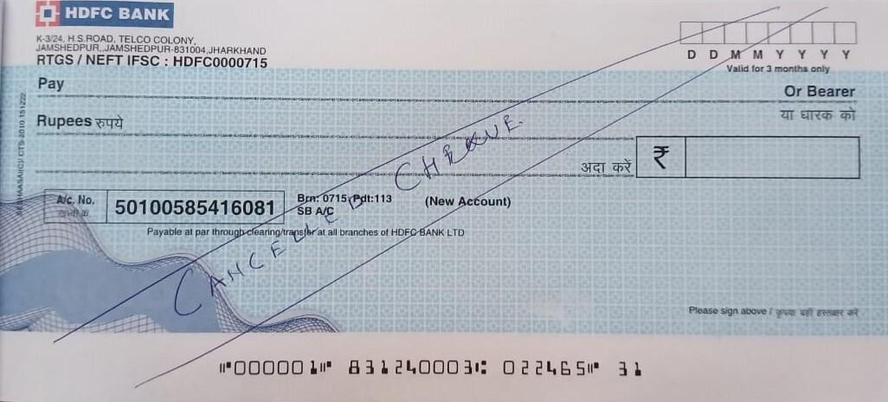
Important Elements of Cheque
Name of Bank
Address
IFSC (Indian Financial System Code)
Date
Validity Period
Cheque Printer
Details and
CTS mark
Payee Name
Other Important elements
Watermark
Ultra Violet light features
Pantographic image (‘Void or Copy’)
Amount in Words
Amount in no.
A/C number
Signature of Drawer
A/C Type
Cheque no.
MICR code
(Magnetic Ink Character Recognition)

Slide 52
Types of Cheque
Bearer Cheque
Payment is made to the person bearing or carrying the cheque.
Order Cheque
Payment to the person whoes name is mentioned.
Bank will do background check to authenticate the identity.
Does not require the payee’s name to be written on it.
Payment in the form of cash.
Payment in the form of cash or account transfer.
Crossed Cheque
Two parallel lines on the top left corner.
It can only be deposited directly in to bank account.
Source: https://www.hdfcbank.com/personal/resources/learning-centre/save/different-types-of-cheque-you-need-to-know

Slide 53
Types of Cheque
Open Cheque
Not Crossed.
Post dated Cheque
Future dated cheque.
Stale Cheque
More than 3 months old cheque.
Can be encased at any bank.
Can not be cashed or deposited until the date mentioned.
Invalid cheque.
Source: https://www.hdfcbank.com/personal/resources/learning-centre/save/different-types-of-cheque-you-need-to-know

Slide 54
Types of Cheque
Self Cheque
‘self’ written in payee column.
Cancel Cheque
Two parallel lines across the cheque and written ‘CANCELLED’ between them.
Banker’s Cheque
Issued by the bank itself.
To withdraw money from your own account.
Not used for financial transaction.
Typically used for high-value transaction.
Amount is debited & then cheque is issued by the bank.
Source: https://www.hdfcbank.com/personal/resources/learning-centre/save/different-types-of-cheque-you-need-to-know

Slide 55
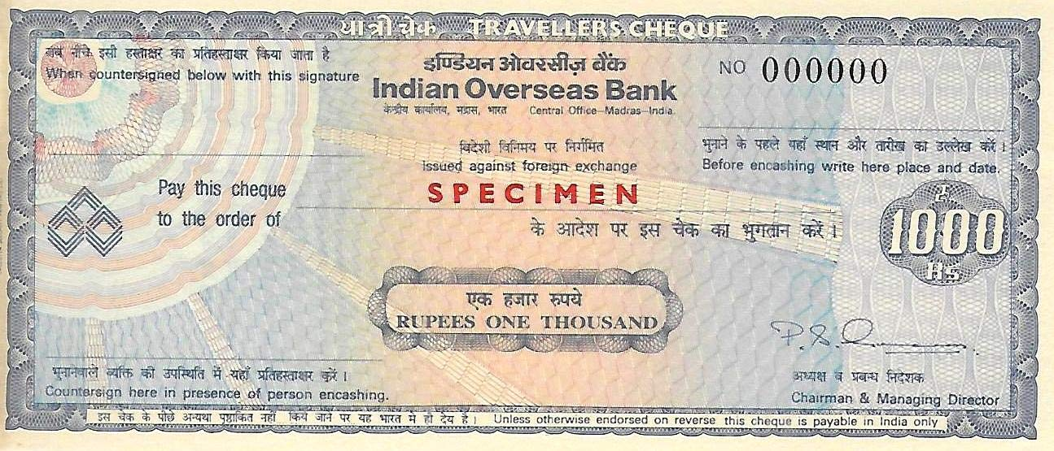
Types of Cheque
Traveller’s Cheque
Pre-printed, fixed amount cheque.
Designed for travelers to exchange for local currency.
Traveller’s cheque do not expire and can be used for future trip
Source: https://www.hdfcbank.com/personal/resources/learning-centre/save/different-types-of-cheque-you-need-to-know

Slide 56
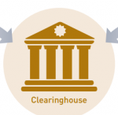

Cheque Truncation System (CTS)
Cheque Truncation is an online, image based cheque clearing system.
Outward Cheque
(MICR data and Image)
Outward Cheque
(MICR data and Image)
Inward Return
Inward Return
Presenting
Bank
Paying Bank
Data Capturing (Scanning)
Functions
Accept &
Payment
Processing
Common Warehouse (Physical cheques are stored)
For 10 years
Source: RBI, Geeks for Geeks.org, and NPCI document

Slide 57



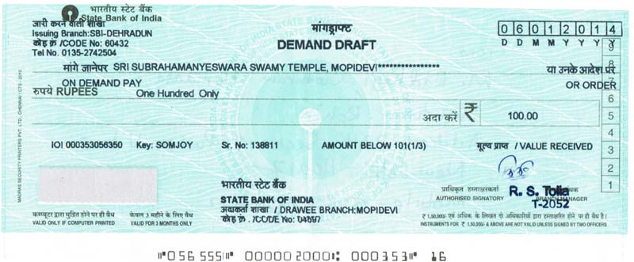
Demand Draft (DD)
It is prepaid financial tool used for fund transfer.
Cash/ from account
DD
Sample DD

Slide 58

Demand Draft (Cont.)
Types
Sight DD - Immediate payment when it is presented.
Time DD - Only payable after a specified date (future date).
Unlike cheque, there is no probability of bouncing as it is prepaid.
Bank often charge fees for issuing a DD.
Description of Service | Service Charge
Upto ₹5,000/- | ₹25/- (incl. GST)
Above ₹5,000/- upto ₹10,000/- | ₹50/- (incl. GST)
Above ₹10,000/- upto ₹1,00,000/- | ₹5/- (incl. GST) per ₹1000/-(Min.₹60/-incl. GST)
Above ₹1,00,000/- | ₹4/- (incl. GST) per ₹1000/Min.₹600/-incl. GST Max.₹2000/-incl. GST
Source: https://sbi.co.in/documents/16012/76239/021122-Service+Charges+as+on+30.09.2022.pdf/74a6c260-1569-5654-897b-ccfabd1bfd03?t=1667374607627

Slide 59
Card Transaction

Slide 60
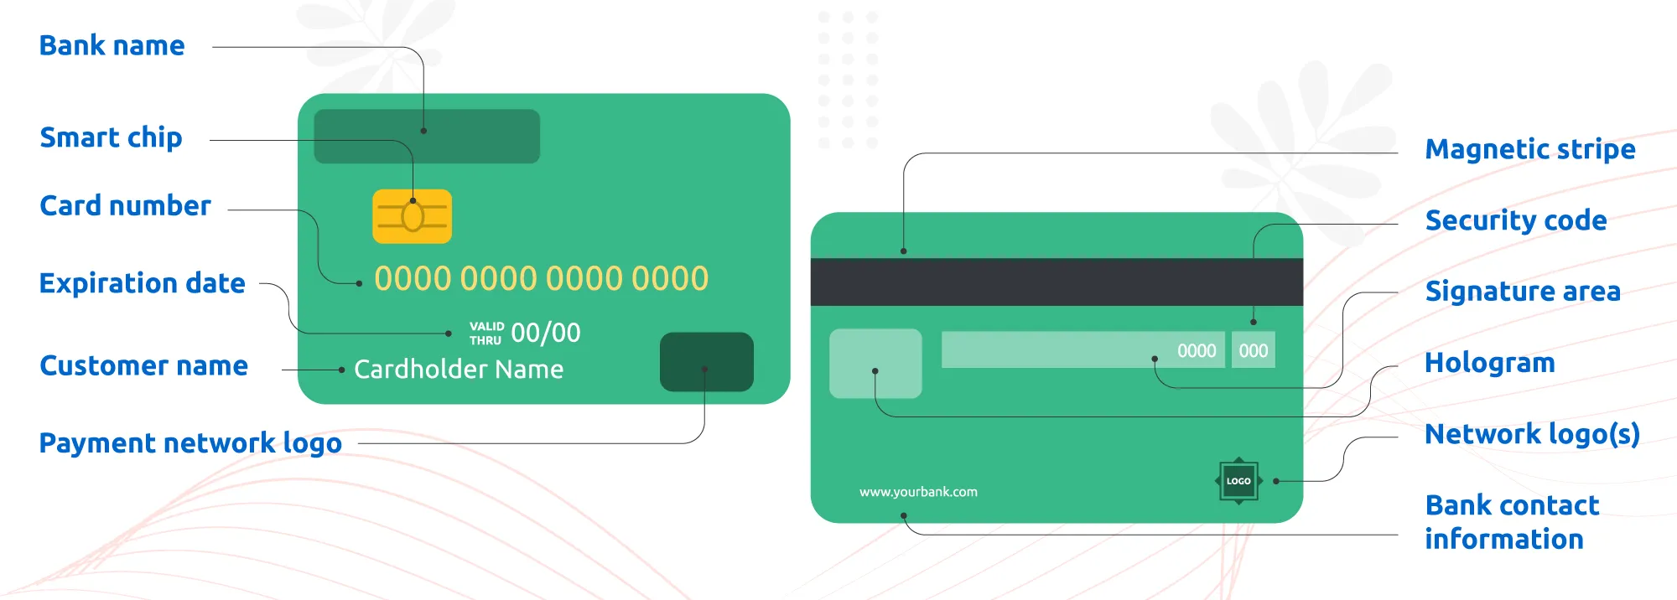
Debit Card
A debit card is a plastic card issued by a bank or financial institution to its account holders.
It allows you to make electronic transactions, both online and in-person, by accessing the funds available in your linked bank account.
NFC - (Near-field communication)
(CVV) - Card Verification Value

Slide 61

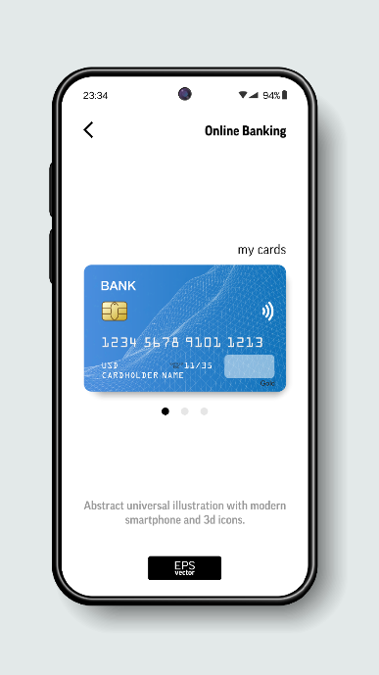


Debit Card
Card Networks
Types of Debit card
Usage
Cash Withdrawals
Point of Sale (PoS) Transactions
In-Person Purchases
Contactless Payments
Online Transactions
E-commerce Purchases
Bill Payments
Fund Transfers
1. Physical Debit Card
2. Virtual Debit Card

Slide 62
Other Facilities on Debit Card
E-Mandate
An e-mandate on a debit card is a digital payment service that allows you to authorize recurring payments from your bank account to a merchant or service provider.
It essentially creates a standing instruction for your bank to automatically debit the specified amount from your debit card at regular intervals.
EMI
Debit card EMI (Equated Monthly Installment) allows you to convert high-value purchases into installments, similar to a credit card EMI, but using your savings or current account balance instead of a credit limit.
Insurance
Card liability cover, Personal accident cover, Air accident cover, Purchase protection cover etc.
At least make one transaction in a month.

Slide 63
Fees and Charges
Annual / Renewal Fee /Add-on Card Annual fee.
ATM Withdrawal
On-Us Transaction: 5 free transactions in a month.
Off-Us Transaction
At Metro ATMs: 3 Free Transactions. (Six metro locations, viz. Bengaluru, Chennai, Hyderabad, Kolkata, Mumbai, and New Delhi)
At Non-Metro ATMs: 5 Free Transactions
Charges beyond prescribed limit of free transactions
Cash Withdrawal - Rs 23/- plus applicable taxes (w.e.f. 1st May, 2025)
Non-Financial Transaction - Rs 8.50/- plus applicable taxes
Source: https://www.rbi.org.in/commonman/English/Scripts/FAQs.aspx?Id=497

Slide 64
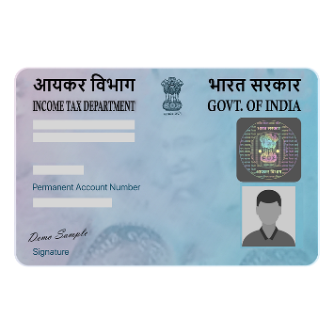


Forex Card
Most convenient ways to carry money when travelling to a foreign country.
It is pre-paid card.
Can not be used in India.
Foreign Exchange Rate prevalent on the day of purchase of the card.
Mainly 3 documents are required.
15+ Currency options are offered by bank.
Currently many banks are offering the validity of 3 to 5 years.
Max limit as per RBI is USD 250,000 per financial year.
Cash/ from account
PAN Card
Passport
Form A2

Slide 65


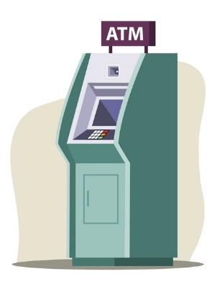


Types of Forex Cards and Usage
Single Currency Forex Card
Multiple Currency Forex Card
Single currency (often USD)
15+ currencies
Students, heavy ATM users, or travelers of one country.
Frequent travelers to multiple countries
Cross currency charges will be applied
Cross currency charges can be avoided
Usage
Foreign ATM
Merchant POS
Any online transactions

Slide 66
Benefits of Forex Card
Convenience
No need to carry cash. They are accepted at all merchant outlets and ATMs worldwide.
Security
Chip and PIN protection. In case of loss or theft, most Forex Cards can be blocked.
Cost-effectiveness
Forex Cards have lower fees than International Debit or Credit Cards.
Can save you from fluctuating exchange rates while transacting abroad.
Reloadable
You can reload money onto the card at any time, online through Internet banking/mobile banking app.
Multi-currency support
Allowing you to load funds in various currencies on a single card.

Slide 67
Various Charges
Card issuance Fee: At the time of card issuing.
ATM Withdrawal Fee: Some banks may charge a fee for ATM withdrawals, especially if the withdrawal amount exceeds a certain limit.
Currency Conversion Fee: At the time of loading the money.
Reload charges: When you reload the card.
Cross Currency Conversion Fee: This fee is charged for converting your currency to the local currency during a transaction.
Cash Advance/Cash@POS Transactions Fee: Cash withdrawal at merchant POS chargable.
Lost Card Replacement Fee: Separate charges for Indian and International location.
Source: Website of HDFC Bank, ICICI Bank, AXIS Bank

Slide 68
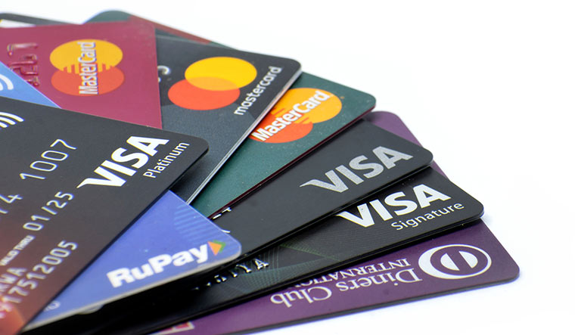
Credit Card: Introduction
A credit card is a type of credit facility, provided by banks that allow customers to borrow funds within a pre-approved credit limit.
It enables customers to make purchase transactions on goods and services.
A credit card is a financial tool offered by a bank as a type of loan, with a line of revolving credit that you can access with your card account.

Slide 69
Benefits and Disadvantages of Credit Card
Benefits of Credit Card
Easy access to credit
Building a line of credit
EMI facility
Incentives and offers
Flexible credit
Record of expenses
Purchase protection
Disadvantages of Credit Card
Minimum due trap
Hidden costs
Easy to overuse
High interest rate
Credit card fraud

Slide 70
Credit Card: Guidelines on Credit Card Operations (RBI)
Introduction
This circular is aimed at providing general guidance to banks/NBFCs on their credit card operations, and the systems and controls expected of them in managing their credit card business.
It also sets out the best practices that they should aim to achieve.
Issue of Cards
Banks in India can undertake credit card business either departmentally or through a subsidiary company set up for the purpose.
Prior approval of the Reserve Bank is not necessary for banks for undertaking credit card business either independently or in tie-up arrangement with other card issuing banks.
Each bank must have a well documented policy and a Fair Practices Code for credit card operations.
Banks/NBFCs should ensure prudence while issuing credit cards.

Slide 71
Credit Card: Guidelines on Credit Card Operations (RBI)
Types of Credit Cards
Banks may issue credit cards including co-branded credit cards, corporate credit cards to the employees of their corporate customers, as well as add-on credit cards. (Ex. Cash back credit cards, Travel credit cards, Business credit cards, Student credit cards, Secured credit cards)
Compliance with Know Your Customer (KYC) Norms
The instructions/guidelines on KYC applicable to banks, issued by RBI from time to time, may be adhered to in respect of all cards issued, including co-branded, corporate, and add on credit cards.
Interest Rates and Other Charges
While determining the interest rate on credit card dues, the latter being in the nature of non-priority sector personal loans.
Banks should also prescribe a ceiling rate of interest, including processing and other charges, in respect of credit cards.

Slide 72
Loans

Slide 73
Loans
According to Cambridge Advanced Learner’s Dictionary, a loan means “a sum of money which is borrowed, often from a bank, and has to be paid back, usually together with an extra amount of money that you have to pay as a charge for borrowing.”
The loans may be repaid in installments or at the expiry of a certain period. The loan may be made with or without security.
Once repaid in full or in part, a loan cannot be withdrawn again by the customer. In case a borrower wants a further loan, he has to arrange for a fresh loan.
Types of Loans
Secured Loans
Unsecured Loans

Slide 74
Secured Loan
Secured Loans
Home Loans
Loans Against Property
Loans Against Insurance Policies
Gold Loans
Loans Against Mutual Funds
Loans Against Fixed Deposits
Vehicle loan
A secured loan is a loan given out by a financial institution wherein an asset is used as collateral or security for the loan.
For example, you can use your house, gold, etc., to avail a loan amount that corresponds to the asset’s value.
In the case of a secured loan, the bank or financial institution that is dispensing the loan will hold on to the ownership deed of the asset until the loan is paid off.

Slide 75
Unsecured Loan
Unsecured Loans
Personal Loans
Credit Card Loans
Short-term Business Loans
Flexi Loans
Education Loans
Consumer Durable Loans
Unsecured loans, like the name suggests, is a loan that is not secured by a collateral such as land, gold, etc.
These loans are comparatively riskier to a lender and therefore associated with a high interest rate.
When a lender releases an unsecured loan, he does so after evaluating your financial status and assessing whether or not you are capable of repaying your loan.

Slide 76

Personal Loans
Generally, banks give a loan against some security, so that it can fall back on it in case of a default.
However, sometimes loans are given against personal security without any tangible security.
Examples are salary loan, loan to pensioners, loan to professionals, etc. Most of the banks give loans to the salaried class as the source of income is regular.

Slide 77
Procedure and Practices for Salary Loans
Target group: Permanent employees with a minimum service/experience of say three years, with a Govt./quasi Govt./boards/endowments/reputed companies/corporate industrial establishments, etc.
The stipulation of minimum period of service may vary from bank to bank.
Purpose: For meeting of marriage/educational and medical expenses, to celebrate family functions and for other household expenses.
Security: Sometimes banks insist on the guarantee of another person, if there is no collateral security, or in case, the account is with the branch, a letter giving an undertaking from the borrower to debit his account for the EMI.
Documents: Proof of employment and salary certificate are normally obtained.
After sanction of the loan, banks take the necessary loan documents such as; DPN (Demand Promissory Note), salary loan agreement, etc., from the borrower and a guarantee agreement from the guarantor, if any.

Slide 78
Procedure and Practices for Salary Loans
Eligible Amount: The eligible amount of a loan is calculated based on the gross/net salary.
While arriving at the quantum of loan, the minimum take home pay say, forty per cent of the gross salary, will be stipulated after the proposed EMI.
Some banks consider a greater amount of the loan, if the employer gives an undertaking to the bank to recover the EMI from the salary and remit it into the bank.
In addition, when the salary credited with an account, maintained with the branch, banks normally consider a larger quantum of loan.

Slide 79
Personal Loans: Important Aspects
Maintain a good credit history. A credit score or the CIBIL score represents your creditworthiness based on your history of credit repayment
Compare the interest rates in the market
Assess all costs
Consider your needs to choose the right loan amount
Evaluate your ability to repay the loan

Slide 80
Home Loan
The home loan is the predominant loan in the present context. Most of the banks are offering these loans at competitive terms. Home loans are available to resident Indians and NRIs.
Home loans are availed either for
Purchase of an under-construction
Purchase ready property from a developer
Purchase of a resale property
To construct a housing unit on a plot of land
To make improvements and extensions to an already existing house

Slide 81
The Procedure and Practices for Home Loans
Target Group: Normally, the target group is the salaried class, professionals, self-employed and businessmen.
Purpose: The purpose of the loan is for the purchase or construction of house or flats, repairs and renovation of house, and in some banks, for purchase of house sites also.
Quantum of loan: The quantum of eligible loan is fixed based on the gross monthly income/net monthly income.
For this, banks ask for a salary certificate for the salaried class or the Income tax return for others. Bank also ask for the statement of bank account for a prescribed period.
Age: Banks fix the lower and upper age for availing the loan taking in to consideration the remaining period of service, in the case of salaried class and the income earning capacity during the period of loan for others.

Slide 82
The Procedure and Practices for Home Loans
Repayment: Most of the banks are giving long repayment period, say 20-25 years. The repayment will be based on equated monthly instalments (EMI).
Security: Generally, the property purchased or constructed out of the bank loan is taken by way of mortgage.
Sometimes, when the income of the spouse is taken for arriving at the quantum of loan, his/ her guarantee is also taken as personal security.
Margin: Banks stipulate that a certain percentage of the project cost, say fifteen per cent, is to be borne by the borrower from his own sources.
When the loan is for repairs/renovation, banks stipulate a higher margin.
Rate of Interest: When compared to the rate of interest for other loans, the rate of interest for home loan is cheaper.
Banks also offer a floating rate and a fixed rate option to the borrower.

Slide 83

Home Loans: Procedure
Fill The Loan Application Form & Attach The Documents
Pay The Processing Fee
Discussion With The Bank
Valuation Of The Documents
The Sanction/Approval Process
Processing The Offer Letter
Processing The Property Papers Followed By A Legal Check
Processing A Technical Check & The Site Estimation
The Final Loan Deal
Signing The Agreement
The Loan Disbursal

Slide 84
NPA

Slide 85
Introduction
A non-performing asset (NPA) is a classification used by financial institutions for loans and advances on which the principal is past due and on which no interest payments have been made for a period of time.
In general, loans become NPAs when they are outstanding for 90 days or more, though some lenders use a shorter window in considering a loan or advance past due.
This is the general definition of a non-performing asset over the world, however each country has its own procedure and requirements to declare an asset as non-performing.
In India for an asset to be classified as an NPA the borrower should have the principal or interest on the loan or advance given by the lender overdue for a period of 90 days.

Slide 86
Classification of Assets
1. Standard Assets
2. Sub-Standard Assets
3. Doubtful Debts
4. Loss Assets

Slide 87
Classification of Assets
Standard Assets
They are NPAs that have been past due for anywhere from 90 days to 12 months, with a normal risk level.
Sub-Standard Assets
They are NPAs that have been past due for more than 12 months. They have a significantly higher risk level, combined with a borrower that has less than ideal credit.
Banks usually assign a haircut (reduction in market value) to such NPAs because they are less certain that the borrower will eventually repay the full amount.

Slide 88
Classification of Assets
Doubtful Debts
Non-performing assets in the doubtful debts category have been past due for at least 18 months.
Banks generally have serious doubts that the borrower will ever repay the full loan. This class of NPA seriously affects the bank’s own risk profile.
Loss Assets
These are non-performing assets with an extended period of non-payment.
With this class, banks are forced to accept that the loan will never be repaid, and must record a loss on their balance sheet.
The entire amount of the loan must be written off completely.

Slide 89
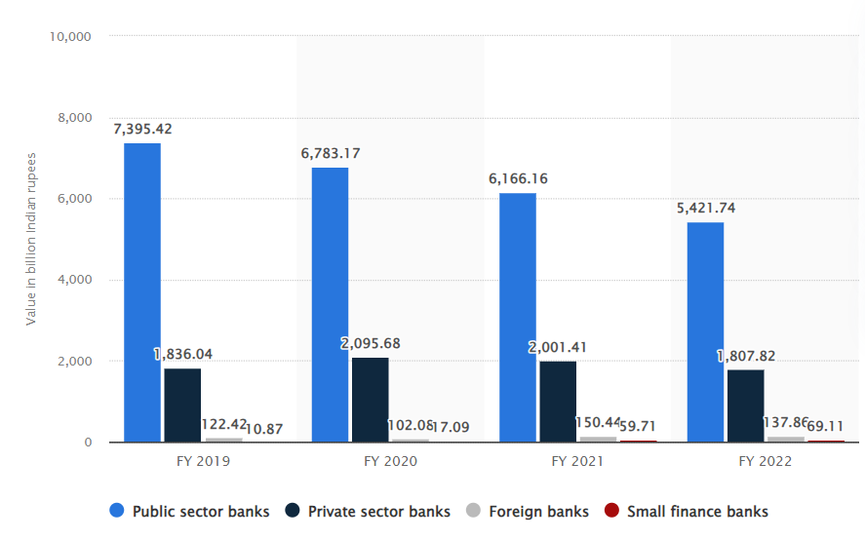
Gross NPA from 2019 to 2022
Source: https://www.statista.com/statistics/1222935/india-gross-npa-of-banks-by-sector/
Latest Report by RBI: https://rbi.org.in/Scripts/AnnualPublications.aspx?head=Statistical%20Tables%20Relating%20to%20Banks%20in%20India

Slide 90
Causes of NPA (Non Performing Assets)
There are many causes of NPA (Non Performing Assets). All of the causes can be categorized under two broad categories.
Causes
External Factors
Internal Factors

Slide 91
Causes of NPA (Non Performing Assets)
External Factors
Ineffective recovery tribunal
Industrial sickness
Natural calamities
Willful defaults
Change on govt. policies
Lack of demand
Internal Factors
Defective lending process
Improper SWOT analysis
Poor credit appraisal system
Absence of regular industrial visit
Fraud

Slide 92
CIBIL Score

Slide 93
CIBIL - Credit Information Bureau (India) Limited
CIBIL Score is a 3 digit numeric summary of your credit history, derived by using details found in the ‘Accounts’ and ‘Enquiries’ sections on your CIBIL Report and ranges from 300 to 900.
The closer your score is to 900, it is considered as good CIBIL Score. It is based on 36 months of your credit history.
Your CIBIL Score is one of the most important parameters considered by lenders before approving your loan application.
CIBIL Score also provides lenders necessary insights into your credit history through past patterns of credit usage and loan repayment behavior.
It act as a guiding principles for lenders, making the loan approval process faster.
Source: https://www.cibil.com/faq/credit-score-and-loan-basics

Slide 94
Major Factors Affecting CIBIL Score
Four major factors that impact your CIBIL Score
Payment History
Your payment history is one of the factors that lenders consider when determining your creditworthiness.
It shows how consistently you have made your payments on time and in full. Late payments, missed payments and delinquencies can negatively impact your CIBIL Score.
Credit Utilisation
Credit utilisation refers to the amount of available credit you're using.
Higher credit utilisation suggests you may be over-extended, making you appear to be at credit risk to the lenders.
Aim to keep your credit utilisation ratio well within your available credit limit.
Source: https://www.cibil.com/faq/credit-score-and-loan-basics

Slide 95


Major Factors Affecting CIBIL Score
Credit Mix
Balanced mix of credit is important. (i.e. loan account, credit card etc.).
Having a balanced mix between secured loans (such as Auto, Home Loans) and unsecured loans (such as Personal Loan, Credit Card) is likely to have more positive effect on your score.
Credit Enquiries
When you apply for new credit, lenders will often check your credit report to assess & onboard customers with a proven track record of making timely payments.
This can have a marginal impact on your CIBIL Score.
Applying for credit, too frequently in a short period of time can therefore negatively impact your CIBIL Score.
Source: https://www.cibil.com/faq/credit-score-and-loan-basics

Slide 96
How can I improve my CIBIL Score?
You can improve your CIBIL Score by maintaining a good credit history, which is essential for loan approvals by lenders. Follow these 6 steps which will help you better your score.
Always pay your dues on time
Late payments are viewed negatively by lenders.
Keep your balances low
Always be prudent to not use too much credit, control your utilization.
Apply for new credit in moderation
You don’t want to reflect that you are continuously seeking excessive credit; apply for new credit cautiously.
Source: https://www.cibil.com/faq/credit-score-and-loan-basics

Slide 97
How can I improve my CIBIL Score?
Maintain a healthy mix of credit
It is better to have a healthy mix of secured (such as home loan, auto loan)and unsecured loans (such as Personal loan, Credit Card ).
Monitor your co-signed, guaranteed and joint accounts monthly
In co-signed, guaranteed or jointly held accounts, you are held equally liable for missed payments.
Review your credit history frequently throughout the year
You don’t want to reflect that you are continuously seeking excessive credit; apply for new credit cautiously.
Too many unsecured loans may be viewed negatively.
Your joint holder’s (or the guaranteed individual) negligence could affect your ability to access credit when you need it.

