Slide 1

Unit-3 Direct Tax
Banking, Financial Services and Insurance
(BFSI)
DU#2301CS594
CO 3: explain the fundamental concepts of income tax, including definitions, tax rates, surcharges, rebates, residential status, heads of income, return filing, and computation of total income and tax payable by an individual.
CA Dhaval Simejiya
dhaval.simejiya@darshan.ac.in
99043 25008

Slide 2

Looping
Topics
Introduction, Important Definitions
Rates of Tax, Surcharge & Cess
Rebate for Resident Individuals
Treatment of Special Items
Residential Status
Basics of Heads of Income
Compulsory Filing of Return of Income
Income to be Considered While Computing Total Income of Individuals
Computation of Total Income and Tax Payable by an Individual
Return of income

Slide 3
Introduction
“Taxation includes the imposition of any tax or impost, whether general or local or special, and tax shall be construed accordingly."
Taxes are considered to be the “cost of living in a society”. Taxes are levied by the Governments to meet the common welfare expenditure of the society.

Slide 4
Types of Taxes
Direct Tax
Indirect Tax
Levied directly on individuals or organizations
Imposed on goods and services

Slide 5
Direct Tax
What is a direct tax?
It's a tax levied directly on a person's income or wealth.
Can the person who pays the tax recover it from someone else?
No, the burden of a direct tax cannot be shifted.
Can you give an example?
Income tax is a direct tax.

Slide 6
Introduction to Income Tax Act
Income tax in India is a tax directly paid by person to the government based on their income (and profit, in the case of business).
The income tax law in India consists of the following components -
Income Tax Act
Annual Finance Act
Income Tax Rules
Circulars/ Notifications
Legal decisions of Courts

Slide 7
Definitions

Slide 8

Assessee
Assessee means a person by whom any tax or any other sum of money is payable under this Act. It includes –
Every person in respect of whom any proceeding under this Act has been taken, for the assessment of
His income, or
The income of any other person in respect of which he is assessable, or
The loss sustained by him or by such other persons, or
The amount of refund due to him or to such other person.
8

Slide 9
Person
There are seven categories covered under the term “Person”.
This includes –
An Individual (Salaried Person, Person who is a sole proprietor, Teacher etc.)
HUF (Hindu Undivided Family)
A Company (TATA Motors Limited, Infosys Ltd.)
A Firm (ABC partnership Firm) & Limited Liability Partnership
An Association of persons (AOP) / Body of Individuals (BOI), even without registration
A Local Authority (Rajkot City Development Authority)
Every Artificial Judicial Person (Universities), not covered above
Firm
Company
AOP/BOI
HUF
Local Authority
Artificial Juridical
Person
Individual
9

Slide 10
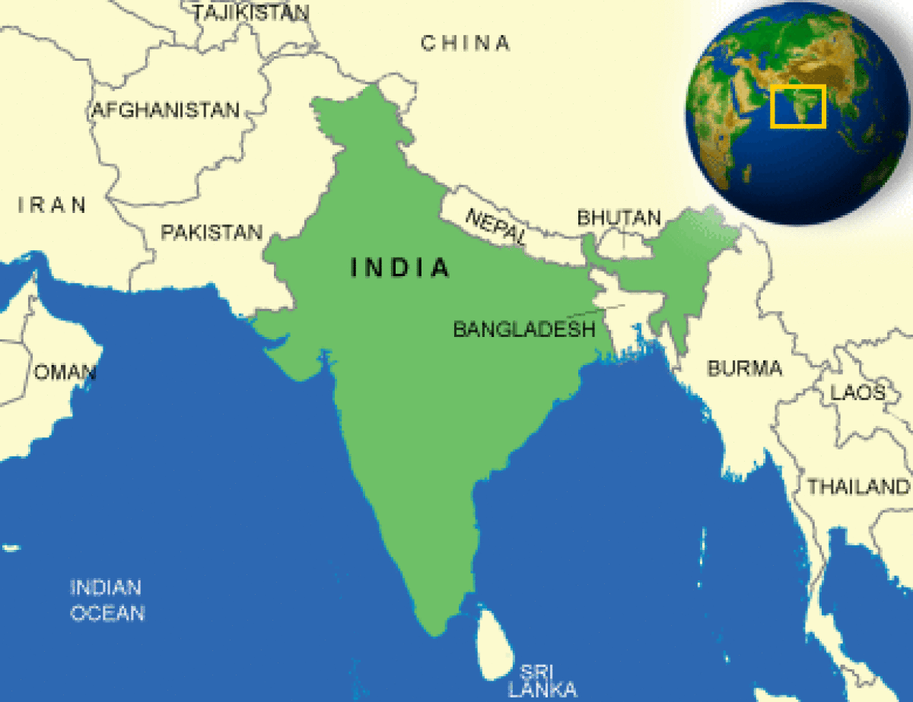
India
The definition of “India” is different is many Acts of our country.
As per the Income Tax Act, 1961; “India” means –
The territory of India as per the Constitution,
It’s territorial waters, seabed and subsoil underlying such waters,
Continental shelf,
Exclusive economic zone, or
Any other specified maritime zone and the air space above its territory and territorial waters.
10

Slide 11
Other Definitions
Assessment: Assessment is the procedure by which the income of an assessee is determined.
Income: Income is the money received by a person (individual or business) periodically on a daily, weekly, monthly or yearly basis.

Slide 12
Previous Year & Assessment Year
Previous Year:
The Previous Year is the financial year (12-month period) immediately before the Assessment Year. It is the year during which the income is earned, and this income will be taxed in the Assessment Year.
Assessment Year:
The Assessment Year is the year following the Previous Year, in which the income earned during the Previous Year is assessed and taxed by the government.

Slide 13
Financial and Assessment Year Sequence
Income Earned
Previous Year End
Income Taxed
Previous Year Start
Assessment Year
The financial year concludes on 31st March 2024.
Income earned during the financial year 2023-’24.
The financial year begins on 1st April 2023.
The assessment year 1st April 2024 to 31st March 2025.
The earned income is taxed in the assessment year 2024-’25.

Slide 14
Previous Year Assessment Year
01-04-2020
31-03-2021
01-04-2021
31-03-2022
Income earned
Assessment of Tax
01-04-2021
31-03-2022
01-04-2022
31-03-2023
Income earned
Assessment of Tax
01-04-2023
31-03-2024
01-04-2024
31-03-2025
Income earned
Assessment of Tax

Slide 15
For the purpose of our study
Financial Year
2024-25
Assessment Year
2025-26

Slide 16
Heads of Income as per The Income Tax Act, 1961
Salary
Income earned from employment
Income from House Property
Income from renting or owning property
Profit & Gains from Business or Profession
Income from business activities or professional services
Capital Gains
Profit from selling assets
Income from Other Sources
Income from sources not covered by other categories

Slide 17
Income Tax Slab Rate for Individuals in Old Tax Regime
Old Tax Regime (if you are claiming for Deductions and Exemptions)
This is for individuals whose age is less than or equal to 60 years
Tax rebate up to ₹ 12,500 is applicable for resident individuals, if the total income does not exceed ₹ 5,00,000 (not applicable for NRIs)
Total Income | Old Regime Income Tax Slab Rates
Upto ₹ 2,50,000 | Nil
₹ 2,50,001 – ₹ 5,00,000 | 5%
₹ 5,00,001 – ₹ 10,00,000 | 20%
Above ₹ 10,00,000 | 30%

Slide 18
Income Tax Slab Rate for Individuals in Old Tax Regime (Contd.)
Old Tax Regime (if you are claiming for Deductions and Exemptions)
This is for individuals whose age is more than 60 years but less than or equal to 80 years (Senior Citizen)
Total Income | Old Regime Income Tax Slab Rates
Upto ₹ 3,00,000 | Nil
₹ 3,00,001 – ₹ 5,00,000 | 5%
₹ 5,00,001 – ₹ 10,00,000 | 20%
Above ₹ 10,00,000 | 30%

Slide 19
Income Tax Slab Rate for Individuals in Old Tax Regime (Contd.)
Old Tax Regime (if you are claiming for Deductions and Exemptions)
This is for individuals whose age is more than 80 years (Super Senior Citizen)
Total Income | Old Regime Income Tax Slab Rates
Upto ₹ 5,00,000 | Nil
₹ 5,00,001 – ₹ 10,00,000 | 20%
Above ₹ 10,00,000 | 30%

Slide 20
Income Tax Slab Rate for Individuals in New Tax Regime
New Tax Regime (if you are NOT claiming for Deductions and Exemptions)
This is for individuals (of all age groups) and HUFs
Tax rebate up to ₹ 25,000 is applicable for resident individuals, if the total income does not exceed ₹ 7,00,000 (not applicable for NRIs).
Total Income | New Regime Income Tax Slab Rates
Upto ₹ 3,00,000 | Nil
₹ 3,00,001 – ₹ 7,00,000 | 5%
₹ 7,00,001 – ₹ 10,00,000 | 10%
₹ 10,00,001 - ₹ 12,00,000 | 15%
₹ 12,00,001 – ₹ 15,00,000 | 20%
Above ₹ 15,00,000 | 30%

Slide 21
Rebate under section 87A
Taxable Income Limit
Rebate Amount
Lower of income-tax or 12,500
Old Tax Regime
≤ 5 lakhs
Lower of income-tax or 25,000
New Tax Regime
≤ 7 lakhs

Slide 22
Health and Education Cess
To improve the Health and Educational facility of India, additional amount of tax levied on the taxable amount calculated + Surcharge (If any) i.e. known as Health and Education Cess (H & E Cess)
Rate of Health and Education Cess is 4%.
This is levied on the amount of income tax plus surcharge (if any).

Slide 23
Health and Education Cess (Cont.)
For Example,
Suppose ₹ 5,000 is taxable amount as per the income tax slab rate
Add 4% Health and Education Cess (H & E Cess) on it.
Therefore
₹ 5,000 Taxable Amount
+ ₹ 200 (H & E Cess)
₹ 5,200 Tax Liability (Tax payable)
Calculate Income Tax
Is Surcharge Applicable?
Add Surcharge
Calculate Total Tax
Apply 4% Health and Education Cess
Total Tax Amount

Slide 24
Example 1: Mr. A (Aged 35) is having an annual salary of ₹10,00,000, with the deductions of ₹2,50,000. So calculate the income tax in both old and new slabs and suggest the best slab for him.
ANS: Tax calculation as per Old Tax Slab
Particulars | Amount
Annual Salary | 10,00,000
Deductions (80C,80D) | 2,50,000
Standard Deduction | 50,000
Total Deduction | 3,00,000
Taxable Income | 7,00,000
Range | Rate | Amount | Taxable Amount
Up to 2,50,000 | 0% | 2,50,000 | 0
2,50,001 – 5,00,000 | 5% | 2,50,000 | 12,500
5,00,001 – 10,00,000 | 20% | 2,00,000 (7,00,000 - 5,00,000) | 40,000
Above 10,00,000 | 30% | - | -
Tax Amount |  |  | 52,500
(+) Health and Education Cess (4%) |  |  | 2,100
Total Payable Tax |  |  | 54,600

Slide 25
Tax calculation as per New Tax Slab
Particulars | Amount
Annual Salary | 10,00,000
Deductions (80C,80D) | Not Allowed
Standard Deduction | 75,000
Total Deduction | 75,000
Taxable Income | 9,25,000
Range | Rate | Amount | Taxable Amount
Up to 3,00,000 | 0% | 3,00,000 | 0
3,00,001 – 7,00,000 | 5% | 4,00,000 | 20,000
7,00,001 – 10,00,000 | 10% | 2,25,000 (9,25,000 - 7,00,000) | 22,500
10,00,001 – 12,00,000 | 15% | - | -
12,00,001 – 15,00,000 | 20% | - | -
Above 15,00,000 | 30% | - | -
Tax Amount |  |  | 42,500
(+) Health and Education Cess (4%) |  |  | 1,700
Total Payable Tax |  |  | 44,200
Tax as per Old Slab | 54,600 | Here we can see that the Total Tax as per New Tax Slab is less then the Old Ta Slab, so here we can recommend Mr. A to opt for New Tax Slab
Tax as per New Slab | 44,200

Slide 26
Example 2: Mr. B (Aged 40) is having an annual salary of ₹7,50,000, with the deductions of ₹1,75,000. So calculate the income tax in both old and new slabs and suggest the best slab for him.
ANS: Tax calculation as per Old Tax Slab
Particulars | Amount
Annual Salary | 7,50,000
Deductions (80C: LIC, PF) | 1,50,000
80D: Medical Insurance | 25,000
Standard Deduction | 50,000
Total Deduction | 2,25,000
Taxable Income | 5,25,000
Range | Rate | Amount | Taxable Amount
Up to 2,50,000 | 0% | 2,50,000 | 0
2,50,001 – 5,00,000 | 5% | 2,50,000 | 12,500
5,00,001 – 10,00,000 | 20% | 25,000 (5,25,000 - 5,00,000) | 5,000
Above 10,00,000 | 30% | - | -
Tax Amount |  |  | 17,500
Rebate u/s 87A (if Taxable Income < 5,00,000) |  |  | -
(+) Health and Education Cess (4%) |  |  | 700
Total Payable Tax |  |  | 18,200

Slide 27
Tax calculation as per New Tax Slab
Particulars | Amount
Annual Salary | 7,50,000
Deductions (80C,80D) | Not Allowed
Standard Deduction | 75,000
Total Deduction | 75,000
Taxable Income | 6,75,000
Range | Rate | Amount | Taxable Amount
Up to 3,00,000 | 0% | 3,00,000 | 0
3,00,001 – 7,00,000 | 5% | 3,75,000 (6,75,000 – 3,00,000) | 18,750
7,00,001 – 10,00,000 | 10% | - | -
10,00,001 – 12,00,000 | 15% | - | -
12,00,001 – 15,00,000 | 20% | - | -
Above 15,00,000 | 30% | - | -
Tax Amount |  |  | 18,750
Rebate u/s 87A (if Taxable Income < 7,00,000) |  |  | 25,000
Total Payable Tax |  |  | 0
Tax as per Old Slab | 18,200 | Here we can see that the Total Tax as per New Tax Slab is Zero, So here we can recommend Mr. B to opt for New Tax Slab
Tax as per New Slab | 0

Slide 28
Example 03
Anjali is working part-time as an assistant and earns ₹ 6 lakh annually. She saves via PPF and pays health insurance. The details are..
Annual Income: 6,00,000
PPF: 1,00,000 (80C)
Health Insurance: 20,000 (80D)

Slide 29
Tax Calculation as per Old Slab:
Particulars | Amount
Annual Salary | 6,00,000
Deductions (80C: PPF) | 1,00,000
Deductions (80D: Insurance) | 20,000
Standard Deduction | 50,000
Total Deduction | 1,70,000
Taxable Income | 4,30,000
Range | Rate | Amount | Taxable Amount
Up to 2,50,000 | 0% | 2,50,000 | 0
2,50,001 – 5,00,000 | 5% | 1,80,000 (4,30,000 – 2,50,000) | 9,000
5,00,001 – 10,00,000 | 20% | - | -
Above 10,00,000 | 30% | - | -
Tax Amount |  |  | 9,000
Rebate u/s 87A (if Taxable Income < 5,00,000) |  |  | 12,500
Total Payable Tax |  |  | 0

Slide 30
Tax Calculation as per New Slab:
Particulars | Amount
Annual Salary | 6,00,000
Deductions (80C,80D) | Not Allowed
Standard Deduction | 75,000
Total Deduction | 75,000
Taxable Income | 5,25,000
Range | Rate | Amount | Taxable Amount
Up to 3,00,000 | 0% | 3,00,000 | 0
3,00,001 – 7,00,000 | 5% | 2,25,000 (5,25,000 - 3,00,000) | 11,250
7,00,001 – 10,00,000 | 10% | - | -
10,00,001 – 12,00,000 | 15% | - | -
12,00,001 – 15,00,000 | 20% | - | -
Above 15,00,000 | 30% | - | -
Tax Amount |  |  | 11,250
Rebate u/s 87A (if Taxable Income < 7,00,000) |  |  | 25,000
Total Payable Tax |  |  | 0
Tax as per Old Slab | 0 | Here we can see that the Total Tax in both Tax Slab is zero because of the rebate.
Tax as per New Slab | 0

Slide 31
Example: 4 Mr. C (Aged 40) is having an annual salary of ₹15,00,000, with the deductions of ₹ 2,50,000. So calculate the income tax in both old and new slabs and suggest the best slab for him.
ANS:
Tax calculation as per Old Tax Slab
Particulars | Amount
Annual Salary | 15,00,000
Deductions (80C, 80D) | 2,50,000
Standard Deduction | 50,000
Total Deduction | 3,00,000
Taxable Income | 12,00,000
Range | Rate | Amount | Taxable Amount
Up to 2,50,000 | 0% | 2,50,000 | 0
2,50,001 – 5,00,000 | 5% | 2,50,000 | 12,500
5,00,001 – 10,00,000 | 20% | 5,00,000 | 1,00,000
Above 10,00,000 | 30% | 2,00,000 (12,00,000 – 10,00,000) | 60,000
Tax Amount |  |  | 1,72,500
Rebate u/s 87A (if Taxable Income < 5,00,000) |  |  | -
(+) Health and Education Cess (4%) |  |  | 6,900
Total Payable Tax |  |  | 1,79,400

Slide 32
Tax calculation as per New Tax Slab
Particulars | Amount
Annual Salary | 15,00,000
Deductions (80C,80D) | Not Allowed
Standard Deduction | 75,000
Total Deduction | 75,000
Taxable Income | 14,25,000
Range | Rate | Amount | Taxable Amount
Up to 3,00,000 | 0% | 3,00,000 | 0
3,00,001 – 7,00,000 | 5% | 4,00,000 | 20,000
7,00,001 – 10,00,000 | 10% | 3,00,000 | 30,000
10,00,001 – 12,00,000 | 15% | 2,00,000 | 30,000
12,00,001 – 15,00,000 | 20% | 2,25,000 (14,25,000 – 12,00,000) | 45,000
Above 15,00,000 | 30% | - | -
Tax Amount |  |  | 1,25,000
Rebate u/s 87A (if Taxable Income < 7,00,000) |  |  | -
Health & Education Cess |  |  | 5,000
Total Payable Tax |  |  | 1,30,000
Tax as per Old Slab | 1,79,400 | Here we can see that the Total Tax as per New Tax Slab is Less than the Old tax Slab, So here we can recommend Mr. C to opt for New Tax Slab
Tax as per New Slab | 1,30,000

Slide 33
Surcharge
Old Tax Slab F.Y. 2024-’25
New Tax Slab F.Y. 2024-’25
Income Range
Tax Rate
Income Range
Tax Rate
Up to 50 Lakh
0%
Up to 50 Lakh
0%
50 Lakh - 1 Crore
50 Lakh - 1 Crore
10%
10%
1 Crore - 2 Crore
1 Crore - 2 Crore
15%
15%
2 Crore - 5 Crore
Above 2 Crore
25%
25%
Above 5 Crore
37%

Slide 34
Example 5
Example for Surcharge:
Annual Income from Salary: 55,00,000
No any deductions claimed
Calculate the Income tax in both Old and New regimes and suggest the optimal tax slab for this salary.

Slide 35
Tax Calculation as per Old Slab:
Particulars | Amount
Annual Salary | 55,00,000
Deductions | Not Claimed
Standard Deduction | 50,000
Total Deduction | 50,000
Taxable Income | 54,50,000
Range | Rate | Amount |  | Taxable Amount
Up to 2,50,000 | 0% | 2,50,000 | - | 0
2,50,001 – 5,00,000 | 5% | 2,50,000 | (5,00,000 – 2,50,000) | 12,500
5,00,001 – 10,00,000 | 20% | 5,00,000 | (10,00,000 – 5,00,000) | 1,00,000
Above 10,00,000 | 30% | 44,50,000 | (54,50,000 – 10,00,000) | 13,35,000
Tax Amount |  |  |  | 14,47,500
(+) Surcharge (10%) |  |  |  | 1,44,750
Amount before Cess |  |  |  | 15,92,250
(+) Health and Education Cess (4%) |  |  |  | 63,690
Total Payable Tax |  |  |  | 16,55,940

Slide 36
Tax Calculation as per New Slab:
Particulars | Amount
Annual Salary | 55,00,000
Deductions | Not Claimed
Standard Deduction | 75,000
Total Deduction | 75,000
Taxable Income | 54,25,000
Range | Rate | Amount |  | Taxable Amount
Up to 3,00,000 | 0% | 3,00,000 | - | 0
3,00,001 – 7,00,000 | 5% | 4,00,000 | (7,00,000 – 3,00,000) | 20,000
7,00,001 – 10,00,000 | 10% | 3,00,000 | (10,00,000 – 7,00,000) | 30,000
10,00,001 – 12,00,000 | 15% | 2,00,000 | (12,00,000 – 10,00,000) | 30,000
12,00,001 – 15,00,000 | 20% | 3,00,000 | (15,00,000 – 12,00,000) | 60,000
Above 15,00,000 | 30% | 39,25,000 | (54,25,000 – 15,00,000) | 11,77,500
Tax Amount |  |  |  | 13,17,500
(+) Surcharge (10%) |  |  |  | 1,31,750
Amount before Cess |  |  |  | 14,49,250
(+) Health and Education Cess (4%) |  |  |  | 57,970
Total Payable Tax |  |  |  | 15,07,220

Slide 37
Comparison
Particulars | Old Slab | New Slab
Income | 55,00,000 | 55,00,000
Deductions | Not claimed | Not Claimed
Standard Deduction | 50,000 | 75,000
Taxable Income | 54,50,000 | 54,25,000
Tax Amount | 14,47,500 | 13,17,500
Surcharge | 1,44,750 | 1,31,750
HEC | 63,690 | 57,970
Total Tax Amount | 16,55,940 | 15,07,220
Here we can see that the Total tax amount in New slab is less than the Old slab, So here the New slab is Optimal regime.

Slide 38
Special rates of tax in respect of Certain Incomes
Sr. No. | Section | Income | Rate of Tax
(a) | 112 | 1. Long term capital gains [other than LTCG taxable as per section 112A and mentioned in (2) below] arising -
 |  | a) from transfer of capital asset which takes place before 23.7.2024 | 20% with indexation
 |  | b) from transfer of capital asset which takes place on or after 23.7.2024-
 |  | from transfer of any land or building or both by an individual or a HUF, being a resident | Lower of 20% with indexation or 12.5% without indexation
 |  | from transfer of other capital asset | 12.5% without indexation

Slide 39
Sr. No. | Section | Income | Rate of Tax
(a) | 112 | 2. Long-term capital gains arising from transfer of unlisted securities or shares of company in which public are not substantially interested by non-resident assessee-
 |  | - If transfer takes place before 23.7.2024 | 10% without indexation and foreign currency fluctuation
 |  | - If transfer takes place on or after 23.7.2024 | 12.5% without indexation and foreign currency fluctuation

Slide 40
Sr. No. | Section | Income | Rate of Tax
(b) | 112A | LTCGs on transfer of – • Equity share in a company • Unit of an equity oriented fund • Unit of business trust Note: LTCG up to 1.25 lakh is exempt. LTCG exceeding 1.25 lakh is taxable | 10% on LTCG > 1.25 lakhs if transfer takes place before 23.7.2024
 |  |  | 12.5% on LTCG > 1.25 lakhs if transfer takes place on or after 23.7.2024

Slide 41
Sr. No. | Section | Income | Rate of Tax
(c) | 111A | Short-term capital gains on transfer of – • Equity shares in a company • Unit of an equity oriented fund • Unit of business trust | 15% if transfer takes place before 23.7.2024
 |  |  | 20% if transfer takes place on or after 23.7.2024

Slide 42
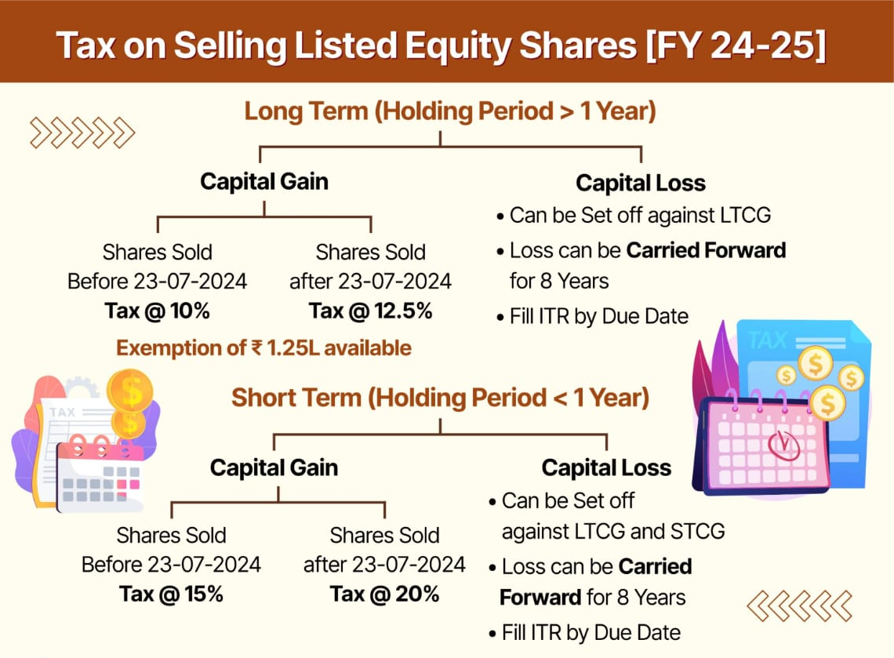

Slide 43
Sr. No. | Section | Income | Rate of Tax
(d) | 115BB | Winnings from • Lotteries; • Crossword puzzles; • Races including horse races; • Card games and other games of any sort; • Gambling or betting of any form or nature (other than winning from any online game) | 30%
(e) | 115BBJ | Net winnings from online games | 30%
(f) | 115BBE | Unexplained money, investment, expenditure, etc. deemed as income under section 68 or section 69 or section 69A or section 69B or section 69C or section 69D. | 60%

Slide 44
Residential Status

Slide 45

Introduction
According to the Income Tax Act, 1961, taxation depends on an assessee’s residential status.
Residential Status is computed separately for each previous year for every assessee.
The Residential Status of an Individual is to be determined based on the period of stay of the taxpayer in India.

Slide 46
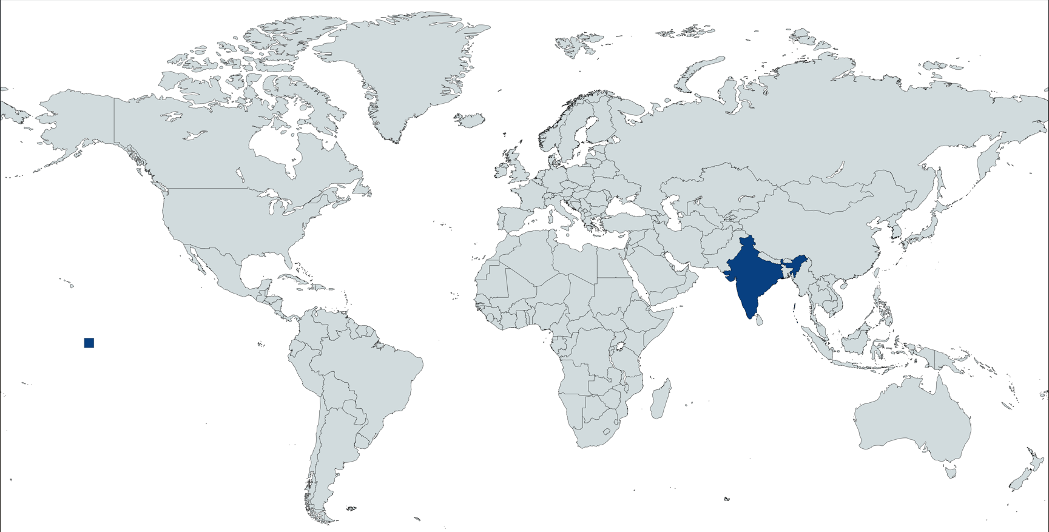
Meaning of Residential Status
Residential Status means the status of a person with reference to how long the person has stayed in India.
The period of stay is calculated in the form of number of days for each financial year in India.

Slide 47

Classification of Assessees Based on Residential Status
Residential Status
Individual and HUF
Resident
Ordinarily Resident (OR)
Resident but not Ordinarily Resident
Non –Resident (NRI)
Other than individual and HUF
Resident (OR)
Non Resident

Slide 48
How to Determine the Residential Status of Individual?
Two different conditions need to be checked
Basic Condition:
to determine if the individual is
Resident of India
Non Resident of India
Additional Conditions:
to determine if the individual is
Resident and Ordinary Resident (ROR)
Resident but not Ordinary Resident (RNOR)

Slide 49
For Resident (Basic Conditions):
An individual is said to be resident in India in any previous year, if he satisfies any one of the following conditions -
He has been in India during the previous year for minimum 182 days,
OR
He has been in India for minimum 365 days during the 4 years immediately preceding the previous year AND has been in India for minimum 60 days in the relevant previous year.
Resident
Non-resident
Fulfills both or any one conditions.
Does not fulfill any condition.

Slide 50
Basic Conditions to Determine Residential Status of an Individual
Residential Status
Basic Conditions
182 days or more during PY
60 Days or more in PY & 365 days or more in 4 Years (Preceding PY)

Slide 51
Example: 1 Deepak is an Indian working in Dubai since 2017. He visits India every year for 90 days. In FY 2024-25, he stayed in India for 80 days.
Days Stayed in India;
FY/PY | Days Stayed | Total Days Stayed in India
2017-’18 | 90 | 90
2018-’19 | 90 | 180
2019-’20 | 90 | 270
2020-’21 | 90 | 360
2021-’22 | 90 | 450
2022-’23 | 90 | 540
2023-’24 | 90 | 630
2024-’25 | 80 | 710

Slide 52
ANS:
Basic Conditions | In Actual | Result (Fulfillment)
Must stay of 182 Days or more in India during the FY. | He stayed only 80 days in India during FY 2024-’25 | Condition not Fulfilled
OR
Must stay of 60 days or more in India During the FY and 365 days or more in the 4 Preceding FY. | He stayed 80 days during FY 24-25 but in 4 preceding FY he stayed only for 360 days, | Condition not Fulfilled.
Here Deepak has not Fulfilled any Basic Conditions, So we can say that Deepak is ‘Non-Resident’.

Slide 53
Example 2
Mr. Shyam, an Indian Citizen is employed in the Canada for the last 12 years. He returned to India and stayed for 185 Days in previous year. Determine, is he Resident or Non Resident of India for the assessment year 2025-26?

Slide 54
Answer
Assessment Year: 2025-’26
Previous Year: 2024-’25
Year | Stayed in India
1st April to 31th March | 185 Days
Basic Conditions | Stayed | Is it satisfied?
1) Stayed in India for 182 days or more during PY | PY. 2024-’25 = 185 | Yes
Mr. Shyam Sharma satisfies the first basic condition, means he is Resident of India and
Therefore, there is need to check the additional conditions to determine his final Residential status as per the Income Tax Act, 1961.

Slide 55
For Resident and Ordinary Resident (Additional Conditions)
An individual shall be termed as “Resident and ordinary resident (ROR)” if he satisfies the following additional conditions:
He is resident in India for minimum 2 years out of the 10 years preceding the relevant previous year; AND
He has been in India for a minimum period of 730 days in the 7 years preceding the relevant previous year.

Slide 56
Example 3
Pooja was in the US for 3 years. She returned to India on 1st July 2024 and stayed till 31st March 2025.
Days Stayed in India;
FY/PY | Days Stayed | Total Days Stayed in India
July 2024 | 31 | 31
August 2024 | 31 | 62
September 2024 | 30 | 92
October 2024 | 31 | 123
November 2024 | 30 | 153
December 2024 | 31 | 184
January 2025 | 31 | 215
February 2025 | 28 | 243
March 2025 | 31 | 274

Slide 57
Answer
Basic Conditions | In Actual | Result (Fulfillment)
Must stay of 182 Days or more in India during the FY. | She stayed 274 days in India during FY 2024-’25 | Condition Fulfilled
She is Resident
Here Pooja has Fulfilled First Basic Condition, So we can say that Pooja is ‘Resident for FY 2024-’25’.

Slide 58
Answer
Additional Conditions | In Actual | Result (Fulfillment)
Must be Resident in India for at least 2 Out of 10 preceding FY. | She is resident for only 1 FY which is FY 2024-’25. | Condition not Fulfilled
And
Must stayed in India for at least 730 days in last 7 FY. | She stayed only 274 days in India. | Condition not Fulfilled
She is Resident but Not Ordinary Resident (RNOR)
Here Pooja has Fulfilled First Basic Condition, but not fulfilled Additional conditions, So we can say that Pooja is ‘Resident but Not Ordinary Resident for FY 2024-’25’.

Slide 59
Example 4
Mrs. Simona is a Foreign Citizen. She came to India and stayed for 110 Days in PY and in 4 Preceding PY she had stayed in India for 405 Days. Determine, is she Resident or Non Resident of India for the Assessment Year 2025-26?

Slide 60
Answer
Year | Stayed in India
Assessment Year: 2025-’26
Previous Year: 2024-’25
1st April to 31th March | 110 Days
4 Preceding PY | 405 Days
Basic Conditions | Stayed | Is it satisfied?
1) Stayed in India for 182 days or more during PY | PY. 2024-’25 = 110 D | No
2) Stayed in India for 60 Days or more in PY & 365 days or more in 4 Preceding PY |  | Yes
2023-24
2022-23
= 405 D
2021-22
2020-21
She satisfies the second basic condition, means she is resident of India.

Slide 61
Residential Status of Other Persons
Hindu Undivided Families (HUFs)
Basic Conditions:
An HUF is considered a resident in India if the control and management of its affairs are wholly or partially situated in India.
The residential status of the Karta (the head of the HUF) plays a significant role in determining the HUF's status.

Slide 62
Residential status of HUF (Additional Conditions):
Is the control and management of its affairs situated wholly or partly in India?
YES
NO
Is Karta resident in India in any 2 PYs out of 10 PYs preceding the relevant PY?
(+)
Is his stay in India for 730 days or more during the 7 PYs preceding the relevant PY?
HUF is Non resident
YES
NO
HUF is ROR
HUF is RNOR

Slide 63
Residential Status of Other Persons
Firms and Association of Persons (AOPs)
The residential status of a firm or AOP depends on the residential status of its partners or members.
If all the partners/members are residents, the firm/AOP is considered a resident;
if any partner/member is a non-resident, the firm/AOP is treated as a non-resident.

Slide 64
Residential Status of Other Persons (Contd.)
Companies
Companies in India are classified as resident or non-resident based on different criteria.
A company is considered a resident if it is an Indian company (i.e. registered in India) or if its place of effective management is situated in India during the relevant previous year.
Trusts and Other Organizations
The residential status of trusts, charitable institutions, and other organizations shall be determined based on the residential status of the individuals who control and manage them.

Slide 65
Residential status of Company:
Yes
The company is a resident in India
Is the company an Indian Company?
Yes
Is POEM of the company in India?
No
The company is a Non-resident
No

Slide 66
Scope of Total Income
Extent of Tax Liability
Resident and Ordinary Resident (ROR)
All kinds of income whether received/accrued in India or not shall be taxed in India
Resident but Not Ordinary Resident (RNOR)
Only income derived from a business controlled in or a profession set up in India will be included in Total Income
Non – Resident (NR)
Only that income which is earned from India or to be received/accrued in India

Slide 67
Scope of Income/ Incidence of Tax Based on Residential Status
Income | Res. & Ordinary Res. | Res. (but Not Ordinary Res.) | Non Res.
1. Income Received in India, Earned in India or elsewhere.
Taxable
Taxable
Taxable
2. Income to be Received in India, Earned in India or elsewhere.
Taxable
Taxable
Taxable
3. Income received from Business outside India, Business control and managed in India.
Taxable
Taxable
Not Taxable
4. Income received outside of India from other sources.
Taxable
Not Taxable
Not Taxable

Slide 68
Heads Of Income:
Salaries
House Property
Business or Profession
Capital Gains
Other Sources
Salary, pension etc. earned is taxable under this head.
Rental income is taxable under this head.
Income derived from carrying on any business or profession is taxable under this head.
Profit from sale of a capital asset is taxable under this head.
Income not taxable under the first four heads will be taxed under this head.

Slide 69
Income from Salary:
"Salary is the payment received by an individual for rendering services under an employer-employee relationship.“
Section 15 to 17 of the Income Tax Act, 1961 governs Income from Salary.
Components of the salary:
Basic Salary:
Fixed Monthly Pay = Fully Taxable
Allowances:
HRA (House Rent Allowance
DA (Dearness Allowance
Transport Allowance
Children Education Allowance
3. Perquisites & Benefits:
Rent-free Accommodation
Motor Car Facility
Employee Stock Options (ESOPs)
Interest-free/Concessional Loans
Club/Meal/Refreshment Facility
Medical Insurance by Employer

Slide 70
Other Inclusions:
Pension
Bonus/Incentives
Periodic payments to employees after their retirement.
Payments made to employees exceeding their salary.
Gratuity
Commission
A lump sum payment to employees upon retirement.
Earning a percentage from sales or completed tasks.
Leave Encashment
Converting unused leave days into cash payments.

Slide 71
Calculation of Salary:
Income under the head “Salary” | Amount | Amount
Salary/Bonus/Commission etc. | A
Taxable Allowance | B
Value of Taxable perquisites | C
Gross Salary (A+B+C) |  | D
Less: Deductions under section 16 |  | E
Net Taxable Income from Salary (D-E) |  | F

Slide 72
Exercise
Mr. Ritesh is the Manager of the production department of a reputed software company. He is getting following amount for the services rendered by him to the company -
₹ 1,50,000 per month as Basic Salary (BS)
₹ 10% of Basic Salary as Dearness Allowances (DA)
₹ 10,000 (p.m.) as Servant Allowance
For perfectly performing the duty, company has provided additional ₹ 70,000 as Cash Allowance
Compute the taxable salary of Mr. Ritesh Deshmukh for assessment year 2024-25.

Slide 73
Answer
Statement Showing Computation of Income under the head Salary of Mr. Ritesh (Specified Employee)
AY:2024-25 PY: 2023-24 | He is ROR
Components | Amount ₹
Basic Salary (BS) (₹ 1,50,000 × 12 months) | 18,00,000
Add:
Dearness Allowances (DA) (10% of BS) | 1,80,000
Servant Allowance (₹ 10,000 p.m.) | 1,20,000
Cash Allowance | 70,000
Gross Salary | 21,70,000
Less: Deductions from Salary | —
Standard Deduction u/s 16 (upto ₹ 50,000) | 50,000
Net Salary/Taxable Salary income | 21,20,000

Slide 74
Income from House property
It refers to the income earned by the owner of a building or land attached to it (like a garden, garage, etc.) by renting it out or deemed to be let out.
Only the owner can be taxed under this head.
Conditions for Taxability:
Property Type
Ownership
Usage
The property must consist of buildings or land appurtenant.
The assessee must be the owner of the property.
The property should not be used for own business or profession.

Slide 75
Annual Value of the let-out property
Gross Annual Value
Municipal taxes paid by the owner during the previous year
Net Annual Value

Slide 76
Deductions from Annual Value
Deductions are allowed from the net annual value
30% of NAV (Standard deduction)
Interest on borrowed capital
Interest on loans taken for reasons can be claimed as deduction
Acquisition
Construction
Repairs
Renewal
Reconstruction.

Slide 77
Format
Particular | Amount
Gross Annual Value | XXX
Less: Municipal Tax | XXX
Net Annual Value (NAV) | XXX
Less: Standard Deduction u/s 24(a) (30% of NAV) = (XXX) Deduction u/s 24(b) (Home Loan Interest) = (XXX) | (XXX)
Income from House Property | (XXX)

Slide 78
Example: 1
Leased Property with Loan
Rent: ₹25,000/month = ₹3,00,000
Municipal Tax: ₹20,000
Home Loan Interest: ₹2,00,000
Calculate the income from House property.

Slide 79
Answer
Particular | Amount
Gross Annual Value (25,000*12) | 3,00,000
Less: Municipal Tax | (20,000)
Net Annual Value (NAV) | 2,80,000
Less: Standard Deduction u/s 24(a) (30% of NAV) = (84,000) Deduction u/s 24(b) (Home Loan Interest) = (2,00,000) | (2,84,000)
Income from House Property | (4,000)
There is a loss in the calculation of income so this loss can be carry forward to other income head.

Slide 80
Example 2
Leased Property with Loan
Rent: ₹35,000/month = ₹4,20,000
Municipal Tax: ₹20,000
Home Loan Interest: ₹1,50,000
Calculate the income from House property.

Slide 81
Answer
Particular | Amount
Gross Annual Value (35,000*12) | 4,20,000
Less: Municipal Tax | (20,000)
Net Annual Value (NAV) | 4,00,000
Less: Standard Deduction u/s 24(a) (30% of NAV) = (1,20,000) Deduction u/s 24(b) (Home Loan Interest) = (1,50,000) | (2,70,000)
Income from House Property | 1,30,000

Slide 82
Example 3
Two Rented Houses
House A rent: ₹12,000/month = ₹1,44,000
House B rent: ₹15,000/month = ₹1,80,000
Total Rent = ₹3,24,000
Municipal Tax: ₹24,000
Interest on Loan: ₹2,50,000
Calculate the income from House property.

Slide 83
Calculation as per Old Regime
Particular | Amount
Gross Annual Value (12,000 + 15000 = 27000*12) | 3,24,000
Less: Municipal Tax | (24,000)
Net Annual Value (NAV) | 3,00,000
Less: Standard Deduction u/s 24(a) (30% of NAV) = (90,000) Home Loan Interest (Maximum 2L allowed)= (2,00,000) | (2,90,000)
Income from House Property | 10,000

Slide 84
Profit & Gain from Business or Profession
Profession
Services using intellectual or specialized skills
Business
Profit/Gain
Trade, commerce, or manufacture with profit intention
Net income after deducting expenses from receipts

Slide 85
Types of Incomes under this Head (Sec. 28)
Business Profits
Earnings from business or professional activities
Contract Compensation
Payments for contract termination or modification
Association Income
Revenue from trade or professional associations
Export Incentives
Government Subsidies
Benefits like Duty Drawback for exports
Cash subsidies or grants from the government

Slide 86
Calculation:
Allowable Expanses:
Expenses
Example
Gross Receipts
Rent, rates, taxes
Office rent, property tax
Repairs and insurance
Machinery maintenance
Depreciation (Sec. 32)
Wear & tear on assets
Less: Allowable Expenses
Salary, bonus
Paid to employees
Interest on loans
For business purposes
Legal professional fees
Fees, audit charges
Net Profit
Bad debts (written off)
Irrecoverable payments
Advertisement and marketing
Print and digital ads

Slide 87
Example 1
One business is having..
Receipts = ₹10,00,000
Expenses = ₹3,00,000
Depreciation = ₹50,000
Salary = ₹1,50,000
Interest on Loan = ₹2,00,000
Calculate the Net Profit from above information.

Slide 88
Calculation of Profit from Business
Particular | Amount | Amount
Gross Receipts |  | 10,00,000
Less: Allowable Expanses: |  | (7,00,000)
Business Expenses | 3,00,000
Depreciation | 50,000
Salary | 1,50,000
Interest on Loan | 2,00,000
Net Profit |  | 3,00,000

Slide 89
Example: 2
One business is having..
Receipts = ₹20,00,000
Expenses = ₹5,00,000
Depreciation = ₹1,00,000
Salary = ₹2,50,000
Repairing Expenses = ₹50,000
Rent Expenses = ₹ 4,80,000
Calculate the Net Profit from above information.

Slide 90
Calculation of Profit from Business
Particular | Amount | Amount
Gross Receipts |  | 20,00,000
Less: Allowable Expanses: |  | (14,00,000)
Business Expenses | 5,00,000
Depreciation | 1,20,000
Salary | 2,50,000
Repairing Expenses | 50,000
Rent | 4,80,000
Net Profit |  | 6,00,000

Slide 91
Income from Capital Gain:
Capital Gain is the profit earned when a capital asset is sold for more than its purchase price.
Formula:
Capital Gain = Sale Price – (Purchase Price + Improvement Cost + Expenses on Sale)
It includes Capital assets, any property held by a person- movable or immovable or whether related to business or not.
Land and Building
Shares & Mutual Funds
Jewellery
Vehicles

Slide 92
Types of Capital Assets:
Rates:
Asset Type
STCA Holding Period
LTCA Holding Period
Listed Security, Equity Fund Unit, Unit of UTI, Zero Coupon Bond
≤ 12 months
> 12 months
Other Capital Assets
≤ 24 months
> 24 months
Example
Shares sold within a year
Land held for 4 years
STCG Other assets
LTCG Shares (above ₹1.25 lakh)
LTCG Land/building, gold, etc.
Capital Gain
STCG Shares (STT paid)
20%
20% with indexation & 12.5% without indexation
Tax Rate
20%
12.5%

Slide 93
Computation of Short Term Capital Gain
Particulars | Amount | Amount
Full value of consideration received or accruing as a result of transfer | xxx
Less: Expenditure incurred wholly and exclusively in connection with such transfer (for e.g., brokerage on sale) (Note: Deduction on account of STT paid will not be allowed) | xxx
Net Sale Consideration |  | xxx
Less: Cost of acquisition | xxx
Cost of improvement | xxx | xxx
Short-term capital gain (STCG) |  | xxx
Less: Exemption under section 54B/ 54D |  | xxx
Short-term capital gain chargeable to tax |  | xxx

Slide 94
Computation of Long Term Capital Gain
Particulars | Amount | Amount
Full value of consideration received or accruing as a result of transfer | xxx
Less: Expenditure incurred wholly and exclusively in connection with such transfer (for e.g., brokerage on sale) (Note: Deduction on account of STT paid will not be allowed) | xxx
Net Sale Consideration |  | xxx
Less: Cost of acquisition | xxx
Cost of improvement | xxx | xxx
Long-term capital gain (STCG) |  | xxx
Less: Exemption under section 54/54B/54D/54EC/54F |  | xxx
Long-term capital gain chargeable to tax |  | xxx

Slide 95
Example 1
Asset Sold: Equity Shares (sold within 10 months) Date of Purchase: 01-Aug-2024 Date of Sale: 20-May-2025 Sale Consideration: ₹1,50,000 Purchase Price: ₹1,00,000 Expenses on Transfer: ₹2,000
Calculate the short term capital gain and also calculate the tax on it.

Slide 96
Calculation of Short Term Capital Gain
Particular | Amount | Amount
Full Value of Consideration (Sell value) | 1,50,000
Less: Expenses on Transfer | (2,000)
Net Sale Consideration |  | 1,48,000
Less: Cost of Acquisition (Purchase) |  | (1,00,000)
Short Term Capital Gain |  | 48,000
Tax (20%) |  | 9,600
Add: Cess (4%) |  | 384
Total Tax on STCG |  | 9,984

Slide 97
Example 2
STCG on Equity
Date of Purchase: 01-May-2024
Date of Sale: 20-Fab-2025
Buy Price: ₹80,000
Sell Price: ₹1,20,000
Calculate the short term capital gain and also calculate the tax on it.

Slide 98
Calculation of Short Term Capital Gain
Particular | Amount | Amount
Full Value of Consideration (Sell value) | 1,20,000
Less: Expenses on Transfer | -
Net Sale Consideration |  | 1,20,000
Less: Cost of Acquisition (Purchase) |  | (80,000)
Short Term Capital Gain |  | 40,000
Tax (20%) |  | 8,000
Add: Cess (4%) |  | 320
Total Tax on STCG |  | 8,320

Slide 99
Example: 3
Asset Sold: Listed Shares Purchase Date: 01-Jan-2022 Sale Date: 10-Feb-2025 Purchase Price: ₹1,00,000 Sale Price: ₹2,35,000 Transfer Expenses: ₹1,000
Calculate the long term capital gain and also calculate the tax on it.

Slide 100
Calculation of Long Term Capital Gain
Particular | Amount | Amount
Full Value of Consideration (Sell value) | 2,35,000
Less: Expenses on Transfer | (1,000)
Net Sale Consideration |  | 2,34,000
Less: Cost of Acquisition (Purchase) |  | (1,00,000)
Long Term Capital Gain |  | 1,34,000
Less: Exemption |  | (1,25,000)
Taxable LTCG |  | 9,000
Tax (12.5% without Indexation) |  | 1,125
Add: Cess (4%) |  | 45
Total Tax on LTCG |  | 1,170

Slide 101
Example: 4
LTCG on Land with Indexation
Bought: ₹ 3L in FY 2008-09 (CII=137)
Sold: ₹ 15L in FY 2024-25 (CII=363)
Indexed Cost = ₹3L × 363/137 = ₹7,94,891/-
Exemption u/s 54 = Rs.1,25,000/-
Calculate the long term capital gain and also calculate the tax on it.

Slide 102
Calculation of Long Term Capital Gain
Particular | Amount | Amount
Full Value of Consideration (Sell value) | 15,00,000
Less: Expenses on Transfer | -
Net Sale Consideration |  | 15,00,000
Less: Cost of Acquisition (Purchase)(with Indexation) |  | (7,94,891)
Long Term Capital Gain |  | 7,05,109
Less: Exemption |  | (1,25,000)
Taxable LTCG |  | 5,80,109
Tax (20% with Indexation) |  | 1,16,022
Add: Cess (4%) |  | 4641
Total Tax on LTCG |  | 1,20,663

Slide 103
Income from Other Sources:
"Income from Other Sources" is like a miscellaneous income basket. If income doesn’t fall under other heads (like Salary, House Property, Business/Profession, or Capital Gains), it gets taxed here.
As per Section 56(1) of the Income Tax Act, 1961:
“Income which is not chargeable to tax under any of the first four heads shall be chargeable under the head ‘Income from Other Sources’.”
Interest
Lottery/Game show
Gifts
Dividends
Fully taxable income.
Taxable if aggregate value exceeds ₹50,000 annually.
Taxable in the recipient's hands.
Taxed at 30% flat rate (+) cess.

Slide 104
Common Examples:
Winnings
Income from lotteries & games
Family Pension
4
5
Income after death of a salaried person
Gifts
Received gifts
exceeding a threshold
3
Taxable Income
Examples
Rental Income
6
Income from renting out assets
Dividends
2
Income from shares in companies
7
Advance Forfeited
1
Income from canceled deals
Interest
Income from bank deposits and savings

Slide 105
Tax on Gifts:
Relatives
Friends or Others
Marriage or Inheritance
Gifts received from relatives are not taxable.
Gifts from friends or others are taxable if the value exceeds ₹50,000.
Gifts received on marriage or through inheritance are not taxable.
1
2
3

Slide 106
Example 1
Raj won ₹1,00,000 in a Diwali lucky draw and ₹50,000 in a TV quiz show
Computation of income from other sources:
Particulars | Amount
Lottery Winnings | 1,00,000
Quiz show Winning | 50,000
Total Income from Other Sources | 1,50,000
Tax (30%) | 45,000

Slide 107
Example 2
Suresh receives ₹1,20,000 per year as family pension after the death of his wife (a govt. employee).
Computation of income from other sources:
Particulars | Amount
Family Pension Received | 1,20,000
Less: Deduction (1/3 of pension or ₹15,000) | 15,000
Taxable Family Pension | 1,05,000
Tax (30%) | 15,750

Slide 108
Assessees Required to file Return of Income Compulsorily

Slide 109
01
Company
Firm

Slide 110
02
Resident with Foreign Assets
Individuals residing outside India with foreign assets or signing authority.
High Income Individuals
Individuals, HUFs, AOPs, BOIs, and artificial juridical persons exceeding basic exemption limit.

Slide 111
03
High Deposits
Deposited over Rs. 1 crore in current accounts.
Foreign Travel
Incurred expenses over Rs. 2 lakh for foreign travel.
Electricity Consumption
Incurred expenses over Rs. 1 lakh towards electricity.

Slide 112
04
Business Sales
Total sales, turnover or gross receipts in the
business are greater than Rs. 60 lakhs.
Professional Receipts
Total gross receipts in profession are
greater than Rs. 10 lakhs.
TDS/TCS Credit
Aggregate TDS and TCS credit is greater than
or equal to Rs. 25,000 (Rs. 50,000 for senior citizens).
Savings Deposit
Deposit in one or more savings bank account is greater
than or equal to Rs. 50 lakhs.

Slide 113
ITR-1
Applicable only for Individual
Salary/Pension
House Property
Other sources
Agricultural Income
Capital Gain
Income from salary or pension.
Income from interest, family pension,
dividends etc.
Capital Gain income u/s 112A up to
Rs.125000
Income from one house property is included.
Income from agriculture
up to ₹ 5,000.
For AY 2025-26

Slide 114
ITR-2
Applicable for Individual (Not eligible for ITR 1) and HUF
Income Source
ITR-1 Ineligible
Income not from business or profession.
Not eligible to file ITR-1 form.
For AY 2025-26

Slide 115
ITR-3
Applicable For
Income Source
Individual and Hindu Undivided Family (HUF).
Having Income under the head Profits and Gains.
For AY 2025-26

Slide 116
ITR-4
Applicable for Individual, HUF and Firm (other than LLP)
Business/
Profession Income
Salary/Pension Income
House Property Income
Other Sources Income
Agricultural Income
Income received as salary or pension.
Income from interest,
Family pension, dividends, etc.
Income from business or profession computed presumptively under specified sections.
Income a single house property.
Income earned from agricultural activities, up to ₹ 5,000.
For AY 2025-26

Slide 117
ITR 5
Firm
Limited Liability Partnership (LLP)
Association of Persons (AOP)
Body of Individuals (BOI)
Artificial Juridical Person (AJP) referred to in clause (vii) of Section 2(31)
Local Authority referred to in clause (vi) of Section 2(31)
Representative Assessee referred to in Section 160(1)(iii) or (iv)
Cooperative Society
Society Registered under Societies Registration Act, 1860 or under any other law of any State
Trust other than Trusts eligible to file Form ITR-7
Estate of Deceased Person
Estate of an Insolvent
Business Trust referred to in Section 139(4E) and Investment Fund referred to in Section 139(4F)
For AY 2025-26

Slide 118
ITR 6
Indian Company
Body corporate incorporated by or under the laws of country outside India
Any institution, association or body, whether incorporated or not and whether Indian or Non-Indian which is declared by general or special order of the Board, to be Company, etc.
For AY 2025-26

Slide 119
ITR 7
Income derived from Property held under Trust wholly / in part for charitable or religious purposes
Chief Executive Officer of every Political Party
Various entities like Research Association, News Agency, etc. mentioned in Section 10
University, College or other Institution referred in Section 35
For AY 2025-26

Slide 120
Due Dates:
31st October of assessment year
for Companies, individuals required audit, and Partners
of firms requires audit in firms.
31st July of assessment year
for All other assessees.

Slide 121
Belated Return of Income: u/s 139(4)
A return of income for any previous year, which has not been furnished within the time allowed u/s 139(1), may be furnished at any time before:
Three months prior to the end of the relevant assessment year
OR
Completion of the assessment
whichever is earlier

Slide 122
Revised Return of Income: u/s 139(5)
Return filed u/s 139(1) or u/s 139(4) can be revised u/s 139(5), if any omission or any wrong statement is discovered by the assessee, at any time before:
Three months prior to the end of the relevant assessment year
OR
Completion of the assessment
whichever is earlier

