Slide 1


Unit-5 Financial Concepts
Banking, Financial Services and Insurance(BFSI)
DU # 2301CS594
CO 5: apply time value of money principles in personal finance scenarios such as EMI calculations, retirement planning, and loan decisions.
Prof. Vatsal Raval
Vatsal.raval@darshan.ac.in
9428285444

Slide 2

Looping
Topics
Time Value of Money: (Theory and Numerical) Concepts, Reasons for Preference of Money.
Future Value (Compounding), Future Value of a Single Cash Flow, Future Value of an Annuity, Sinking Fund, Future value of Uneven Cash Flow.
Present Value (Discounting), Present Value of a Single Cash Flow, Present Value of an Annuity.

Slide 3

Topics
Capital Recovery & Loan Amortization
Present value of Uneven Cash Flow, Present value of Perpetuity
Value of an Annuity Due: Future Value of an Annuity Due, Present Value of an Annuity Due, Multi-period Compounding
Looping
CO 5: apply time value of money principles in personal finance scenarios such as EMI calculations, retirement planning, and loan decisions.

Slide 4
Price of Gold and Petrol Over Past 25 Years
Year | Gold Price 24 k (Per 10 g) | Petrol Price (Per Litre)
2001 | 4,300 | 29
2005 | 7,000 | 38
2011 | 26,400 | 63.77
2015 | 26,343 | 60.50
2021 | 48,720 | 95.41
2022 | 52,670 | 95
2023 | 65,330 | 98
2024 | 77,913 | 100
2025 | 1,04,000 | 105

Slide 5
Time Value of Money
Time value of money is financial concept which states that some of money is worth more than the sum amount in future.
This is because money has potential capacity to earn interest or return.
This can also be invested to grow in value over a period of time.

Slide 6

Concept of Time Value of Money
The concept of the time value of money implies that the value of money depends on the time when it is received.
The simple concept of the value of money is that the value of money received today is more than the value of the same amount of money received after a certain period.
Money received in the future is not as valuable as money received today.
>
Money Received Today
Money Received in Future

Slide 7
Why is Money Worth More Today?
Interest earning
Money kept in a bank or invested can earn interest or return.
Inflation
Over time prices of goods and services increases so purchasing power of money decreases.
Risk
Future is uncertain having cash in hand is good choice.
Opportunity Cost
Having money now gives you opportunity to invest or spend it in a better way.

Slide 8
Important Terms
Short Form | Description
PV | Present Value – Current value of money
FV | Future Value – Value of current money at a future date with interest
r | Rate of Interest at which money grows over a period of time
n | Number of years or months for which money is invested
P | Principal amount at the beginning
A | Annuity is a series of equal payment made at regular intervals

Slide 9
Example
You have 1,000 today. And you deposited this money in bank at 4% interest rate per year.
FV = 1000 + (4% of 1000)
FV = 1000 + 40
FV = 1040
Now someone promises to you to give 1,040 after a year. How much is that valuable today if interest rate is 4%?
PV = FV / (1+r)
PV = 1040 / (1+0.04)
PV = 1000

Slide 10
Importance of Time Value of Money
Helps in comparing investment options.
Useful for calculation of EMI of loan.
Helps in valuing bonds, insurance, retirement plan.
Money received today is better than money receivable in future.
TVM helps to understand how value of money changes over a period of time.

Slide 11
Reasons for Preference of Money
People prefer money over other forms of wealth like gold land and goods because money is more useful and convenient in everyday life.
Medium of Exchange
Store of Value
Unit of Account
Liquidity
Standard of Deferred Payment
Easy to Carry and Store
Legal Tender

Slide 12

Reasons for Preference of Money
Medium of Exchange
Money is accepted everywhere to buy goods and services.
You can pay 100 to buy fruits, mobile, and recharge.
You don’t have to carry goods to trade just like barter system.

Slide 13

Reasons for Preference of Money
Store of Value
Money can be saved and used in the future.
If you earn 10,000 today save it you can use.
It in a future month it is not perishable goods like fruit money does not spoil.

Slide 14


Reasons for Preference of Money
Unit of Account
Money helps to measure the value of goods and services in common unit.
A pen cost 10 shirt, cost 500, denim cost 800.
It helps to make calculation easy you can budget or predict expenses.

Slide 15
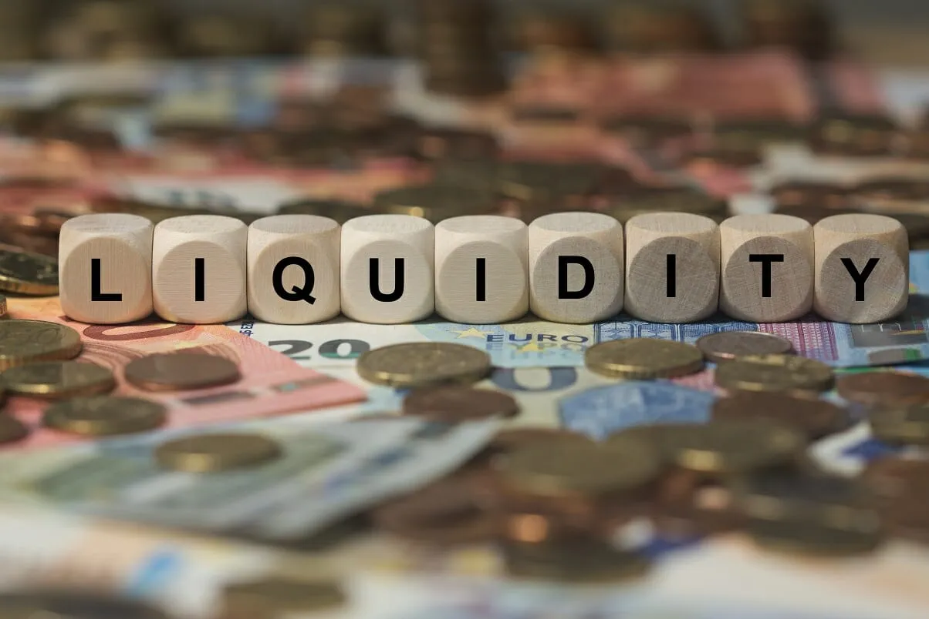
Reasons for Preference of Money
Liquidity
It is most liquid asset it can be used immediately without converting it.
You can note directly by a thing with land or gold.
It can be used instant in transactions.

Slide 16

Reasons for Preference of Money
Standard of Deferred Payment
Money is used to settle debts or future payments.
It ensures clarity in credit transactions.

Slide 17
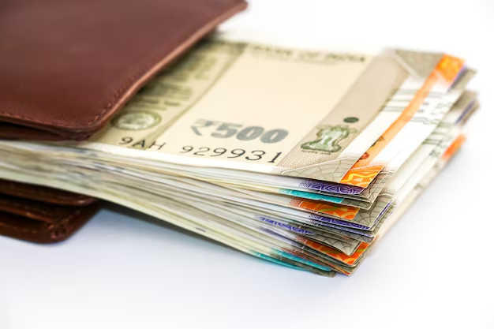
Reasons for Preference of Money
Easy to Carry and Store
Money is light and compact.
You can carry 5000 in your wallet but you cannot carry the rice bag of same value.
It is convenient in handling.

Slide 18
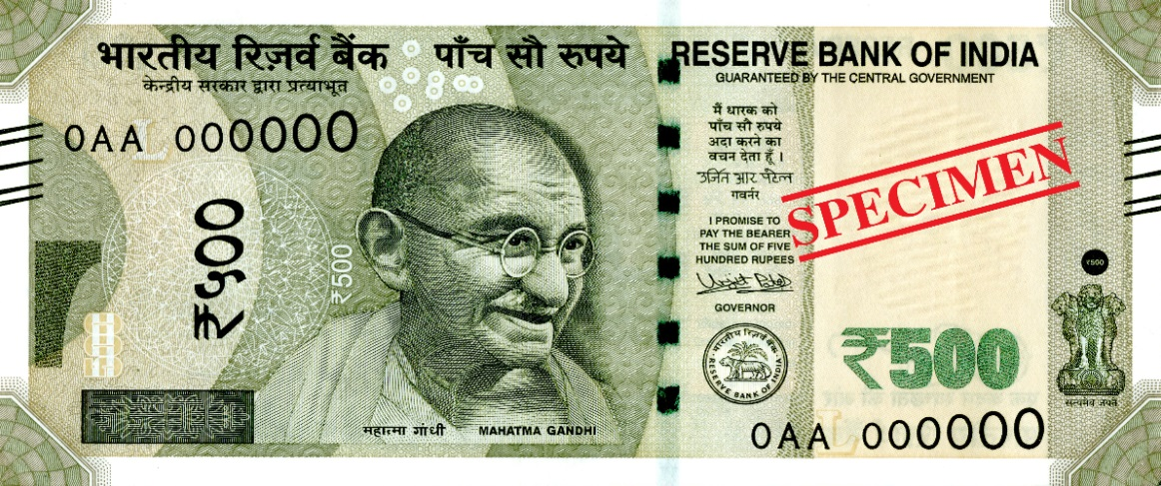

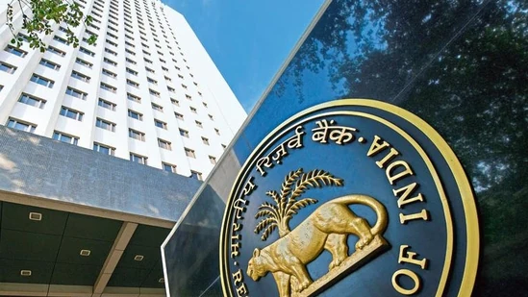
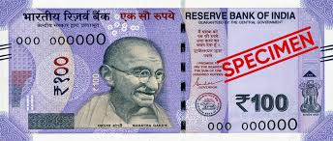
Reasons for Preference of Money
Legal Tender
The government recognised money like coins and notes are official legal tender for payments.
a shopkeeper or tea vendor has to accept 20 note as a legal tender or promissory note for the sale of tea or other goods.

Slide 19
Concept of Compounding and Discounting
In finance the value of money changes over a time.
A rupee today is not same as rupee tomorrow.
Money earns more money over a period of time.
This concept leads towards two important points:
Compounding and
Discounting

Slide 20
Future Value / Compounding
Grow your money over a time.
Compounding is the process of earning interest on both the principal amount and interest that already earned.
It finds future value from present value.
For example, you have invested Rs. 1,000 at an annual interest rate of 10 percentage for two years.
Year | Particulars | Interest | Total
1 | 1,000 * 10% | 100 | 1100
2 | 1,100 * 10% | 110 | 1210

Slide 21
Present Value / Discounting
Present value is exact opposite of Future value.
Discounting is the process of finding out how much a future amount of money is worth today this is also known as calculating present value.
It finds present value from future value.
The present value of money to be received in future will always less.
For example, if you will receive rupees 1210 after two years at the rate of interest 10% how much is that worth today?
PV = FV / (1+r)^{n}
PV = 1210 / (1+0.10)2
PV = 1210 / 1.21
PV = 1000

Slide 22
Methods/Techniques of Time Value of Money
Future Value
Present Value
Future Value of A Single Amount
Future Value of An Annuity
Intra – Year Compounding
Present value of A Single Amount
Present Value of An Annuity
Present Value of A Perpetuity
Intra – Year Discounting

Slide 23
1) Future Value of a Single Amount
Suppose your father gave you Rs. 10,000 on your eighteenth birthday. You deposited this amount to a bank at 10% rate of interest for one year. How much future sum would you receive after one year ?........after two years?
Value of present cash inflow or cash outflow after a certain no. of years at a specific interest rate is called the future value of Single Cash flow.

Slide 24

Formula
$$FVn=P{(1+r)}^{n}$$
$$\text{Where}\text{,}$$
$$\text{F}\text{V}\text{ = }\text{Future} \text{Value}$$
$$\text{P}\text{ = }\text{Present} \text{Value}$$
$$\text{r} \text{= }\text{Interest} \text{Rate}$$
$$\text{n}\text{ =} \text{No}\text{. }\text{of} \text{Years}$$

Slide 25
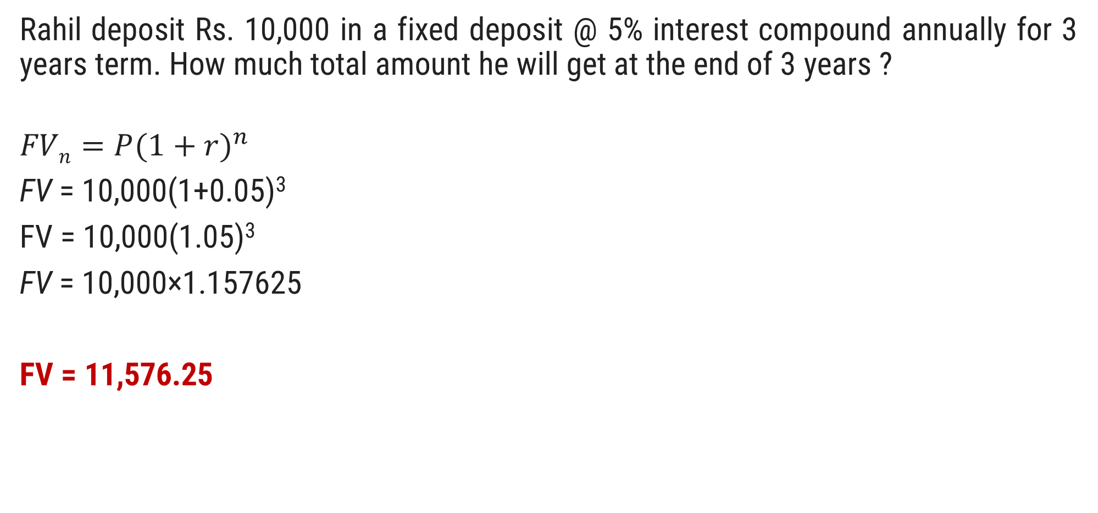
Question.01
Rahil deposit Rs. 10,000 in a fixed deposit @ 5% interest compound annually for 3 years term. How much total amount he will get at the end of 3 years ?
$$FVn=P{(1+r)}^{n}$$
FV = 10,000(1+0.05​)³
FV = 10,000(1.05)³
FV = 10,000×1.157625
FV = 11,576.25

Slide 26
Question.02
Virat deposits Rs. 1,000 in a fixed deposit @ 12% interest compound annually for 8 years term. How much total amount he will get at the end of 8 years ?
FV = 1,000(1+0.12)⁸
FV = 1,000(1.12)⁸
FV = 1,000×2.476
FV = 2,476

Slide 27
Uneven Cashflow
Example: Let's say you have the following uneven cash flow stream:
Year 1: 1000, Year 2: 2000, and Year 3: 1500.
And the interest rate is 5% per year.
Solution:
Year 1: FV = 1000 * (1 + 0.05)² = 1102.5
Year 2: FV = 2000 * (1 + 0.05)¹ = 2100
Year 3: FV = 1500 * (1 + 0.05)⁰ = 1500
Total FV: 1102.5 + 2100 + 1500 = 4702.5

Slide 28
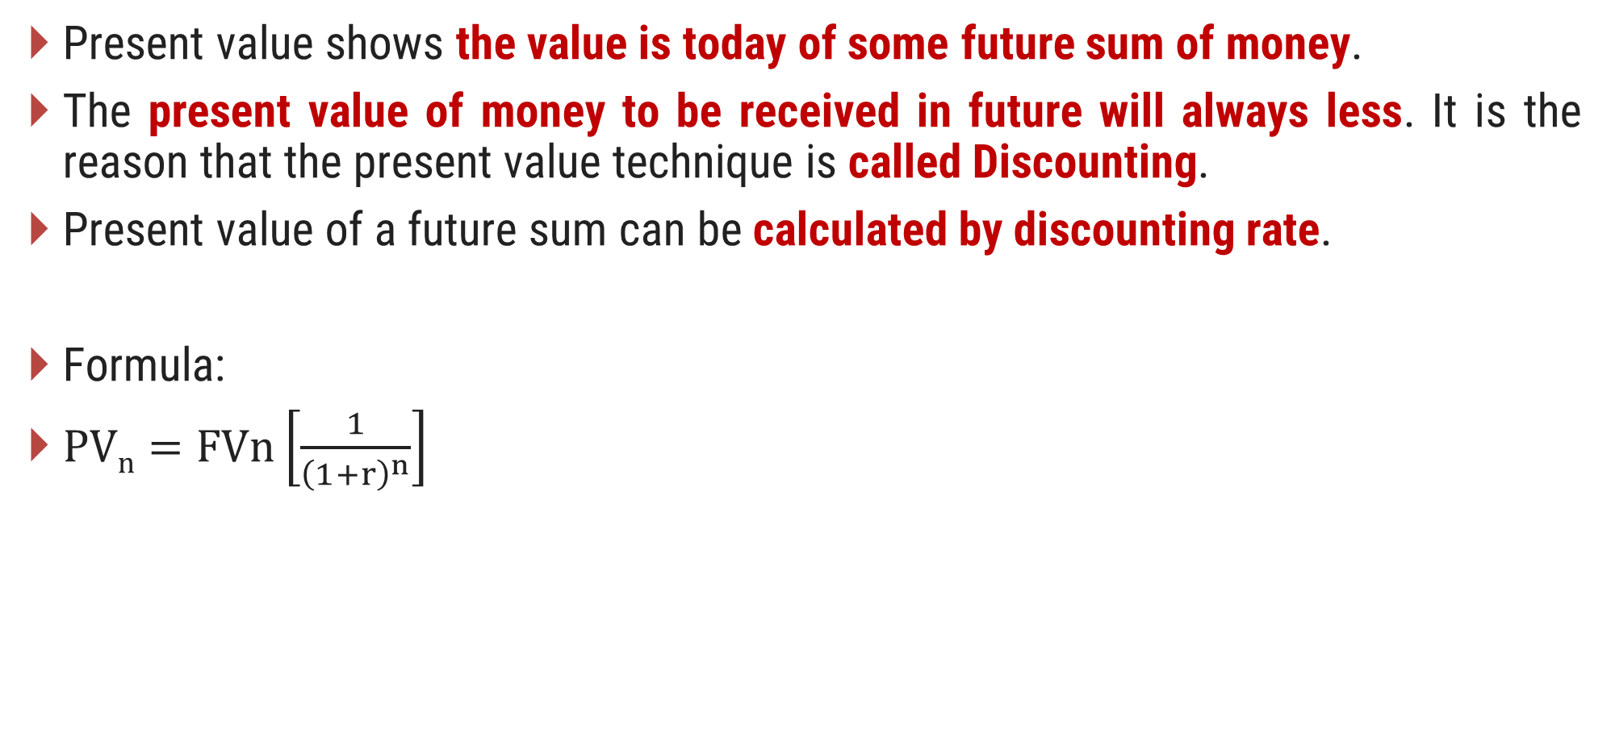
2) Present Value of a Single Amount
Present value shows the value is today of some future sum of money.
The present value of money to be received in future will always less. It is the reason that the present value technique is called Discounting.
Present value of a future sum can be calculated by discounting rate.
Formula:
$PVn=FVn\left[\frac{1}{{\left(1+r\right)}^{n}}\right]$

Slide 29

Question.03
Ms. Dhanashree is going to get Rs. 2,50,000 after 6 years from one money back insurance policy. Calculate the present value of this amount if her required rate of return is 12% p.a.
$$P= \frac{F}{{(1+r)}^{n}}$$
$$P= \frac{2,50,000}{{(1+0.12)}^{6}}$$
$$P= \frac{2,50,000}{{(1.12)}^{6}}$$
$$P= \frac{2,50,000}{1.974}$$
$$P=1,26,646$$

Slide 30
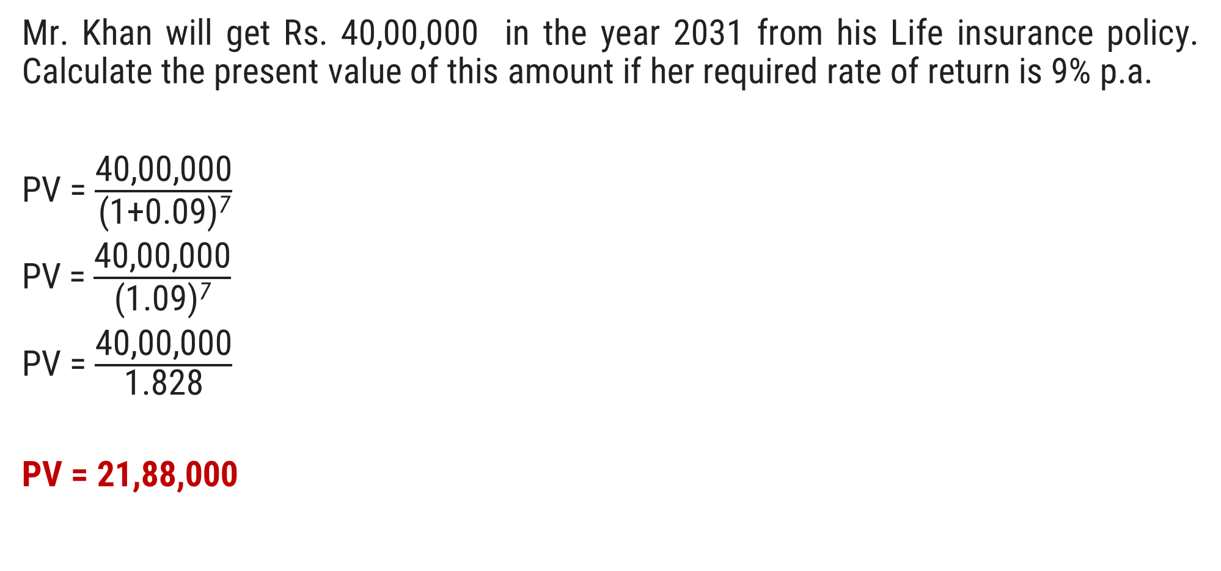
Question.04
Mr. Khan will get Rs. 40,00,000 in the year 2031 from his Life insurance policy. Calculate the present value of this amount if her required rate of return is 9% p.a.
PV = $\frac{\text{40,00}\text{,}\text{000}}{\text{(1+0.}\text{09}\text{)}\text{7}}$​
PV = $\frac{\text{40,00}\text{,000}}{\text{(1}\text{.}\text{09}\text{)}\text{7}}$
PV = $\frac{\text{40,00,}\text{000}}{\text{1.}\text{8}\text{28}\text{​}}$
PV = 21,88,000

Slide 31
Question.05
Calculate the present value of an uneven cash flow, using a discount rate of 12%.
Years | 2024 | 2025 | 2026 | 2027 | 2028 | 2029 | 2030 | 2031
Cash Flow | 1000 | 2000 | 2000 | 3000 | 3000 | 4000 | 4000 | 5000

Slide 32
Solution
Year | Cash flow | PVIF (12%) | Present Value
2024 | 1000 | 0.893 | 893
2025 | 2000 | 0.797 | 1,594
2026 | 2000 | 0.712 | 1,424
2027 | 3000 | 0.636 | 1,908
2028 | 3000 | 0.567 | 1,701
2029 | 4000 | 0.507 | 2,028
2030 | 4000 | 0.452 | 1,808
2031 | 5000 | 0.404 | 2,020
 |  |  | 13,376

Slide 33
3) Future Value of an Annuity
Annuity is a fixed payment (receipt) each year for a specified no. of years.
An annuity is a stream of constant cash flow occurring at regular interval of time.
For example, the premium payments of a life insurance policy.
When cash flow occur at the end of each period the annuity is called an ordinary annuity or a deferred annuity.

Slide 34

Continue
Formula
$FVAn=A\left[\frac{{(1+r)}^{n} −1}{r}\right]$
Where,
FVA = Future value of an annuity
A = Constant periodic flow
r = Rate of Interest
n = Numbers of years

Slide 35
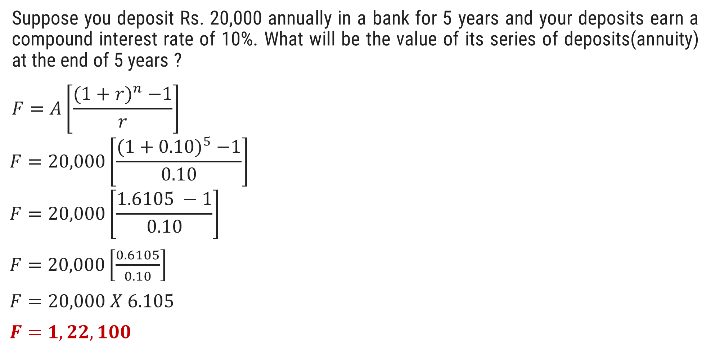
Question.06
Suppose you deposit Rs. 20,000 annually in a bank for 5 years and your deposits earn a compound interest rate of 10%. What will be the value of its series of deposits(annuity) at the end of 5 years ?
$$F=A\left[\frac{{(1+r)}^{n} −1}{r}\right]$$
$$F=20,000\left[\frac{{(1+0.10)}^{5} −1}{0.10}\right]$$
$$F=20,000\left[\frac{1.6105 −1}{0.10}\right]$$
$F=20,000\left[\frac{0.6105}{0.10}\right]$
$F=20,000 X 6.105$
$F=1,22,100$

Slide 36

Question.07
Mr. Viraj went to SBI to open a recurring Deposit Account and decided to deposit Rs. 15,000 every year for a period of 6 years. If bank pay him 8% interest per annum. Calculate the total amount accumulated at the end of tenure.
$$F=A\left[\frac{{(1+r)}^{n} −1}{r}\right]$$
$$F=15,000\left[\frac{{(1+0.08)}^{6} −1}{0.08}\right]$$
$F=15,000 X 7.336$
$F=1,10,040$

Slide 37

4) Present Value of Annuity
Current Value of annual cash flow for certain no. of years at specific interest rate is called present value of an Annuity.
Formula:
$$P=A\left[\frac{1}{r}− \frac{1}{{r(1+r)}^{n}}\right]$$

Slide 38
Question.07
Ms. Sushmita is going to get Rs. 25,000 every year at the end of each year for next 9 years as a part of her investment of one Investment Scheme. She wants to know the present value of this cash inflow. Calculate if her required rate of return is 9% per annum.

Slide 39

Solution
$$P=A\left[\frac{1}{r}− \frac{1}{{r(1+r)}^{n}}\right]$$
$$P=25000\left[\frac{1}{0.09}− \frac{1}{{0.09(1+0.09)}^{9}}\right]$$
$$P=25000\left[11.111− \frac{1}{{0.09(1.09)}^{9}}\right]$$
$$P=25000\left[11.111− \frac{1}{0.196}\right]$$
$$P=25000\left[11.111−5.102\right]$$
$$P=25000\left[6.009\right]$$
$$P=1,50,225$$

Slide 40
Question.08(Practice)
Suppose you expect to receive Rs. 22,000 annually for 7 years , each receipt occurring at the end of the year. What is the present value of this stream of benefits if the discount rate is 8% ?

Slide 41
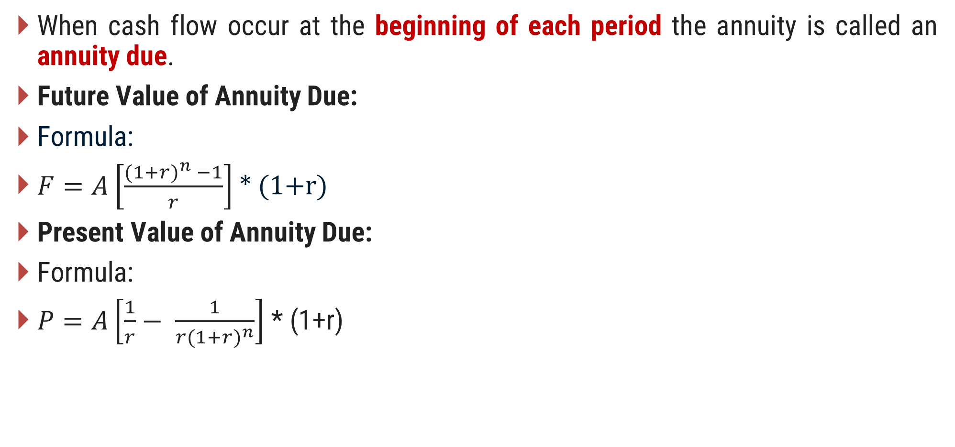
Value of Annuity Due
When cash flow occur at the beginning of each period the annuity is called an annuity due.
Future Value of Annuity Due:
Formula:
$F=A\left[\frac{{(1+r)}^{n} −1}{r}\right]$ * (1+r)
Present Value of Annuity Due:
Formula:
$P=A\left[\frac{1}{r}− \frac{1}{{r(1+r)}^{n}}\right]$ * (1+r)

Slide 42
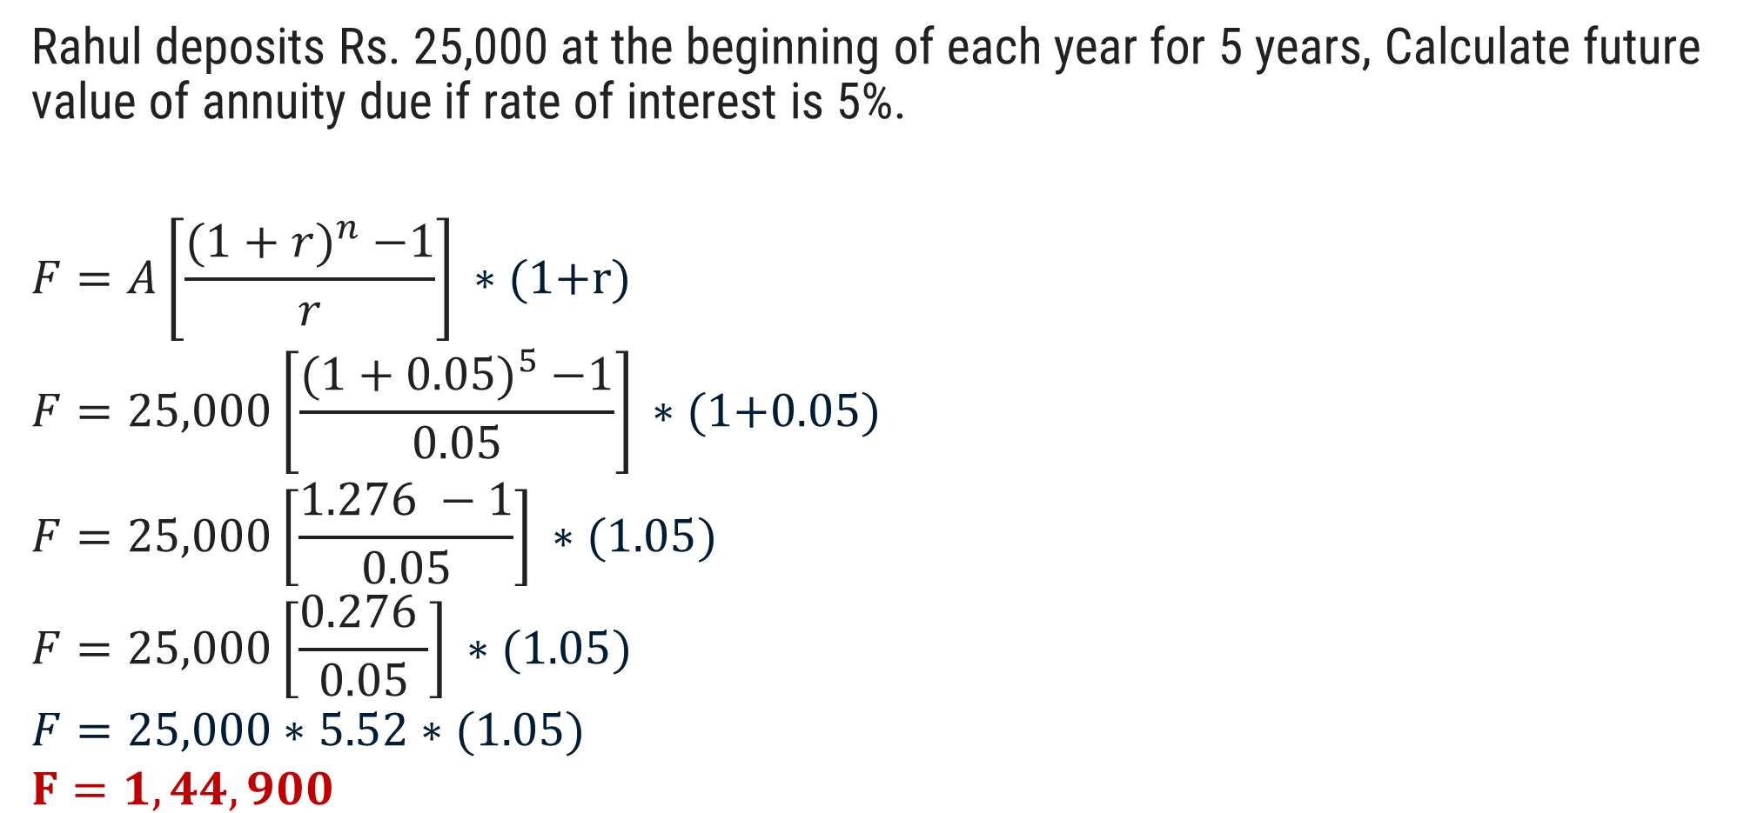
Question.09
Rahul deposits Rs. 25,000 at the beginning of each year for 5 years, Calculate future value of annuity due if rate of interest is 5%.
$$F=A\left[\frac{{(1+r)}^{n} −1}{r}\right]\text{ ∗ (1+}\text{r}\text{)}$$
$$F=25,000\left[\frac{{(1+0.05)}^{5} −1}{0.05}\right]\text{ ∗ (1+}\text{0.05}\text{)}$$
$$F=25,000\left[\frac{1.276 −1}{0.05}\right]\text{ ∗ (1}\text{.05}\text{)}$$
$$F=25,000\left[\frac{0.276 }{0.05}\right]\text{ ∗ (1}\text{.05}\text{)}$$
$$F=25,000\text{ ∗ 5.52}\text{ ∗ }\text{(1.05)}$$
$$F=1,44,900$$

Slide 43
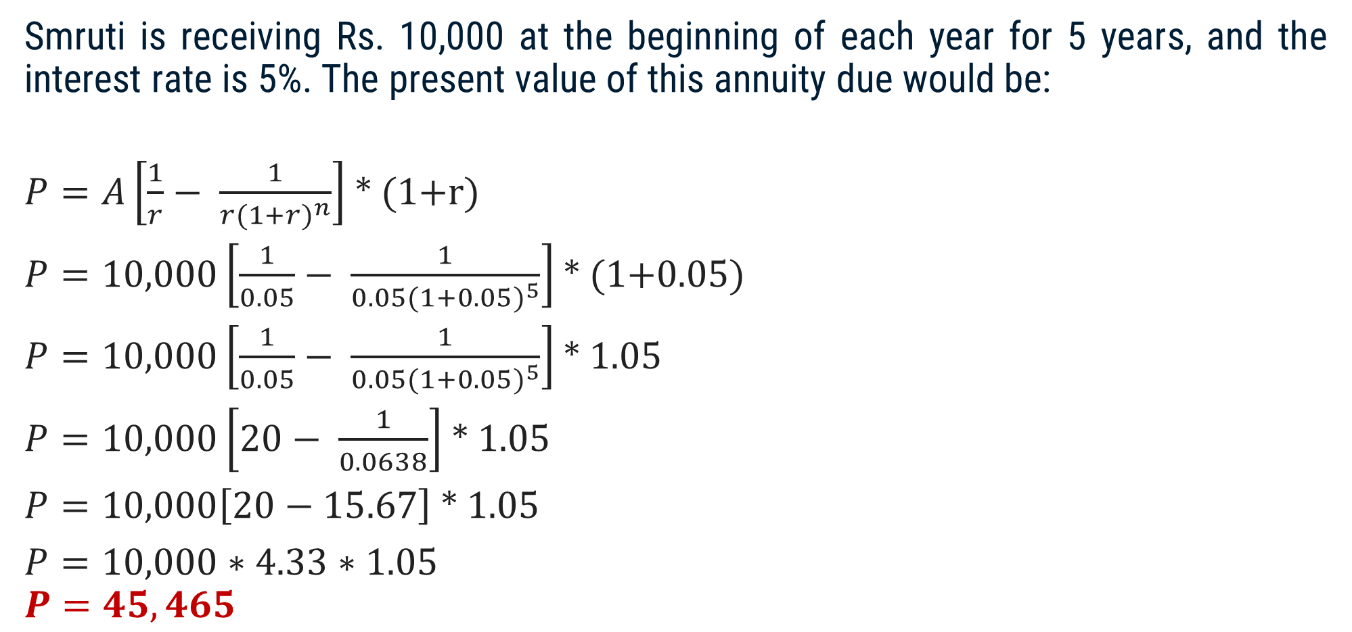
Question.10
Smruti is receiving Rs. 10,000 at the beginning of each year for 5 years, and the interest rate is 5%. The present value of this annuity due would be:
$P=A\left[\frac{1}{r}− \frac{1}{{r(1+r)}^{n}}\right]$ * (1+r)
$P=10,000\left[\frac{1}{0.05}− \frac{1}{{0.05(1+0.05)}^{5}}\right]$ * (1+0.05)
$P=10,000\left[\frac{1}{0.05}− \frac{1}{{0.05(1+0.05)}^{5}}\right]$ * 1.05
$P=10,000\left[20− \frac{1}{0.0638}\right]$ * 1.05
$P=10,000\left[20−15.67\right]$ * 1.05
$P=10,000∗4.33∗$ 1.05
$$P=45,465$$

Slide 44

5) Present Value of a Perpetuity
A perpetuity is an annuity of infinite duration.
For example, the British government has issued bonds for infinite.
Formula
$PVAn$ = A/r

Slide 45
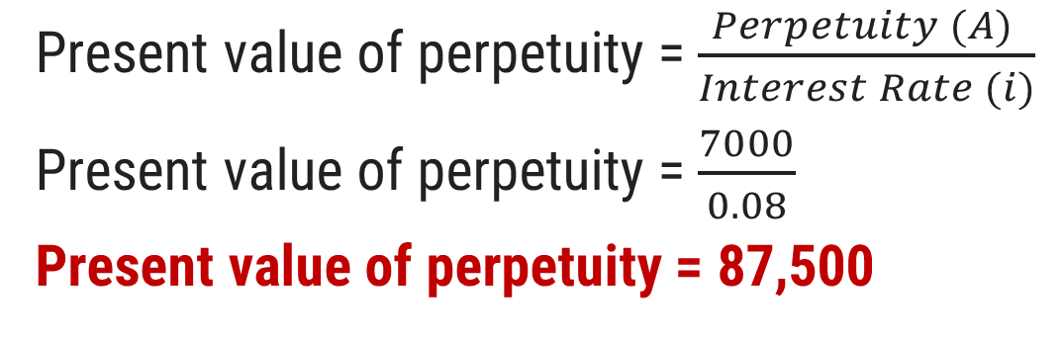
Question.11
One insurance scheme promise to pay Rs. 7,000 per annum for infinite period of time if you invest a lump sum amount today, if your required rate of return is 8%, calculate the amount which you will be willing to pay today. If investment required in this scheme is Rs. 93,000. Would you like to go for investment?
Solution
A = 7000
i = 8%
Comment: We should not invest in this insurance scheme as amount of investment is more than present value of cash flow.
Present value of perpetuity = $\frac{Perpetuity (A) }{Interest Rate (i)}$
Present value of perpetuity = $\frac{7000}{0.08}$
Present value of perpetuity = 87,500

Slide 46
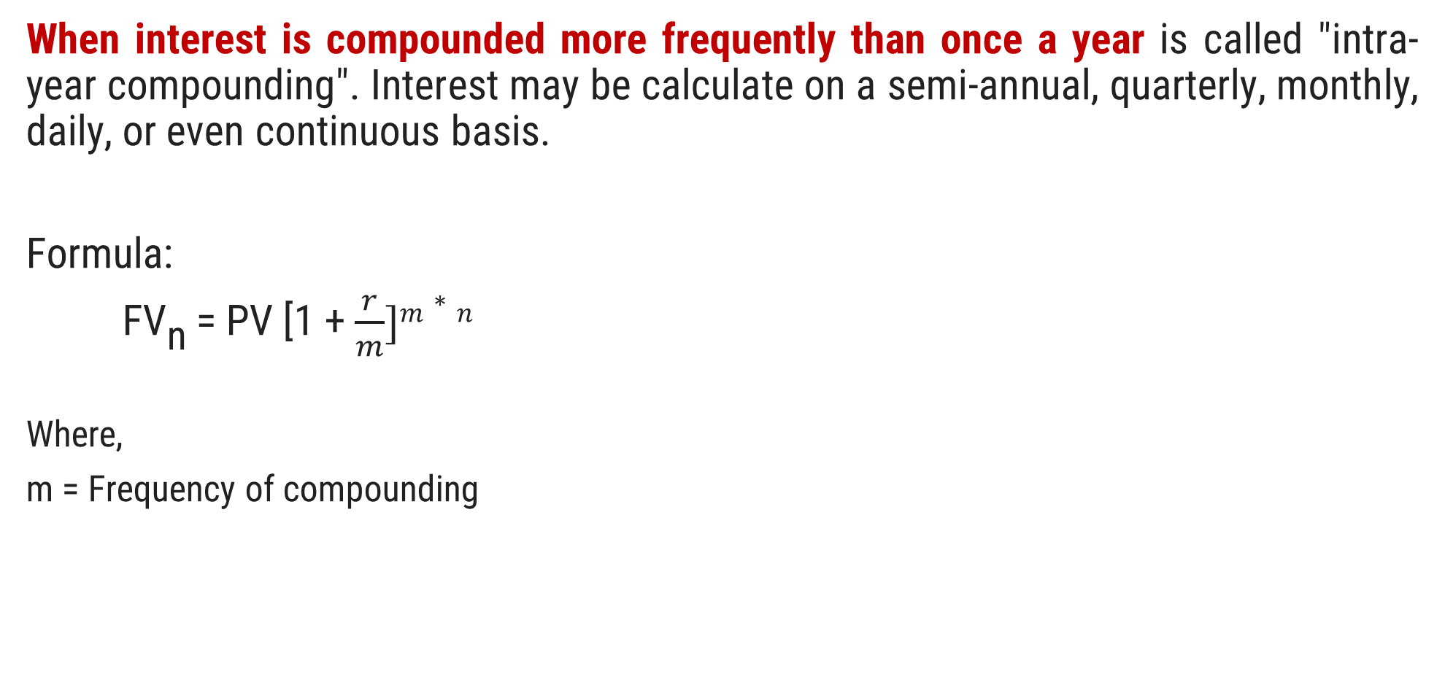
6) Intra – Year Compounding
When interest is compounded more frequently than once a year is called "intra-year compounding". Interest may be calculate on a semi-annual, quarterly, monthly, daily, or even continuous basis.
Formula:
FV_{n} = PV [1 + $\frac{r}{m}]m∗n$
Where,
m = Frequency of compounding

Slide 47
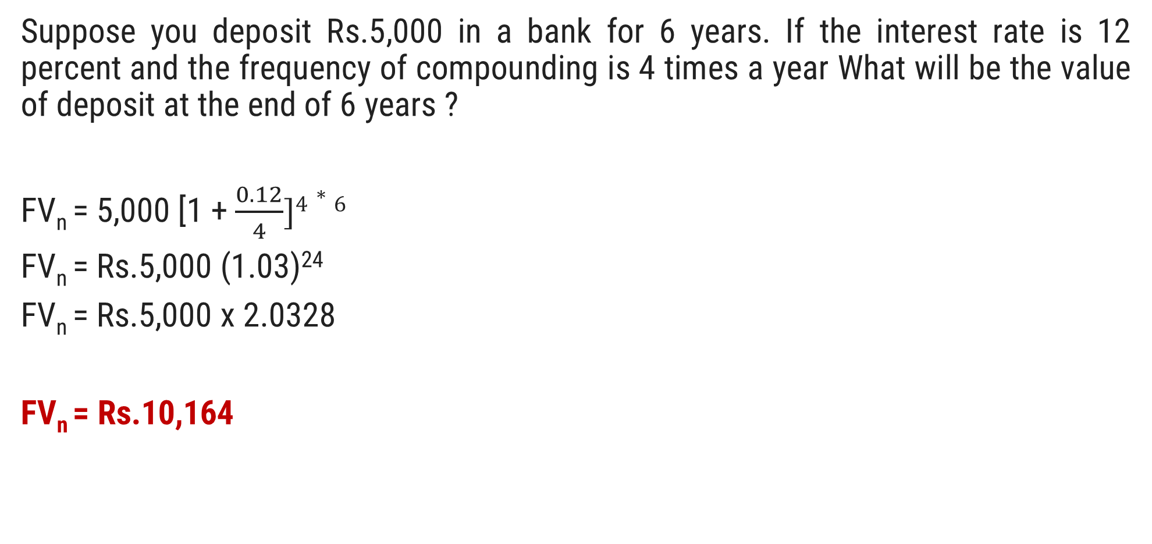
Question.12
Suppose you deposit Rs.5,000 in a bank for 6 years. If the interest rate is 12 percent and the frequency of compounding is 4 times a year What will be the value of deposit at the end of 6 years ?
FV_{n} = 5,000 [1 + $\frac{0.12}{4}]4∗6$
FV_{n} = Rs.5,000 (1.03)²⁴
FV_{n} = Rs.5,000 x 2.0328
FV_{n} = Rs.10,164

Slide 48

07) Intra – Year Discounting (Shorter discounting periods)
Present value of money when discounting take place more than one time in a year is called Intra – Year Discounting .
Formula:
PV = FV_{n}$[\frac{1}{1+r/m}]$^{m*n}

Slide 49
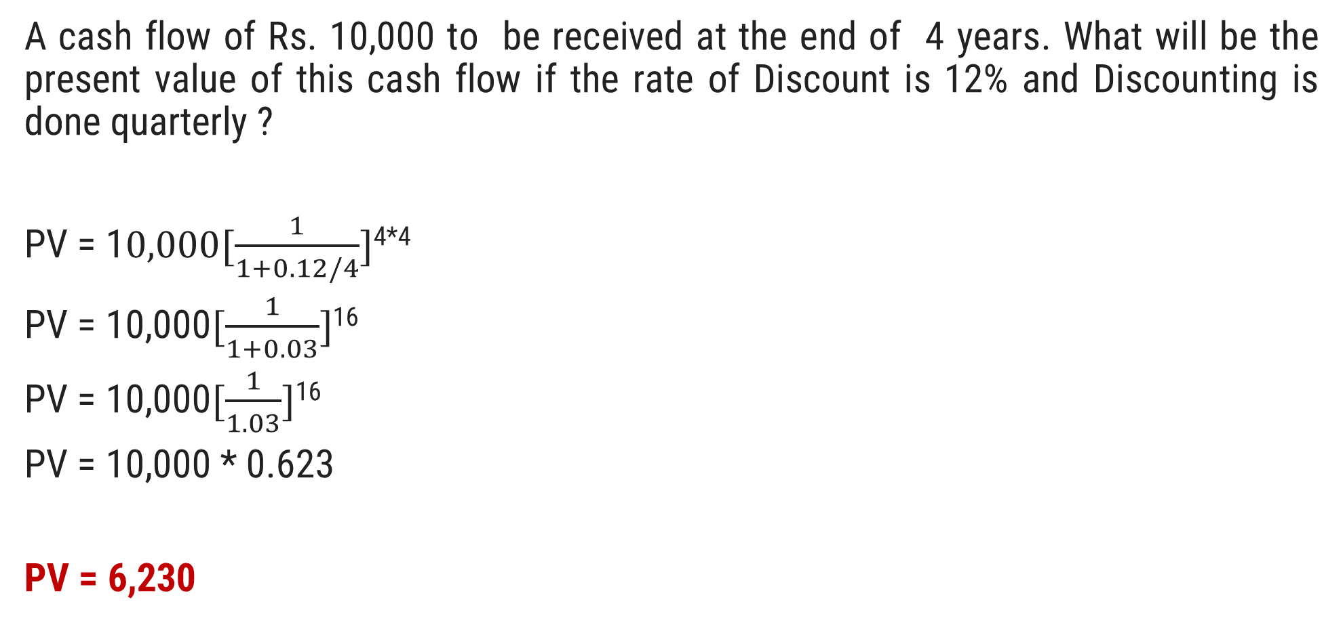
Question.13
A cash flow of Rs. 10,000 to be received at the end of 4 years. What will be the present value of this cash flow if the rate of Discount is 12% and Discounting is done quarterly ?
PV = 1$0,000[\frac{1}{1+0.12/4}]$^{4*4}
PV = 10,000$[\frac{1}{1+0.03}]$¹⁶
PV = 10,000$[\frac{1}{1.03}]$¹⁶
PV = 10,000 * 0.623
PV = 6,230

Slide 50
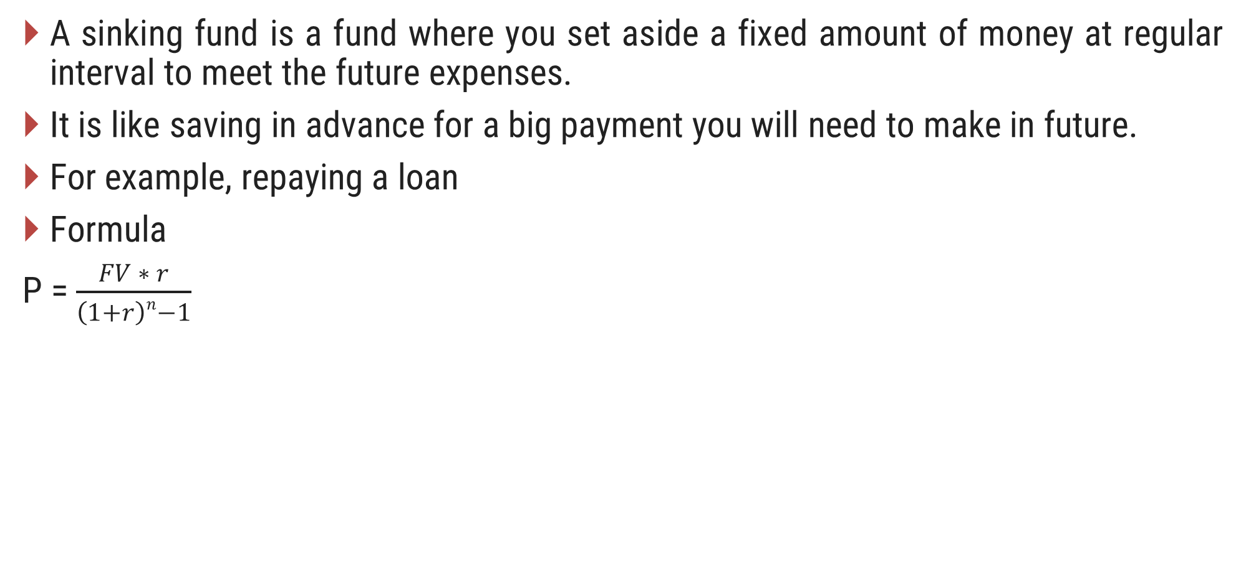
Sinking Fund
A sinking fund is a fund where you set aside a fixed amount of money at regular interval to meet the future expenses.
It is like saving in advance for a big payment you will need to make in future.
For example, repaying a loan
Formula
P = $\frac{FV ∗ r}{\left(1+r\right)n−1}$

Slide 51
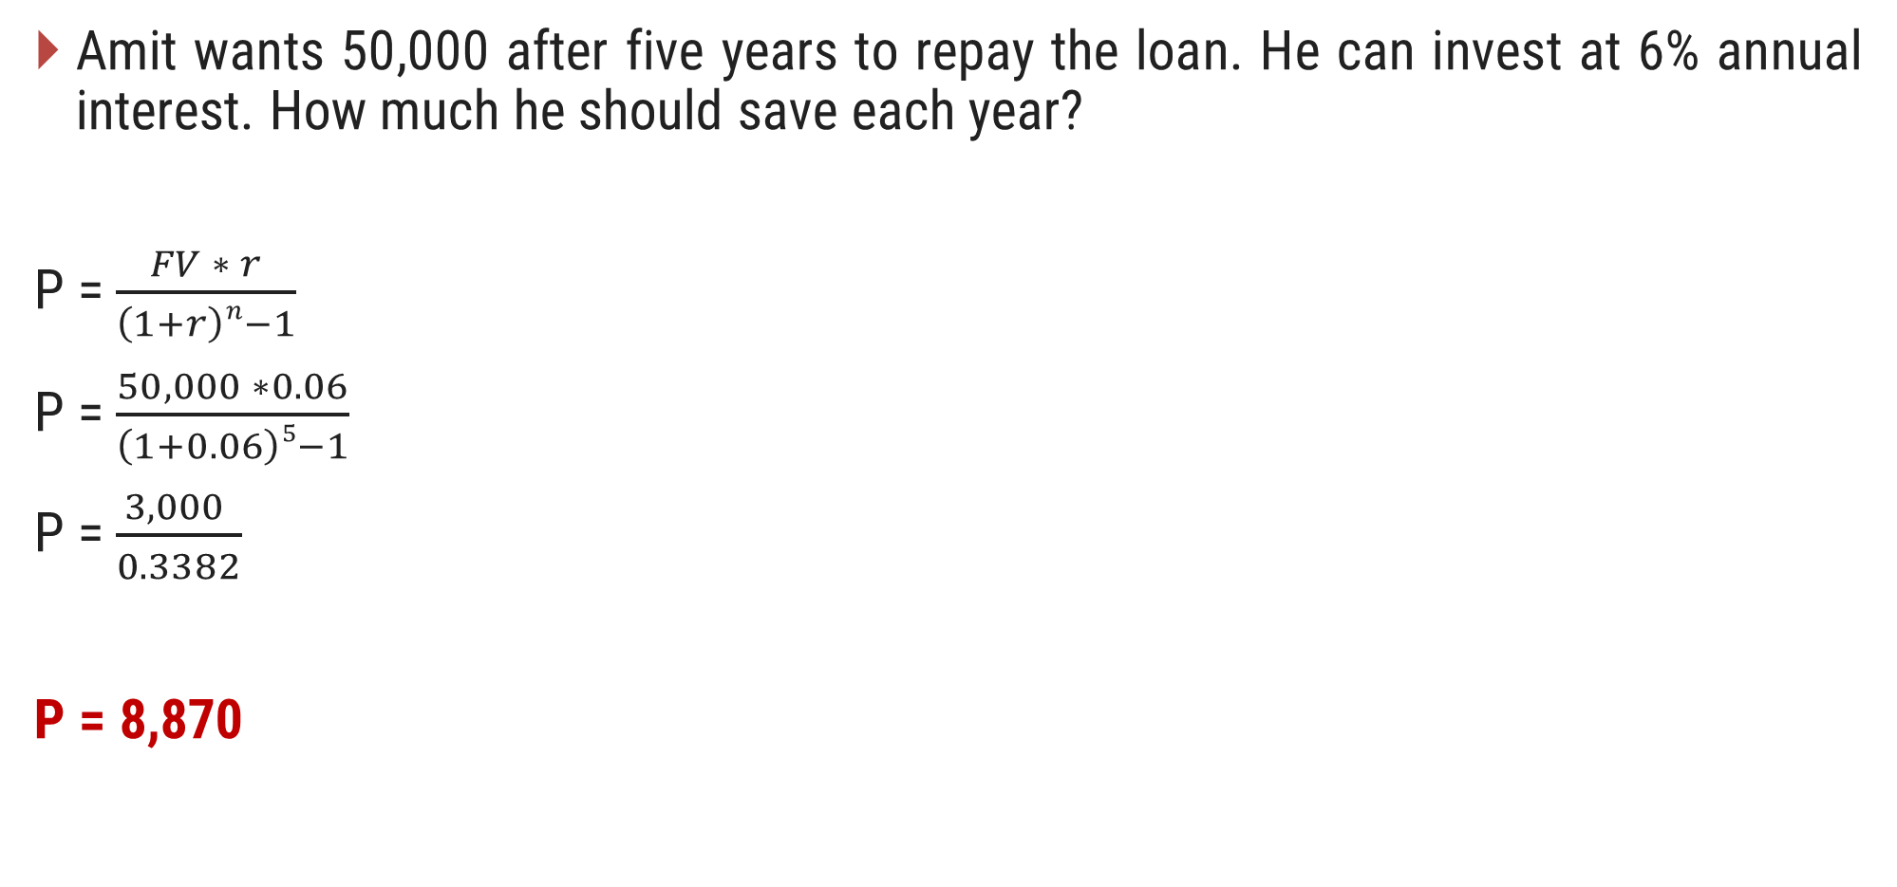
Question.14
Amit wants 50,000 after five years to repay the loan. He can invest at 6% annual interest. How much he should save each year?
P = $\frac{FV ∗ r}{\left(1+r\right)n−1}$
P = $\frac{50,000 ∗0.06}{\left(1+0.06\right)5−1}$
P = $\frac{3,000 }{0.3382}$
P = 8,870

Slide 52
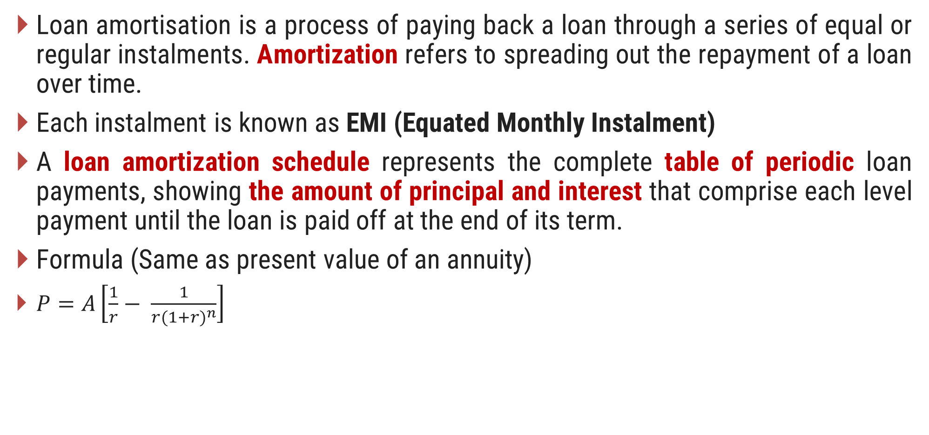
Loan Amortisation & Capital Recovery
Loan amortisation is a process of paying back a loan through a series of equal or regular instalments. Amortization refers to spreading out the repayment of a loan over time.
Each instalment is known as EMI (Equated Monthly Instalment)
A loan amortization schedule represents the complete table of periodic loan payments, showing the amount of principal and interest that comprise each level payment until the loan is paid off at the end of its term.
Formula (Same as present value of an annuity)
$P=A\left[\frac{1}{r}− \frac{1}{{r(1+r)}^{n}}\right]$

Slide 53
Importance
Expenses Clarity
Cost Awareness
Pre-payment Decision
Tax Calculation

Slide 54
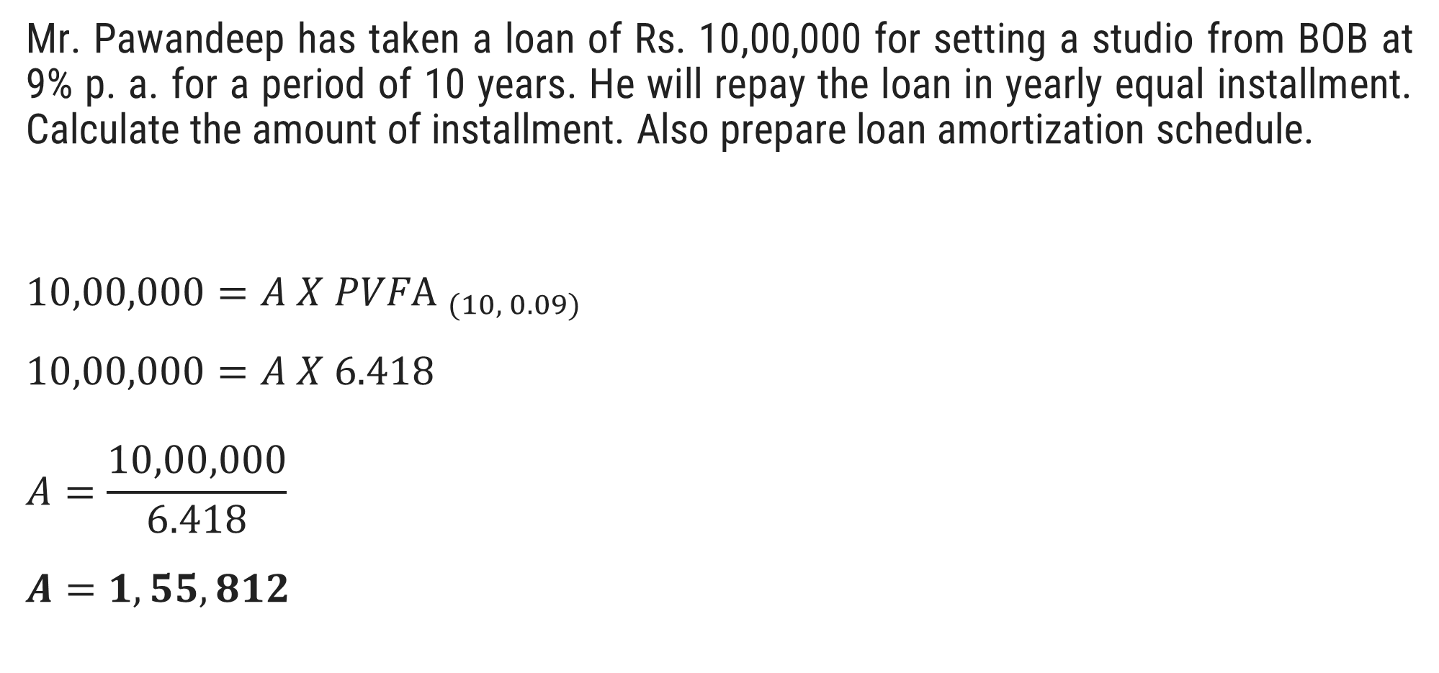
Question.15
Mr. Pawandeep has taken a loan of Rs. 10,00,000 for setting a studio from BOB at 9% p. a. for a period of 10 years. He will repay the loan in yearly equal installment. Calculate the amount of installment. Also prepare loan amortization schedule.
$$10,00,000={A X PVF\text{A} }_{(10, 0.09)}$$
$$10,00,000=A X 6.418$$
$$A=\frac{10,00,000}{6.418}$$
$$A=1,55,812$$

Slide 55
Solution
Loan amortization schedule (Loan Account Passbook)
Year | Installment | Interest | Principal Repayment | Outstanding
0 | NA | NA | NA | 10,00,000
1 | 155,812 | 90,000 | 65,812 | 9,34,188
2 | 155,812 | 84,077 | 71,735 | 8,62,453
3 | 155,812 | 77,621 | 78,191 | 7,84,262
4 | 155,812 | 70,584 | 85,228 | 6,99,034
5 | 155,812 | 62913 | 92,899 | 6,06,135
6 | 155,812 | 54,552 | 1,01,260 | 5,04,875
7 | 155,812 | 45,439 | 1,10,373 | 3,94,502
8 | 155,812 | 35,505 | 1,20,307 | 2,74,195
9 | 155,812 | 24,678 | 1,31,134 | 1,43,061
10 | 155,812 | 12,876 | 1,42,936 | 125*
*Rounding off Error

Slide 56
Question.16
Mr. Ram has taken a Home loan of Rs. 25,00,000 at 7% p. a. for a period of 5 years. He will repay the loan in early equal installment. Calculate the amount of installment. Also prepare loan amortization schedule.
Ans. 6,09,756

Slide 57
Solution
Loan amortization schedule (Loan Account Passbook)
Year | Instalment | Interest | Principal Repayment | Outstanding
0 | NA | NA | NA | 25,00,000
1 | 6,09,756 | 1,75,000 | 4,34,756 | 20,65,244
2 | 6,09,756 | 1,44,567 | 4,65,189 | 16,00,055
3 | 6,09,756 | 1,12,004 | 4,97,752 | 11,02,303
4 | 6,09,756 | 77,161 | 5,32,595 | 5,69,708
5 | 6,09,756 | 39,880 | 5,69,876 | -168*
*Rounding off Error

Slide 58

Calculation of EMI
Formula:
$EMI=P\left[ \frac{{r(1+r)}^{n}}{{(1+r)}^{n} − 1}\right]$
Where,
P = Principal Amount
r = Rate of interest
n = Total number of monthly instalments

Slide 59
Question.17
Mr. Jay borrowed 1,00,000 @ 10% interest rate for 3 years. Calculate EMI.
Solution
Symbol | Meaning | Value in this case
P | Principal (loan amount) | 1,00,000
r | Monthly interest rate | 0.10 / 12 = 0.0083333
n | Total number of monthly instalments | 3 years × 12 = 36 Months

Slide 60
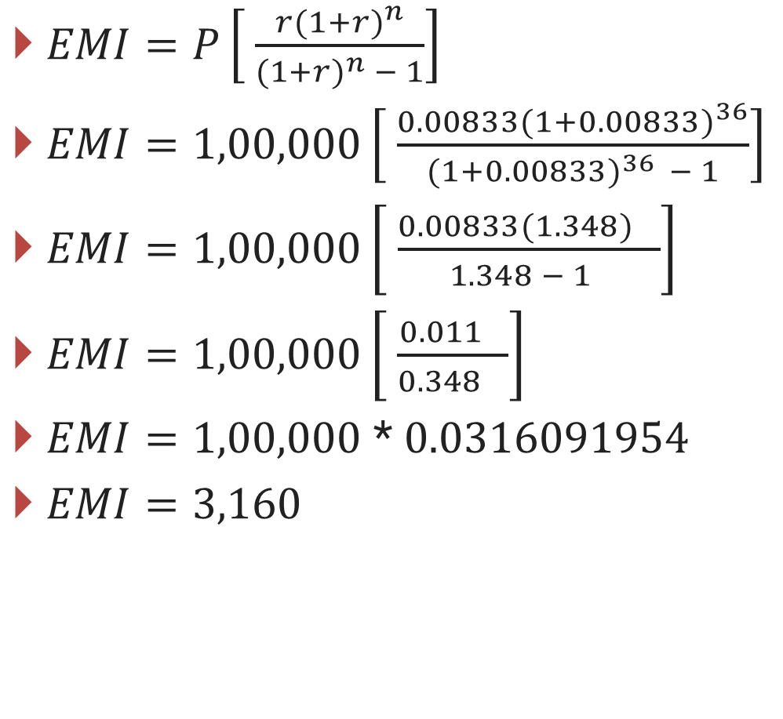
Solution
$EMI=P\left[ \frac{{r(1+r)}^{n}}{{(1+r)}^{n} − 1}\right]$
$EMI=1,00,000\left[ \frac{{0.00833(1+0.00833)}^{36}}{{(1+0.00833)}^{36 }− 1}\right]$
$EMI=1,00,000\left[ \frac{{0.00833(1.348)}^{}}{{ 1.348 − 1}^{}}\right]$
$EMI=1,00,000\left[ \frac{{0.011}^{}}{{0.348}^{}}\right]$
$EMI=1,00,000$ * 0.0316091954
$EMI=3,160$

Slide 61
Loan Amortization Schedule
Month | Opening Balance | EMI | Interest Paid | Principal Paid | Closing Balance
1 | 1,00,000.00 | 3160 | 833.33 | 2326.67 | 97673.33
2 | 97,673.33 | 3160 | 813.94 | 2346.06 | 95327.27
3 | 95327.27 | 3160 | 794.39 | 2365.61 | 92961.66
4 | 92961.66 | 3160 | 774.68 | 2385.32 | 90576.34
5 | 90576.34 | 3160 | 754.8 | 2405.2 | 88171.14
6 | 88171.14 | 3160 | 734.76 | 2425.24 | 85745.9
7 | 85745.9 | 3160 | 714.55 | 2445.45 | 83300.45
8 | 83300.45 | 3160 | 694.17 | 2465.83 | 80834.62
9 | 80834.62 | 3160 | 673.62 | 2486.38 | 78348.24
10 | 78348.24 | 3160 | 652.9 | 2507.1 | 75841.14
11 | 75841.14 | 3160 | 632.01 | 2527.99 | 73313.15
12 | 73313.15 | 3160 | 610.94 | 2549.06 | 70764.09

Slide 62
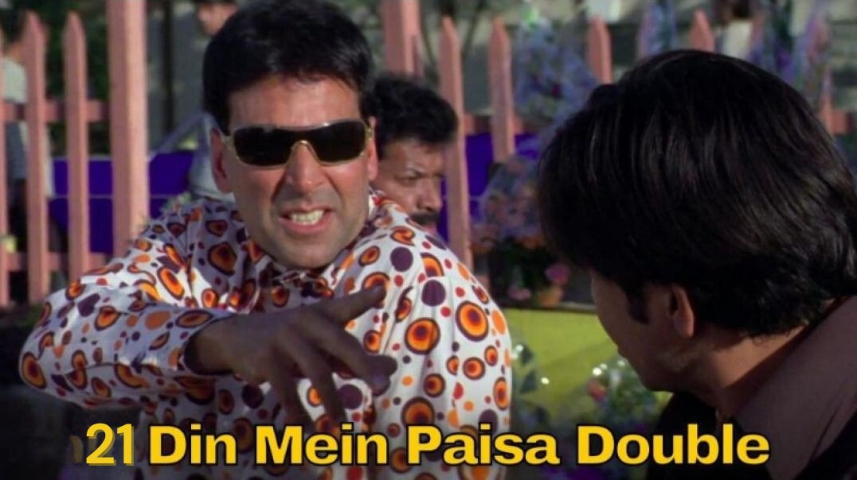
Doubling Period
These are quick mental math rules used in finance to estimate how many years it will take for an investment to double.
Investors commonly ask the question; How long would it take to double the amount at a given rate of interest?

Slide 63
Rule of 72
The Rule of 72 estimate the number of years it takes your money to double at a certain annual interest.
Formula: Time to double = 72 / interest rate
Example:
If rate of interest is 8%, Time = 72 / 8 = 9 years

Slide 64
Rule of 70
The Rule of 70 is similar to Rule of 72 and is used for lower interest or inflation rates.
Formula: Time to double = 70 / interest rate
Example:
If rate of interest is 5%, Time = 70 / 5 = 14 years

Slide 65
Rule of 69
The rule of 69 is more accurate formula for continuous compounding interest It is mostly used in advanced financial calculation.
Formula: Time to double = 0.35 + 69/Interest Rate
Example:
If rate of interest is 6%, Time = 0.35 + 69 / 6 = 11.85 years

Slide 66
Practice
As an illustration of this rule of thumb, the doubling period is calculated for two interest rates, 10 percent and 15 percent.
Find out Interest Rate Doubling Period.

Slide 67
When to Use?
Rule | Used for | Formula | Example (Interest Rate = 7%)
72 | Simple Compounding used when interest rates are between 6 to 10 %. | 72 / interest rate | = 72 / 7 = 10.28 years
70 | Better for economic growth or inflation rate | 70 / interest rate | = 70 / 7 = 10 years
69 | Continuous compounding | 0.35 + 69/Interest Rate | = 0.35 + 69 / 7 = 10.20 years

Slide 68

Investment
Investment refers to putting your money in an asset with the aim of generating income.
Investment refers to the act of allocating resources, such as money or capital, into assets or ventures with the expectation of generating income, profit, or growth in value over time.

Slide 69
Investment Avenues
Deposit
Precious Metal
Currency
Mutual Funds
Real Estate
Bonds
Shares
INVESTMENT AVENUES

Slide 70
Types of Investments in India
Unit Linked Insurance Plans (ULIPs)
Life insurance with market-linked returns and flexibility to invest in equity, debt, or both.
Lock-in period: 5 years.
Tax benefits under Section 80C and 10(10D).
Savings/Endowment Plans
Low-risk plans with fixed returns and life cover.
Suitable for long-term financial goals.
Tax benefits under Section 80C and 10(10D).
Public Provident Funds (PPF)
Long-term investment with fixed returns.
Lock-in period: 15 years.
Tax benefits under Section 80C.
Returns exempt under the Income Tax Act, 1961.

Slide 71
Types of Investments in India
Fixed Deposits
Low-risk investment with fixed returns.
Lock-in period varies.
Suitable for short-term goals.
Stocks
High-risk investment with market-linked returns.
Requires understanding of the stock market.
Mutual Funds
Market-linked instruments managed by professionals.
Variety of options: equity, debt, or mixed funds.
Investments can be made as lump sum or periodic.
Real Estate
Traditional investment option with potential for rental income or capital appreciation.
Returns vary depending on market conditions, location, and more.

Slide 72
Systematic Investment Plan (SIP)
Systematic Investment Plan or SIP is a method of investing in mutual funds wherein an investor chooses a mutual fund scheme and invests the fixed amount of his choice at fixed intervals.
SIP investment plan is about investing a small amount over time rather than investing one-time huge amount resulting in a higher return.
How Does SIP work?
Once you apply for one or more SIP plans, the amount is automatically debited from your bank account and invested in the mutual funds you have purchased at the predetermined time interval.
At the end of the day, you will be allocated the units of mutual funds depending on the NAV (Net Asset Value) of the mutual fund.

Slide 73

Importance of SIP at early age

