Slide 1








OrderSystem
Parth Dagia | DevSecOps Capstone | github.com/parthdagia05/devOps-final
A cloud-native order platform shipped through a full DevSecOps pipeline: CI with security gates, GitOps delivery, Kubernetes, Terraform on AWS and live observability
Notes:
Introduce the project: an order system with two Spring Boot microservices, and everything around it needed to run it in production: CI/CD, security scanning, GitOps, Kubernetes, Terraform and monitoring.

Slide 2
What I built
2
7
3
2
Spring Boot microservices
CI/CD pipeline jobs
security scanners
AWS availability zones
order-service + inventory-service on Java 25
build, scan, package, publish and deploy
Gitleaks, Trivy FS, Trivy image
VPC, EKS and RDS via Terraform
Goal: every change goes from git push to running pods with no manual steps, and is tested, scanned and observable on the way.
Notes:
Four numbers that sum up the scope. The goal is that a git push is the only manual action needed to ship.

Slide 3

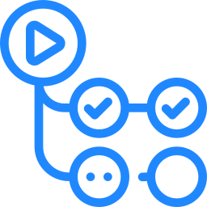
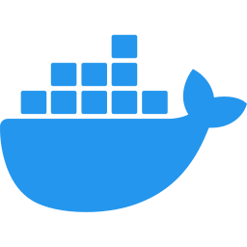
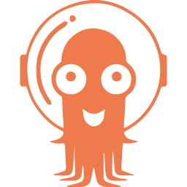
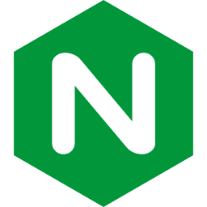
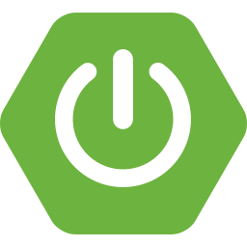



Architecture overview
DELIVERY
GitHub
source of truth
GitHub Actions
build, test, scan
GHCR
image:<sha>
Argo CD
auto sync
KUBERNETES CLUSTER
Ingress
orders.local
order-service
2 to 5 pods (HPA)
inventory-service
stock checks
Prometheus
scrape 5s
PostgreSQL 17
PVC 1Gi
Grafana
dashboard
Notes:
Top row is the delivery path: code in GitHub, Actions builds and scans it, images land in GHCR tagged with the commit SHA, Argo CD syncs the cluster. Bottom row is runtime: Ingress routes to order-service, which checks inventory-service and stores orders in Postgres. Prometheus scrapes both services and Grafana visualises it.

Slide 4
Application layer
order-service :8080
inventory-service :8081
POST, GET /api/orders and /api/orders/{id}
Checks stock with inventory-service before saving
Spring Data JPA on PostgreSQL 17
Actuator health probes and metrics
GET /api/inventory/{productCode}
In-memory stock catalogue
Same health and metrics endpoints
Reached over cluster DNS
Multi-stage Docker builds: JDK stage compiles, JRE stage ships only the jar. Local dev runs on Docker Compose.
Notes:
Two small services so the platform has a real service to service call and a database. Both expose health and Prometheus endpoints, which the probes and monitoring depend on.

Slide 5
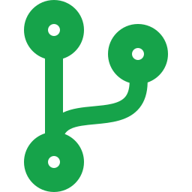
CI/CD pipeline on GitHub Actions
1
Build & Test (Postgres service)
2
Gitleaks secret scan
6 Build & scan image
7 Update image tags
3
Trivy filesystem scan
Matrix over both services
Trivy image scan
Push ghcr.io/…:<sha>
Rewrites tags in kubernetes/ and Helm values
Commits to main
4
Helm lint + template
5
Terraform fmt + validate
Runs on every push and PR to main. Jobs 6 and 7 publish only from main, after all checks pass.
Notes:
Five checks run in parallel. The image job builds each service, scans it and pushes it tagged with the commit SHA. The last job writes that tag back into the manifests, and that commit is what Argo CD deploys.

Slide 6

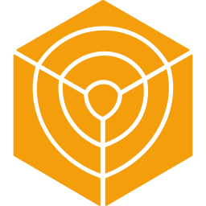


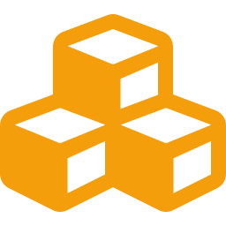

Security built into the pipeline
Secret scanning
Dependency + IaC scan
Image scanning
Gitleaks scans the full git history and blocks the pipeline on a finding
Trivy checks Maven dependencies, K8s and Terraform misconfiguration
Trivy reports HIGH and CRITICAL CVEs that have a fix in each image
Supply chain
Least privilege
Secrets handling
Every third-party action is pinned to a commit SHA
Read-only token by default; jobs request only the scopes they need
DB password via TF_VAR, K8s Secret for creds, tfvars gitignored
Notes:
Security is part of the pipeline rather than a separate step. Secrets, dependencies, infrastructure code and images are all scanned, and the pipeline itself is hardened with pinned actions and a minimal token.

Slide 7
GitOps with Argo CD
1
git push to main
root-application
watches gitops/apps/
2
CI pushes image:<sha> to GHCR
order-system
kubernetes/ → orders
monitoring
monitoring/ → monitoring
3
CI commits the new tag to kubernetes/
prune: removed from Git, removed from cluster
selfHeal: manual kubectl changes are reverted
4
Argo CD detects the commit and syncs
Notes:
The cluster never gets kubectl apply from CI. CI only changes Git; Argo CD pulls. App of apps means adding a file under gitops/apps is enough to onboard a new component.

Slide 8
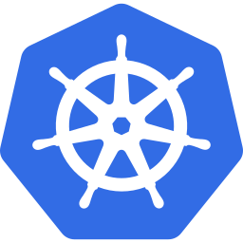


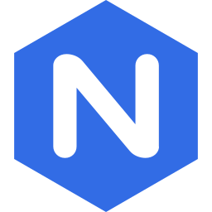


Kubernetes resources
Deployments
Probes
Autoscaling
order-service x2, inventory-service x1, Postgres, all with requests and limits
Readiness gates traffic, liveness restarts stuck containers
HPA scales order-service from 2 to 5 pods at 70% CPU
Ingress
Config + Secrets
Storage
NGINX routes orders.local to the order-service Service
ConfigMap for the DB URL, Secret for credentials, injected as env
1Gi PersistentVolumeClaim keeps Postgres data across restarts
Notes:
Runs locally on a two-node kind cluster and is portable to EKS. Each resource here maps to a file in kubernetes/ numbered in apply order. There is also a debug-drills folder with six broken manifests for troubleshooting practice.

Slide 9
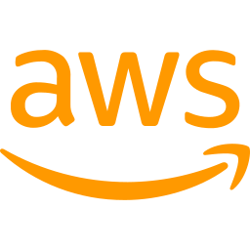
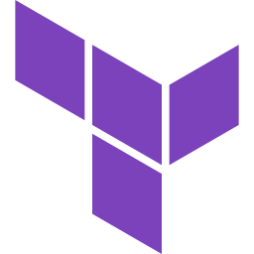
AWS infrastructure with Terraform
VPC 10.0.0.0/16 | ap-south-1
Workflow
AZ a
AZ b
Public subnet
Internet GW route, NAT gateway
Public subnet
Internet GW route, load balancers
terraform init
terraform plan
terraform apply
update-kubeconfig
terraform destroy
EKS control plane managed by AWS; nodes only in private subnets.
Private subnet
EKS worker node (t3.medium)
RDS PostgreSQL 17
Private subnet
EKS worker node (t3.medium)
RDS subnet group
Notes:
Two AZs for availability. Worker nodes and the database sit in private subnets and reach the internet only through the NAT gateway. RDS accepts connections only from inside the VPC. The DB password is passed in through an environment variable, never committed.

Slide 10

Observability
Prometheus targets
Alert rules
Grafana dashboard
order-service UP
inventory-service UP
prometheus UP
Scrapes /actuator/prometheus every 5 seconds
OrderServiceDown
target down for 30s
InventoryServiceDown
target down for 30s
HighOrderErrorRate
sustained HTTP 5xx
Service up status
JVM heap usage
Request rate by endpoint and status
5xx error count
Datasource and dashboard provisioned from Git
Notes:
Micrometer exposes metrics from both services. Prometheus scrapes them and evaluates alert rules; Grafana is provisioned with the datasource and dashboard, so a fresh cluster has monitoring with no clicks.

Slide 11
Problems hit and how I fixed them
Tests failed in CI
EKS nodes cannot join
Cause: The context test needs a database
Fix: Added a postgres:17 service container to the job
Cause: Private subnets had no route out
Fix: Added a NAT gateway and private route table
Argo CD could not sync
Trivy scan rate limited
Cause: kind cluster config sat inside the synced folder
Fix: Moved it to cluster/ and built the app of apps folder
Cause: Maven Central returned HTTP 429
Fix: Switched the FS scan to offline mode
Notes:
Real issues found while bringing the pipeline up end to end, each with its root cause and fix.

Slide 12

Live walkthrough
github.com/parthdagia05/devOps-final
Codebase
CI/CD run
Terraform + AWS
Argo CD sync
kubectl status
Prometheus targets
Grafana dashboard
Notes:
Switch to the live demo in this order: folder structure, trigger a push and watch Actions, terraform plan and the AWS console, Argo CD synced app, kubectl get pods svc ingress, Prometheus targets, Grafana dashboard.

