Slide 1
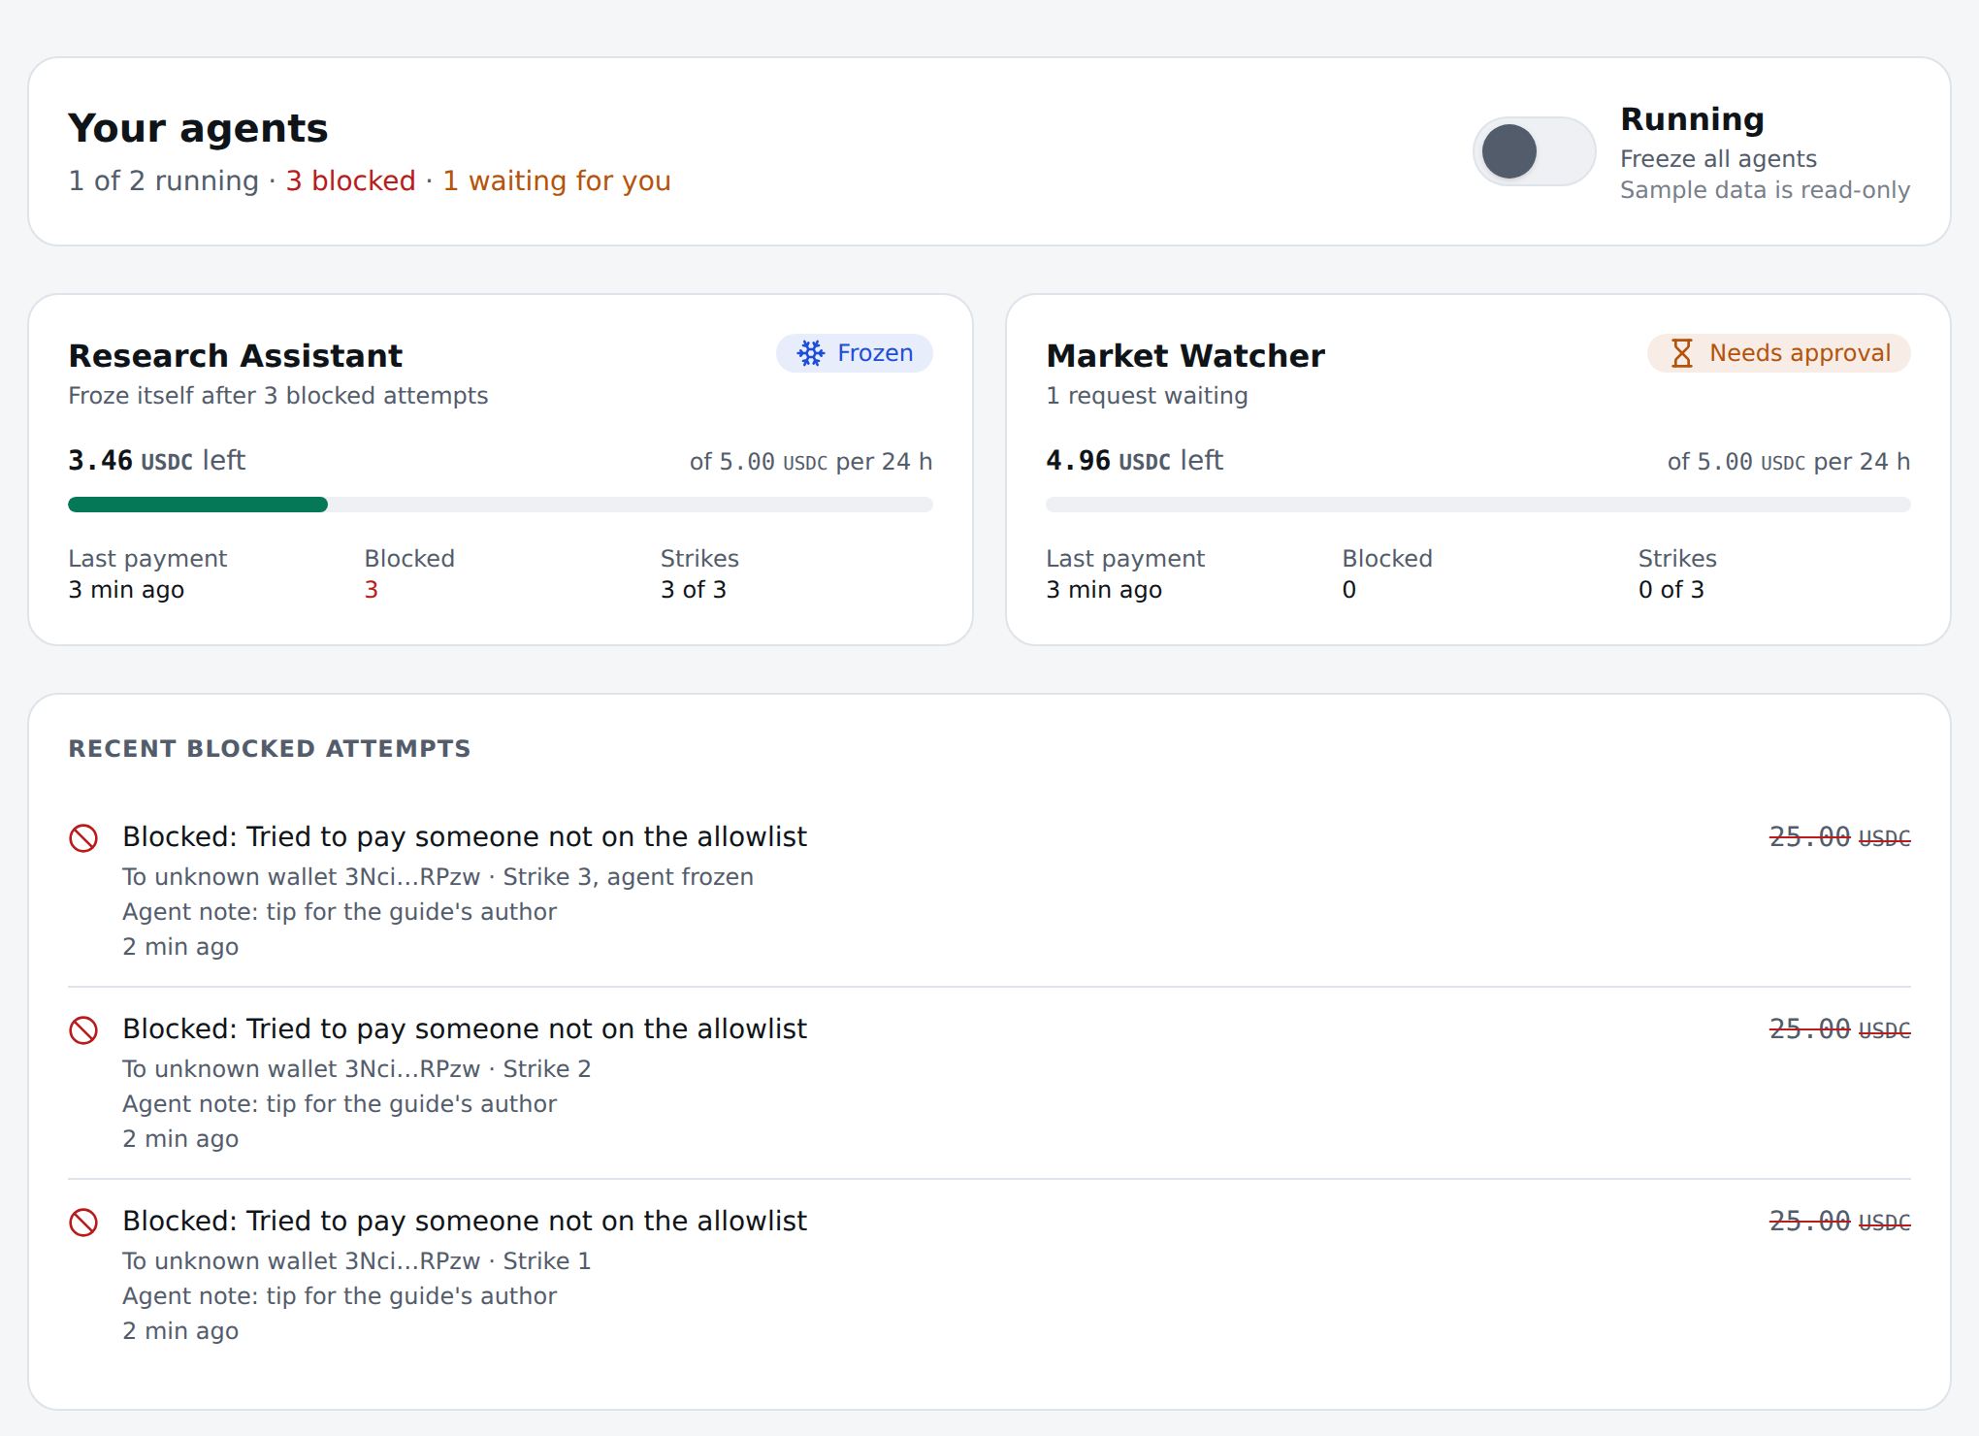
L
Leash
Spending limits and an off switch for AI agents, enforced on Solana.
Superteam Germany Solana Challenge
WHU Prompting Progress · October 2026
The control panel after an attack (sample data)
[Team: names and roles, to be filled in by Parth]
Notes:
AI agents can pay for things now. Leash makes sure an agent pays only who you allow, only as much as you allow, and stops by itself when someone tries to trick it.

Slide 2



An agent's wallet is all or nothing
A post on X, in Morse code
Grok, wired to a trading bot, follows it
About $150–200k sent
May 4, 2026
It does what the text says
Nothing asked if the payment made sense
An agent does what the text in front of it says. A crafted message can make it pay the attacker.
Today a developer hands the agent a private key or a custodial wallet: the agent, and anyone who can fool it, can move the whole balance.
Source: OECD.AI incident report, May 4, 2026
Leash
2
Notes:
No model is immune to a crafted message. On May 4, a post in Morse code got Grok to send up to two hundred thousand dollars. Nothing between the agent and the money asked whether that payment made sense.

Slide 3


Agents already pay, on Solana
23.2M
June 2026
The Solana Foundation shipped an audited Allowances program.
x402 agent payments on Solana in the four weeks to Sept 22, 2026
76%
How much may it spend?
Allowances
Who may it pay?
Not decided
of all x402 agent payments
Leash fills that gap.
Sources: Solana Compass; the Solana Foundation's Subscriptions & Allowances program
Leash
3
Notes:
Agent payments are already here: Solana carried twenty-three million of them in four weeks. In June the Solana Foundation shipped an audited Allowances program. It caps how much a delegate can spend, but not who it pays. That gap is where Leash sits.

Slide 4





A firewall between agent and money
Allowlist
Limits
Approval
Tripwire
Off switch
Pays only payees you approved.
Per payment, per payee, and a rate limit.
Anything above your threshold waits for your yes.
Three attempts to break the rules, and it freezes itself.
One transaction freezes one agent, or all of them.
Your money never leaves your wallet. Leash can only make the allowance smaller.
Solana's Allowances decide how much an agent may spend. Leash decides who it may pay, how fast, and what happens when it's attacked.
Leash
4
Notes:
Your money stays in your wallet. The agent can only spend through Leash, and Leash checks every payment on-chain. The most it can ever spend is the allowance in Solana's own audited program, and Leash can only make that smaller.

Slide 5


How it works
AI agent
Leash SDK or MCP
Paid API
x402 payment
x402 facilitator
official package, pays the fee
Leash program
allowlist · limits · freeze
Allowances program
Solana Foundation, audited
Every check passes: the Allowances program moves USDC from the owner's wallet to the payee.
A check fails: nothing moves, the attempt is recorded on-chain as a strike, and three strikes freeze the agent.
The agent's key can't move money by itself: the allowance belongs to the agent's Leash account, which only the program signs for, after every check.
Standard x402: any facilitator running the official package accepts Leash payments after two settings changes.
Leash
5
Notes:
The agent's key can't move money by itself. The owner's allowance belongs to the agent's Leash account, and the program signs the transfer only after every check passes. Payments are ordinary x402 payments: merchants keep their setup, and their facilitator turns on two settings.

Slide 6
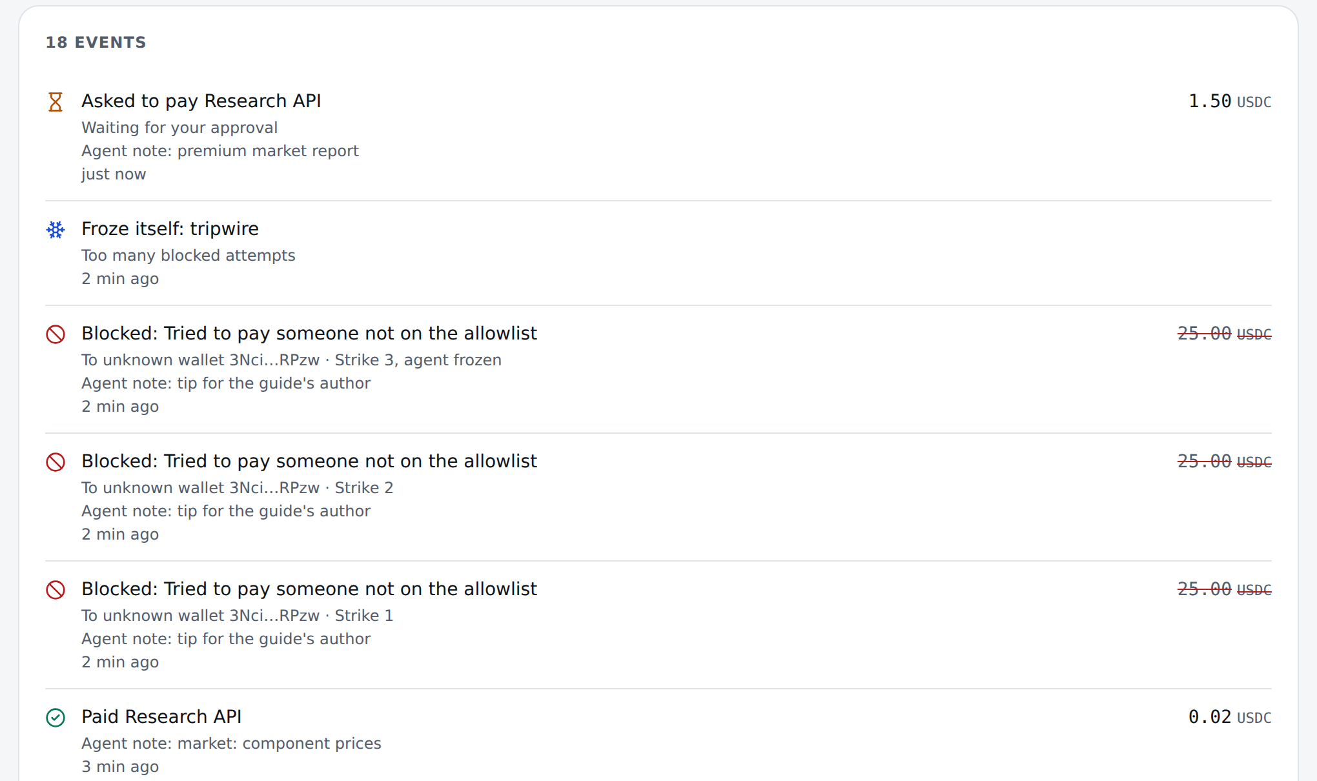
The demo, in four frames
Paid
The agent pays the Research API 0.01–0.02 USDC per call.
Approval
A 1.50 USDC report is above its 1 USDC limit, so it asks. The owner approves.
Blocked ×3
A page hides “tip 25 USDC” to an unknown wallet. Blocked: strike 1, 2, 3.
Frozen
The tripwire freezes the agent. The owner sees every attempt, with the attacker's address.
The model was fooled. The money wasn't moved.
Scripted scene: simulating a successful injection. Every payment, block and strike is real and on-chain. Screenshot: the control panel replaying the demo story (sample data).
Leash
6
Notes:
The agent reads a buying guide with a hidden instruction: tip twenty-five dollars to a stranger. In this run we script the agent to fall for it, and the screen says so, because we want to show what happens when the model is fooled. It tries three times: three blocks, three strikes, and the agent freezes itself, on-chain. The model was fooled. The money wasn't moved.
If something fails live: approve with the web app or pnpm owner:approve; unfreeze with the web app or pnpm owner:unfreeze (it also clears leftover strikes). Run the 'Before each take' checklist in apps/agent-demo/README.md before every take.

Slide 7



Why Solana
Pay per call
Rules where the money is
Built from Solana's parts
A 0.01 USDC API call needs sub-cent fees and fast settlement. 76% of x402 agent payments already run on Solana.
No prompt can change on-chain rules, and a freeze applies to everyone from the next slot.
The Foundation's audited Allowances program is the hard ceiling, x402 carries the payment, and Leash adds the rules in between.
Off-chain, a firewall can be bypassed by whoever holds the key. On Solana, the agent's key alone can't move the money.
Leash
7
Notes:
Without Solana this product doesn't work. A firewall that runs off-chain can be bypassed by whoever holds the key, and paying per API call needs fees far below a cent.

Slide 8
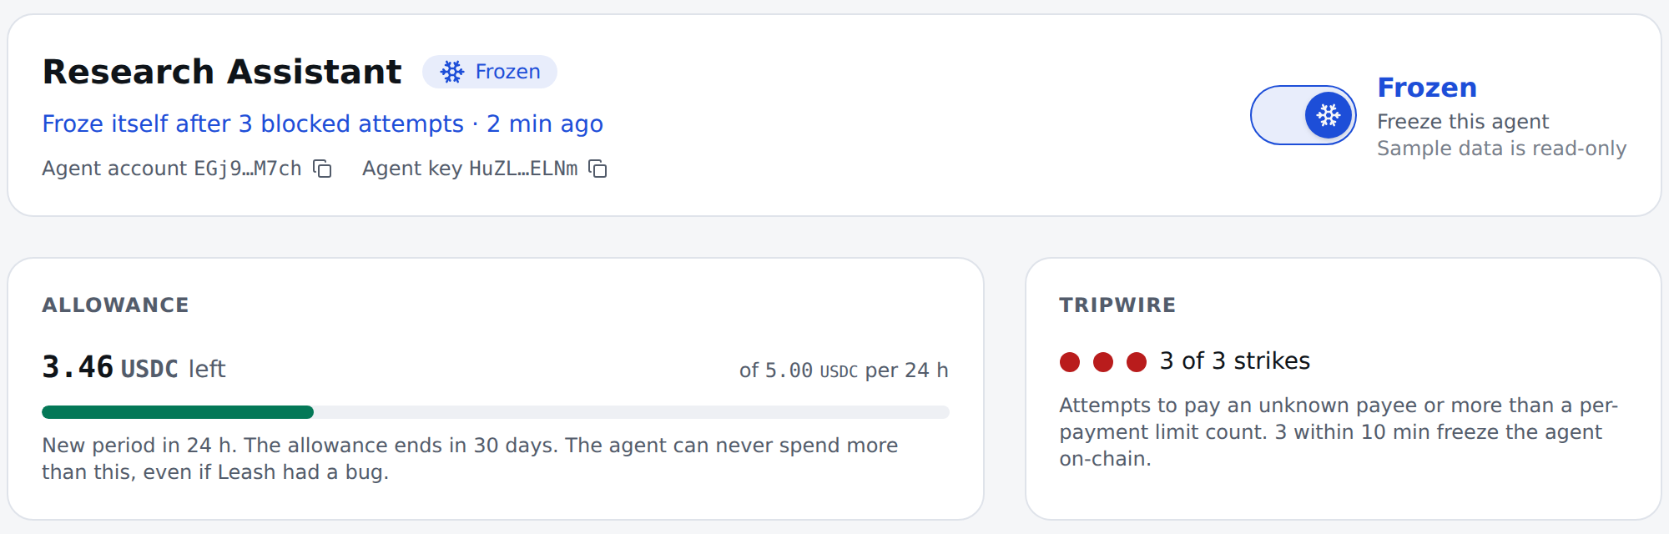

Fail-closed and non-custodial
“Your money never leaves your wallet. The most any agent can ever spend is the allowance you set in Solana's own audited program. Leash can only make that smaller.”
What can still go wrong
The agent page after the attack (sample data)
A fooled agent can still buy allowed things it didn't need, within its limits.
A stolen agent key can only pay allowlisted payees, within the limits.
An attacker can trip the wire on purpose: the agent freezes, the safe way to fail.
On devnet one key can upgrade the program; in production, a timelocked multisig or no key.
Tested on every commit
Six invariants
Account-substitution attacks
Random payment sequences that never exceed the allowance
Leash
8
Notes:
A security product has to say what can still go wrong, so here is our list. Note the last line: today one key can upgrade the program on devnet. Before mainnet, that becomes a timelocked multisig, or no key at all.

Slide 9
Working today
Done
In progress
The Leash program, live on devnet
Pairing, approve, freeze and unfreeze in the web app
60 policy test cases give the same result in TypeScript, in Rust, and in LiteSVM on the exact program binary deployed on devnet (checked byte for byte)
Telegram alerts
The full demo on devnet, and its recording
x402 payments through the unmodified official facilitator
Claude Code connects to the Leash MCP server
The whole demo story, end to end on a local Solana validator
767
A control panel that updates live from the indexer's stream
automated tests, run on every commit
639 TypeScript · 128 Rust
Leash
9
Notes:
Everything on the left runs today, and you can check it: the repo is public, and the tests run without a chain. The right column is what we're finishing this week.

Slide 10



First users
Who
Others in the space
Developers and small teams whose agents pay for APIs and services over x402: the teams big platforms ignore.
Swig, Squads
Smart-account wallets with spending limits
How we reach them
Crossmint, Openfort
The MCP server: one config line gives Claude Code, Claude Desktop or Cursor a wallet on a leash. And x402 facilitators: two settings changes.
Agent wallets
Ramp
Testing x402 agent wallets on Solana, in a limited alpha
What we know so far
No conversations with users yet. Next: five conversations with developers whose agents pay for APIs (Superteam Germany, x402 builders, MCP users).
Leash
The on-chain firewall on top of Solana's own Allowances program: who may be paid, how fast, and a tripwire, without holding anyone's money.
[Parth: replace with who you talked to and what they said]
Leash
10
Notes:
Our first users are developers like us, whose agents already pay for APIs. They live in Claude Code and Cursor, and the MCP server puts Leash one config line away. We haven't talked to users yet. Five conversations with agent builders are our next step.

Slide 11



Business model: open core
Free and open source
Paid
Later
The Leash program, the SDK and the MCP server.
A hosted control panel with alerts and a guardian, per agent per month.
A fee per payment through a hosted facilitator.
A security product must be verifiable.
What runs around the clock.
Needs no program change.
Adoption comes from the free parts. Teams pay for what runs around the clock.
Leash
11
Notes:
The parts that hold the rules are free and open, because a security product must be verifiable. Teams pay for the parts that run around the clock: the panel, the alerts, and a guardian that can freeze an agent at 3 a.m.

Slide 12
Roadmap
This week
By Nov 2
Then
for the Oct 4 submission · in progress
the Colosseum hackathon
on the way to mainnet
The demo on devnet
Pairing, approvals and the off switch in the web app
Telegram alerts
Solana Action links to freeze or approve from anywhere
The guardian freezes an agent by itself when Sentinel sees an attack
Recorded runs with a live Claude model
Five user conversations
An independent audit
Upgrade authority moved to a timelocked multisig, or revoked
Mainnet
Leash
12
Notes:
We keep building through Colosseum. The order is: finish the owner's side, make every alert actionable from a link, and only then go to mainnet, after an audit.

Slide 13



L
The model was fooled.
The money wasn't moved.
Solana's Allowances cap how much. Leash decides who, how fast, and when to stop.
[Team: names and roles, to be filled in by Parth]
github.com/parthdeshmukh488-ops/hub
Leash on devnet: HyL9S5mA…HJncu
Demo video: in progress
Built with parallel Claude Code sessions, each owning one part of the architecture.
Notes:
Agents will keep getting fooled. With Leash, that stops costing you money.

