Slide 1

Bike-sharing demand: what 50,000 trips can and cannot tell us
SQL (MySQL) and Power BI analysis · Parth Dhawan · October 2026
7 tables · 8 SQL scripts · 3-page Power BI dashboard · Coding Ninjas case study
Notes:
This is a SQL and Power BI case study on a bike-sharing service: 50,000 trips across five US cities in 2023. The short version: the brief expected a weekday commute pattern, but once you look per day and per hour, demand is flat, and the data itself fails several reality checks. I will show what the data can and cannot support.

Slide 2



Flat demand, and no commute story in this data
138 vs 136
3,461
32
trips a day, weekend vs weekday
trips imply over 40 km/h on a bike
stations gain or lose 40+ bikes
Weekends hold 29% of trips only because there are fewer of them. Per day they are busier.
With 72 over-capacity stations and 899 repairs dated before purchase, the data looks generated.
Station net flow, revenue mix and repair types still give usable answers.
Notes:
Three messages. First, the weekday-heavy totals are a calendar effect: per day, weekends are slightly busier. Second, the data fails basic physics and logic checks, so it is generated rather than observed. Third, some questions are still answerable: station imbalance, revenue mix and repair types.

Slide 3





Seven tables, eight SQL scripts, one dashboard
1. Load
2. Check
3. Explore
4. Analyse
5. Report
7 CSVs into MySQL with one build script
Nulls, duplicates, durations + 7 reality checks
Dimensions, date ranges and measures
Demand, segments, maintenance, revenue
3-page Power BI dashboard
The data: 50,000 trips · 5,000 riders · 200 stations · 1,000 bikes · 9,998 repairs · 5 US cities · all of 2023.
Business question from the brief: where and when to position bikes, how to balance stations, and where maintenance is needed.
Notes:
The workflow: load seven related CSVs into MySQL, check them, explore, analyse and report. The check step is where the story changed: the files are clean on the surface, but they fail reality checks. Everything runs from one script and is re-checked on every push by GitHub Actions.

Slide 4
Weekends look quieter, but per day they are busier
2023 has 260 weekdays and 105 weekend days. The 2.4× gap in totals is the calendar, not commuters.
Notes:
On totals, weekdays look 2.4 times busier, which is what the brief expected. But there are 2.5 times more weekdays in a year. Divide by days and weekends come out slightly busier: 138 trips against 136. So a weekday commuter strategy is not supported by this data.

Slide 5
No rush hour: trips barely change across the day
5.5%
gap between the busiest hour (8 AM) and the quietest
158 / 200
stations peak outside commute hours (75% by chance)
32.2 vs 31.9
minutes per trip, peak vs off-peak
Notes:
A real bike-share shows sharp morning and evening peaks. Here every hour sits between 2,030 and 2,145 trips, a 5.5% spread. The commute hours in amber are no busier than the rest, 158 of 200 stations peak outside them, and trips are the same length at any hour.

Slide 6




Four checks show the data is generated, not observed
72 of 200
3,461
stations report more bikes available than they can hold
trips imply over 40 km/h, up to 120 km/h; distance and duration correlate at 0.001
899
1 city / hour
repairs are dated before the bike was bought; 996 of 1,000 last-service dates disagree with the log
weather is logged for one city at a time, so it cannot explain city demand
Clean on the surface: 0 duplicate trips, 0 missing values, 0 negative durations. 2 duplicate repair rows removed.
Notes:
Before reporting patterns, I tested whether the data could support them. It is clean on the surface, but stations hold more bikes than their capacity, thousands of trips would need car speeds, repairs happen before bikes exist, and weather covers one city per hour. So I report the method and these limits rather than a commute story.

Slide 7


Three answers the data can still support
Rebalancing
Revenue mix
Maintenance
+65 / −63
60.3%
r = 0.04
Station 1 gains 65 more bikes than it loses; Station 148 loses 63. 32 stations are off by 40 or more.
of 136,065 in fares comes from subscriptions. February's −15.2% dip is −6.1% per day: mostly its 28 days.
between a bike's trips and its repairs. Flat tyres lead with 2,586 of 9,998 repairs.
None of these depend on realistic trip speeds or timing, so they hold even on generated data.
Notes:
Some questions do not depend on realistic trip physics. Net flow per station gives a rebalancing list. The revenue split is clear, and the February dip is mostly a short month. Repairs do not follow usage here, so usage-based servicing cannot be justified from this data.

Slide 8
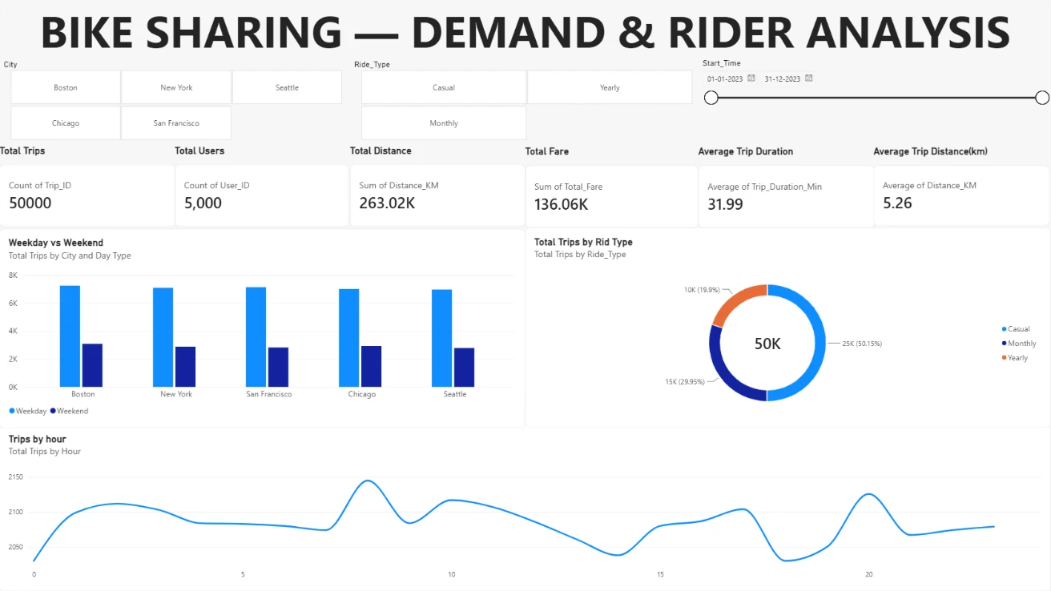
A 3-page Power BI dashboard on the MySQL tables
1. Overview
KPIs, weekday vs weekend by city, ride types, trips by hour
2. Operations
Station peaks, issues by bike type and season, age and gender
3. Revenue growth
Monthly revenue and month-on-month growth
Slicers for city, ride type and date. Arrivals use an inactive relationship with USERELATIONSHIP.
Notes:
The dashboard sits on the MySQL tables with slicers for city, ride type and date. Page one is the overview, page two covers operations and maintenance, page three tracks revenue growth. Next fixes: show weekday versus weekend per day, start the hourly axis at zero, and use US seasons.

Slide 9

Next steps: rebalance now, collect real data before planning
1 Rebalance the 32 most imbalanced stations on a daily route, starting with the biggest gainers and losers.
2 Report demand per day and per station-hour, never as raw totals across uneven periods.
3 Collect dock-sensor counts, GPS distance and odometer readings, then rerun the commute and maintenance analysis.
4 Fix the source: cap available bikes at capacity and block repair dates before purchase dates.
Notes:
One action is ready now: a rebalancing route for the most imbalanced stations. The rest is about getting data that can answer the original questions: per-day reporting, real sensor and GPS data, and source-level validation so impossible values never reach a report.

Slide 10



Happy to walk you through the SQL
Every number in this deck is reproduced by the repo's build and checked on every push.
github.com/parthdhawan921-ops/bike-sharing-demand-analysis
parthdhawan921-ops.github.io/Parth_Personal/#bike
parthdhawan921@gmail.com · +91 70823 35959
Notes:
Thank you. The repository rebuilds the database and checks these figures on every push, and the interactive case file on my portfolio has the totals-versus-per-day toggle.

