Slide 1

$3.93M a month left in shopping carts
Cart leakage and retention · Databricks SQL · Parth Dhawan · October 2026
2.4 GB · 20.7M shopping events · 4.52M carts · 465 categories · Oct 2019 to Feb 2020
Notes:
This project looks at an online cosmetics shop: 20.7 million shopping events over five months, analysed in Databricks SQL. The question is how much money is left in carts that never get bought, where it sits, and what a simple reminder would be worth.

Slide 2


Three out of four carts are never bought
76.5%
$3.93M
~$91K
of carts abandoned
left unbought a month
a month from a reminder
3.46M of 4.52M carts were not bought within 7 days, and the rate holds at 75% to 78% every month.
Half of it sits in just 23 of 465 categories, so the fix can start small.
If a reminder wins back 10% of carts, after a 25% margin and $0.01 per message.
Notes:
Three numbers. 76.5% of carts are abandoned, and that rate is steady every month. That leaves 3.93 million dollars of products unbought each month, half of it in 23 categories. A reminder that wins back just 10% would add about 91 thousand dollars a month.

Slide 3
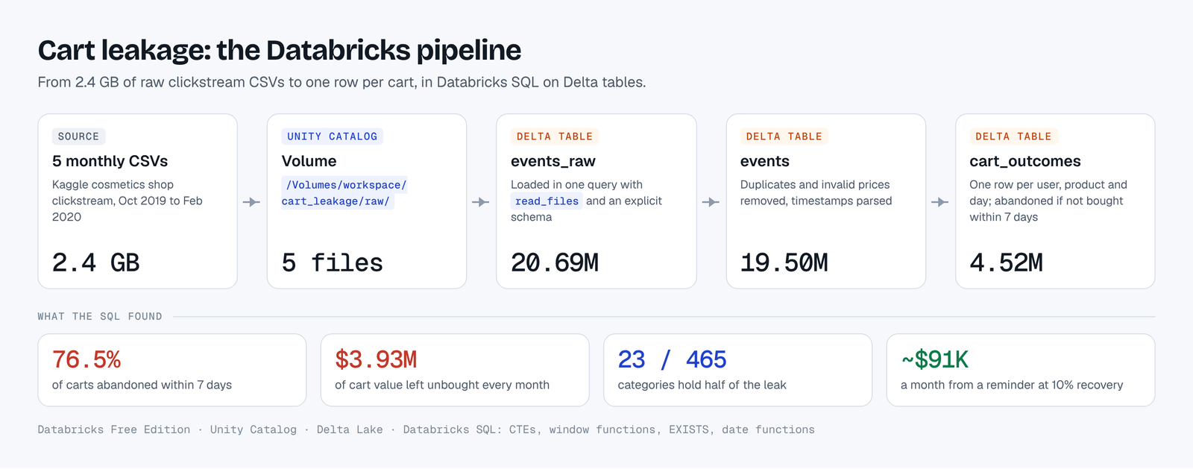
2.4 GB of raw clicks to one row per cart, in Databricks
Each step is its own Delta table, so every number can be traced back to the raw clicks.
Notes:
Five monthly files, 2.4 gigabytes, land in a Unity Catalog volume. One read_files query loads them into a Delta table. Each step after that is its own table: raw events, cleaned events, and finally one row per cart, which is what the analysis runs on.

Slide 4
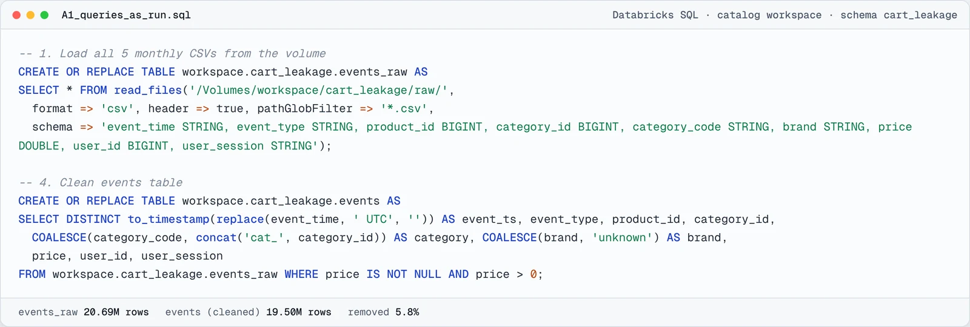
Cleaned before counting
19.50M events
4.52M carts
7-day window
kept of 20.69M: duplicates and invalid prices removed (5.8%)
one per user, product and day, so repeat clicks count once
abandoned = the same product not bought within 7 days
Notes:
Before counting anything, I removed duplicate rows and invalid prices: 5.8% of events. Then I defined a cart precisely: one per user, product and day. Abandoned means the same user did not buy that product within seven days. The last seven days of data are left out, so every cart gets a full window.

Slide 5
The leak is at the cart, not the shelf
24.9%
of viewers add something to a cart
27.8%
of those who add to a cart go on to buy
84%
of sessions with a cart end with no purchase
Notes:
Of 1.6 million users who viewed a product, about a quarter added something to a cart. But fewer than three in ten of those went on to buy. By session, 84% of sessions with a cart end without a purchase. So the biggest drop is between cart and checkout.

Slide 6
Half the leak sits in 23 of 465 categories
5% → 50%
18% → 80%
7.3%
23 categories, 5% of the range, hold half of all unbought value
83 categories hold 80% of it
the most any single category holds, so there is no one culprit
Notes:
The leak is concentrated. 23 categories, about 5% of the range, hold half of all unbought value, and 83 hold 80%. No single category holds more than 7.3%, so there is no one culprit, but a reminder can start with a short list.

Slide 7
Rank by value, not by cart count
strong
Only 4,036 carts, yet 3.3% of the leak: about $189 per abandoned cart. A few expensive carts matter more than many cheap ones.
40.1% of the leak has no brand recorded, so brand results cover the rest.
Notes:
By cart count, runail, grattol and irisk lead. But ranking by value tells a different story: the brand strong has only about 4,000 carts and still holds 3.3% of the leak, because each abandoned cart is worth about 189 dollars. 40% of the leak has no brand recorded, which I flagged.

Slide 8

New buyers rarely come back
9.2%
What I caught
October showed 18.5%, twice the rate.
The data starts in October, so long-time customers look new that month. I reported it as unreliable instead of as growth.
of November and December first-time buyers bought again the next month.
A reminder brings back carts; a second-order offer could bring back customers.
Notes:
Only about 9% of new buyers in November and December came back the next month. October looked twice as good, but that is an artefact: the data starts in October, so customers who had bought before look new. I flagged that cohort as unreliable rather than reporting it as growth.

Slide 9
A reminder is worth about $91K a month at 10%
How it is priced
Recovered sales × 25% margin, minus $0.01 per reminder to every abandoned cart.
At 10%: $393K of sales recovered a month.
Margin and cost are my assumptions; the win-back rate is untested.
Notes:
Here is what a reminder could be worth. At a 10% win-back rate, about 393 thousand dollars of sales come back each month, which is about 91 thousand dollars after a 25% margin and the cost of the messages. The margin and message cost are my assumptions, and the win-back rate needs a real test.

Slide 10



Next steps: test, then scale
1 Start the reminder with the 23 categories that hold half of the unbought value.
2 Run it against a random holdout group, so the real win-back rate replaces my 10% assumption.
3 Add a second-order offer for new buyers: only 9.2% come back on their own.
4 Fix the data at the source: 42% of events have no brand and 98% no category name.
Notes:
My recommendation is to test before scaling. Start with the 23 categories that hold half the leak, measure against a random holdout, then scale on the real number. Separately, a second-order offer for new buyers, and better brand and category data at the source.

Slide 11



Happy to walk you through the SQL
Every query is in the repo exactly as it ran in Databricks.
github.com/parthdhawan921-ops/cart-leakage-analysis
parthdhawan921-ops.github.io/Parth_Personal/#cart
parthdhawan921@gmail.com · +91 70823 35959
Notes:
Thank you. All the SQL is in the repository exactly as it ran, and the case file on my portfolio lets you change the win-back rate and margin and see the value update.

