Slide 1

Retail sales in Databricks: the course SQL overstated orders by 83%
Databricks SQL · Unity Catalog · Parth Dhawan · October 2026
4 tables · 4,494 order lines · 6 course queries · 5 corrected queries · 5 Databricks charts
Notes:
This is a retail sales analysis I built in Databricks SQL from the LinkedIn Learning course Databricks for Data Analysts. I ran the course queries, then checked what each number actually counted. Two counting mistakes overstated orders by 83% and sales by 22%. I will show how I found them, how I fixed them, and what the corrected data says.

Slide 2



Two counting mistakes, then one clear customer story
+83%
+22%
60%
orders overstated
sales overstated
from the top 20%
4,494 product lines were counted as orders. There are 2,453 real orders.
€1.83M included €303K of tax and €23K of shipping. Net sales are €1.50M.
of net sales, after the fix: 160 of 800 customers bring €900,673.
Notes:
Three messages. One: the course counted product lines as orders, so orders were 83% too high. Two: its sales figure included tax and shipping, 22% too high. Three: once both are fixed, the business story is clear. The top 20% of customers bring 60% of net sales.

Slide 3
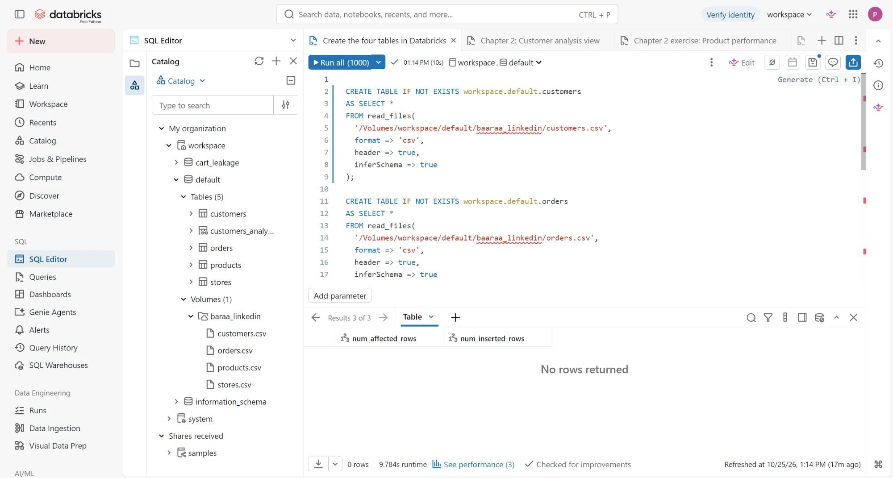




Built end to end in Databricks SQL
Volume
4 CSVs uploaded to Unity Catalog
Delta tables
Loaded with read_files and schema inference
SQL editor
6 course queries and 5 charts
Corrected views
Every number checked against the raw tables
Data: 800 customers, 4,494 order lines, 250 products and 20 stores across 10 European countries, 2022 to 2025.
Notes:
Everything ran in Databricks Free Edition. I uploaded the four CSVs to a Unity Catalog Volume and loaded them into Delta tables with read_files. I ran the six course queries in the SQL editor and saved five charts. Then I wrote corrected views and checked every number against the raw tables.

Slide 4
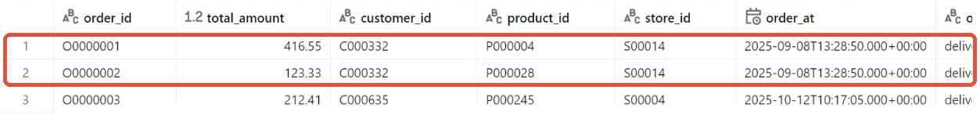
Spot it: rows 1 and 2 are one order, counted twice
Same customer
Same second
Same store
One order number
C000332
13:28:50
S00014
ES-202512-28364
4,494 rows ÷ 2,453 order numbers = 1.83 product lines per order. So COUNT(order_id) counts products in baskets, not orders. The fix is COUNT(DISTINCT order_number).
Notes:
This is the course dashboard dataset, straight from my Databricks screen. Rows 1 and 2 have the same customer, the same second and the same store, and they share one order number. It is one order with two products. Each row is a product line, so counting rows counts products, not orders. On average an order has 1.83 lines.

Slide 5
"Sales" included tax and shipping
€1.83M
€1.50M
0 of 4,494
what the course called sales (total_amount)
net sales: line subtotal minus discount
rows where net + tax + shipping ≠ total
Notes:
The course summed total_amount as sales. I reconciled it row by row: on every one of the 4,494 rows, total_amount equals net sales plus tax plus shipping. Tax is not revenue, so the real sales figure is net sales: 1.50 million euros, not 1.83 million.

Slide 6
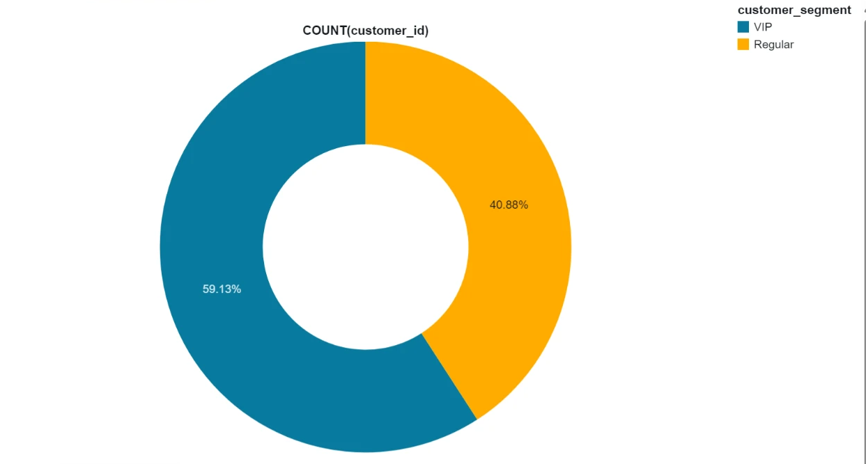
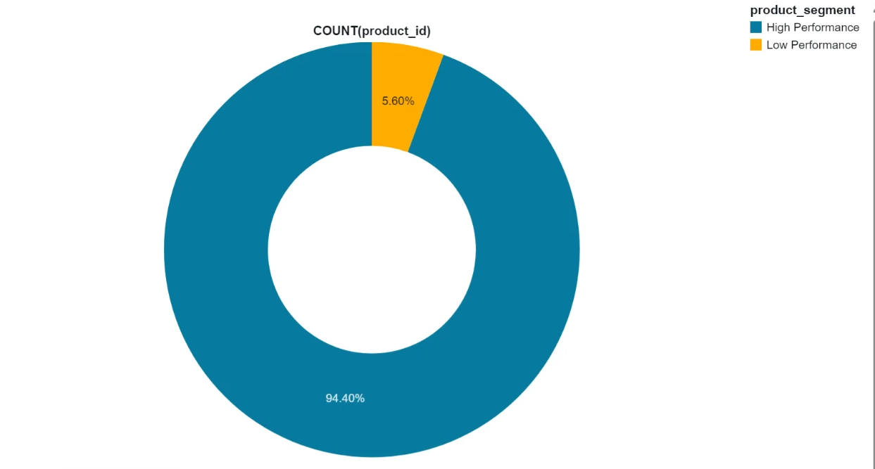
A flat €1,000 rule makes almost everyone "top"
59% of customers are "VIP"
94% of products are "High Performance"
Course view: spent over €1,000 = VIP
Course exercise: €1,000 or more = High
Fix: rank instead of a fixed amount. Top 20% = 160 customers and 50 products, a segment that actually separates.
Notes:
These are my charts in the Databricks SQL editor on the course queries. A flat 1,000-euro cut labels 59% of customers as VIP and 94% of products as high performance. A segment that holds most of the rows does not separate anyone. I replaced it with a ranking: the top 20%, which is 160 customers and 50 products.

Slide 7
Four fixes, each checked against the raw tables
Course SQL | Problem | My fix | Result
COUNT(order_id) | Counts product lines | COUNT(DISTINCT order_number) | 2,453 orders
SUM(total_amount) | Adds tax and shipping | line_subtotal − discount | €1.50M net sales
> €1,000 = VIP | 59% of customers are VIP | NTILE ranking: top 20% | 160 customers
GROUP BY order_at | One row per order time | One row per customer | 800 rows, 1 each
The course versions stay unchanged in the repo next to my versions, with the expected result written under every corrected query.
Notes:
Here are the four fixes. Count distinct order numbers, use net sales, rank customers instead of a fixed cut, and give one row per customer instead of per order time. I kept the course SQL unchanged next to mine, so anyone can compare them line by line.

Slide 8
After the fix: 160 customers bring 60% of sales
€612.90 average order · 25.8% gross margin · 63% of four years of sales came in 2025
Notes:
With real orders and net sales, the picture is simple. The top 20% of customers, 160 people, bring 60% of net sales. Sales grew every year, and 2025 alone is 63% of the four-year total. The average order is about 613 euros at a 25.8% gross margin.

Slide 9
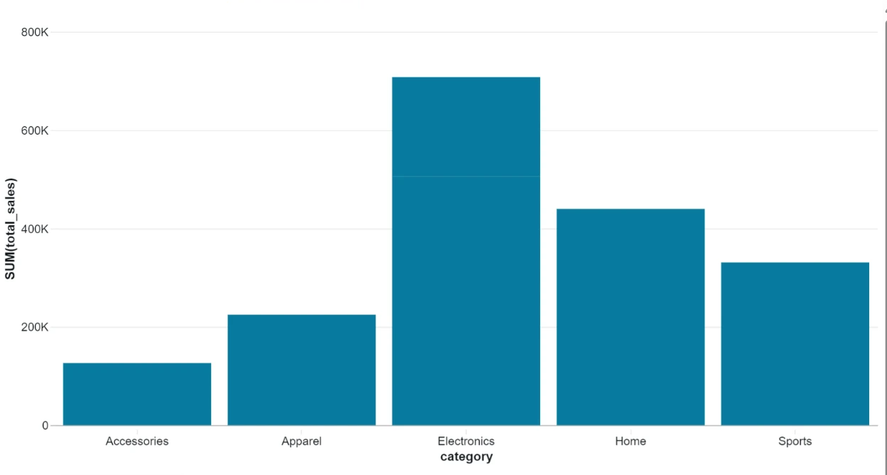
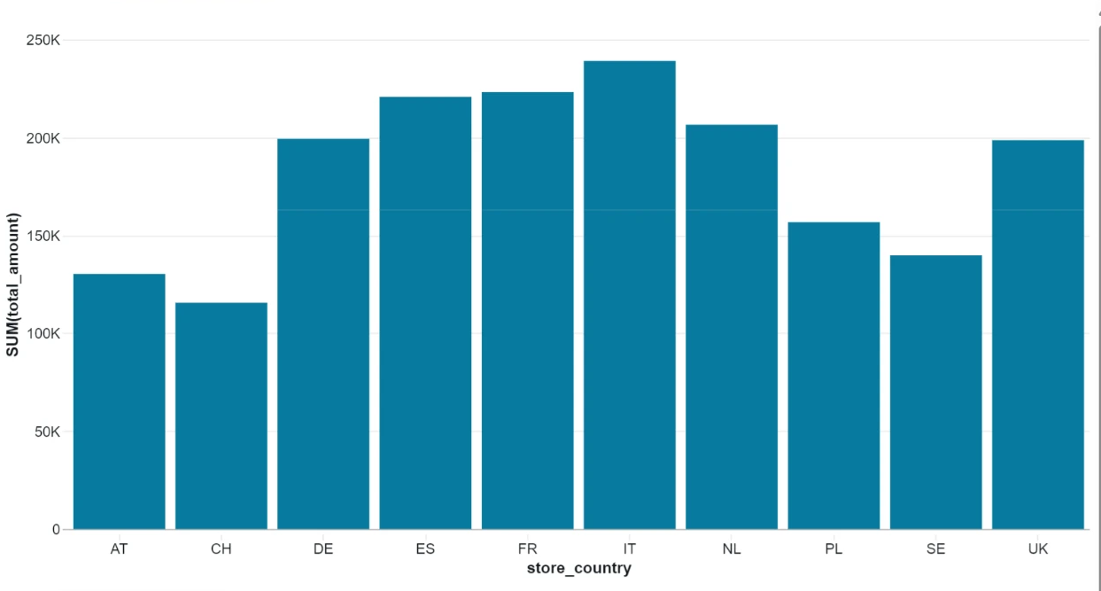
Where sales come from
Electronics leads with 39% of sales
Italy sells most, Switzerland least
Physical stores bring 51% of sales and online 49%. These charts come from my Databricks SQL editor on the course queries, so amounts include tax; on net sales the shares and rankings hold.
Notes:
These three charts are from the Databricks SQL editor on the course queries, so their amounts include tax. I checked them on net sales too: Electronics stays at 39 percent, the country ranking is identical, and physical stores stay just over half of sales.

Slide 10




Next steps
1 Protect the top 160 customers with a retention offer: they hold 60% of net sales.
2 Rebuild the dashboard counters on the corrected view: distinct orders and net sales.
3 Fix the source: order-number dates disagree with order_at on 4,416 lines, and 377 sales predate the product launch.
4 Run the data-check query before every refresh, so a counting mistake never reaches a report.
Notes:
One business action and three data actions. Protect the 160 customers who hold most of the sales. Rebuild the dashboard on the corrected view. Fix the two date problems at the source. And run the data-check query before every refresh.

Slide 11



Happy to walk you through the SQL
Course SQL and my corrected SQL sit side by side in the repo, with expected results under every query.
github.com/parthdhawan921-ops/databricks-sql-analytics
parthdhawan921-ops.github.io/Parth_Personal/#dbx
parthdhawan921@gmail.com · +91 70823 35959
Notes:
Thank you. The repository has the course SQL and my corrected SQL side by side, and the case file on my portfolio has a toggle between the course numbers and the corrected ones.

