Slide 1
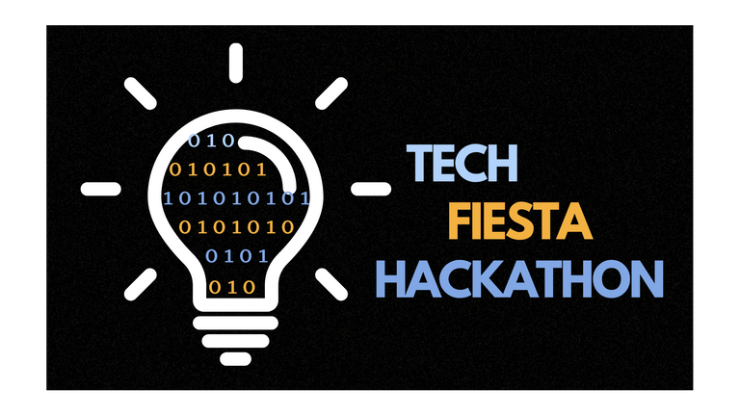
TECHFIESTA 2025
Problem Statement ID – T2K25C9
Problem Statement Title - Healthcare Data Integration System
Domain - Healthcare
Team Name - X
Team Leader Name - Kartikey Sapkal

Slide 2
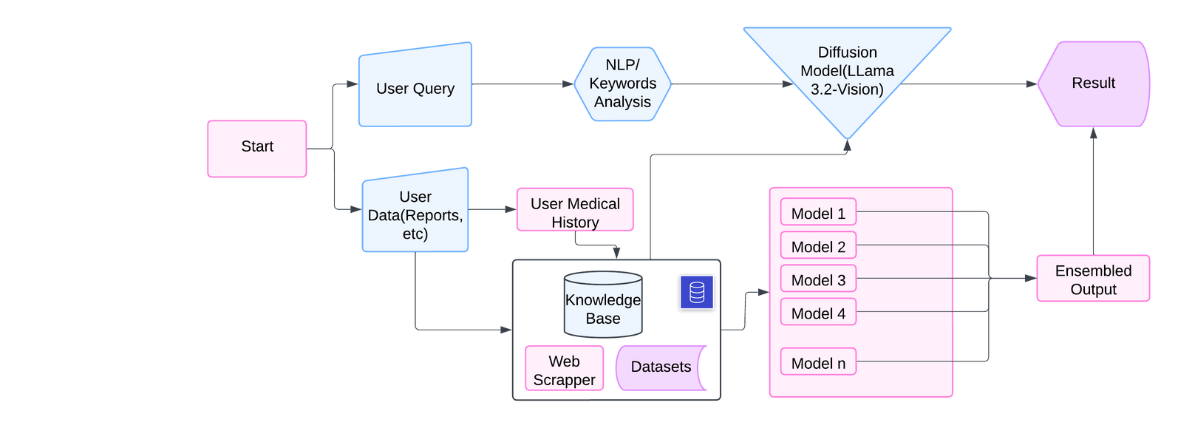
Proposed Solution
Unified Analysis and Fusion Framework
2. Deep Learning for medical image analysis
Uses CNNs (e.g., ResNet, EfficientNet), ViT, and U-Net for analysis.
Ensemble learning for higher accuracy; Grad-CAM for decision explainability.
3. Webscrapper for realtime updates
Purpose: Collect real-time medical data to keep the system updated with latest knowledge and guidelines.
4. Unified analysis framework
Unified Analysis Framework
Integration: Merges LLM and ML outputs.
Capabilities: Aligns images with patient data, enabling iterative feedback for better analysis.
Multimodal LLM’s for Data Analysis
5. Compliance and scalability
Analyze healthcare reports, patient records, and medical images.
Enhanced with RAG to integrate external medical knowledge (e.g., PubMed, UMLS).
Cross-references patient history and clinical findings dynamically.
Compliance & Scalability
Privacy: Federated learning keeps patient data secure and meets HIPAA/GDPR rules.
Scalability: Cloud platforms manage large datasets and real-time processing.
Idea submission
01

Slide 3
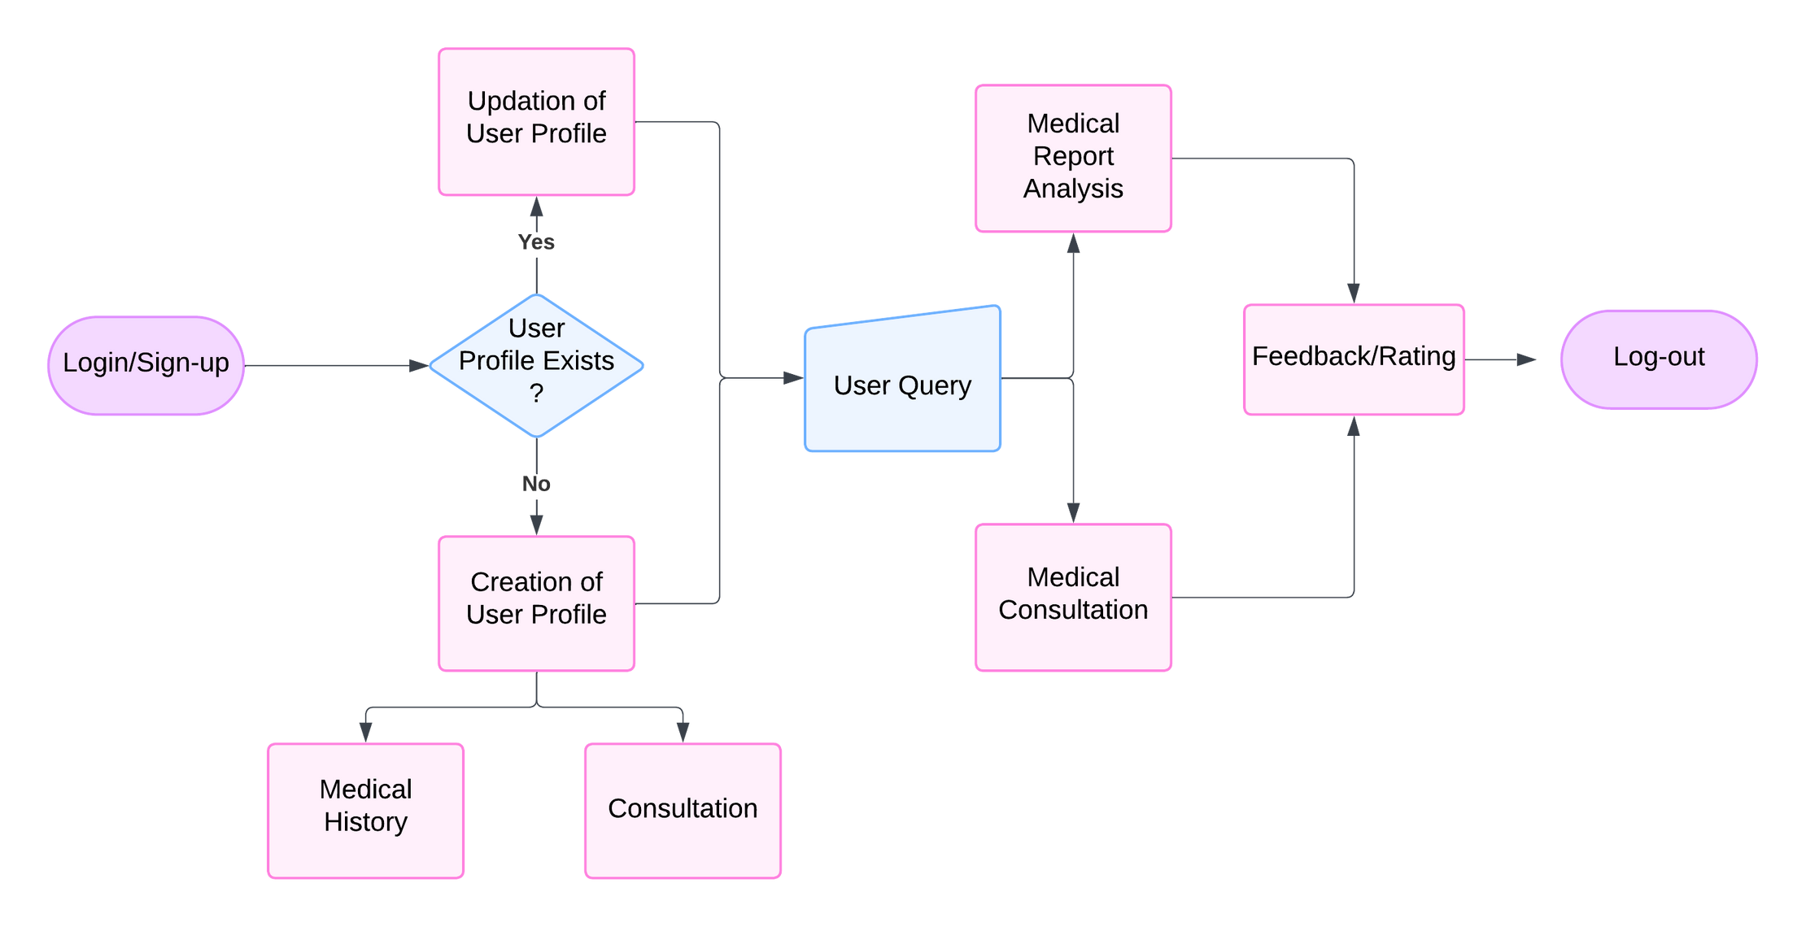
Process flow diagram
Idea submission
02

Slide 4
Methodology used
Step 1: Data Collection and Preprocessing
Healthcare data, including patient histories, medical images, lab results, and clinical notes, is gathered from various sources. Textual data is cleaned, tokenized, and normalized for LLM compatibility, while image data is enhanced using preprocessing techniques like segmentation and noise reduction. APIs and web scrapers fetch real-time medical guidelines and research updates. A PostgreSQL database stores structured and unstructured data securely, supporting efficient querying and retrieval.
Step 3: Privacy, Scalability, and Medical History Management
Data privacy is ensured through federated learning, training models locally without transferring raw data. Scalable cloud infrastructure and containerization with Dockerfacilitate seamless deployment and scaling. A medical history management module tracks patient data, enabling longitudinal analysis and personalized healthcare recommendations.
Step 2: Multimodal AI Analysis and Ensembling
Fine-tuned LLMs analyze textual data using Retrieval-Augmented Generation (RAG) for context extraction. Deep learning models (e.g., CNNs, Vision Transformers) process medical images to identify abnormalities. Ensembling techniques like stacking and boosting combine predictions from multiple models, improving accuracy and robustness. Outputs from both text and image analyses are merged using attention-based mechanisms to deliver unified insights.
Step 4: Explainability, User Interaction, and Support
AI outputs are made interpretable using Grad-CAM for image visualizations and SHAP/LIME for text insights. The system includes a medical support chatbot, powered by fine-tuned LLMs, to assist professionals and patients with queries. An intuitive user interface ensures accessible interaction, boosting trust and improving decision-making.
This comprehensive methodology ensures secure, scalable, and accurate healthcare analysis, integrating advanced AI tools and user-centric features.
Idea submission
03

Slide 5
Solution Concept and Feasibility
Technical Feasibility
Financial Feasibility
Integration: Fits existing hospital IT.
Performance: High accuracy in healthcare data analysis.
Scalability: Cloud handles large, real-time data.
Cost Savings: Cuts costs by 50%.
ROI: Faster, accurate workflows.
Operational Feasibility
Constraints
Data Security: Federated learning & encryption.
Model Accuracy: Use explainable AI (Grad-CAM, LIME).
Scalability: Auto-scaling cloud.
Cost: Optimize resources, use audits.
Interface: Simple, minimal training.
Compliance: Meets HIPAA/GDPR(For Data Security).
Maintenance: Auto-monitoring & update
Idea submission
04

Slide 6
Use cases & Description
Radiologist & Medical decision making
Diagnostic cost & time reduction
Description: Uses deep learning/LLMs to boost diagnostic accuracy.
Impact:
Accuracy: Up to 95%
Time Reduction: 30-40%
Description: Automates analysis to cut costs and save time.
Impact:
Cost: 40% reduction
Time: 50% faster diagnostics
Healthcare consultants
Accessible & user friendly platform
Description: Integrates images, reports, and histories for insights.
Impact:
Efficiency: 50% faster analysis
Outcomes: 80% alignment with recommendations
Description: Secure web platform for professionals and patients.
Impact:
Adoption: 90% usage rate
Insights: Real-time updates for 95%
Idea submission
05

Slide 7
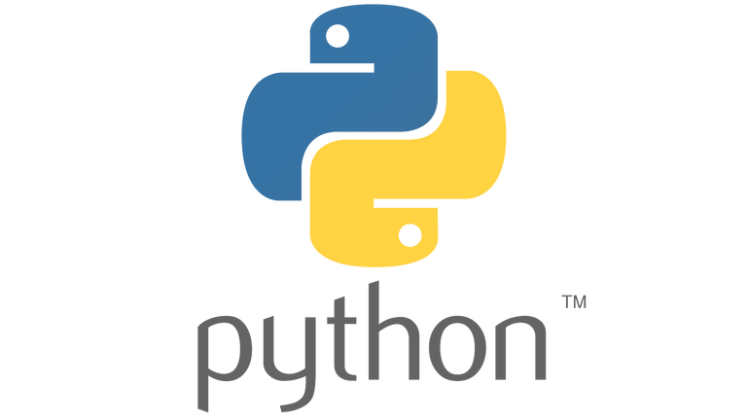

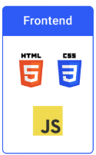

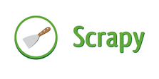
Technology stack used
Backend
Languages: Python
Frameworks: Flask, Ollama
Libraries: PyTorch/TensorFlow, Hugging Face Transformers
1
Frontend
2
Languages: HTML, CSS, JavaScript
Frameworks: Tailwind CSS, Bootstrap
Libraries: Vue.js,Chart.js,D3.js
Database
Relational: PostgreSQL
3
Non-Relational: Mongo-DB
Real-time
4
Web Scraping: Scrapy
Cloud & DevOps
Containerisation: Docker
Scalability: Kubernetes
Monitoring: Grafana
Version Control: Git
5
Idea submission
06

Slide 8
Constraints
Data Privacy & Security :
Challenge: Protecting sensitive data while following HIPAA/GDPR.
Solution:
End-to-end encryption for data protection.
Federated learning keeps data on local devices.
Regular updates to security protocols.
Scalability & Resource Management
Challenge: Managing large data volumes and peak usage.
Solution:
Cloud infrastructure with auto-scaling.
Data partitioning and caching to reduce latency.
Cost & Budget Constraints
Challenge: High costs of AI healthcare systems.
Solution:
Use cost-effective cloud and open-source tools.
Regular performance reviews to optimize resources
Idea submission
08

Slide 9
Constraints
Challenge: Protecting sensitive data while following HIPAA/GDPR.
Solution:
End-to-end encryption for data protection.
Federated learning keeps data on local devices.
Regular updates to security protocols.
Data privacy & security
Challenge: Managing large data volumes and peak usage.
Solution:
Cloud infrastructure with auto-scaling.
Data partitioning and caching to reduce latency.
Scalablity & resource management
Cost & budget
Challenge: High costs of AI healthcare systems.
Solution:
Use cost-effective cloud and open-source tools.
Regular performance reviews to optimize resources
Idea submission
08

