Slide 1

SRA : Smart
Resume
Analyser
Prepared by
Parth Dubey
“We Analyse your Skills Smartly”

Slide 2
What is SRA?
This project “SRA: Resume Analyzer” is about to analyze the resume of any IT person, on the based on resume our smart system will give the smart recommendation to the user. It is very easy to use and smart application, in this application user just need to upload the resume. It will automatically analyze the resume. After that it will give you the recommendations.
Technology is playing a very vital role in changing our life in many ways. There are many sectors which benefited after implementing technology in it.
Now it’s time for evolution in very field. With the use of Artificial Intelligence every field is growing widely. With this project our aim is to use AI in job sectors. This system can be use by any fresher, graduate or experienced people.
Our future aim to create same module for companies oriented also, so with this application companies can directly shortlist the people using AI. We are using the core concepts of Natural Language Processing for analyzing the resume. This is just first step for implementing Artificial Intelligence in the field of Job Recruitment sector.

Slide 3
Why SRA?
The main purpose of building this project is to create a smart technology for corporate hiring world. Nowadays there are thousands of people are unemployed or they are finding the jobs. Our Aim is to provide a smart system that can give the perfect recommendation based on the resume of user, It will give the recommendation of Job working industry, tools & Technology, courses, and resume writing techniques. So with this help user can create a better resume so it will increase the chances of getting a job in good company.

Slide 4
Literature Survey
According to [1], In this paper authors have explained Automated Resume Screening System using Natural Language Processing. They have used stemming, lemmatization, POS Tagging, Chunking and Tokenization. They have used Cosine Similarity to get the ranking of the Candidates.
In [2], Paper explained different techniques for the Resume Parsing using Natural Language Processing. They have used OCR to fetch to text from the resume. They are using the Tokens and Semantic Analysis to pre-process the text of resume. They are using Ranking algorithms to select the candidate.

Slide 5


Tools & Technologies
Python Programming
NLTK & Pyparser for NLP
Streamlit for Backend
PDFMiner for extracting PDF
Base64 for PDF displaying
Pillow
Numpy
Github for management
Pycharm IDE
BS4 and requests for Web Scraping

Slide 6
Hardware & Software Requirements
 | Hardware | Software
Developers | 1. 4 GB RAM 2. 256 GB Storage 3. Intel i5 5th Gen + Processor | 1. Anaconda or Python 2. Pycharm IDE 3. Streamlit, PDFMiner 4. Pyparser, NLTK
Users | 1. Mobile 2. Tablet/PC 3. Laptop | 1. Any Browser like Chrome, Firefox etc (Updated version) 2. Working Internet

Slide 7


Key-Features of SRA
Resume Store / Remove
PDF Extracting

Slide 8


Key-Features of SRA
Career Recommendation
Based on Skills
Course Recommendation
Based on Skills

Slide 9


Key-Features of SRA
Skills Recommendation
Based on SKills
Easy User - Interface
(No Registration)

Slide 10
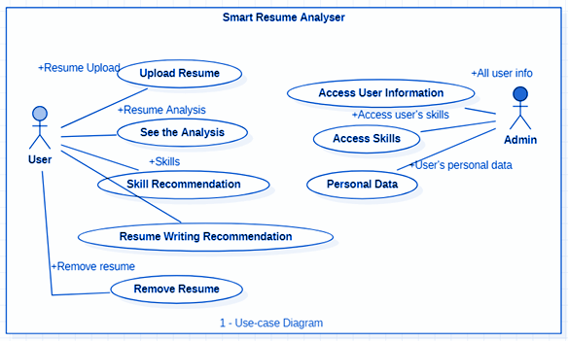
Use-Case Diagram

Slide 11
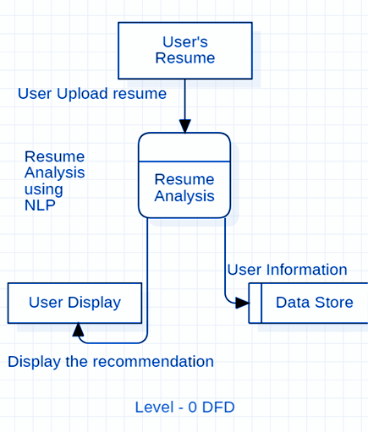
Level - 0 DFD

Slide 12
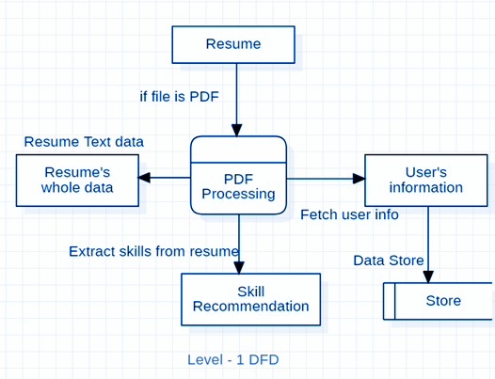
Level - 1 DFD

Slide 13
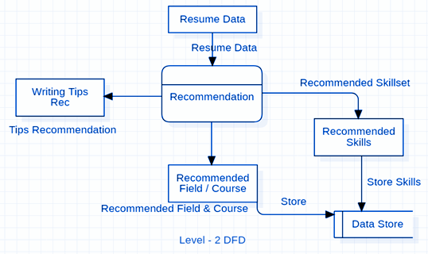
Level - 2 DFD

Slide 14
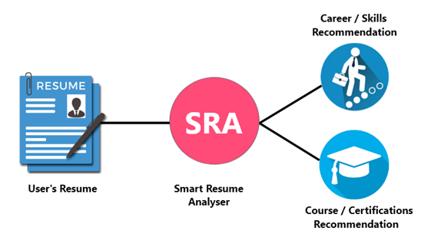
Workflow of System

Slide 15
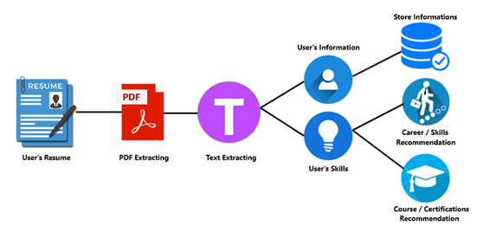
Workflow of SRA

Slide 16
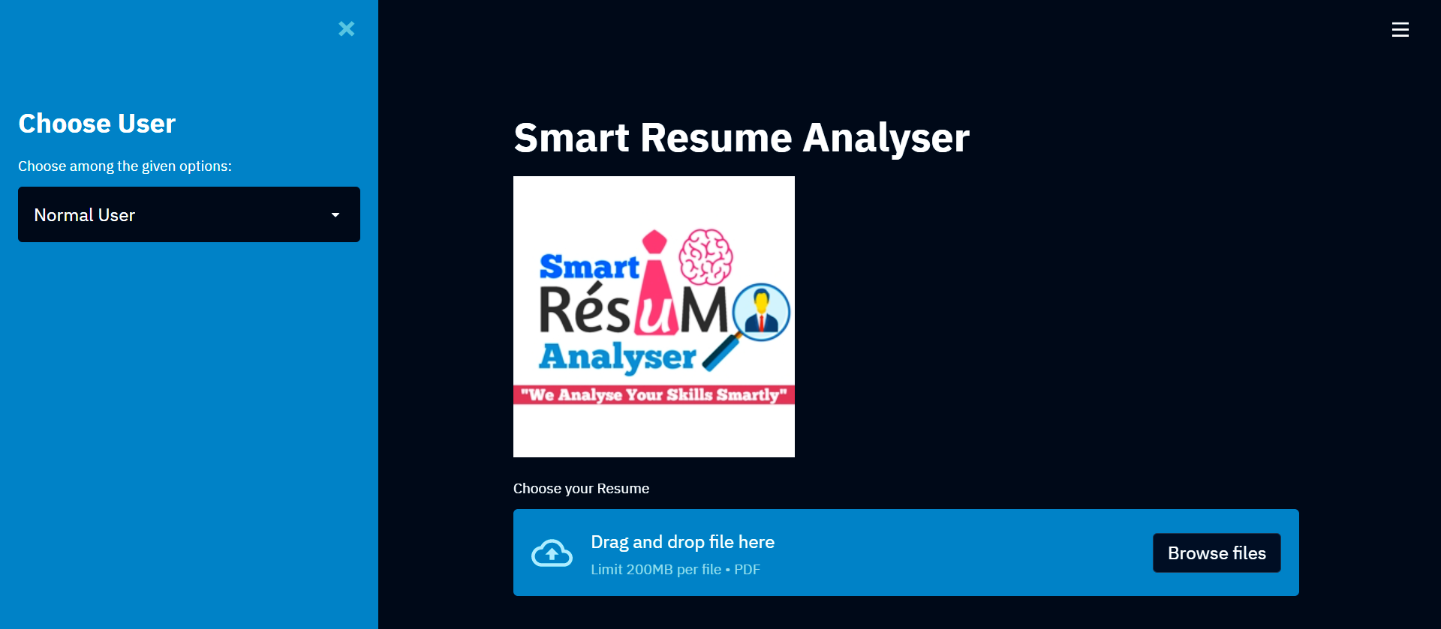
Homepage of Application

Slide 17
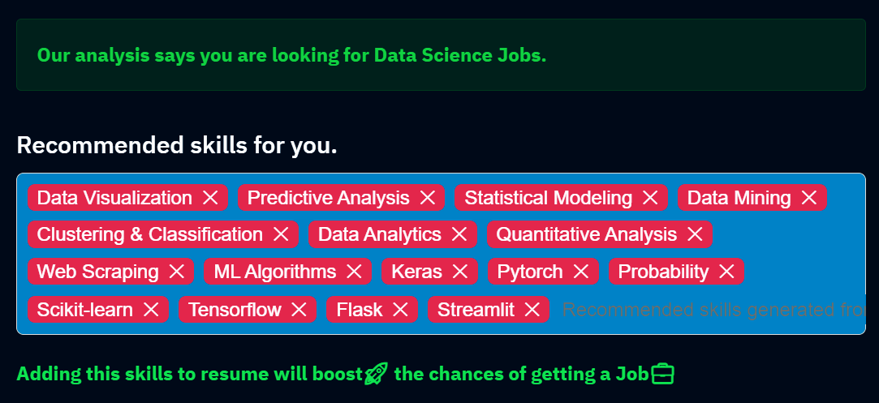
Career & Skills Recommendations

Slide 18
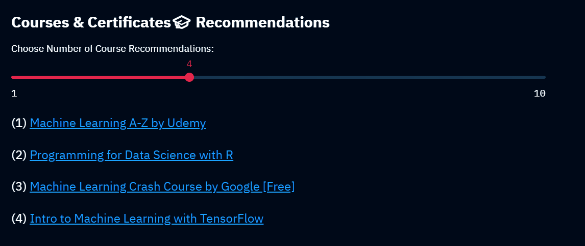
Courses Recommendations

Slide 19
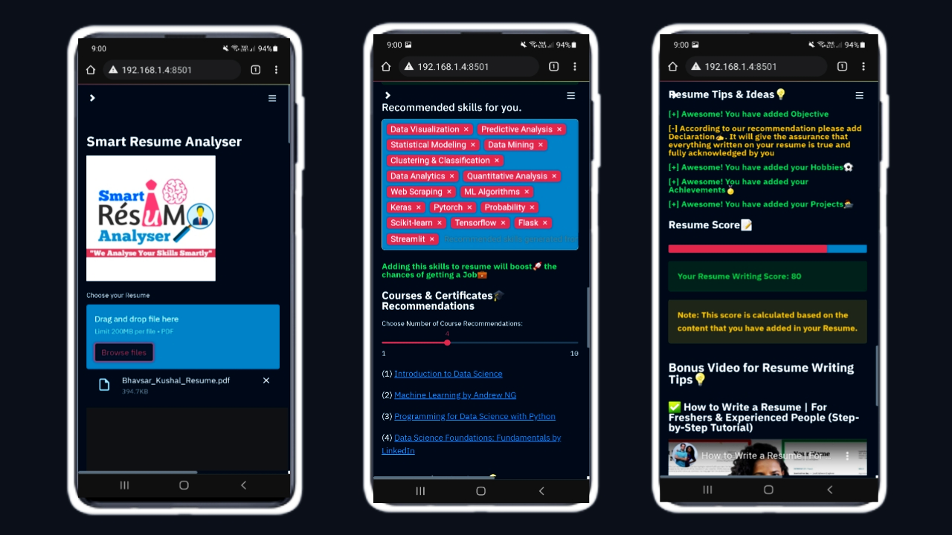
Responsible UI in Mobile Browser

Slide 20
Future Work
Currently web applications is deployed on local, our future aim is to deploy on the internet (AWS or Heroku).
In future we will add more formats of resume, currently it is supporting only PDF format for uploading the resume.
This system currently working with the limited types of field and recommendations, we can say it is only working for IT professional for now. We will add more fields data in future for all resume recommendations
We are getting good accuracy of fetching the user data, still at some time data displayed is wrong which is fetched from the PDF. We will improve this in future.
Currently we haven’t displayed charts and visualizations at user side, we will add it in future. It will show all the charts based on the data
In mobile view of application some time UI is lagging, we will fix it soon.

Slide 21
Conclusion
The purpose of this project is to learn the Natural Language Processing. We have research too many skills, tools and technologies for different types of IT jobs. Then we have done NLP processing that can recommend the Skills, Courses and career field. We learn to create one-page application development using Streamlit python. We have gathered the knowledge of Plotly for the visualization and Data analytics which is created in Admin Side. We have covered this project according to scheduled time. In this project we learn time management, Non-technical skills like documentations, diagrams drawing, Technical skills like NLP, Database handling, Visualization, Web scraping, Web development and many more things from this project.

Slide 22
Thanks for your attention
Have Questions? Ask us
?

