Slide 1
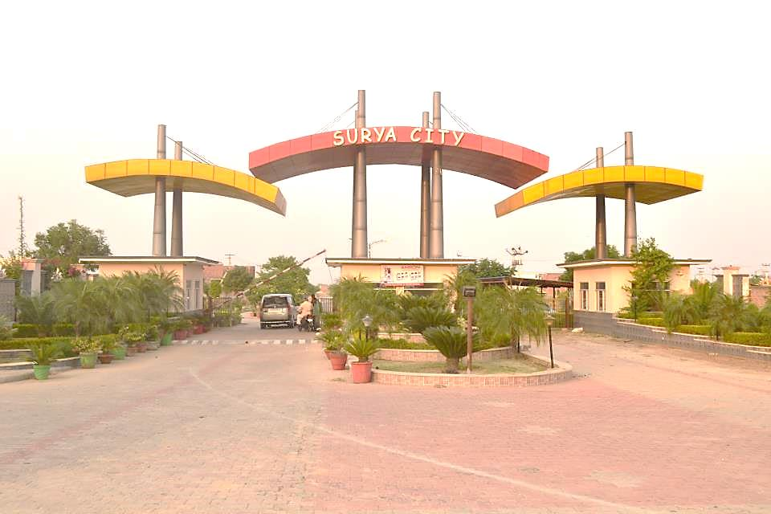
Welcome at Surya City

Slide 2


Slide 3
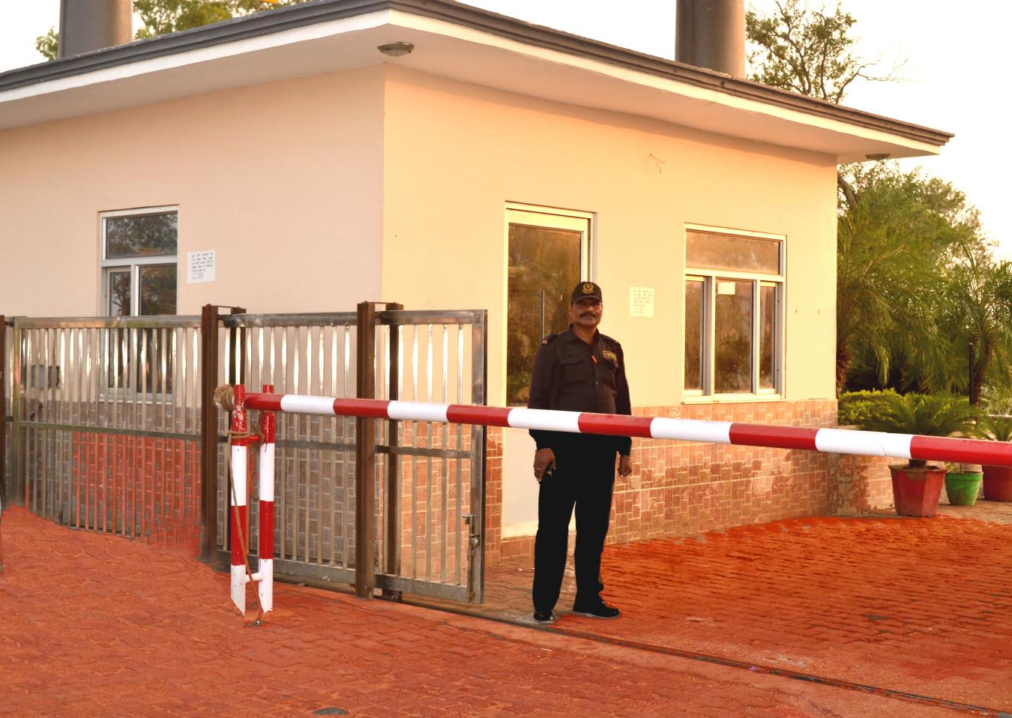
High Security

Slide 4
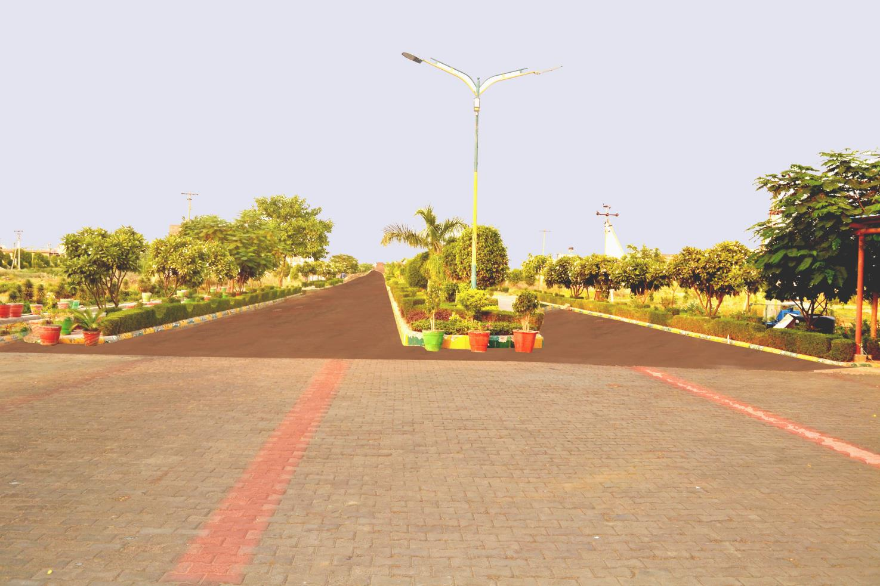
Wide Roads with Foot Path and Greenery

Slide 5
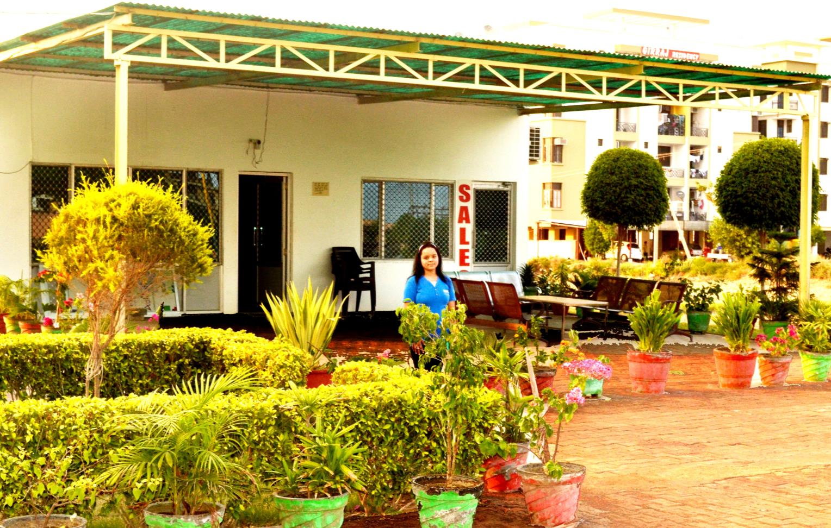
Office

Slide 6
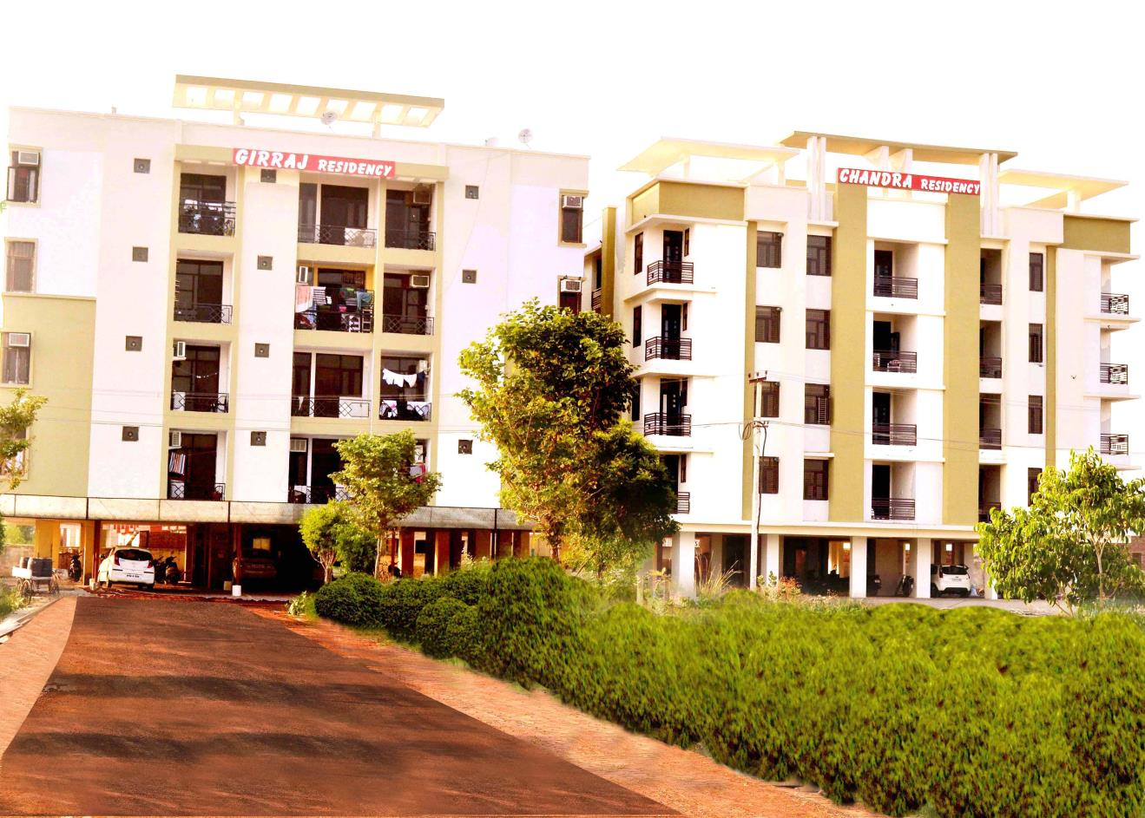
Multistory Buildings

Slide 7
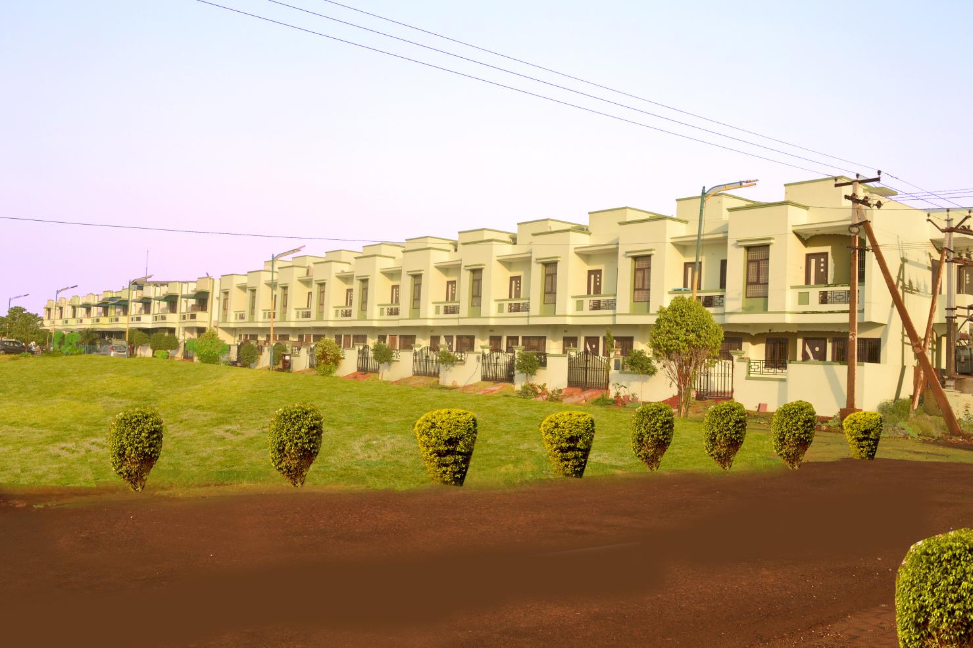
Villas

Slide 8
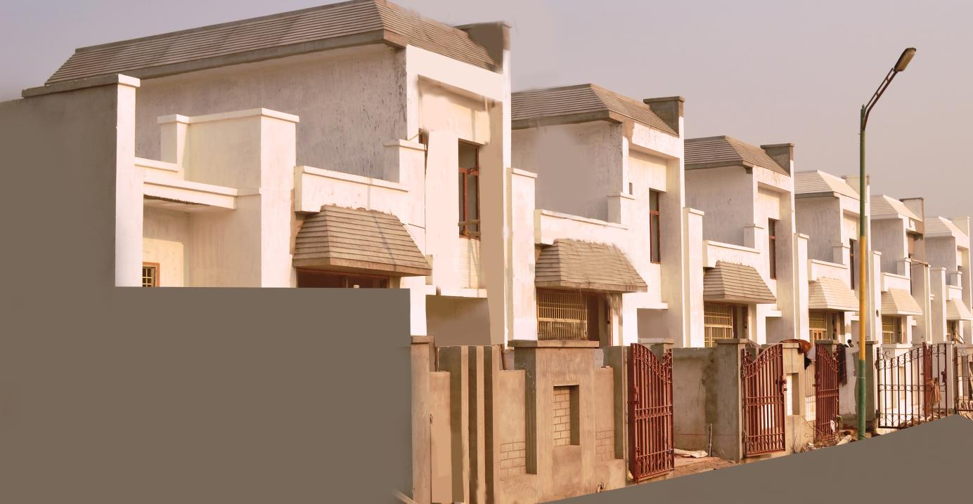
Villas

Slide 9
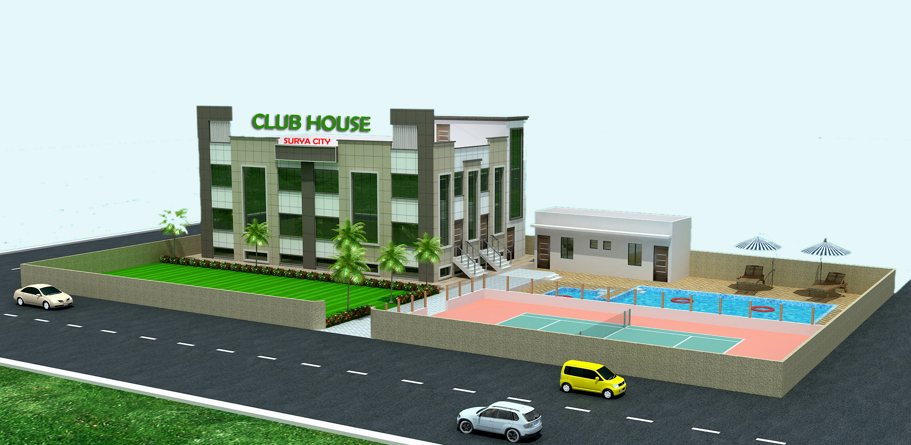
Club House

Slide 10
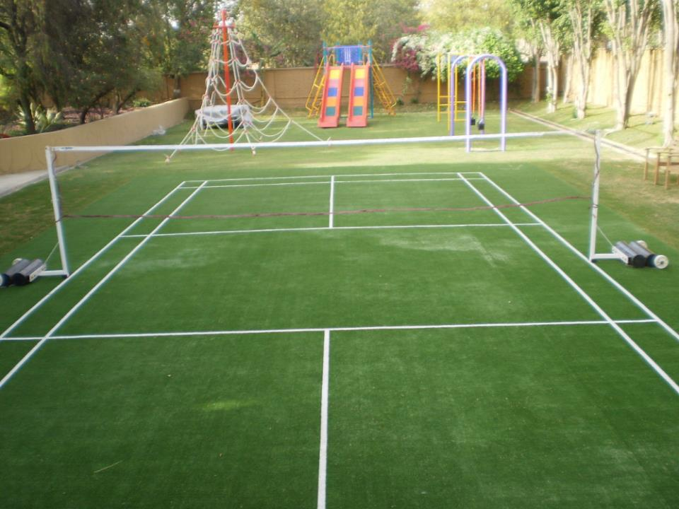
Badminton Court &
Kids Play Zone

Slide 11
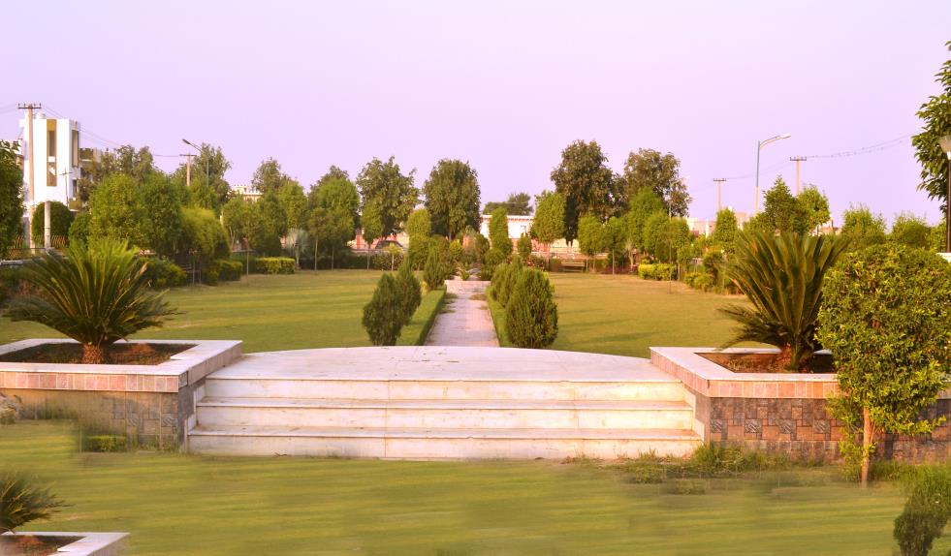
Parks

Slide 12
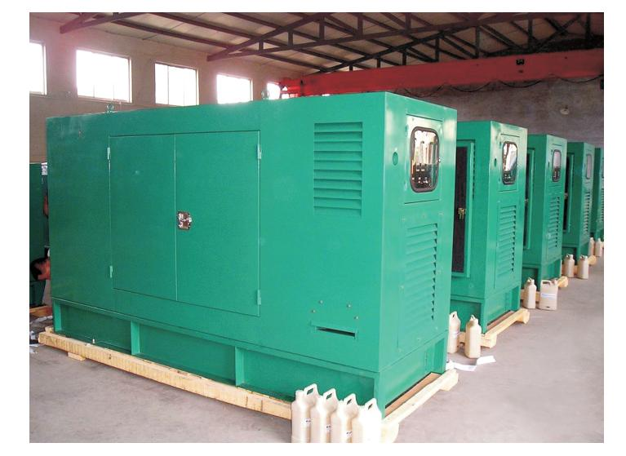
Power Backup

Slide 13
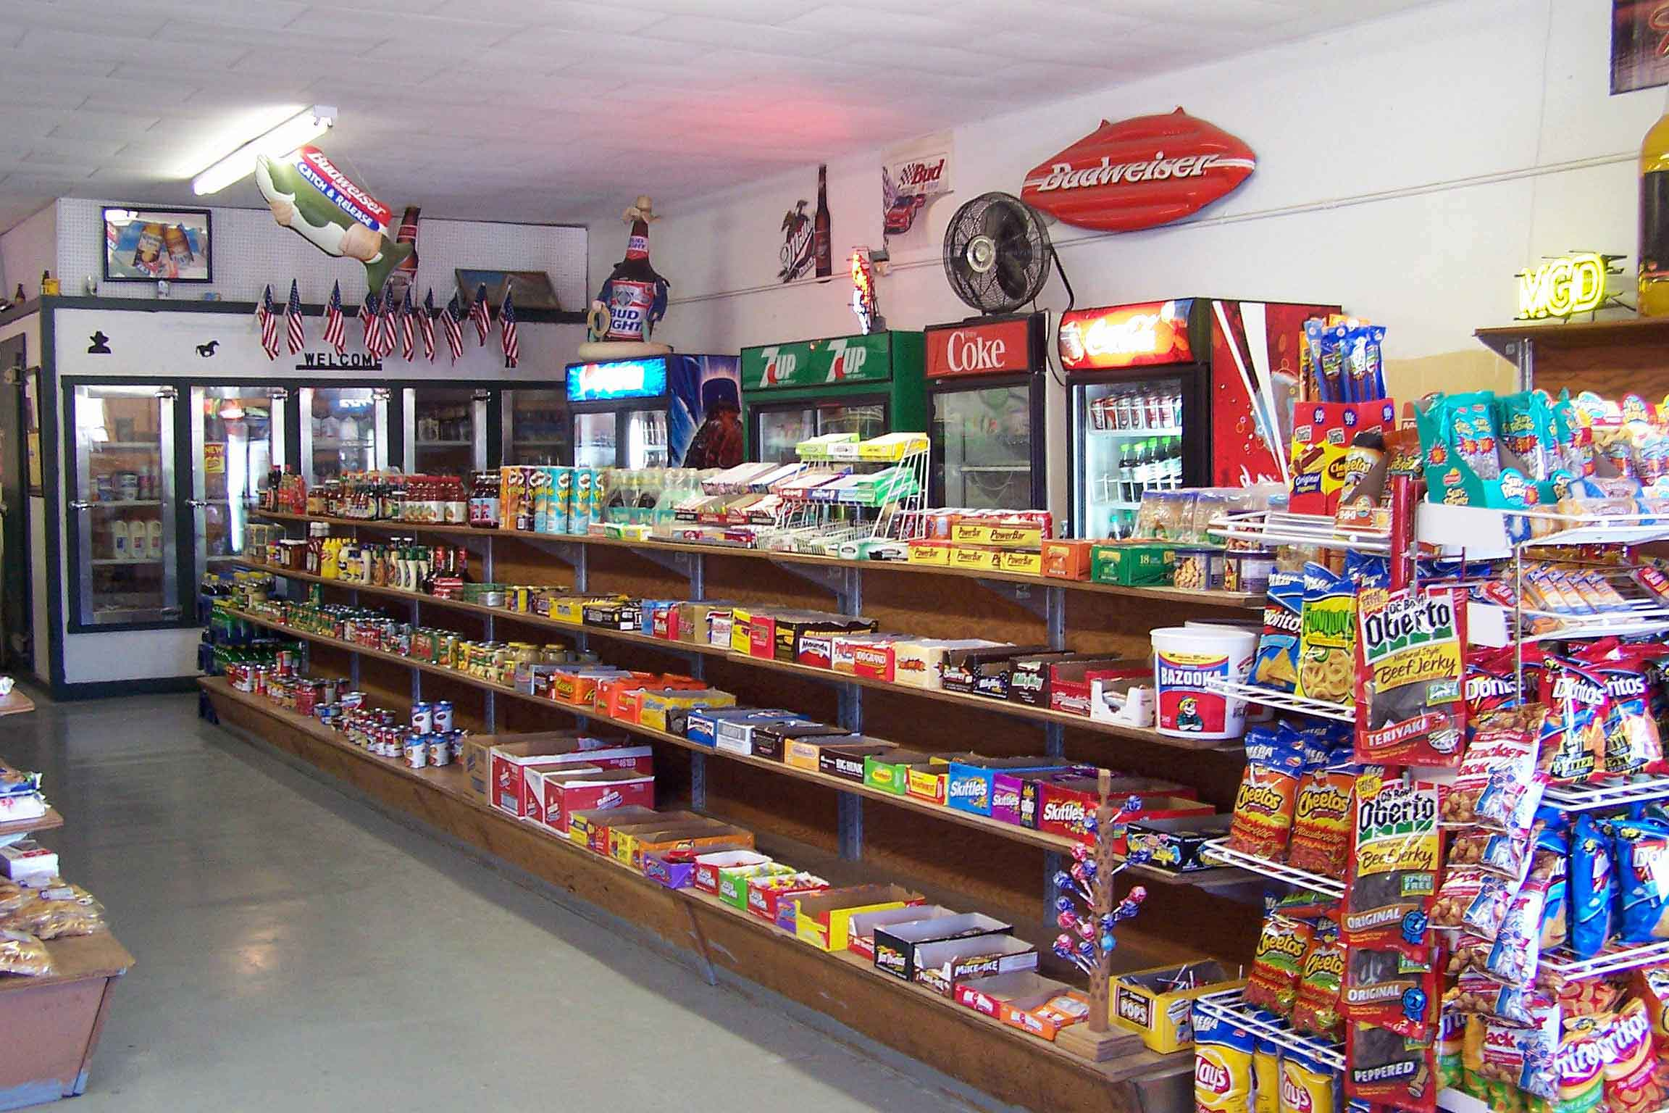
Shopping Area

Slide 14
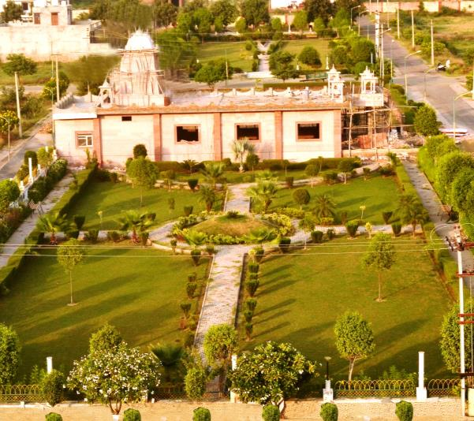
Temple

Slide 15
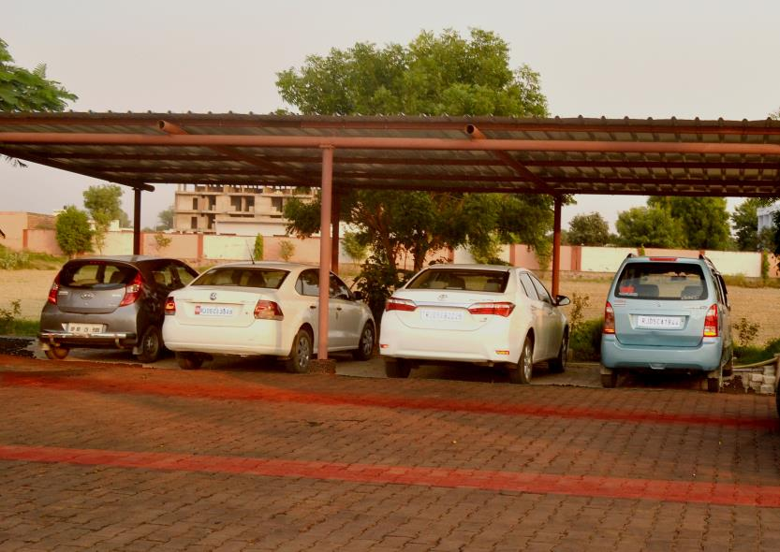
Parking Space

Slide 16

Your are Welcome in your Wonderful
HOME

