Slide 1


Gujarat University School of Emerging Science and Technology Inventory Problem
Topic: Warehouse Inventory Automation (Amazon Robotics)
Data Science & AIML (Sem-6)
Parth Patel (DS 24)
Enrollment No. 202222600010
Vivek Prajapati (AIML 27)
Enrollment No. 202222700022

Slide 2
Introduction
Warehouse inventory automation is transforming the way goods are managed, stored, and shipped in large-scale operations like Amazon. By integrating advanced robotics and technology, this system automates tasks such as sorting, picking, packing, and transporting items.
Amazon Robotics uses smart robots and software to improve efficiency, accuracy, and speed in warehouses. This not only helps in meeting the growing demand for faster deliveries but also reduces operational costs and ensures a safer work environment for employees.
Through automation, companies like Amazon are setting new standards in modern warehouse management.

Slide 3
Objectives
Better inventory management:
Use technology to keep track of stock more easily, so there’s always the right amount of products, and less need for physical work.
Faster order packing:
Robots can help pack and pick items quickly, speeding up order delivery and making customers happy.
Safer environment :
Robots can handle heavy lifting and repetitive tasks, keeping workers safe from injuries and dangerous conditions.

Slide 4
Constraint
High starting cost :
Setting up robotic systems and automation technology requires high starting costs.
Care and stops :
Robots need maintenance, and any technical issues can cause delays in operations.
Space requirements :
Implementing robotics may require changing the design of warehouses. This helps create enough space for machines to move and work efficiently.

Slide 5
Literature review
Warehouse inventory automation is revolutionizing logistics, with Amazon Robotics leading advancements in robotic systems. Studies highlight that AI-powered robots improve inventory tracking, reduce errors, and enhance warehouse efficiency (Wang et al., 2022).
Research on Amazon’s Kiva robots shows that they optimize space and speed up order processing by reducing manual effort (Kim & Lee, 2021).
However, challenges such as high setup costs, maintenance requirements, and warehouse redesigns remain key concerns (Chui et al., 2023).
Research shows that automation leads to long-term benefits, including faster operations, cost savings, and improved worker safety (Smith & Johnson, 2024).

Slide 6
Methodology
This study include things like keeping track of inventory, picking orders, and moving materials around. The goal is to make everything more efficient and accurate while cutting down on the amount of manual labor needed. This can involve everything from basic systems like conveyor belts to more advanced tech like robots and AI-powered software. By integrating Economic Order Quantity (EOQ) and Reorder Point (ROP) models with real-world constraints like Automation setup, Automation maintenance, and Space-requirement .

Slide 7
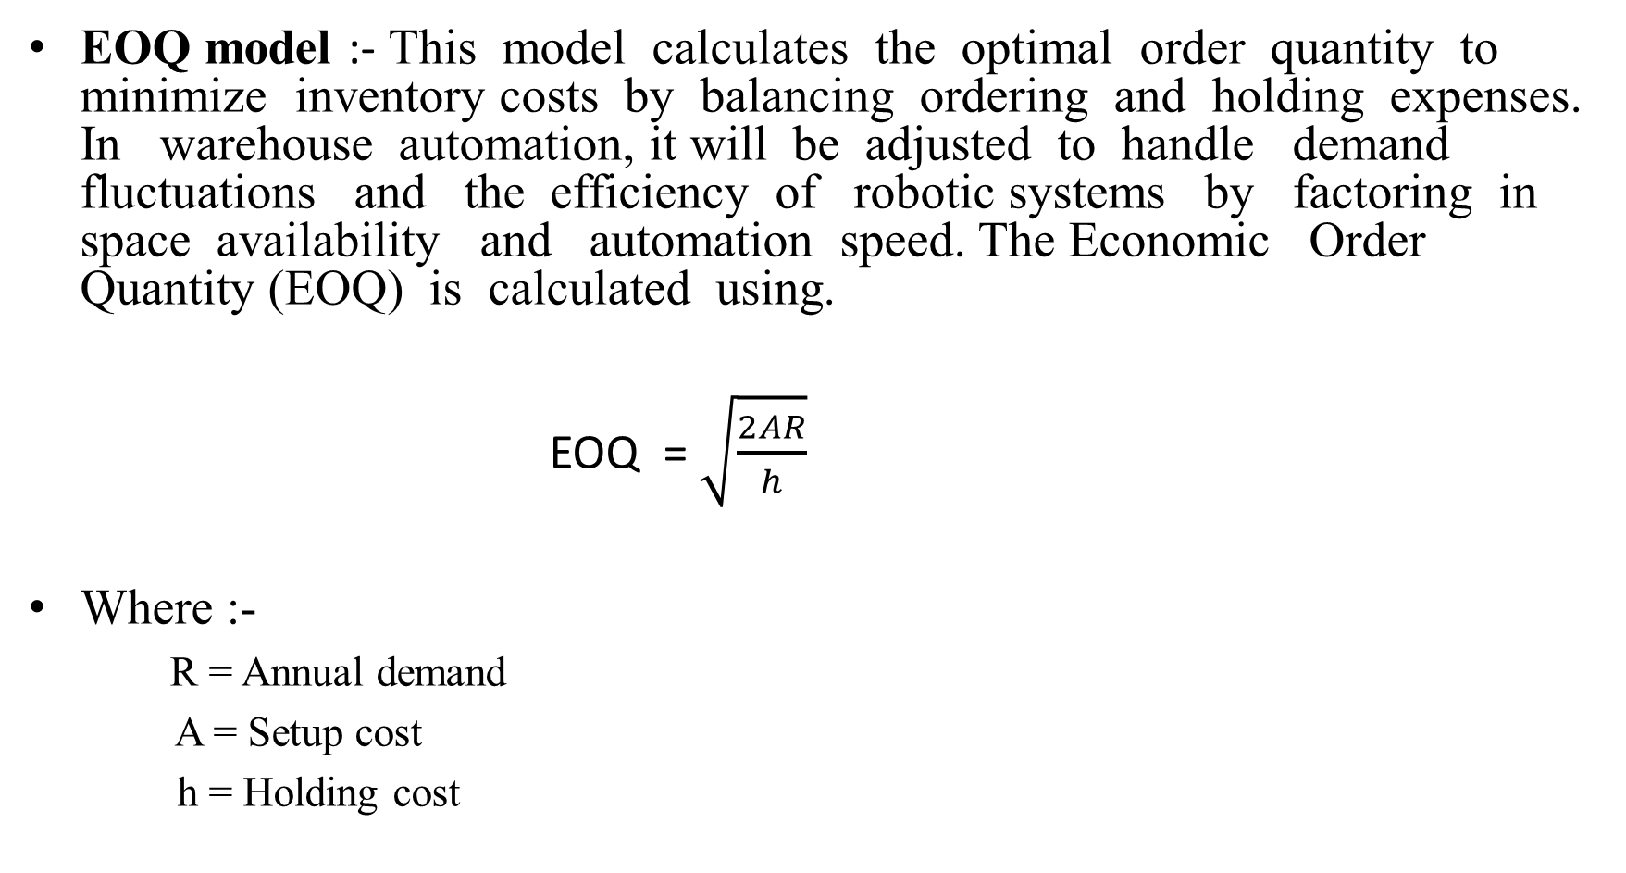
Model development
EOQ model :- This model calculates the optimal order quantity to minimize inventory costs by balancing ordering and holding expenses. In warehouse automation, it will be adjusted to handle demand fluctuations and the efficiency of robotic systems by factoring in space availability and automation speed. The Economic Order Quantity (EOQ) is calculated using.
EOQ = $\sqrt{\frac{2AR}{h}}$
Where :-
R = Annual demand
A = Setup cost
h = Holding cost

Slide 8
Model development
ROP model :- This model determines when new stock should be ordered to prevent inventory shortages. In warehouse automation, it will consider lead times, robotic picking speed, and emergency stock requirements to ensure products are always available, especially during high-demand periods like sales events. This model helps maintain a smooth and efficient inventory flow, reducing delays and ensuring timely order fulfillment. The formula for calculating the ROP is:
ROP = R × LT
Where :-
R = Average demand per unit of time (usually per day or per month)
LT = Lead time (the time it takes for the order to be delivered after placing it, usually in days or months)

Slide 9
Model Adjustment
1. Automation setup model :-
Challenge :-
Some categories might have significantly higher or lower EOQ values due to variations in sales, restock costs, and storage costs. This can lead to understocking or overstocking, affecting the overall efficiency of warehouse operations.
Solution :-
Instead of applying the same 20% extra cost for all products, we can make the adjustment flexible based on each product’s demand and category.
Fast-selling products = A lower cost adjustment to allow frequent restocking.
Slow-selling products = A higher cost adjustment to avoid excess inventory.

Slide 10
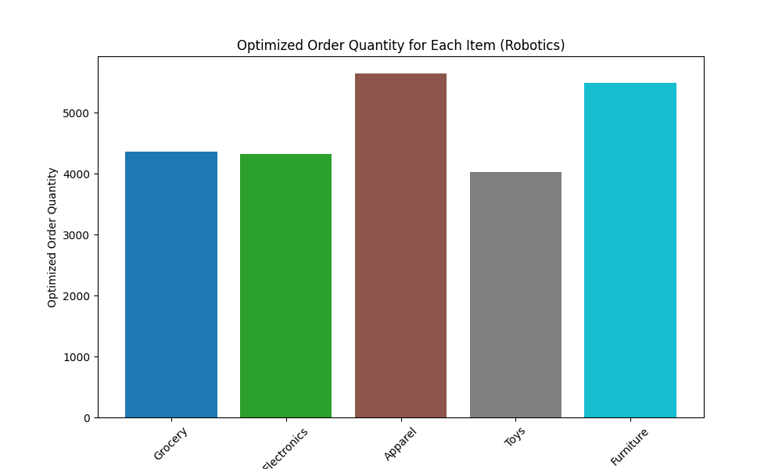

Slide 11
Model Adjustment
2. Automation Maintenance model:-
Challenge :-
When robotics systems undergo maintenance, order processing speed may reduce, affecting overall efficiency.
Solution :-
The EOQ adjustment in the code compensates for maintenance days, ensuring that inventory is pre-stocked. Additionally, staggered maintenance schedules and backup automation systems can minimize disruptions.

Slide 13
Model Adjustment
3. Automation Space-requirement model :-
Challenge:-
Space requirements : Implementing robotics may require changing the design of warehouses. This helps create enough space for machines to move and work efficiently.
Solution :-
The bar chart analysis helps identify product categories that require more space due to automation. By reducing EOQ by 9%-10%, the model ensures optimized inventory storage, allowing better movement for robotic systems. This data-driven approach supports strategic warehouse redesign, improving space utilization while maintaining operational efficiency.

Slide 14
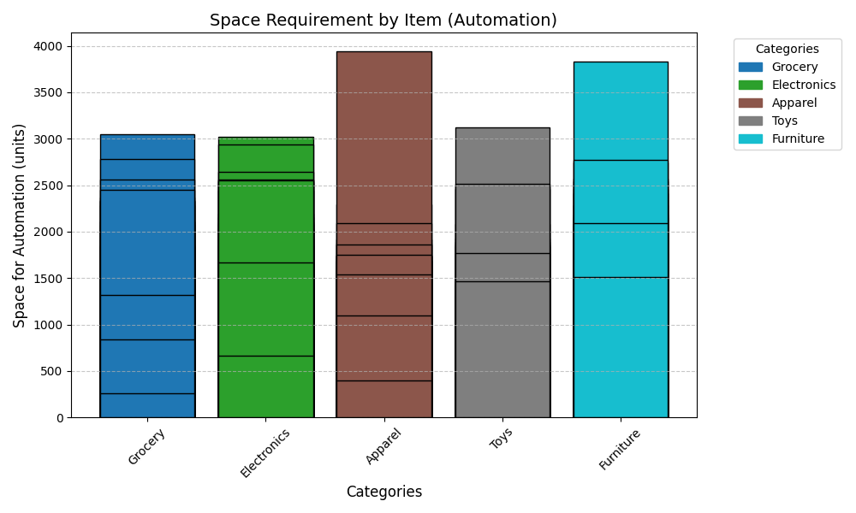

Slide 15
Conclusion
Warehouse inventory automation, like Amazon Robotics, is changing the way products are stored, picked, and shipped. Using robots and smart technology makes the process faster, more accurate, and safer for workers. It helps businesses save money and deliver orders quickly.
There are some challenges, like high costs, maintenance needs, and space adjustments. By using smart planning and flexible systems, these problems can be managed. As technology improves, automation will continue to make warehouses more efficient and reliable, helping businesses grow and serve customers better.

Slide 16
References
Wurman, P. R., D Andrea, R., & Mountz, M. (2008). Coordinating Hundreds of Cooperative, Autonomous Vehicles in Warehouses. AI Magazine.
Gu, J., M., & McGinnis, L. F. (2010). Research on warehouse design and performance evaluation: A comprehensive review. European Journal of Operational Research, 203(3), 539–549.
Resh , C., & Günthner, W. A. (2016). Automation in Intralogistics: Current Developments and Future Trends. Procedia CIRP, 57, 662–667.

