Slide 1
Predicting with MLOps in Cloudera AI
210917
Notes:
Copyright © 2010–2023 Cloudera. All rights reserved. Not to be re-
produced or shared without prior written consent from Cloudera.

Slide 2
Introduction
Notes:
The goal of this chapter is to introduce Cloudera, Cloudera’s products, educational services, and the training environment.

Slide 3
Introduction
Introduction to MLOps
Working with Git
Introduction to CI-CD concepts
Introduction to Docker
Introduction to Kubernetes
Introduction to Cloudera AI
Introduction to CML API
Model Registry
Mlops with Mlflow
Mlops in Cloudera AI
Monitoring ML Systems
Configuring and Managing ML Workspaces
Data Access and Lineage
Data Visualization in Cloudera AI
Introduction to AMPs and the Workbench
Autoscaling, Performance, and GPU Settings

Slide 4
Trademark Information
The names and logos of Apache products mentioned in Cloudera training courses, including those listed below, are trademarks of the Apache Software Foundation
All other product names, logos, and brands cited herein are the property of their respective owners
Apache Accumulo | Apache Hadoop | Apache Kudu | Apache Ranger
Apache Avro | Apache HBase | Apache NiFi | Apache Solr
Apache Airflow | Apache Hive | Apache Oozie | Apache Spark
Apache Atlas | Apache Iceberg | Apache ORC | Apache Sqoop
Apache Bigtop | Apache Impala | Apache Ozone | Apache Tez
Apache Druid | Apache Kafka | Apache Parquet | Apache Zeppelin
Apache Flink | Apache Knox | Apache Phoenix | Apache ZooKeeper
Notes:
This slide is intended to clearly convey to students that, while we may sometimes refer to products like Hadoop, Hive, and Impala later in the course, these are simply shorthand for the longer and more formal names. Apache Hadoop, as well as many related software projects that Cloudera helps to develop and distribute, is owned by the Apache Software Foundation (ASF). The slide is not intended to introduce these products; that will be done later, if needed.
Throughout its history, Cloudera has been strongly committed to a community-driven, Hadoop-based platform based on open standards that meets the highest enterprise expectations for stability and reliability. Cloudera’s Chief Architect, Doug Cutting, served as Director of the ASF for more than five years. He has been an Apache committer for more than 15 years, serving alongside dozens of other Clouderans who also help to work on many of the open source projects. In fact, Cloudera employees have founded more than 20 successful Hadoop ecosystem projects, including Apache Hadoop itself. Cloudera is a Platinum-level sponsor of the ASF. http://apache.org/foundation/thanks.html.
Additionally, course material may make occasional and incidental references to other product names covered by trademark, such as commercial software from partner companies or brand names for hardware on which one might deploy a cluster. Reference to any products, services, processes or other information, by trade name, trademark, manufacturer, supplier, or otherwise does not necessarily constitute or imply endorsement, sponsorship, or recommendation by Cloudera.

Slide 5
Introduction
About This Course
Introductions
About Cloudera
About Cloudera Educational Services
Course Logistics

Slide 6
Course Objectives
During this course, you will learn
Get hands-on experience with essential tools like Git for version control and GitHub Actions for building CI/CD pipelines
Dive into Docker to learn how to containerize applications and manage Docker images and containers effectively.
Understand Kubernetes for container orchestration, including practical deployment.
Gain a deep understanding of the MLOps lifecycle, from model development to production deployment.
Explore the CML platform to manage machine learning projects, including how to navigate the CML environment and handle different workflows.
Integrate MLFlow for effective experiment tracking, model versioning, and reproducibility, ensuring that your models are governed and maintained efficiently.
Get practical experience in managing and registering models using CML’s API, enabling seamless interaction with the platform.
Notes:
Establish your credibility and enthusiasm here. You’ll likely want to mention your experience as an instructor, plus any relevant experience as a developer, system administrator, DBA, or business analyst. If you can relate this to the audience (because you’re from the area or have worked in the same industry), all the better.
This is also an opportunity to get to know the students, so you can tailor your explanations and analogies to the experience that they already have. It’s a good idea to draw out a grid corresponding to the seat layout and write students’ names down as they introduce themselves, allowing you to remember someone’s name a few days later based on where they’re sitting.
The next section will be "About Cloudera," and the background notes begin here, and continue on the "About Cloudera" slide. Google, at the turn of the millennium, realized that their vision of leveraging planet-scale search data couldn’t be completed with the available technologies. Rejecting expensive enterprise-class servers, they chose large numbers of industry-standard hardware instead. They got more cheap servers for the same price as a few expensive servers. But cheap servers fail more frequently—thus the importance of handling failures in software. Google also rejected standard database technologies, because they don’t scale to the extent of need they projected. Google created their own technologies: The Google file system (GFS), a distributed map-reduce implementation, and later Big Table.
Around the time that Google published papers on GFS and MapReduce, a software engineer named Doug Cutting was working to improve the scalability of an open source tool (Apache Nutch) used to crawl web pages in order to index their content. Inspired by Google’s papers, he created a distributed filesystem and map-reduce implementation that ultimately led to the Apache Hadoop project. (See this history of Hadoop for more.)

Slide 7
Course Objectives (2)
Understand the complete MLOps workflow in CDP, covering everything from data ingestion and exploration to model training and deployment.
Explore hands-on labs focused on setting up model monitoring, managing API integrations, and registering models for continuous operation.
Delve into continuous model monitoring using tools like Evidently AI, ensuring that you can track model performance, detect data drift, and maintain the health of your machine learning systems over time.
Learn how to configure and manage ML workspaces in CML, including how to set up auto-scaling, provision workspaces, and monitor environments using Grafana dashboards.
Notes:
Establish your credibility and enthusiasm here. You’ll likely want to mention your experience as an instructor, plus any relevant experience as a developer, system administrator, DBA, or business analyst. If you can relate this to the audience (because you’re from the area or have worked in the same industry), all the better.
This is also an opportunity to get to know the students, so you can tailor your explanations and analogies to the experience that they already have. It’s a good idea to draw out a grid corresponding to the seat layout and write students’ names down as they introduce themselves, allowing you to remember someone’s name a few days later based on where they’re sitting.
The next section will be "About Cloudera," and the background notes begin here, and continue on the "About Cloudera" slide. Google, at the turn of the millennium, realized that their vision of leveraging planet-scale search data couldn’t be completed with the available technologies. Rejecting expensive enterprise-class servers, they chose large numbers of industry-standard hardware instead. They got more cheap servers for the same price as a few expensive servers. But cheap servers fail more frequently—thus the importance of handling failures in software. Google also rejected standard database technologies, because they don’t scale to the extent of need they projected. Google created their own technologies: The Google file system (GFS), a distributed map-reduce implementation, and later Big Table.
Around the time that Google published papers on GFS and MapReduce, a software engineer named Doug Cutting was working to improve the scalability of an open source tool (Apache Nutch) used to crawl web pages in order to index their content. Inspired by Google’s papers, he created a distributed filesystem and map-reduce implementation that ultimately led to the Apache Hadoop project. (See this history of Hadoop for more.)

Slide 8
Introduction
About This Course
Introductions
About Cloudera
About Cloudera Educational Services
Course Logistics

Slide 9
Course Objectives
About your instructor
About you
Currently, what do you do at your workplace?
What is your experience with database technologies, programming, and query languages?
How much experience do you have with UNIX or Linux?
What is your experience with big data?
What do you expect to gain from this course? What would you like to be able to do at the end that you cannot do now?
Notes:
Establish your credibility and enthusiasm here. You’ll likely want to mention your experience as an instructor, plus any relevant experience as a developer, system administrator, DBA, or business analyst. If you can relate this to the audience (because you’re from the area or have worked in the same industry), all the better.
This is also an opportunity to get to know the students, so you can tailor your explanations and analogies to the experience that they already have. It’s a good idea to draw out a grid corresponding to the seat layout and write students’ names down as they introduce themselves, allowing you to remember someone’s name a few days later based on where they’re sitting.
The next section will be "About Cloudera," and the background notes begin here, and continue on the "About Cloudera" slide. Google, at the turn of the millennium, realized that their vision of leveraging planet-scale search data couldn’t be completed with the available technologies. Rejecting expensive enterprise-class servers, they chose large numbers of industry-standard hardware instead. They got more cheap servers for the same price as a few expensive servers. But cheap servers fail more frequently—thus the importance of handling failures in software. Google also rejected standard database technologies, because they don’t scale to the extent of need they projected. Google created their own technologies: The Google file system (GFS), a distributed map-reduce implementation, and later Big Table.
Around the time that Google published papers on GFS and MapReduce, a software engineer named Doug Cutting was working to improve the scalability of an open source tool (Apache Nutch) used to crawl web pages in order to index their content. Inspired by Google’s papers, he created a distributed filesystem and map-reduce implementation that ultimately led to the Apache Hadoop project. (See this history of Hadoop for more.)

Slide 10
Introduction
About This Course
Introductions
About Cloudera
About Cloudera Educational Services
Course Logistics

Slide 11
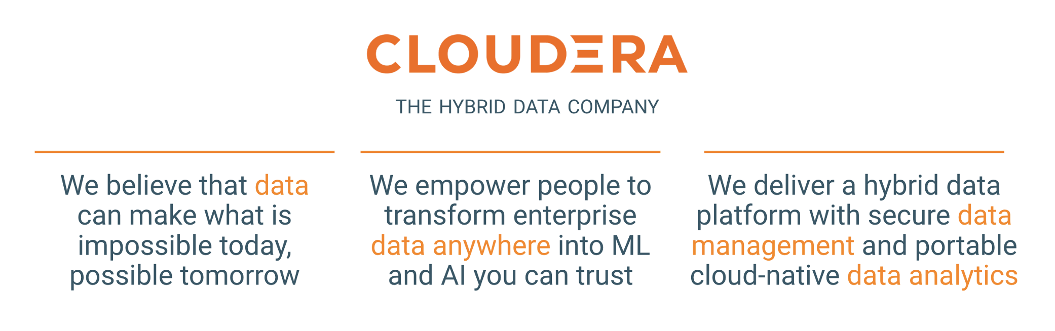
About Cloudera
Notes:
We help with a hybrid data cloud platform with an integrated suite of secure cloud-native data services to make it easier to manage and secure the entire data lifecycle – from ingest to experimentation, Edge to AI – in any cloud or data center ----- a hybrid data cloud for your company…
Our WHY is that we genuinely believe that data can make things previously deemed impossible, possible. Today, we talk to our smartphones and other devices and they talk back - providing real-time insights into everything from sports scores to understanding gene sequencing. Cloudera powers that capability for the largest smartphone maker in the world.
Our HOW is that we EMPOWER PEOPLE in organizations to build these powerful data apps. So we don’t make these apps ourselves, our customers do. And our customers include the world’s top banks, telecommunications companies and healthcare providers. So next time your credit card company sends you a fraud alert for a potential misuse of your card in real time - You’re Welcome. It’s likely that Cloudera helped provide the technology that made that data app possible.
And lastly, WHAT we provide our customers is a Hybrid Data Platform and an integrated suite of Data Services that make all of this data magic possible on any cloud!

Slide 12

Future Data Ecosystem
“The future data ecosystem should leverage distributed data management components — which may run on multiple clouds and/or on-premises — but are treated as a cohesive whole with a high degree of automation. Integration, metadata and governance capabilities glue the individual components together.”
Strategic Roadmap for Migrating Data Management to the Cloud Published 21 March 2022 - ID G00746011, Analyst(s): Robert Thanaraj, Adam Ronthal, Donald Feinberg
Notes:
The industry and the analysts agree… the future data ecosystem is a hybrid one….. Multi-cloud and on-premises… but with common security governance and control plane. Make no mistake… Cloudera is the only company currently positioned to deliver this hybrid data platform.

Slide 13
A More Specific Definition of Hybrid
Hybrid = Freedom to move existing and future applications, data, and users bi-directionally between the data center and multiple public clouds
Applications include streams, pipelines, workloads, workspaces, and other data products
Data considerations include formats, policies, metadata, replication etc.
Users need to leverage existing skills and processes, while continuously modernizing
Notes:
A definition from Cloud Standards Customer Council ISO17788.
Long version: “a cloud deployment model using at least two different cloud deployment models” where the deployment models can be IaaS, PaaS, SaaS, and/or XaaS and the deployments involved remain unique entities but are bound together by appropriate technology that enables interoperability, data portability and application portability.
Shorter version: using at least two different cloud deployments where the deployments remain unique entities but enable interoperability, data portability and application portability

Slide 14
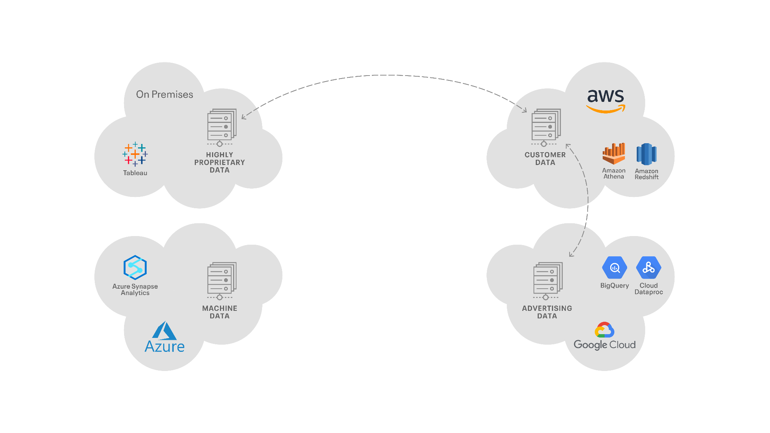
Cloudera’s Hybrid Platform
Portable – Interoperable – Open – Secure

Slide 15
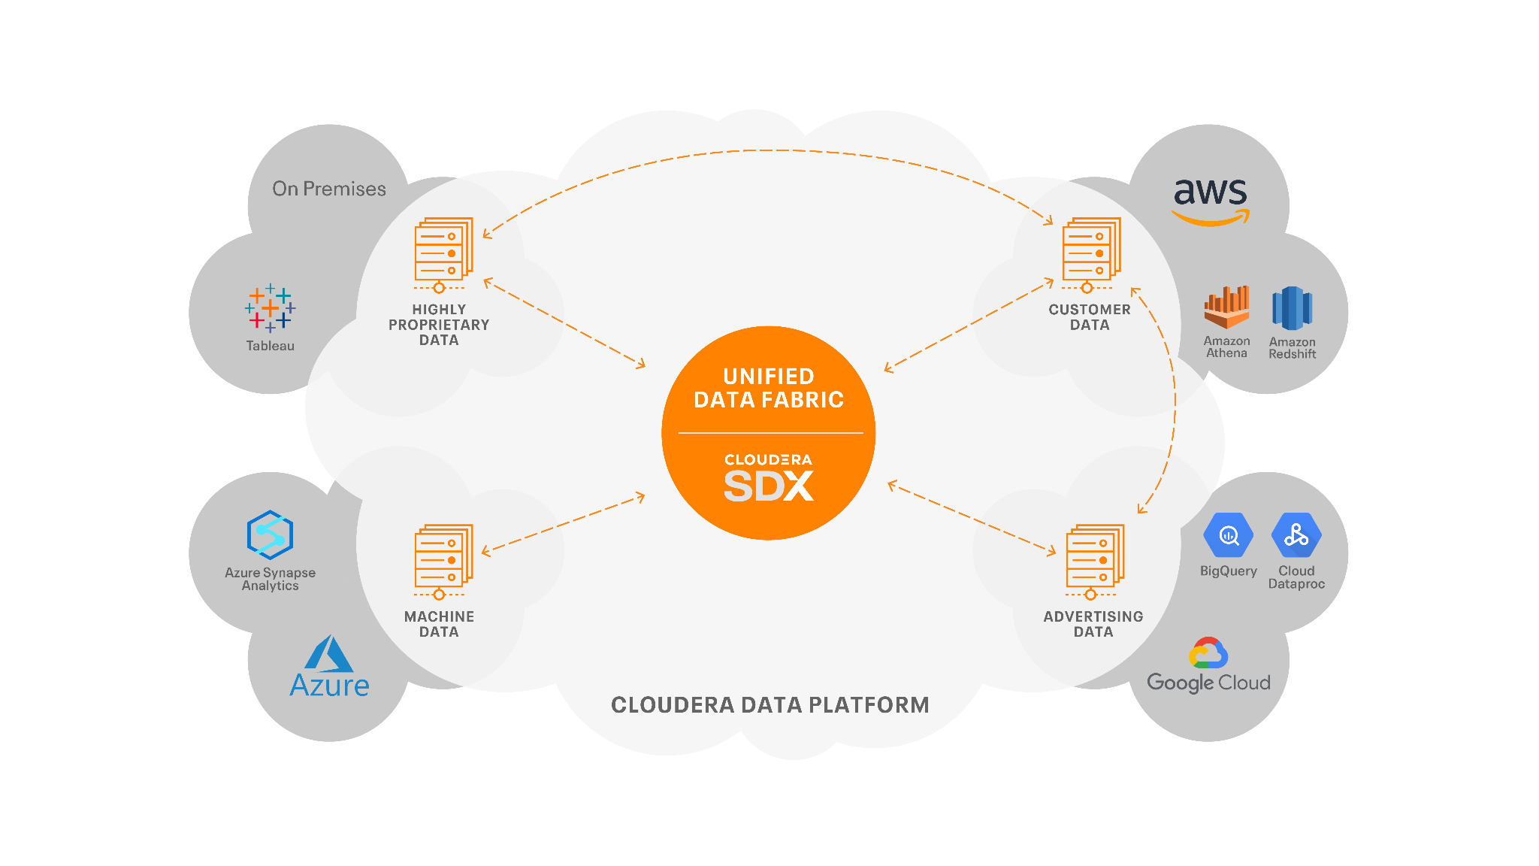
Cloudera’s Hybrid Platform (2)
Portable – Interoperable – Open – Secure

Slide 16
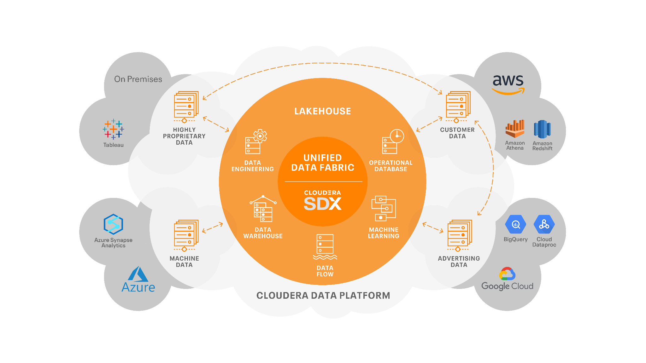
Cloudera’s Hybrid Platform (3)
Portable – Interoperable – Open – Secure

Slide 17
Cloudera Hybrid Platform – Enabling Data Fabric
Forrester’s Definition
A Data Fabric orchestrates disparate data sources intelligently and securely in a self-service manner, leveraging data platforms such as data lakes, data warehouses, NoSQL, translytical, and others to deliver a unified, trusted, and comprehensive view of customer and business data across the enterprise to support applications and insights.
Notes:
The term “translytical” is quite a new term in the IT industry and can be defined as a single data platform that can support workloads that are diverse including transactional, operational, and analytical information in real-time. Translytical data platforms integrate in-memory tools to support SSD, flash, and DRAM.

Slide 18
Cloudera Hybrid Platform – Enabling Data Fabric (2)
Forrester’s Definition
1
6
Global distributed platform, in-memory, embedded, self-service, APIs
Global data access
AI/ML
Data management
Metadata/catalog
Data security
Data governance
Data processing
Data quality
Data lineage
Policies
5
Data modeling, preparation, curation, graph engine
Data discovery
AI/ML
4
Transformation, integration, cleansing
Data orchestration
AI/ML
3
Hadoop NoSQL Spark
Data platform —processing
Data lake EDW/BDW
Data processing and persistence
AI/ML
2
Ingestion, streaming, data movement
Data ingestion and streaming
AI/ML
AI/ML
Cloud
Data sources
On-premises
Notes:
By Definition:
It Orchestrates disparate data sources intelligently and securely in a self-service manner,
leveraging data platforms such as data lakes, datawarehouses, NoSQL, translytical, and others
to deliver a unified, trusted,and comprehensive view of customer and business data across the enterprise to support applications and insights.

Slide 19
Cloudera Hybrid Platform – Enabling Data Lakehouse
Gartner’s Definition
Data lakehouses integrate and unify the capabilities of data
warehouses and data lakes, aiming to support AI, BI, ML and data
engineering (“multifunction analytics”) on a single platform.

Slide 20
The “Lakehouse” – Best of Both Worlds
When ALL data needs to come together to answer critical business challenges
DATA WAREHOUSE
HIGHLY CURATED
PRECISE
COMPLETE
WELL GOVERNED
LAKEHOUSE
EXPLORE AND DISCOVER
TRENDS AND STATISTICS
PREDICT AND LEARN
RAPID TIME TO INSIGHT
DATA LAKE
VARYING CURATION
DEGREES OF ACCURACY
SEMI, UNSTRUCTURED
HIGH GRANULARITY
Notes:
This diagram illustrates the evolution and relationship between three data storage concepts: Data Warehouse, Data Lake, and Lakehouse, and their roles in addressing business challenges.
1. Data Warehouse:
Description: Traditional structured data storage optimized for analytics and reporting.
Characteristics:
Highly curated: Data is cleaned and organized.
Precise: High accuracy and consistency.
Complete: Contains only business-critical data.
Well-governed: Strict management and policies to ensure data security and compliance.
Use Case: Ideal for generating standardized reports and conducting structured analysis.
2. Lakehouse (Middle section):
Description: A unified data architecture that combines the best of both Data Lakes and Data Warehouses.
Characteristics:
Supports exploration and discovery of data trends and statistics.
Allows predictive analysis and machine learning.
Provides rapid insights due to its flexible and scalable nature.
Use Case: Serves organizations looking to perform advanced analytics while maintaining governance and control.
3. Data Lake:
Description: A vast storage repository for raw, unstructured, and semi-structured data.
Characteristics:
Varying curation: Not all data is processed or cleaned.
Degrees of accuracy: Data might not be standardized.
Semi-structured or unstructured: Includes files like videos, images, and logs.
High granularity: Stores raw, detailed data without summarization.
Use Case: Suitable for storing large amounts of diverse data for data scientists and engineers to process later.
Key Insights:
Integration: The Lakehouse acts as a bridge between the highly structured Data Warehouse and the flexible Data Lake.
Purpose: By combining these paradigms, businesses can:
Manage structured and unstructured data efficiently.
Enable both operational reporting and exploratory analysis.
Drive better decision-making by integrating all types of data sources.

Slide 21
Cloudera Hybrid Platform – Enabling Data Mesh
Data as a Product
Distributed data products oriented around domains and owned by independent cross-functional teams who have embedded data engineers and data product owners, using common data infrastructure as a platform to host, prep and serve their data assets.
Notes:
Here is what the Gartner says:
A data fabric is a technology-enabled implementation capable of many outputs, only one of which is data products.
A data mesh is a solution architecture for the specific goal of building business-focused data products.

Slide 22







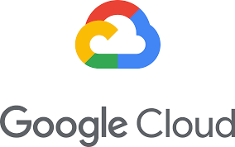
Cloudera Hybrid Platform – Enabling Data Mesh (2)
METADATA | SECURITY | | CONTROL | GOVERNANCEENCRYPTION
Domain B
Domain C
Sales Order Domain owned by revenue team
User Shopping History served as a product
CDP
CDP
Domain A
Domain D
Recommendation/ Personalization Data Domain served for downstream users
CDP
CDP
Customer Data owned by the CRM team
Notes:
This diagram illustrates how the Cloudera Hybrid Platform enables a Data Mesh architecture across multiple domains using the principles of governance, security, and metadata management.
Key Elements:
Cloudera SDX (Shared Data Experience):
Provides a unified layer for Metadata, Security, Control, Governance, and Encryption across domains.
Ensures consistent data policies, data lineage, and access control across the platform.
Domains (A, B, C, D):
Represent decentralized, domain-specific data ownership aligned with the Data Mesh paradigm.
Each domain is a logical unit owning specific data and governed by a specific team.
Domains in Detail:
Domain A (Yellow):
Purpose: Stores and manages Customer Data.
Ownership: Managed by the CRM team.
Characteristics: Acts as the foundational domain for customer-related data.
Domain B (Purple):
Purpose: Manages the Sales Order Domain.
Ownership: Owned by the Revenue team.
Characteristics: Focuses on transactional and order data that may be consumed by other domains.
Domain C (Blue):
Purpose: Hosts User Shopping History.
Ownership: Treated as a Data Product to be consumed by other domains or external users.
Characteristics: Provides insights into user behavior and shopping patterns.
Domain D (Green):
Purpose: Focuses on Recommendation/Personalization Data.
Ownership: Provides downstream data products for personalized user experiences.
Characteristics: Uses data from other domains (e.g., customer data, shopping history) to build advanced recommendation systems.
Cloud Infrastructure:
The hybrid platform operates across multiple cloud providers:
Red Hat OpenShift: Provides container orchestration and hybrid deployment capabilities.
AWS, Azure, Google Cloud: Multi-cloud support to manage workloads and storage efficiently.
Key Points of Interaction:
Data Sharing:
Domains are interconnected via shared data products, enabling cross-domain collaboration.
For example:
Domain A (Customer Data) shares curated data with Domain C (User Shopping History).
Domain C provides its shopping history data to Domain D for recommendations.
Data Ownership and Decentralization:
Each domain is independently governed, adhering to the Data Mesh principle of domain-oriented decentralization.
Governance and Security:
Cloudera SDX ensures:
Unified security policies across domains.
Governance frameworks for compliance.
Data encryption to protect sensitive information.
Purpose of the Diagram:
To showcase how the Cloudera Hybrid Platform facilitates a Data Mesh architecture by decentralizing data ownership while maintaining centralized governance and security. This approach enhances scalability, enables data as a product, and fosters collaboration across teams and domains.

Slide 23
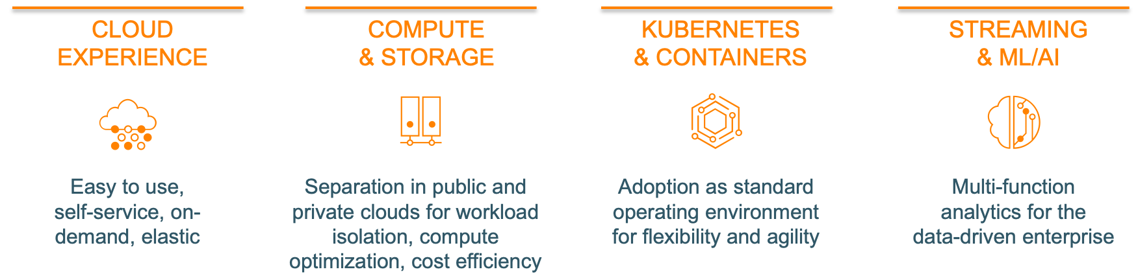
Trends in Architecture and Technology
Cloud experience that is simple, flexible, on-demand
Separation of compute and storage for optimized deployments and cost savings
Kubernetes with containers for flexibility and efficiency
Analytics with real-time streaming, machine learning (ML), and artificial intelligence (AI)
Notes:
Some of the significant trends in architecture and technology include use of the cloud that is easy, self-service, on-demand, and elastic; compute and storage that are separate, allowing workload isolation, optimized deployments, and cost efficiency; the use of Kubernetes and containers for flexibility and agility; and analytics with real-time streaming, machine learning, and artificial intelligence for the data-driven enterprise.

Slide 24
Introduction
About This Course
Introductions
About Cloudera
About Cloudera Educational Services
Course Logistics

Slide 25
Cloudera Educational Services
We offer a variety of ways to take our courses
Instructor-led, both in physical and virtual classrooms
Private and customized courses also available
Self-paced, through Cloudera OnDemand
Courses for all kinds of data professionals
Executives and managers
Data scientists and machine learning specialists
Data analysts
Developers and data engineers
System administrators
Security professionals
Notes:
You can see a list of customers that we can reference on our website https://www.cloudera.com/about/customers.html. Note that Cloudera also has many
customers who do not wish us to refer to them, and it is essential that we honor this. The only exception to this important rule is that you may refer to something that was intentionally made available to the public in which Cloudera or that customer has disclosed that they are a Cloudera customer. For example, it is permissible to mention an article in a reputable trade publication in which Cloudera’s CEO mentions a specific customer or the keynote address that the customer’s CTO gave at the Strata conference talking about the benefits they’ve experienced as a Cloudera customer.

Slide 26


Cloudera Education Catalog
A broad portfolio across multiple platforms
Not all courses shown here
See our website for the complete catalog
Administrator
Administrator
Administrator Private Cloud Base
Administrator CDP Public Cloud
Security Administration
Upgrading
HDP/CDH to CDP
Data Steward
Data Governance
Data Analyst
Analyst Hive/Impala
CDP Data Visualization
Developer Data Engineer
Spark Development
Spark Performance Tuning
NiFi Flow Management
Kafka/Stream Processing
Architecture
HBase
Flink
Data Scientist
CDSW
Data Science
CML
General
OnDemand Library CDP|CDF
“CDP” Essentials, AWS Fundamentals
“Just Enough” Python, GIT, Scala
Live OnDemand
Tech Overviews
Notes:
Note that the course “titles” here are not their true, full titles. The intent of this slide is to give a quick view of the breadth of courses in our catalog, not to go over each one. These short titles are meant to convey the content of the courses, in limited space, rather than provide a full reference for students to follow.
Feel free to emphasize any courses that could be of particular interest to your students. You also might use the link to show the full course catalog, as we may have added new courses since this was produced.

Slide 27
Cloudera OnDemand
Our OnDemand catalog includes
Courses for developers, data analysts, administrators, and data scientists
Exclusive OnDemand-only courses, such as those covering CDP Public Cloud Administration and Cloudera Data Science Workbench
Free courses
Features include
Video lectures and demonstrations
Hands-on exercises through a browser-based virtual environment
Purchase access to a library of courses or individual courses
Full OnDemand Library subscription

Slide 28
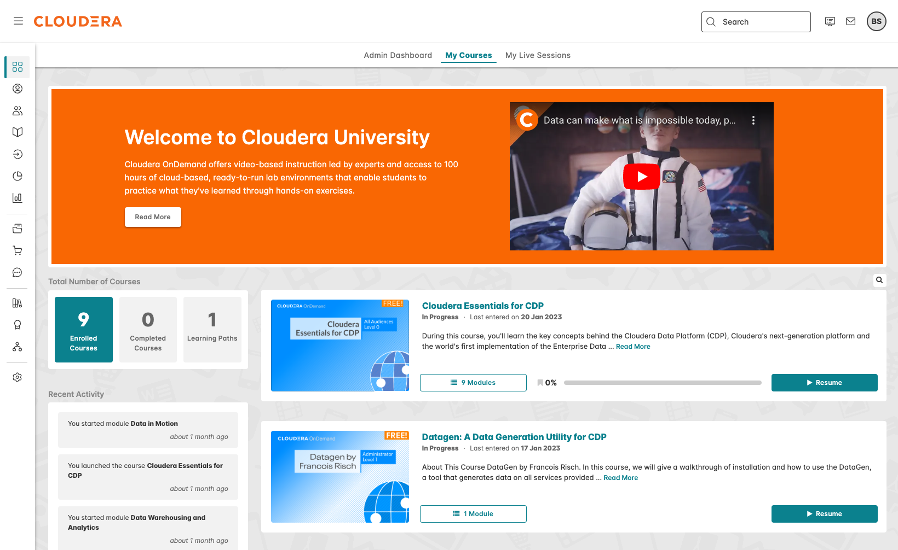
Accessing Cloudera OnDemand
Cloudera OnDemand subscribers can access their courses online through a web browser

Slide 29
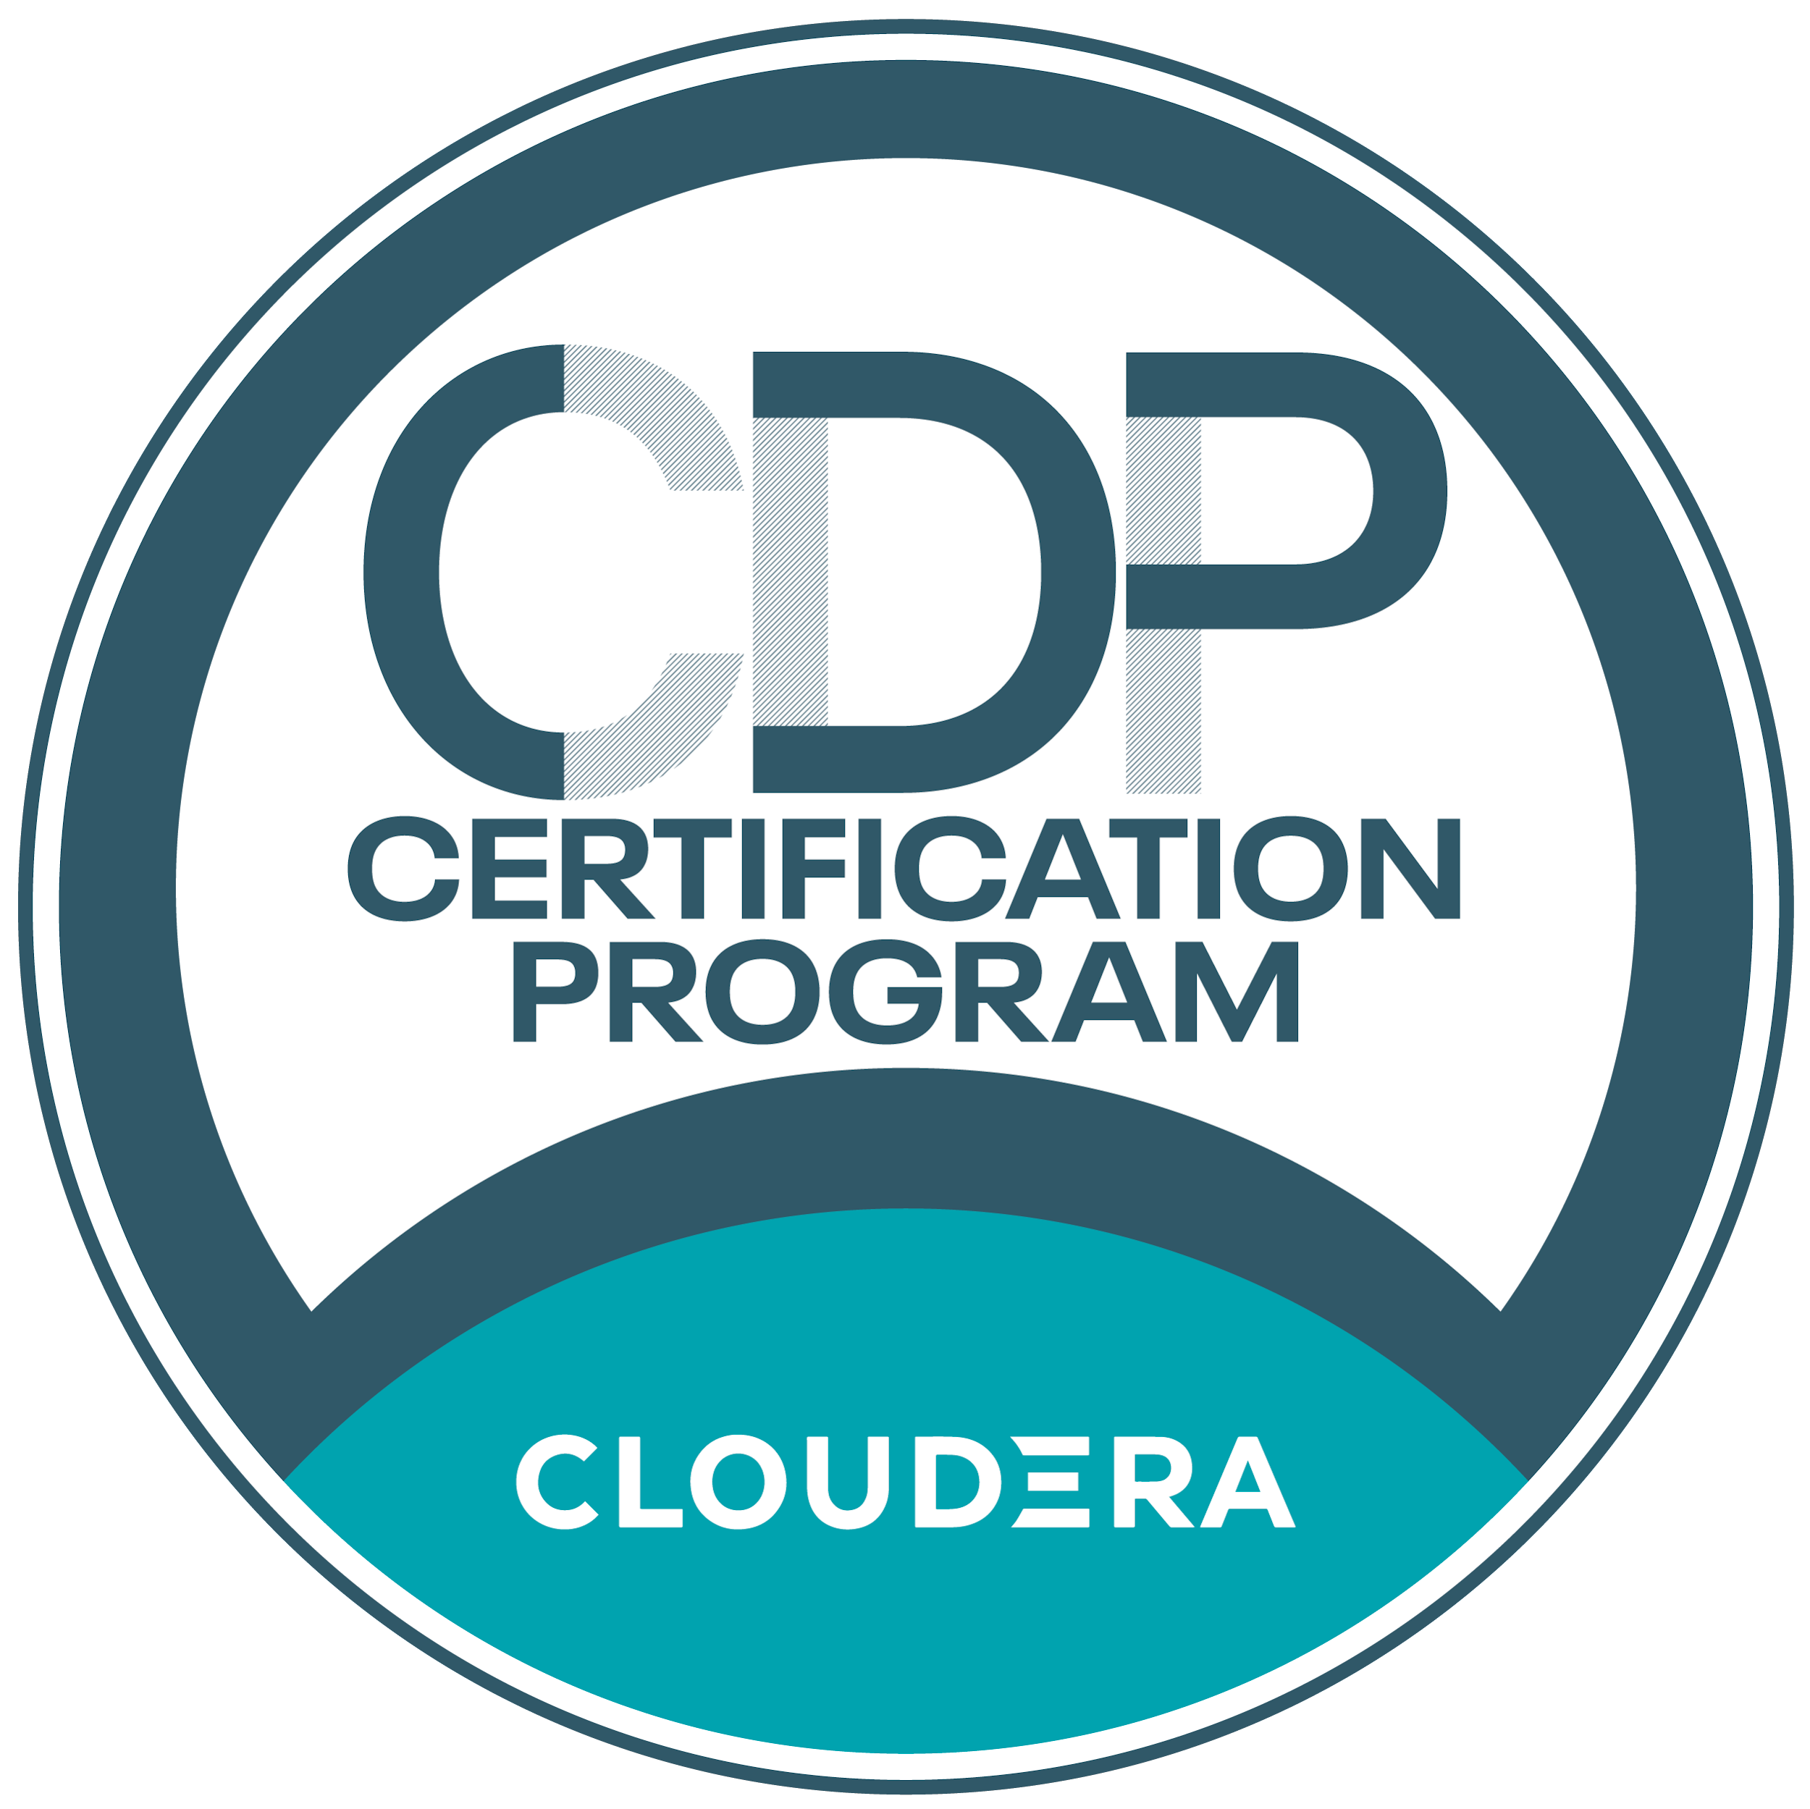
CDP Certification Program
New role-based certifications
Cloudera Certified Generalist
Cloudera Certified Administrator
Private Cloud Base
Public Cloud
Cloudera Certified Data Engineer
Cloudera Certified Analyst
Cloudera Certified Machine Learning Engineer
Cloudera Data Operator
Convenient online, proctored exams
Digital badges
https://www.cloudera.com/services-and-support/training/certification.html
Notes:
A CCA (Cloudera Certified Associate) exam is our entry level exam. To achieve CCA certification, candidates complete a set of core tasks on a working cluster instead of answering multiple-choice questions. Each exam maps to a Cloudera course:
• CCA Spark and Hadoop Developer (CCA175) → Developer Training for Spark and Hadoop
• CCA HDP Administrator (CCA121)→ Cloudera HDP Administrator Training
• CCA CDH Administrator (CCA131)→ Cloudera Administrator Training
• CCA Data Analyst (CCA159) → Data Analyst Training
We also have a CCP (Cloudera Certified Professional) exam.
• CCP Data Engineer (DE575)

Slide 30
Introduction
About This Course
Introductions
About Cloudera
About Cloudera Educational Services
Course Logistics

Slide 31
Logistics
Class start and finish time
Lunch
Breaks
Restrooms
Wi-Fi access
Notes:
“Virtual machines” is a cue for the instructor to explain briefly how to perform hands-on exercises in this class; for example, whether that is through virtual machines running locally or in the cloud. This is also a good time to verify that the virtual machines are already running, and to start them if they are not.

Slide 32
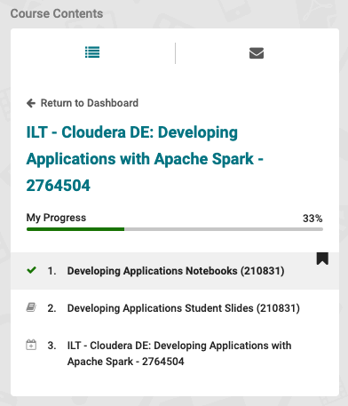
Downloading the Course Materials
Log in using https://education.cloudera.com/
Click Sign In on the top right
If necessary, create an account
If you have forgotten your password, use the Forgot your password link
Locate the course
Find the course in your list of enrollments, or enter the course title in the search bar
Click on the course title
Access the materials
Click on Content across the top
Click on the module to view or download the contents
If there is more than one module, use the Course Contents panel on the left to navigate
Notes:
Emphasize that students must, at the very least, download the exercise instructions.

Slide 33
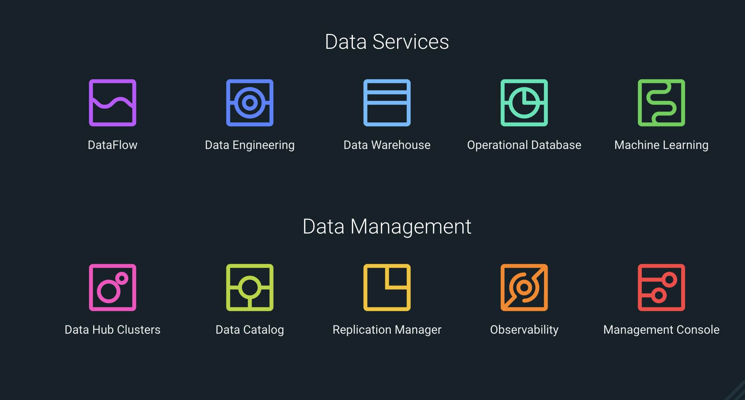
Exercise Environment Overview
Notes:
Be sure to mention the following:
• Which students are assigned to which UserIDs
• When the environment will be online
• When the environment will be permanently destroyed

