Slide 1
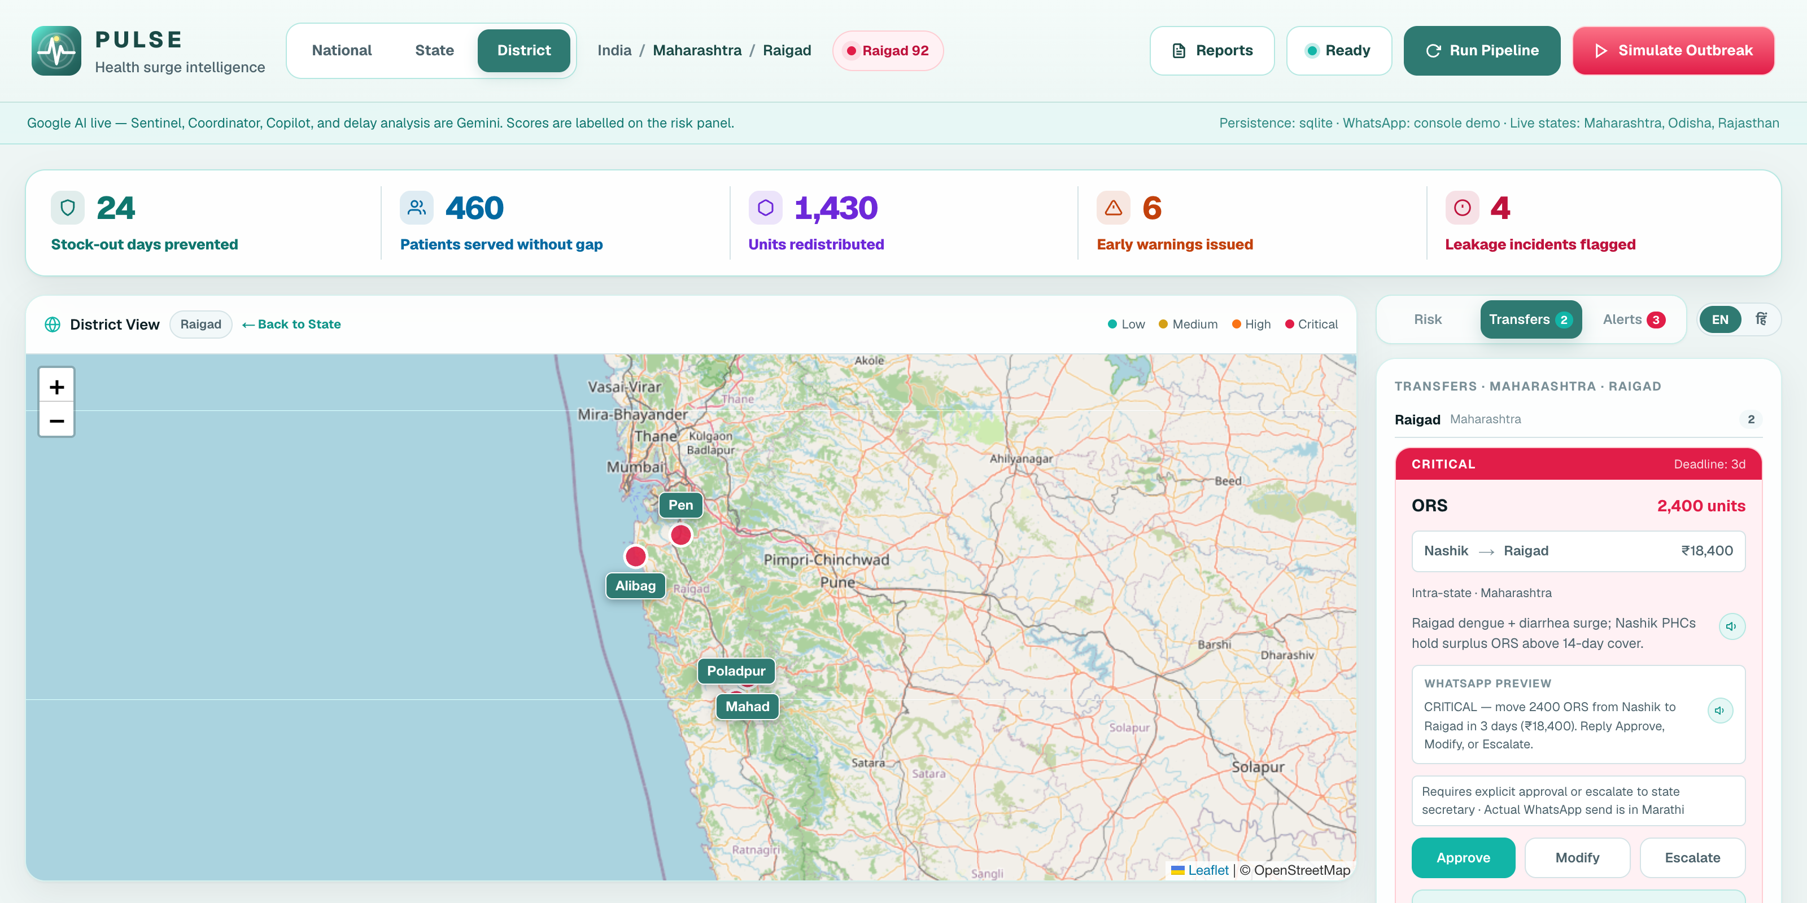
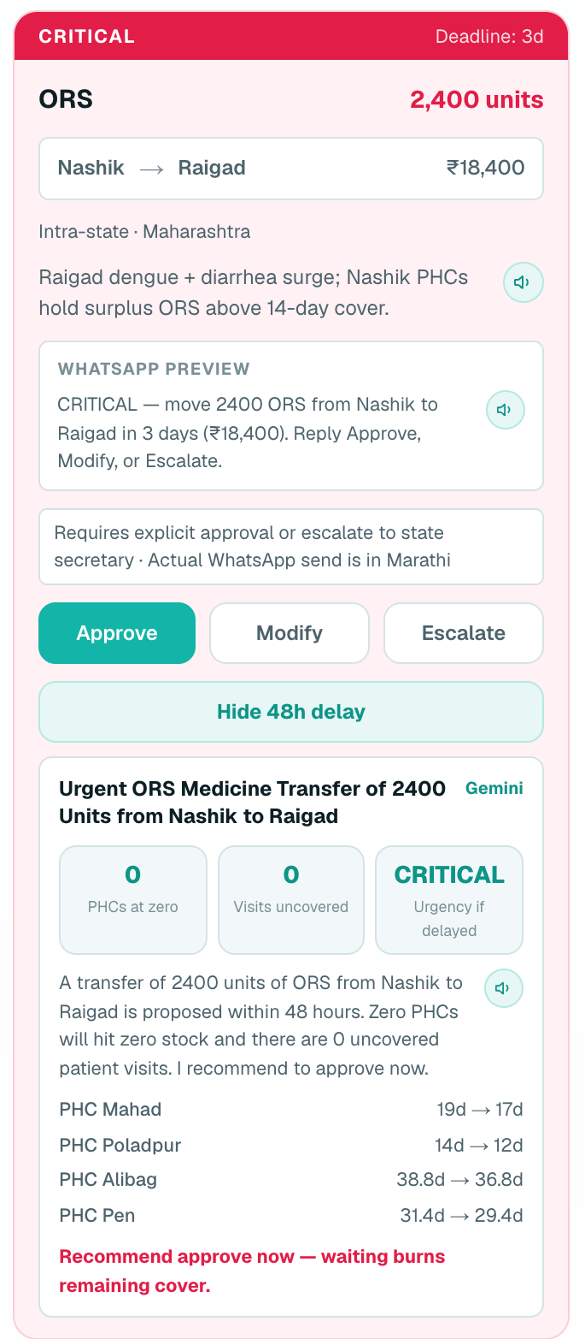
PULSE
Health surge intelligence
CODE FOR COMMUNITY · TRACK 03 · SMART HEALTH & SUPPLY CHAIN
Predict the surge.
Move the medicine.
Before the shelf is empty.
Predictive Unified Health Surge Engine — an AI command centre for India's Primary Health Centres that forecasts district outbreaks, plans the stock transfer, and alerts the CMO on WhatsApp in their own language.
● LIVE ON GEMINI
PRESENTED BY
Live pulse-web-ahao.onrender.com
Code github.com/parthgoyal15/PULSE
AICoders

Slide 2
02 THE PROBLEM
The shelf empties before the alert arrives
Rural India's PHCs usually learn about a surge when patients are already being turned away.
~25,000
4
Next door
Primary Health Centres
signals, 4 silos
is where the surplus sits
The first — and often only — point of care for rural India.
Rainfall, symptom searches, IDSP case counts and PHC stock never meet on one screen.
A neighbouring district often holds the ORS or antimalarials the hotspot is missing.
WHAT BREAKS TODAY
Late detection
Stranded surplus
English-first alerts
Silent leakage
Stock-outs are found at the counter, not forecast.
No quick way to match a donor district to a hotspot.
CMOs and ASHAs live on WhatsApp, in Marathi, Odia, Hindi.
Dispensing far above footfall looks like a busy OPD.
PULSE · AICoders · Code for Community — Track 03
02 / 12

Slide 3
03 THE SOLUTION
PULSE closes the loop: signal to shelf
Five AI agents turn scattered signals into a medicine transfer a CMO can approve in one tap.
1
2
3
4
5
Sense
Score
Plan
Alert
Act
Rainfall, symptom search trends, IDSP-style case counts, PHC stock
Sentinel rates every district 0–100 with days-to-surge
Coordinator picks an intra-state donor, quantity, cost and deadline
Reporter writes the CMO's WhatsApp in Marathi, Odia or Hindi
Approve → donor PHCs drain, receivers fill, impact KPIs update
AND AROUND THE LOOP
CMO Copilot
48h cost-of-delay
Leakage detection
Weekly & post-incident reports
2019 backtesting
English / हिंदी + read-aloud
Map: India → state → district → PHC
PULSE · AICoders · Code for Community — Track 03
03 / 12

Slide 4
04 THE PRODUCT
One screen. One decision. Stock moves.
Live on the public demo — Raigad district, Maharashtra, on a dengue + diarrhoea surge.
1
Live impact KPIs
Stock-out days prevented, patients served, units moved, warnings, leakage.
1
2
Drill-down map
India → state → district → PHC pins, coloured by Sentinel risk.
3
2
3
Transfer plan
Nashik → Raigad · 2,400 ORS · ₹18,400 · deadline 3 days.
4
One-tap decision
4
Approve, Modify or Escalate — with the WhatsApp preview; the real send is in Marathi.
On Approve donor PHCs drain highest-stock first, receivers fill lowest-stock first — a real inventory change, not a toast.
PULSE · AICoders · Code for Community — Track 03
04 / 12

Slide 5
05 AI APPROACH
Gemini reasons. Code counts.
Five narrow agents on Google Gemini — with arithmetic kept in code and every output labelled.
Sentinel
Fuses 4 signals into a district risk score, level and days-to-surge
Grounded
Copilot sees only the live board. It cannot invent a PHC or a transfer ID.
Coordinator
Builds the transfer: donor, medicine, quantity, cost, urgency
Deterministic numbers
Days of supply, PHCs hitting zero, uncovered visits and units moved are computed, not generated.
Reporter
Vernacular CMO WhatsApp + weekly and post-incident briefs
Transparent
Copilot
Answers CMO questions from live risk, transfers and stock only
Every score is tagged Gemini or MOCK. Flash-Lite first, Flash fallback, quota cooldown.
Leakage
Flags PHCs whose dispensing outruns footfall; audit / notify
HUMAN-IN-THE-LOOP GUARDRAILS
< 100
100–1,000
> 1,000
auto
CMO approves
escalate to state
PULSE · AICoders · Code for Community — Track 03
05 / 12

Slide 6
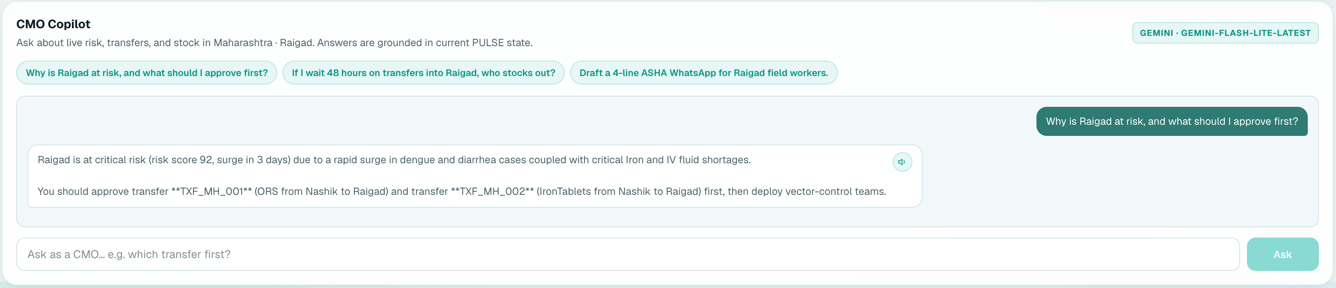
06 AI IN ACTION
Ask it why. Ask what waiting costs.
CMO Copilot and the 48-hour what-if — captured from the live deployment.
CMO COPILOT
IF DELAYED 48H
Answers in context
48h what-if
In their language
“Why is Raigad at risk?” → risk 92, surge in 3 days — approve TXF_MH_001 and TXF_MH_002 first.
Projects each receiving PHC's days of cover if the CMO waits, names who hits zero, and writes the brief.
Every insight in English or हिंदी, with one-tap read-aloud.
PULSE · AICoders · Code for Community — Track 03
06 / 12

Slide 7
07 WHO IT SERVES
Built for the people who keep PHCs stocked
Decisions on the app they already use — WhatsApp — in the language they already speak.
DECIDES
RECEIVES
AUDITS
OVERSEES
District CMO
PHC medical officer & pharmacist
Block / district health officer
State health secretariat
Sees district risk, the cost of waiting, and a ready transfer. One tap: Approve, Modify or Escalate.
Stock arrives before the surge peaks. Pins show which PHC is at 2 days of cover.
Leakage flags turn ‘busy OPD’ into a scheduled audit or notification.
Large moves (> 1,000 units) escalate to the state; one view across districts.
AND ULTIMATELY
मराठी
ଓଡ଼ିଆ
हिंदी
English
The rural patient who finds ORS on the shelf — and the ASHA worker whose WhatsApp update Copilot drafts.
Maharashtra
Odisha
Rajasthan
All states
PULSE · AICoders · Code for Community — Track 03
07 / 12

Slide 8
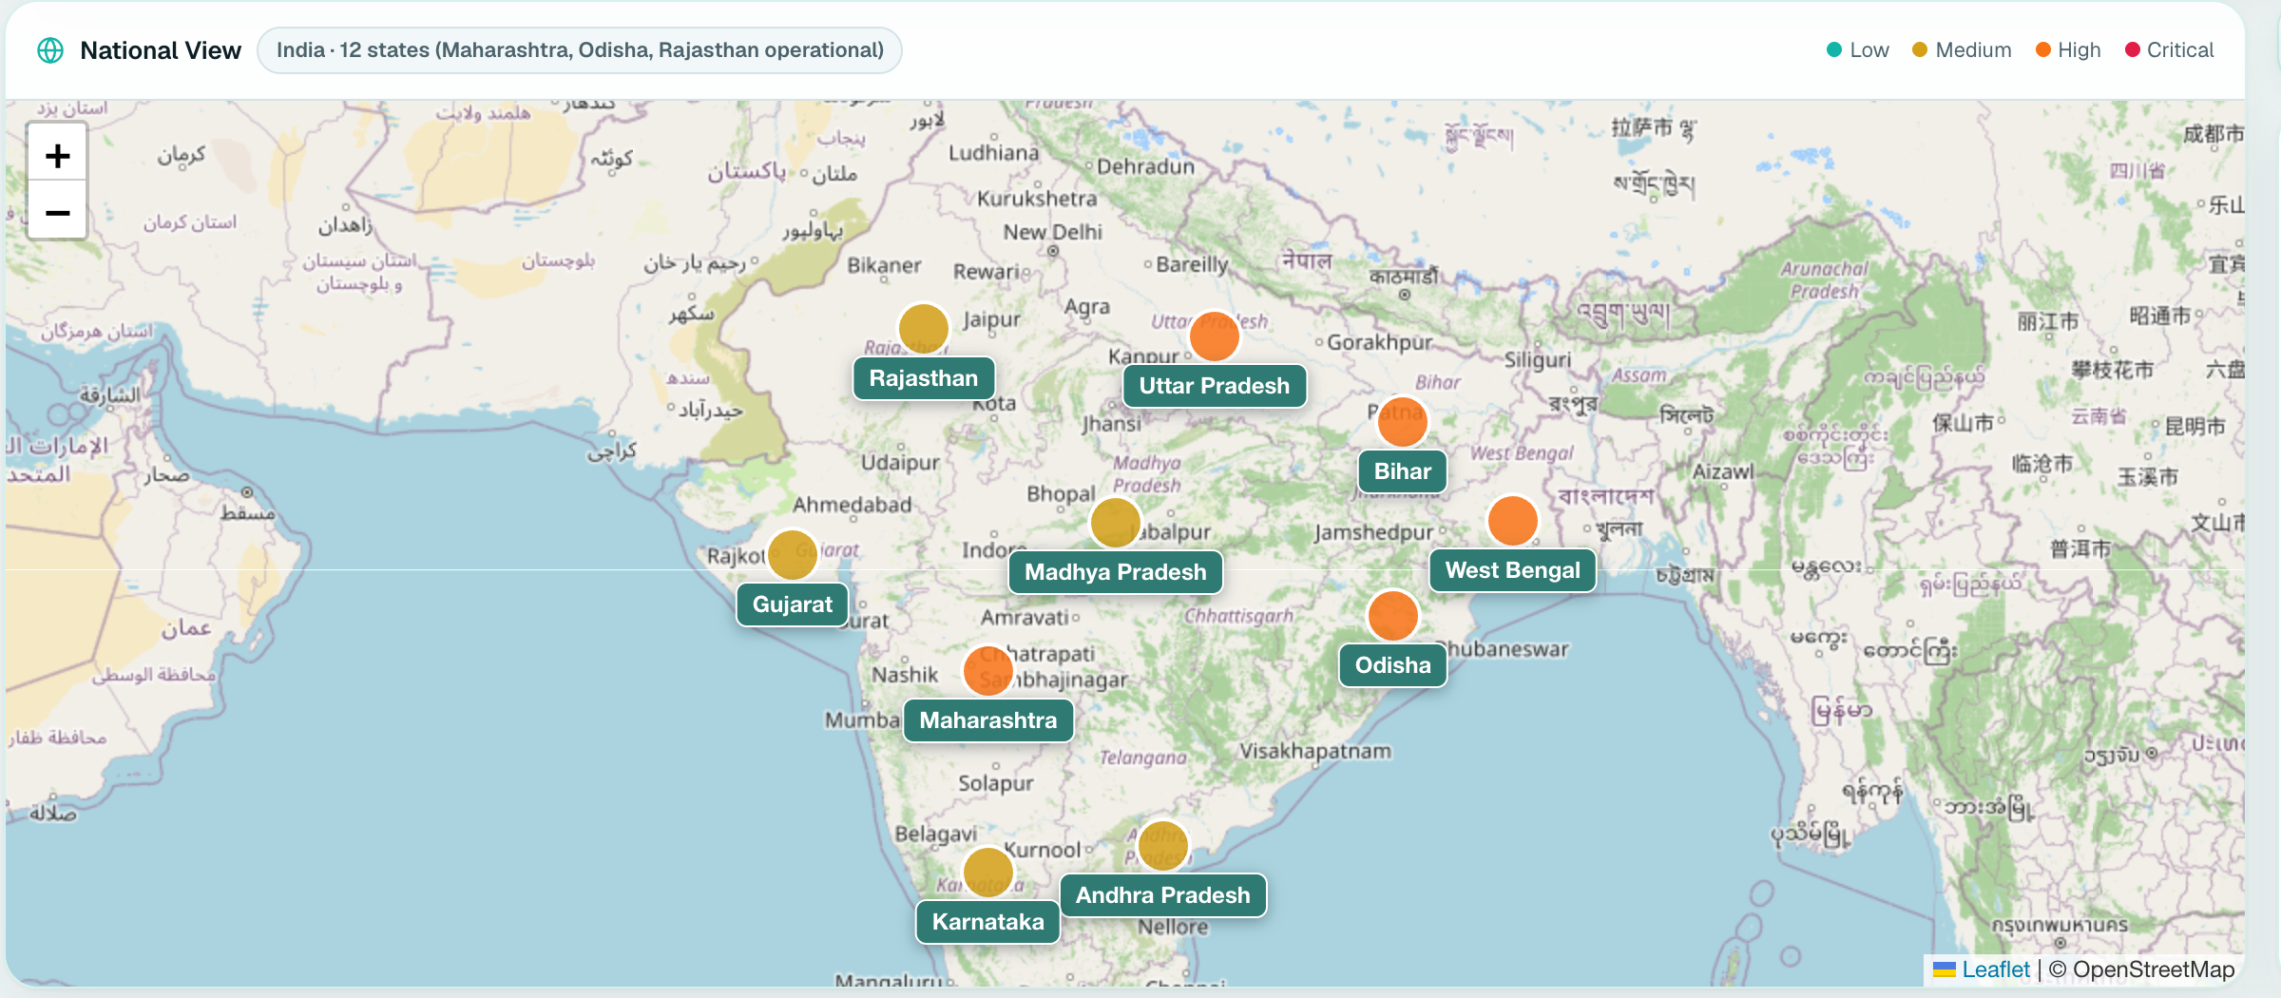
08 LIVE ACROSS INDIA
Three states live. One engine.
Same agents, three outbreaks, three languages — intra-state donors first, inter-state as fallback.
MAHARASHTRA
92
Raigad · Dengue + diarrhoea
CRITICAL
Nashik → Raigad · 2,400 ORS + 500 iron
मराठी
ODISHA
88
Puri · Flood diarrhoea
CRITICAL
Cuttack → Puri · 1,150 ORS + 500 IV fluids
ଓଡ଼ିଆ
12 states on the national map · 3 fully operational · 9 ready to onboard with a district list and language pack.
RAJASTHAN
86
Barmer · Malaria + heat
CRITICAL
Jodhpur → Barmer · 900 Artemisinin + 1,600 ORS
हिंदी
PULSE · AICoders · Code for Community — Track 03
08 / 12

Slide 9
09 IMPACT
Impact on the board — and in hindsight
Live demo counters today, plus a modelled replay of the 2019 Raigad dengue season.
ON THE LIVE BOARD
24
460
1,430
6
4
stock-out days prevented
patients served without a gap
units redistributed
early warnings issued
leakage incidents flagged
2019 RAIGAD DENGUE — MODELLED BACKTEST
16 days
14,200
₹1.85 Cr
~86×
earlier warning than the actual stock-out
patients hit by the 9-day historical stock-out
cost of inaction — vs ₹2.15 lakh to pre-position
return on acting early
Backtest is a labelled counterfactual (Reports → Backtesting) built on illustrative IDSP-style data, not a claim PULSE ran in 2019.
PULSE · AICoders · Code for Community — Track 03
09 / 12

Slide 10
10 WHY IT'S DEPLOYABLE
Deployable today, not a notebook
A running public service with production guardrails — open it any time, no setup.
✓
Live public URL
ARCHITECTURE
pulse-web-ahao.onrender.com — open it any time.
✓
Seeded, story-ready board
Signals
Flask API
Google Gemini
Corridors, transfers and KPIs ready — no setup.
Open-Meteo · trends · IDSP-style cases · PHC stock
5 agents · SQLite · stock math · gunicorn
Flash-Lite → Flash ladder · labelled
✓
Secrets stay server-side
Gemini key on the API; never in the browser.
✓
Fails soft
Next.js dashboard
WhatsApp Cloud API
Rate-limited? Labelled MOCK keeps the loop alive.
Map · transfers · Copilot · reports · EN / हिं
Vernacular CMO alerts · console fallback
✓
Real persistence
Approvals, stock moves and audits in SQLite.
✓
Open source
Hosted on Render: pulse-web + pulse-api, one render.yaml.
Code, architecture and runbook on GitHub.
PULSE · AICoders · Code for Community — Track 03
10 / 12

Slide 11
11 HOW IT SCALES
From 3 states to every district in India
A new state is configuration, not a rewrite: a district list, a donor map and a language pack.
NOW
NEXT
THEN
Pilot
State rollout
National
• 3 operational states, 12 districts
• Sample PHCs, IDSP-style baselines
• Marathi · Odia · Hindi · English
• Adapters for state HMIS / drug-store stock
• IDSP-IHIP case feed, Postgres
• WhatsApp Business number per district
• All ~780 districts, ~25,000 PHCs
• Inter-state fallback via central stores
• 22 scheduled languages
WHY IT SCALES
Config, not code
Cheap per district
Guardrails scale
Zero new app
States, donors and languages are data.
Flash-Lite first; code does the math.
Autonomy bands grow with quantity.
CMOs act from WhatsApp they already use.
PULSE · AICoders · Code for Community — Track 03
11 / 12

Slide 12
12 WHY PULSE
Why PULSE wins Track 03
Most health AI stops at a prediction. PULSE finishes the supply-chain job.
Dashboards
Chatbots
PULSE
THE ASK
Forecasts district surge
◐
—
✓
Open the board. Approve a transfer. Watch the stock move.
Plans intra-state transfer
—
—
✓
CMO alert in local language
—
◐
✓
Approve actually moves stock
—
—
✓
pulse-web-ahao.onrender.com
github.com/parthgoyal15/PULSE
Leakage detection
—
—
✓
Cost-of-delay what-if
—
—
✓
Thank you — presented by
AICoders
Grounded, labelled AI output
—
◐
✓
PULSE · AICoders · Code for Community — Track 03
12 / 12

