Slide 1
Background Subtraction for Vision-Based Applications,
Background subtraction is an essential preprocessing step for vision-based applications.
It involves extracting the moving foreground from the static background in images or videos.
Having an image of the background alone makes this process more manageable.
However, when you don't have a background image, it becomes a complicated process.
Shadows of moving objects in the foreground can complicate the process further, as they could be marked as foreground.

Slide 2
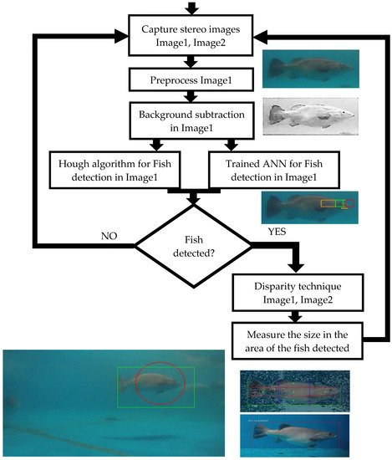

Slide 3
Background Subtraction in computer vision
Background subtraction is a commonly used technique for detecting moving objects in a scene.
It uses a static camera to generate a foreground mask or binary image that only contains pixels of moving objects.
The method involves subtracting the current frame from background models to identify the static part of a scene.
The background model consists of everything that is considered to be part of the background based on the characteristics of the observed scene.
Background subtraction is widely used in various computer vision applications, including object tracking, surveillance, and video analysis.

Slide 4
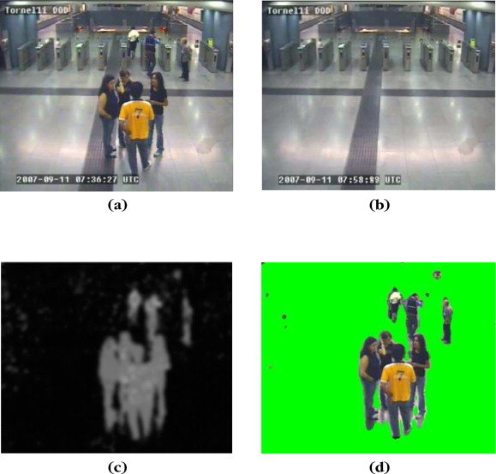

Slide 5
Background Subtraction for Moving Objects Detection,
Moving average should effectively track the changes in the background, to detectmoving objects in image or video.
Obtaining a good estimate of the background is the primary issue in background subtraction.
The approach of estimating the background pixel value using a moving average is effective.
In this approach, previous values of the pixel are weighted in the average to consider gradual changes in the background.
Environmental changes like weather, movement of objects, etc. affect the background and need to be considered for accurate movement detection.

Slide 6
