Slide 1
Machine Learning Revolution in the Technology Industry
Machine Learning has become a prominent technology in today's high-tech products.
Deep Learning has revolutionized the scientific community's perspective on ML techniques with its mind-blowing achievements.
The 2006 publication of how to train a deep neural network by Geoffrey Hinton et al. marked the beginning of the Machine Learning Tsunami.
Yann Lecun's deep convolutional neural networks pioneered the image recognition field since the 1990s.
There is an increasing demand for experts in Machine Learning to join the industry.

Slide 2
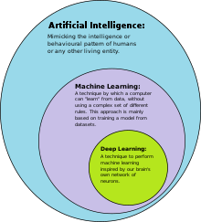

Slide 3
Introduction to Machine Learning Frameworks.
Scikit-Learn is an efficient and easy-to-use Python framework for implementing Machine Learning algorithms.
The book covers various Machine Learning techniques, including the popular linear regression and some of the Deep Learning techniques.
You can apply Machine Learning to vast amount of data and discover hidden patterns, such as segmenting customers, detecting fraud, and recommending products.
The book focuses on hands-on learning through practical examples and minimal theory.
Distributed computations across multi-GPU servers enable the training and implementation of massive neural networks.

Slide 4
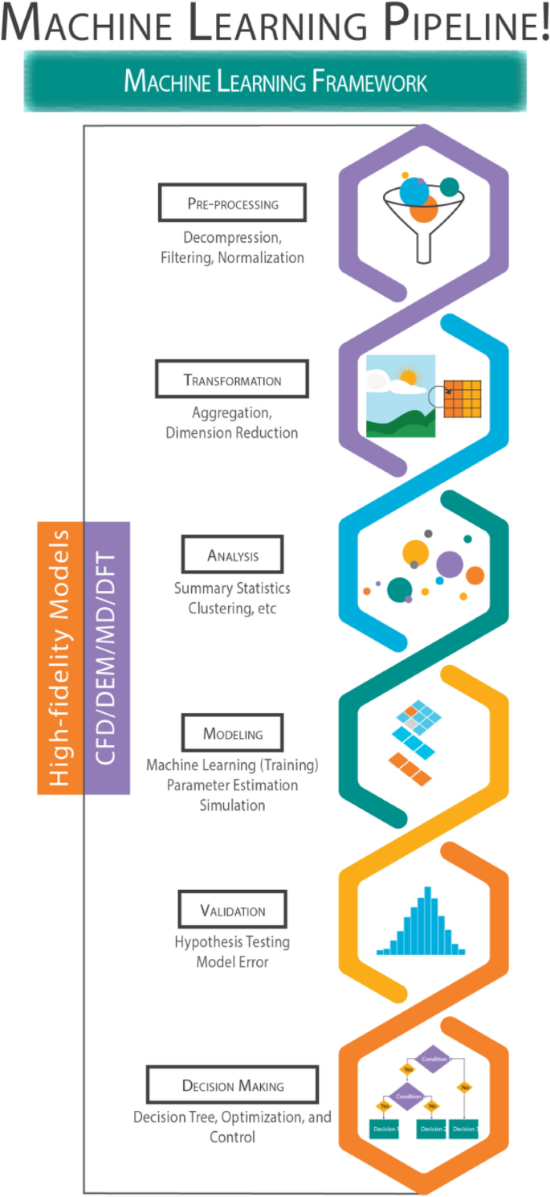

Slide 5
Fundamentals of Machine Learning and Prerequisites
Understanding college-level math is essential for those who want to understand the inner workings of machine learning.
Machine learning faces challenges such as underfitting and overfitting.
Part I of the book covers the fundamentals of Machine Learning.
The book assumes that readers have prior Python programming experience.
Familiarity with NumPy, Pandas, and Matplotlib, which are Python's main scientific libraries, is required.

Slide 6
