Slide 1
Visual Perception
Visual perception is the process by which the brain interprets the information gathered by the eyes and gives it meaning.
It involves the complex interplay between the eyes, the brain, and the environment.
The different aspects of visual perception include depth perception, color perception, pattern recognition, visual memory, and visual attention.
Visual illusions are a fascinating aspect of visual perception that demonstrate the brain's ability to interpret visual cues in unexpected ways.
Deficits in visual perception, such as color blindness and visual agnosia, can have significant impacts on a person's daily life.

Slide 2


Slide 3
Perception of Depth in Visual Processing,
Perception of depth in visual processing can be done through ordinal distance information and metric distance perception.
Ordinal distance perception involves inferring the relative arrangement of visible objects to estimate depth perception.
Metric distance perception provides a more accurate estimate of absolute distance for judging the distance between your eyes and objects in the environment.
Perception of depth can occur through the occlusion of objects, where they appear closer if blocking a view of a farther object.
Through distance cues such as height in the visual field and binocular disparities, humans can accurately perceive the range of distances in the real world.

Slide 4
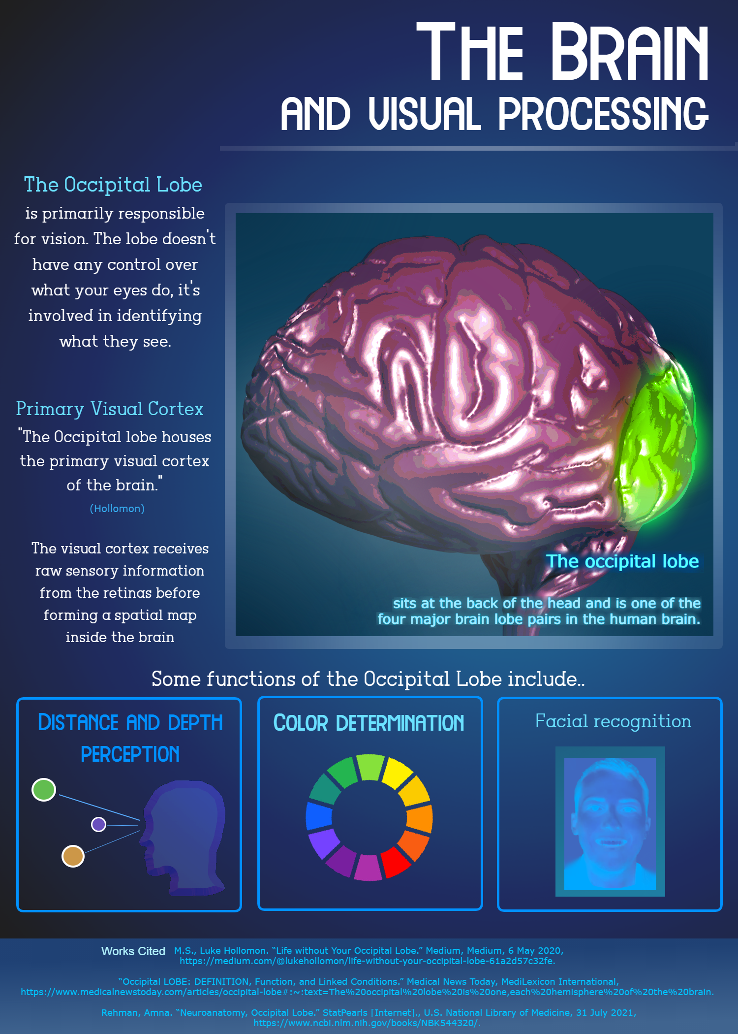

Slide 5
Monocular vs. Stereo Cues for Perception
A sensory cue is a piece of information derived from sensory stimulation that is useful for perception
Depth cues obtained from photoreceptors or single eye movements are called monocular depth cues
Monocular cues are more abundant than stereo cues and can be used to extract depth information from a single photograph
Stereo depth cues require both eyes and involve the perception of depth through slight differences between the images the two eyes receive
Both monocular and stereo cues are used by humans and computer vision algorithms to perceive depth in the environment.

Slide 6


