Slide 1
Developing Sustainable Water Management System for the Ganges River in Prayagraj
1. The Ganges River in Prayagraj faces significant challenges in water management.
2. Poor water quality due to high levels of pollutants and salinity was reported by the participants.
3. Inefficient water usage and wastage due to leaks, evaporation, were reported as prevailing practices.
4. Lack of proper infrastructure like wells, reservoirs, and pipelines further aggravated the situation.
5. The report aims to suggest potential solutions to improve the water management system in the area, particularly for the Ganges River and its tributaries. Artificial Intelligence and Machine Learning will be used to develop a sustainable approach to manage water more efficiently.

Slide 2
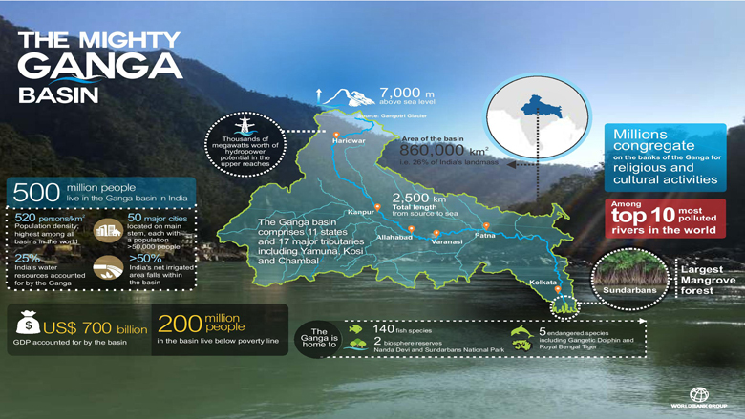

Slide 3
Water Management Strategies.
1. Implementing technology like remote sensing and data analysis for real-time information on water availability, usage and quality.
2. Encourage collaboration between government, NGOs, and private sector organizations to address the challenges of water management.
3. Engage local communities in water management decisions by creating community-based water management committees.
4. Improving the efficiency of water usage, investing in infrastructure upgrades, and improving water quality.
5. Foster community-based initiatives like water-saving projects to build local capacity and drive sustainable water management practices.

Slide 4
