Slide 1

Hackathon Project Final Presentation
January 26th, 2025
Green Bay Frackers
Satvik Duddukuru: Departments of Computer Science and Mathematics (CNS)
Joshua Yue: Departments of Computer Science and Mathematics (CNS)
Parth Gupta: Department of Computer Science (CNS)
Akshat Kumar: Department of Computer Science (CNS)
Rashed AlSuhabi: Department of Petroleum and Geosystems Engineering (COCKRELL)

Slide 2
Executive Summary
1. Our goal: predict the energy required for hydraulic fracturing.
2. What we did: cleaned data, implemented a categorical boost (CatBoost) algorithm, and developed an uncertainty model with data augmentation.
3. Learnings: building an effective workflow for categorical data sets, and understanding hydraulic fracturing problems.
4. Recommendation: data thrives in numbers; more comprehensive data will benefit future endeavors.

Slide 3
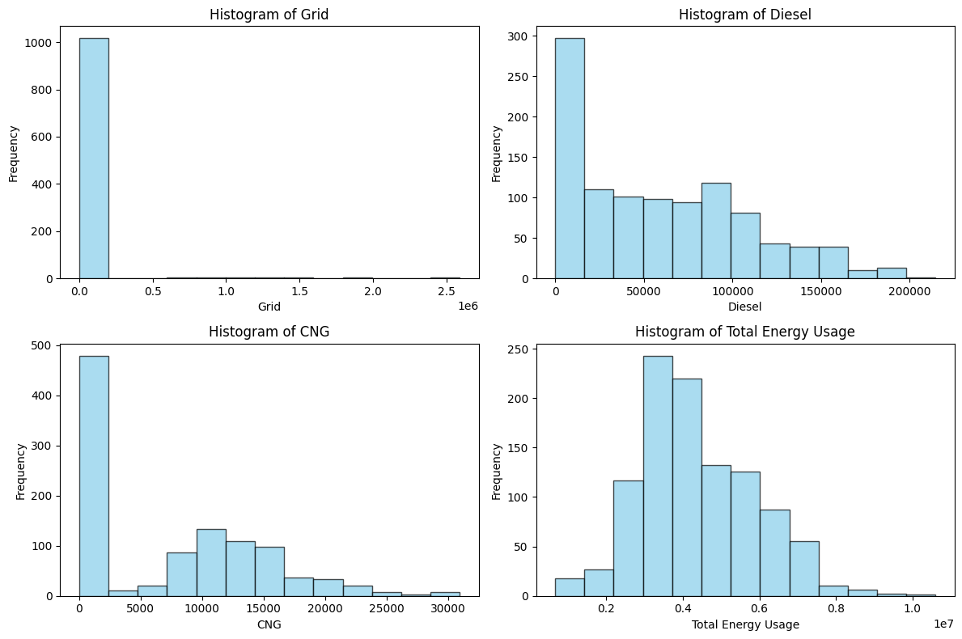
Reframing the Problem
Target values have different scales for different fuel types (Diesel, Grid, CNG)
We opted for a single model that predicts “energy consumed”
We then scale this number by a factor that represents each energy source’s efficiency

Slide 4
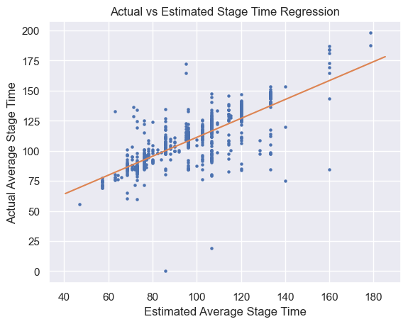
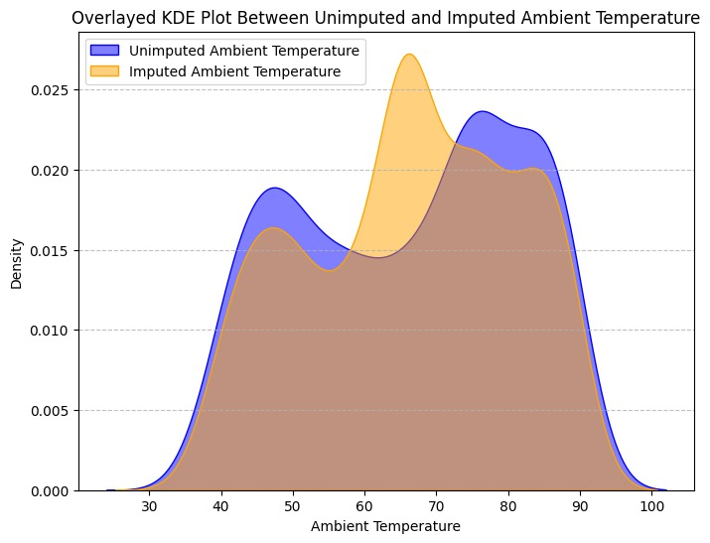
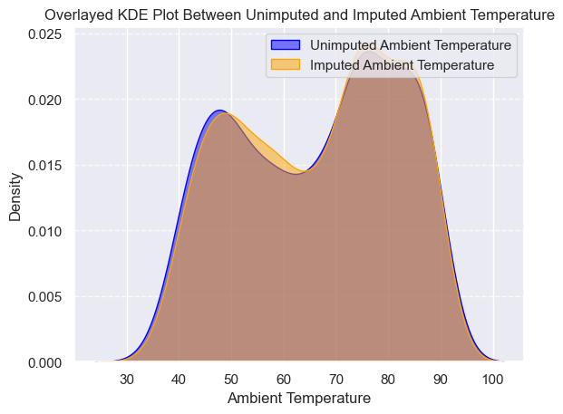
Data Imputation
We had to account for incomplete data. Used linear regression to impute Estimated Average Stage Time from Actual Stage Time and vice versa
Used Category Boosting with specific features to impute temperature - better distribution achieved than with mean imputation

Slide 5
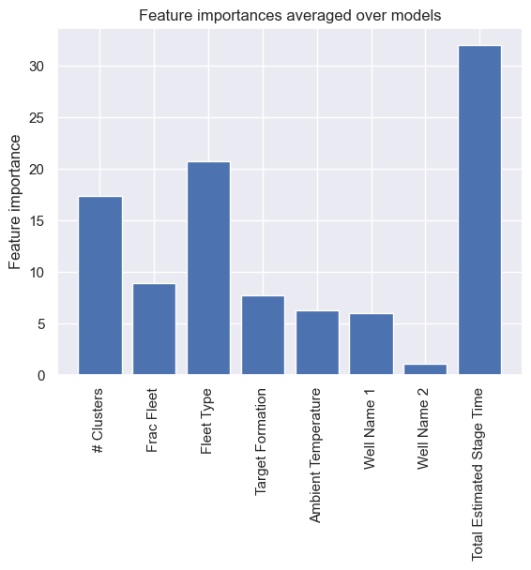
Feature Selection
Used Category Boosting to rank top 8 features
Total Estimated Stage Time
Fleet Type
# Clusters
Frac Fleet
Target Formation
Ambient Temperature
Well Name 1
Well Name 2

Slide 6
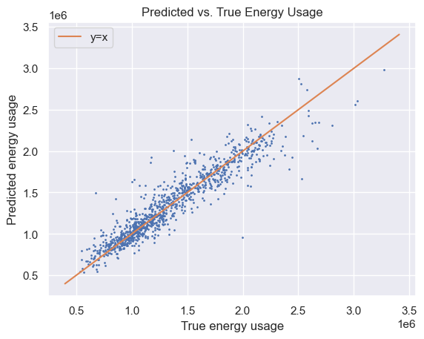
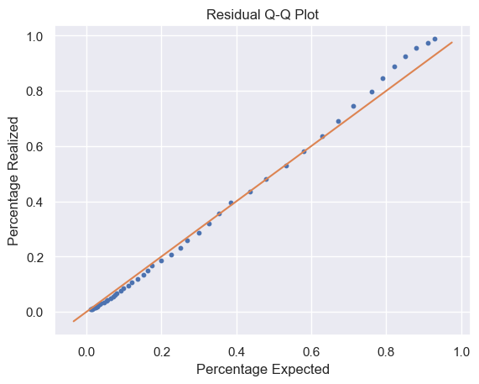
Model Results
The data was mostly categorical
We opted for a category-based model to adapt

Slide 7
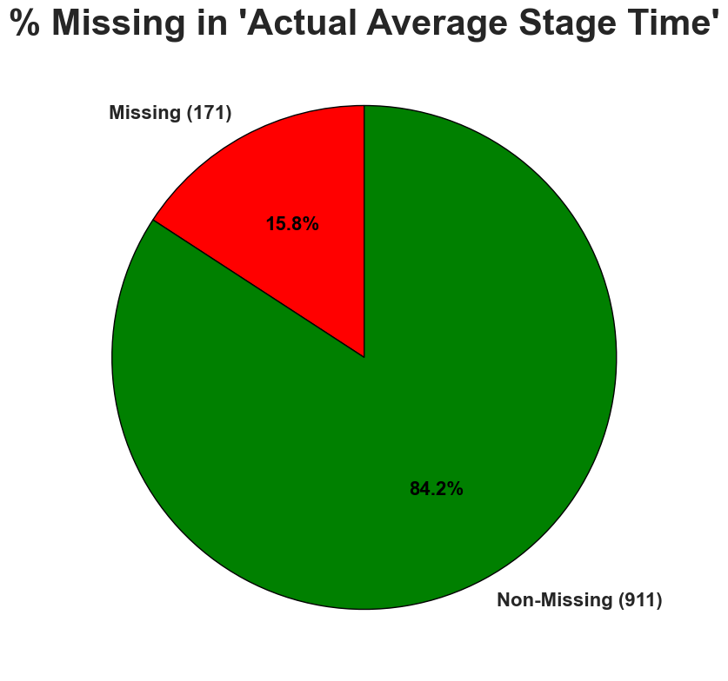
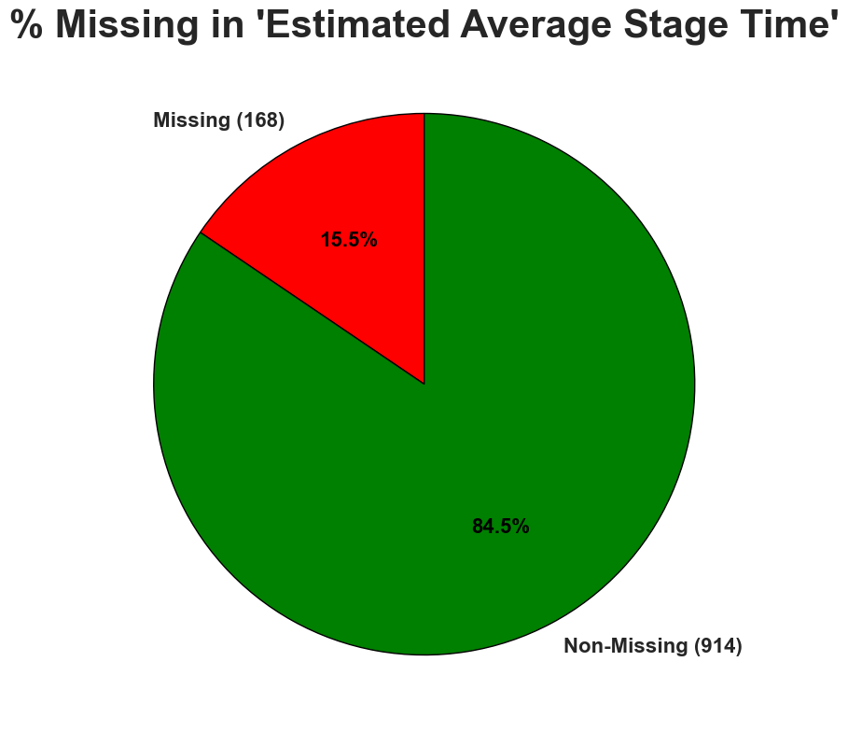
Understanding the Dataset
Predicting data is inherently uncertain
More uncertainty when data is unreliable
Up to 16% was missing in some categories
How did we avoid unreliability? We augmented the data to account for uncertainty
What do we recommend? More exhaustive datasets – include margins of error, provide more samples and better coverage

Slide 8
Impact
We can estimate fuel requirements for a drilling operation with our model
Allows us to optimize fuel allocation and usage
This allows us to make more informed cost-benefit analyses

Slide 9
Feedback

