Slide 1
.NET/C# Training
Parthiban
12/12/2023
Notes:
This template can be used as a starter file for presenting training materials in a group setting.
Sections
Right-click on a slide to add sections. Sections can help to organize your slides or facilitate collaboration between multiple authors.
Notes
Use the Notes section for delivery notes or to provide additional details for the audience. View these notes in Presentation View during your presentation.
Keep in mind the font size (important for accessibility, visibility, videotaping, and online production)
Coordinated colors
Pay particular attention to the graphs, charts, and text boxes.
Consider that attendees will print in black and white or grayscale. Run a test print to make sure your colors work when printed in pure black and white and grayscale.
Graphics, tables, and graphs
Keep it simple: If possible, use consistent, non-distracting styles and colors.
Label all graphs and tables.

Slide 2
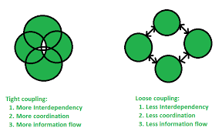
Dependency Injection in C#
Notes:
Give a brief overview of the presentation. Describe the major focus of the presentation and why it is important.
Introduce each of the major topics.
To provide a road map for the audience, you can repeat this Overview slide throughout the presentation, highlighting the particular topic you will discuss next.

Slide 3
public class CustomerRepository {
private readonly Database database;
public CustomerRepository(Database database) {
this.database = database;
}
public void Add(string CustomerName) {
database.AddRow("Customer", CustomerName);
}
}
public class Database {
public void AddRow(string Table, string Value) {}
}
Notes:
Give a brief overview of the presentation. Describe the major focus of the presentation and why it is important.
Introduce each of the major topics.
To provide a road map for the audience, you can repeat this Overview slide throughout the presentation, highlighting the particular topic you will discuss next.

Slide 4
Loose Coupling
public class CustomerRepository {
private readonly IDatabase database;
public CustomerRepository(IDatabase database) {
this.database = database;
}
public void Add(string CustomerName) {
database.AddRow("Customer", CustomerName);
}
}
public interface IDatabase {
void AddRow(string Table, string Value);
}
public class SqlDatabase: IDatabase {
public void AddRow(string Table, string Value) {
//Logic to add new customer in sql table
}
}
public class XMLDatabase: IDatabase {
public void AddRow(string Table, string Value) {
//Logic to add new customer in XML Document
}
}
Notes:
Give a brief overview of the presentation. Describe the major focus of the presentation and why it is important.
Introduce each of the major topics.
To provide a road map for the audience, you can repeat this Overview slide throughout the presentation, highlighting the particular topic you will discuss next.

Slide 5
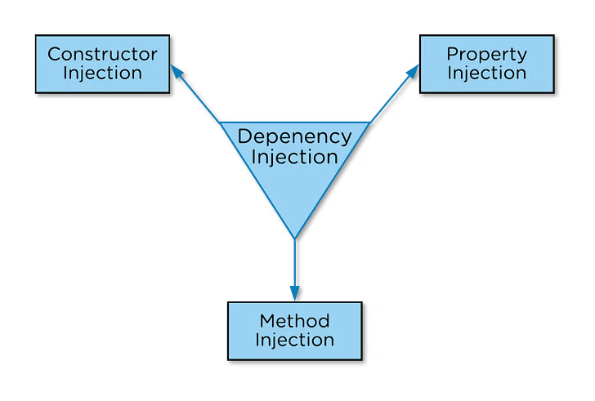
Ways to Implement C# Dependency Injection
Notes:
Give a brief overview of the presentation. Describe the major focus of the presentation and why it is important.
Introduce each of the major topics.
To provide a road map for the audience, you can repeat this Overview slide throughout the presentation, highlighting the particular topic you will discuss next.

Slide 6
Constructor Injection in C#
public interface text
{
void print();
}
class format : text
{
public void print()
{
Console.WriteLine(" here is text format");
}
}
Notes:
Give a brief overview of the presentation. Describe the major focus of the presentation and why it is important.
Introduce each of the major topics.
To provide a road map for the audience, you can repeat this Overview slide throughout the presentation, highlighting the particular topic you will discuss next.

Slide 7
public class constructorinjection
{
private text _text;
public constructorinjection(text t1)
{
this._text = t1;
}
public void print()
{
_text.print();
}
}
class constructor
{
static void Main(string[] args)
{
constructorinjection cs = new constructorinjection(new format());
cs.print();
Console.ReadKey();
}
}
Notes:
Give a brief overview of the presentation. Describe the major focus of the presentation and why it is important.
Introduce each of the major topics.
To provide a road map for the audience, you can repeat this Overview slide throughout the presentation, highlighting the particular topic you will discuss next.

Slide 8
Property Injection in C#
public interface IService {
void Serve();
}
public class Service1 : IService {
public void Serve() {
Console.WriteLine("Service1 Called");
}
}
public class Service2 : IService {
public void Serve() {
Console.WriteLine("Service2 Called");
}
}
public class Client {
private IService _service;
public IService Service {
set { this._service = value; }
}
public ServeMethod() {
this._service.Serve();
}
}
Notes:
Give a brief overview of the presentation. Describe the major focus of the presentation and why it is important.
Introduce each of the major topics.
To provide a road map for the audience, you can repeat this Overview slide throughout the presentation, highlighting the particular topic you will discuss next.

Slide 9
static void Main(string[] args)
{
//creating object
Service1 s1 = new Service1();
Client client = new Client();
client.Service = s1; //passing dependency
//TO DO:
client.ServeMethod();
Service2 s2 = new Service2();
client.Service = s2; //passing dependency
//TO DO:
client.ServeMethod();
}

Slide 10
Method Injection in C#
public interface Iset
{
void print();
}
public class servic : Iset
{
public void print()
{
Console.WriteLine("print........");
}
}

Slide 11
public class client
{
private Iset _set;
public void run(Iset serv)
{
this._set = serv;
Console.WriteLine("start");
this._set.print();
}
}
class method
{
public static void Main()
{
client cn = new client();
cn.run(new servic());
Console.ReadKey();
}
}

Slide 12
UI
BAL(Business Layer)
Data Access Layer
class DataAccess
{
}

Slide 13
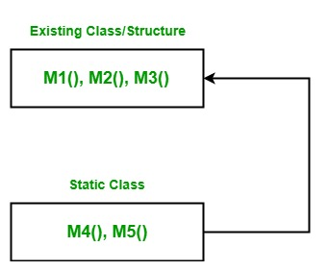
Extension Method in C#

Slide 14
class Geek {
// Method 1
public void M1()
{
Console.WriteLine("Method Name: M1");
}
// Method 2
public void M2()
{
Console.WriteLine("Method Name: M2");
}
// Method 3
public void M3()
{
Console.WriteLine("Method Name: M3");
}
}
}

Slide 15
static class NewMethodClass {
// Method 4
public static void M4(this Geek g)
{
Console.WriteLine("Method Name: M4");
}
// Method 5
public static void M5(this Geek g, string str)
{
Console.WriteLine(str);
}
}

Slide 16
public static void Main(string[] args)
{
Geek g = new Geek();
g.M1();
g.M2();
g.M3();
g.M4();
g.M5("Method Name: M5");
}

Slide 17
public class Class1
{
public string Display()
{
return ("I m in Display");
}
public string Print()
{
return ("I m in Print");
}
}
public static class XX
{
public static void NewMethod(this Class1 ob)
{
Console.WriteLine("Hello I m extended method");
}
}

Slide 18
static void Main(string[] args)
{
Class1 ob = new Class1();
ob.Display();
ob.Print();
ob.NewMethod();
Console.ReadKey();
}
public static class ExtMetClass
{
public static int IntegerExtension(this string str)
{
return Int32.Parse(str);
}
}

Slide 19
static void Main(string[] args)
{
string str = "123456";
int num = str.IntegerExtension();
Console.WriteLine("The output using extension method: {0}", num);
Console.ReadLine();
}

Slide 20
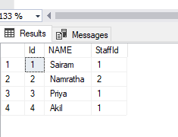
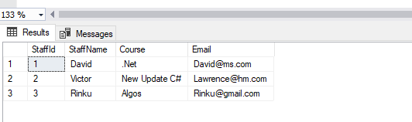
from staffs in _context.TrainingStaffs
join stds in _context.TrainingStudents
on staffs.StaffId equals stds.StaffId
select new TrainingOutput{ StudentId = stds.Id,
StudentName = stds.Name,
StaffId = stds.StaffId.Value,
Course = staffs.Course,
StaffName = staffs.StaffName,
Email = staffs.Email
};

Slide 21
DB
UI
Converted Image Base 64 Binary Stream
DB
Image Processing

Slide 22
Image Name,Path,Format
Server img1,img2 img3
Image Processing

Slide 23
Amazon Header1
Amazon Categories
http://GetHeader1
GetHeader2
AmazonFooter
GetFooter

Slide 24
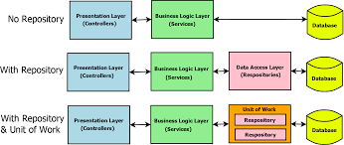

Slide 25
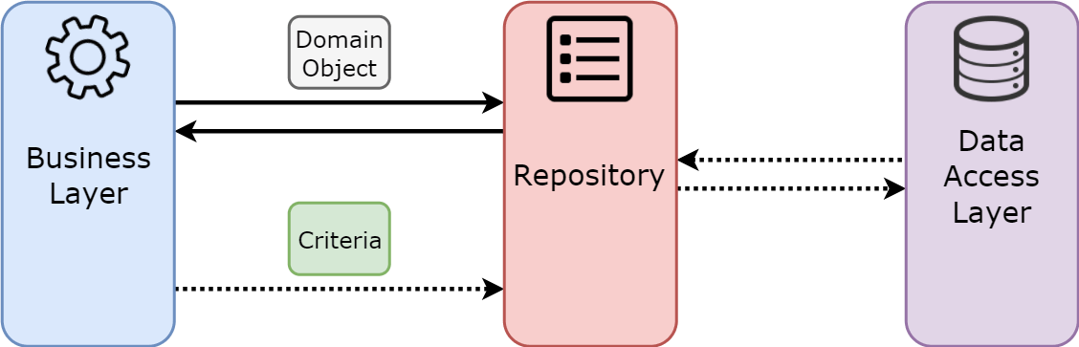

Slide 26
IRepositoryBase<T>
Generic (Owner Interface)
Create
Read();
Update();
Delete();
Generic (T)
Create
Read();
Update();
Delete();
Owner Property class
IRepositoryBase<T>
Generic (Account Interface)
Create
Read();
Update();
Delete();
Generic (T)
Create
Read();
Update();
Delete();
Accoun t Property class

