Slide 1
.NET/C# Training
Parthiban
27/12/2023
Notes:
This template can be used as a starter file for presenting training materials in a group setting.
Sections
Right-click on a slide to add sections. Sections can help to organize your slides or facilitate collaboration between multiple authors.
Notes
Use the Notes section for delivery notes or to provide additional details for the audience. View these notes in Presentation View during your presentation.
Keep in mind the font size (important for accessibility, visibility, videotaping, and online production)
Coordinated colors
Pay particular attention to the graphs, charts, and text boxes.
Consider that attendees will print in black and white or grayscale. Run a test print to make sure your colors work when printed in pure black and white and grayscale.
Graphics, tables, and graphs
Keep it simple: If possible, use consistent, non-distracting styles and colors.
Label all graphs and tables.

Slide 2
Middlewares
Middleware is a component that is assembled into an application pipeline to handle requests and responses.
Middleware:
Sits between the requestor and the target.
Can directly modify the response.
Can log things.
Can use the data within the request to generate the response.
Notes:
Give a brief overview of the presentation. Describe the major focus of the presentation and why it is important.
Introduce each of the major topics.
To provide a road map for the audience, you can repeat this Overview slide throughout the presentation, highlighting the particular topic you will discuss next.

Slide 3
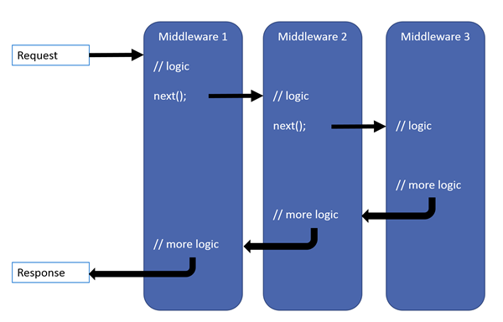
Middleware is a great place to do the following:
Authorization
Authentication
Diagnostics
Error handling and logging

Slide 4
Run() : inline middleware.
This method only receives only context parameter and doesn’t know about the next middleware. These delegates are usually known as terminal delegates because they terminate or end the middleware pipeline.
Use() helps us to chain the delegates one after the other.
This method will accept two parameters, context and next

Slide 5
Map()
Map extensions are used for branching the pipeline. Map extensions branch the request pipeline based on matching the given request path. If the request path starts with the given path, the branch is executed.

Slide 6
app.Map("/BranchOne", MapBranchOne);
app.Map("/BranchTwo", MapBranchTwo);
app.Run();
static void MapBranchOne(IApplicationBuilder app) {
app.Run(async context => {
await context.Response.WriteAsync("You are on Branch One!");
});
}
static void MapBranchTwo(IApplicationBuilder app) {
app.Run(async context => {
await context.Response.WriteAsync("You are on Branch Two!");
});

