Slide 1
Phase 0
https://socket.io/get-started/chat/
Emitting Events
Client
Server
New Message Event
socketServer.on(“Connected”, ..
{
socketFromClient.on(“New Message Event”, ..
}
socketClient.emit(“New Message Event”,…

Slide 2
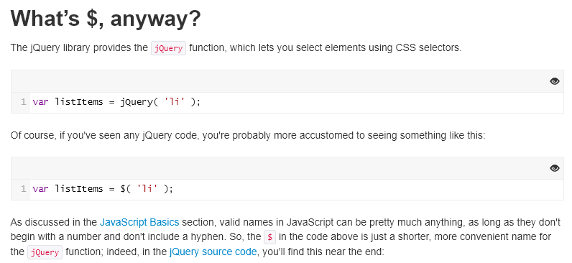
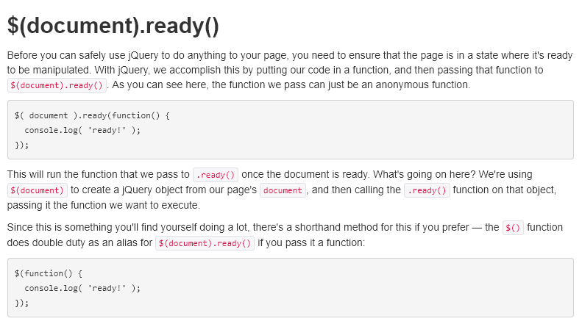



Phase 0
Client Side:
Getting started with
Jquery function:
Define a function to
do client socket operations
Access html elements
Via jquery, modify them
http://jqfundamentals.com/chapter/jquery-basics
https://www.w3schools.com/jquery/html_val.asp
https://www.w3schools.com/jquery/event_submit.asp
https://css-tricks.com/return-false-and-prevent-default/

Slide 3
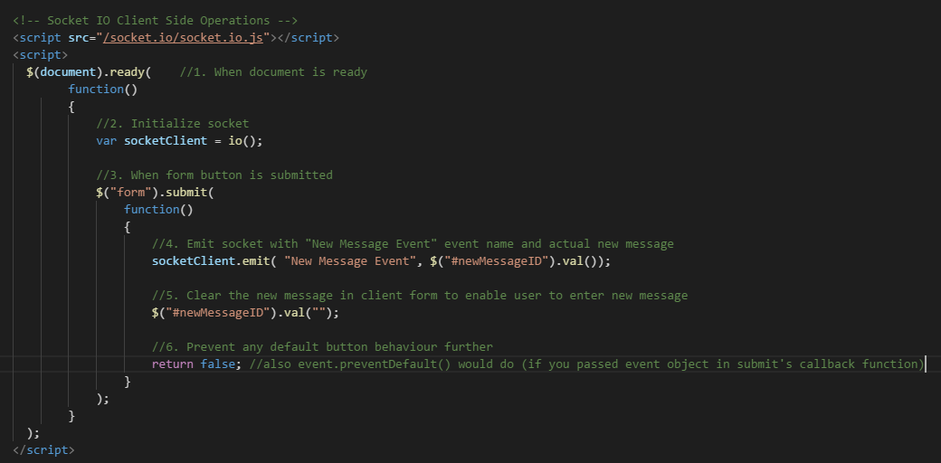
Phase 0
Client Side: (Sender)
Psuedocode
1. (when document is ready)
{
2. Initialize socket
3. (when form button is submitted)
{
4. Emit socket with “New Message Event” and new Message from form input
5. Clear new Message in form input
6. Avoid any default button action further
}
}
Actual code
Note: since we user jquery, it has to be included before socket operations in client, so include jsincludes.ejs above the code below

Slide 4
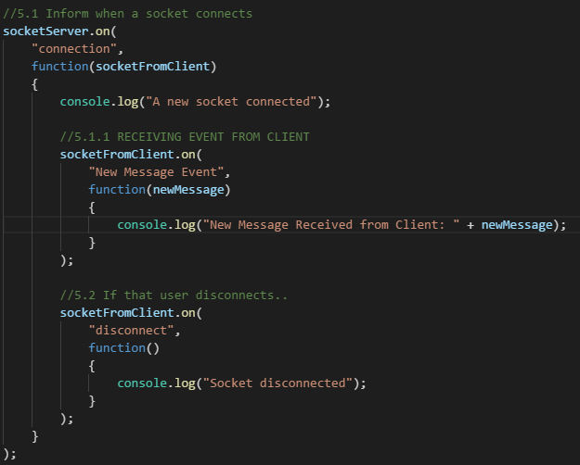
Phase 0
Server Side: (Receiver)
Psuedocode
Inside socket connected code module..
(when socketFromClient receives “New Message Event”)
{
Print that to console
}
Actual code

Slide 5
Phase 0
https://socket.io/get-started/chat/
Broadcasting Events
(Server broadcasting new messages it received, to all clients)
Client
Server
Broadcast Event
socketClient.on(“Broadcast Event”, ..
{
//update that in page
}
socketServer.emit(“Broadcast Event”,
//message to be broadcastsed);
We could also skip the client which sent that message in first place, using socketServer.broadcast.emit but that’s for later.
Now broadcasting to all clients.

Slide 6
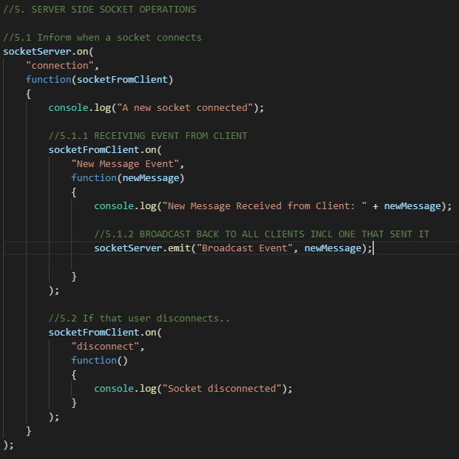
Phase 0
Server Side: (Sender)
Psuedocode
Inside socket connected code module..
(when socketFromClient receives “New Message Event”)
{
(broadcast that to all clients incl, one that sent it)
(event name: Broadcast Event)
}
Actual code

Slide 7
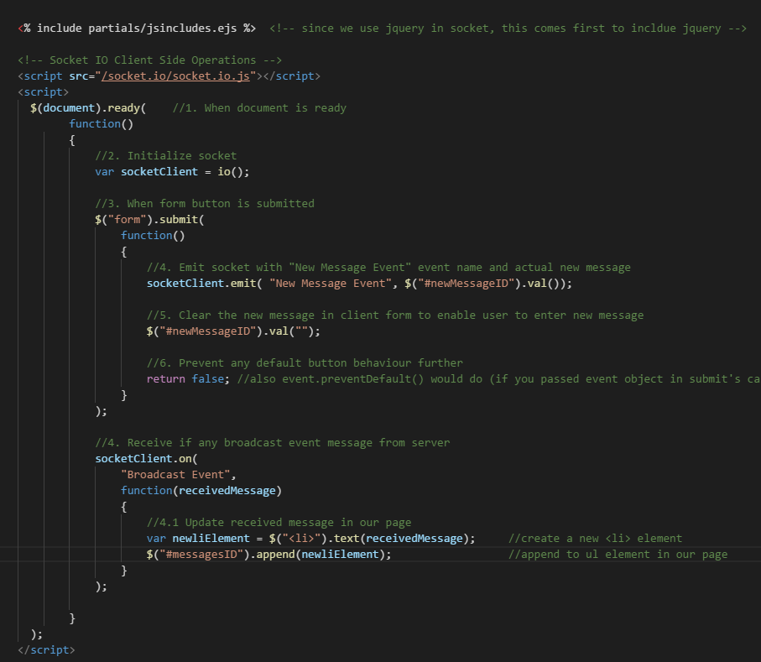
Phase 0
Client Side: (Receiver)
Psuedocode
(when document is ready)
{
// after previous stuff
(when server broadcast anything,
get that by agreed event name
“Broadcast event” along with its data)
{
update that data in html
}
}
Actual code

