Slide 1
Phase 0
https://socket.io/get-started/chat/
Emitting Events
Client
Server
New Message Event
socketServer.on(“Connected”, ..
{
socketFromClient.on(“New Message Event”, ..
}
socketClient.emit(“New Message Event”,…

Slide 2
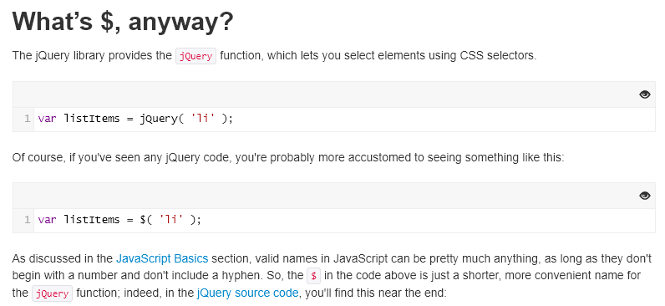
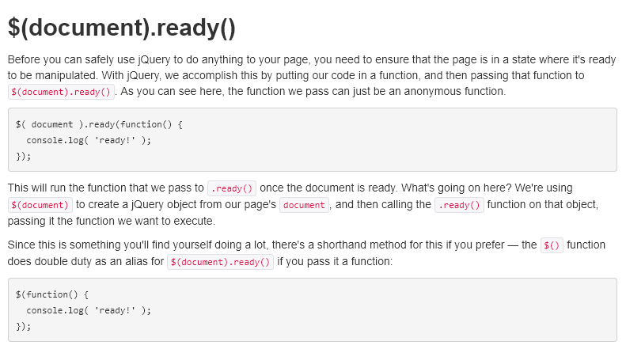



Phase 0
Client Side:
Getting started with
Jquery function:
Define a function to
do client socket operations
Access html elements
Via jquery, modify them
http://jqfundamentals.com/chapter/jquery-basics
https://www.w3schools.com/jquery/html_val.asp
https://www.w3schools.com/jquery/event_submit.asp
https://css-tricks.com/return-false-and-prevent-default/

Slide 3
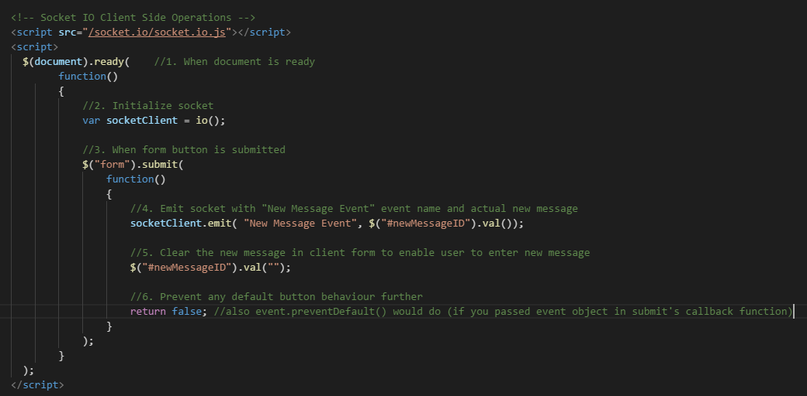
Phase 0
Client Side: (Sender)
Psuedocode
1. (when document is ready)
{
2. Initialize socket
3. (when form button is submitted)
{
4. Emit socket with “New Message Event” and new Message from form input
5. Clear new Message in form input
6. Avoid any default button action further
}
}
Actual code
Note: since we user jquery, it has to be included before socket operations in client, so include jsincludes.ejs above the code below

Slide 4
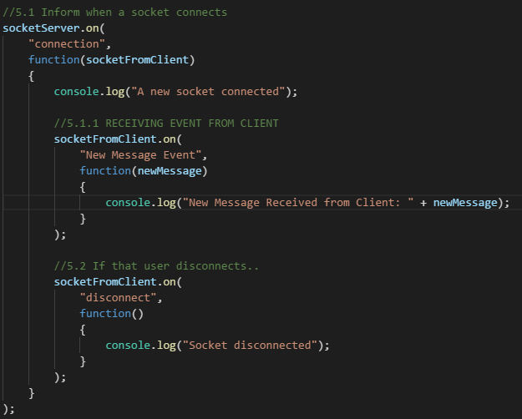
Phase 0
Server Side: (Receiver)
Psuedocode
Inside socket connected code module..
(when socketFromClient receives “New Message Event”)
{
Print that to console
}
Actual code

Slide 5
Phase 0
https://socket.io/get-started/chat/
Broadcasting Events
(Server broadcasting new messages it received, to all clients)
Client
Server
Broadcast Event
socketClient.on(“Broadcast Event”, ..
{
//update that in page
}
socketServer.emit(“Broadcast Event”,
//message to be broadcastsed);
We could also skip the client which sent that message in first place, using socketServer.broadcast.emit but that’s for later.
Now broadcasting to all clients.

Slide 6
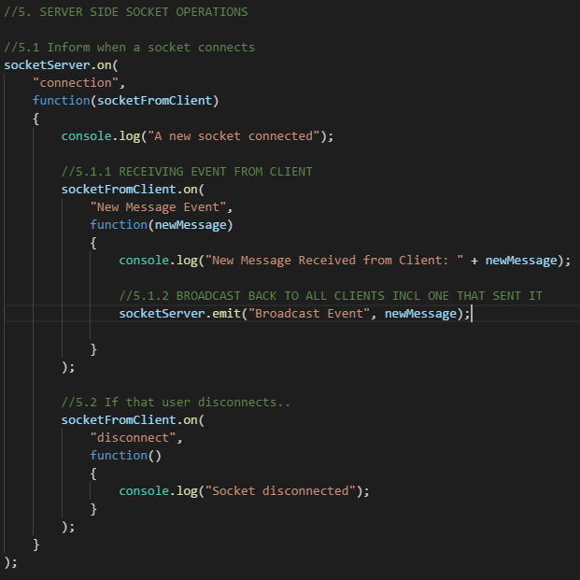
Phase 0
Server Side: (Sender)
Psuedocode
Inside socket connected code module..
(when socketFromClient receives “New Message Event”)
{
(broadcast that to all clients incl, one that sent it)
(event name: Broadcast Event)
}
Actual code

Slide 7
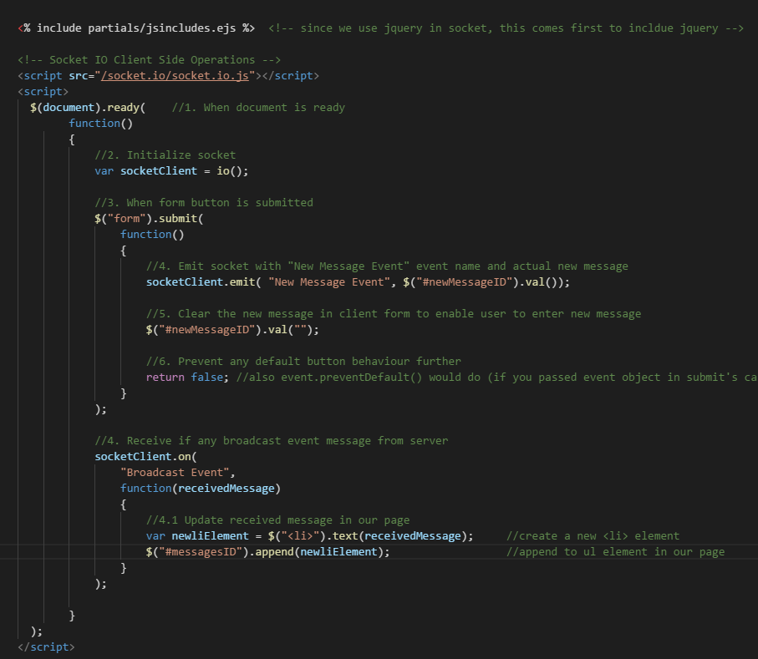
Phase 0
Client Side: (Receiver)
Psuedocode
(when document is ready)
{
// after previous stuff
(when server broadcast anything,
get that by agreed event name
“Broadcast event” along with its data)
{
update that data in html
}
}
Actual code

Slide 8
Phase 1
1.0 Enter username first – to be unique in current and session – then enters chat window page
1.1 Online Userlists display on right/left pane
1.2 Display User’s message on right, others on left of chat window
2.1 Private messaging (italicized, diff color)
2.2 When receiver offline, inform sender, it is so.
2.3 Auto Scroll

Slide 9
Phase 1
1.0 Enter username first – to be unique in current and session – then enters chat window page
Client:
Initially username window is visible
Chat Window is not
After userNamevalidation, if new User in session. Chat Window is visible. Till then not.
userNameValidation:
Client sends username to Server
Server checks and responds validity
Client shows Chat window or ask another user name accordingly.
username Window
Message Card
Online Users
Sever:
Client sends newUser event with username.
If username already exists, send failure response (send false via callback)
If no, add to user array, and send success response (send true via callback)
Chat Window

Slide 10
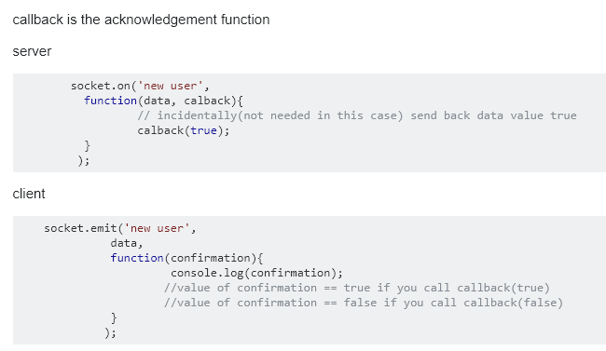
Phase 1
1.0 Enter username first – to be unique in current and session – then enters chat window page
How do we send validity via callback? Just as below
callback(true), that value true is received as confirmation (or any argument) in callback function on caller or client side

Slide 11
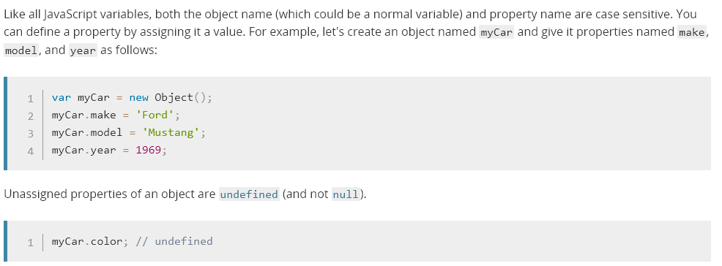
Phase 1
1.0 Enter username first – to be unique in current and session – then enters chat window page
In javascript, it is possible to define a new property for an object, but just giving it a value.
We need to know this basics, because we will attach username to the incoming socket from each client, to be able to identify particular socket later for other operations..

Slide 12
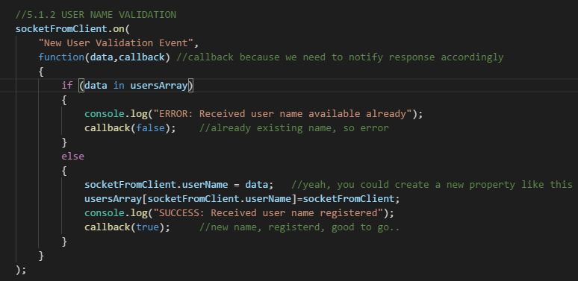
Phase 1
Server:
Note above, how socket gets new property “username” with new username, and how its pushed in the usersArray

Slide 13
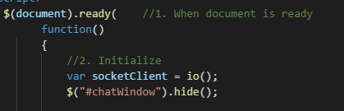
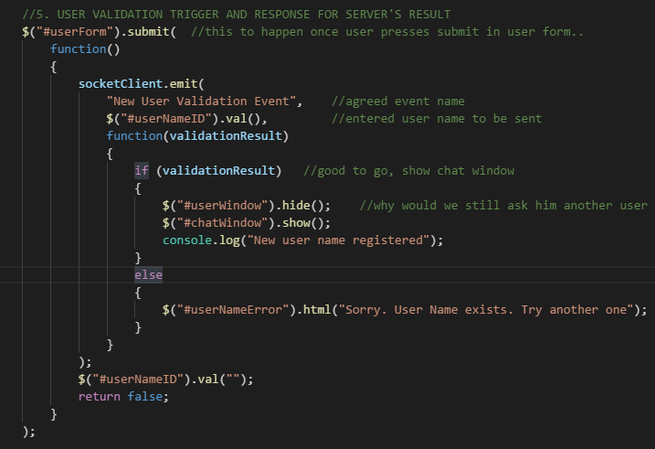
Phase 1
We hide chatWindow initially
Client:

Slide 14
Phase 1
1.0 Enter username first – to be unique in current and session – then enters chat window page
1.1 Online Userlists display on right/left pane
1.2 Display User’s message on right, others on left of chat window
2.1 Private messaging (italicized, diff color)
2.2 When receiver offline, inform sender, it is so.
2.3 Auto Scroll
Object.keys plays a helpful role in retrieving online users. If you recall, how we stored online users
It is as below:
Here, username string is used as a key and value is respective socket object itself in userArray.
So when you print Object.keys(usersArray), you get the list of keys, that is the userNames.
So to display online users, we could just send Object.keys(usersArray) to client, and client can simply
iterate to list the key Names. (Of course we have to remove them in usersArray when socket
Disconnects)

Slide 15
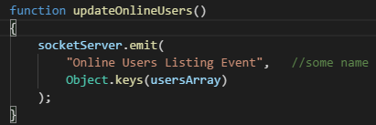
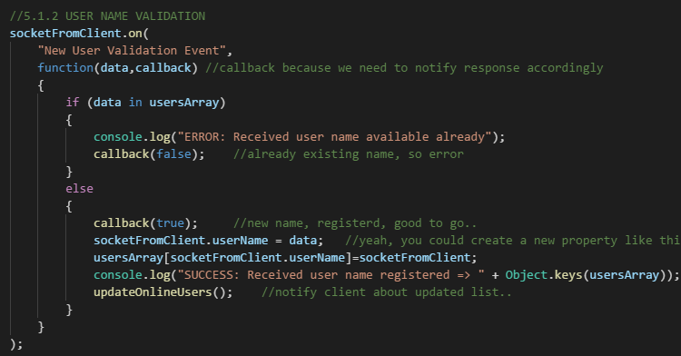
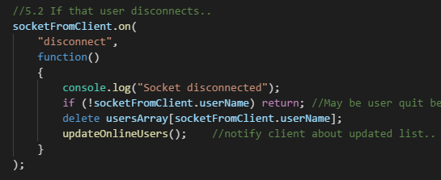
Phase 1
We need to update online lists on basically two occasions:
When new user joins, (New User Validation Event)
When existing user quits (Disconnect Event)
So we will define the server emitting usersArray in a function, so we could call at both above
Scenarios
Server

Slide 16
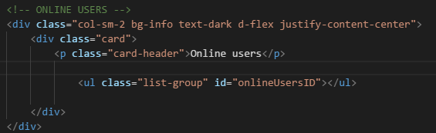
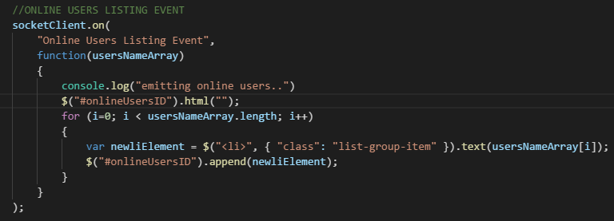
Phase 1
Client

Slide 17
Phase 1
1.0 Enter username first – to be unique in current and session – then enters chat window page
1.1 Online Userlists display on right/left pane
1.2 Display User’s message on right, others on left of chat window
2.1 Private messaging (italicized, diff color)
2.2 When receiver offline, inform sender, it is so.
2.3 Auto Scroll
This is the essence:
When we get user name validated, we store current user name temporarily on client side.
When new message broadcasted, on client side, we shall check if incoming data’s username matches with client side. If so, align accordingly.
Oh, for this, from server side, we send both message and username who sent that message.

Slide 18
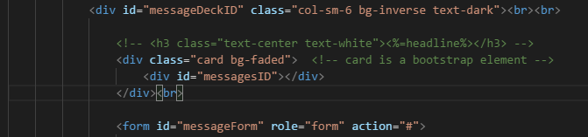
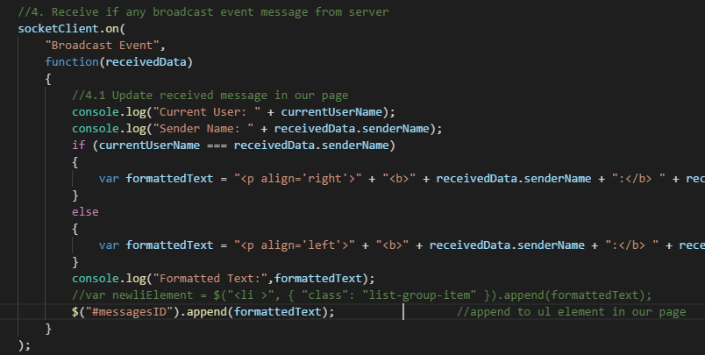
Phase 1
Client

Slide 19
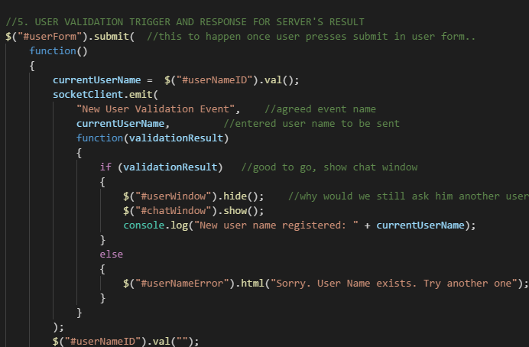
Phase 1
Client

Slide 20
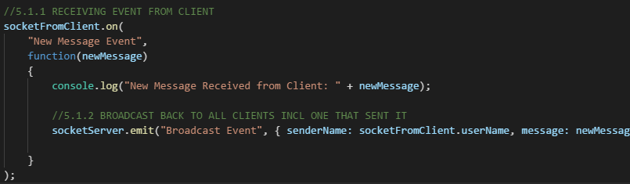
Phase 1
Server

Slide 21
Phase 2
Logic
2.1 Private messaging (italicized, diff color)
2.2 When receiver offline, inform sender, it is so.
2.3 Auto Scroll
Private Message should start with @username. So on server side, we could identify if an
Incoming message from any socket is a private message or not by below method.
If (incomingMessage.substr(0,1) === “@”)
{
Step 1: Then it’s a private message. Next to extract user name to whom it was intended
}
Else
{
Step 2: Broadcast message to all (usual stuff)
}
We will look into detail, Step 1 next. (Step 2 is default broadcast, done already)
Note:
Substr(starting position, no of characters) => returns extracted string indexOf(textTobefound) => returns starting point of that text in given string

Slide 22
Phase 2
Logic
If (incomingMessage.substr(0,1) === “@”)
{
Step 1: Then it’s a private message. Next to extract user name to whom it was intended
1.1 Get the raw message excluding “@”
1.2 If nothing after user name, it means user forgot to write message. Return error in cb.
1.3 If there is something after user name, then investigate further
1.4.1 Get user name (characters before first occurance of “ “)
1.4.2 Get message (characters after that)
1.4.3 If user is not online (check in usersArray), return error in cb
1.4.4 If not, do 2 things:
1.4.4.1 Whisper to intended recipient socket (get that socket from usersArray)
1.4.4.2 To one who sent private message, broadcast Private event with his socket
itself (so it goes to him only)
}
Note:
Due to possibility of returning error message in call back, client side “New Message Event” should
Handle callback now (so far we did not)
For diff private message style, lets us a css class : whisper

Slide 23
Phase 2
Summary before coding
Client | Server
1. Send “New Message Event” with call back as it could be a private msg also. In case, data available in cb, print that (so sender knows there is an error) | 1. Validate “New message event” for private message. 1.1 If only username, notify via cb 1.2 If user not online, notify via cb 1.3 If user online, emit 2 events Whisper: To intended recipient (emit via recipient socket from usersArray) Private: To sender (emit via his own socket)
2. Implement 2 event listeners. Whisper: Just print in chat window Private : Just print in chat window (use diff style for private – use CSS)

Slide 24
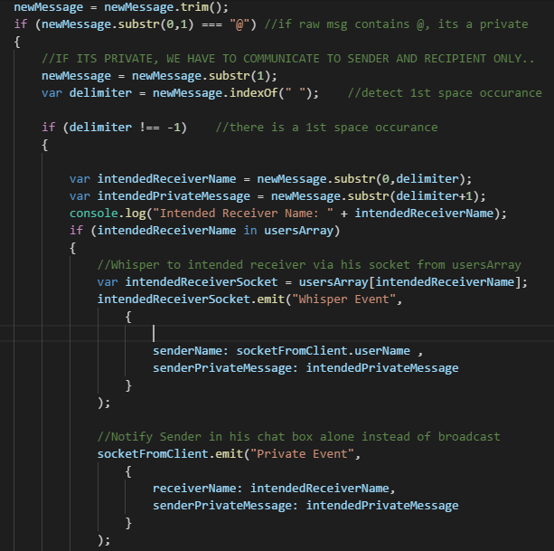
Phase 2
Server (errors not shown)

Slide 25
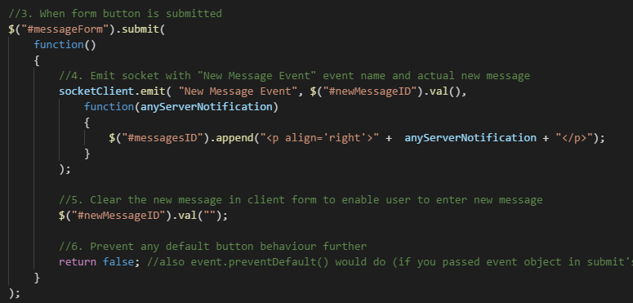
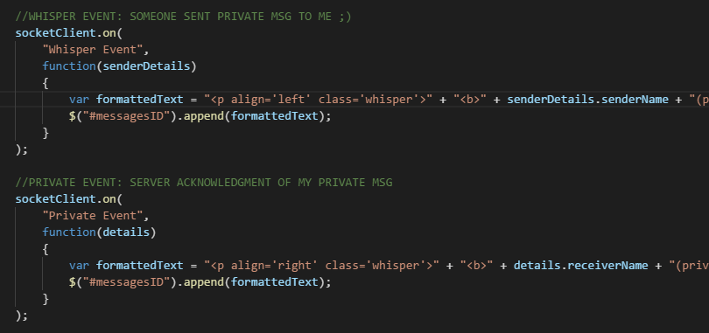
Phase 2
Client (handling server response about private message)

Slide 26
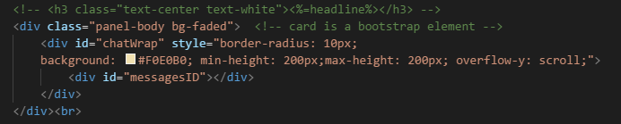

Phase 2
2.1 Private messaging (italicized, diff color)
2.2 When receiver offline, inform sender, it is so.
2.3 Auto Scroll
Let us use 2 divs for chat message window.
An outer one, say chatWrap (here we enable scroll)
An inner one, say messagesID, div where we enter chat messages
Then below code can do the trick of automatically scrolling down as messages fill up div.
$("#chatWrap").scrollTop($("#messagesID").outerHeight());
We will put that in a function, and call whenever we append any msg to messagesID in client.

