Slide 1
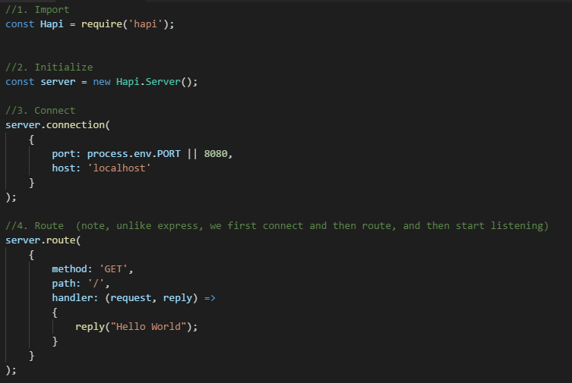
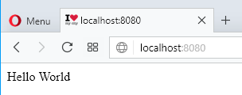
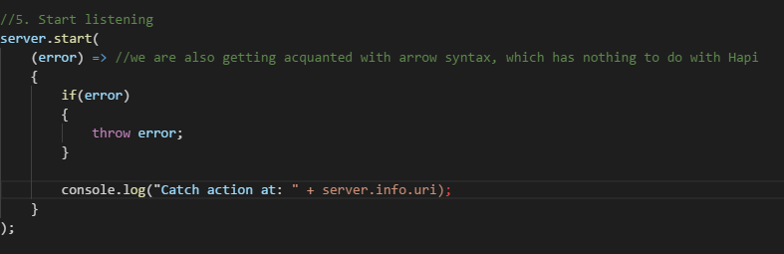
Step 1

Slide 2
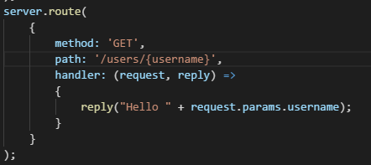
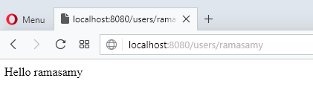
Step 2
One more routing..

Slide 3
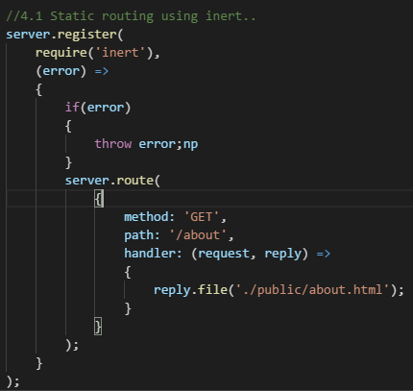
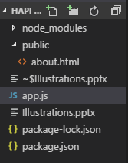
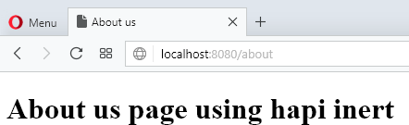

Step 3
Routing for static pages..
Not working in hapi 17+, inert 5x, so make sure of dependencies.
This one works at this moment:

Slide 4
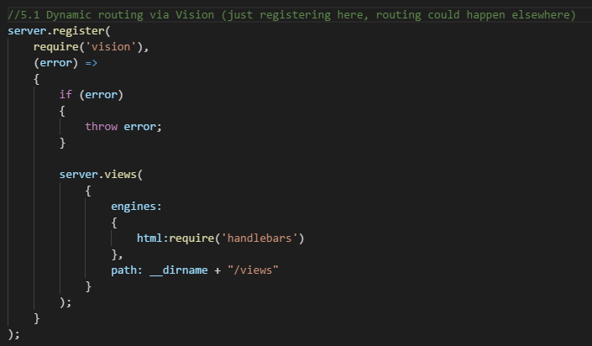
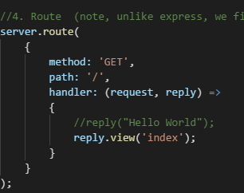
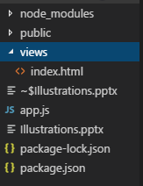
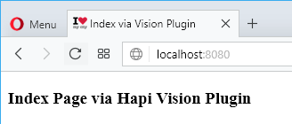
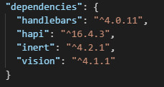
Step 4
Routing for dynamic pages via Vision plugin (template using handlebars)

Slide 5
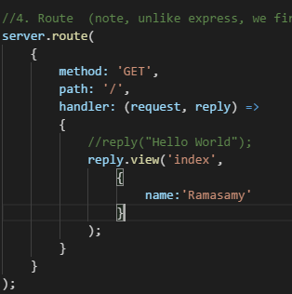
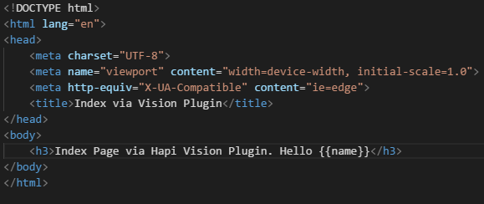
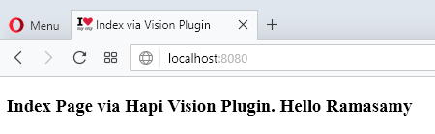
Step 5
Passing on data to handlebar template…

Slide 6
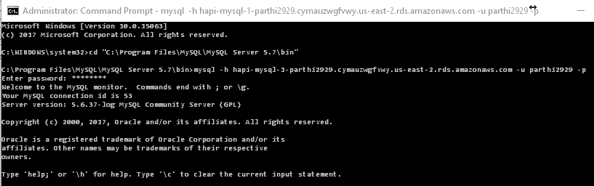
Step 6
Set up AWS account, install mySQL, connect to AWS DB and create few rows in it as guided by Edureka.
Below are current credentials we are going to use (we will not focus setting up AWS and mySQL here)
Endpoint/host: hapi-mysql-1-parthi2929.cymauzwgfvwy.us-east-2.rds.amazonaws.com
Username: parthi2929
Password: <aha,contactme>
DB: parthiDB

Slide 7
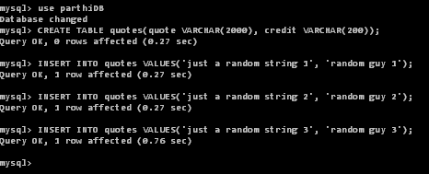
Step 6
Table name: quotes
Quote | Credit
Random string 1 | Random guy 1
Random string 2 | Random guy 2
Random string 3 | Random guy 3

Slide 8
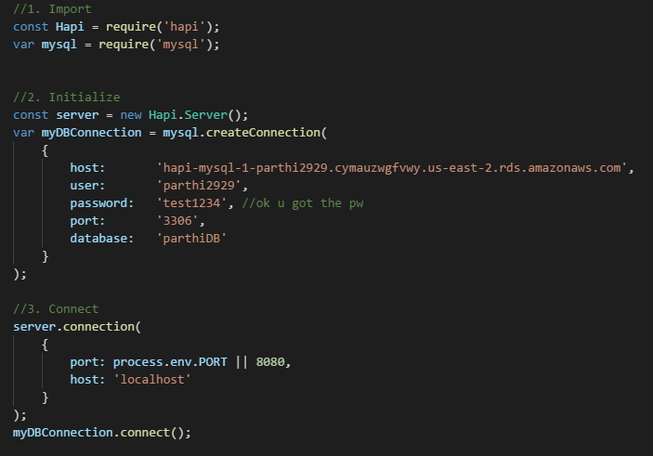
Step 7
We now would connect to AWS DB via node js mysql and just print the quote in index.html..

Slide 9
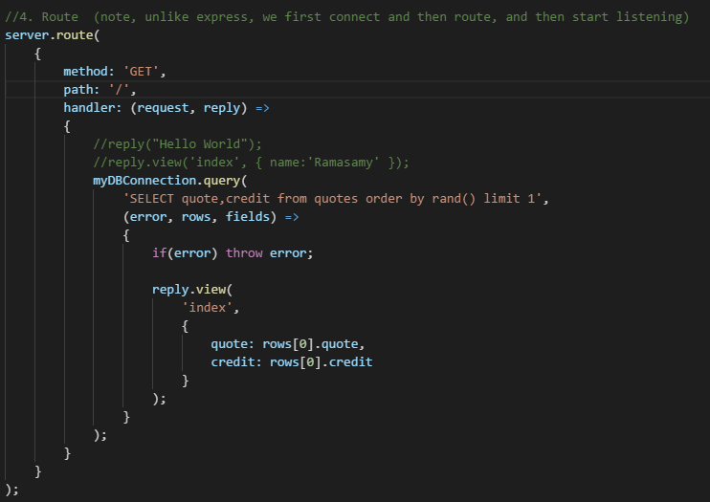
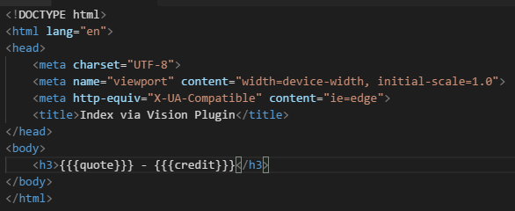
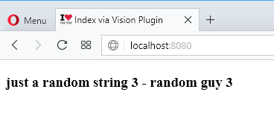
Step 7
We now would connect to AWS DB via node js mysql and just print the quote in index.html..
Refreshing it would select randomly a
ow of the SQL table to show here

