Slide 1


RAMAKRISNA MISSION VIDYAMANDIRA
SARA - Seat Allocation with Rectangular

Slide 2

The Allocation Challenge
Seating students for examinations remains one of the most complex operational challenges in academic administration. Manually, this allocation is time-consuming, prone to human error, and creates inefficiencies across examination logistics.

Slide 3
Why This Matters
Redundant Exam System .
Inefficient.
It is a Matter of headache.

Slide 4

Introducing
SARA
Intelligent. Efficient. Reliable.

Slide 5
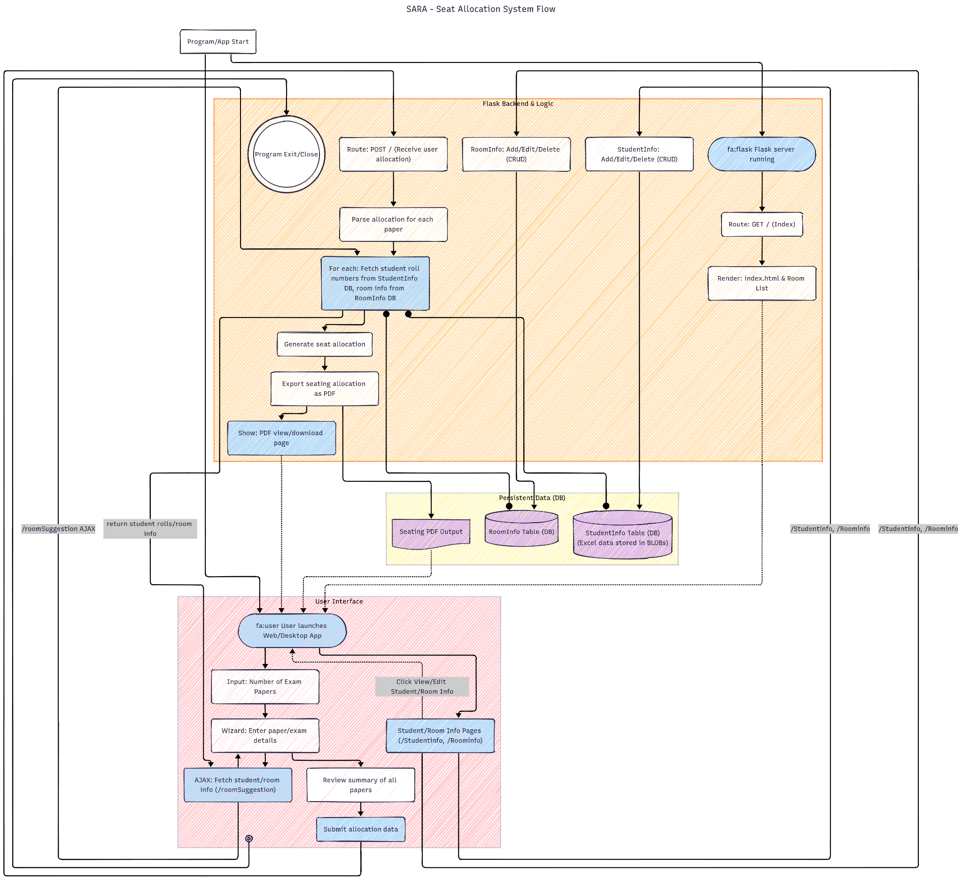
How It Works
Data Input
Constraint analysis with client side scripting
Allocating seat in a rectangular 2D array
Verification & Export

Slide 6
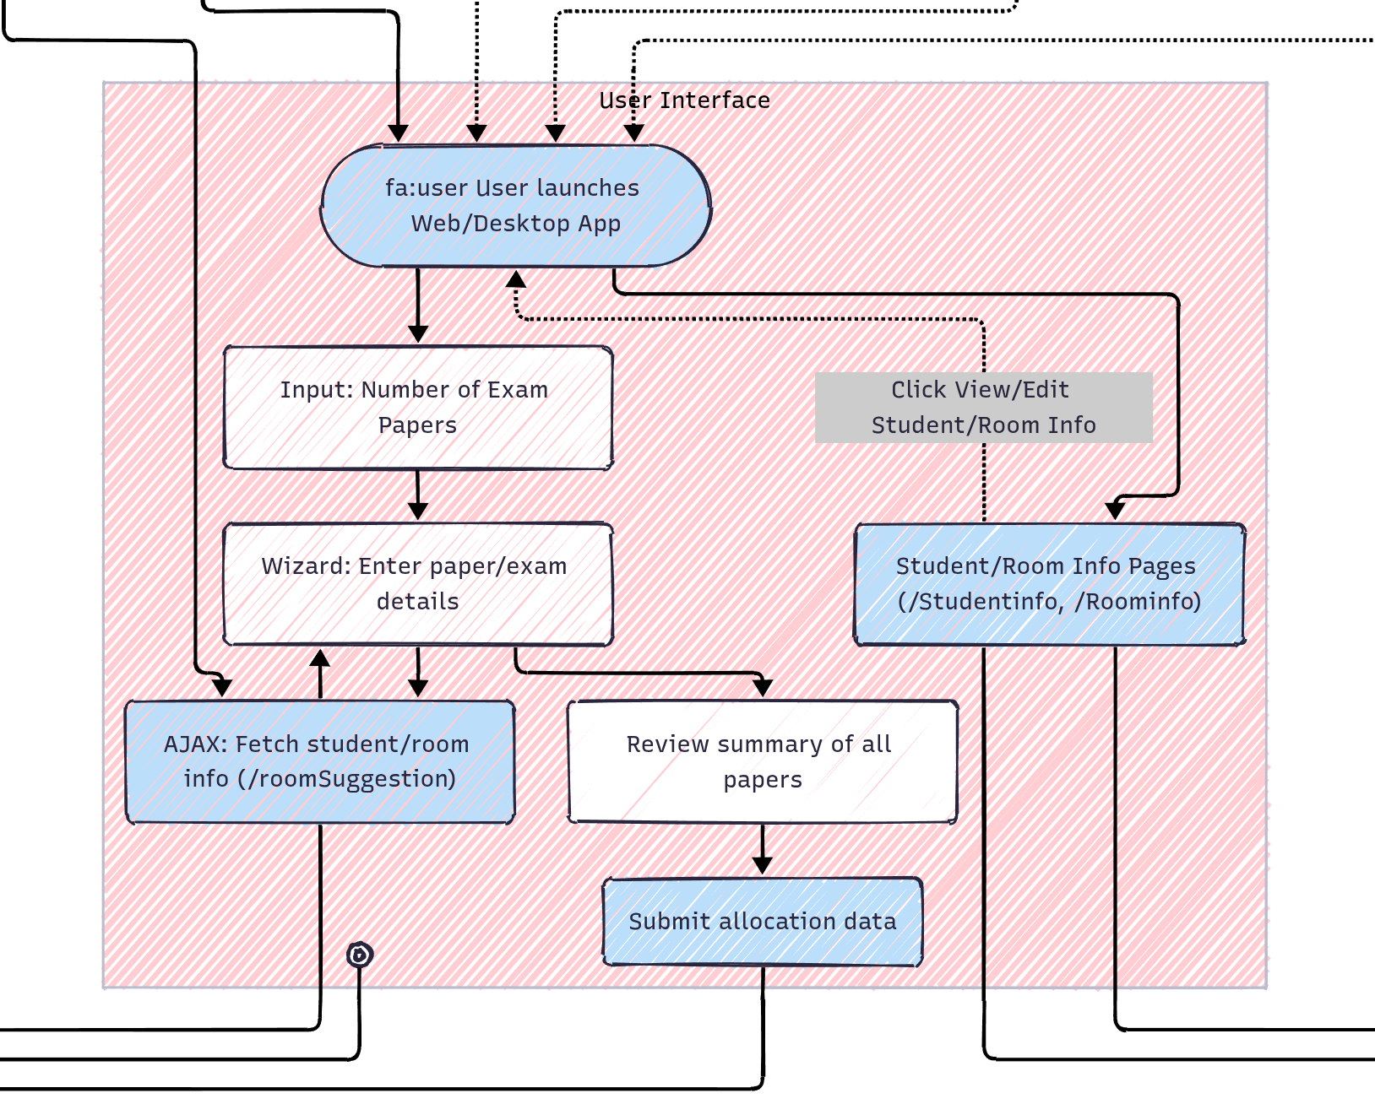
FRONTEND
Architecture
provides the way to database
takes input for seat allocation
verify the logical validity of
input data
sends the data to the BACKEND

Slide 7
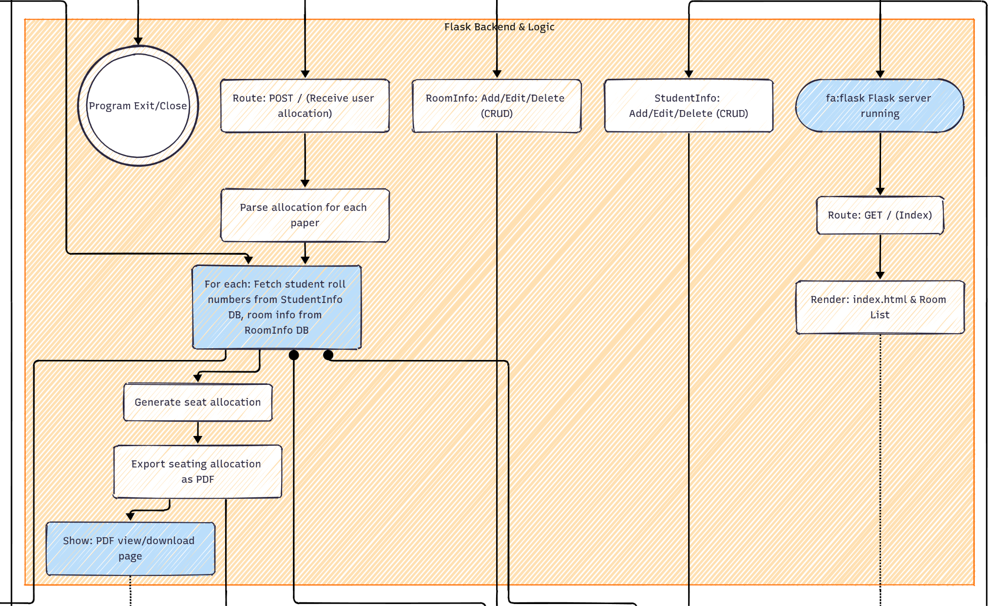
BACKEND
Architecture
After getting all inputs, it Allocates seat
convert the data into pdf
provide the pdf
Also changes the database table

Slide 8
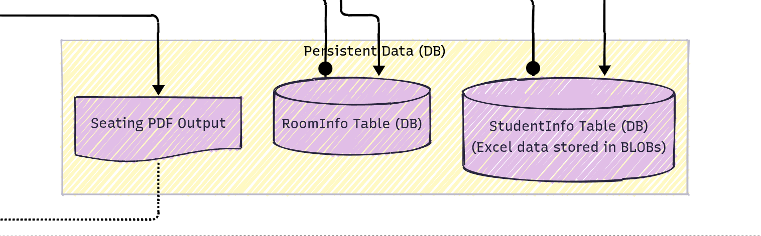
DATABASE

Slide 9

Future Scope
Commercialization
Introducing other entities
Increasing security and encryption
Dynamic Subject according to database

Slide 10
References
Visual Studio Code
LLMs
flask: https://flask.palletsprojects.com/en/stable/quickstart/#a-minimal-application
Javascript,HTML, CSS, MYSQL

Slide 11
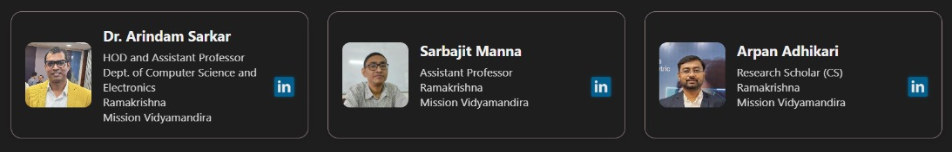
Acknowledgement

Slide 12
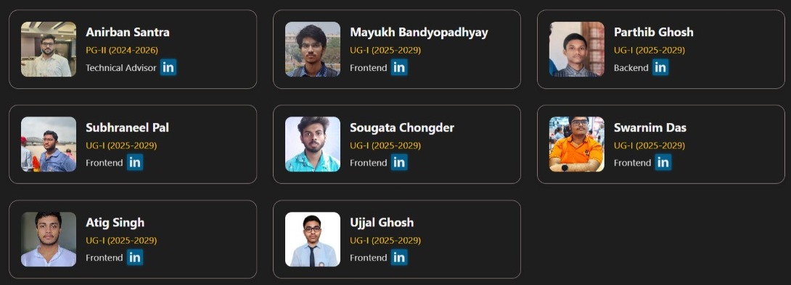
Our Team

Slide 13

Thank You

