Slide 1


RAMAKRISNA MISSION VIDYAMANDIRA
SARA - Seat Allocation with Rectangular

Slide 2

The Allocation Challenge
Seating students for examinations remains one of the most complex operational challenges in academic administration. Manually, this allocation is time-consuming, prone to human error, and creates inefficiencies across examination logistics.

Slide 3
Why This Matters
Inefficient seating allocation affects more than just logistics. It impacts student experience, staff wellbeing, and institutional reputation. When systems fail, exams are delayed, venues are misallocated, and stakeholder confidence diminishes.
The ripple effect: frustrated students, overworked coordinators, and compromised examination integrity.

Slide 4
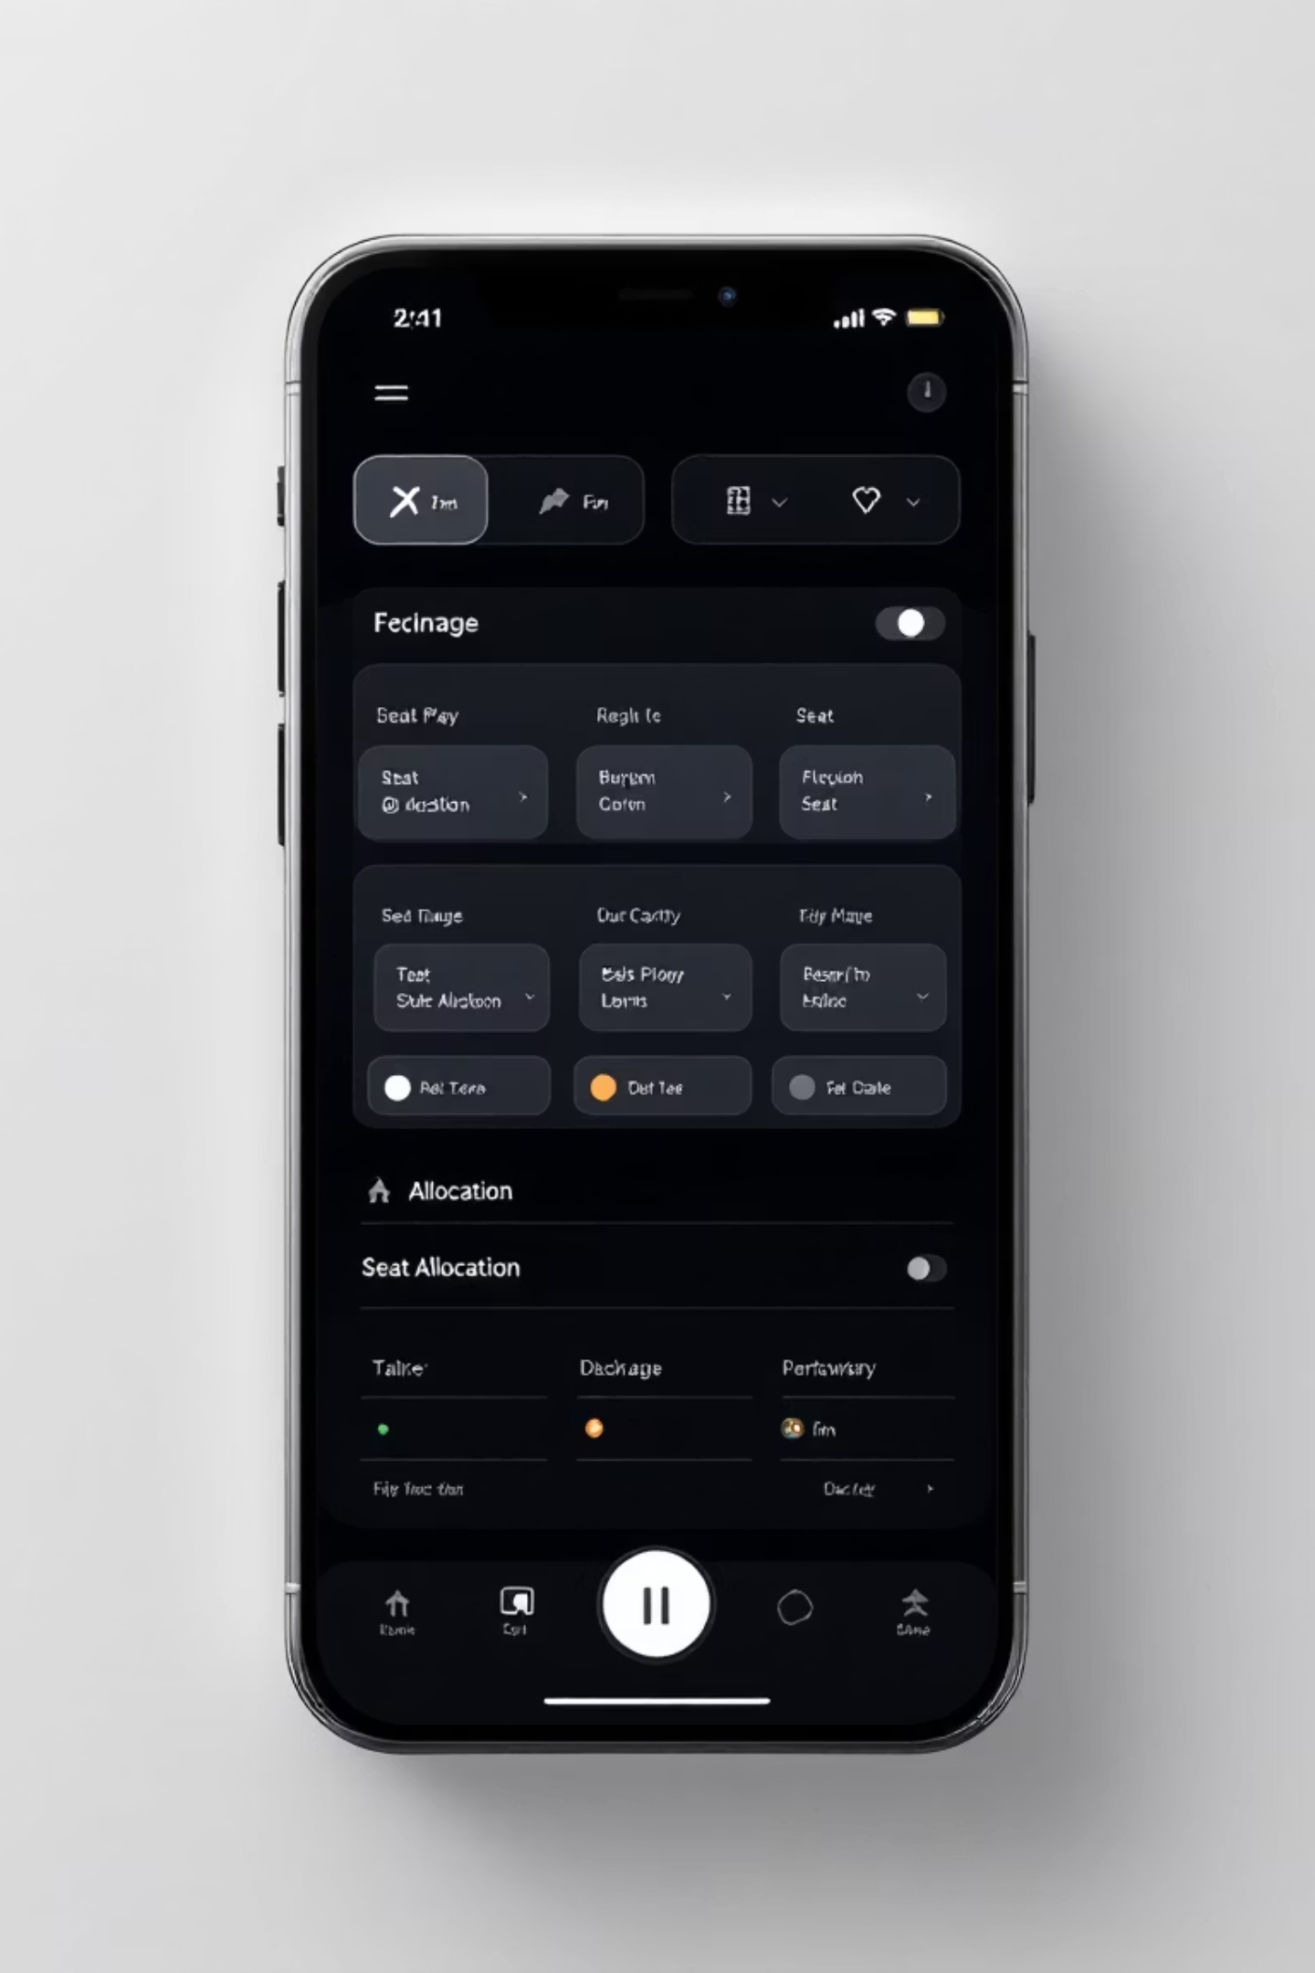

Introducing SARA
Seat Allocation with Rectangular Array transforms examination coordination from chaos into clarity. SARA is purpose-built for academic institutions, delivering intelligent, automated seat allocation that respects constraints whilst optimising space utilisation.
Intelligent. Efficient. Reliable.

Slide 5
How SARA Works
SARA's algorithm processes student data, exam requirements, and venue constraints simultaneously—delivering optimised seating arrangements in seconds, not hours.
Constraint Analysis
Data Input
SARA evaluates accessibility requirements, separation policies, and capacity restrictions automatically.
Feed student information, exam details, and venue dimensions into the system.
Verification & Export
Rectangular Array Allocation
Outputs verified seating charts in multiple formats—ready for printing, digital displays, and institutional records.
The proprietary algorithm arranges students optimally within rectangular matrices, maximising efficiency.

Slide 6

The SARA Advantage
Speed
Allocate thousands of students in seconds, not days.
Accuracy
Eliminates human error and conflicting allocations entirely.
Compliance
Enforces institutional policies automatically across all allocations.
Flexibility
Adapts instantly to last-minute changes, cancellations, and adjustments.

Slide 7
System Architecture
SARA's rectangular array algorithm forms the intelligent core—processing constraints and optimising allocation patterns with mathematical precision.
01
02
03
Parse Requirements
Build Array Structure
Apply Constraints
Venue dimensions, student count, and special accommodations are converted into algorithmic parameters.
The rectangular matrix framework is established, defining row and column boundaries.
Separation rules, accessibility requirements, and policy restrictions are layered into the allocation logic.
04
05
Optimise Placement
Validate & Output
Students are positioned to maximise space utilisation whilst minimising conflicts.
Final verification ensures all constraints are satisfied before delivering the allocation report.

Slide 8

Real-World Impact
Institutions using SARA report:
85% reduction in coordination time
Zero allocation conflicts per examination cycle
Improved student experience and reduced anxiety
Enhanced staff efficiency and job satisfaction
Greater confidence in examination integrity

Slide 9

SARA in Action
From raw data to perfect allocation—witness the transformation of examination coordination.
Before: Chaos
Manual systems, conflicting entries, delayed results.
After: Clarity
Automated allocation, verified accuracy, instant deployment.

Slide 10

Thank You
Examination Coordination. Perfected.
Ramakrishna Mission Vidyamandira
SARA
Seat Allocation with Rectangular Array
Excellence in Education
Transforming examination administration for institutions worldwide.

