Slide 1

Product Review Analysis
By:
Parthiban.M
Jagadhesh.B

Slide 2
OBJECTIVE
Knowing the product acceptance of the customers.
Helping in identifying the reasons for the customer churn.
Helping in improving the product recommendations for a better shopping experience to the customers.

Slide 3
DATA DESCRIPTION
DATA SOURCE : Product Reviews data and Metadata from Amazon spanning November 1997 - October 2018.
CATEGORIES USED FOR THIS ANALYSIS : Digital Music and Musical Instruments.
DIGITAL MUSIC : 13,09,016 Records.
MUSICAL INSTRUMENTS : 15,12,530 Records.
SAMPLE TAKEN : 2,40,000 Records.

Slide 4
TREATMENT TO THE DATASET
For the analysis, the review text is taken as the input.
Merged review data with meta data.
Null values are dropped.
The review text is cleaned.

Slide 5
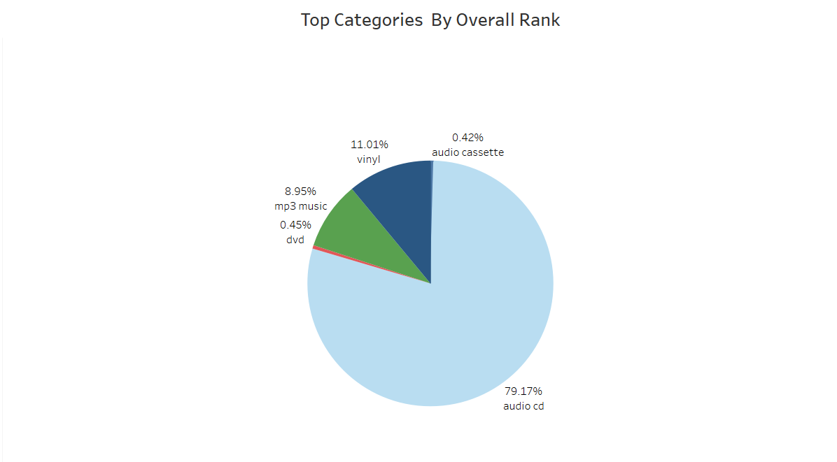
EDA OF THE DATASET

Slide 6
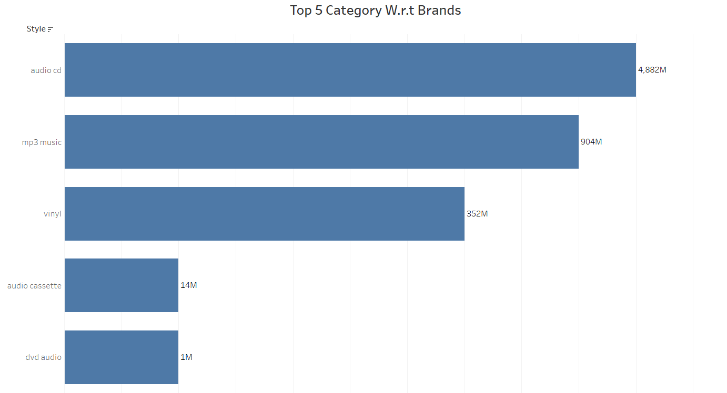
EDA OF THE DATASET

Slide 7
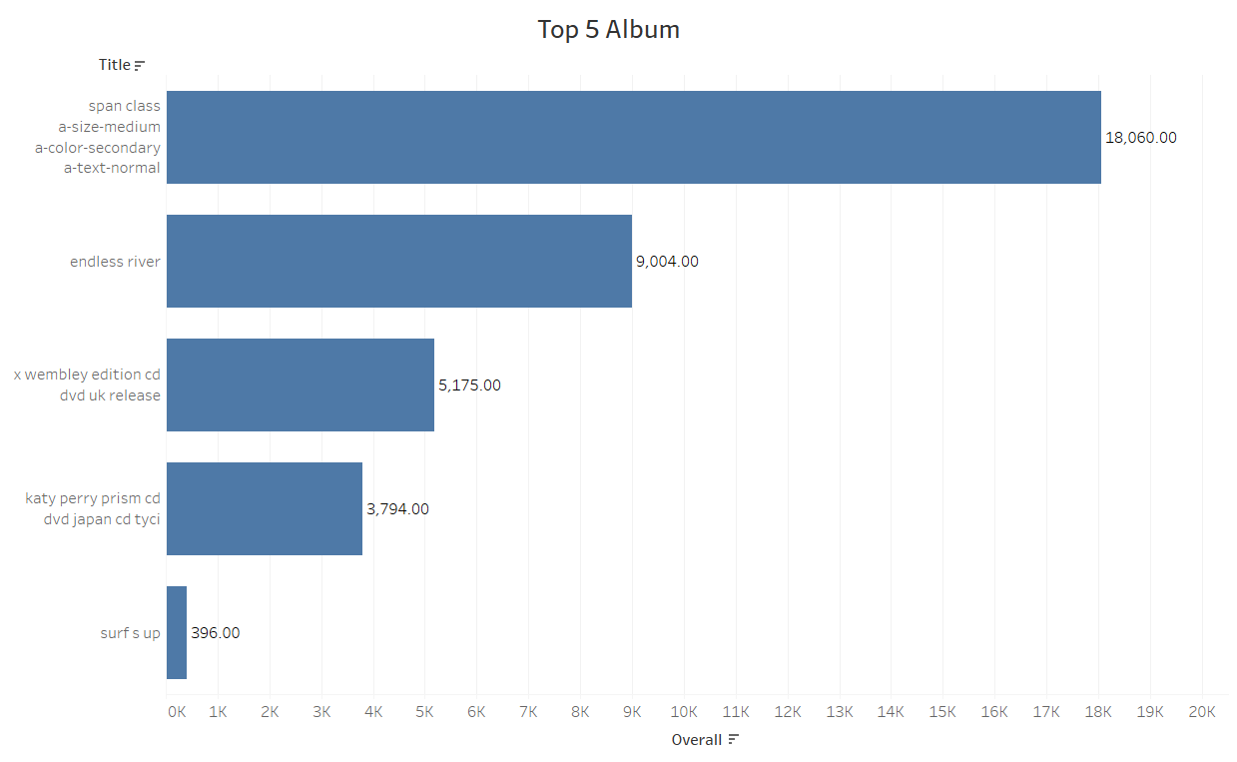
EDA OF THE DATASET

Slide 8
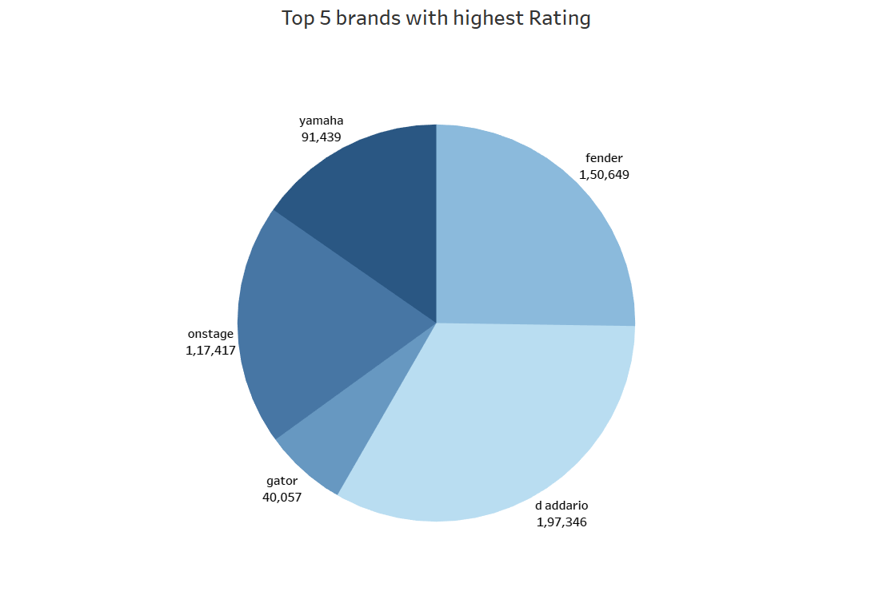
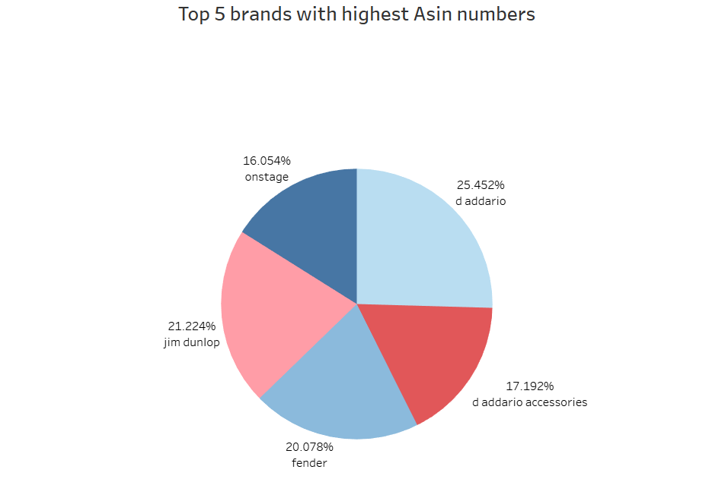
EDA OF THE DATASET

Slide 9
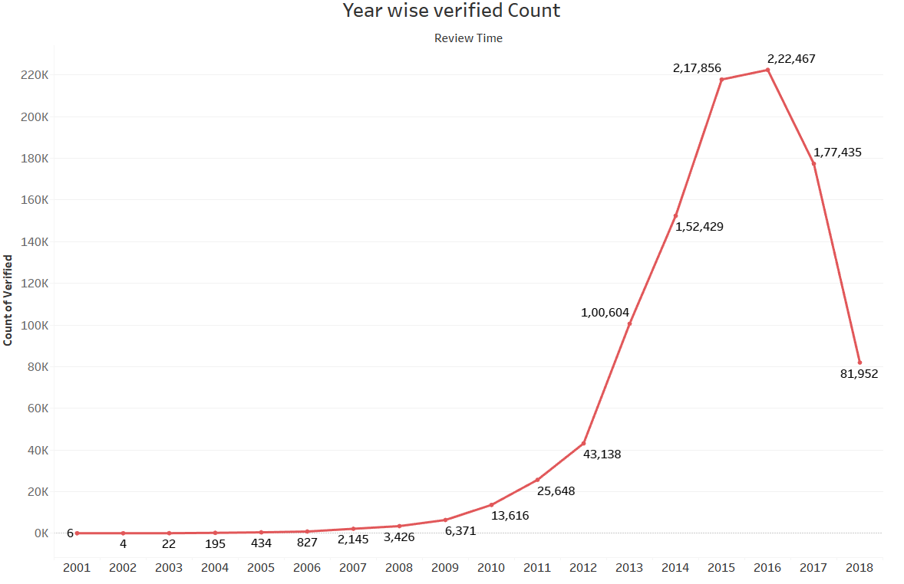
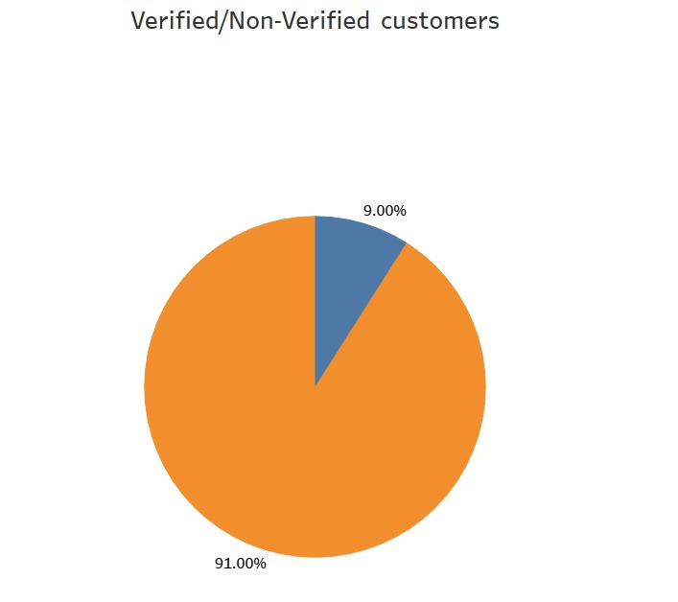

EDA OF THE DATASET

Slide 10
TEXT SENTIMENT COMPARISION
REVIEW TEXT
this guitar is good for a year old it s a beautiful guitar but a small size guitar the scale length of an average guitar should be around and this only has a scale length that makes a difference if you are looking to fit a year old other than the scale length i would say this is a good guitar so if you are looking for a young child and want a step up from a toy then this would be your choice small size guitar.
In our assumption this sentence gives a neutral review because the reviewer is saying that this product doesn’t suit for him and suggesting it as a good product for a particular type of customers .
When analysing this review with Sentiment Intensity Analyser the model predicts it as a positive sentiment.
Now when we use BERT model it predicts it as a Neutral or Average sentiment.
Due to high computational time and limitation of resources we are using Sentiment Intensity Analyser.

Slide 11
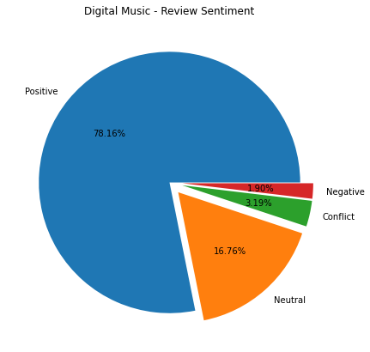
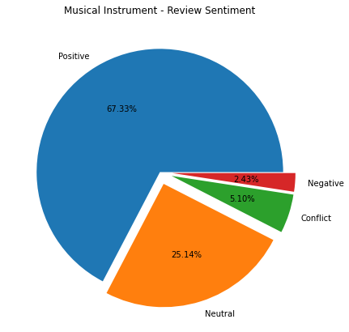
PREDICTING SENTIMENTS
The sentiments of the review text is predicted using Sentiment Intensity Analyzer model.

Slide 12
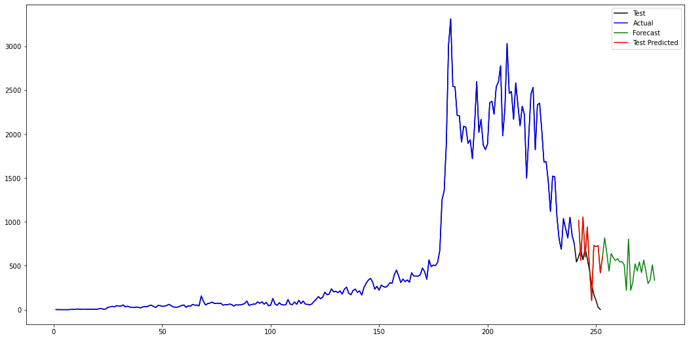
POSITIVE REVIEWS COUNT FORECAST FOR DIGITAL MUSIC CATEGORY
Count of the reviews
OCT 2020
NOV 2018
Time period over the years(1997 - 2018)

Slide 13
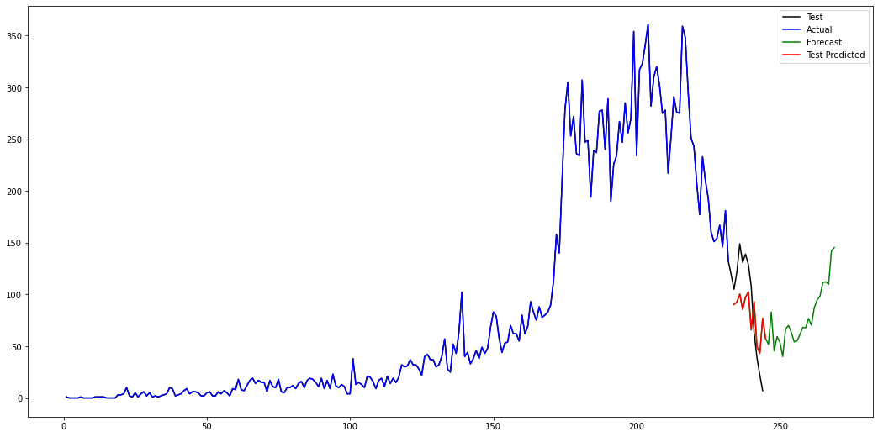
NEGATIVE REVIEWS COUNT FORECAST FOR DIGITAL MUSIC CATEGORY
Count of the reviews
OCT 2020
NOV 2018
Time period over the years(1997 - 2018)

Slide 14
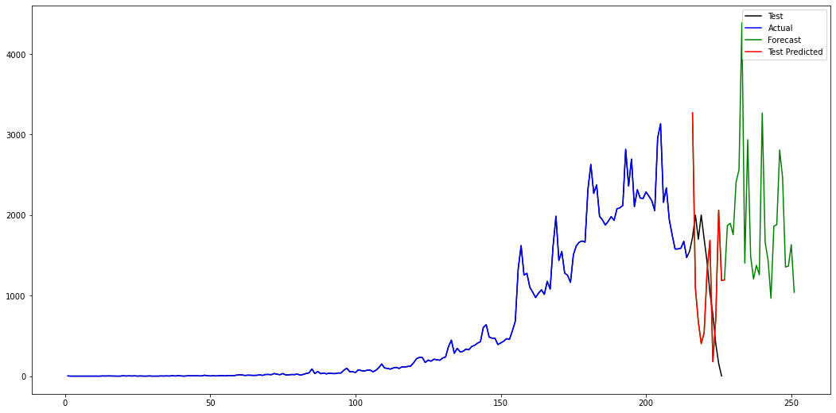
POSITIVE REVIEWS COUNT FORECAST FOR MUSICAL INSTRUMENTS CATEGORY
Count of the reviews
OCT 2020
NOV 2018
Time period over the years(1997 - 2018)

Slide 15
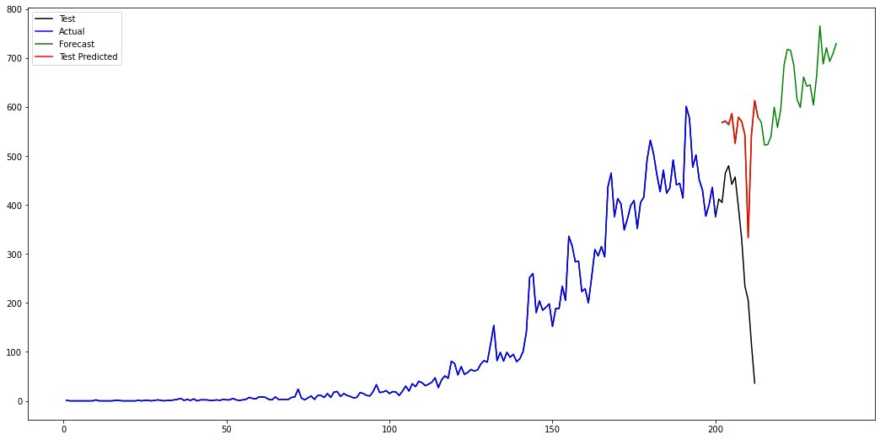
NEGATIVE REVIEWS COUNT FORECAST FOR MUSICAL INSTRUMENTS CATEGORY
OCT 2020
Count of the reviews
NOV 2018
Time period over the years(1997 - 2018)

Slide 16
TOP 2 DIGITAL MUSIC CATEGORY REVIEW SUMMARY
POSITIVE
PRODUCT ID | TITLE | CATEGORY | SUMMARY
B00NPZI1ZS | endless river | audio_music | Floyd FINALE 2014 "the endless river...forever and ever...
B00NPZI1ZS | endless river | vinyl | Great Addition To My Pink Floyd Vinyl Collection
NEGATIVE
PRODUCT ID | TITLE | CATEGORY | SUMMARY
B006J2FKXK | span class a-size-medium a-color-secondary a-t. | audio_music | Weakest Killers album.
B000NP1OLQ | mike love looking back with love | vinyl | One of the worst albums ever recorded - who green-lighted this monstrosity

Slide 17
TOP 2 MUSICAL INSTRUMENT CATEGORY REVIEW SUMMARY
POSITIVE
PRODUCT ID | TITLE | CATEGORY | SUMMARY
B0002E1NNC | Elixir Strings 80/20 Bronze Acoustic Guitar | Instrument Accessories | No need for a thousand dollar guitar
B000XI6O2W | Singing Machine SMM-205 Unidirectional Dynamic | Microphones_Accessories | Definitely an affordable option if you're just doing karaoke at home.
NEGATIVE
PRODUCT ID | TITLE | CATEGORY | SUMMARY
B0002E1G5C | DAddario Accessories Pro-Winder Guitar String | Instrument Accessories | Prepare to use wire cutters if you buy this.
B00DY1F2CS | NEEWER Adjustable Microphone Suspension Boom | Microphones_Accessories | Lasted for a month before acting bad. Started becoming loose

Slide 18
PRODUCT RECOMMENDATION DIGITAL MUSIC – CUSTOMER WISE
USER ID = A12R54MKO17TW0
This user has already purchased 3 products from the top products list.
Recommending other 5 products related to his purchase.
PRODUCT ID | PRODUCT TITLE
B000BUVYI6 | america s singing sweethearts
B0002HM888 | the story of willow
B00029NRYK | in heat
B000GIP83K | time-life sounds of the eighties s the late
B0009X6NK4 | sounds of the season the nbc collection

Slide 19
PRODUCT RECOMMENDATION DIGITAL MUSIC – ITEM WISE
PRODUCT ID = B000057K1Y - hidden treasures
Recommending other 5 products related to this product.
PRODUCT ID | PRODUCT TITLE
B0000041RT | mozart die entfuhrung aus dem serail solti ven
B000006XAN | mr jordan
B0000074HI | best of tight fit
B000007UVW | imaginos
B000007W4Z | concerto suite for electric guitar and orchestra

Slide 20
PRODUCT RECOMMENDATION MUSICAL INSTRUMENT – CUSTOMER WISE
USER ID = A129WUT5OMBKG
This user has already purchased 17 products from the top products list.
Recommending other 5 products related to his purchase.
PRODUCT ID | PRODUCT TITLE
B0055V7UR0 | Dunlop PVP101 Pick Variety Pack, Assorted, Lig.
B001SBN6BA | Your Cable Store 6 Foot XLR 3 Pin Female
B000RKVH0K | GLS Audio Vocal Microphone ES-58-S &amp
B000RW1NVG | Boss NS-2 Noise Suppressor Pedal
B00AHEWBM4 | Xotic SP Compressor Pedal

Slide 21
PRODUCT RECOMMENDATION MUSICAL INSTRUMENT – ITEM WISE
PRODUCT ID = B0002D00F0 - Hohner 38C Mini Harmonica
Recommending other 5 products related to this product.
PRODUCT ID | PRODUCT TITLE
9792372326 | QSC K10 2-Way Powered Speaker - 1000 Watts, 1x10"
B00004TT3S | Boomwhackers Octavator Tube Caps
B00005ML71 | Yamaha FC5 Compact Sustain Pedal for Portable
B000068NSX | Fender 18 Feet California Clear Instrument Cab
B000068NUO | Hosa MID-503 Serviceable 5-Pin DIN to Service

Slide 22
CONCLUSION
Using text classification, we can predict sentiments for the future reviews & help to build an interactive chatbot for the website which helps to understand the customer’s feedback in real time.
From time series forecast, it can be seen that sentiment of digital music data have decreased over time. In contrast to instrument data, which provides trending sentiment.
Top rated & Frequently bought together products & brands can be recommended to the customers who are shopping in that related category.
Promote the best-rated products and issue warnings for products with negative ratings from a large number of customers. Thus, there will be less client churn.

Slide 23


