Slide 1





FACE RECOGNITION BASED
SMART ATTENDANCE
SYSTEM
Date:18.03.21
Time:02:00 PM
SNAP GENERATION
1.PARTHIBAN S
TEAM MENTOR:
Mrs . KARTHIKA.D
AP/CSE
2.PRAGADEESHWARAN G
3.MOHAN RAJ M
https://arunai.org/ideathon

Slide 2

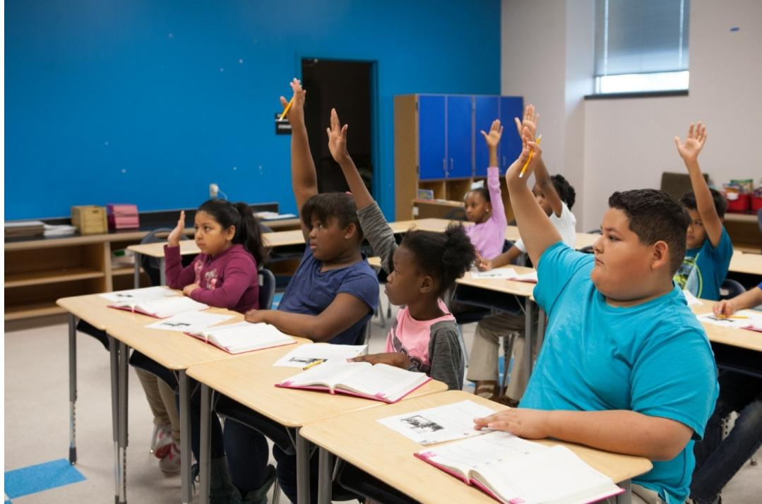
INTRODUCTION
ABSTRACT
PROBLEM STATEMENT
MY IDEA
FLOW CHART
DEMO
CONCLUSION

Slide 3

INTRODUCTION
Every organization requires an attendance system to maintain record of presence of student and employees.
Manual method includes pen and papers which consumes lot time and wastage of resources.
It has risk of proxies and human error.
They have their own method to do the same.
Some do manually and some use automated attendance system.
https://arunai.org/ideathon

Slide 4

PROBLEM STATEMENT
It requires paper record to Store the data.
Duplicate data entry and attendance entry.
It requires more time to take attendance,
based on the number of students or
employee.
Maintaining attendance register daily is difficult time consuming
task.
It causes some human errors.
https://arunai.org/ideathon

Slide 5
ABSTRACT
Attendance is a compulsory requirement of every organization.
There are many automated methods of the same available like biometric, RFID , eye detection , voice recognition , and many more.
This system uses face recognizer library for facial recognition and storing attendance.
The absentee’s are informed to there parents through mobile phone as a message format.

Slide 6
MY IDEA
First register 360’dimensional view of students or employee.
To recognize more images at a time with one picture or slow motion video.
Send automatic notification or alert to parents through email or message.
Avoid duplicate data entry and human error.
Reducing time to take attendance for students or employee.
Doesn’t need paper record to Store the data.
https://arunai.org/ideathon

Slide 7
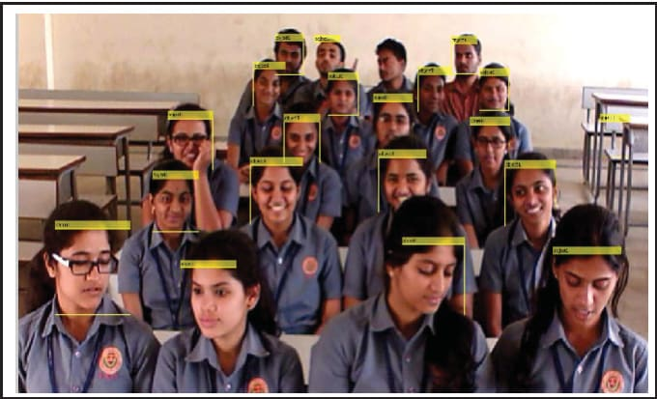
ADVANTAGES
Increases security.
Automated and accurate.
Portability.
saves time.
Prevent loss of productivity.
Convenient to use.
Better worker attendance system.
https://arunai.org/ideathon

Slide 8
FLOW CHART
Recognized image= student id
start
NO
Email send to parent
Image capture
YES
Record attendance
Dataset creation
Generate excel sheet report
stop
Face recognition
https://arunai.org/ideathon

Slide 9

DEMO
https://arunai.org/ideathon

Slide 10
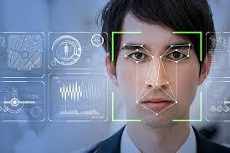
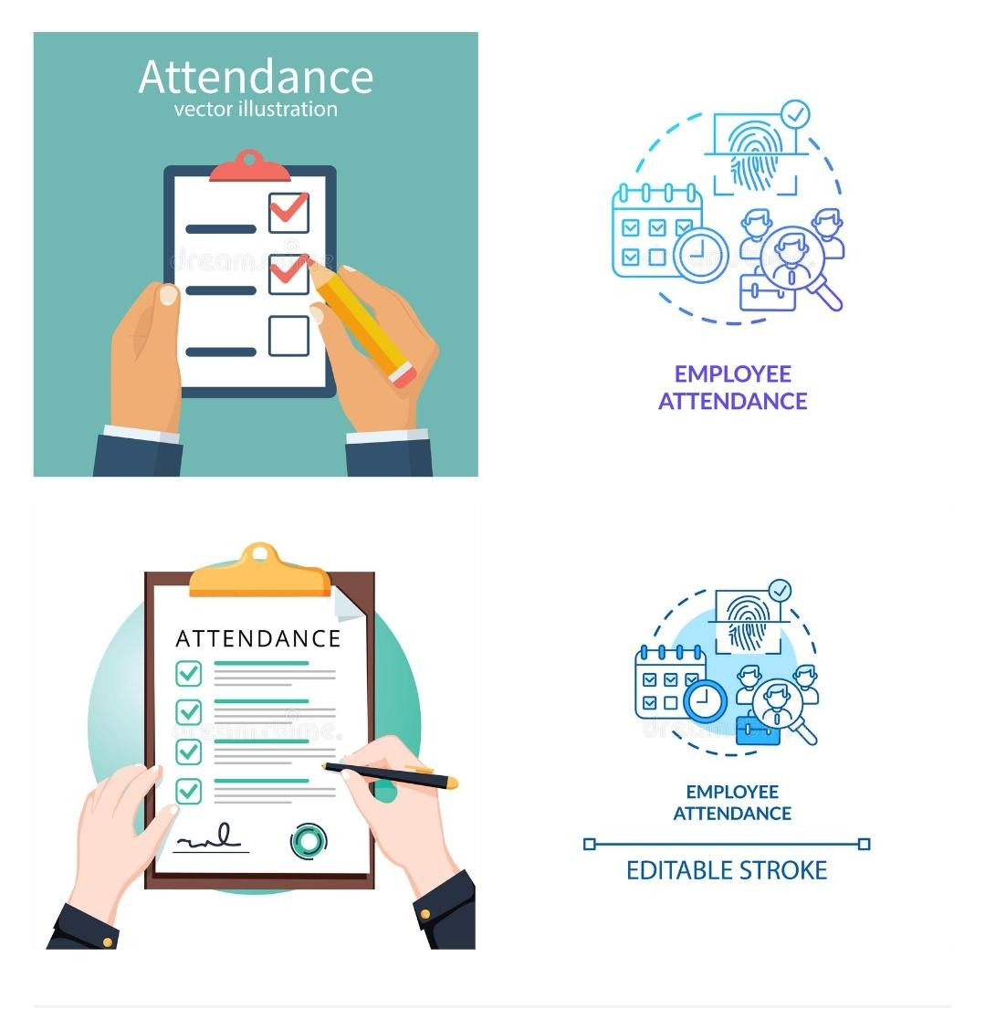
CONCLUSION
As we all know that face is an important identity of each and every person , so we use face recognition system.
The future scope of the project can be increasing speed and accuracy of the model.

Slide 11
THANK YOU!!
https://arunai.org/ideathon

